Slide 1
2023 CEOS Chair Year & Plenary Objectives
Pakorn Apaphant, GISTDA
Agenda Item # 1.2
SIT Technical Workshop 2023
18th - 19th October 2023, ESA/ESRIN

Slide 2
GISTDA CEOS Chair Theme 2023
For 2023 GISTDA has prioritised the theme:
“Space Technology for Better Environments,
Economies, and Humanity”

Slide 3
GISTDA CEOS Chair Priorities 2023
1
Supporting CEOS Preparations and Inputs to the Global Stocktake of the UNFCCC Paris Agreement
Workshop
GISTDA - SilvaCarbon 2023 CEOS Workshop on Uptaking Global AFOLU Datasets
CEOS Agency Datasets
Continued expansion of the offering of CEOS Agency datasets available to support the GST and countries’ assessments of their Nationally Determined Contributions (NDCs)
GHG & AFOLU Roadmap
Support the Implementation of both the GHG Roadmap and AFOLU Roadmap
2
Supporting Exploration of New Geometries for Space Agencies and CEOS with New Space
New Space
Task Team
Work with CEOS New Space Task team led by SIT Chair to develop New Space Economy document as a means for knowledge sharing with CEOS Agencies
Promote sharing of information between CEOS members
Collaboration
Opportunities
Define actions within CEOS framework
Workshops/Meetings as inputs to the border CEOS discussion on New Space opportunities.
Facilitate a discussion during CEOS 2023 timeframe
Notes:
As CEOS chair, GISTDA is committed to a set of priority focal areas for 2023 that are respond to the long-term priorities of the organisation. In 2023 there has been a greater focus on:
Supporting the preparations offered by CEOS Members and Associates to the first Global Stocktake of the United Nations Framework Convention on Climate Change (UNFCCC). The Global Stocktake is a fundamental component of the Paris Agreement and will be used to monitor its implementation and to evaluate the collective progress made in achieving the agreed goals. This will be the very first of its kind and is due to be delivered at COP-28, which will be held in the United Arab Emirates in November / December this year.
Supporting exploration of new geometries for space agencies and CEOS with “New Space” which really encompasses all commercial activities in EO, not just “new” ventures. A dedicated Task Team has been set up for one-year to to explore collaborative opportunities with New Space. The idea is for the Task Team to propose a set of defined actions that could sit within the CEOS framework, and which could enhance the outcomes of CEOS entities who are working with the commercial sector either at national or international levels. The focus is on both upstream and downstream, in other words right across the whole value chain. The Task team has two main goals, which are basically to promote sharing of information between CEOS members on this important topic and also to work on a white paper.

Slide 4
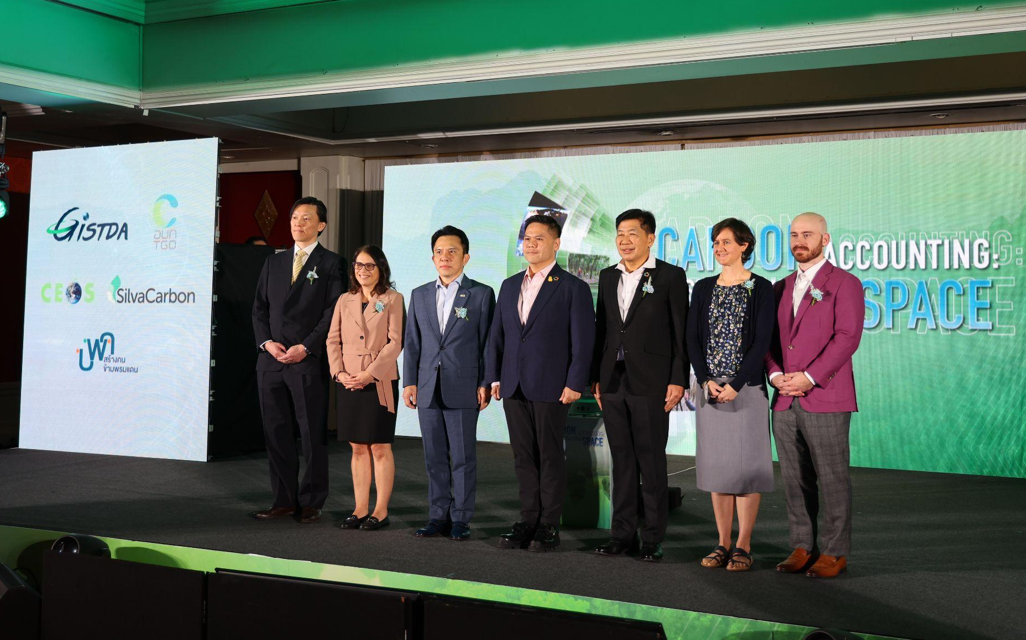
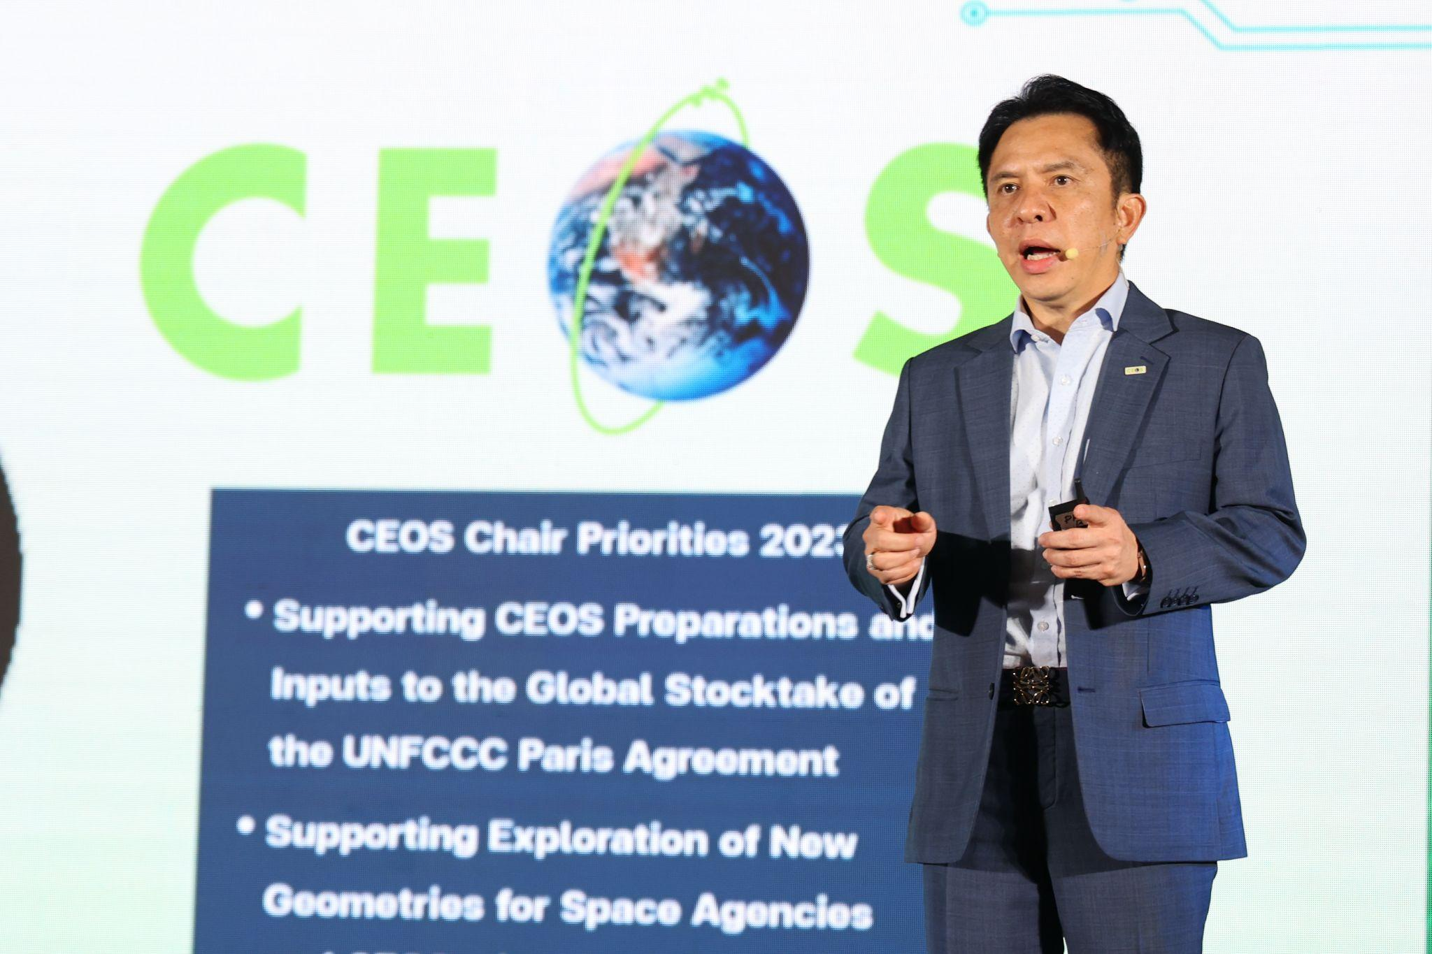
CEOS Chair Activities:
GISTDA SilvaCarbon Workshop 2023
Key outcomes:
Improved awareness and understanding of the potential of AFOLU datasets
Enhanced capacity and skills among participants to use and apply AFOLU datasets and technologies
Strengthened collaboration and partnerships among stakeholders and experts
Increased knowledge sharing of best practices and success stories related to AFOLU data and its applications
Notes:
Improved awareness and understanding of the potential of AFOLU datasets for monitoring and managing forests and land use at the global scale
Enhanced capacity and skills among participants to use and apply AFOLU datasets and technologies in their work, research and policymaking
Strengthened collaboration and partnerships among stakeholders and experts working on AFOLU-related issues, leading to new research projects, initiatives, and networks
Increased knowledge sharing of best practices and success stories related to AFOLU data management and application, contributing to a more informed and evidence-based decision-making process

Slide 5
Satellite Earth Observation & Carbon Accounting Workshop (Nov. 14)
Special Plenary Side Event, Nov. 14 Morning
Focus: Application of satellite Earth observation for carbon accounting
Participants: Carbon market practitioners and policy-makers from across Asia
Objectives:
Providing an overview of carbon accounting using space-based Earth observation
Exploring a collaborative opportunity and user requirements for international space agencies
Thanks to our CEOS Agency speakers!
ESA: Representative
JAXA: Osamu Ochiai
NOAA: Jeff Privette
NASA: Dr. Karen St. Germain / Dr. Julie Robinson (TBC)

Slide 6
GISTDA CEOS Chair Priorities 2023
1
Supporting CEOS Preparations and Inputs to the Global Stocktake of the UNFCCC Paris Agreement
Workshop
GISTDA - SilvaCarbon 2023 CEOS Workshop on Uptaking Global AFOLU Datasets
CEOS Agency Datasets
Continued expansion of the offering of CEOS Agency datasets available to support the GST and countries’ assessments of their Nationally Determined Contributions (NDCs)
GHG & AFOLU Roadmap
Support the Implementation of both the GHG Roadmap and AFOLU Roadmap
2
Supporting Exploration of New Geometries for Space Agencies and CEOS with New Space
New Space
Task Team
Work with CEOS New Space Task team led by SIT Chair to develop New Space Economy document as a means for knowledge sharing with CEOS Agencies
Promote sharing of information between CEOS members
Collaboration
Opportunities
Define actions within CEOS framework
Workshops/Meetings as inputs to the border CEOS discussion on New Space opportunities.
Facilitate a discussion during CEOS 2023 timeframe
Notes:
As CEOS chair, GISTDA is committed to a set of priority focal areas for 2023 that are respond to the long-term priorities of the organisation. In 2023 there has been a greater focus on:
Supporting the preparations offered by CEOS Members and Associates to the first Global Stocktake of the United Nations Framework Convention on Climate Change (UNFCCC). The Global Stocktake is a fundamental component of the Paris Agreement and will be used to monitor its implementation and to evaluate the collective progress made in achieving the agreed goals. This will be the very first of its kind and is due to be delivered at COP-28, which will be held in the United Arab Emirates in November / December this year.
Supporting exploration of new geometries for space agencies and CEOS with “New Space” which really encompasses all commercial activities in EO, not just “new” ventures. A dedicated Task Team has been set up for one-year to to explore collaborative opportunities with New Space. The idea is for the Task Team to propose a set of defined actions that could sit within the CEOS framework, and which could enhance the outcomes of CEOS entities who are working with the commercial sector either at national or international levels. The focus is on both upstream and downstream, in other words right across the whole value chain. The Task team has two main goals, which are basically to promote sharing of information between CEOS members on this important topic and also to work on a white paper.

Slide 7
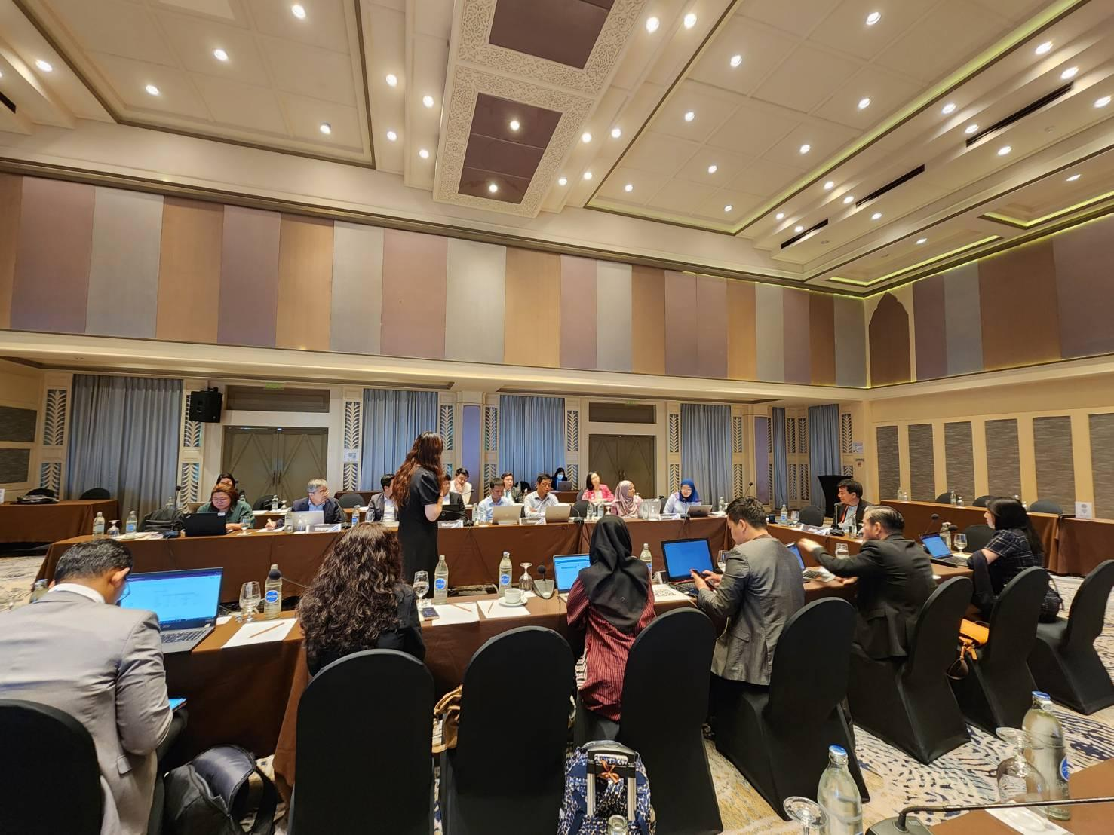
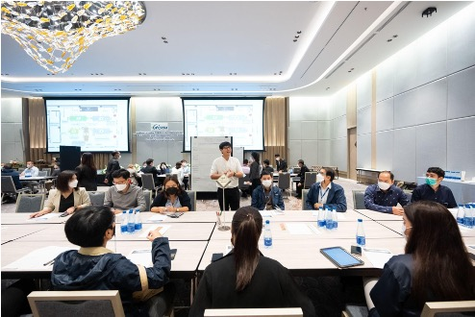
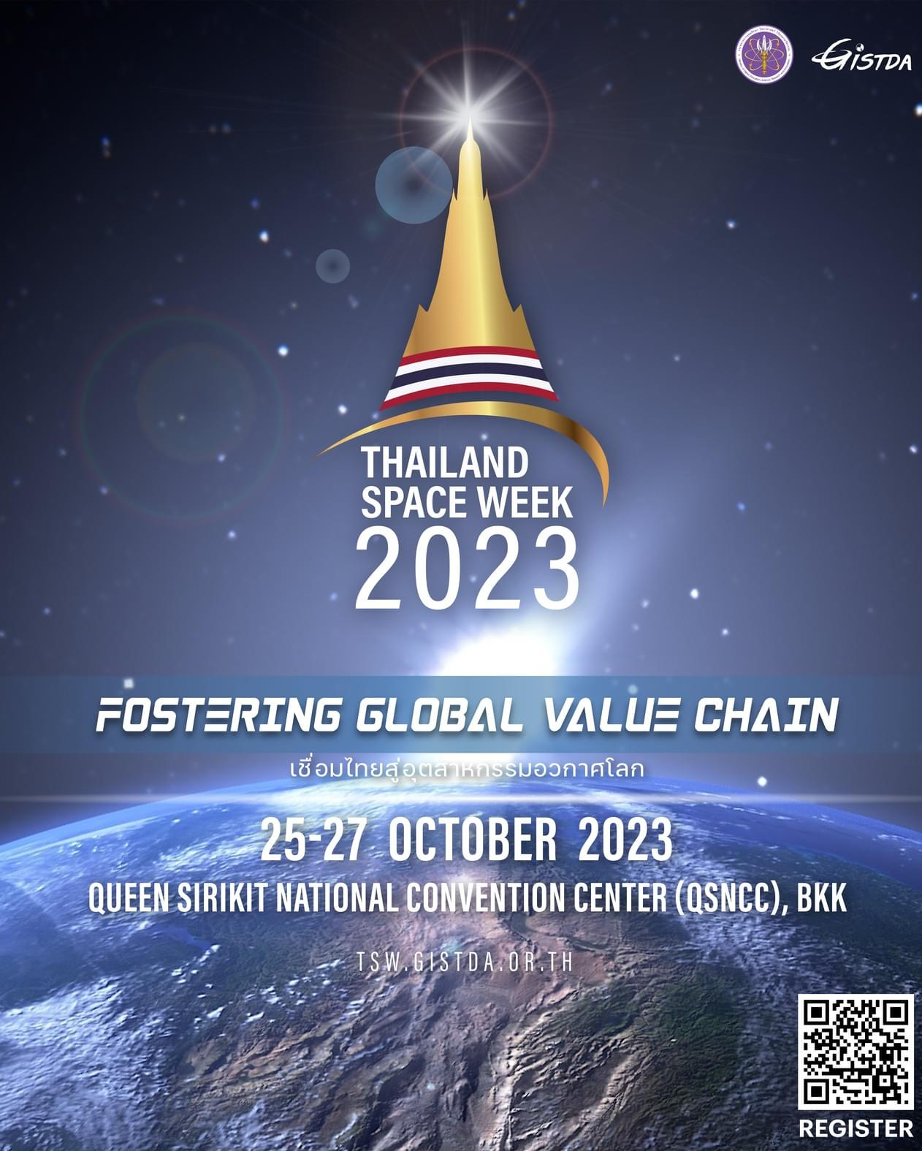
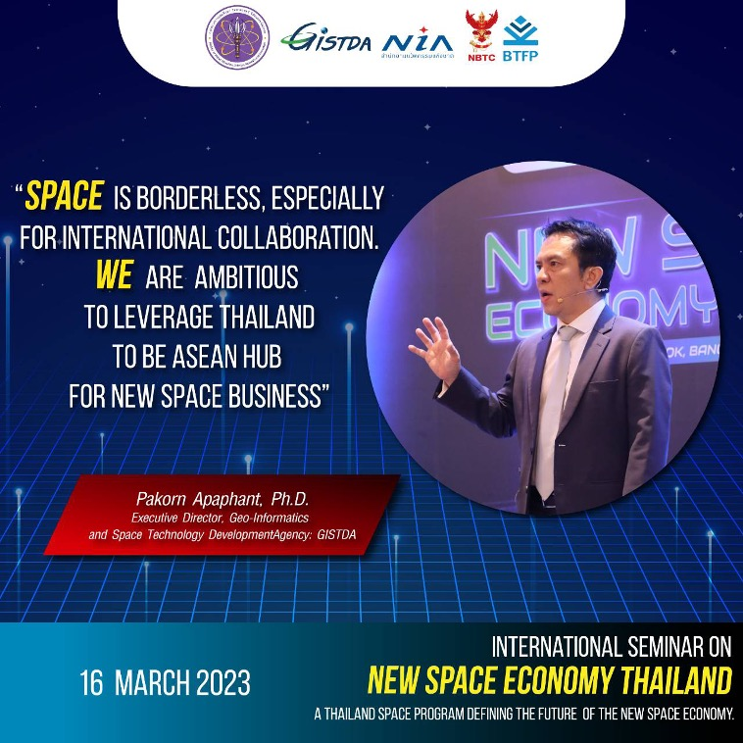
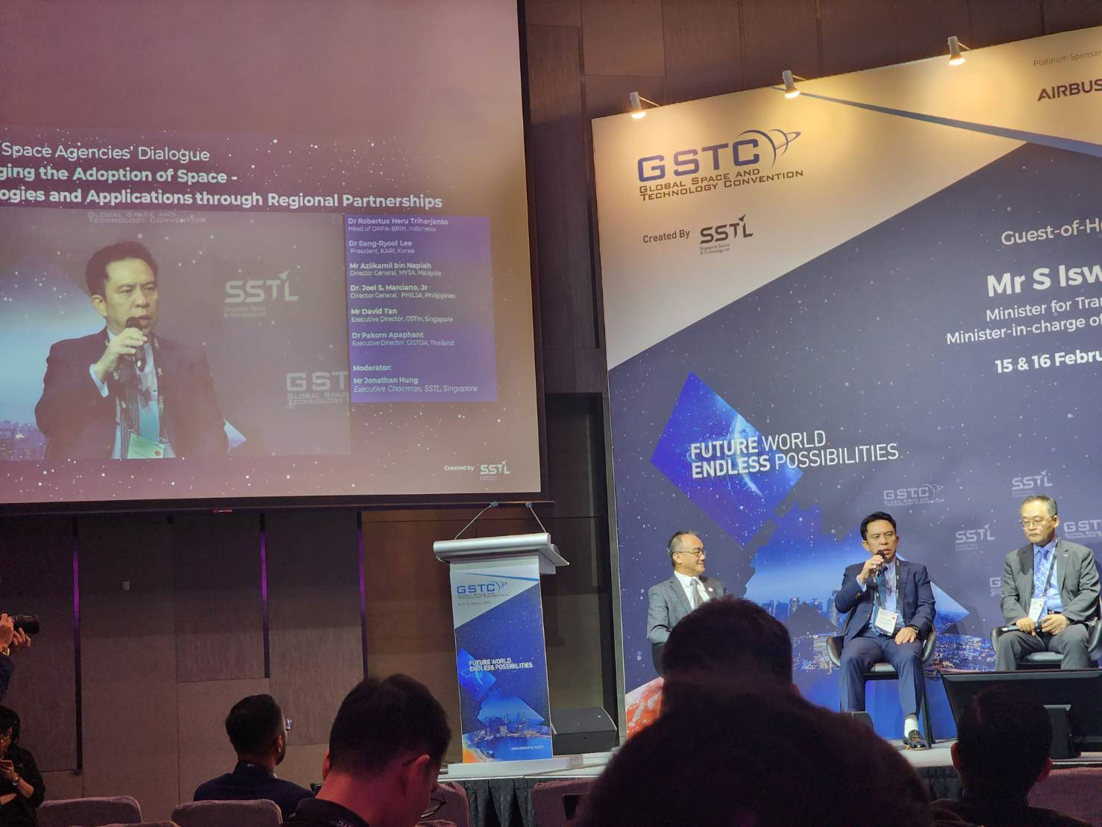
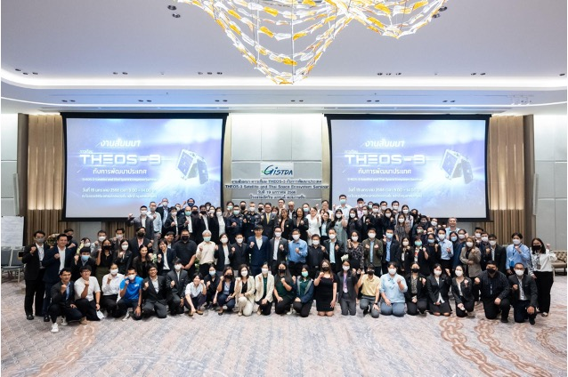
CEOS Chair Activities:
New Space
THEOS-3 Seminar on Thai Space Ecosystem
19 January 2023 in Bangkok, Thailand
Global Space and Technology Convention 2023
15-16 February 2023, Singapore
International Seminar ‘New Space Economy’
16-17 March 2023 in Bangkok, Thailand
ASEAN SCOSA Space Workshop: Observation Gaps Report
(input for New Space White Paper)
30 May - 1 June 2023 in Thailand
Thailand Space Week (upcoming)
25 - 27 October 2023 in Thailand

Slide 8
CEOS Plenary Objectives
14 - 17 November 2023
Chiang Rai, Thailand

Slide 9
CEOS Plenary Objectives
Review the outcomes of the GISTDA 2023 CEOS Chair theme: “Space Technology for Better Environments, Economies, and Humanity”.
Hold a strategic-level discussion on the status of the relationship between CEOS and GEO – which will be informed by this week’s SIT TW discussions
Consider endorsement of nominees for the Vice Chair roles of WGCapD, WGISS, and WGDisasters
Hear status updates and consider decisional items from the CEOS Working Groups (WGs) and Virtual Constellations (VCs), including:
  WGClimate: Space Agency Response to the GCOS IP reporting approach; approval of time series names and definitions.
  WGDisasters: Decisions on demonstrator continuity options
  WGISS: CEOS Interoperability Framework Roadmap; Artificial Intelligence / Machine Learning (AI/ML) white paper
  OCR-VC: Aquatic Carbon Roadmap
Consider endorsement of the New Space Task Team White Paper and recommendations

Slide 10
CEOS Plenary Objectives Contd.
Consider Climate & Carbon decision points:
  Endorsement of the CEOS AFOLU Roadmap.
  Actions to address issues and obstacles impacting the Greenhouse Gas Roadmap, as identified at 2023 SIT Technical Workshop.
  Actions that could be taken in support of the International Methane Emissions Observatory (IMEO).
  CEOS Agency engagement with the WMO Greenhouse Gas initiative.
  Strategies and actions to increase the climate policy relevance of space agencies’ EO data.
  CEOS-UNFCCC interface issue.
Consider endorsement of Ecosystem Extent Task Team’s white paper and recommendations
Discuss the outputs and conclusion of the CEOS Ocean Coordination Group (OCG)

Slide 11
CEOS Plenary Objectives Contd.
Decide the approach for the conclusion of the activities of the CEOS Coastal Observations Applications Services and Tools (COAST) Ad Hoc Team and potentially agree a way forward for the proposal to consider the establishment of a COAST Virtual Constellation (VC).
Consider endorsing the new CEOS Communications Strategy.
CEOS Leadership changes:
  Welcome the Japan Aerospace Exploration Agency (JAXA) as SIT Chair for 2024-2025.
  Consider endorsement of the National Aeronautics and Space Administration (NASA) for the SIT Vice Chair (2024-2025) then SIT Chair (2026-2027) role.
  Consider endorsement of the United Kingdom Space Agency (UKSA) as CEOS Chair for 2025.
  Welcome the Canadian Space Agency (CSA, Canada) as CEOS Chair for 2024 and discuss CSA’s priorities for the coming year.

Slide 12
Week at a Glance
Tuesday, November 14 | Wednesday, November 15 | Thursday, November 16
Side Meetings: Special Side Event: Satellite Earth Observation & Carbon Accounting SDG Coordination Group CEOS Secretariat (314) Methane Analysis Standards Framework SIT Chair Handover (closed) | Welcome and Core Business Special Topics Carbon, Climate, GHG CEOS Working Groups GEO Topics CEOS Virtual Constellations CEOS Agency Reports | New Space Biodiversity Oceans and Coasts Other Business CEOS Agency Reports CEOS Leadership Transitions and Closing Business
14 November 2023 (18:00hrs - 20:00hrs) - Welcome Reception
16 November 2023 (18:00hrs - 21:00hrs) - Hosted Dinner
17 November 2023 (08:30hrs - 18:00hrs) - CEOS 2023 “Unseen Space” Exploration

Slide 13
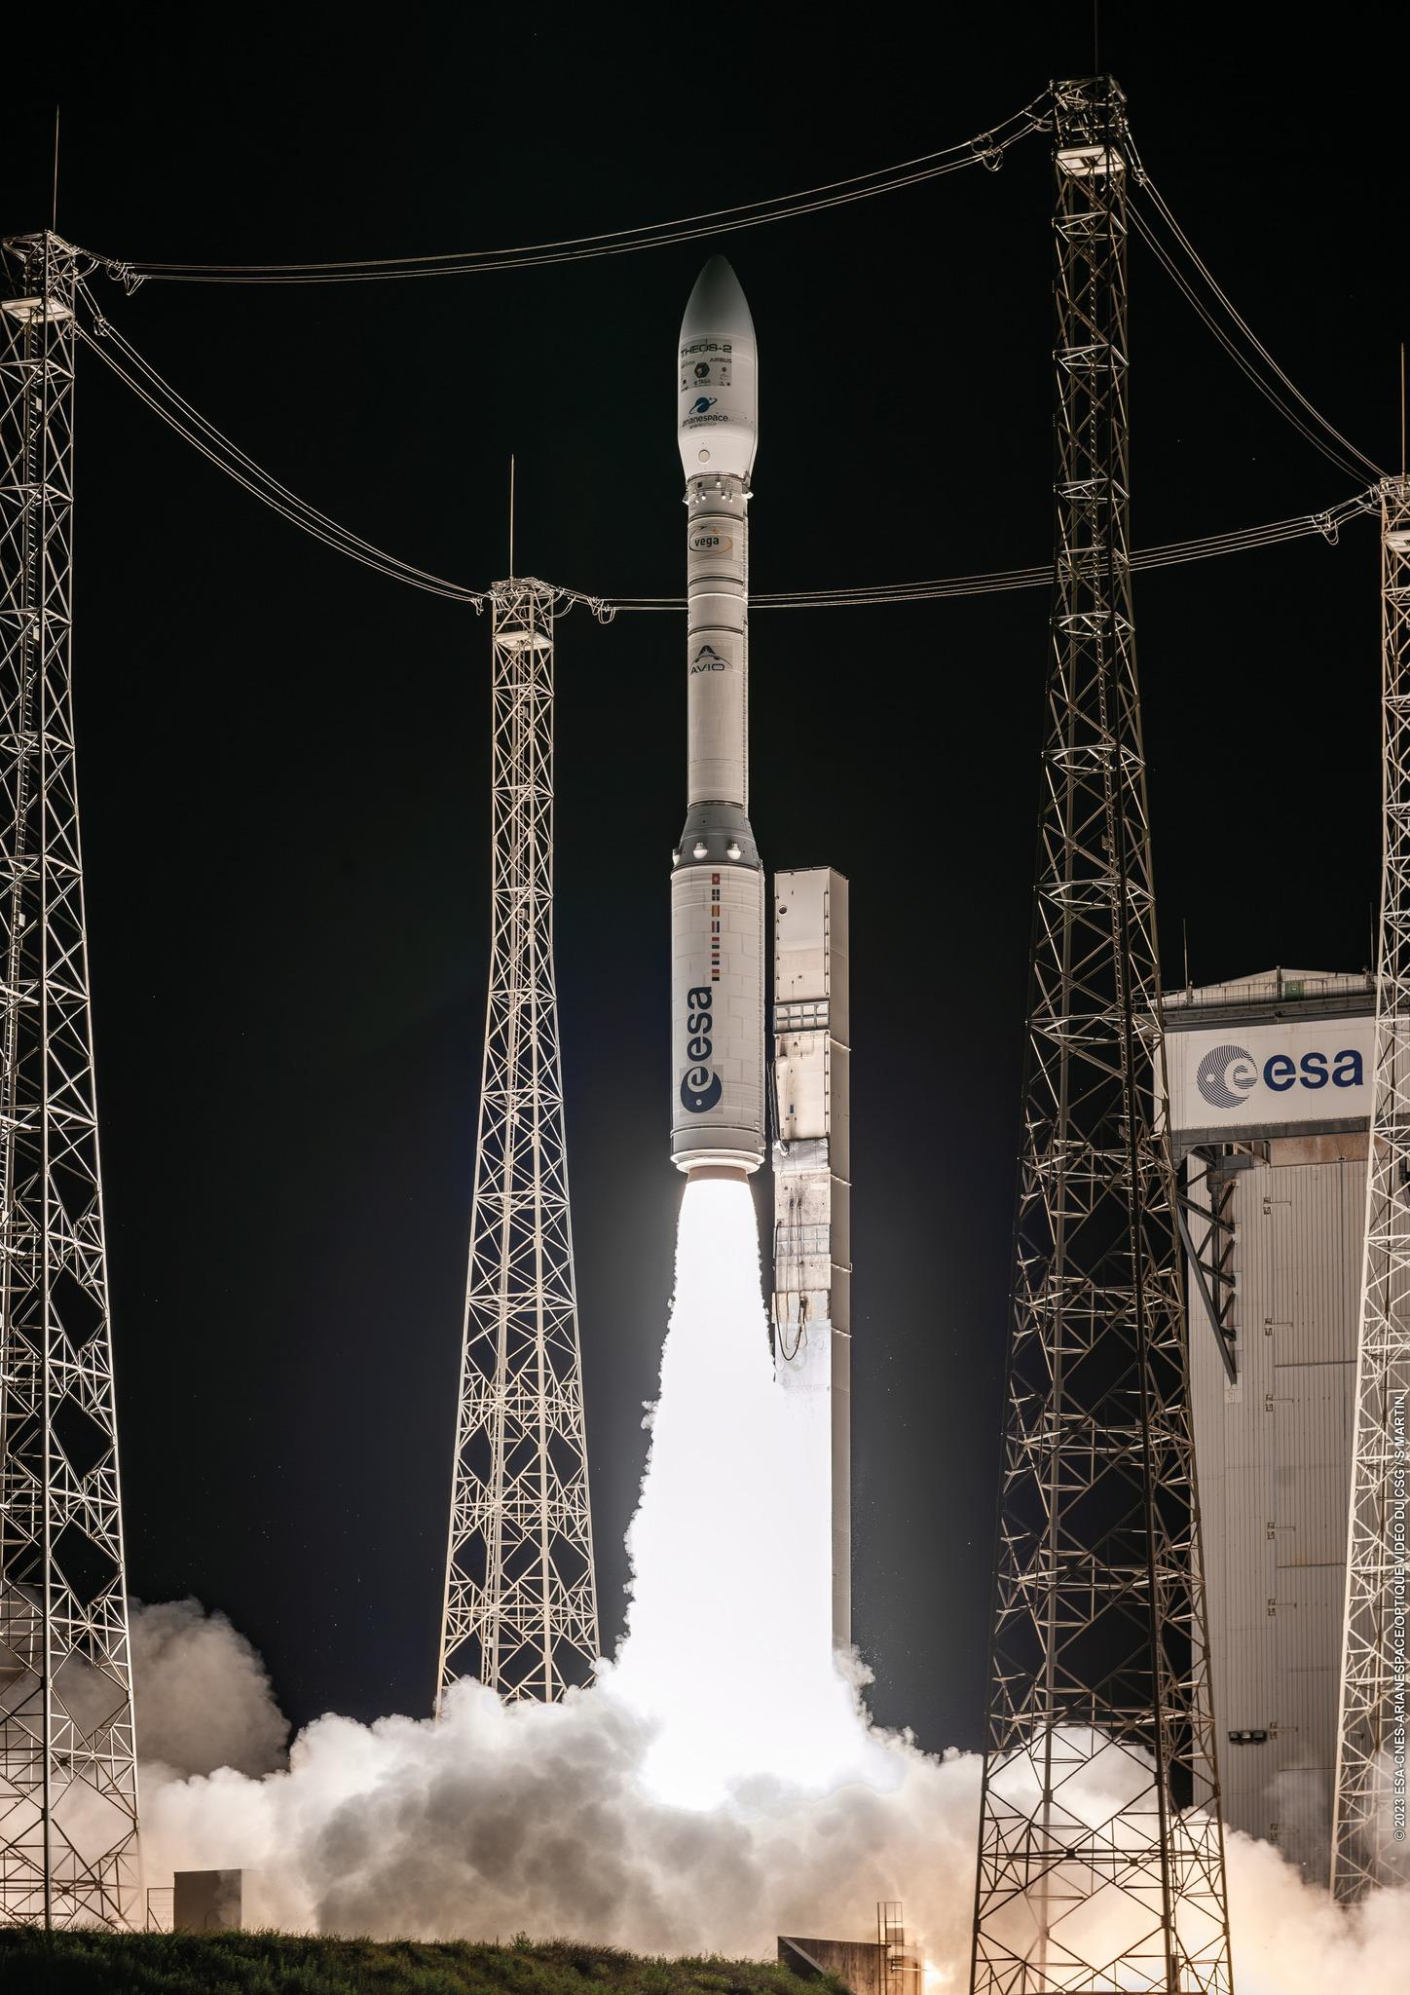
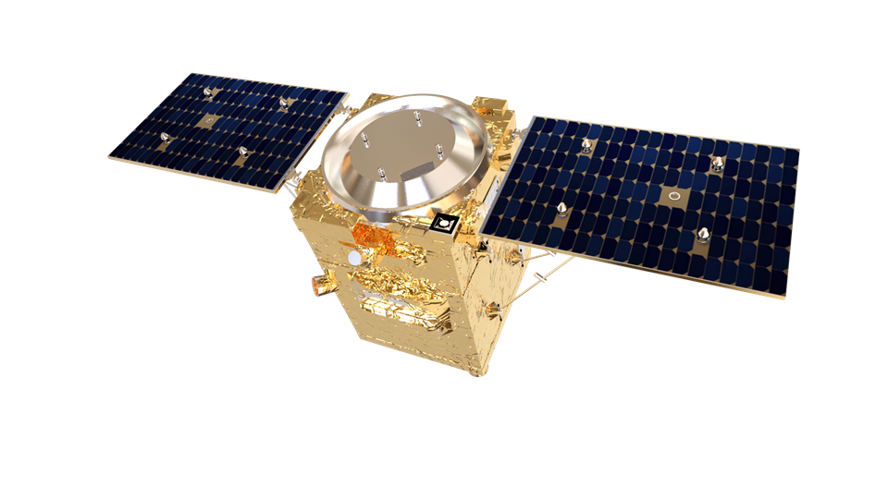

THEOS-2 Launch
Speciticaition
Payload: | Optical, Diameter 500 mm, Focal Length 14.9 m
Spectral Bands: | Panchromatic, Blue, Green, Red, Near Infrared
Altitude: | 621 km
Type: | Sun-synchronous, 9:30 - 10:30 AM descending node
Ground Sampling Distance (nadir): | Panchromatic:0.5 m; Multispectral 2 m
Swath Width: | 10.3 km at nadir
Dynamic Range at Acquisition: | 12 bits per pixel
Dimension Revisit: | 1.9 days within +-45° viewing angle (Mean at the equator)
Thailand's second earth observation satellite, THEOS-2, was successfully launched into orbit from the French Guiana Space Centre on Monday 9 October 2023 BKK time.

