Slide 1

Ocean Observations & Contributions to the
UN Oceans Decade
COVERAGE
CEOS Ocean Variables Enabling
Research & Applications for GEO
https://coverage.ceos.org
Vardis Tsontos, NASA
Agenda Item #9.2
SIT TW 2022, ESA/ESRIN
13th - 15th September 2022

Slide 2
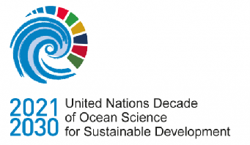


UN Ocean Decade Involvement
COVERAGE
CEOS COVERAGE Initiative
Cross-cutting, Multidisciplinary, interagency collaboration involving the CEOS Ocean VCs, GEO-MBON & GEO-Blue Planet
COVERAGE Serving as:
Cumulative CEOS contribution to the UN Decade of the Oceans
Joint CEOS liaison with stakeholders on the UN Decade Process
“Ocean Shot” Concept Advancement
Concept proposal submitted to Ocean Decade U.S. (National Academy of Science committee) in December 2020
“Next Generation Data Service Infrastructure for a Digitally Integrated Ocean Observing System”
Linkage to UN-SDG 14: “life below water”, emphasizing the role of Earth Observations and data infrastructures in supporting ecosystem-based management efforts
Presented & published in special edition of Marine Technology Society Journal (June 2021) https://doi.org/10.4031/MTSJ.55.3.45
COVERAGE highlighted as a focal development area for the Ocean Decade in the recent report by the National Academies of Sciences Decade US committee on Cross-Cutting Themes for U.S. Contributions to the UN Ocean Decade. https://doi.org/10.17226/26363 (April 2022)
Alignment & Coordination with other relevant Ocean Decade efforts
CEOS-COAST, Digital Twins of the Oceans (DITTO), Marine Life 2030, Basin Events to Coastal Impacts (BECI)

Slide 3
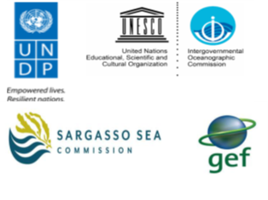
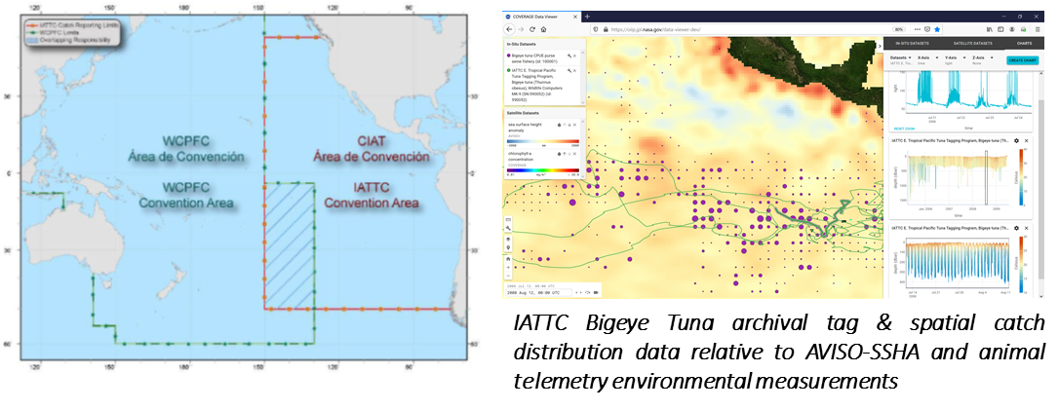
Regional Ecosystem Applications involving
Inter-governmental Agency Partners
COVERAGE
Sargasso Sea Commission (SSC)
Promote stewardship of the Sargasso ecosystem via work program & action plan development for this high seas area
Global Environmental Facility (GEF) funded project (UN IOC & UN FAO oversight)
Ecosystem Diagnostic Analysis (EDA), identifying trends and impacts from available environmental, biological and socio-economic data
Development of an ecosystem-based stewardship approach for the Sargasso Sea, including framework for MPA designation
COVERAGE providing integrative data system
Inter-American Tropical Tuna Commission (IATTC)
21 Nation Intergovernmental Regional Fisheries Management Organization (RFMO)
Responsible for the scientific assessment and management of Tuna and large pelagic fisheries in the E. Tropical Pacific (ETP)
Potential applications of remote sensing data to support fisheries Dynamic Ocean Management, habitat analyses, Spatial catch forecast, By-catch mitigation, Fishery closed area designation
IATTC-COVERAGE regional spin-off application

Slide 4
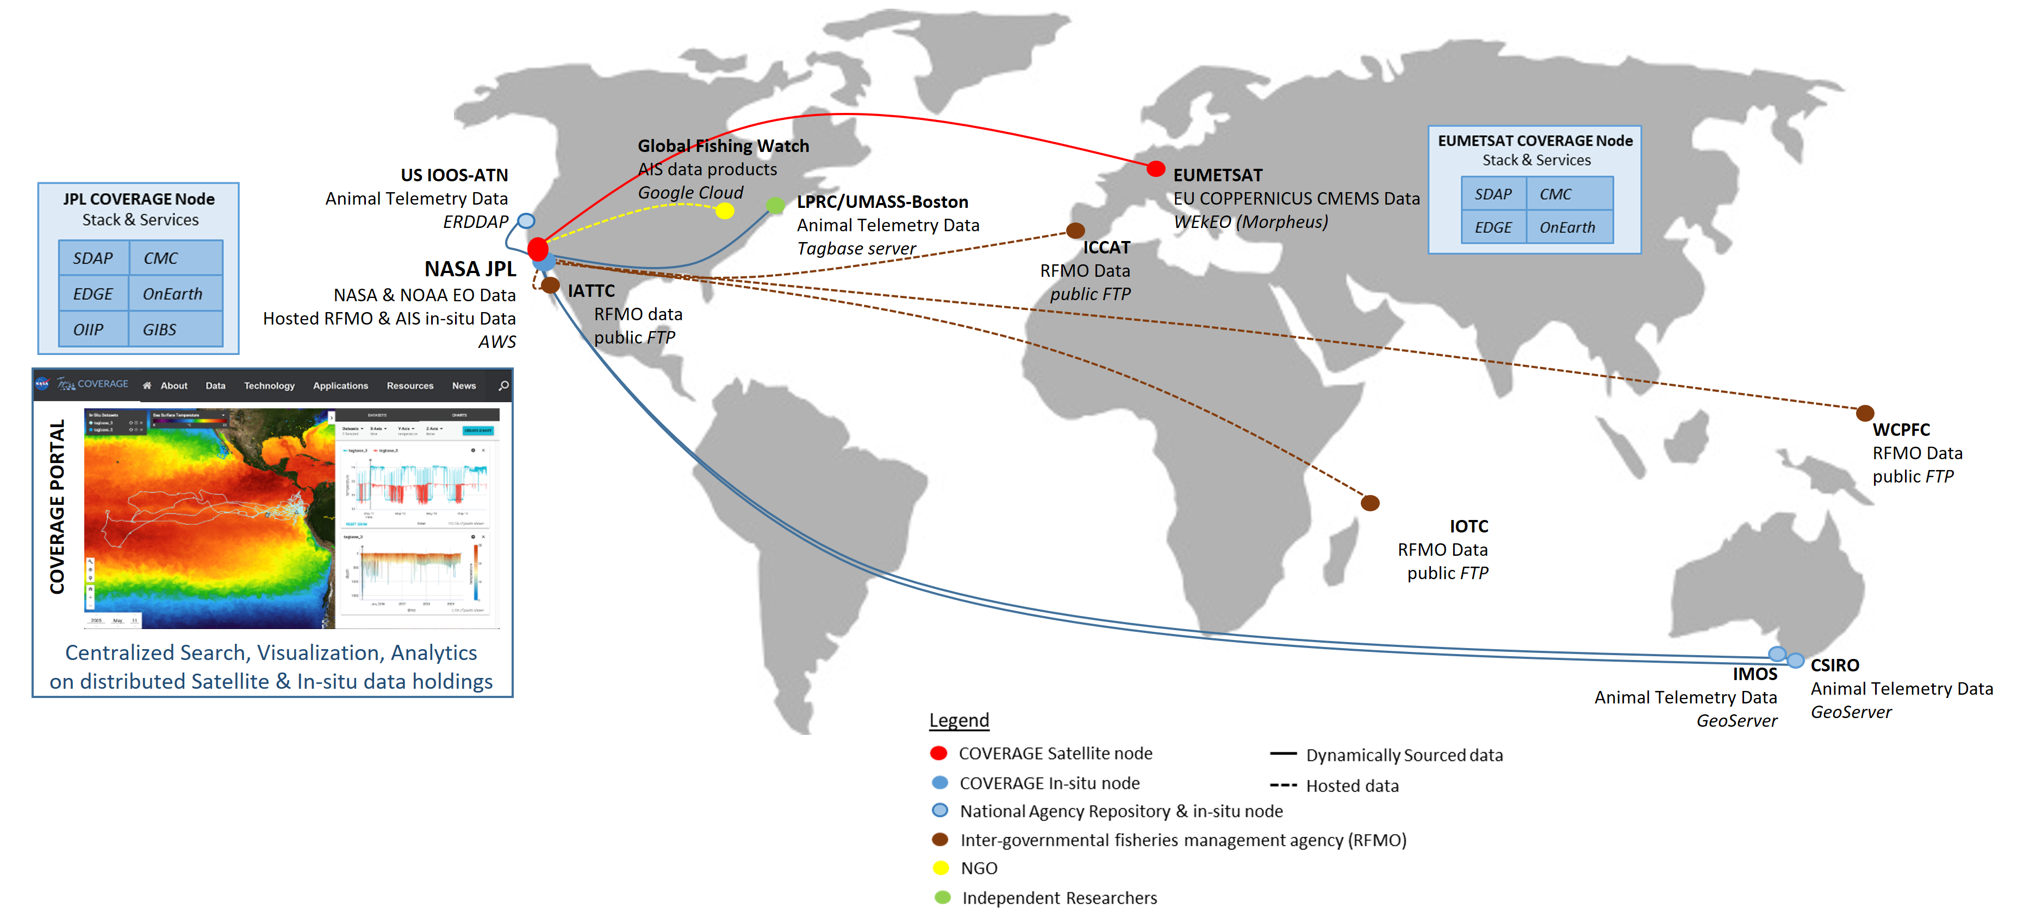
Distributed Data Architecture
Supporting the Fisheries/Ecosystem Thematic Application Pilot
COVERAGE
Cloud nodes on NASA/AWS & EUMETSAT/WEkEO hosting COVERAGE software stack and serving US and European/CMEMS EO datasets respectively
Interfaces to GOOS regional Ocean Observing System elements serving in-situ data (e.g. IMOS-Australia, IOOS-US)
Integration of fisheries-related data (AIS, Animal telemetry, RFMO Catch/Effort series)

Slide 5
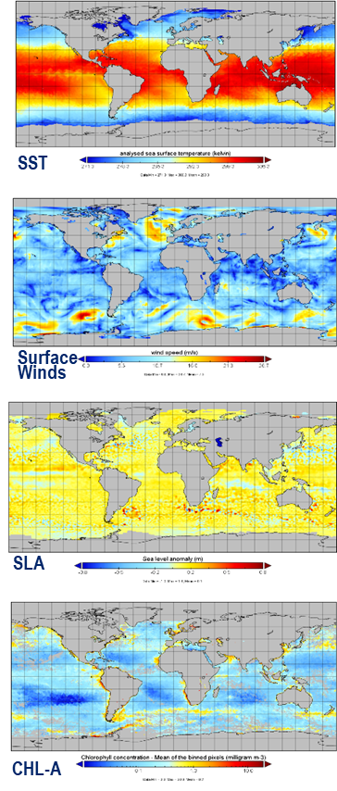
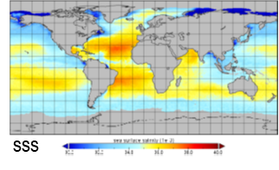
Constituent CEOS Agency Ocean Data
Baseline Dataset: High value, L4 Global Reanalysis & NRT products
COVERAGE
Sea Surface Temperature
- METOFFICE-GLO-SST-L4-NRT-OBS-GMPE-V3 (GHRSST-CMEMS/UK Met.Office)
- MUR25-JPL-L4-GLOB-v4.2 (GHRSST- NASA/Measures)
Ocean Surface Winds
- WIND_GLO_WIND_L4_REP_OBSERVATIONS_012_006 (CERSAT/IFREMER - CMEMS)
- WIND_GLO_WIND_L4_NRT_OBSERVATIONS_012_004 (CERSAT/IFREMER - CMEMS)
- RSS_CCMP_WINDS_V2.1 (NASA/Measures – RSS)
Ocean Surface Topography
- SEALEVEL_GLO_PHY_L4_NRT_OBSERVATIONS_008_046 (AVISO/CLS - CMEMS)
- SEALEVEL_GLO_PHY_L4_MY_008_047 (AVISO/CLS - CMEMS)
SEA_SURFACE_HEIGHT_ALT_GRIDS_L4_2SATS_5DAY_6THDEG_V_JPL1812 (NASA/Measures - JPL)
- NOAA_LSA_SLA_GLOB_L4_NRT and DT (NOAA/LSA)
Ocean Color
- JPL-MRVA25-CHL-L4-GLOB-v3.0 (NASA/COVERAGE -JPL)
- OCEANCOLOUR_GLO_CHL_L4_REP_OBSERVATIONS_009_082 (Globcolour – CMEMS)
- OCEANCOLOUR_GLO_CHL_L4_NRT_OBSERVATIONS_009_033 (Globcolour – CMEMS)
- NOAA_MSL12-NRT-CHL-Daily-L4 and DT (NOAA/Coastwatch)
Sea Surface Salinity
- OISSS_L4_multimission_7day_v1 (NASA/SCP – IPRC-SOEST, RSS)
- OISSS_L4_multimission_Monthly_v1 (incl. SSS-anomaly field) (NASA/SCP – IPRC-SOEST, RSS)
- CCI_OISSS_L4_multimission_Weekly_v3.21 (ESA/CCI – ESA CCI, CEDA-NERC)
- CCI_OISSS_L4_multimission_Monthly_v3.21 (NASA/SCP –ESA CCI, CEDA-NERC)
sss

Slide 6
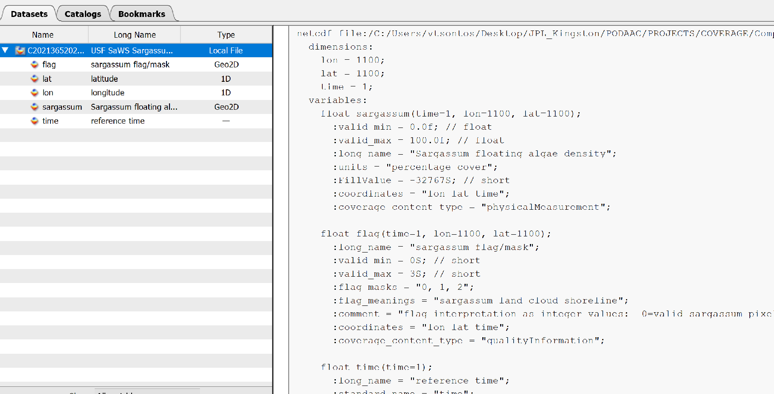
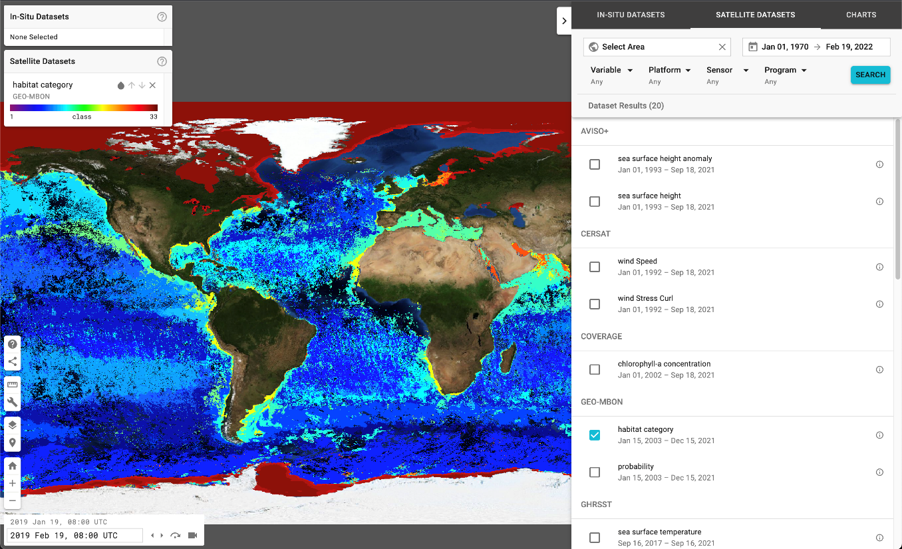
Value-added EO Data Products Included
In Support of COVERAGE’s Regional Ecosystem Applications
COVERAGE
GEO-MBON “SeaScapes” marine habitat classification monthly product integrated in COVERAGE Viewer
Sargassum Floating Algal Index Product
Served via NOAA-Coastwatch THREDDS
Developed by M. Kavanaugh (OSE)
Developed by Chuanmin Hu (USF, Optical Oceanography Lab)
Available via USF Satellite-based Sargassum Watch System (SaWS) as PNG imagery for several regions, including Bermuda
COVERAGE-USF collaborated to develop a netCDF-CF compliant dataset now integrated and served by COVERAGE

Slide 7
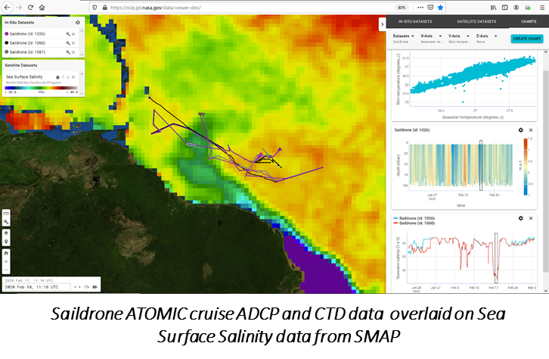
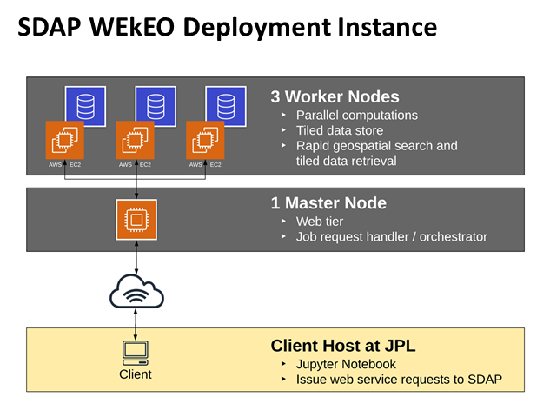
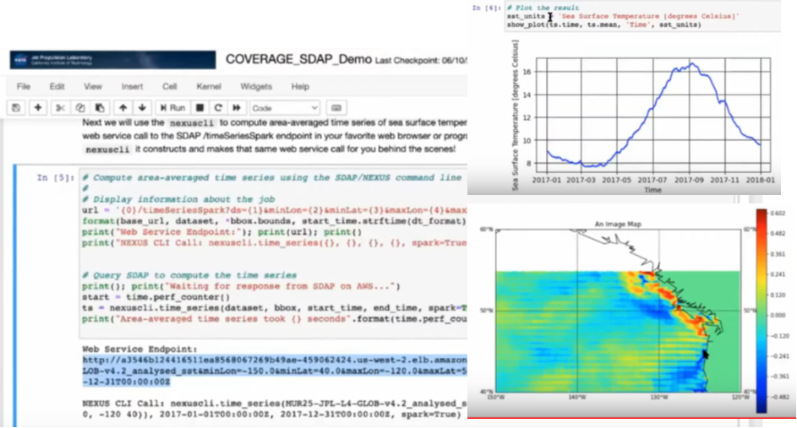
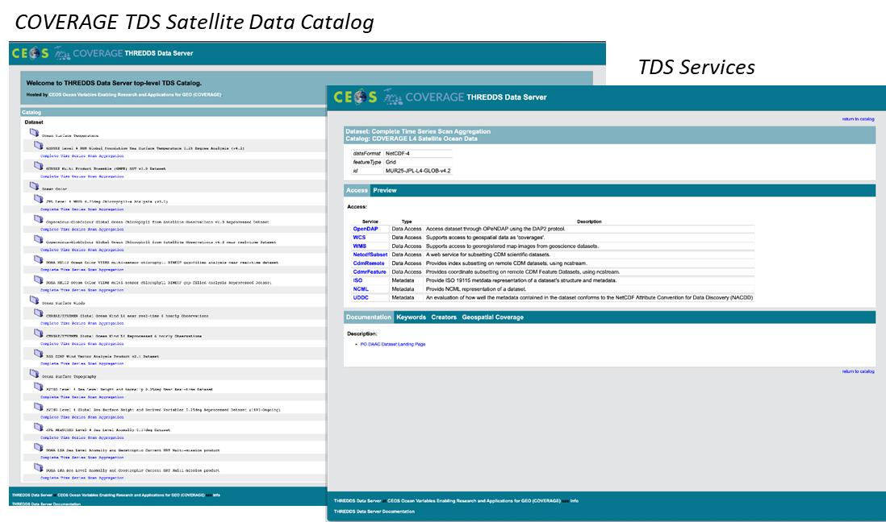
Core Data Services
Accessible via COVERAGE Prototype Portal https://coverage.ceos.org
COVERAGE
Web-based Data Visualization
Integrated visualization of satellite & in-situ data (generalized capability)
Synchronized horizontal and vertical views of data and their evolution over time (custom time step intervals)
Integrated dataset Search & Filtering
Online Help & URL sharing
Analytics
Science Data Analytics Platform (SDAP) – Apache.org open source project
“Enabling Big Data Science Without Download” – based on a range of built in parallel computing functions for satellite & model data
Full suite of COVERAGE EO data included
Deployed on both NASA/AWS and EUMETSAT/WEkEO nodes
Interfaces: SDAP-API and Jupyter notebooks
SDAP Jupyter Notebook Interface
Data Access & Subsetting
Powered by THREDDS v5 in the Cloud
Deployed on both COVERAGE AWS and WEkEO nodes
TDS catalogs accessing COVERAGE dataset granule repositories natively in S3 object stores
Bundled Services/APIs: NCCS (subsetting/download), OPeNDAP, WMS, WCS, ISO metadata

Slide 8

COVERAGE Promotional Video Highlighting CEOS Data & Technical capabilities
COVERAGE

Slide 9
Concluding Remarks
COVERAGE
Acknowledgement: Many thanks to EUMETSAT for provisioning of WEkEO cloud computing resources, and to our advisory board members from several agencies.
A reusable software platform with core capabilities & data has been assembled, capable of supporting interdisciplinary marine applications. This can be extended further to support specific application use cases.
Integrates a range of interagency satellite Ocean datasets and select value-added EO products with support also for in-situ data.
Ongoing UN Decade program engagement on behalf of CEOS.
COVERAGE is partnering with 2 Intergovernmental agencies (SSC and IATTC) to support emerging ecosystem-based management approaches that include remotely sensed environmental data in assessment frameworks.

