Slide 1
SIT Technical Workshop 2022
Road to a GEO Post-2025 and CEOS Engagement
Marie-Josée Bourassa/CSA
Katy Matthews/NOAA
Andreas Obrecht/GEO Secretariat
Agenda Item 8.4
SIT TW 2022, ESA/ESRIN
14th - 15th September 2022

Slide 2
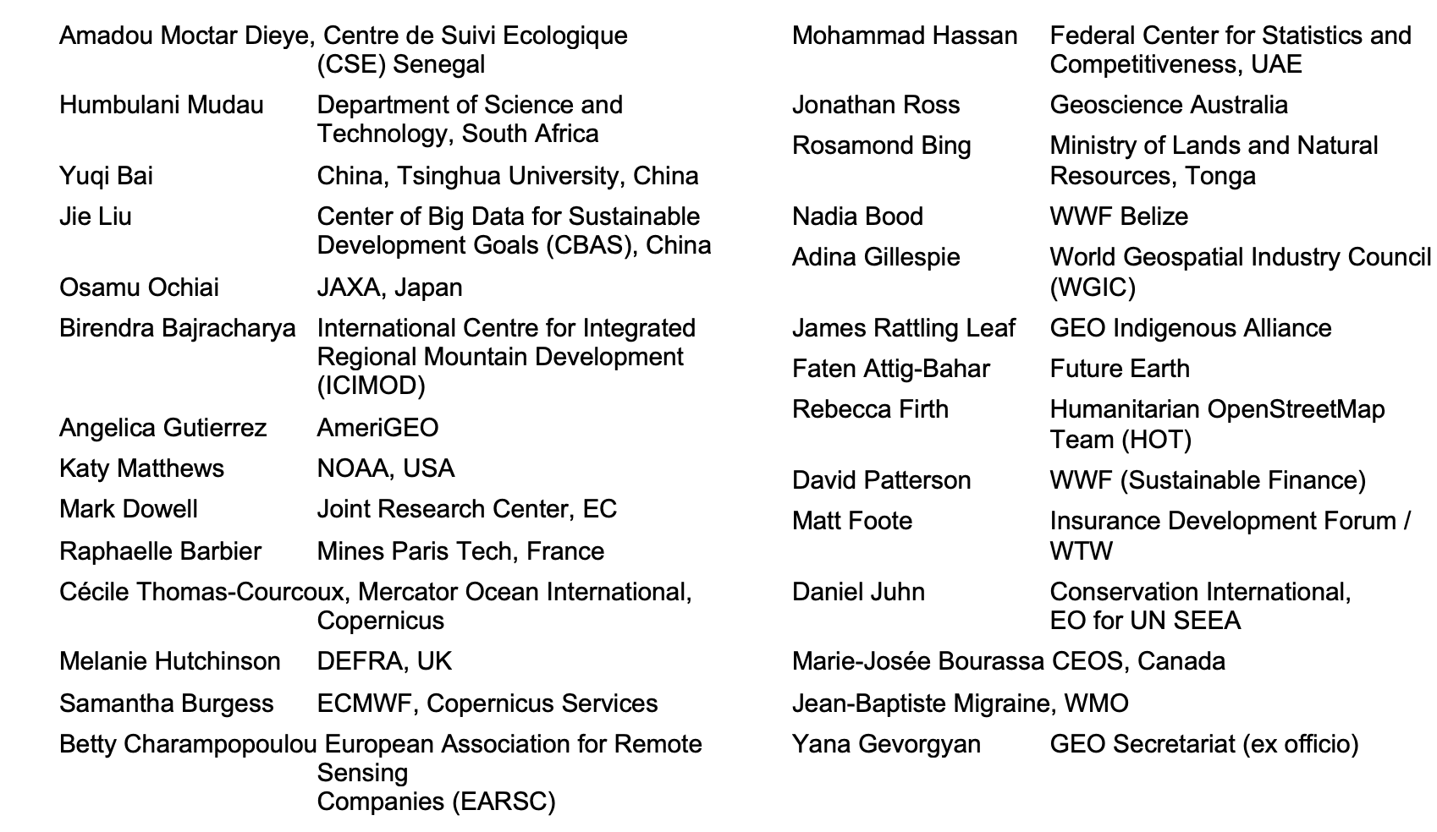
Composition of the Working Group

Slide 3
Indicative sequence
1st meeting (virtual)
2nd meeting (virtual) 11-12.7.
3rd meeting (virtual) 30-31.8.
4th meeting (on site) 20-21.9.
GEO Week 31.10.-4.11.
2022
Community engagement
Further meetings of the post-2025 working group
60th Executive Committee meeting (March 2023)
July 2023
Ministerial Conference (October 2023) in South Africa
2023
(indicative)
…
Community engagement
Ministerial working group

Slide 4
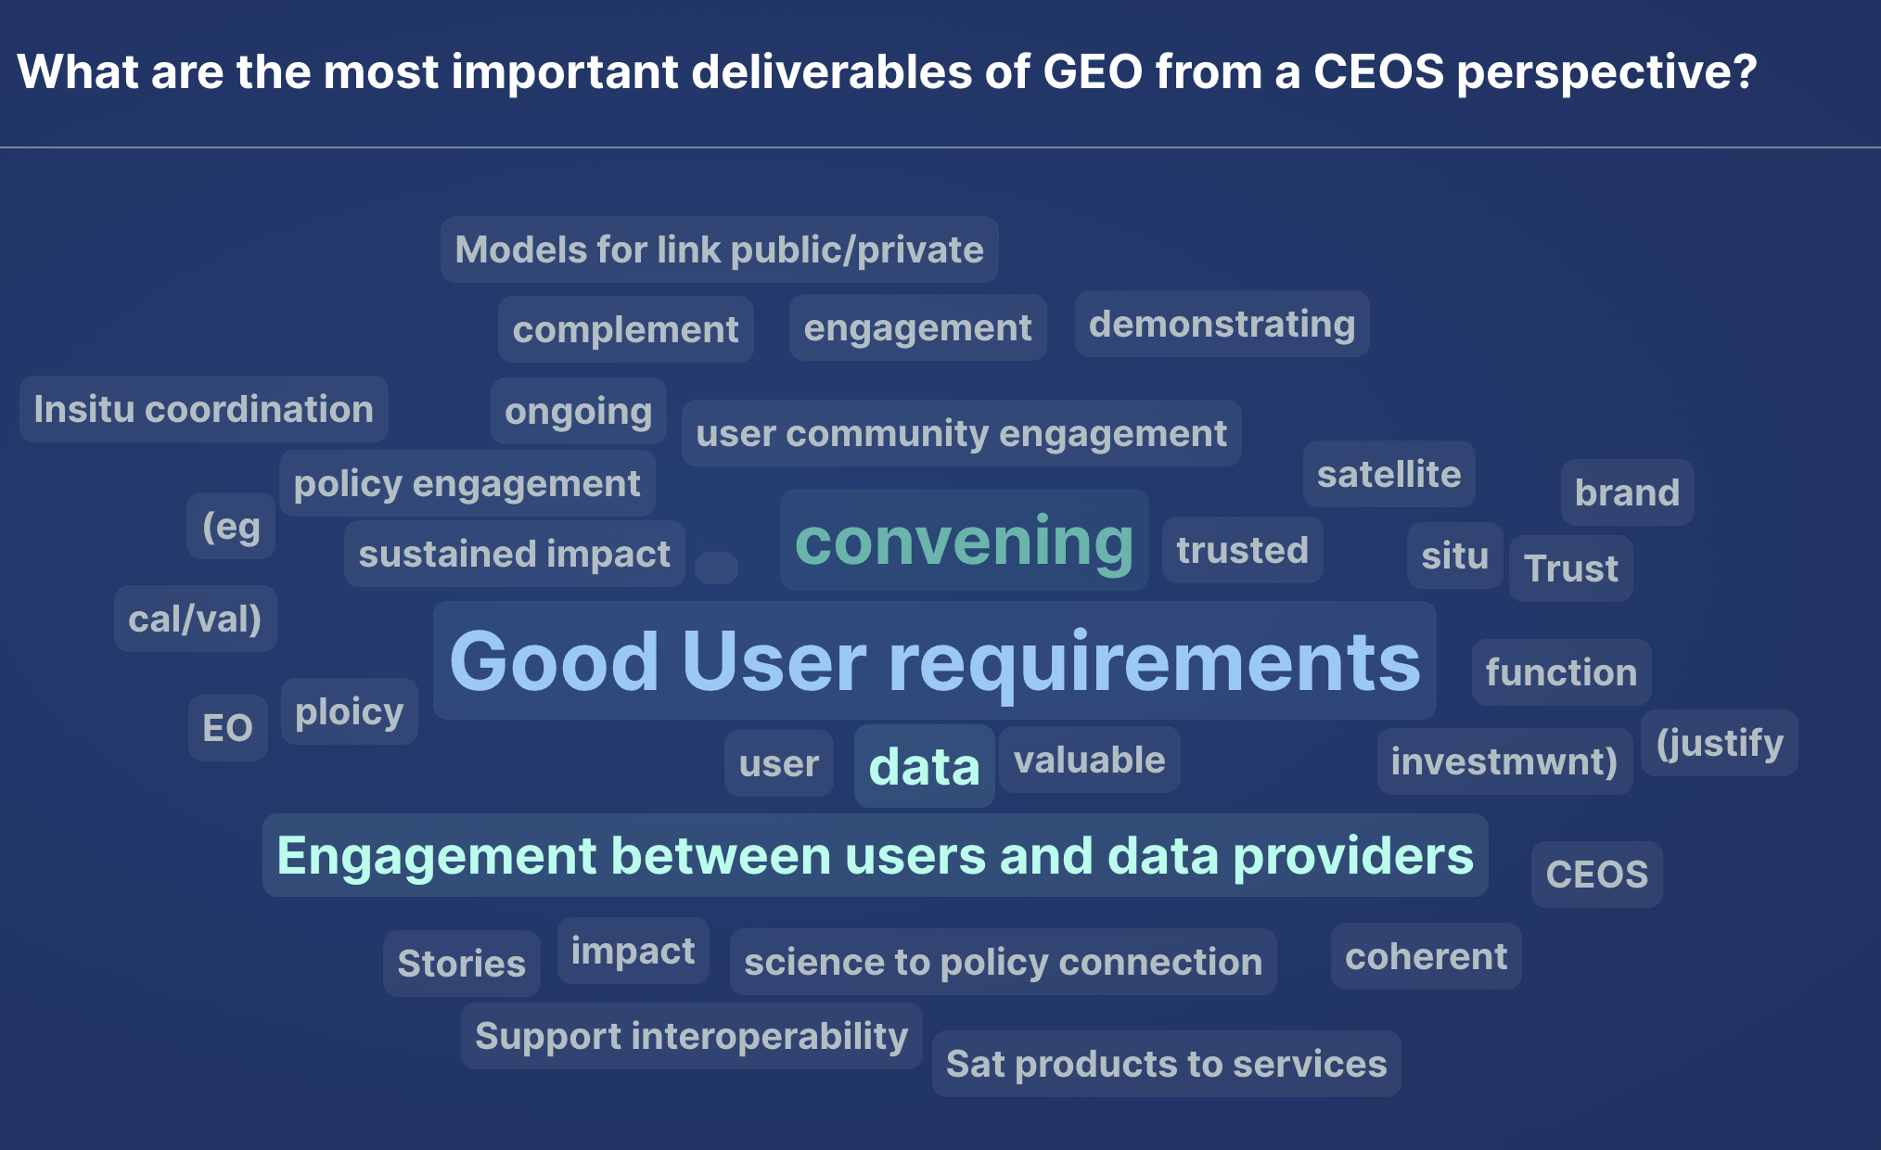
Side meeting (13.9.22) results

Slide 5
Value of GEO Collaboration to CEOS
Have a variety of stakeholders and a wide-ranging participation
Uniquely placed to convene users and providers, of all types, by creating environments of open collaboration
Engaged in capacity-development, in particular at country and regional level
Strong coordination in many work plan activities, such as GEOGLAM, GFOI, and SDG coordination
Ability of CEOS and GEO to work together to provide training and capacity development around the use of satellite data
Wider distribution of the use cases for satellite data, for example for DRR and disaster response

Slide 6
Considerations for GEO Post-2025
Quantify, assess, and convey user requirements and needs
Continue to convene, facilitate, and establish fora and partnerships among different types of organizations
Expand user communities, at local, national, regional and global levels
Continue CEOS cooperation to optimize replication of successful EO applications and pursue partnerships to successfully scale them
Increasingly deliver sustained services and mobilise resources
Ensure that any nexus approach is responding to user needs and interest of partners and doesn’t lose the value of GEO as a convener

