Slide 1
CNES CEOS Chair Priorities 2022
Paths to Sustainability: from strategy to practical measures
Dr. Selma Cherchali CNES
Item 8.2
SIT TW
14-15 September 2022

Slide 2
Overview
Reminder of CNES themes and priorities
  Provide an update on ongoing CNES activities on the themes
Plenary preparations and information

Slide 3
Paths to Sustainability: from strategy to practical measures
Ensuring Long-term Sustainability of CEOS Strategies
Sustained Operation and Application of CEOS Demonstrators
                Explore Establishment of Services from CEOS Demonstrators
CEOS Support to the UNFCCC Global Stocktake
        Implementation of the CEOS Strategy to Support the Global Stocktake of the UNFCCC Paris Agreement through the support of the CEOS Biomass Protocol uptake & GEO-TREES
Support to CEOS Cal-Val Initiatives
CEOS Protocol for Cross-calibration of Thermal Infrared Measurements
Joint Multi-thematic Cal-Val Sites to Develop CEOS Agency Synergies and Support Future Applications
Slide 3

Slide 4
Priority #1

Slide 5
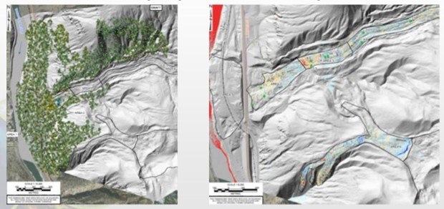
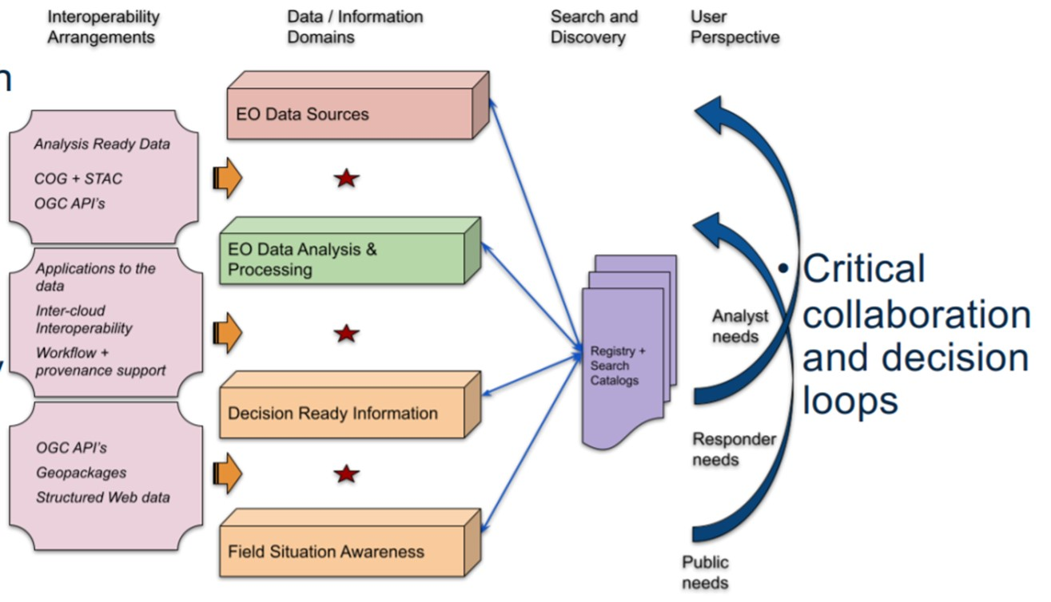

Priority #1: Ensuring Long-term Sustainability of CEOS Strategies
Disaster Risk Reduction and Response, & Capacity Building
Identify demonstrators / R&D stage activities across CEOS suitable to transition to operational services.
Continue to develop model partnerships through Demonstrators, specifically Recovery Observatory (RO)
Develop synergies between CEOS projects and identify support mechanisms with key external stakeholders. Engagement with GEO is key in that manner.

Slide 6
Progress: Ensuring Long-term Sustainability of CEOS Strategies
Disaster Risk Reduction and Response, & Capacity Building
WGDisasters Recovery Observatory (RO)
Cited in the UN Space Agenda 2030
RO sustainability sub-group started at the WGDisasters meeting #17 in March.
Links established with WGCAPD
  WGCAPD/WG Disasters joint action: RO guidelines and actions for 2022 and 2023
WGDisasters activities sustainability
Sub-team created within the WG’s Demonstrators to address sustainability issues
To ensure long term sustainability:
Keep on working on the development of strong and visible links with GEO and WG GEO DRR:
  RO integrated as a case study in the GEO EO risk toolkit
  GEO4DRM
Continuous efforts have to be provided for strong policy linkages: e.g., Sendai framework, International Charter "Space and Major Disasters".

Slide 7
Priority #2

Slide 8
Priority #2: CEOS Support to the UNFCCC Global Stocktake
Ensure Strong and Unified CEOS Support to the UNFCCC Global Stocktake
Support Global Stocktake data requirements:
  CNES with UKSA and DLR will ensure planned missions, such as MicroCARB & MERLIN, to provide practical support to Global Stocktake data requirements
  AFOLU & GHG Roadmaps
Engage with countries for adaptation and mitigation support
  Provide use cases through Space for Climate Observatory (SCO)
Biomass Protocol – CNES is enhancing ongoing activities by :
  supporting secretariat of GEO-TREES
  funding two biomass protocol implementation sites

Slide 9
Progress: Support Global Stocktake data requirements:
BIOMASS and GEOTREES
BIOMASS mission will be launched between Q3 2023 and Q1 2024
Biomass data will not be optimized until GEOTREES can establish new reference sites to develop plot coverage with LIDAR and NISAR data.
  CNES will use its position as GEO-TREES Sec to work in particular on the governance (GEO, CEOS and external) of the project and ensuring links with CEOS.

Slide 10
Progress: Engage with countries for adaptation and mitigation support: Space for Climate Observatory (SCO)
The Space for Climate Observatory is part of the wider EO global community as a GEO participating organization. Its Charter gathers over 31 partners including 21 space agencies.
The Space for Climate Observatory offers applications with a sustainable framework, providing operational tools at a local scale to answer specific needs suited for specific geographical areas
CNES level in-depth analysis of possible ties with different CEOS WGs
Outcome: propose a series of applications that have links with WGs.
Notes:
SCO is a best-effort based network, open to all public and private entities involved in the Earth Observation sector. It was created to answer some shortcomings surrounding the use of satellite data for climate action: while such data is instrumental in understanding Earth’s climate, it unfortunately does not translate necessarily into operational tools that can be used by decision-makers and the wider audience.
SCO aims at providing such applications, designed at the local scale together with their end-users, to favour climate adaptation, mitigation and monitoring. It also endeavours to foster cooperation in the field and build a network where such tools can be shared and highlighted.
Provide operational tools for climate adaptation, mitigation and monitoring 1) at a local scale, using satellite-based observation tools together with in-situ data and models, 2) designed to answer specific needs of the general public and decision-makers, 3) that can easily be modified to suit other geographic areas facing similar climate stakes.
Foster cooperation around these applications to favour their reuse and communicate on them
Build a network for space agencies and public and private entities involved in the use of EO data for operational climate action
Space for Climate Observatory (SCO) possible links :
WGDisasters: FloodDAM in pole position as a project to be proposed.
WGCapD: VietSCO, EDUSCO and TROPISCO and/or mangroves

Slide 11
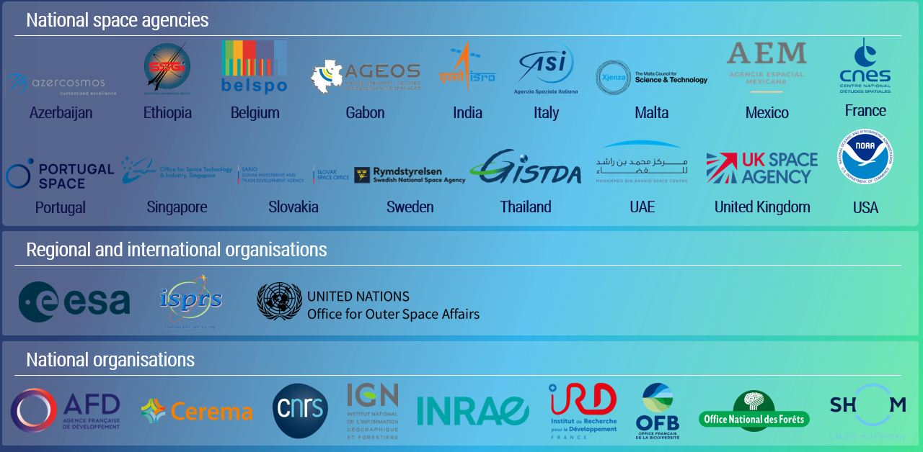


SCO’s international Charter

Slide 12
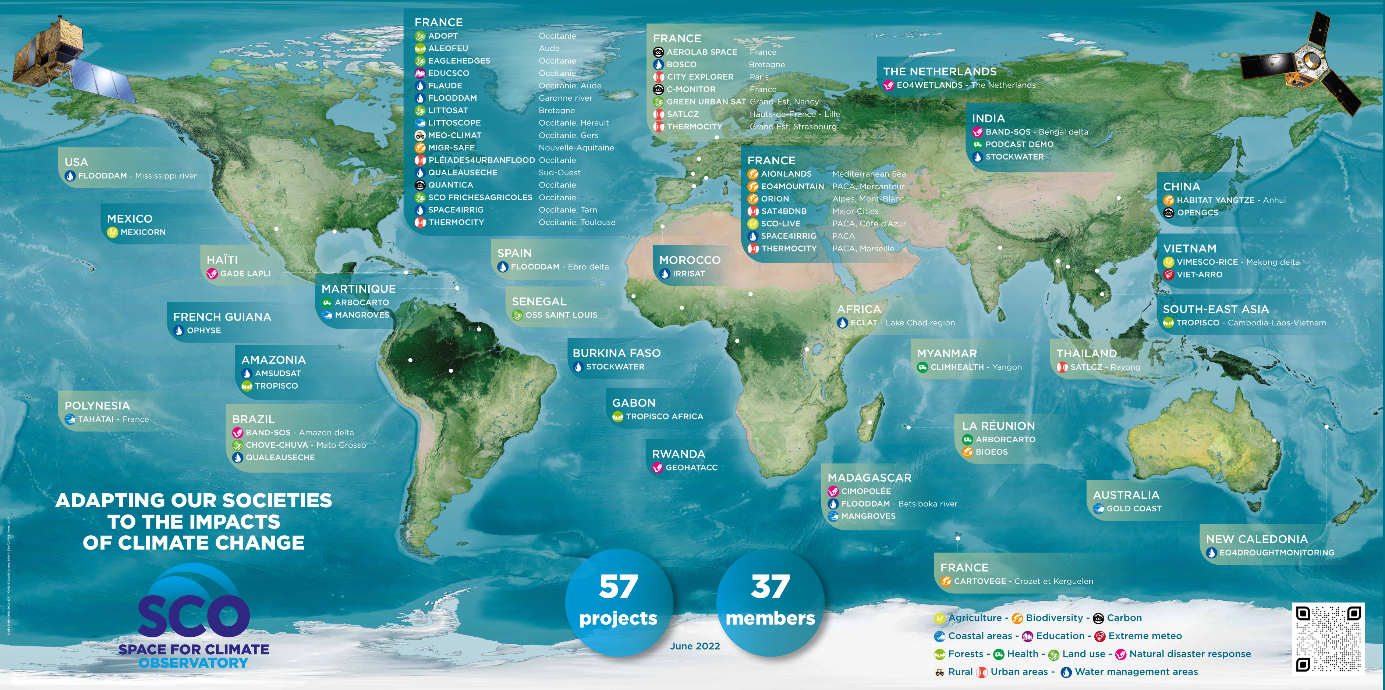
SCO projects and applications around the world

Slide 13
Priority #3

Slide 14
Priority #3: Support to CEOS Cal-Val Initiatives
Increased CEOS Agency Cal-Val Collaboration
CEOS protocol to support the cross-calibration of thermal infrared measurements from future CEOS Agency missions:
  WGCV supporting – CEOS Work Plan 2022-2024 task established
  Definition of a common network of in situ calibration sites to harmonize calibration methods for thermal infrared instruments taking advantage of the previous work done in the “Land Surface Temperature Product Validation Best Practice Protocol” written by LPV WGCV subgroup
  Connections Trishna (CNES/ISRO) made with ESA (LSTM), NASA/JPL (SBG), CSIRO (Aquawatch), etc.
  Goal: maximize the benefit of these missions for users
Location of ground observational networks currently used to validate standard LST products derived from US and European spaceborne instruments.

Slide 15
Progress: Thermal Infrared Cal/Val
Strong interest in the upcoming LPV and IVOS subgroups that will focus on the development of a network of calibration sites
LPV and IVOS subgroups would also represent interesting perspective for TIR:
  Trishna focus for CNES
  Points such as the development of multi-purpose sites or the transposition of work carried out in the visible field to the thermal infrared are topics for discussion.
  Seeking collaboration opportunities with a number of CEOS Agencies
CNES will increase representation in WGCV
Notes:
CNES will increase representation in WGCV → JM Delvit : Terrain Mapping
Infrared and Visible Optical sensors subgroup → IVOS

Slide 16
36th CEOS Plenary

Slide 17
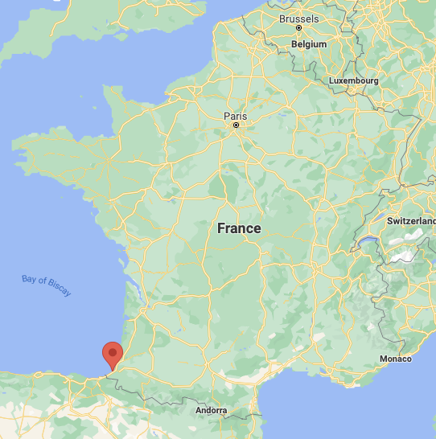
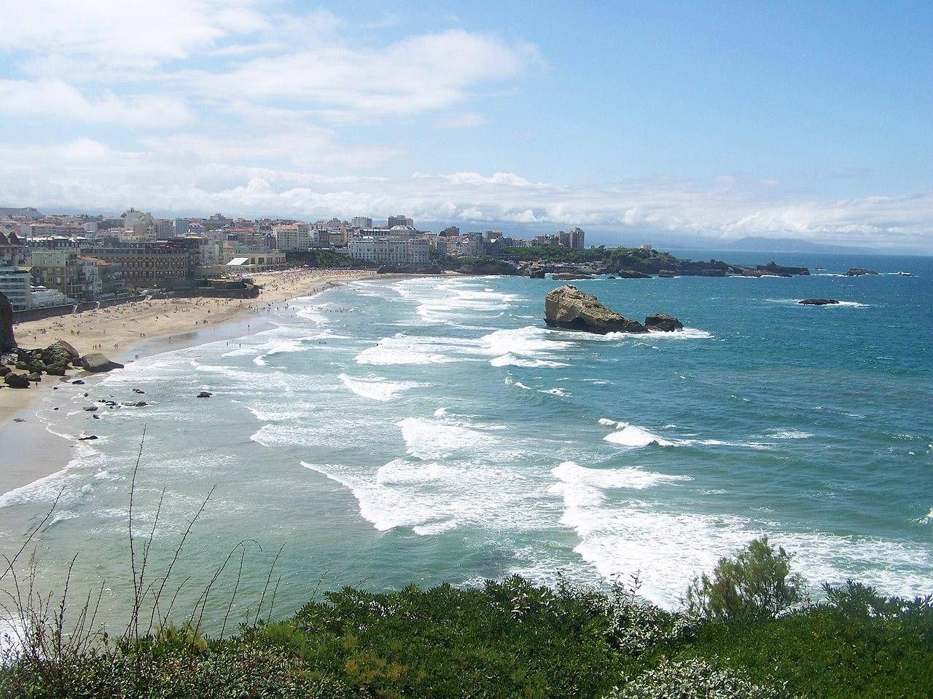
36th CEOS Plenary
The CNES team looks forward to welcoming you to Biarritz, France!
Photo: Florian Pépellin, CC-BY-SA 3.0

Slide 18
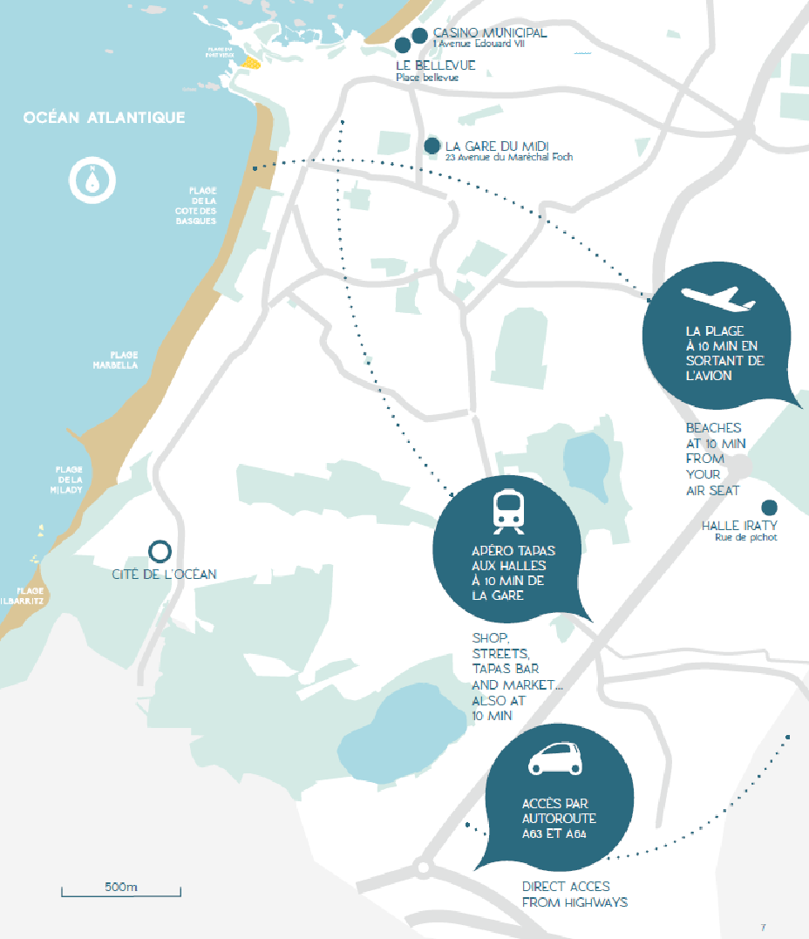
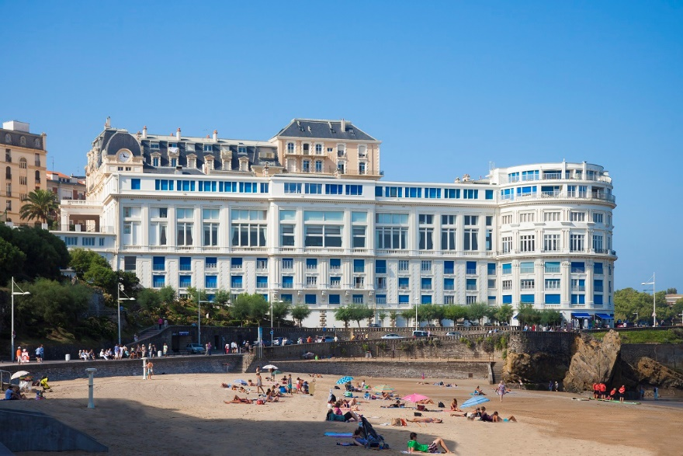
36th CEOS Plenary
The plenary will be held at the Bellevue congress centre.
The dates are November 29th - December 1st, 2022.

Slide 19
The Plenary at a glance
Monday, Nov 28 | Tuesday, Nov 29th | Wednesday, Nov 30th | Thursday, Dec. 1st | Friday, Dec. 2nd
 | Side meetings | Plenary | Plenary | Visit (TBD)
 | Lunch | Lunch | Lunch
 | Side meetings | Plenary | Plenary
Arrival of participants | Welcome cocktail | Gala diner |  | Departure of participants

Slide 20
Plenary Logistics
Please register before the end of September
Side meetings : please inform us of your needs as soon as possible
Hotel information provided
Draft objectives document will be further elaborated from SIT TW onwards and presented in the following weeks
Social event info :
  Gala Diner 30th of November
  Visits program will be proposed shortly

Slide 21
Thank you!

