Slide 1
White Paper: “Monitoring Surface PM2.5: An International Constellation Approach to Enhancing the Role of Satellite Observations”
Atmospheric Composition Virtual Constellation (AC-VC) B. Veihelmann, ESA, AC-VC Co-Chair S. Kondragunta, NOAA, AC-VC Topical Lead AQ Aerosol
Agenda Item # 5.1
SIT TW 2022, ESA/ESRIN
13th - 15th September 2022

Slide 2
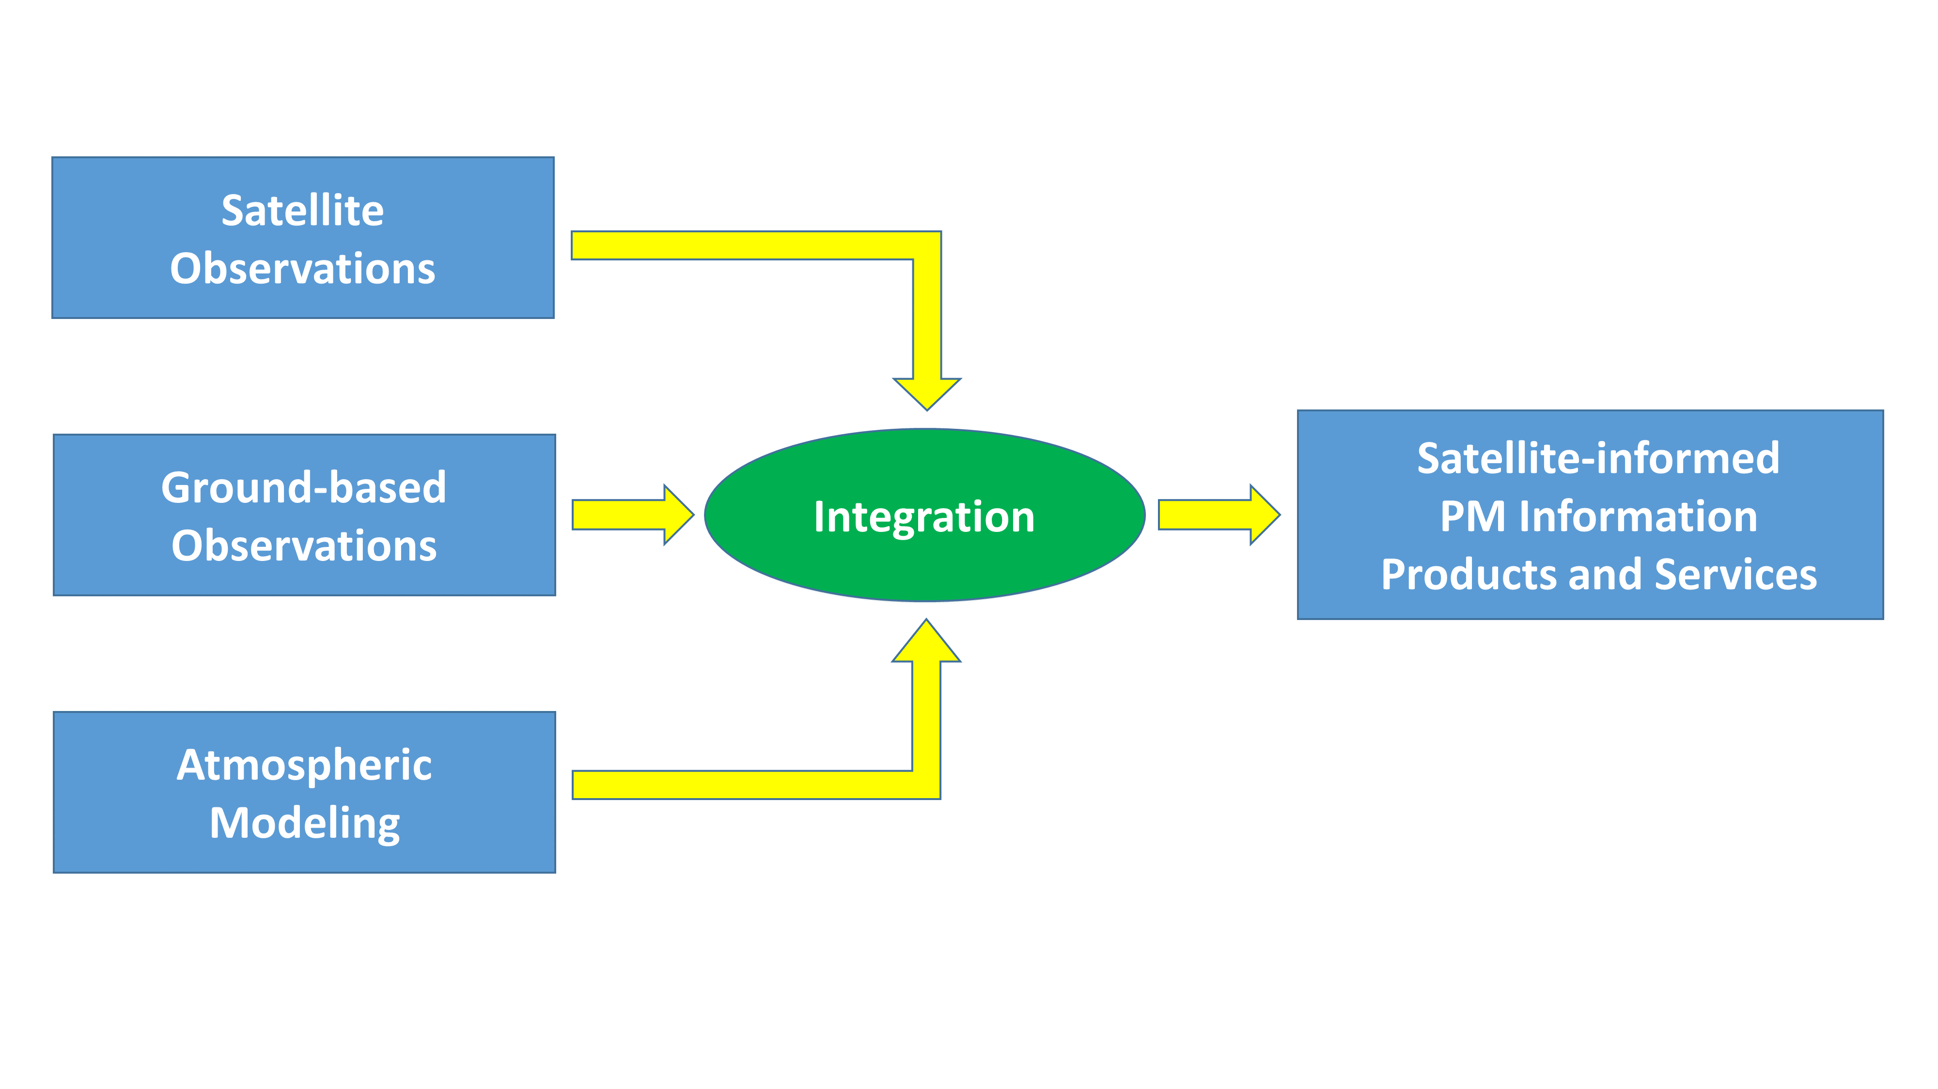
Purpose
Objective: Strengthen the role of satellite missions with aerosol observation capabilities in monitoring particulate pollution of air
Room for improvement
Collaborative constellation approach
Not covered by other inter-agency coordinating groups
AC-VC gathered experts on
aerosol observations
air quality modelling
Whitepaper with actionable recommendations

Slide 3
White Paper
Title: “Monitoring Surface PM2.5: An International Constellation Approach to Enhancing the Role of Satellite Observations”
Authors: 46 from academia and space agencies, led by S. Kondragunta (NOAA) and B. Veihelmann (ESA)
Executive Summary (1/2 page)
Recommendations (1 page)
Detailed discussion: status, needs, best practices (42 pages)
Satellite sensors that bring PM information
Satellite products and consistency
Approaches to constrain particulate pollution levels
Validation
Outlook
References
Appendices

Slide 4
Recommendations
Exploit NRT information from meteorological imagers
Exploit vertical information from spectrometers
Exploit information from multi-angle polarimetric imagers
Enhance consistency of aerosol products (→ AEROSAT)
Develop synergistic aerosol retrievals from multiple sensors
Enhance radiometric consistency of space-borne sensors (→ GSICS)
Develop statistical PM estimation tools including machine learning
Improve consistency of AOD and PM trends in models and observations
Improve aerosol models in Level-2 assimilation schemes (→ AEROCOM)
Improve consistency of aerosol representation in models and satellite products
Improve uncertainty estimates in satellite aerosol products
Develop schemes for assimilation of Level-1 satellite data
Collect comprehensive reference sets to better linking PM and satellite observables
Validate satellite-informed PM products
Facilitate validation data access
Satellite Products
Methods
Validation

Slide 5
Way Forward
Draft available on https://ceos.org/meetings/2022-sit-technical-workshop
You are invited to review!
Feedback (tracked changes to word doc) needed within 1 month (by 15 Oct 2022)
Presentation at CEOS Plenary Meeting for endorsement (Nov/Dec 2022)

