Slide 1
Suggestion for a CEOS Interoperability Framework
Peter Strobl, EC
Agenda Item #5.1
SIT TW 2022, ESA/ESRIN
13th - 15th September 2022

Slide 2
Background
CEOS Analysis-Ready Data (CEOS-ARD) suite of specs aims at increasing the interoperability of Earth observation datasets.
CEOS-ARD is a first step on the interoperability spectrum :
From WGISS & LSI developed CEOS Interoperability Terminology Report (2020)

Slide 3
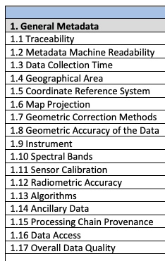
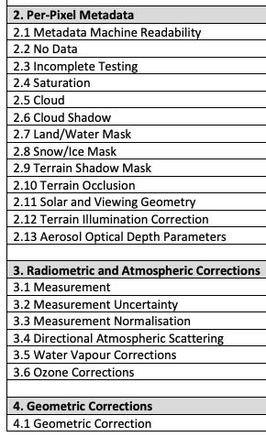
Background
The CEOS-ARD Product Family Specifications (PFS) define parameters which facilitate interoperability
Only a subset of what needs to be considered when trying to achieve full interoperability of datasets

Slide 4
What is Interoperability?
Interoperability is the “ability of two or more systems or components to exchange information and to use the information that has been exchanged.”
ISO 25964 Thesauri and Interoperability with other Vocabularies (ISO 25964-2:2013)
Interoperability has several aspects with different requirements, e.g:
Exchange requires technical and organisational connectivity
Use requires common understanding and legal agreement
… and what exactly is ‘information’ btw?

Slide 5
Why a framework?
Addressing the full scope of interoperability requires a framework that captures all aspects of the problem.
The following (non-exhaustive list) are equally important factors to consider, and each have a number of component pieces:
Structural / Data Architecture
Accessibility / System / Data Presentation
Formats / Syntactic / Data Language
Terminology / Semantics / Data Context
Factors and components are distributed across many CEOS groups (e.g., LSI-VC, WGISS, WGCV, etc.), and therefore a robust framework and coordination mechanisms are needed to address all of the necessary pieces.

Slide 6
CEOS (LSI) ‘Interoperability Spectrum’, thus far:
CEOS LSI-VC Vision:
Sensor Agnostic Land Surface Data from all Missions
Total Interoperability, straight from data providers – increased transparency and openness vs downstream efforts (e.g., GEE, Sinergise), for all users, and taking advantage of broad range of CEOS missions
Enable the use of complementary sensors to achieve a coherent single data stream to enable characterization of change on the Earth’s surface through time.
Harmonisation vs homogenisation?
Structural / Data Architecture
CEOS-ARD
Minimum Data Processing Level + Documented
Uncertainty measures
Consistent / Interoperable Metadata
MRI Framework and PFS parameters?
LSI-VC / CEOS-ARD OG
Interoperability Blocks / Activity Areas
Common References: Grids, DEM, GCP(?)
Discrete Global Grid System (DGGS)
Strobl / WGCV
Terminology / Semantics / Data Context
Strobl / Molch / Woolliams / WGCV
Formats / Syntactic / Data Language
COG / Cloud-enabling
WGISS
Accessibility / System / Data Presentation
STAC
Hanson / USGS
WGISS

Slide 7
Various (non-EO-specific) frameworks exist…

Slide 8
Interoperability Layers
Example from knowledge organisation (KO), https://www.isko.org/cyclo/interoperability

Slide 9
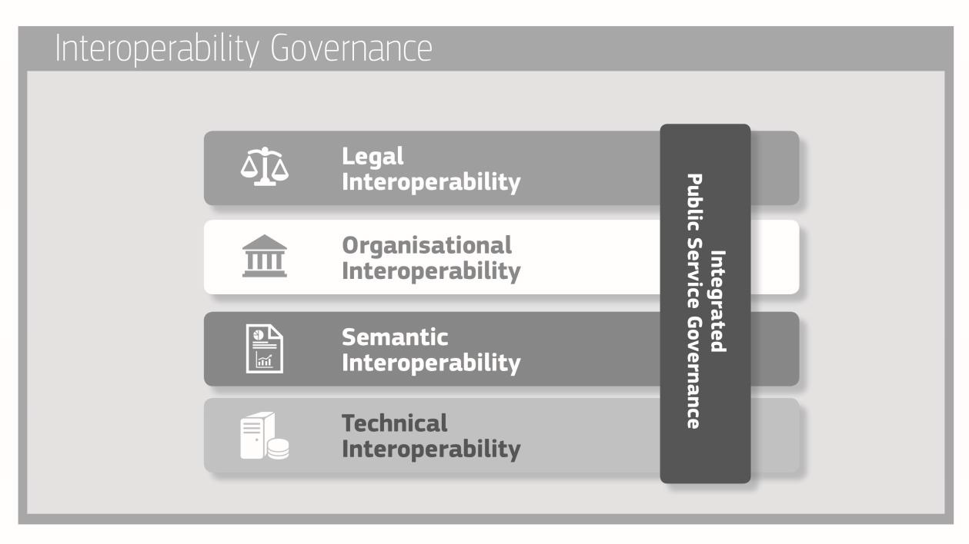
European Interoperability Framework
https://eur-lex.europa.eu/resource.html?uri=cellar:2c2f2554-0faf-11e7-8a35-01aa75ed71a1.0017.02/DOC_3&format=PDF

Slide 10
European Open Science Cloud - Interoperability Framework
Legal interoperability* is about ensuring that organisations operating under different legal frameworks, policies and strategies are able to work together. This might require that legislation does not block the establishment of European public services within and between Member States and that there are clear agreements about how to deal with differences in legislation across borders, including the option of putting in place new legislation.
Organisational interoperability refers to the way in which organisations align their business processes, responsibilities and expectations to achieve commonly agreed and mutually beneficial goals (source: European Interoperability Framework).
Semantic Interoperability. It ensures that the precise format and meaning of exchanged data and information is preserved and understood throughout exchanges between parties, in other words ‘what is sent is what is understood’.*
Syntactic interoperability. If two or more systems use common data formats and communication protocols and are capable of communicating with each other using open standards (source: Interoperability - Wikipedia)
Technical interoperability. A characteristic of an Information Technology (IT) system, whose interfaces are completely understood, to work with other IT systems, at present or in the future, in either implementation or access, without any restrictions or with a controlled access (source: Interoperability - Wikipedia).
https://op.europa.eu/en/publication-detail/-/publication/d787ea54-6a87-11eb-aeb5-01aa75ed71a1/language-en
*https://joinup.ec.europa.eu/collection/nifo-national-interoperability-framework-observatory/glossary

Slide 11
… and a preliminary EO adaptation …

Slide 12
An early geospatial (EO) IF

Slide 13
Faces 1-3
Parametrisation
Semantics
Quality metrics
Metadata
Discretisation
Digitisation
Binning (1D)
Gridding (2D)
Encoding
Formats
File systems
Databases
Tiling
Organisation
[some illustrations courtesy: R. Gibb; P. Baumann/rasdaman]
Notes:
Parameter: definitions such as ‘clouds’, land cover’, ‘spectral reflectance’, maybe also ‘Level 2’, or resolution classes (MR, HR, VHR), quality parameters etc.
Binary, continous, discontinuous, categorical,

Slide 14
Faces 4-6
IT Hardware (storage, proc. network)
Facilities (buildings, power, …)
Functionality:
Querying
I/O
Manipulation
Analysis
Visualisation
APIs
Standards
P. Strobl, P. Baumann, A. Lewis, Z. Szantoi, B. Killough, M. Purss, M. Craglia, S. Nativi, A. Held and T. Dhu, (2017), "The Six Faces of the Data Cube” BiDS’17, Toulouse (France), https://publications.europa.eu/en/publication-detail/-/publication/78a7f64a-d3ee-11e7-a5b9-01aa75ed71a1/language-en
Notes:
7

Slide 15
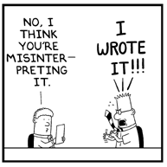
Why is Terminology important?
Harmonised use of a term
Clear outline of a technical concept
Facilitation of targeted discussions
Avoiding of misunderstanding
© Dilbert

Slide 16
Example: “In-situ”
NASA:
Latin for 'in original place.' Refers to measurements made at the actual location of the object or material measured. Compare remote sensing.
INSPIRE:
The FeatureOfInterest is a sampling feature which is co-located with the ultimate FeatureOfInterest (i.e. the sampledFeature).
OGC:
Not available
No consistent spelling: in_situ, in-situ, in situ, in-Situ, insitu, …

Slide 17
Example: “Remote sensing”
ISO:
collection and interpretation of information about an object without being in physical contact with the object
NASA:
The technology of acquiring data and information about an object or phenomena by a device that is not in physical contact with it. In other words, remote sensing refers to gathering information about the Earth and its environment from a distance, a critical capability of the Earth Observing System. For example, spacecraft in low-Earth orbit pass through the outer thermosphere, enabling direct sampling of chemical species there. These samples have been used extensively to develop an understanding of thermospheric properties. Explorer-17, launched in 1963, was the first satellite to return quantitative measurements of gaseous stratification in the thermosphere. However, the mesosphere and lower layers cannot be probed directly in this way--global observations from space require remote sensing from a spacecraft at an altitude well above the mesopause. The formidable technological challenges of atmospheric remote sensing, many of which are now being overcome, have delayed detailed study of the stratosphere and mesosphere by comparison with thermospheric research advances. Some remote-sensing systems encountered in everyday life include the human eye and brain, and photographic and video cameras.
INSPIRE:
The FeatureOfInterest is a sampling feature which is also the ultimate FeatureOfInterest (i.e. the sampledFeature).
OGC:
Acquisition of raster images of the Earth, often involving spectral frequencies other than the visible band, by devices typically carried on airborne or satellite platforms. Sometimes refers also to image analysis of these images

Slide 18
Example: “Resolution”
ISO - resolution (a. of a sensor) (b. of imagery)
smallest difference between indications of a sensor that can be meaningfully distinguished Note to entry: For imagery, resolution refers to radiometric, spectral, spatial and temporal resolutions.
smallest distance between two uniformly illuminated objects that can be separately resolved in an image
NASA:
A measure of the ability to separate observable quantities. In the case of imagery, it describes the area represented by each pixel of an image. The smaller the area represented by a pixel, the more accurate and detailed the image.
INSPIRE:
Resolution expresses the size of the smallest object in a spatial data set that can be described. It refers to the amount of detail that can be discerned. It is also known as granularity. Resolution is also limited because geo-spatial databases are intent

Slide 19
Semantic elements
Terminology (specialized words or meanings)
Taxonomy (within-dimension hierarchy)
Ontology (multidimensional relationship)
What do we mean by ‘Earth’ ‘Observation’
Do we need to distinguish between ‘observation’ and ‘modelling’, how?
What’s the difference between ‘in-situ’ and ‘remote’
What is the difference between ‘data’, ‘product’, and ‘information
How to parameterise a property that is observed?

Slide 20
LSI-VC-12 Discussion
Do we need a CEOS Interoperability Framework (CEOS-IF)?
Should it focus on LSI or should it encompass all CEOS work?
Do you know of some particularly well-suited frameworks for our purpose?
Which one is, or could be, suitable for your agency?
How many and which components should a CEOS-IF have?
Which of the shown examples would you follow?
What should be adapted?
Where do you see your own expertise best represented?
Which components would LSI-VC lead?
Where could you lead or contribute?
Which components would LSI-VC contribute to?
In which of these areas are you already active and in which frame (agency / national / international)?
Which layers are you interested in and willing to discuss?
Who should deal with the other components?
Which topics should be addressed within CEOS and by whom?
What is out of scope for CEOS and do you have suggestions whom we might need to cooperate with?
Decision: Agree recommendation from the LSI-VC perspective to CEOS as input for the presentation at the 2022 SIT Technical Workshop.

Slide 21
Proposal
The CEOS-IF effort should be built upon and derived from one of these existing, and be in itself a broad, well considered, and well defined framework.
Once an appropriate framework has been agreed:
apply it to the specific problem of Earth observation dataset interoperability
structure future work and define responsibilities across the CEOS organisation.

Slide 22
Progress so far
idea developed following ARD discussion in the LSI-VC leads team
proposal at LSI-VC-11
drafting of discussion paper
presentation of discussion paper at SEC meeting
in-depth discussion at LSI-VC-12 (with WGISS participation)
presentation to SIT-TW and proposal to prepare CEOS plenary action
Feedback also welcome in the Discussion Paper (comments) or via email to matthew@symbioscomms.com and Peter.STROBL@ec.europa.eu

Slide 23
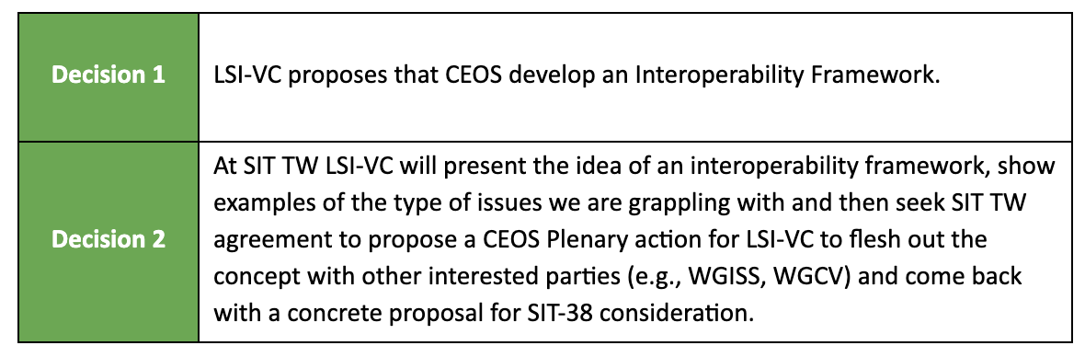
LSI-VC-12 Decisions

Slide 24
SIT TW Presentation
Peter will report on the Interoperability Framework proposal following the discussion at LSI-VC-12
Possibly propose a CEOS Plenary action for LSI-VC to flesh out the concept with other interested parties, and to come back with a concrete proposal for SIT-38 consideration?
Would WGISS be interested in participating in / support such an action ?

Slide 25
re-thinking CEOS Processing Levels
Processing Levels were so far defined as a more or less generic chain of refinement regarding the radiometry (or more general the 'measurand') and the geometry of the (satellite) observation data.
If one considers these two types of refinements separate, a matrix could be built in which classical Processing Levels would (roughly) appear as below:

Slide 26
A new Processing Level matrix
For the discussion of 'Analysis Readiness' of data, a clearer separation of these two 'dimensions' of processing yields a chance to obtain a transparent scheme in which also recommendations about best possible paths (processing sequences) are feasible. This would be advantageous for defining 'Analysis Ready Data' standards at different processing Levels and for their respective interoperability.

