Slide 1
Ocean Surface Topography Virtual Constellation
OST-VC
VC co-lead:
Annick Sylvestre-Baron, CNES
Estelle Obligis, EUMETSAT
Conference Agenda Item 5.1
CEOS SIT Technical Workshop 2022
15 September 2022

Slide 2
OVERVIEW
The Ocean Surface Topography Virtual Constellation (OST-VC) main goal is to implement a sustained, systematic capability to observe the surface topography of global oceans from the basin scale to the mesoscale
Co-chairs
  Annick Sylvestre-Baron (CNES)
  Estelle Obligis (EUMETSAT)
Other members
  Craig Donlon (ESA) also OSTST project scientist
  Eric Leuliette (NOAA) also OSTST project scientist
  Gregg Jacobs (US Navy)
  Kai Matsui (JAXA)
  Nadya Vinogradova (NASA)
  Rashmi Sharma (ISRO)
  New Chinese representative(s) to be nominated

Slide 3
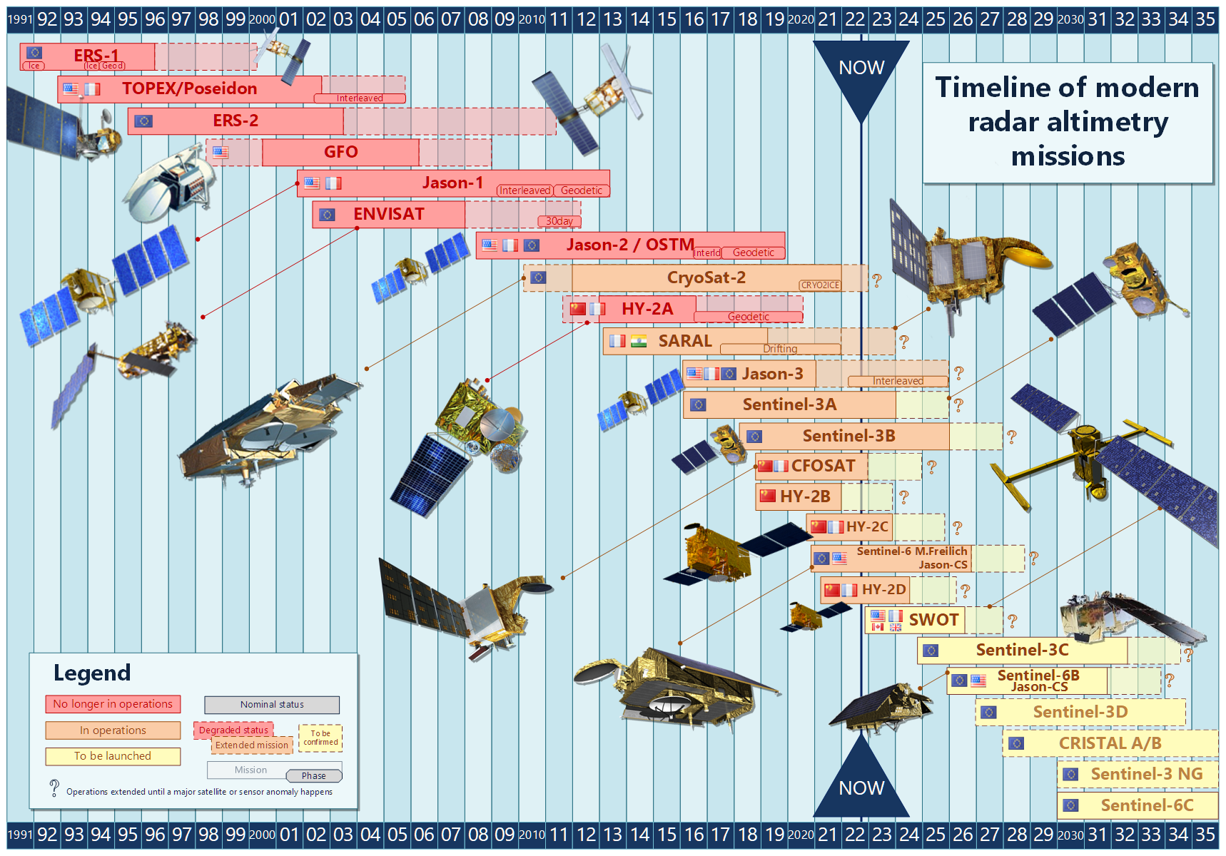
OST-VC missions timeline
2022 updates
S6 Michael Freilich : new altimetry reference satellite since April 7th, 2022 (see dedicated slide)
TOPEX/POSEIDON : 30th Birthday celebrated in August 1992
SWOT: Launch date not early than Dec 5th, 2022 (see dedicated slide)
CFOSAT: 4 years in orbit next October – Extension of lifetime to be decided - Selection ongoing for the renewal of the Science Team (2023-2026)
AltiKa: ISRO-CNES joint mission functioning in mispointing - Extended till December 2022 - Further review in December 2022

Slide 4

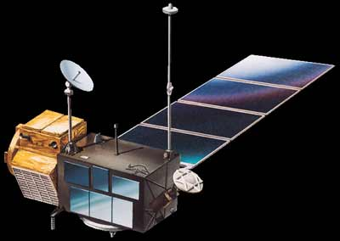
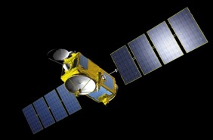
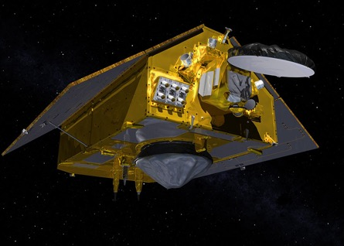
New Altimetry reference satellite
De : Marie-Claire Greening <marie-claire@greeningconsulting.co.uk>
Envoyé : jeudi 24 mars 2022 12:00
À : ceos-associates@lists.ceos.org; ceos-members@lists.ceos.org; ceos-constellations@lists.ceos.org; ceos-adhoc@lists.ceos.org; ceos-sec@lists.ceos.org; ceos-wgs@lists.ceos.org; ceos-experts@lists.ceos.org
Cc : Sylvestre-Baron Annick <Annick.Sylvestre-Baron@cnes.fr>; Estelle Obligis <Estelle.Obligis@eumetsat.int>
Objet : OST-VC - New reference altimetry satellite announcement
Dear CEOS Colleagues
For your information, please find below a communique from the CEOS Ocean Surface Topography Virtual Constellation (OST-VC) co-chairs regarding a new reference altimetry mission.
Kind Regards
Marie-Claire
Considering the Project Scientists recommendation made during the OSTST virtual meeting on March 21-22, 2022; the CEOS OST-VC members declare Sentinel-6 Michael Freilich as the new Reference Altimetry Mission for the worldwide altimetry satellites constellation.
The official date will be fixed by Jason-3 project once Jason-3, the former reference altimetry satellite, begins its move to the interleaved orbit (around April 7, 2022).
OST-VC co-chairs: Annick Sylvestre-Baron/CNES and Estelle Obligis/EUM
TOPEX/Poseidon
1992–2006
Jason-1
2001–2013
Jason-2
2008–2019
Jason-3
2016–
Sentinel-6 MF
2020–

Slide 5
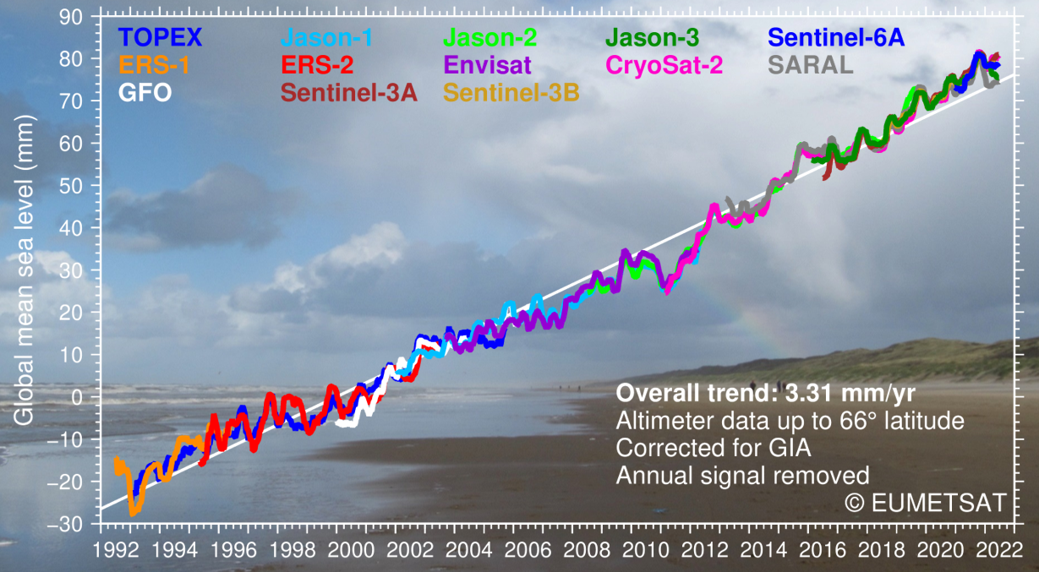
30 years of sea level monitoring from altimetry missions

Slide 6
Sentinel-6
EUMETSAT/ESA/NASA/NOAA/CNES
Sentinel-6 Michaël Freilich
All products operational and disseminated to users (LR & HR, NRT/STC/NTC)
First full reprocessing bringing all data in-line disseminated by EUMETSAT and PO.DAAC in July 2022
CEOS declared S-6 MF as the High Precision Ocean Altimetry reference mission in March 2022
Jason-3 moved to interleaved orbit April 2022, to start its Extended Operations phase
Sentinel-6B
S-6B storage started in July 2022
S-6B launch baselined to Nov 2025
Sentinel-6C update
Mission confirmed now by ESA/EC
Degree of ‘recurrence’ within the Sentinel-6 to be confirmed

Slide 7
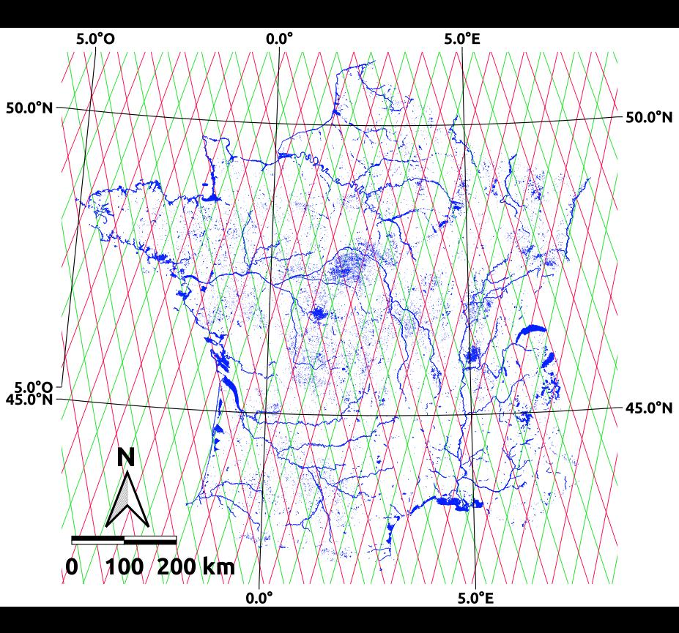

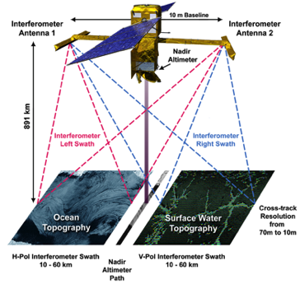
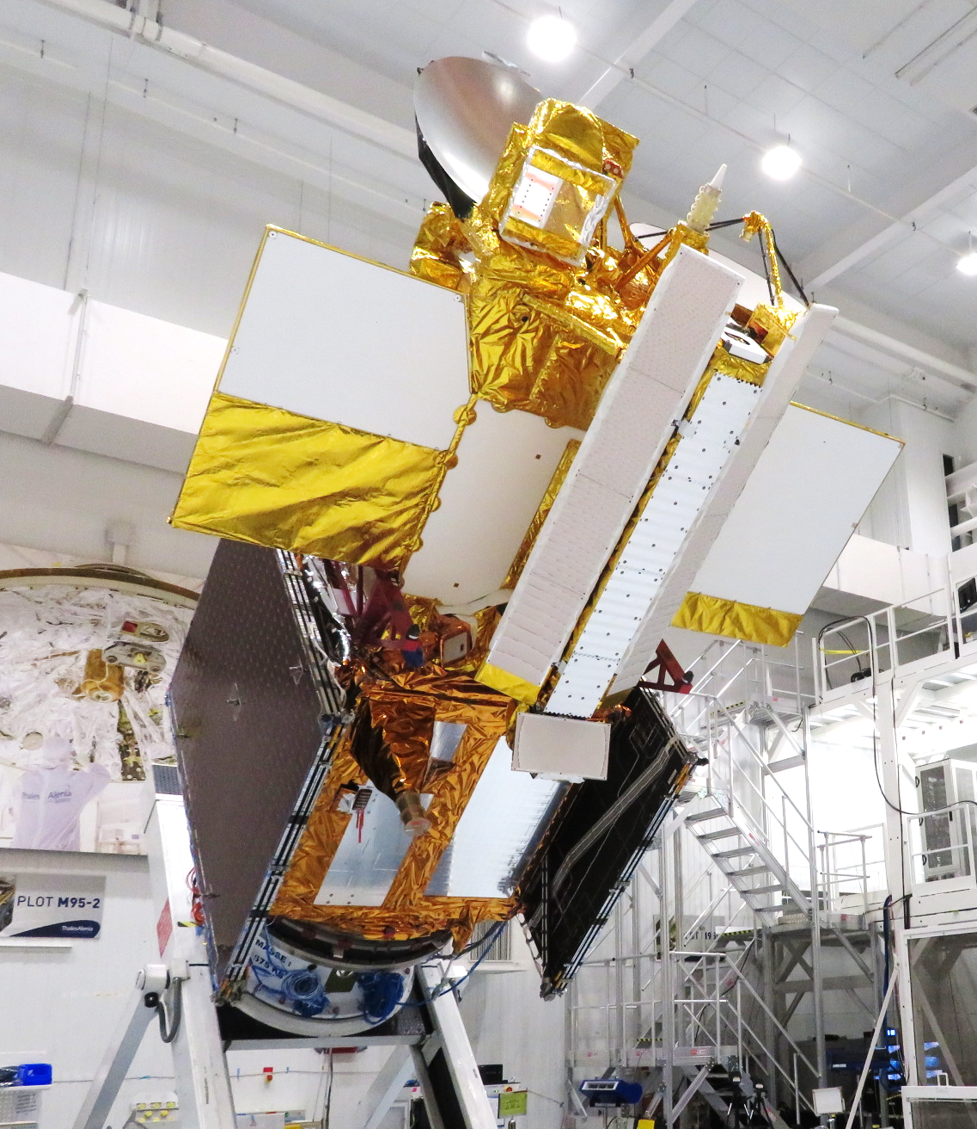
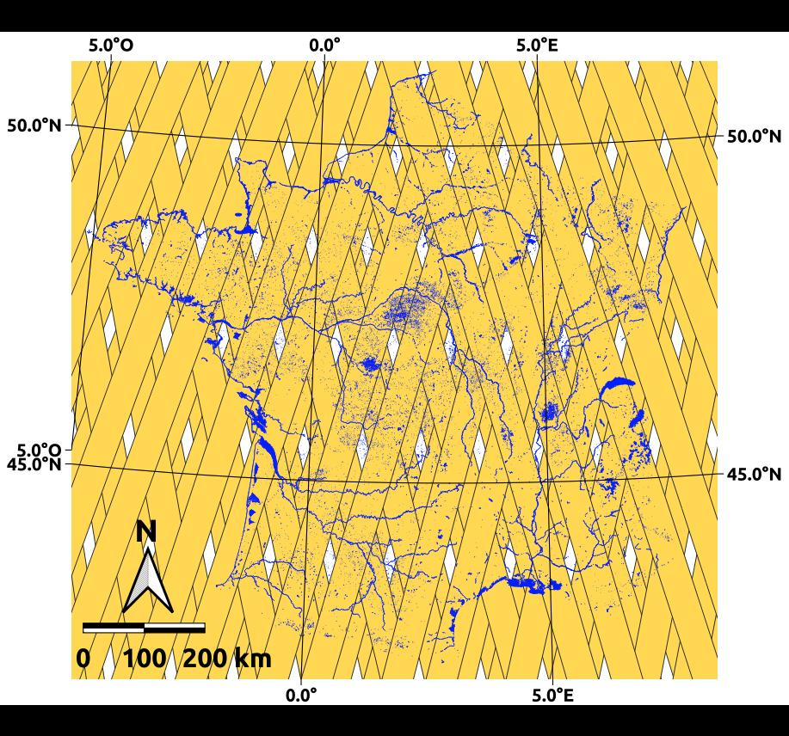
SWOT NASA/CNES/CSA/UKSA
S3-A & S3B (27 days)
Launch: NET Dec 5, 2022
1st wide swath altimeter (Karin)
Highly anticipated by ocean, hydrology and coastal scientists and users
International Science Team
  56 projects – 137 ST members from 26 international organizations based in 17 countries involved
SWOT Early Adopters - lead by NASA&CNES - 21 space agencies involved - since 2018
SWOT mission is on track to be launched NET Dec 5, 2022
©JPL
SWOT (21 days)
©JPL

Slide 8
Copernicus S3NG and S6NG Topography
Mission Requirements
developed at ESA (endorsed by Mission Advisory Group) based on EC user needs
guaranteeing Continuity of Sentinel-3 and Sentinel-6 topography
potential enhancements notably in terms of sampling
S3NG
Final decision to be taken if ESA Phase A/B1 study will continue with the implementation of two dedicated large-satellites carrying wide-swath altimeters or a constellation of 12 nadir altimeters, together with radiometer and POD instruments.
S6NG
Will come after S6C (around 2035 TBC)
On going ESA study on Sentinel-6 sea level stability uncertainty budget
Update of User Requirements if needed

Slide 9
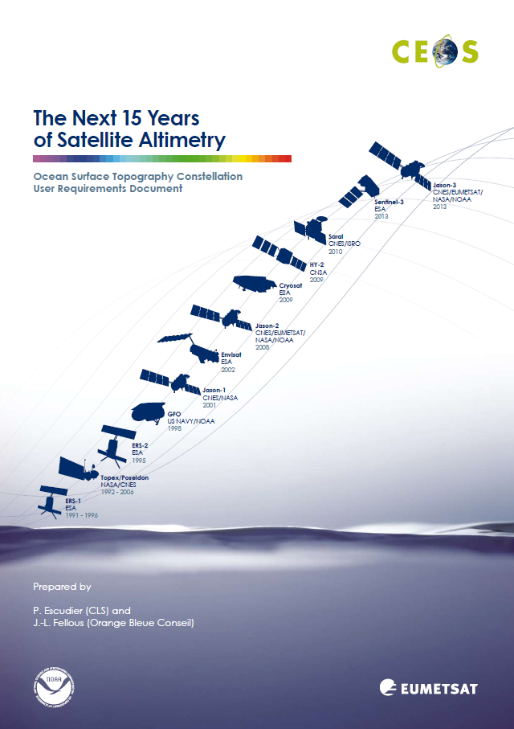
OST-VC white paper status
Action from 2019 SIT meeting to update of the “Next 15 years of altimetry – OST Constellation User Requirement Document”, 2009.
  Integrate new user needs from recent books and white papers from the community
  Delivery of the white paper was expected Q1 2022
BUT many constraints (new missions S6, SWOT, S3-NG…), OSTST renewal, covid impacts, no in presence OSTST meetings,…) overloaded altimetry community during the last three years
New schedule
  OST-VC members side meeting during OSTST meeting (Venise 31 Oct – 4 Nov) to review together the outline of the document OST-VC co-chairs have prepared.
  Final Delivery expected in Q4 2023

