Slide 1
Precipitation Virtual Constellation (P-VC)
Chris Kidd,
NASA/GSFC & UMD/ESSIC
Takuji Kubota, JAXA
Agenda Item 5.1
SIT TW 2022, ESA/ESRIN
13th - 15th September 2022

Slide 2
Precipitation Virtual Constellation (P-VC)
Background: The CEOS Precipitation Virtual Constellation was established in 2007 with the participation of seven CEOS members as one of the four prototype CEOS Constellations.
Purpose: Its primary role is to establish an international framework to guide, facilitate, and coordinate the continued advancement of multi-satellite global precipitation measurement. Its original purposes included:
Facilitating implementation of the Global Precipitation Measurement (GPM) mission and encouraging more nations to contribute to the GPM constellation – GPM is in its 9th year of operation.
Sustaining and enhancing an accurate and timely global precipitation data record including a Fundamental Climate Data Record fit for the purpose specified by GCOS for the monitoring of Precipitation as an Essential Climate Variable (ECV).
P-VC membership: core members from NASA & JAXA (co-chairs), NOAA, ESA, ISRO & CGMS/IPWG chairs.
P-VC science meetings: Aim to provide 2 meetings per year, at the NASA Precipitation Measurement Mission workshop and one at the IPWG workshop (or virtual).
Recent reports: WCRP Precipitation Assessment Report (lead by Remy Roca), White Paper on the Future of the Precipitation Constellation (led by Chris Kidd).
Special precipitation sessions and webinars: at major national, international conferences and virtual.

Slide 3
Precipitation Virtual Constellation (P-VC)
P-VC goals through support from CEOS:
Maintain and enhance the precipitation constellation through current missions, including continuation of precipitation-capable missions beyond end-of-life (where practical) and for mitigation strategies where necessary;
Development and integration of new satellites and sensors to provide a viable and sustainable precipitation constellation, including new technologies (such as EPS-SG, AMSR-3, CMIR, AOS/ACCP, etc)
Develop and refine retrieval schemes to provide precipitation products to the research and user communities, from near real time instantaneous products through to climate-scale data records.
Validate precipitation products through maintaining, expansion and exploitation of global ground validation (e.g. USA, Europe, S.Africa, S.America, Japan, S.Korea, India, Australia, etc).
P-VC is an integral part of the larger precipitation community with direct involvement with the GPM (both NASA and JAXA) science teams and the (CGMS) International Precipitation Working Group.

Slide 4
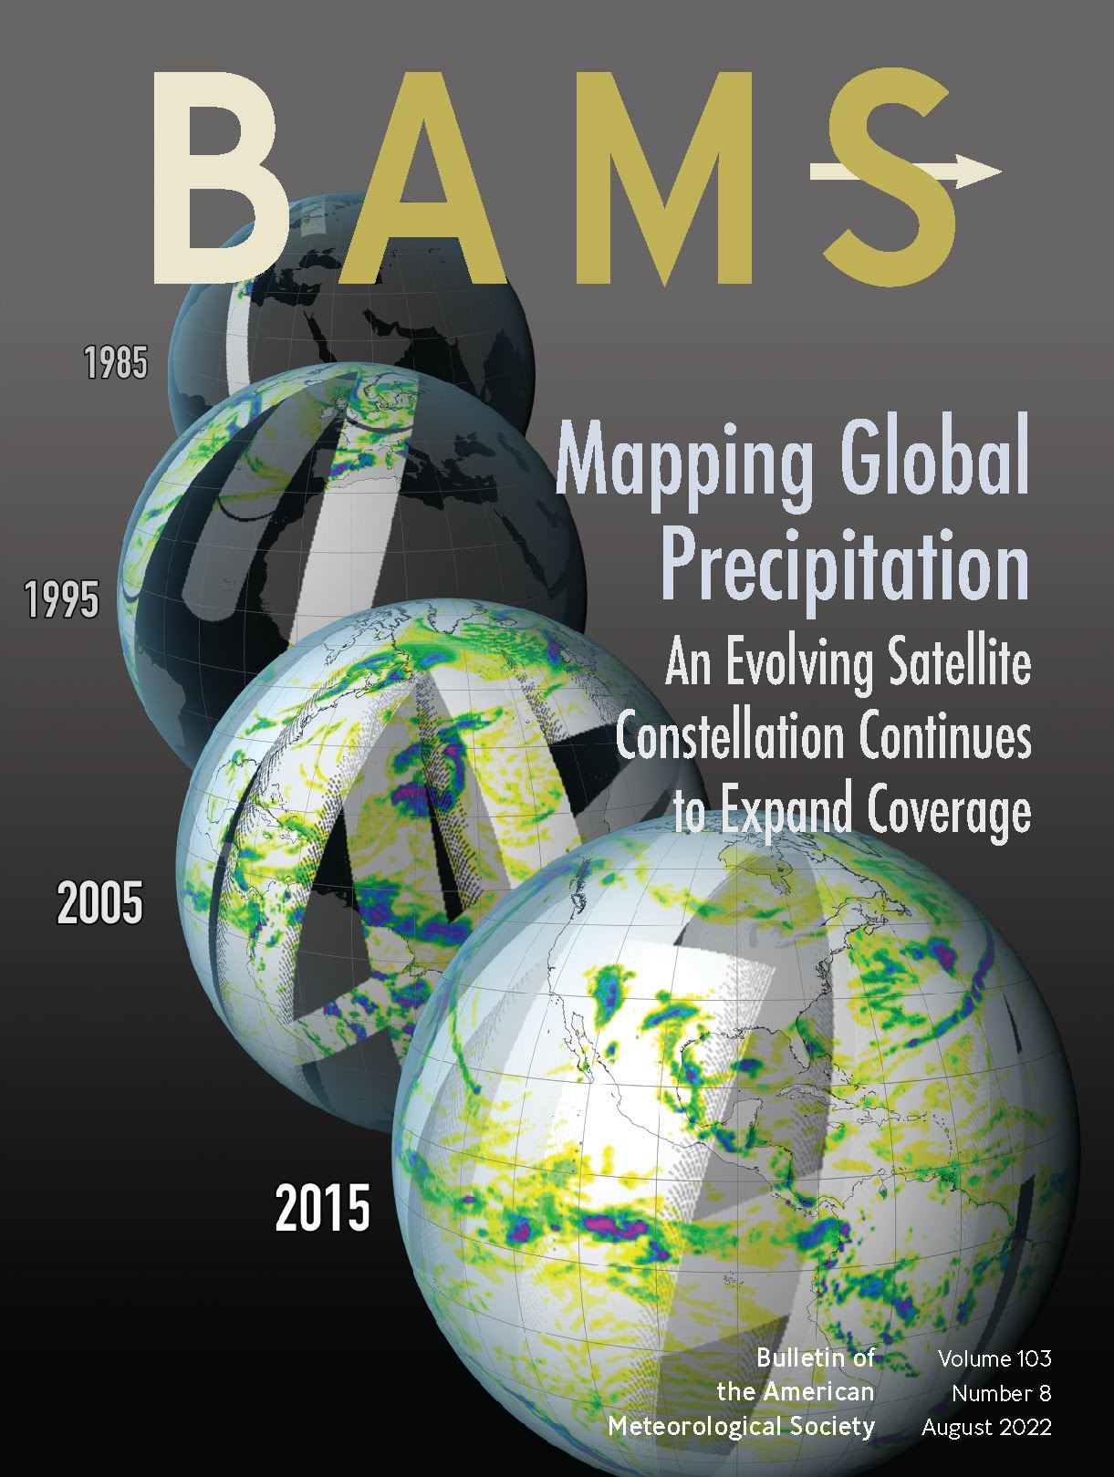
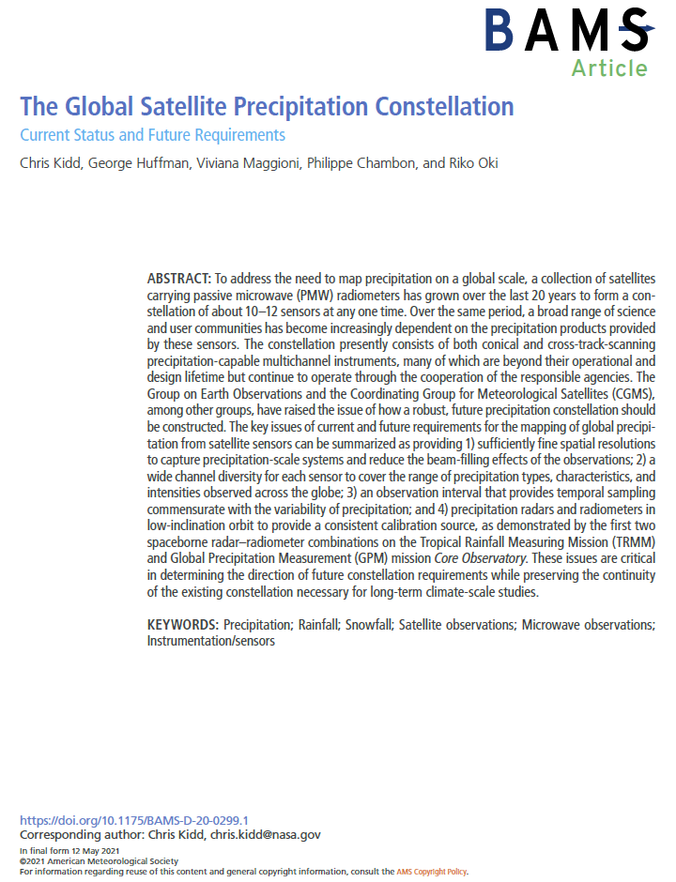
P-VC news updates
A paper from the P-VC activity: “The Global Satellite Precipitation Constellation: Current Status and Future Requirements” published in Bulletin of the American Meteorological Society (Kidd et al. 2021).
This paper provides recommendations to ensure the long-term continuity of global satellite precipitation observations based upon the current precipitation constellation and planned missions
Reports with CGMS/IPWG: P-VC contributions to:
“The Joint IPWG/GEWEX Precipitation Assessment” (July 2021)
https://doi.org/10.13021/gewex.precip
“IPWG Report on Space Radar Applications” (June 2021)
http://ipwg.isac.cnr.it/reports/IPWG_review_applications_space-borne_precipitation_radars.pdf

Slide 5
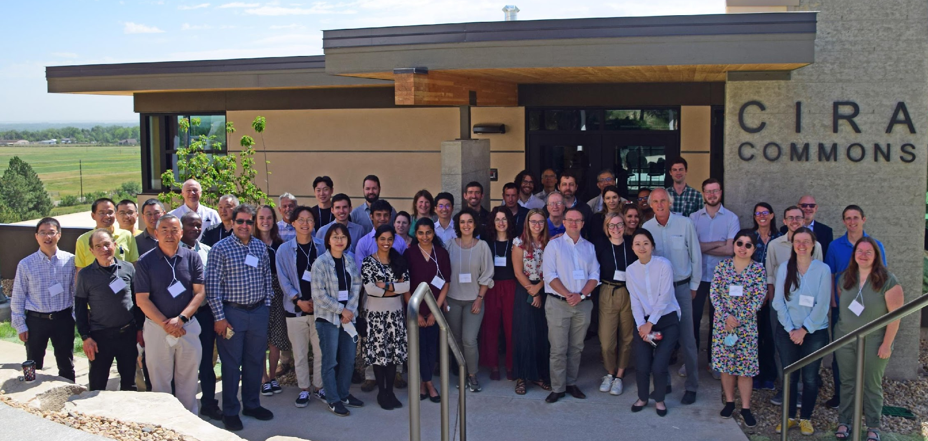
P-VC news updates
Satellites & sensors: GPM constellation currently consists of GPM (Core observatory), AMSR-2, SSMIS-F16/F17/F18, NOAA-NPP/NOAA20 and NOAA19/MetOp-B/C (as of 2 September 2022);
New missions: TROPICS (pathfinder launched 20-June-2021); TROPICS constellation (2023+?); JPSS-2 (2022); EarthCARE (2023?), AMSR-3 (2023), WSF (2023); EPS-SW/2 (2023); AWS (2024); EPS-SG/B (2024); CIMR (2028); AOS/ACCP (2028);
Data processing: NASA PPS/DISC reprocessing of TRMM/GPM products (to V07) completed (pps.eosdis.nasa.gov); JAXA - new GSMaP version completed (JAXA Climate Rainfall Watch)
Meetings and outreach: webinars reaching national and international audiences. (e.g. IPWG Precipitation Constellation, Precipitation Validation; NASA Applications and Outreach team - https://gpm.nasa.gov/applications).
IPWG10/IWSSM6, CSU, Fort Collins, June 2022
New co-chairs: Christian Kummerow & Takuji Kubota

Slide 6
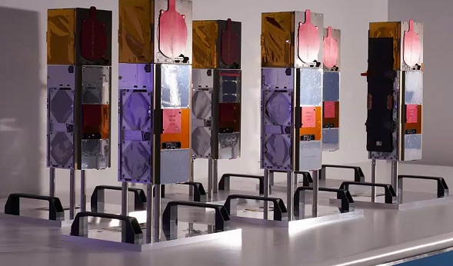
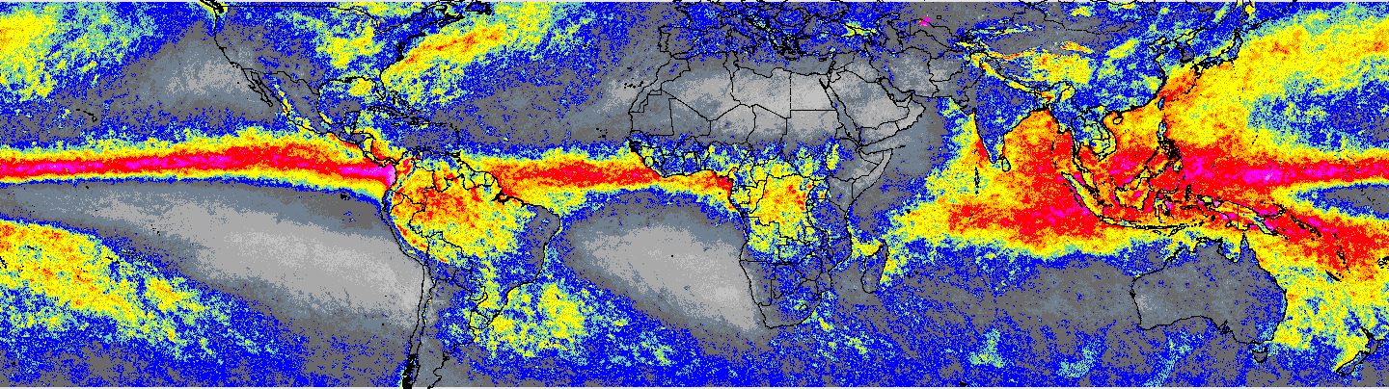
New missions: TROPICS
3U cubesats with cross-track 91-204 GHz passive microwave sensors.
Pathfinder launched 30th June 2021 - sun-synchronous polar orbit.
Two satellites lost in launch on 12 June 2022, leaving…
Four constellation satellites to be launched in 2023(?)
34cm
10cm
10cm
Hurricane Sam 1st October 2021 as viewed by the TROPICS pathfinder
TROPICS01.BRTT.L1B.Orbit01414.V02-01.ST20211001-180106.ET20211001-193623.CT20211002-115426.nc
NASA TROPICS
Precipitation retrievals
(at-launch) PRPS
2021.08.08 – 2022.07.31

Slide 7
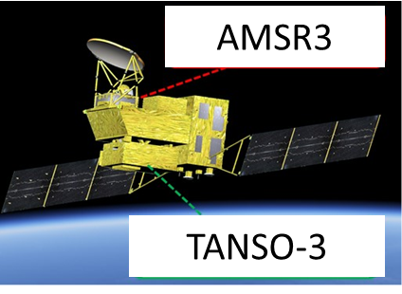
New missions: GOSAT-GW/AMSR3
AMSR3 (AMSR2 follow-on) will be flown on the GOSAT-GW (Global Observation SATellite for Greenhouse gases and Water cycle) with TANSO-3.
AMSR3, led by JAXA, will continue the AMSR-series observations adding new high-frequency channels for solid precipitation retrievals and water vapor analysis for NWP.
Target launch is JFY2023 (Apr. 2023 - Mar. 2024)
Red: Changes from AMSR2 including additional channels
Center frequency [GHz] | Polari-zation | Band width ［MHz］ | NEDT (1σ) | Beam width (spatial resolution)
6.925 / 7.3 | H/V | 350 | < 0.34 K | 1.8°(34km x 58km)
10.25 | H/V | 500 | < 0.34 K | 1.2° (22km x 39km)
10.65 | H/V | 100 | < 0.70 K | 1.2° (22km x 39km)
18.7 | H/V | 200 | < 0.70 K | 0.65° (12km x 21km)
23.8 | H/V | 400 | < 0.60 K | 0.75° (14km x 24km)
36.42 | H/V | 840 | < 0.70 K (TBD) | 0.35° (7km x 11km)
89.0 A/B | H/V | 3000 | < 1.20 K | 0.15° (3km x 5km)
165.5 | V | 4000 | < 1.50 K | AZ=0.23°/ EL=0.30° (4km x 9km)
183.31±7 | V | 2000×2 | < 1.50 K | AZ=0.23°/ EL=0.27° (4km x 8km)
183.31±3 | V | 2000×2 | < 1.50 K | AZ=0.23°/ EL=0.27° (4km x 8km)
AMSR3 will succeed AMSR series observations adding new high-frequency channels for solid precipitation retrievals and water vapor analysis in NWP.
Orbit | Type | Sun-synchronous, Sub-recurrent orbit
 | Altitude | 666km, recurrent cycle 3days (same as GOSAT)
 | MLTAN | 13:30±15min (same as GCOM-W)
Mass |  | 2.6 ton (Including propellant)
Power |  | > 5.3 kW
Design life |  | 7 years
Launch vehicle |  | H-IIA rocket
Mission data downlink rate |  | Direct transmission with X-band: 400 Mbps Direct transmission with S-band: 1 Mbps (Only for AMSR3)
Instrument |  | TANSO-3 (for GHG) AMSR3 (for Water Cycle)
AMSR3 Channel Sets
Specifications

Slide 8
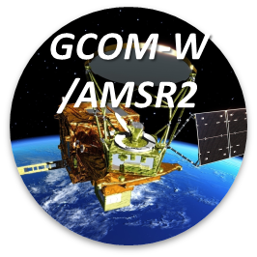
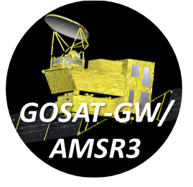
JAXA: Recent Status

Slide 9
NASA Precipitation Processing System (PPS)
NASA (PPS) completed reprocessing all GPM/TRMM data since 1998 to V07.
Level1C
SSMIS: small geolocation and Tc improvement in the SSMIS data. TRMM V05 emissive antenna problem fixed – leading to slight improvement in V07 data.
Other sensors stayed stable.
PMW precipitation retrievals (GPROF)
1) improved light rain
2) enhanced orographic rain
3) better frozen precipitation retrieval
4) probabilistic precipitation rates (together with rain/no-rain flag)
For the radars (TRMM PR and GPM DPR)
1) additional improvements re. sidelobe issues
2) dual frequency retrieval across the entire Ku swath (because of Ka swath scan change)
3) improved retrieval over land

Slide 10
NOAA updates
NOAA Missions
NEW: GOES-18 launched on 01 March 2022, replacing GOES-17 (GOES-West on 06 January 2023).
All precipitation satellites are nominal: NOAA-20, S-NPP, NOAA-19, GOES-16, GOES-17, and GOES-18
JPSS-2 to be launched on 01 November 2022.
QuickSounder (ATMS sensor) funded and planned for 2025+ (with 05:30 LST)
Operational Products
Global GEO Rain Rate (SCaMPR) Global (60°S-60°N), 0.02°/10-min (23 minutes latency): soon to be operational at NOAA.
NESDIS Snowfall Rate (SFR) product incorporating machine learning (ML) techniques (detection and bias correction).
Microwave Integrated Retrieval System (MIRS) - new machine learning (ML) bias correction improves light rain
Operational production of MIRS and SFR products for some satellites have been transitioned to the Cloud.
NOAA CPC MORPHing (CMORPH2) gridded precipitation product running at near real-time – global 0.05°/30-min
Reprocessing
Snowfall Rate (SFR) retrievals for S-NPP and NOAA-20 for the JPSS era (2011-2021)
MiRS Rain Rate for NPP 2011-2015, and S-NPP and NOAA-20 for the entire JPSS-era is ongoing
Products for SmallSats and Future Missions
MiRS has developed experimental algorithms for TROPICS with promising performance
EPS-SG - NOAA is working closely with EUMETSAT on EPS-SG; Generated proxy data for MWS and MWI with prototype MWS rain rate and snowfall rate algorithms, prototype MWI rain rate algorithm, MWI snowfall rate under development
AMSR-3 prototype rain rate algorithm ready; snowfall rate algorithm is under development

Slide 11
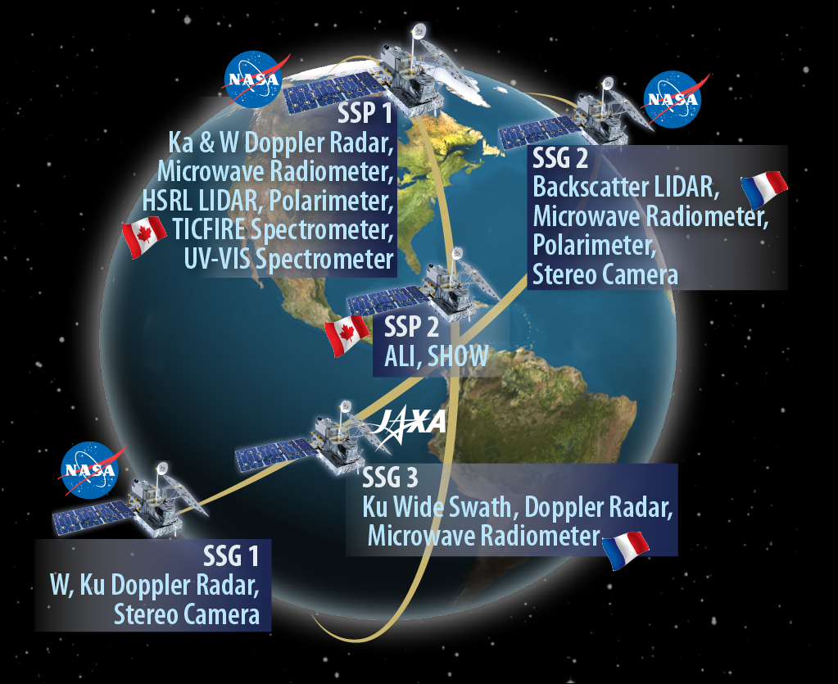
Future: NASA’s Atmosphere Observing System
A NASA-led study on the Earth Science Decadal Survey Aerosols and Clouds, Convection, and Precipitation designated observables has resulted in the Earth System Observatory/Atmosphere Observing System (ESO/AOS)
Two projects: polar component focused on global climate change-related processes, inclined component on processes over varying times of day
Includes Doppler radars, passive microwave radiometers, lidars,
multi-angle polarimeters, tandem stereo cameras and
UV-to-far-IR spectrometers
International contributions from JAXA, CSA, CNES being studied
JAXA studying the feasibility of a next-generation precipitation (Ku) radar with Japanese science team and user community, targeting Doppler observations, higher sensitivity measurements with scanning capability
CNES studying tandem microwave radiometers for time-differenced (1-2 mins) measurements
CSA providing longwave spectrometer, studying limb sounders for aerosols and moisture

Slide 12
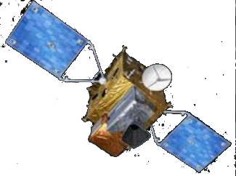
White paper summary:
To ensure the long-term continuity of global satellite precipitation observations:
i) commitment and support for current and planned precipitation-capable missions with free and open data sharing by the appropriate agencies and organisations;
ii) long-term strategy for a viable constellation of precipitation-capable sensors that meet the necessary scientific and user requirements. Specifically,
a) PMW sensors with diverse channels covering the main precipitation-sensitive frequencies with good spatial resolution as exemplified by the AMSR/GMI class of sensors, and
b) operational non-Sun-synchronous AMW/PMW sensors for cross-calibration and reference standard for PMW (and IR) precipitation estimates (e.g. PR/DPR like, CPR sensitivity);
iii) support for continuation of precipitation-capable missions beyond nominal mission lifetime operations, (within deorbiting/sensor degradation);
iv) integrate new technologies, such as smallsats and cubesats, with access to new data sets where these address the necessary scientific and user requirements; and
v) mitigation strategies within the precipitation retrieval schemes to utilise sub-optimal observations (e.g. failed/bad channels), to help ensure continuity in adequate sampling.
(1978-

