Slide 1
CEOS-COAST Update & Progress
Paul DiGiacomoa
Conference Agenda Item 5.1
2022 CEOS SIT TW
Virtual Meeting
14-15 September 2022

Slide 2
CEOS COAST
Our Progress since SIT 36 includes:
Successful Outreach and Stakeholder Engagement Events - introducing COAST to new audiences and demonstrating regional data products and the Application Knowledge Hub to regional pilot stakeholders (Bay of Bengal, Chesapeake Bay)
Exceptional strides to train the internal CEOS teams and to work on product development in the CEOS-EAIL
Continued work advancing thematic products in project areas such as flooding, coastline mapping, coastal eutrophication, especially in the Chesapeake Bay, Bay of Bengal and West Coast Africa
Emerging opportunities to pursue product development in La Plata Estuary for Turbidity and coastal bathymetry
Slide ‹#›

Slide 3
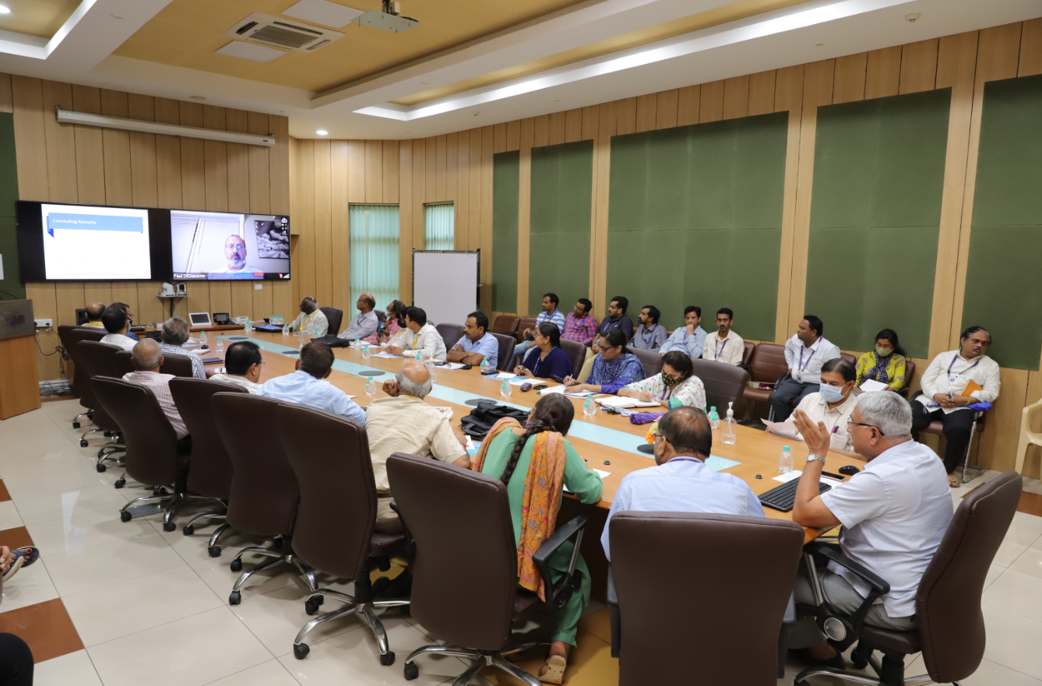
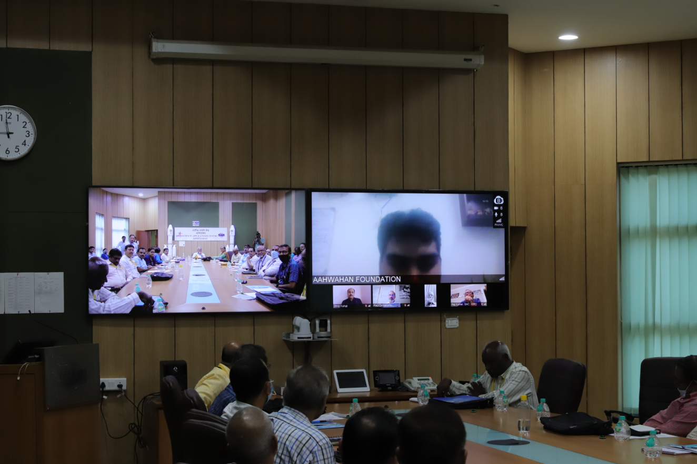
Stakeholder Meeting on EO based Coastal Studies
August 24, 2022, ISRO Ahmedabad, India
Daylong Hybrid meeting held at Space Applications Centre. Attendees from various National Institutes, Academia, ISRO organisations, industries and start-ups. Keynote address by Dr. Shailesh Nayak, Director NIAS (Former secretary Ministry of Earth Science, GoI)
Representatives from industries and start-ups deliberated the requirements from satellite observations and modelling for their coastal activities
Requirement coastal products:
Bathymetry
Shoreline changes
Water quality parameters
Presentations made by
Indian Institute of Technology, Delhi
Indian National Centre for Ocean Information Services, Hyderabad
Geological Survey of India, Kolkata
National Centre for Coastal Research, Chennai
National Institute of Oceanography, Goa
National Centre for Sustainable Coastal Zone Management, Chennai
National Remote Sensing Centre, Hyderabad
Indian Institute of Remote Sensing, Dehradun
Space Applications Centre, Ahmedabad

Slide 4
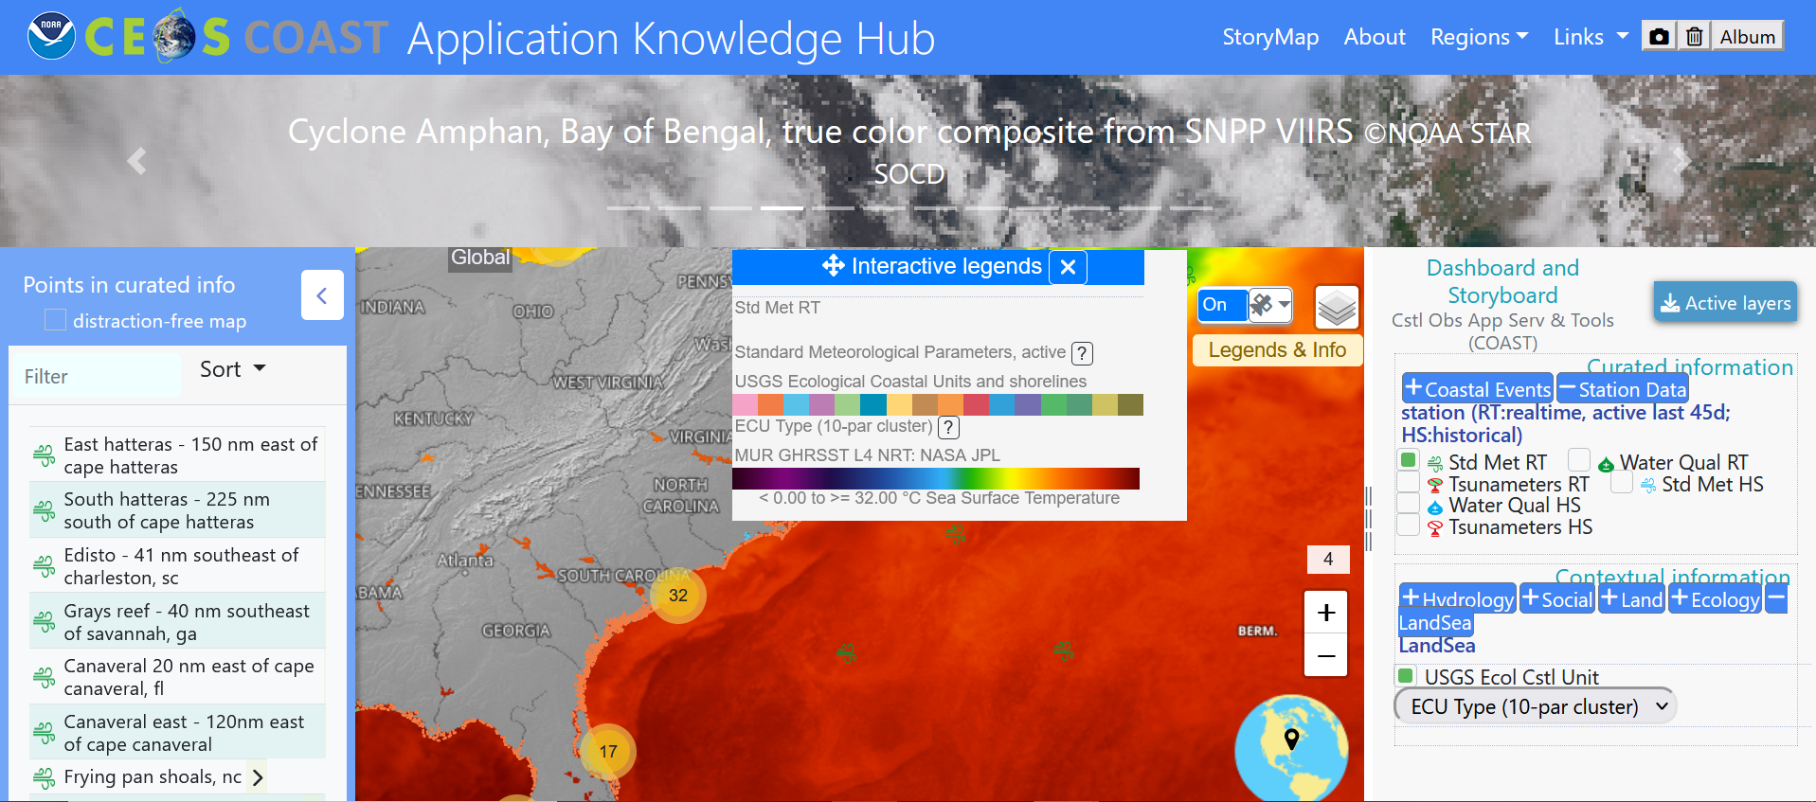
COAST Application Knowledge Hub

Slide 5
Upcoming Work Plan Activities & Needs
Upcoming Product Development Areas:
Blue Carbon (with MBON)
Habitat Mapping/Monitoring (e.g., seagrasses/mangroves, w/GEO Blue Planet)
Biodiversity (with GEOBON; TBC)
Additional Pilot Regions:
Polar (Arctic focus); Asia
Needs:
Ingest and utilize data/products from additional CEOS missions
More emphasis on using the CEOS-EAIL which will require further sustainment and development support to expand capabilities and data offerings
Ask: Looking for interested CEOS agencies to provide active leadership and support in these new and expanding areas
Slide ‹#›
Notes:
Future Product Development Areas: Blue Carbon (with GEOBON) - Evaluate nature-based solutions to coastal resilience.Take the USGS-led Ecological Coastal Units to the next level, advance Habitat Mapping/monitoring (seagrasses/mangroves). Biodiversity - using Radarsat, SWOT for ice monitoring and coastal change over time - perhaps Aquaculture.
Asia and Arctic for pilot regions,
better fulfillment of collaboration with CoastPredict in support of the UN Ocean Decade.

Slide 6
CEOS Governance and Processes
Each Ad Hoc Team will have an initial two-year term and will be required to report at the Plenary after completion of their first year on progress and expectation to meet objectives by the end of the two-year term.
If the Ad Hoc Team is not able to demonstrate significant progress and agency support to accomplish the objectives within the two-year term, the Plenary may decide to disband the Ad Hoc Team after only one year.
If it is clear that the objective of the Ad Hoc Team will exceed the initial two-year term, the Ad Hoc Team will either:
identify an existing permanent mechanism for the activities of the Ad Hoc Team;
recommend Plenary consider the creation of a new permanent mechanism;
or request that Plenary grant a one year extension of the Ad Hoc Team.

Slide 7
Continuity of CEOS-COAST
For discussion and consideration in advance of CEOS Plenary:
Request that Plenary grants CEOS-COAST a one year extension for a third year as an Ad Hoc Team (consistent w/process paper),
-and/or-
In coordination with forthcoming CEOS Ocean Coordination Group recommendations, establish a new AHT for Ocean Decade to subsume COAST et al.
Slide ‹#›

