Slide 1
SIT Technical Workshop 2022
CBERS-4, CBERS 04A and Amazonia 1 Missions
Julio Dalge, INPE
Agenda Item 5.1
SIT TW 2022, ESA/ESRIN
14th - 15th September 2022

Slide 2
Summary
CBERS-4 mission
Beyond design lifetime, fully operational
CBERS 04A mission
3 years of routine operations
Amazonia 1 mission
18 months of routine operations
Forest monitoring and LULC applications
Surface reflectance products for Brazil Data Cube
Image samples
Slide ‹#›

Slide 3
CBERS-4 mission
5th remote sensing satellite of the CBERS program in cooperation with China
Main Purposes
LULC applications (deforestation and agriculture); coastal studies and water reservoir monitoring; urban planning support; natural disaster mitigation
Launched on December 7, 2014
Beyond design lifetime, fully operational
More than 2,000,000 images freely distributed on the Internet (PAN, MUX, IRS and WFI)
www.dgi.inpe.br/catalogo (until May 2022)
www2.dgi.inpe.br/catalogo/explore (from May 2022 on)
Slide ‹#›

Slide 4
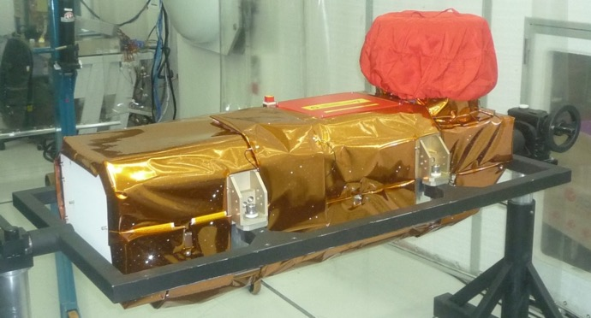
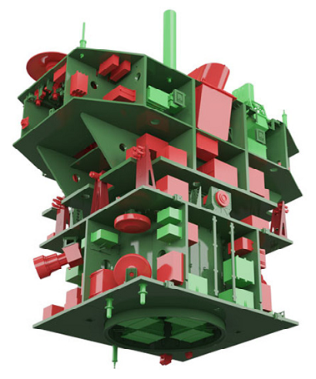
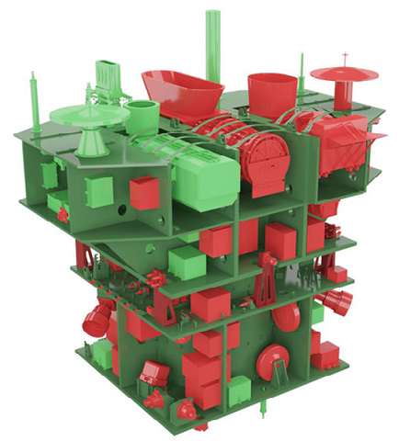
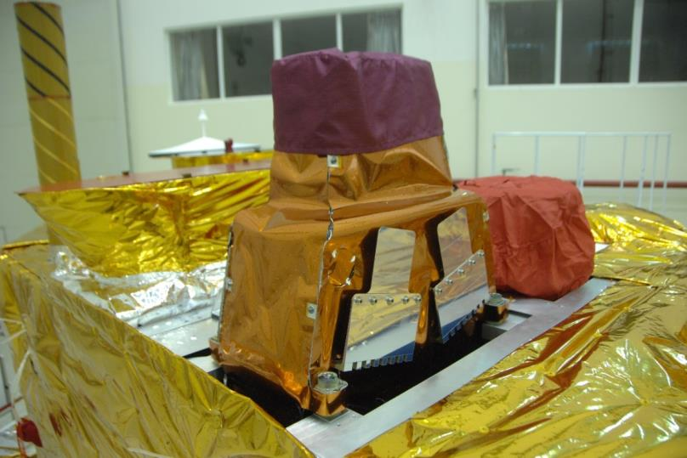
CBERS-4 mission
Slide ‹#›

Slide 5
CBERS 04A mission
6th remote sensing satellite of the CBERS program in cooperation with China
Main Purposes
LULC applications (deforestation and agriculture); coastal studies and water reservoir monitoring; urban planning; support to the Brazilian demographic census; natural disaster mitigation
Launched on December 20, 2019
Fully operational
Around 200,000 images freely distributed on the Internet (WPM, MUX and WFI)
www2.dgi.inpe.br/catalogo/explore
Slide ‹#›

Slide 6
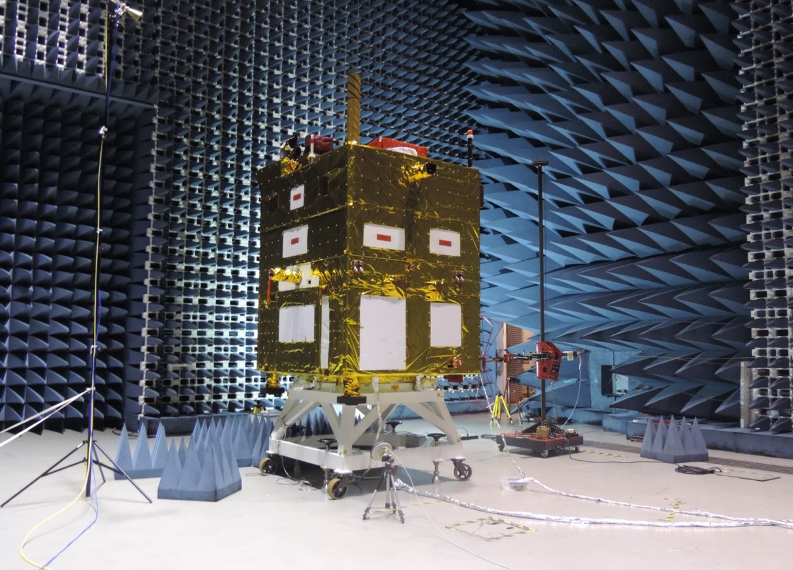
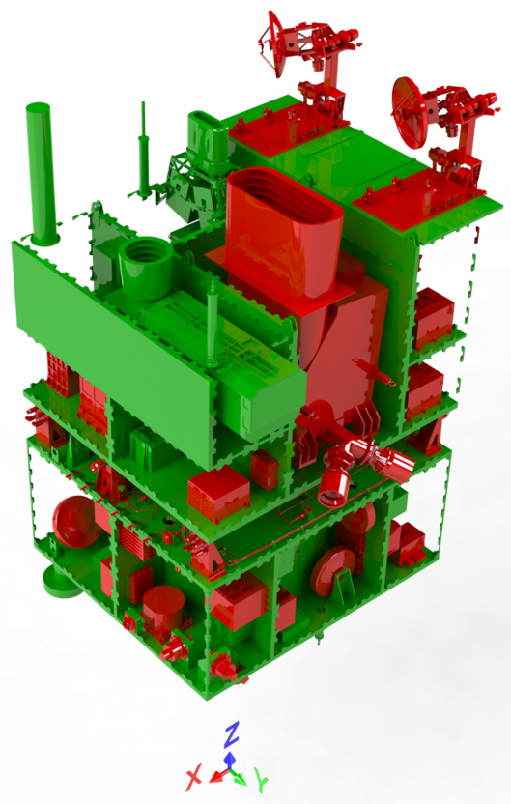
CBERS 04A mission
Slide ‹#›

Slide 7
Amazonia 1 mission
Remote sensing mission fully designed, integrated, tested and operated by Brazil
Main Purposes
LULC applications (deforestation and agriculture); coastal studies and water reservoir monitoring; natural disaster mitigation
Launched on February 28, 2021
Fully operational
More than 5,000 WFI large swath images freely distributed on the Internet
Systematic WFI recording over conterminous USA
www2.dgi.inpe.br/catalogo/explore
Slide ‹#›

Slide 8
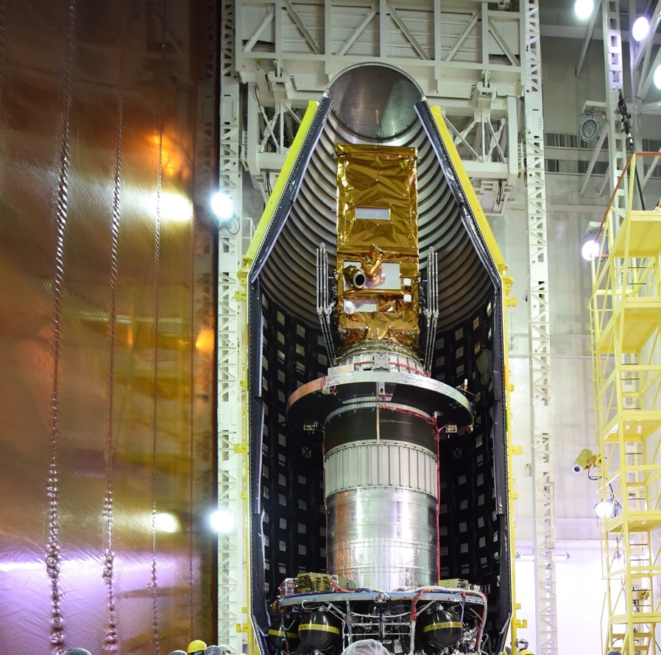
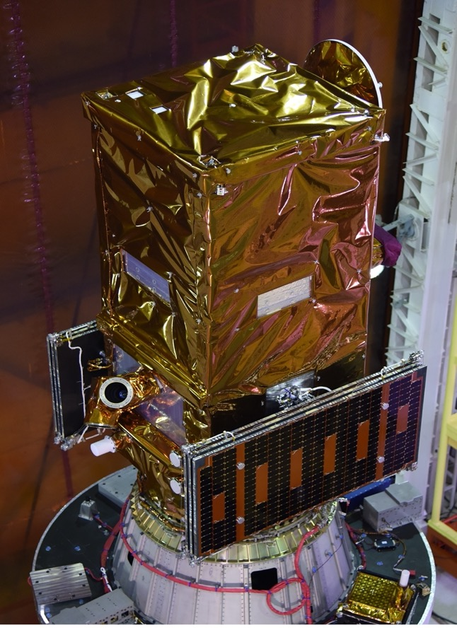
Amazonia 1 mission
Slide ‹#›

Slide 9
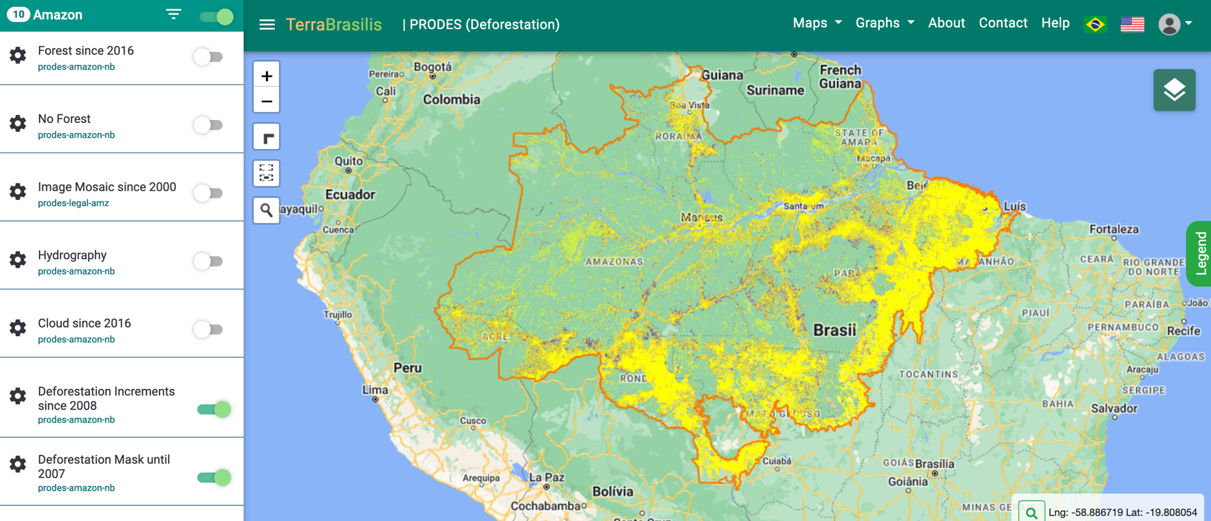
Annual deforestation inventory

Slide 10
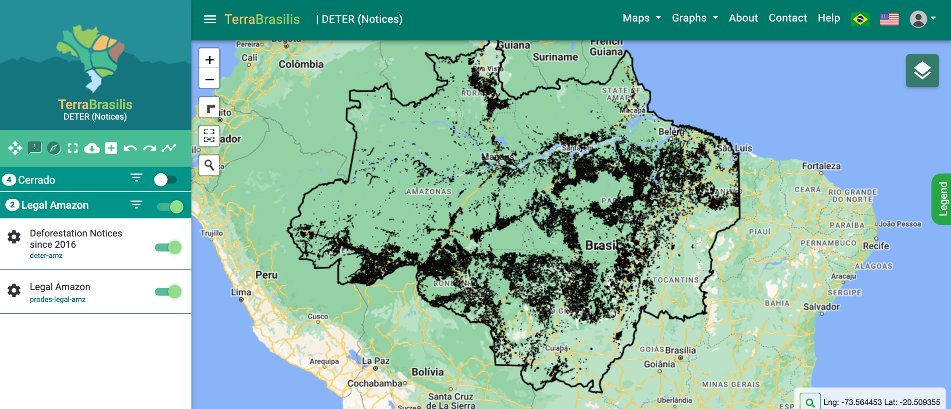
Daily deforestation alerts

Slide 11
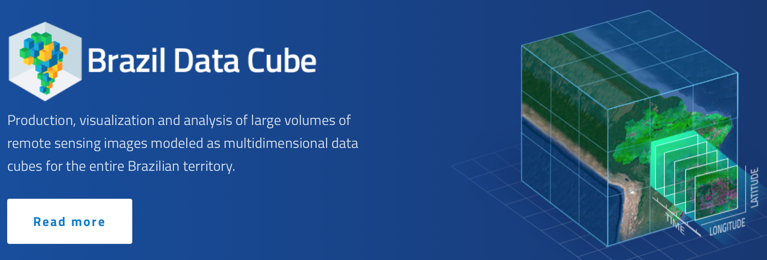
Harmonized surface reflectance

Slide 12
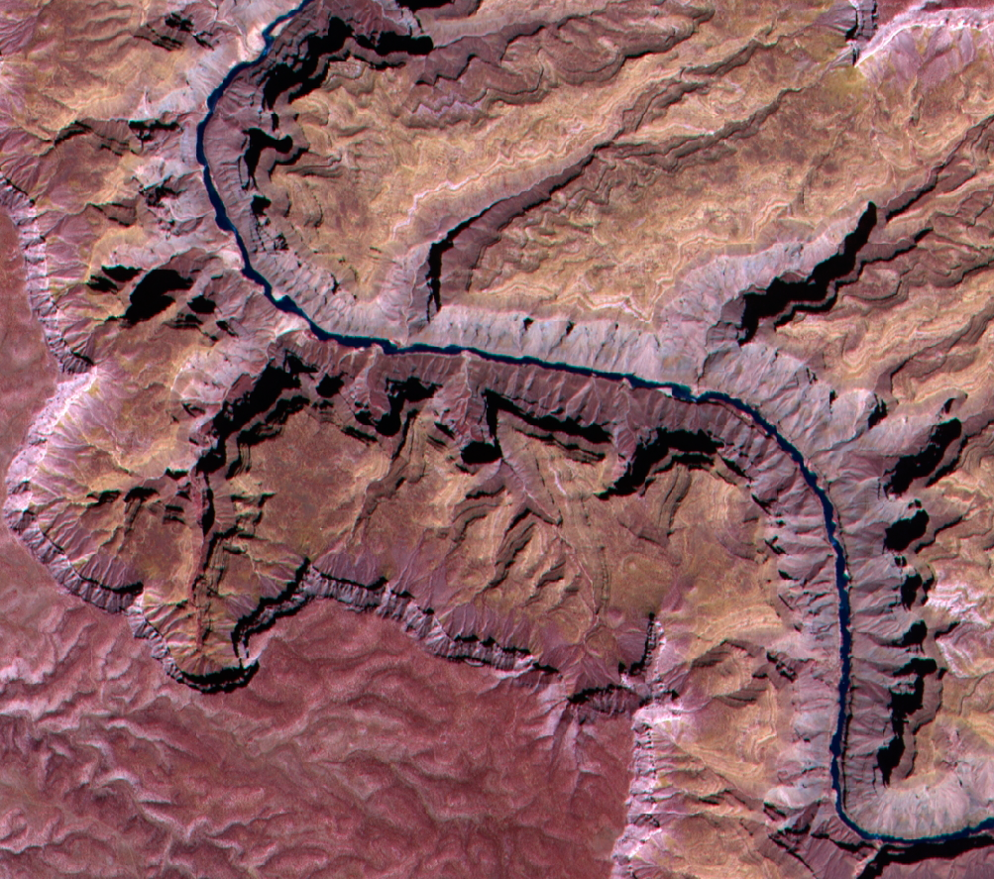
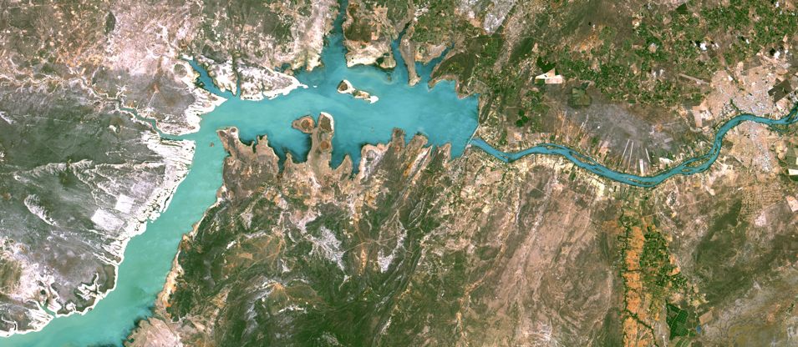
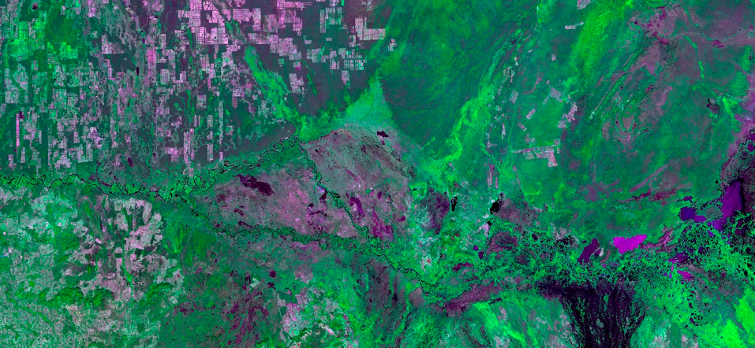
CBERS-4 image samples

Slide 13
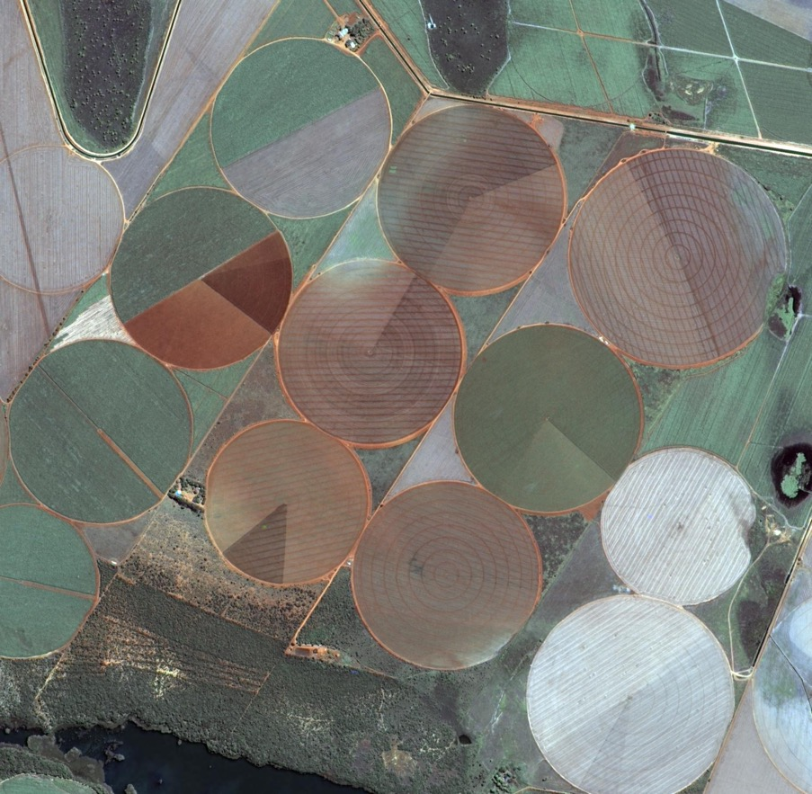
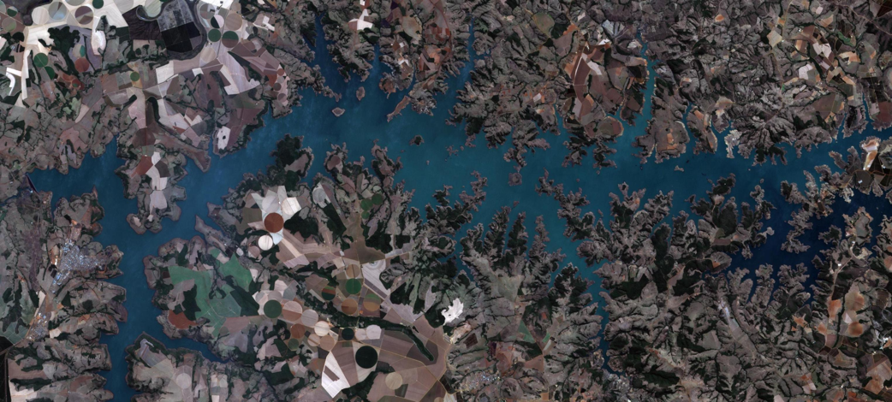
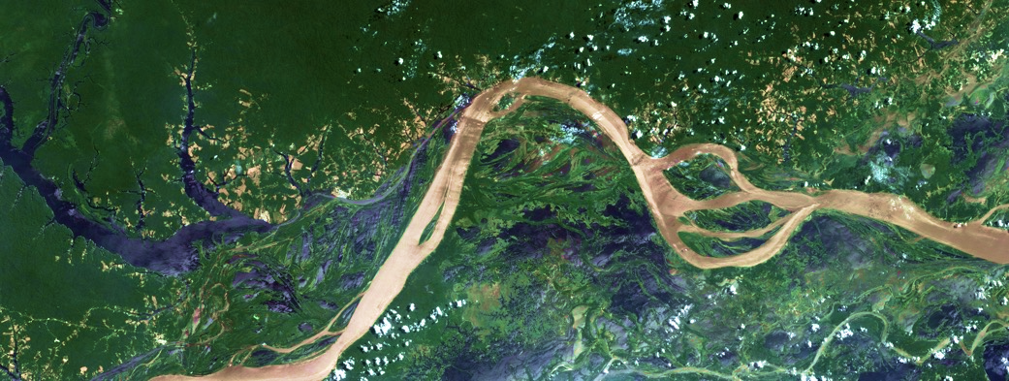
CBERS 04A image samples

Slide 14
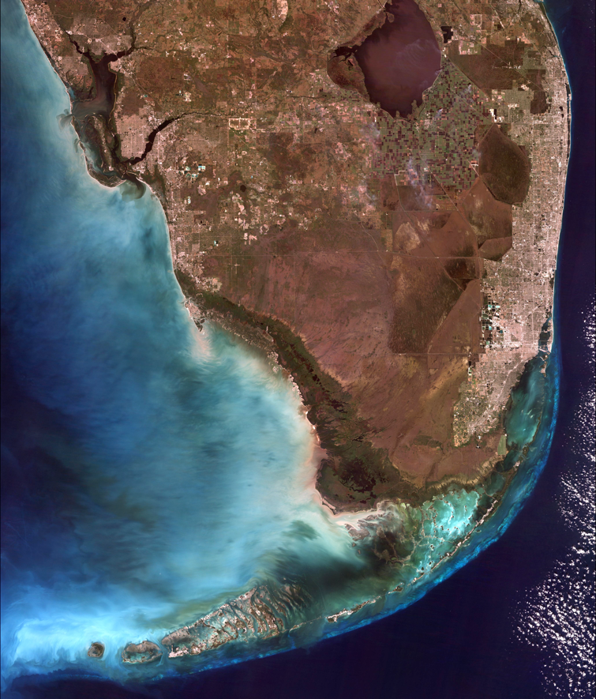
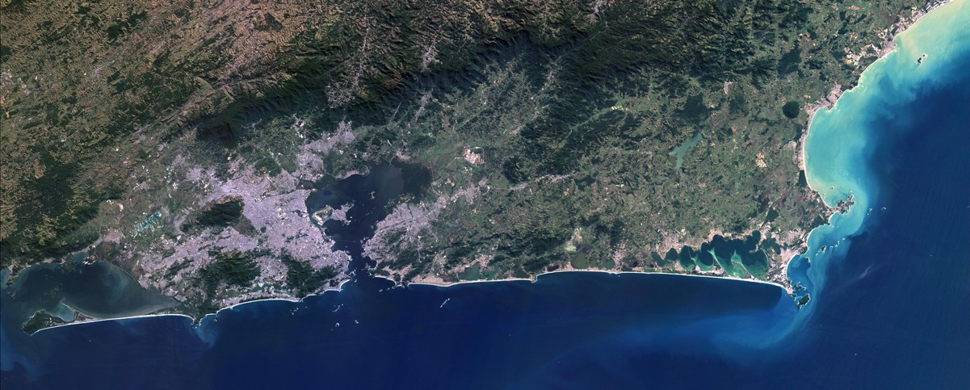
Amazonia 1 image samples

Slide 15
Thank you!
Antonio Carlos Pereira Jr – CBERS Space Segment
Adenilson Silva – Amazonia 1 Space Segment
R. Cartaxo, J. Bacellar, J. Mafra, E. Castejon, J. Arcanjo, J. Dalge – Earth Observation & Geoinformatics Division

