Slide 1
CEOS Support for Biodiversity
Gary Geller (NASA)
Marc Paganini (ESA)
Laurent Durieux (GEO)
Agenda Item 4
SIT TW 2022, ESA/ESRIN
13th - 15th September 2022

Slide 2
Biodiversity in the CEOS Context
Biodiversity: Variety of genes, species, and ecosystems
GEO Biodiversity Observation Network (GEO BON—a flagship)
Key users of EO products include:
International environmental agreements
CBD (Convention on Biological Diversity)
SDG (Sustainable Development Goals)
Ramsar (Convention on Wetlands)
SEEA (System of Environmental Economic Accounting)
IPBES (Intergovernmental Platform on Biodiversity and Ecosystem Services)
CMS (migratory species)
CITES (endangered species)
National governments
NGOs, other organizations….
Notes:
Biodiversity is the variety of life in all its forms and scales—so it includes the variety of ecosystems. This is particularly important WRT space agencies since space-based observations are particularly relevant to ecosystems—there is no better way to monitor ecosystems.
All these organizations have some very clearly identified needs that are not yet being met and to which space-based EO—and CEOS--can contribute. Indicators for the conventions are a good example—many are not yet available, or only for limited areas or timeframes.
GEO BON can facilitate discussion of user needs with CEOS and its members.
Intergovernmental Science-Policy Platform on Biodiversity and Ecosystem Services (IPBES) is the biodiversity equivalent of IPCC.

Slide 3
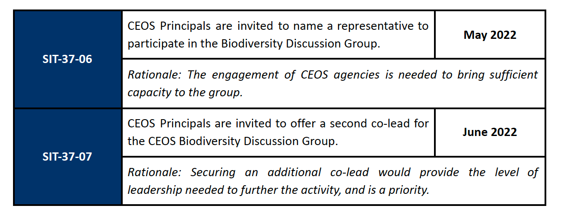
Background
Recent discussions on the role of CEOS in biodiversity
SIT-36 (March 2021)
Plenary (November 2021)
SIT-37 (March 2022)
Plenary: intervention to initiate a Discussion Group
SIT-37

Slide 4
Accomplishments
Deliverable BON-21-02 closed
Explore concepts for a Global Biodiversity Observation System
Workshop at World Biodiversity Forum confirmed top-level concept
Deliverable BON-21-01 nearing closure (due 2022 Q4)
Biodiversity/Ecosystem function relationship
Submitted two new CEOS Deliverables
Further development of GBiOS concept
Notes:
These are largely actions related to GEO BON—but there are big gaps due to need for more agency input.

Slide 5
Where Is Agency Contribution Most Needed?
Ecosystem Extent
Widespread need across many IEAs
Key feedstock for many higher-level products
Essential to understand ecosystem services to society
Strong links to wildfire, water, carbon, floods….
And…Can’t be done without EO
Notes:
Ecosystem Extent is not identical to Land Cover, though LC can be used as a somewhat marginal substitute.

Slide 6
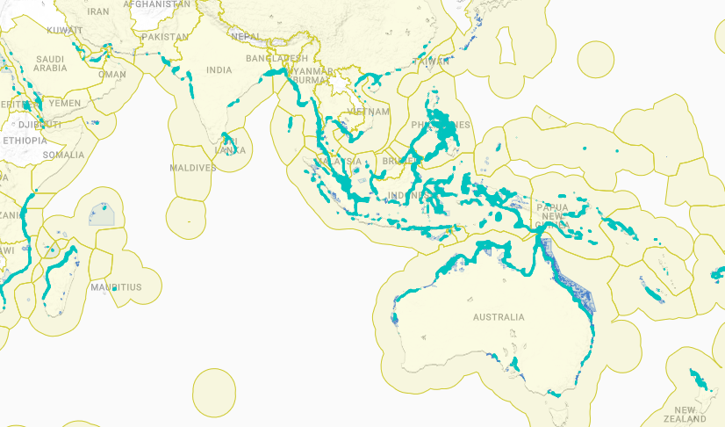
Example: Global Mangrove Watch

Slide 7
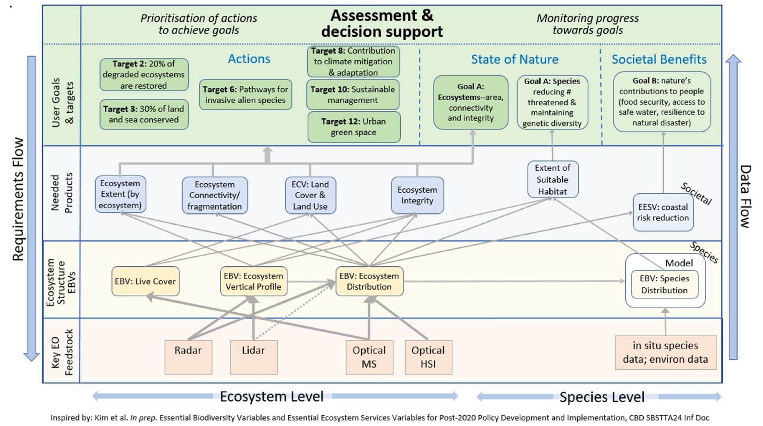
Connecting User Needs to Observations
From SIT-37
Notes:
This figure shows how Agency data flows into Essential Biodiversity Variables and products needed by Conventions and other entities for managing biodiversity.
(Updated version from SIT-37)

Slide 8
Ecosystem Extent:
Simplified Information Flow to Identified CBD Needs
.
Goal A*: Ecosystem area, connectivity
and integrity
Target 2: 20% of degraded ecosystems are restored
Target 10: Sustainable management
CBD Goals
& targets
Target 8: Contribution to climate mitigation & adaptation
Target 11: Ecosystem function and services
Target 6: Pathways for invasive alien species
Target 3: 30% of land and sea effectively conserved
Needed Products
Data Flow
Requirements Flow
Ecosystem Area
Ecosystem Integrity
Ecosystem Connectivity
ECV: Land Cover & Land Use
Ecosystem Extent**
Current products are not sufficient, lacking one or more of: update frequency, needed cover classes, spatial coverage, accuracy
Core Product
Key Feedstock
In situ data for training and validation
Radar
Lidar
Optical MS
Optical HSI
* This is only the ecosystem component of Goal A; Goal A also includes species and genetic components
** Land Cover is usually used as a surrogate but this is inadequate. CBD will likely utilize IUCN Ecosystem Typology V2 (UN SEEA already uses it)
Inspired by: Kim et al. In prep. Essential Biodiversity Variables and Essential Ecosystem Services Variables for Post-2020 Policy Development and Implementation, CBD SBSTTA24 Inf Doc
.
Notes:
CBD will likely utilize the classification scheme called IUCN Ecosystem Typology V2. UN SEEA already uses this. Unlike FAO LCCS and other classification schemes, Ecosystem Typology includes ecosystem process and function and thus has more direct relevance to ecosystem services and society.

Slide 9
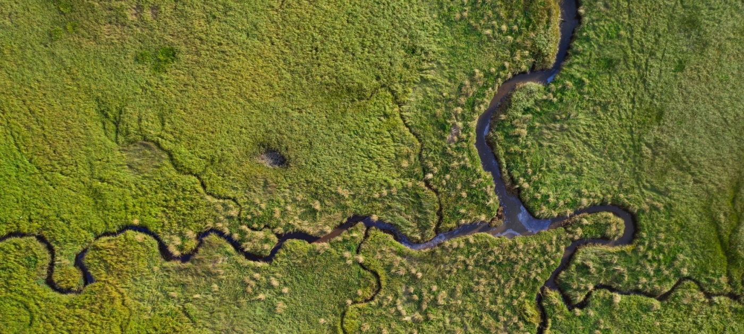
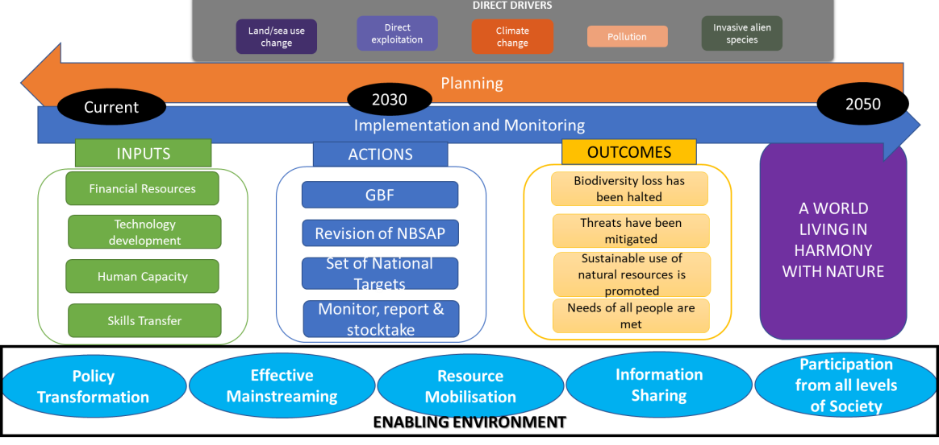
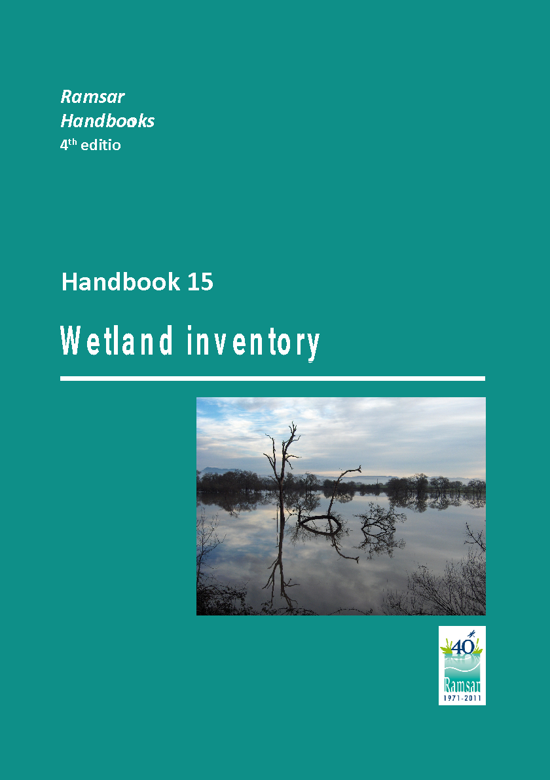
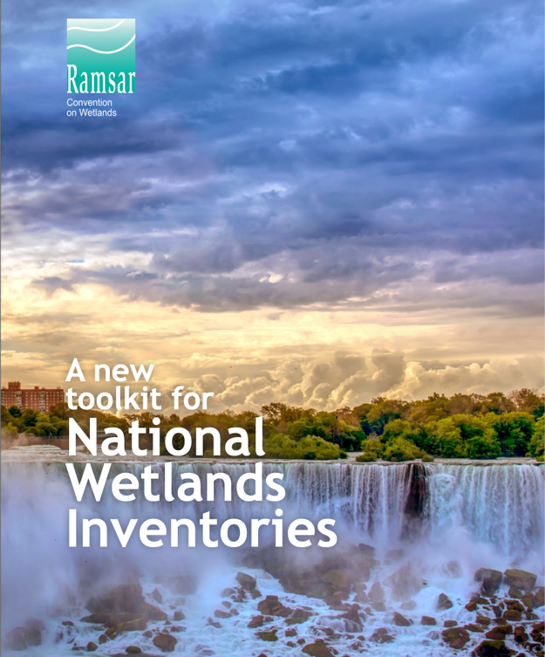
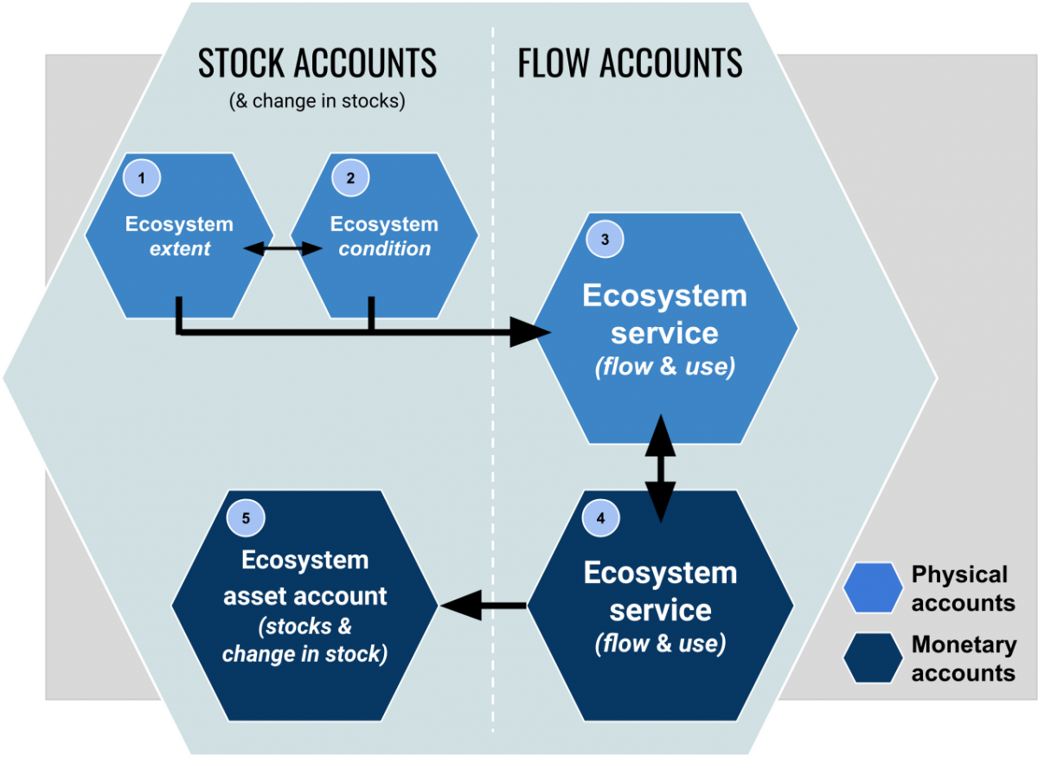
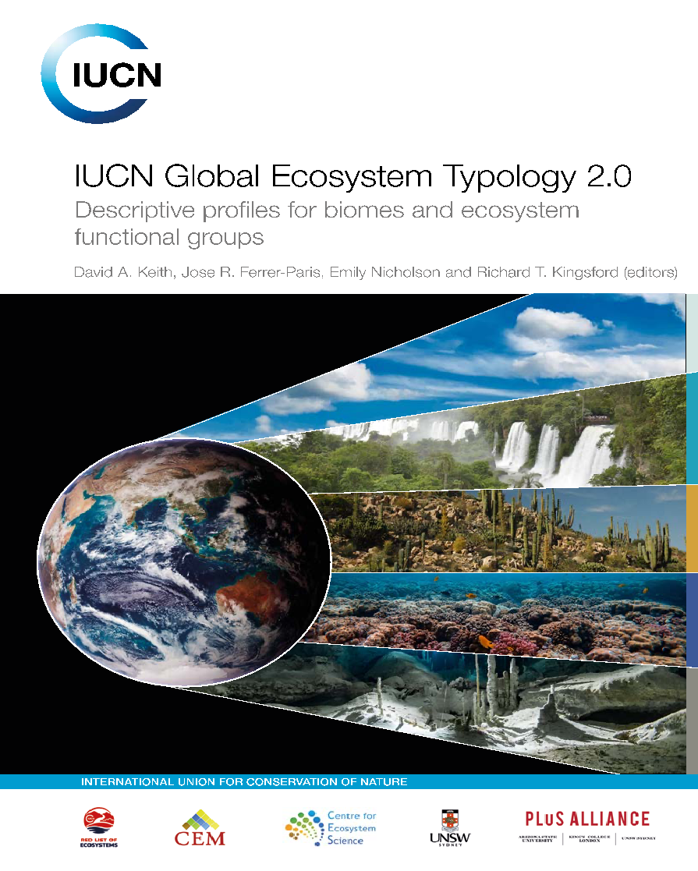
Why Is Ecosystem Extent So Important ?
Convention on Biological Diversity (CBD)
Sustainable Development Goals (SDGs)
Ramsar Convention on Wetlands
Post 2020 Global Biodiversity Framework (GBF)
SDG Target 6.6
Protect and restore water-related ecosystems, including mountains, forests, wetlands, rivers, aquifers and lakes
Ramsar Strategic Plan (2016 – 2024)
Target 8: National wetland inventories are initiated, completed or updated and disseminated and used for promoting the conservation and effective management of all wetlands.
SDG Target 14.2
Sustainably manage and protect marine and coastal ecosystems to avoid significant adverse impacts.
GBF Monitoring Framework
Headline indicator A.0.1 Extent of selected natural ecosystems (forest, savannahs and grasslands, wetlands, mangroves, saltmarshes, coral reef, seagrass, macroalgae and intertidal habitats)
SDG Target 15.1
Ensure the conservation, restoration and sustainable use of terrestrial and inland freshwater ecosystems and their services.
SEEA Ecosystem Accounting
New international standard on Ecosystem Accounting which regulate the production on statistical accounts on ecosystem extent, condition and services.
Measurement framework underpinning the development of monitoring frameworks of other international agreements, such as the CBD post-2020 GBF, the Ramsar Convention on Wetlands, and the 2030 Agenda on Sustainable Development.

Slide 10
Joint CEOS-GEO
Support for Biodiversity
in the context of the
Road to GEO post-2025
Laurent Durieux (GEO)
© Shutterstock
SIT TW 2022, ESA/ESRIN – Session 4 : Biodiversity – Wednesday 14th September 2022, Frascati, Italy
1

Slide 11
Biodiversity
Joint Actions
2022
Original Proposed Collaborations – linked to Ecosystem Extent
CEOS-GEO Coordination to consolidate EO unique position in the post-2020 GBF
Identify new opportunities from recent development of EO capabilities for the Biodiversity agenda
Include biodiversity needs in multi-thematic Cal/Val and ARD development efforts
Support the coordinated production of needed EO data for EBVs
Engage in parallel with Ramsar for wetlands and mangrove monitoring, UNCCD for restoration
and WMO for overlapping needs
Collaborate on the development of a biodiversity Toolkit to facilitate open access to key EO data
for Biodiversity monitoring, Ecosystem accounting and Nature-based Solutions
benefiting from BON in a Box, NatureServe and existing EO Toolkit
Use biodiversity as a transversal communication pathway to position GEO and CEOS
on integration issues
Explore resource mobilization opportunities to develop these joint actions
From CEOS-GEO Coordination Meeting Feb. 2022
CEOS-GEO Coordination Meeting, 8-9 February 2022 - Agenda Item 3.1 Biodiversity joint activities for CBD Post-2020 GBF
3

Slide 12
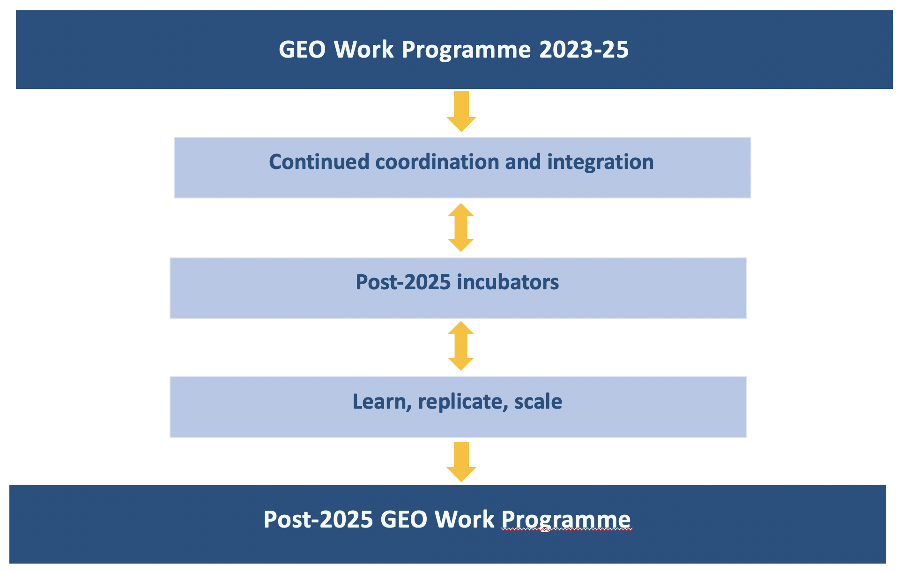
Post-2025 Ideas for incubation
Nature-based Solutions
Global Biodiversity Observation System
Integrated Ecosystem Monitoring
Ocean-Climate
Global Marine Debris Monitoring System
Food-Water-Biosphere
Systemic Risk/DRR
Integrated Floods Forecasting
Global Wildfire Information System
Climate-Urban-Health
Global Integrated Heat and Health Information System
Ecosystem extent is needed to report
on nature-based solutions impacts on biodiversity

Slide 13
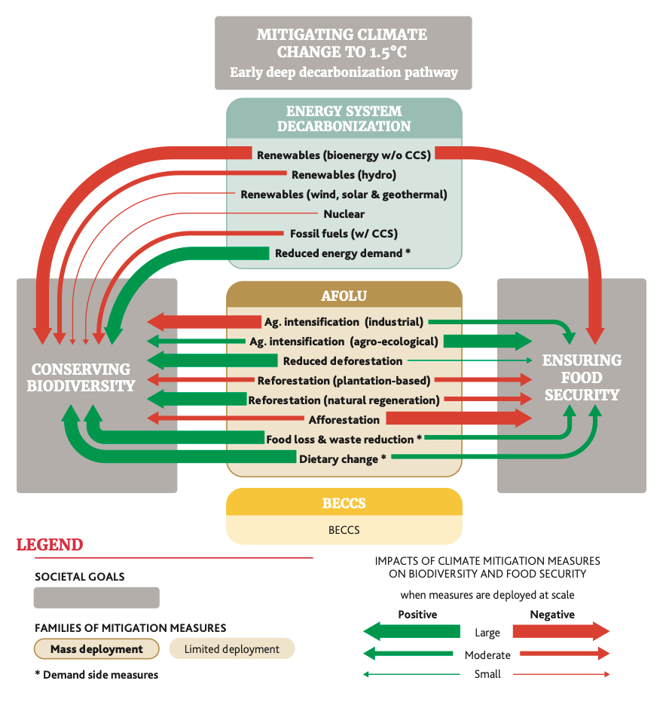
Aligning climate and biodiversity ambitions
Limiting global warming to ensure a habitable climate and protecting biodiversity
are mutually supporting goals, and their achievement is essential for sustainably
and equitably providing benefits to people.
Develop greater collective climate-biodiversity accountability
Support to AFOLU mitigation contribution MUST take into account impact
on biodiversity and food security
Towards a net-zero and biodiversity positive economy
The CEOS/GEO support to AFOLU could benefit the engagement
on Ecosystem extent mapping and monitoring
Deprez, A. et al. (2021). Aligning high climate and biodiversity ambitions
in 2021 and beyond : why, what, and how? IDDRI, Study N°05/21.

Slide 14
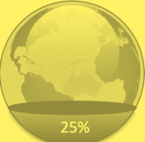
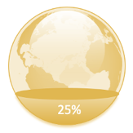
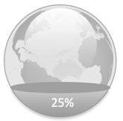
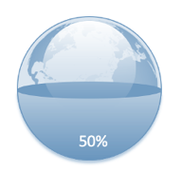
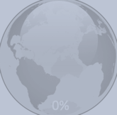
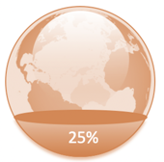
ECV
EEMV
100%
EHV
…where we need to go
EEMV
100%
where we are…
100%
25%
100%
EUV
EGV
100%
EWV
EUV
EHV
25%
100%
25%
0%
EBV
EWV
EBV
EUV – Urban
EAV - Agriculture
EHV - Health
EGV - Geosphere
EBV - Biodiversity
EWV - Water
ECV – Climate
EEMV – Energy & Mineral
ETIV – Transport & Infrastructure
EAV
100%
50%
100%
Lehmann et al., 2022 - https://www.sciencedirect.com/science/article/pii/S1462901122000338
ECV
100%
ETIV
100%
EAV
ETIV
EGV
100%
100%
0%
25%
100%
Other scales
Other policies
GEO key topics and priority policies
Socio-Ecological Earth System
Ecosystem distribution is one of the EBVs and is described as the horizontal distribution of discrete ecosystem units
Notes:
We can intuitively see the benefits of connection across GEO work programme activities
Currently initiatives rarely, if ever, work across disciplines
This suggests a potential to move beyond the stovepipe and develop integrated solutions to complex challenges
A common approach to essential variables may provide one way to enhance integration across the workplan

Slide 15
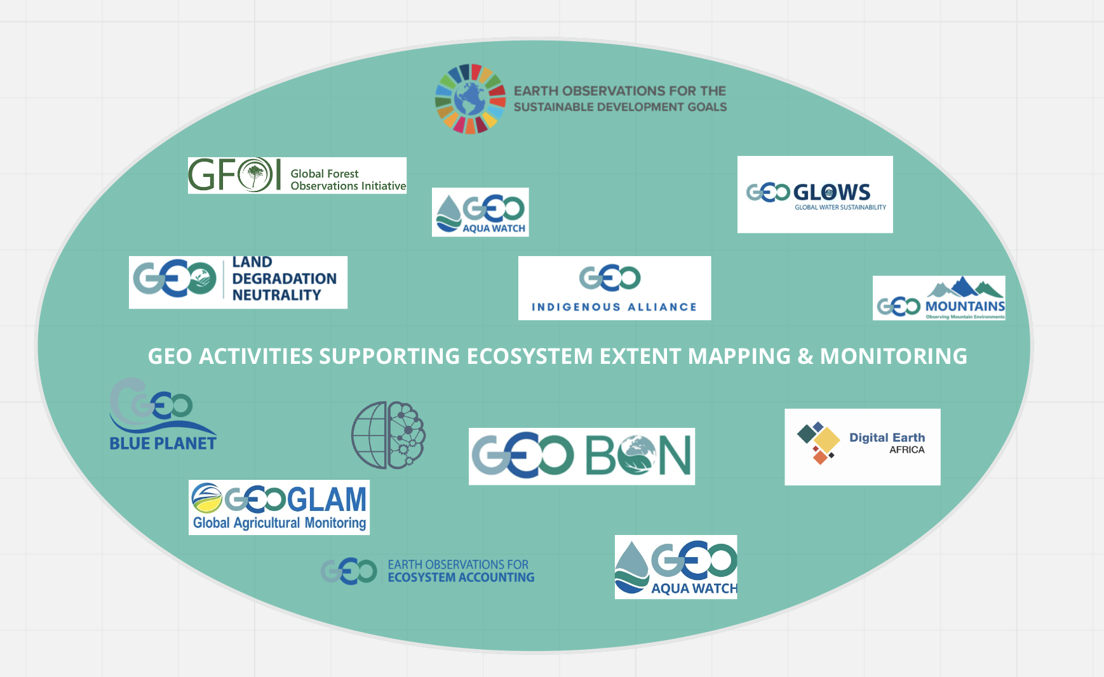
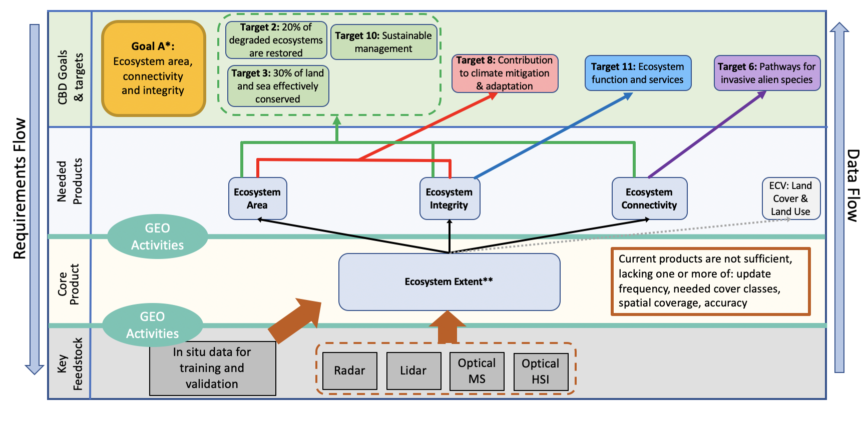
Building on GEO BON Leadership while
taking benefit from the entire GEO Community Capacity
GEO Activities contribution to the ecosystem extent
production flow

Slide 16
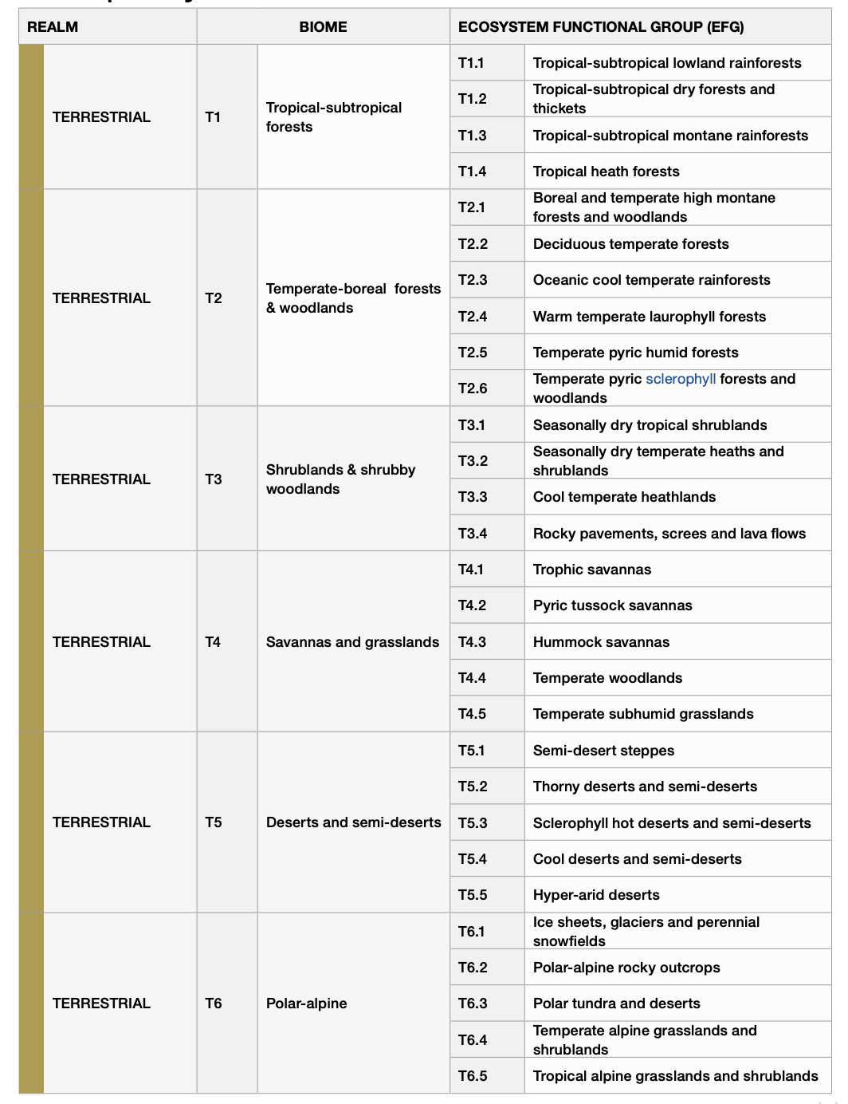
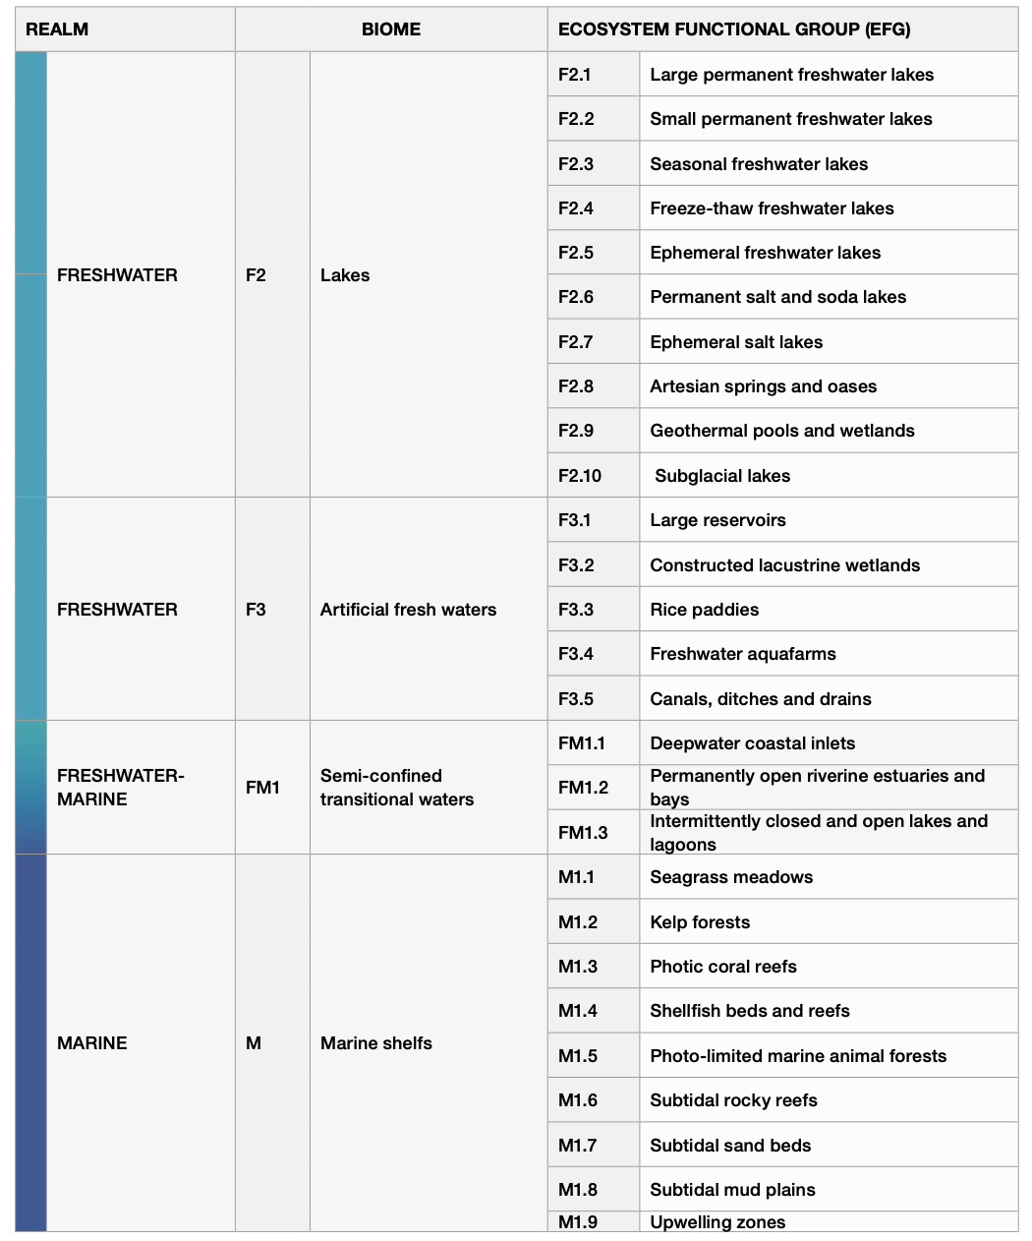
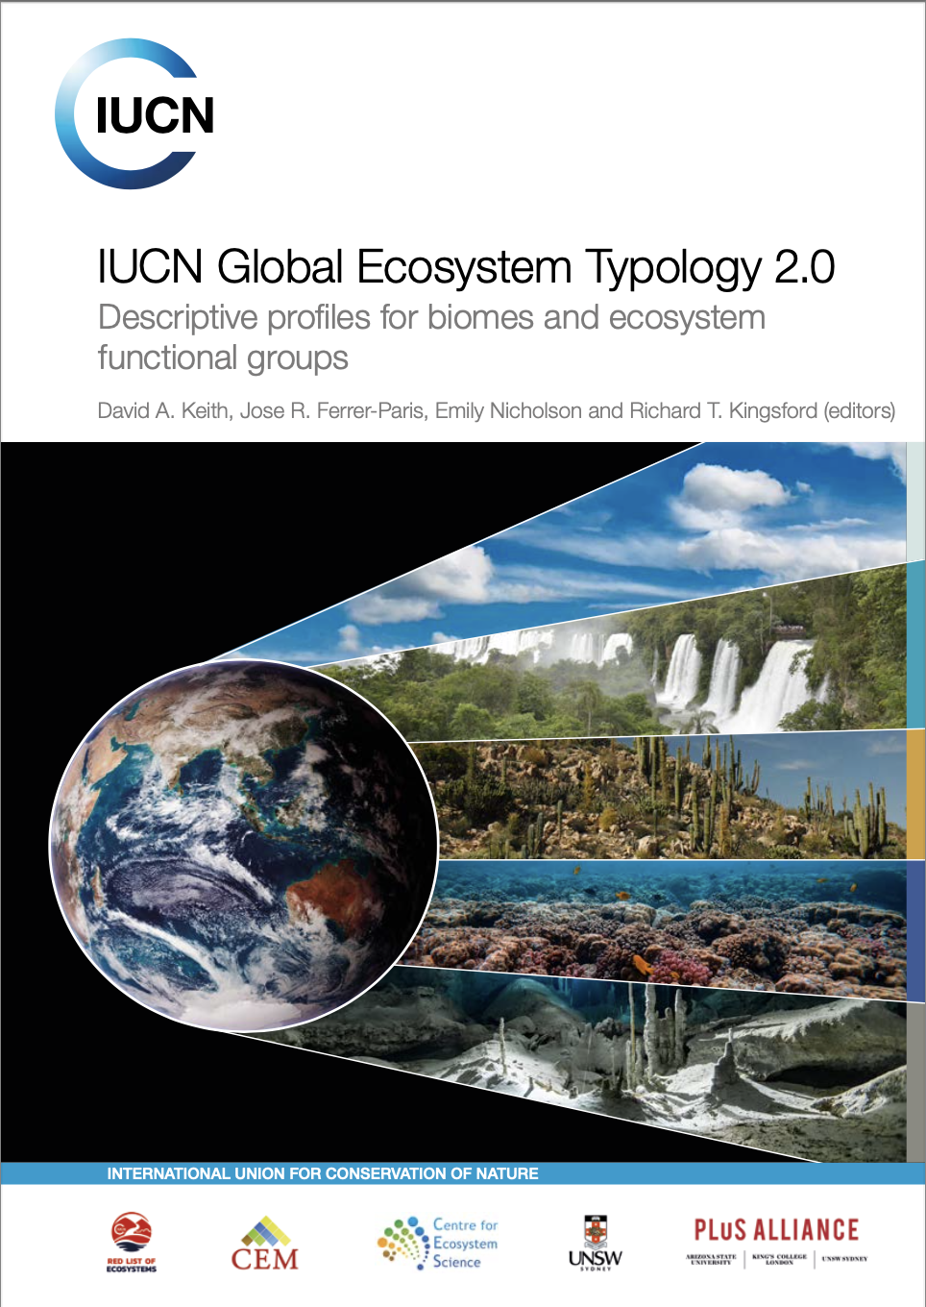
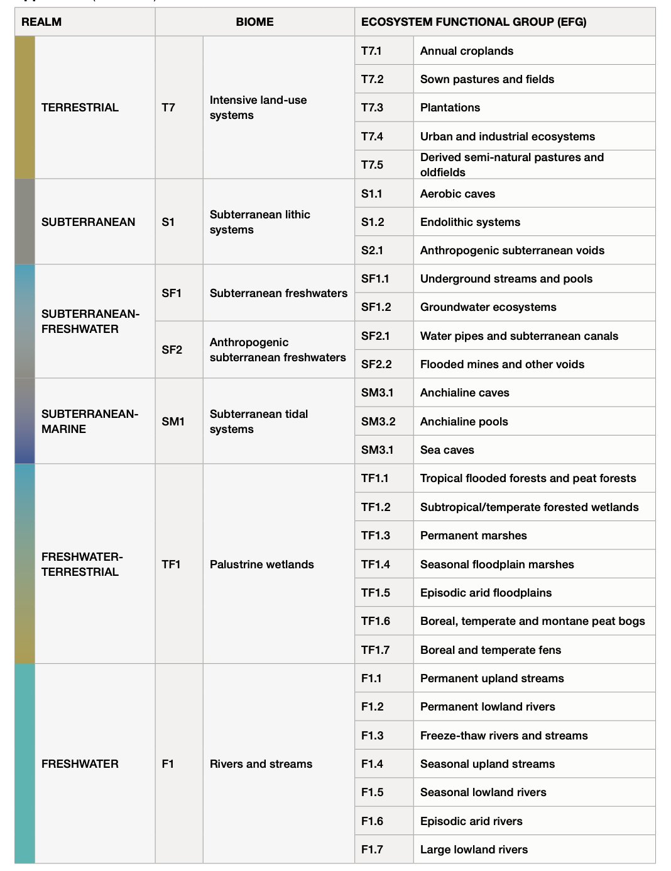
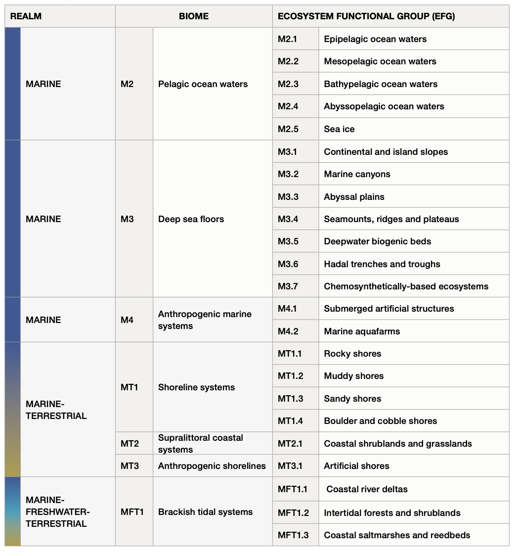
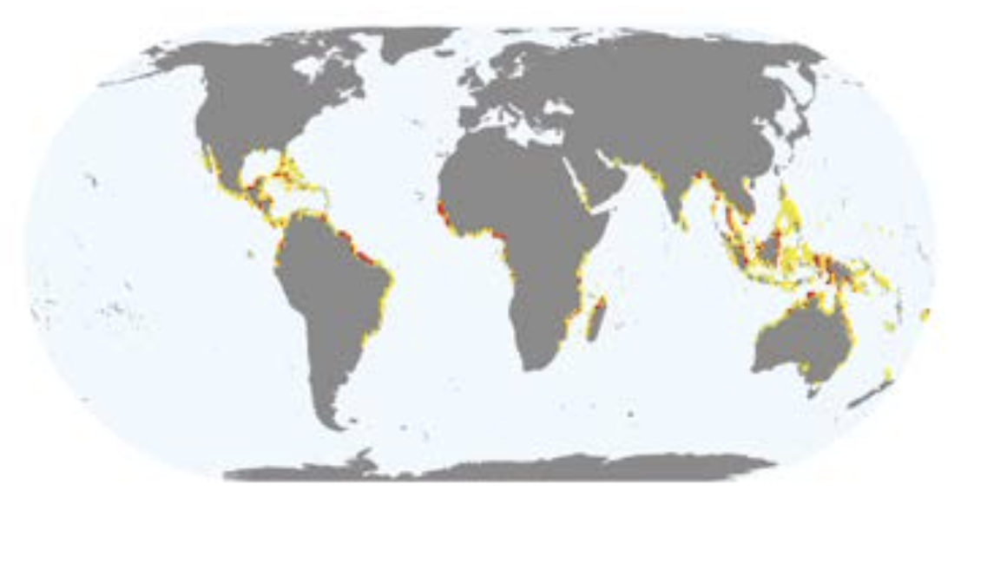
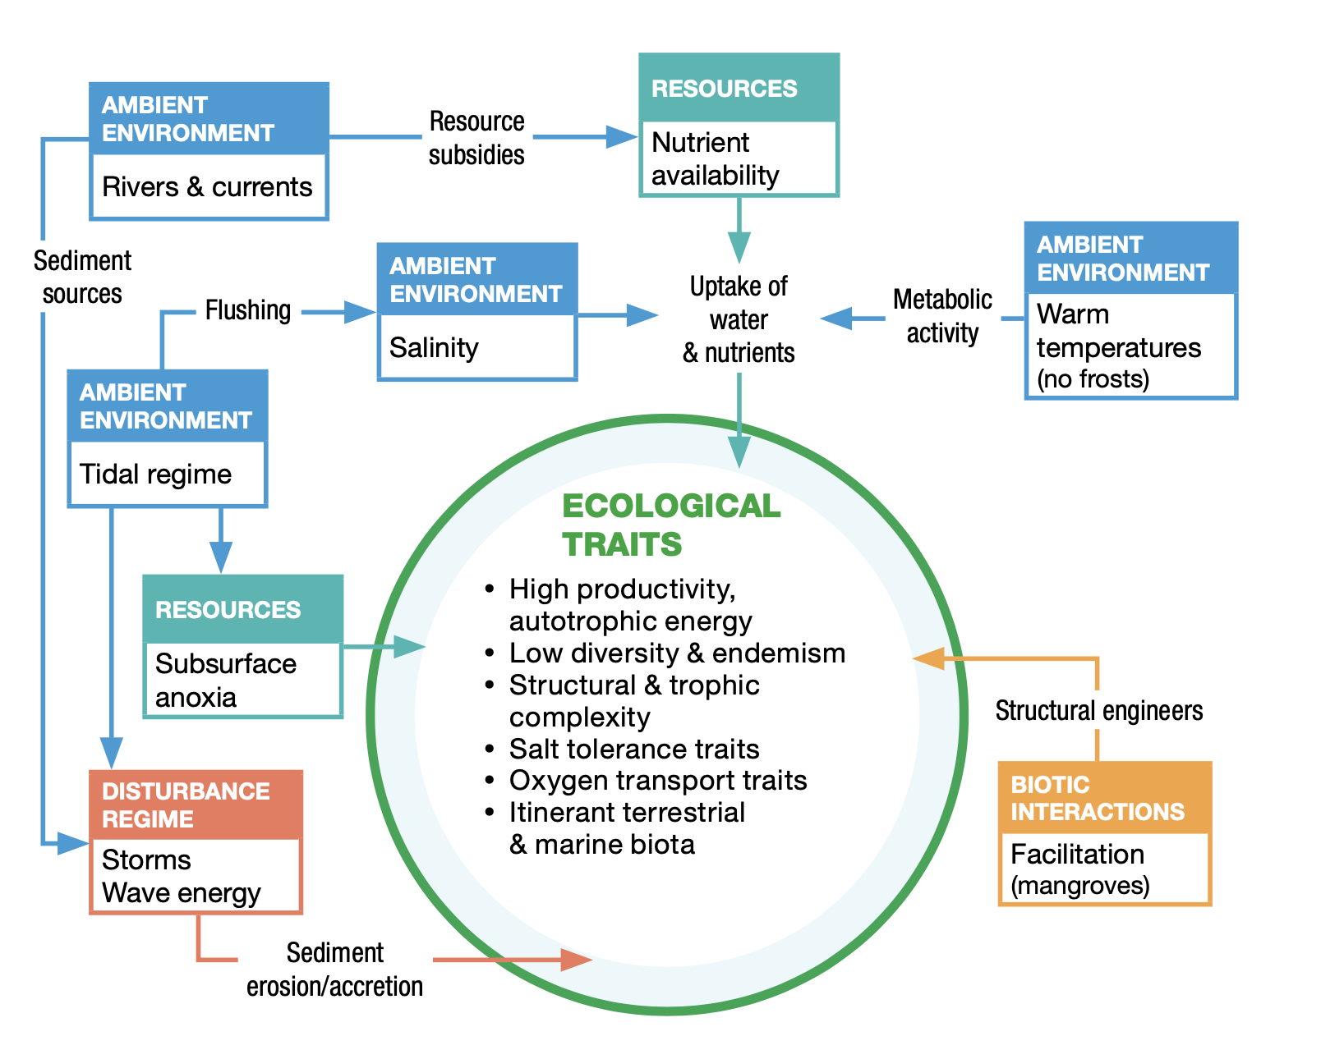
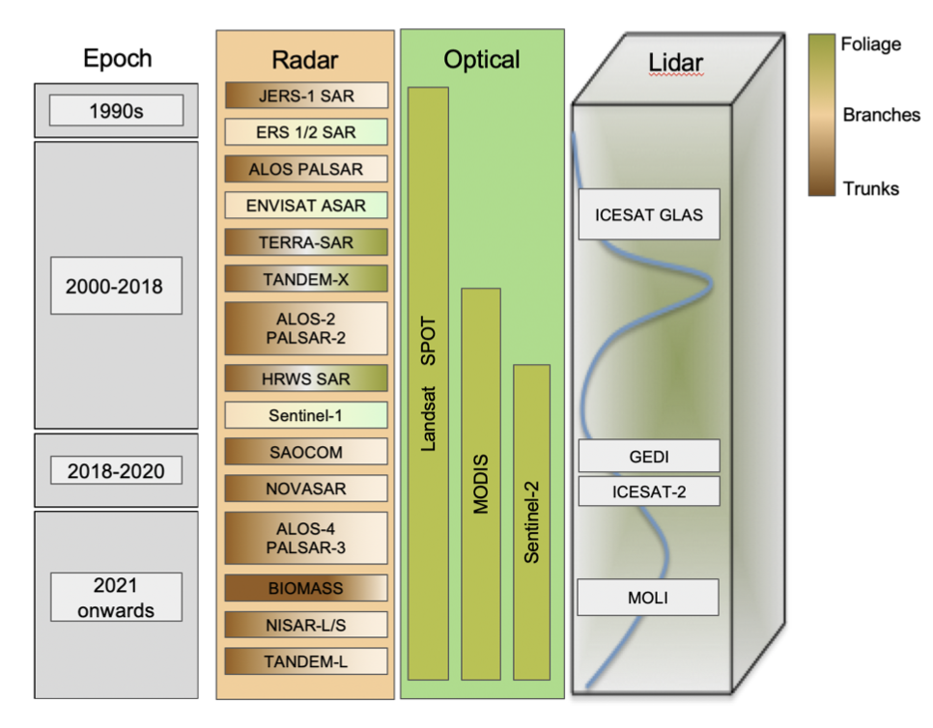
Mangroves extent example
Which EO data to use ?
Which platforms ?
Which GEO activities have the knowledge ?

Slide 17
Backup
(c) 2022 California Institute of Technology. Government sponsorship acknowledged.

Slide 18
IUCN Ecosystem Typology
Hierarchical ecosystem classification system
Probable basis for CBD’s Ecosystem Extent headline indicator
Differs from other classification systems
Includes ecosystem process/function
Selected as standard system by UN SEEA
Likely to be selected by CBD

Slide 19
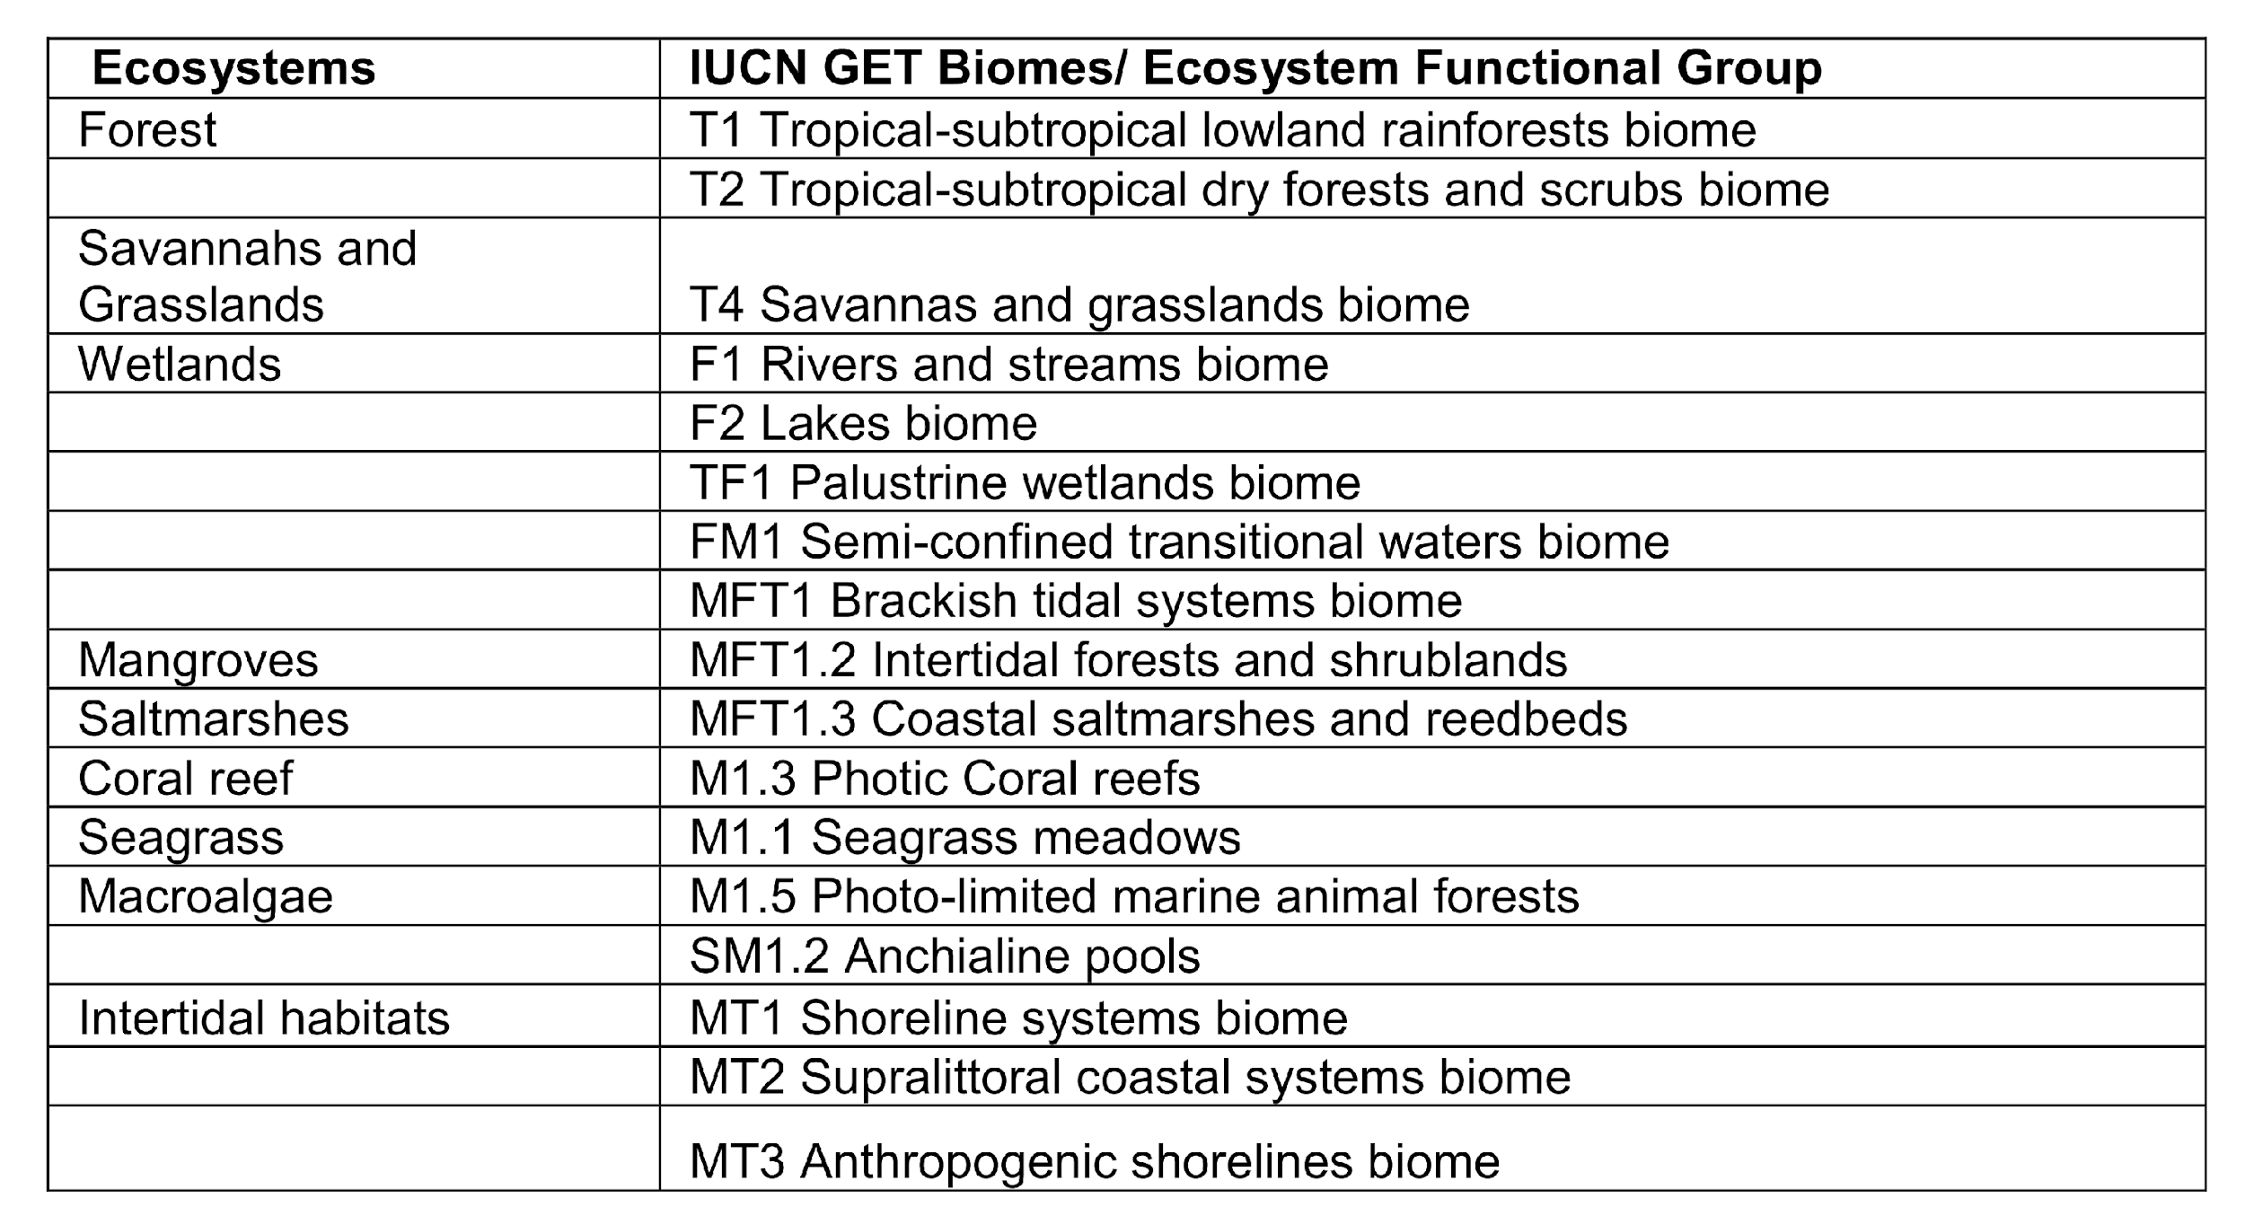
IUCN Ecosystem Typology
From:
CBD/SBSTTA/24/INF/38

Slide 20
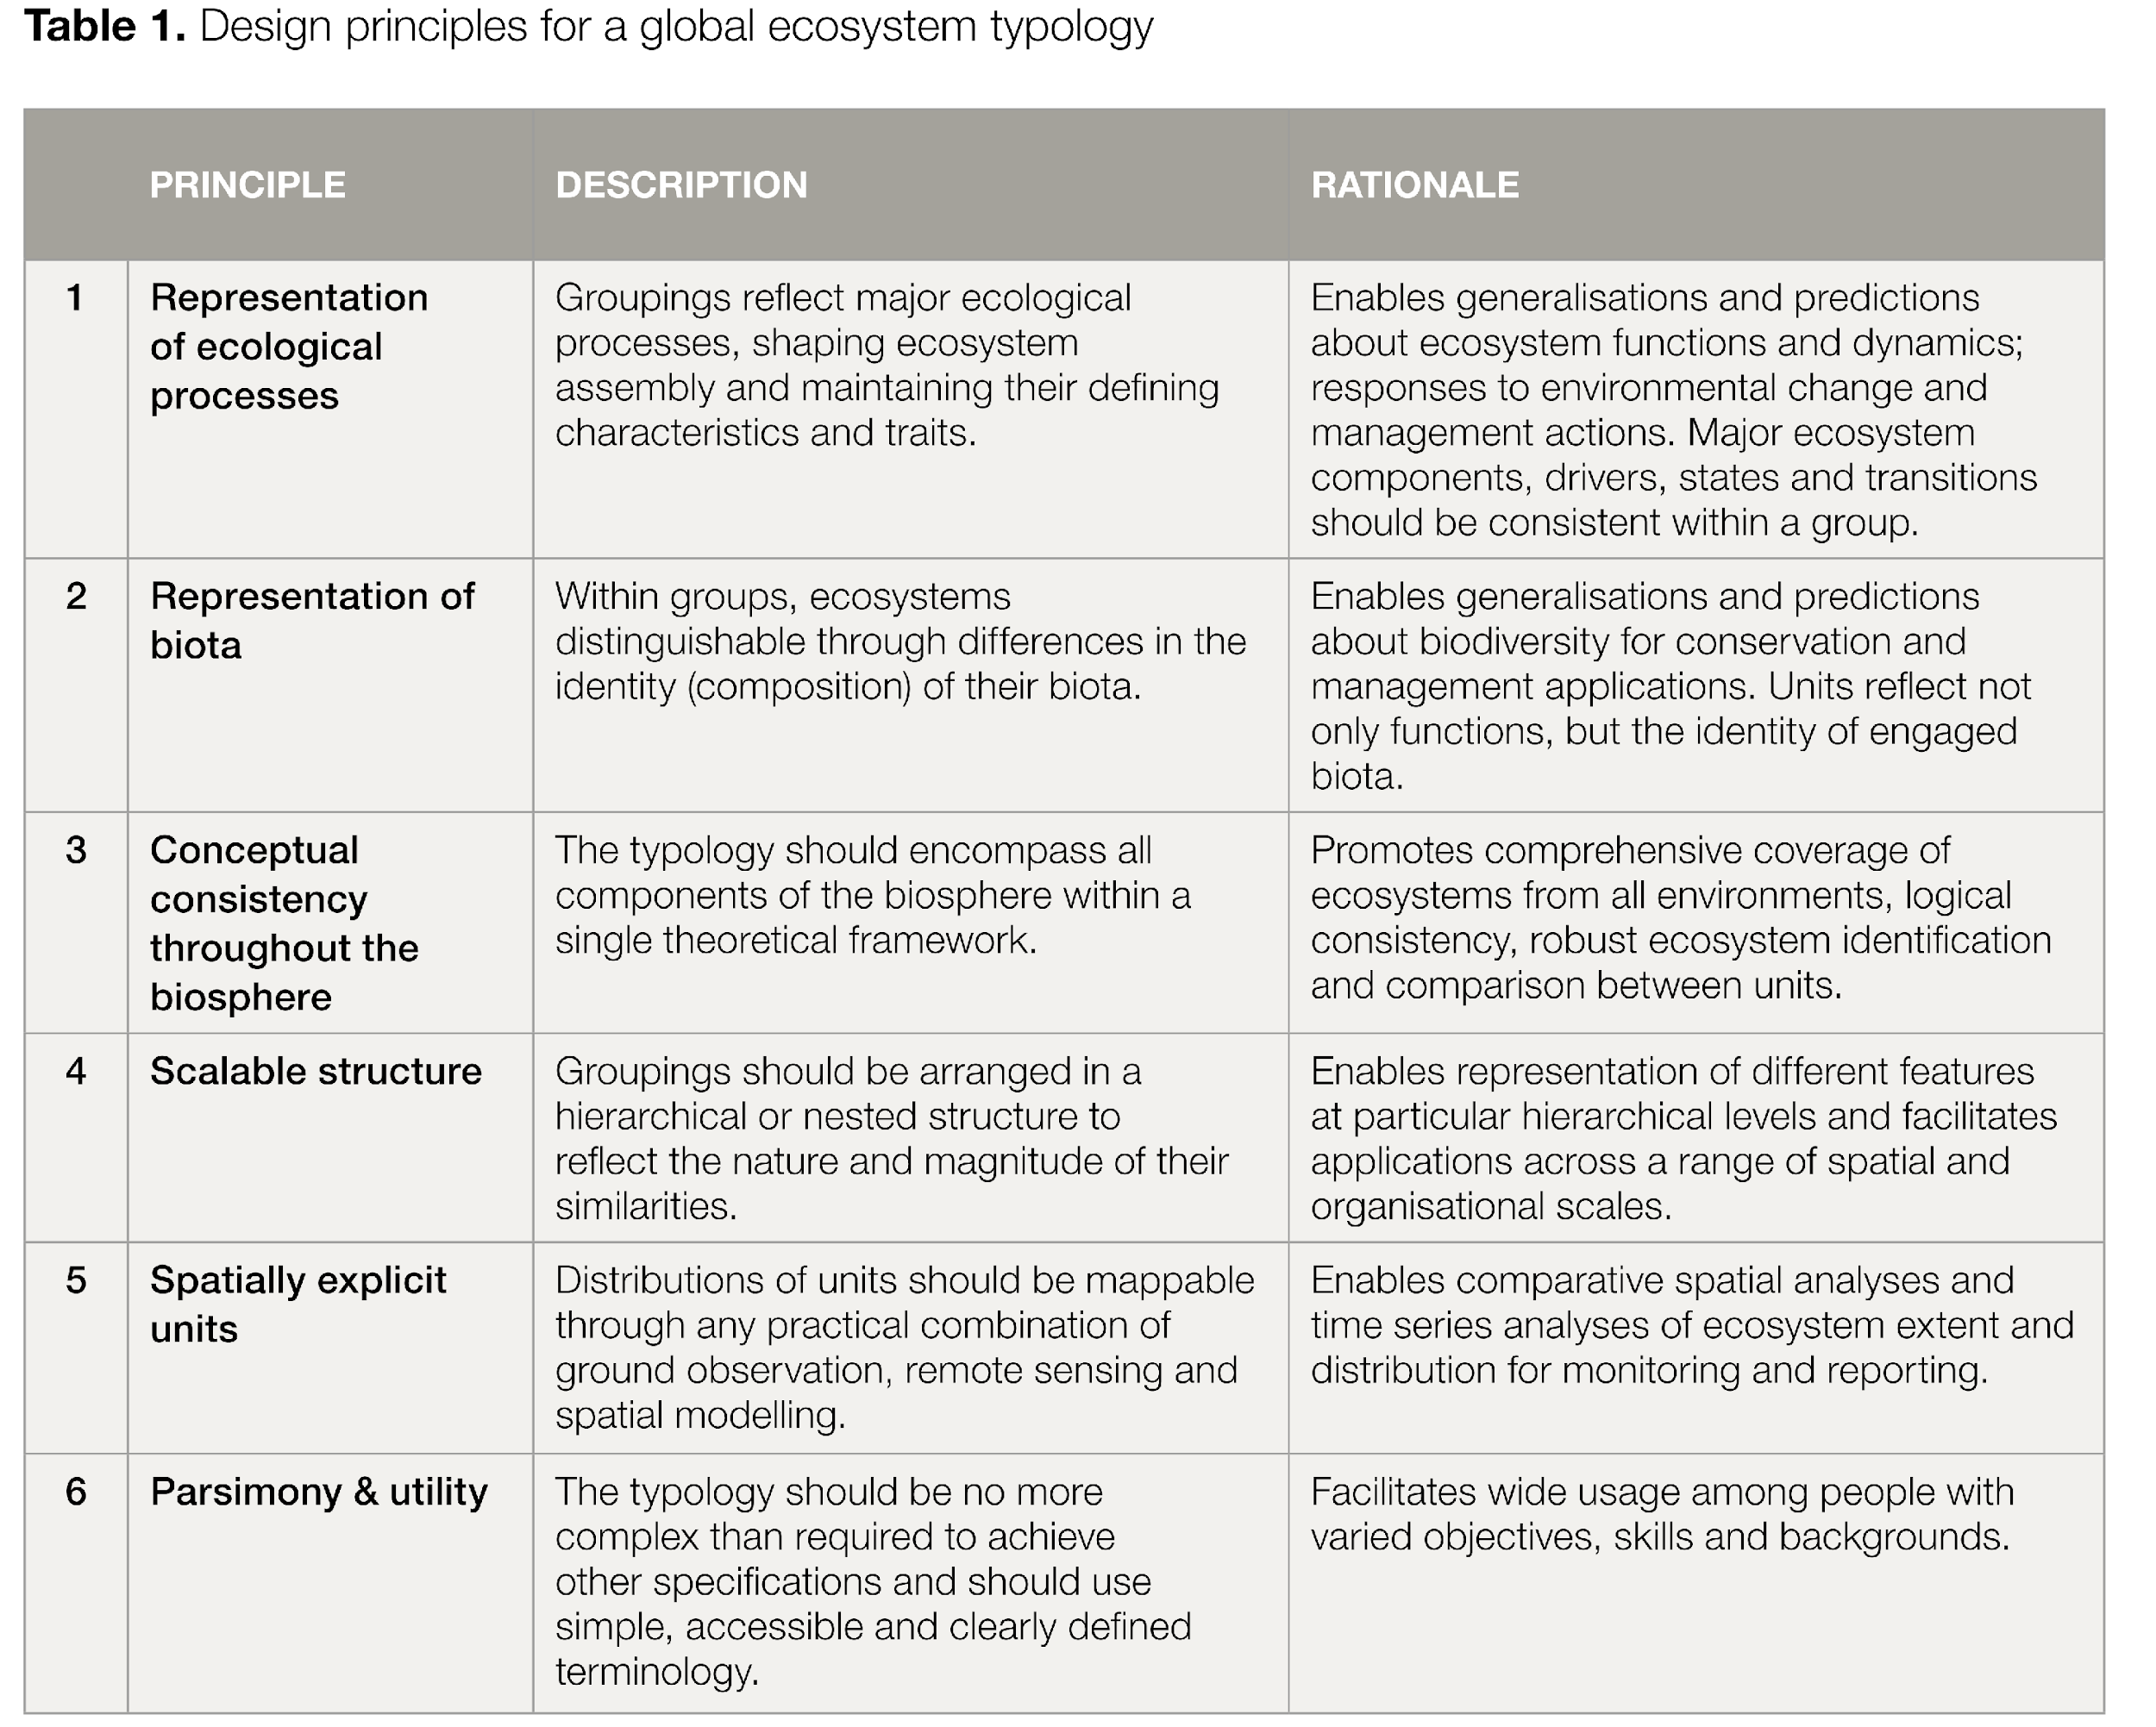
IUCN Ecosystem Typology
Keith et al 2020

Slide 21
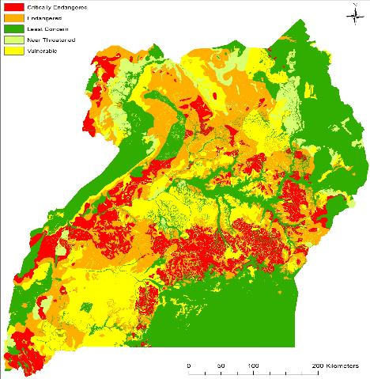
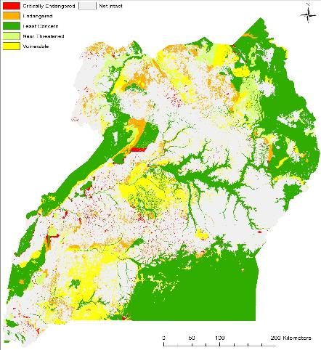
Example: Ecosystem Assessment in Uganda
Original extent of ecosystems
Remaining extent of ecosystems
Monitoring & Assessing
Addresses:
CBD Goal A &
Targets 2, 3, others
Supports response by national governments
Uganda Spatial Biodiversity Assessment (Connect Africa: Stephen Holness, Nelson Mandela University)
Notes:
This slide was shown at SIT-37.
Example output for Uganda to assess what ecosystems in the country remain.
This is being used to inform Uganda’s National Development Plan and prioritize conservation efforts in the country.
Next slide shows how this product feeds into decision support
Slide content courtesy of Mike Gill, NatureServe.

Slide 22
From SIT-37
Notes:
Slide from SIT-37 (in Backups)

