Slide 1
Climate & Carbon Session
Session 3
SIT TW 2022, ESA/ESRIN
14th - 15th September 2022

Slide 2
Session overview
Session 3
SIT TW 2022, ESA/ESRIN
14th - 15th September 2022

Slide 3
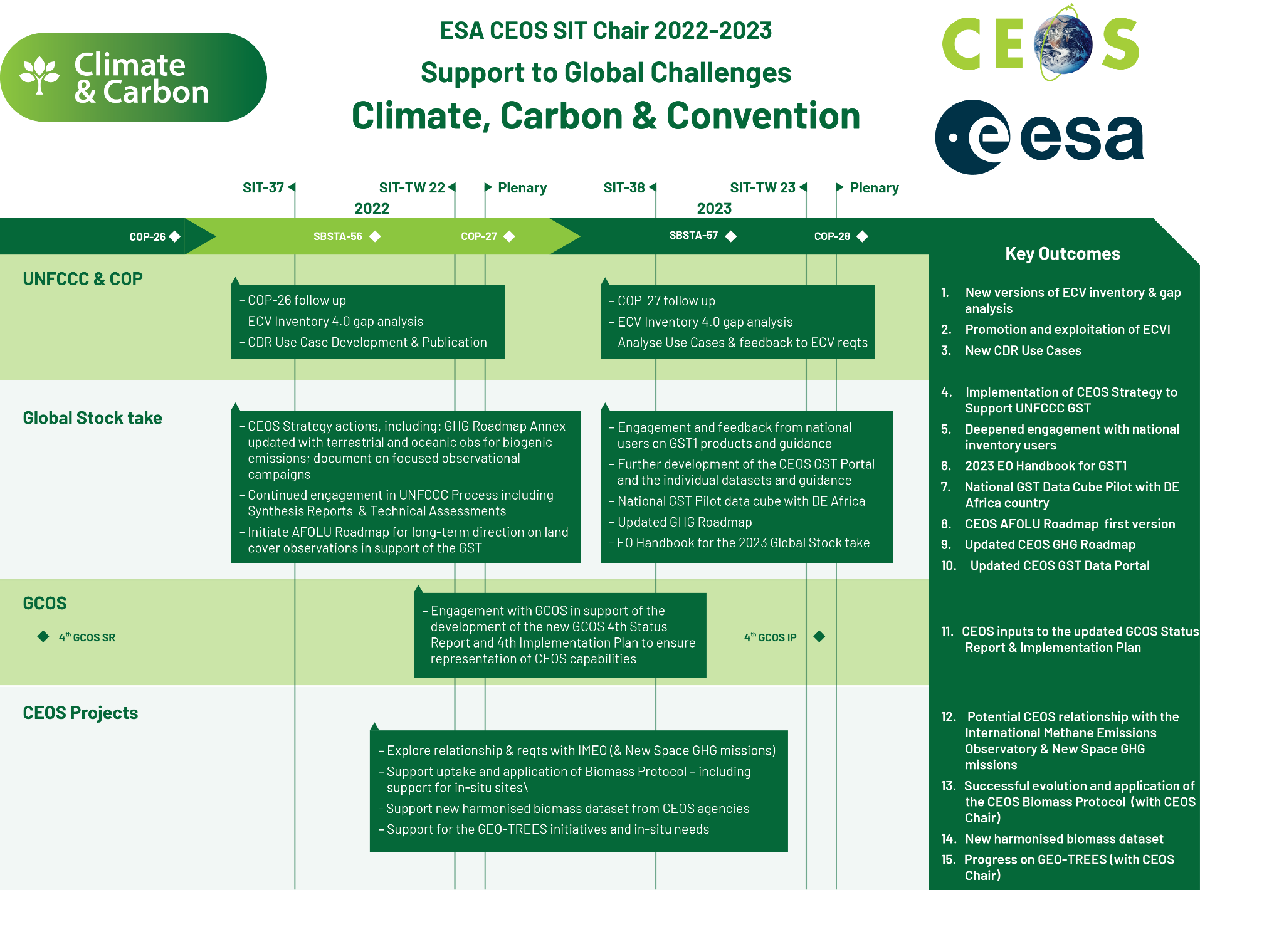
A SIT Chair Term Priority
Slide ‹#›

Slide 4
Session objectives & decisions
Objectives:
Review of the multiplicity of activities right across the CEOS structure in relation to our support to the UNFCCC, the Paris Climate Agreement and its Global Stocktake process (including our COP-27 prep). This includes he work of the WGClimate and opportunities around Agriculture, Forestry and Other Land Uses (AFOLU), greenhouse gases (GHG), campaign actions and above ground biomass.
Decision Points:
COP-27 preparations
Latest on the GST Strategy and the resulting action status
Actions in support of the CEOS-IMEO Collaboration
AFOLU Roadmap feedback, next steps, and intra-CEOS links
Slide ‹#›

Slide 5
Session Agenda
3.1 Session Intro [10 mins]
3.2 WGClimate Update on SBSTA and COP, Recent Activities [15 mins] COP-27 prep (+15 mins)
3.3 GHG Roadmap Update [15 mins]
3.4 AFOLU Roadmap Update [20 mins]
3.5 JRC Workshop Report [15 mins]
3.6 GCOS IP Update [15 mins]
3.7 IMEO Update and Technical Needs [30 mins]
3.8 Ocean Carbon Special Report [15 mins]
3.9 GEO-TREES Update [15 mins]
3.10 WMO GHG Monitoring System [15 mins]
3.11 Adaptation, GEOSEC [15 mins]
Slide ‹#›

Slide 6
CEOS GST Strategy Update
10 Mins
Steve Briggs, SIT Chair Team
Agenda item 3.1
SIT TW 2022, ESA/ESRIN
14th - 15th September 2022

Slide 7
GST Status
GST Strategy Document V3.1 approved at CEOS Plenary Nov 2021
Document contains 9 Recommendations for specific actions on CEOS Agencies and CEOS bodies to support the GST
Actions derived from the recommendations are included in the overall CEO Work Plan and are complementary to those already carried out by CEOS bodies in support of the GST. Ongoing work contributes significantly in areas such as adaptation.
Many different elements of CEOS (WGs, VCs and others) contribute under SIT Chair leadership.
Recommendations addressed in agenda items as below.

Slide 8
GST Actions - update
GST Recommendations 1,2: Update WG Climate GHG Task Force Report Annex C: Contributions to updates include those from:
WGClimate Workshop on Gap Analysis 18-20 May 2022 – report pending. Item 3.2 today.
WMO/GCOS workshop 10-12 May 2022 (tbc, Geneva) on Carbon Cycle in Earth System Science (report available from WMO) + Follow-up meeting 30 Jan 2023
AFOLU/GHG Workshop Nov 2021, JRC/virtual + AFOLU Workshop 12 Sept 22 Item 3.4
Ocean Carbon Workshop Feb 14-18 2022 (virtual) Item 3.8
Carbon from Space IV October 2022, ESRIN (see next slide)
GCOS Science Conference October 2022
Increased involvement from Copernicus CO₂ programme in WGC GHG Task Force

Slide 9
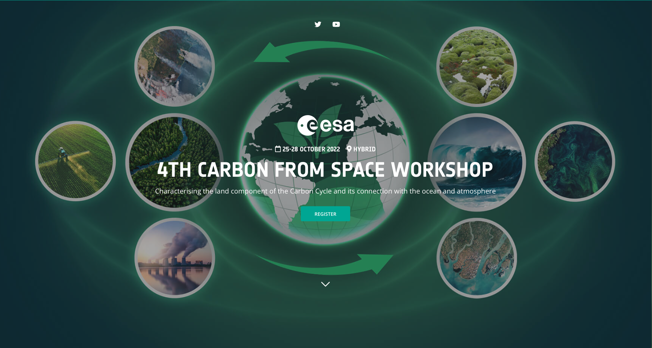
https://4thcarbonfromspace.esa.int/
The 4th Carbon from Space Workshop (ESA-ESRIN) brings together the EO, in situ and Earth system science communities to identify gaps, challenges and issues to address in understanding the carbon cycle. The workshop will focus specifically on the terrestrial component of the carbon cycle and its interactions with the ocean and atmosphere.

Slide 10
GST Actions - update
Recommendation 3: Inform the report of CEOS to UNFCCC/RSO discussion on observations to support the implementation of the Paris Agreement and should pro-actively flow into (b) the consultancy process of the UNFCCC / Ad hoc group for the Synthesis Report on Observations for the GST. CEOS should also report on this at the Earth Information Day at COP26. Actions undertaken include:
Multiple contributions to Earth Information Day at COP26, Glasgow
Representation from WG Climate, GHG Task Force and AFOLU Task Team at RSO discussion at COP
Contributions from all these to the Synthesis Report on Systematic Observations for UNFCCC presented at SBSTA in Bonn, June 2022
See item 3.2

Slide 11
GST Actions - update
Recommendation 4: CEOS should consider, in conjunction with modellers, setting up one or more focussed observational campaigns as a major contribution to the understanding of trends in natural GHG emissions and removals in key areas.
NASA/ESA conducted AMPAC Campaign aimed at understanding methane emissions from tundra under warming conditions. Included airborne, satellite (TROPOMI) and model data.
Discussions on possible campaigns with both public sector and private sector in oil and gas extraction locations eg Permian Basin (see Item 3.7).
Further possibilities for such campaigns in eg Amazon Basin exist and can be considered with science community through e.g. Carbon from Space Workshop, WMO Carbon Workshop

Slide 12
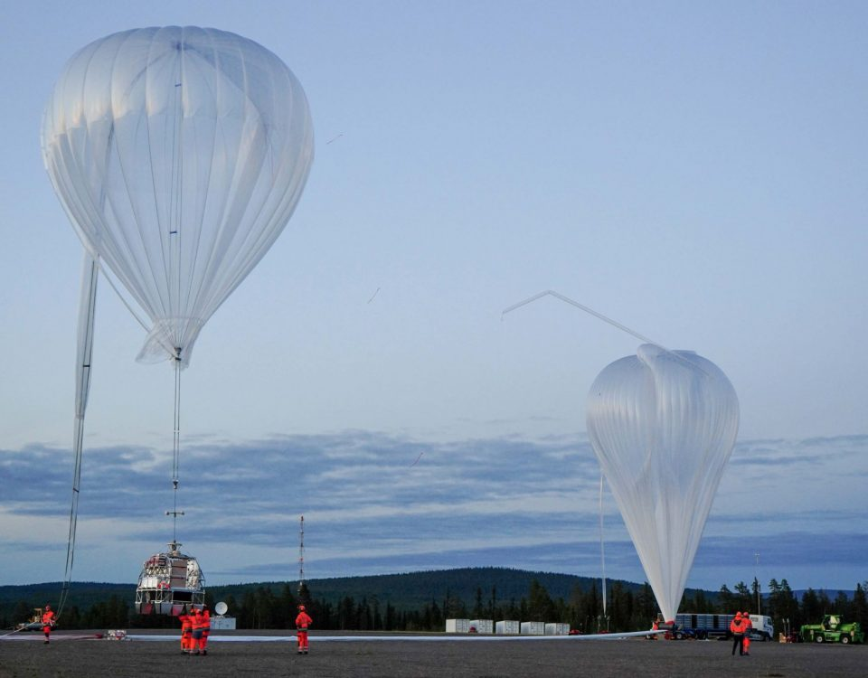
MAGIC4AMPAC: Arctic Methane sensing campaign 2021
Joint science campaign (Europe and US) in Scandinavia with appr. 80 people on-site.
Collaboration with campaign organized by CNES, France
Main objectives: multi-sensor airborne sensing of arctic methane using HyTES (NASA), multiple in-situ (DLR) and Methane lidar (DLR/CNES) + balloon & ground measurements
Data suitable for AMPAC community study, simulation studies for both NASA SBG & Copernicus Expansion LSTM
Balloon launch ESRANGE (SE)
3 Campaign Aircraft at Kiruna Airport (SE)
https://sscspace.com/blog/2021/08/31/cnes-completes-series-of-balloon-flights-from-esrange/

Slide 13
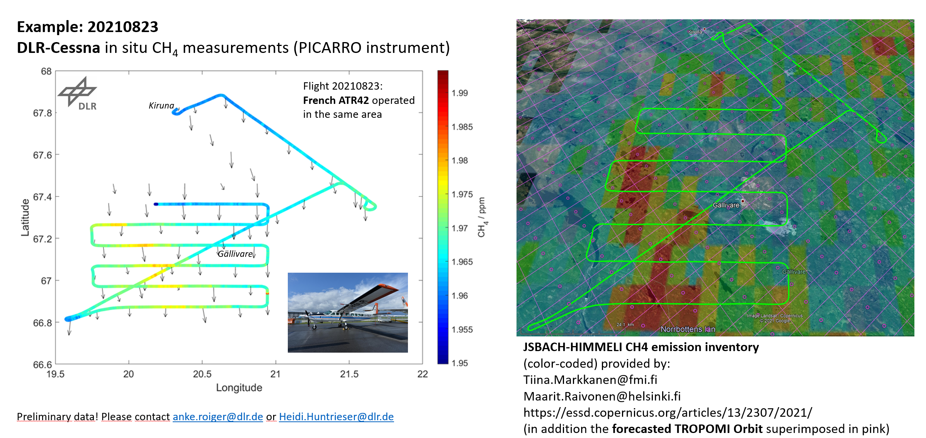
MAGIC4AMPAC: Arctic Methane sensing campaign 2021
First MAGIC4AMPAC results:
Successful airborne measurements of CH₄ from Arctic wetlands in Scandinavia
First intercomparisons with the Finnish JSBACH CH₄-emission inventory are promising
Methane validation flights with TROPOMI were planned and successfully performed
First Methane quicklooks from HyTES! Please contact simon.j.hook@jpl.nasa.gov
In-situ methane measurements boundary layer vs model – DLR Cessna 208
Notes:
JSBACH Model (DE – MPI Jena). TropOmi has trouble with the same scene (biased in early Autumn)

Slide 14
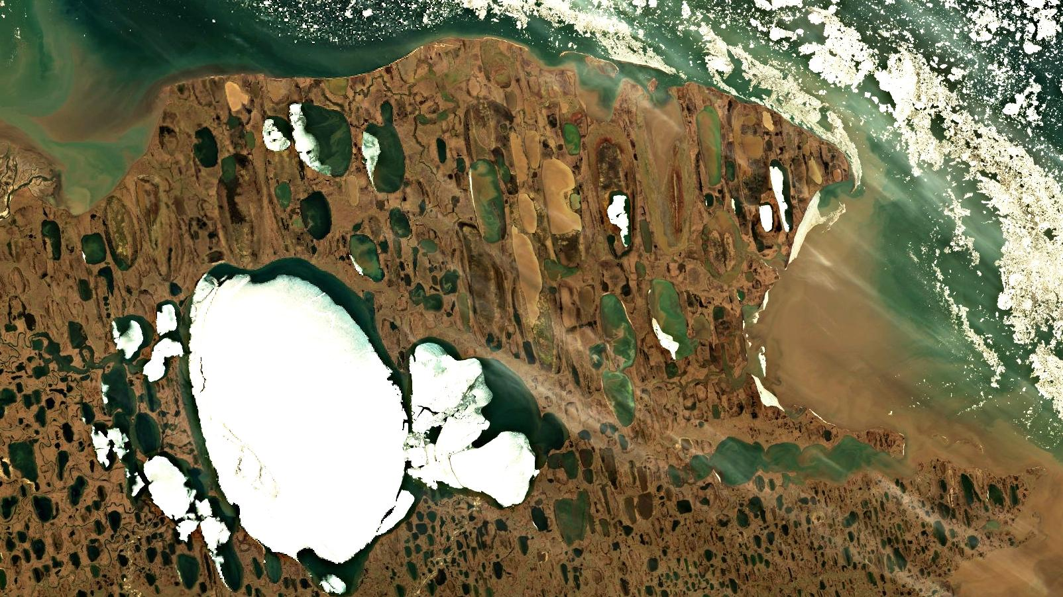
Training course on Arctic Methane and Permafrost 2022

Slide 15
GST Actions - update
Recommendation 5: The AFOLU Roadmap Team and WGClimate GHG Task Team should work together to ensure consistency between data for emissions reported via AFOLU and for prior biogenic terrestrial emissions, and those due to changing land use, in implementing monitoring and verification systems.
Joint AFOLU – GHG Workshop held at JRC/virtual in Nov 2021 (Item 3.5)
Outcomes inform WG Climate discussion on GHG TF Annex C requirements
Continued cooperation between groups including on development of Systematic Observations paper for UNFCCC

Slide 16
GST Actions - update
Recommendation 6: It is recommended that to help in ensuring the take-up of satellite-based methods for AFOLU (and indeed in the context of MVS) CEOS should work with a few selected demonstrator countries to assist them in their national reporting under AFOLU (the model of GFOI can be compared).
Silvacarbon has led action in this area (see Item 3.4)
Recommendation 7: CEOS should work with various partners set out above to identify data requirements and actions for CEOS in relation to adaptation.
Ongoing work in e,g, WG Disasters, LSI-VC, SDGs etc.
WG Climate Use Cases for climate services provide examples of adaptation
Collaboration on adaptation with GEO through its Climate Change Working Group sub-group on Adaptation (See Item 3.11)
3.4)

Slide 17
GST Actions - update
Recommendation 8: CEOS should maintain a watch over the implementation of projects funded through climate fund mechanisms to ensure that all appropriate assistance is given by agencies in their implementation and governance.
Joint work on climate finance with GEO proposed at GEO-CEOS annual briefing,
Recommendation 9: CEOS must continue all efforts to provide the necessary baseline
climate data records which support the long term modelling of the Earth system, its response to changing GHG emissions and other drivers, and impacts of climate change.
Supported through WGClimate gap analysis
Cooperation with GCOS on GCOS IP 2022 satellite elements Item 3.2
Further discussion with GCOS and WMO through WMO GHG Workshops (May 2022, Jan 2023) and GCOS Science Conference (Oct 2022).

Slide 18
WGClimate Report on SBSTA, COP, & Recent Activities
15 Mins
Albrecht von Bargen, DLR
Jeff Privette, NOAA
Agenda item 3.2
SIT TW 2022, ESA/ESRIN
14th - 15th September 2022

Slide 19
General activity overview
ECV Inventory permanently populated and verified. Version 4.0 (06/07 2021) will have ~1,600 climate data record entries
Gap analysis
Action plan
Request to agencies: Please populate ECV inventory continuously!
Unambiguous entry point to UNFCCC
Coordinating SBSTA statements and CEOS contributions to SBSTA/RSO Earth Information Day
Maintain Earth observation role to Global Stocktake
Prep for COP-27 / SBSTA-57
GHG Task Team see agenda topic 2.3
Guided by AC/VC white paper & roadmap
Members from CGMS major WGs & In-situ community
AFOLU roadmap presentation during WGClimate meetings
Use Cases for CDRs based on ECV inventory
Demonstrates their value in climate applications and services
Request to agencies: Please reach out for Use Cases and advertise in your user communities, commercial or institutional!
Benefit: Web appearance and WMO-sponsored publication
“Space element” in GCOS: support implementation plan
GCOS requirements: Regular dialogue with and support to GCOS
Advocating space observations in GEO Climate Change Working Group
See also under http://climatemonitoring.info

Slide 20
Recent activities / Vice-chair nomination
Extra meeting of WGClimate on May 19th, 2022
Only topic: nomination of vice-chair candidate
Dr. Wenying Su (NASA/Langley) had been nominated in full consent
Approval of CGMS during CGMS-50
To be approved during CEOS plenary 2022
Vice-chair term begins with the end of CEOS plenary 2022
Chair term begins with the end of CEOS plenary 2024 (end in 2026)

Slide 21
Gap analysis workshop (I)
ECV inventory consolidated to version 4.1
Gap analysis workshop organized with focus on ECVs driving the Earth’s climate Carbon cycle
Workshop in hybrid format with excellent expert attendance
Some of the ECVs had been target of the gap analysis two years before
ECVs in focus: GHGs, Anthropogenic GHG fluxes, Above Ground Biomass, Land cover, Leaf Area Index, FAPAR, Fire, Permafrost, Ocean colour

Slide 22
Gap analysis workshop (II)
Guiding questions for the workshop
GCOS ECV definition adequacy
ECV coverage in ECV Inventory (existing/planned) identifying gaps in the inventory
Situation of the space segment for the ECV products
Situation of the ground segment for the ECV products
Situation of the science to exploit the measurements
Everything that is important in addition
Recommendations if needed
A brief report with findings related to GCOS IP draft had been submitted to GCOS secretariat Mid-June 2022
Report of gap analysis containing the report of gap analysis carried out in 2019 / 2020 is under draft
Feedback to GST strategy action #1 (and in parts to action #2)

Slide 23
Use cases
Collecting use cases for climate data records
Use case gathering tool at the climatemonitoring.info webpage
Strict review process
Led by NASA (W. Su) and WMO (Z. Andreeva); NOAA/NCEI supports with tremendous effort the publication
More than 20 use cases reviewed, continuous publication process
Started to discuss the link of the activity with similar activities @ ESA/CCI and @ ECMWF
Activity becomes now a routine activity of WGClimate

Slide 24
COP-27 / SBSTA-57 / EID
COP-27 side events agenda now available under https://seors.unfccc.int
Outline of Earth Information Day (EID) is grouped around the climate cycles and the Ocean decade starting with an extra presentation of the new GCOS implementation plan (EID planned for 9-Nov-2022)
Need to be present in person @ COP when present or display a poster!
Small-scale meetings for preparation with UNFCCC
SBSTA-57 statement had been drafted and sent to CEOS-SEC and CGMS-SEC for commenting (only small updates)

Slide 25
COP-27 / others in general
Currently, all entities are in the planning and organization phase
It is expected that we will have in both zones contributions addressing also the different pledges
Note: Parties usually consolidate their input to COP or SBSTA in September and do consolidate their booth program during October time frame.

Slide 26
Decision items for plenary
Approval of incoming vice-chair Dr. Wenying Su, NASA/Langley (Vice-chair term starts with the end of the CEOS plenary 2022 chair term will start with end of the CEOS plenary 2024 chair term ends with the end of CEOS plenary 2026)

Slide 27
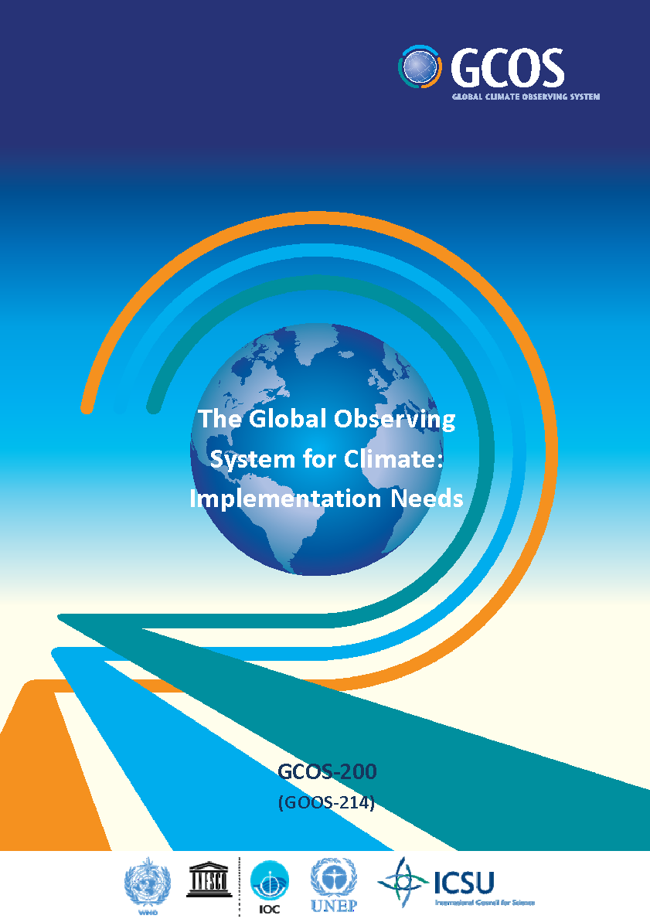
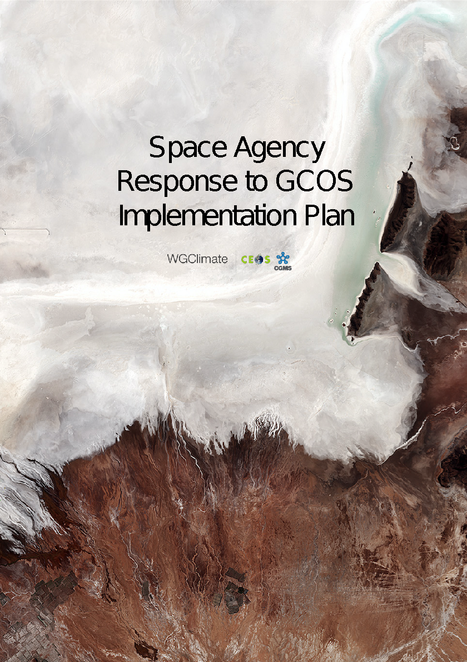
Addressing Observational Needs of Climate, cf. UNFCCC
COP-21 Paris Agreement: Adaptation (Article 7(c)):
Strengthening scientific knowledge on climate, including research, systematic observation of the climate system and early warning systems, in a manner that informs climate services and supports decision-making.
Reports on Progress
@ SBSTA/COP
Needs and Requirements
Coordinated Response

Slide 28
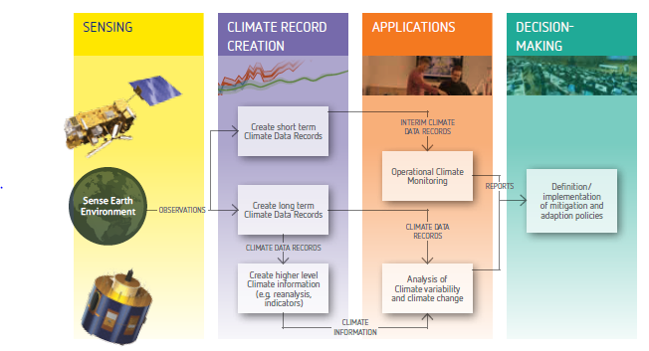
The Architecture for Climate Monitoring from Space
Related WGClimate activity
ECV inventory
Use Cases

Slide 29
Update on Use Cases (Objectives)
Demonstrate the value of climate data records for decision/policy making, e.g., usage of satellite data in a use case with UNFCCC Parties to support the Global Stocktakes (GHG use case)
Understand the application needs to provide feedbacks towards quality improvements for the ECV requirements defined by GCOS
Validate the top-down architecture for climate monitoring from space with a down-top approach ensuring traceability from usage to space-based observing system
Optimize the use of climate data records in applications relevant for climate services and science
Support capacity building by providing/receiving use cases for/from training activities, e.g., for developing countries (link to CGMS and CEOS capacity building activities)

Slide 30
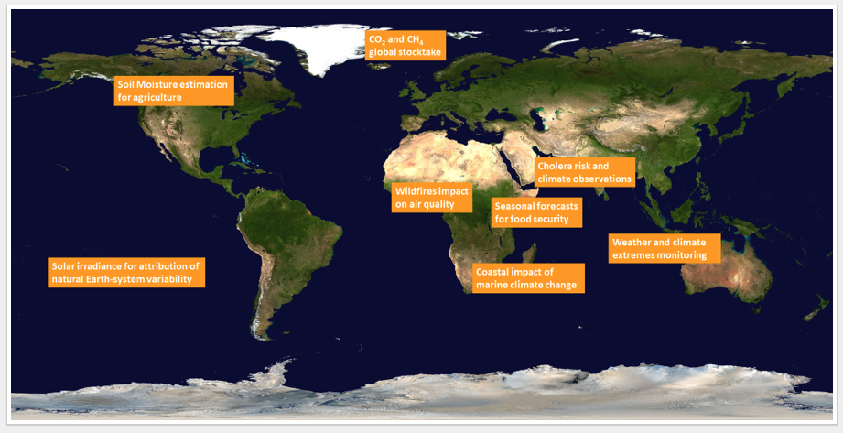
Update on Use Cases (Status)
20 cases received
8 use cases published
1 declined
All others in preparation
Another use cases announced
Link to other sources initiated (C3S, CCI)

Slide 31
WGClimate and GCOS
WGClimate represents the “space component” of/to GCOS
GCOS Status Report published in 2021
Update of GCOS Implementation Plan in 2022
Changes in structure of ECVs expected
Continuous discussion with GCOS: agenda topic of WGClimate
Informal pre-review (Mid-April) by WGClimate
Public review planned for May 2022 (?)
Publication at 2nd Climate Observation Conference co-hosted by GCOS and EUMETSAT (17-19 Oct 2022, Darmstadt)
Presentation of GCOS IP during COP-27
2023/4: Preparation of CEOS Response to GCOS IP

Slide 32
COP-26 contributions from CEOS/CGMS and agencies
UNFCCC / Earth Information Day
Presentation by WGClimate
In addition, presentation of Synthesis Report of Systematic Observations (see agenda topic 2.7)
7 poster contributions by WGClimate and individual agencies
UNFCCC / Structured Expert Dialogue: 1 poster
WMO booth: presentation & discussion with high virtual attendance
UK / Earth Information Day
Further agency events (ESA, JAXA, NASA,….)

Slide 33
COP-26 Pledges
Global Methane Pledge US-EU led initiative, emission reduction of 30% by 2030 compared to 2020; > 100 countries joined
Race to Zero campaign: Commitment to halve emissions by 2030 with aim of a zero carbon world
Forests: Declaration on forests and land use aiming to halt and reverse forest loss and land degradation by 2030; > 140 countries joined
Finance: significant pledges, e.g. to the adaptation fund ($ 356 million); global forest finance pledge: 12 countries / $ 12 billion for 2021-2025
Race to resilience campaign: a metrics framework to verify the climate resilience impact
Glasgow breakthrough agenda: Countries to work on clean technologies & sustainable solutions

Slide 34
UNOOSA / UKSA survey
UNOOSA / UKSA aims to collect information about space & climate
Motivation twofold
It is quite difficult for “newcomers” to have get an overview
UNOOSA wants to sharpen its Space4Climate programme
WGClimate will complete the form with emphasizing its specific role

Slide 35
Conclusion
Awareness to IPCC, UNFCCC & COP needs led to rapid changes in requirements, also valid for GCOS and space observations
Note GCOS-143 (requirements definition) are in some part dated
Hence, the “working environment” of WGClimate is currently under evolution (ECV inventory, GCOS requirements & response)
Use cases establish a link to stakeholder / user community
The COP-26 pledges opens a variety of opportunities for CEOS to provide its capabilities

Slide 36
COP-27 Prep
15 Mins
Agenda item 3.2
SIT TW 2022, ESA/ESRIN
14th - 15th September 2022

Slide 37
EO Event at Canada's COP-27 Pavilion
Marie-Josée Bourassa, CSA
Agenda item 3.2
SIT TW 2022, ESA/ESRIN
14th - 15th September 2022

Slide 38
EO Event at Canada’s COP27 Pavilion
Global Transparency to Move the Global Methane Pledge to Action
Decarbonization Day – November 11
The panel will discuss
the increasingly important role of global transparency in achieving methane emissions reduction;
the Global Methane Pledge that was widely adopted at COP26, and the successes and failures of turning that pledge into action;
how EO satellites are at the heart of global transparency as they deliver specific, actionable insight on the locations of large industrial emissions; and,
the policy and action governments can take now based on this technology-enabled global transparency.
The event targets government leaders determining NDCs and delivering emissions reduction policies. They should walk away from the panel with ideas for how they act now on their methane pledge.
Panelists
Jonathan Wilkinson, Minister of Natural Resources (TBC)
Claire Perry O'Neill - Claire ON Ltd
Catherine McKenna - Climate and Nature Solutions
Manfredi Caltagirone – Head of IMEO, UNEP/IMEO
Marcelo Mena-Carrasco - The Global Methane Hub
Stephane Germain – GHGSat
The panel will be followed by a reception

Slide 39
GHG Roadmap Update
15 Mins
Mark Dowell & John Worden GHG Task team
Agenda item 3.3
SIT TW 2022, ESA/ESRIN
14th - 15th September 2022

Slide 40
Greenhouse Gas Inventories for the
UNFCCC Global Stocktake
Presenter Guidelines 1
To support the 2023 Global Stocktake (GST), Parties to the Paris Agreement are compiling inventories of greenhouse gas (GHG) emissions and removals to assess progress toward their Nationally Determined Contributions (NDCs) to emission reductions.
These inventories are based on bottom-up methods that estimate annual emissions and removals of GHGs from the sectors specified in the 2006 IPCC Guidelines for National Greenhouse Gas Inventories
CEOS has facilitated and proposed for endorsement contributions to the global stocktake for CO₂ and CH₄ emissions based on satellite observations of total column CO₂ and CH₄.
The top-down atmospheric inventories derived from these fluxes
are not as process-specific as bottom-up inventories,
complement those methods by providing a transparent, integrated constraint on fluxes from all processes on spatial scales spanning large power plants or urban areas to nations or the entire globe.
Slide ‹#›

Slide 41
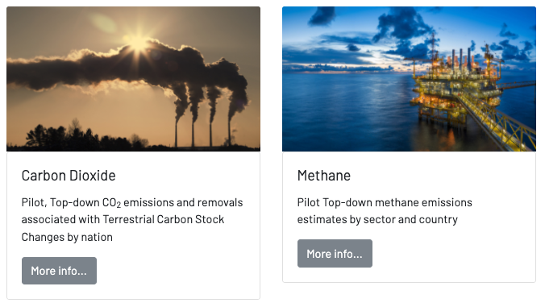
Input to COP-26
https://ceos.org/gst/ghg.html

Slide 42
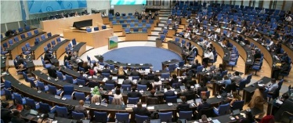
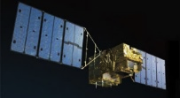
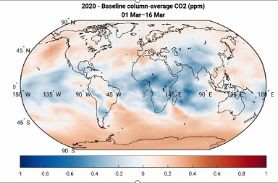
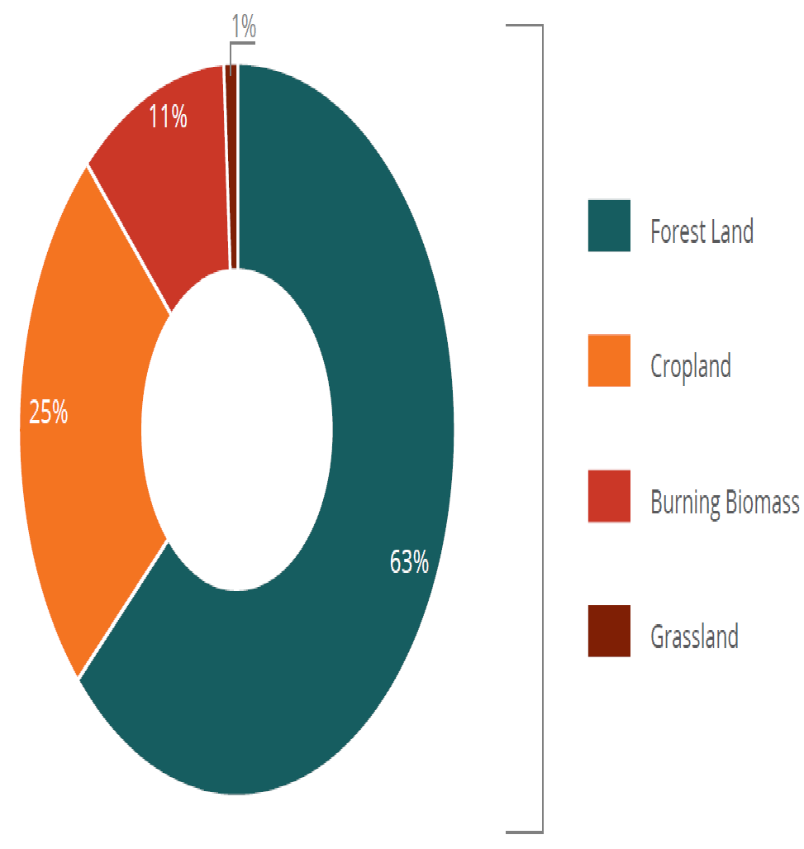
CEOS facilitated and endorsed contributions to stocktake for CO₂ and CH₄ based on satellite total column data sets
Presenter Guidelines 1
These pilot top-down GHG products are intended to start a conversation with stakeholders and users to establish the utility and best practices for combining bottom-up and top-down products to enable a more complete Global Stocktake (Available at https://ceos.org/gst/ghg.html)
Fuel Combustion
Fugitive Emissions
CO₂ Transport & Storage
Energy
Mineral
Chemical
Metal
Non-Energy fuel/solvent
Electronics
Other Products
Global Stocktake
Industry
National GHG Inventory
Livestock
Land
Aggregate
Other
Nationally Determined Contributions
Transparency Framework
(Biennial Reports)
AFOLU
Solid
Biological
Wastewater
Other
Forest
Waste
Crop
National Implementation
Burning
Slide ‹#›
Grassland

Slide 43
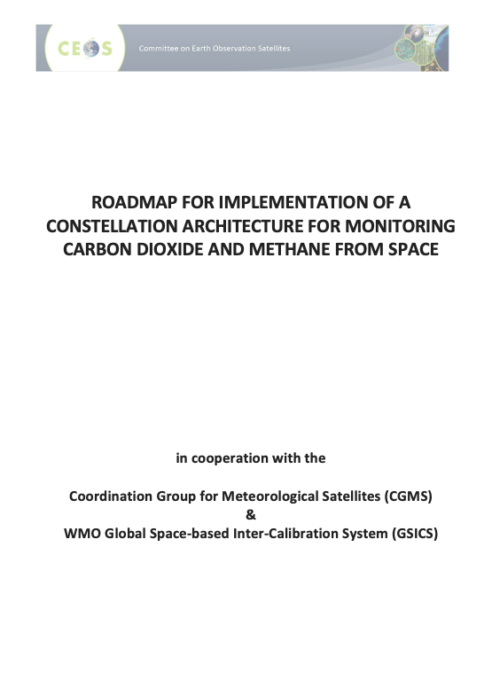
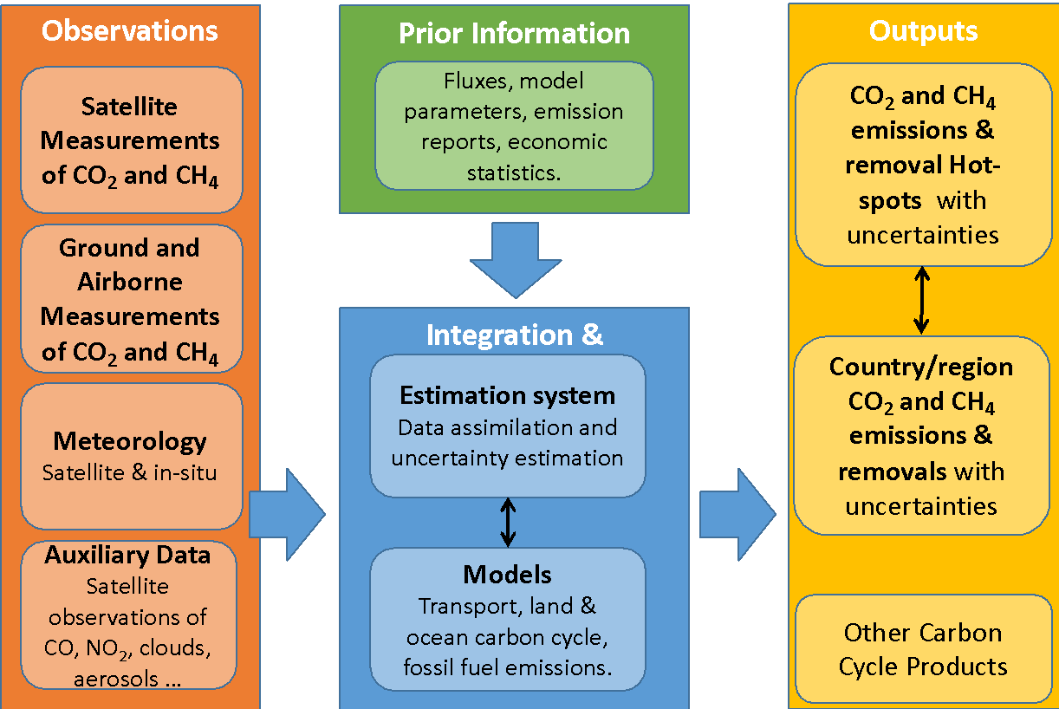
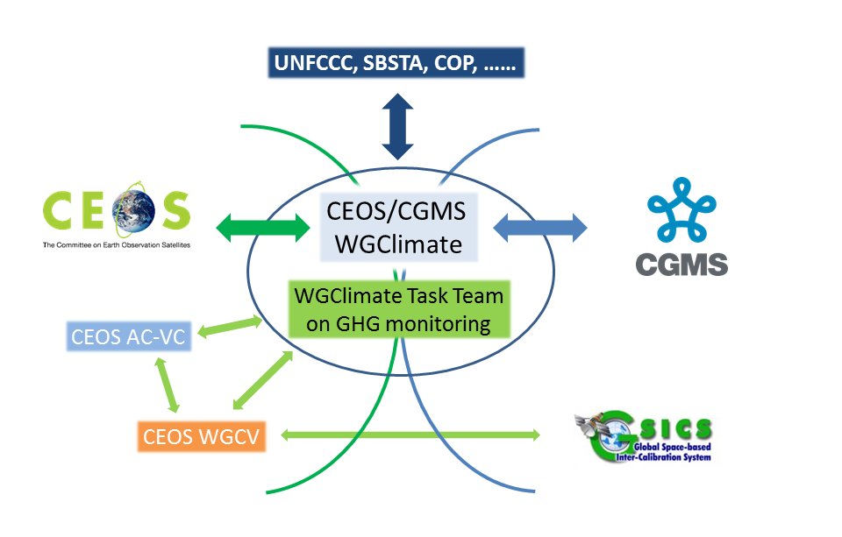
Looking Forward 2nd GST & beyond
Roadmap
System
Stakeholders
NB: Leadership transition in prorgress
space agency engagement in proposed WMO framework

Slide 44
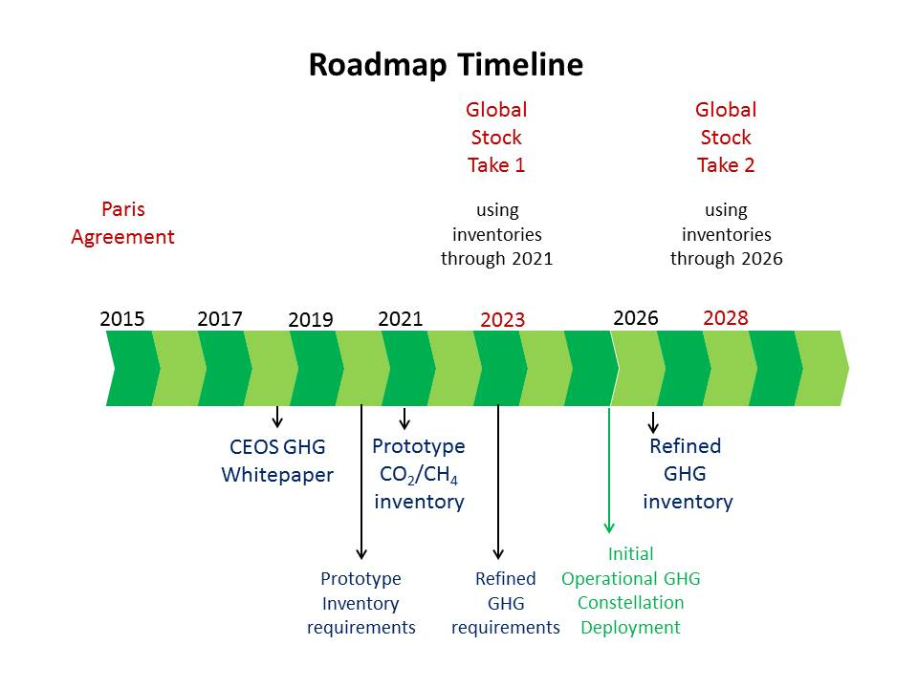
Looking Forward 2nd GST & beyond
Critical actions in transition to operations:
space segment towards WIGOS vision,
standards for operational products,
opertional QC and Cal/Val framework.
identify continuity issues and make proposals for contingency planning
training and end user support,

Slide 45
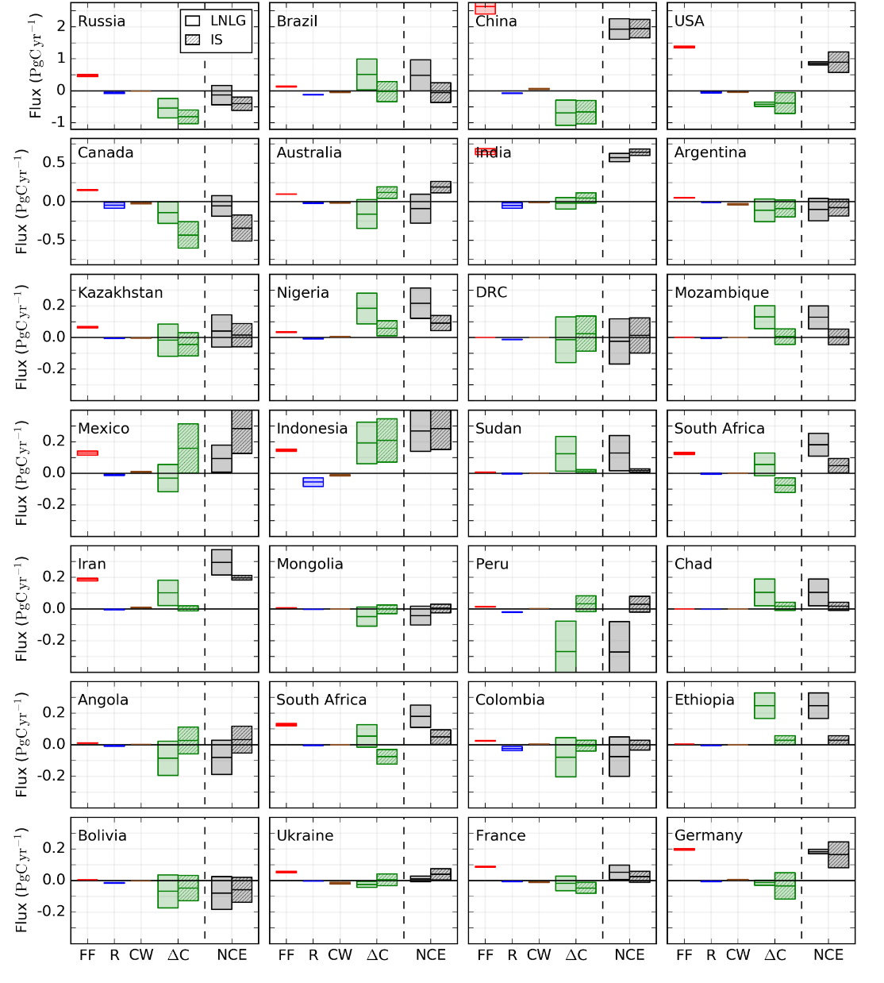
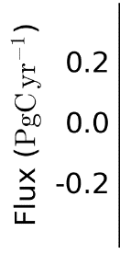
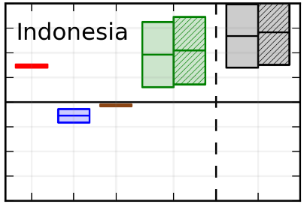
Carbon Stock Changes from CO₂ Emissions/Removals by Sector/Country - Byrne et al. ESSD 2022
Presenter Guidelines 1
In situ (IS) and OCO-2 (LNLG) CO₂ data inform the Net Carbon Exchange (NCE) between surface and atmosphere.
NCE can be further subdivided into fossil fuel emissions (FF), lateral carbon fluxes due to rivers, crop, and wood, and changes in land carbon (ΔC):
NCE = FF + River_{lateral} + Crop+Wood_{lateral} +ΔC
ΔC can be compared with bottom-up estimates of carbon stock changes
2015-2018 median ± standard deviation of fossil fuel (FF), River_{lateral}, Crop_{lateral}+Wood_{lateral} , ΔC, and NCE for 28 countries for inversions using in situ (IS) or OCO-2 Land Nadir and Land Glint (LNLG) data.
Rivers
ΔC
NCE
LNLG | IS
LNLG | IS
Fossil Fuels
Crop+Wood
Plots by Brendan Byrne (NASA/JPL) and the OCO-2 Flux MIP

Slide 46
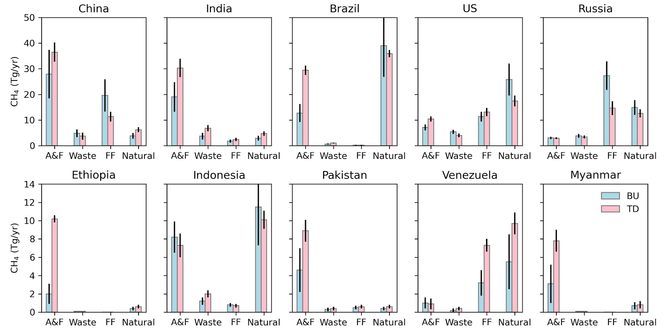
CH₄ Emissions by Sector and Country
Worden et al. ACP 2022
Presenter Guidelines 1
Satellite based top-down observations plus prior information can resolve CH₄ emissions by sector and Country: Can resolve total emissions for about 58 countries
Top 5 emitting countries emit about half of all anthropogenic CH₄ emissions (consistent with inventory data)
Most emissions are from the agricultural sector, primarily livestock

Slide 47
Next Steps
Presenter Guidelines 1
Support efforts to integrate CO₂ and CH₄ based inventories using fluxes from total column data and fossil emissions from high-resolution plume mappers (e.g. GHGSAT and Carbon mapper, Methane-Sat)
EM-27’s uplooking spectrometers are about as accurate as a TCCON site but much cheaper. To what extent can these be used to characterize and adjust XCO2 and XCH4 biases in challenging areas?
Support nascent efforts to develop greenhouse gas information systems (e.g. COCO2, IMEO, NASA)
Intercomparison between CEOS AFOLU estimates and top-down forestry net carbon exchange using atmospheric GHG measurements
Host a workshop on evaluating and attributing uncertainties in top-down CO₂ and CH₄ emissions.
Work with Working Group on Climate to define GHG essential climate variables based on May 2022 gap workshop

Slide 48
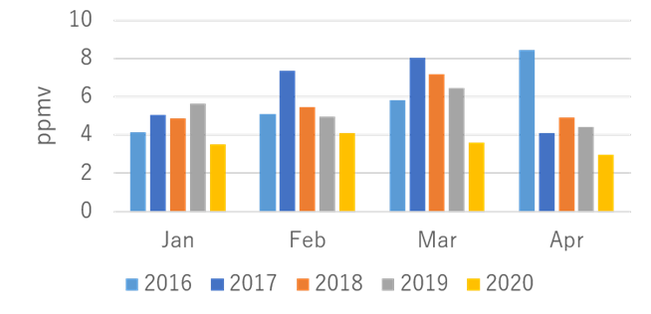
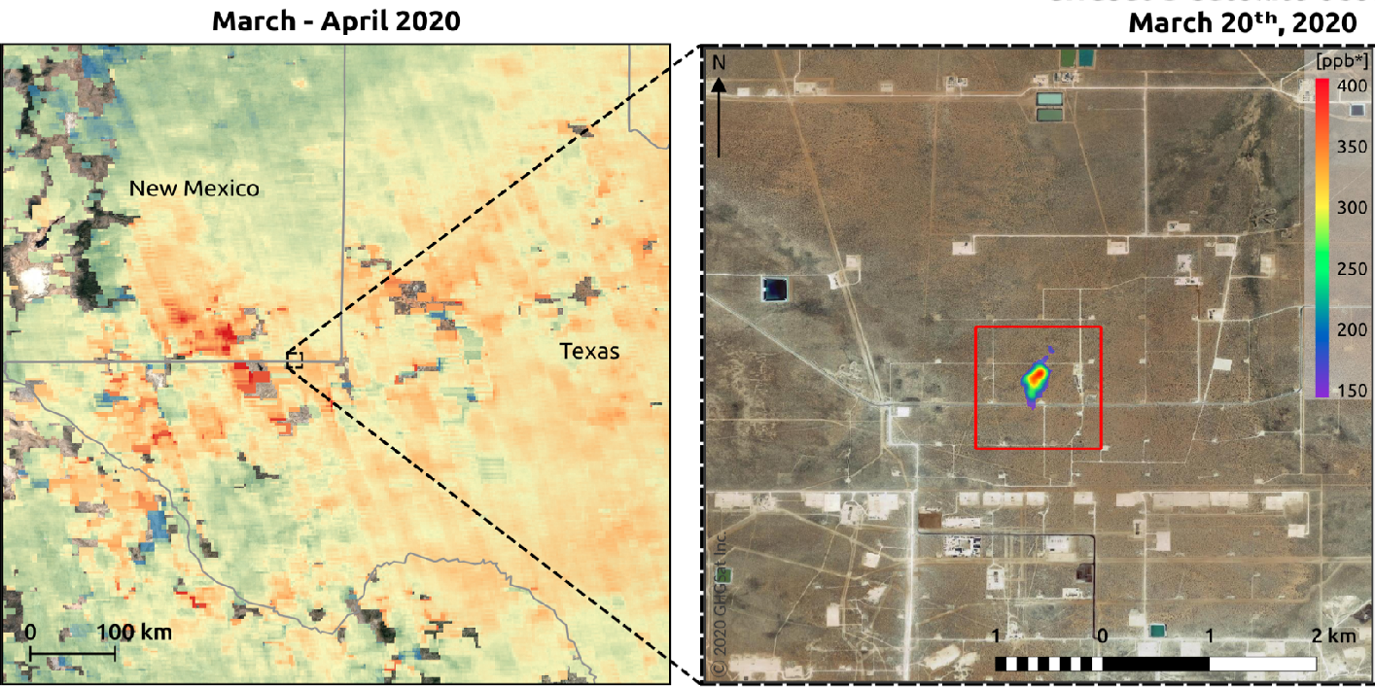
Tracking Emissions from Localized
Hot Spots
Presenter Guidelines 2
GOSAT observes CO₂ over Tokyo
Analyzed by JAXA/EORC
Pilot products are also being developed to track emissions from localized sources including large urban areas, power plants and oil fields
GOSAT team accelerated the development of an upper/lower tropospheric product to track effects of COVID-19 lockdowns on emissions from large urban areas
OCO-2 and TROPOMI teams are tracking CO₂ emissions from individual powerplants and large urban areas
TROPOMI team is tracking methane emissions from fossil fuel extraction, and collaborating with the GHGSat team to locate intense plumes
OCO-2 XCO₂ and TROPOMI NO₂ combined to quantify CO₂ emission by large South African power Plants
Reuter et al., ACP 2020
TROPOMI and GHGSat observe CH₄ emissions over Texas oil fields
Zehner et al. (IWGGMS-16, 2020)

Slide 49
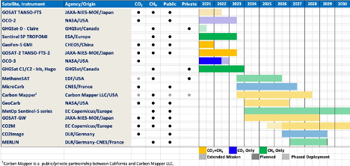
Growing fleet of GHG Satellite

Slide 50
Summary
Additional contributions to GST1 – Technical Assessment
Start Addressing Roadmap Actions looking forward towards GST2 and beyond
Update roadmap and address additional Actions that have emerged in recent years, low latency product demand, commercial sector data and products, standards, new cal/val opportunities
Engage in new WMO international GHG monitoring framework
GHG TT leadership transition foreseen in next months

Slide 51
AFOLU Roadmap Update
20 Mins
AFOLU Roadmap Co-Leads LSI-VC Forests & Biomass Team Agenda item 3.4
SIT TW 2022, ESA/ESRIN
14th - 15th September 2022

Slide 52
Heritage
2020 CEOS Plenary agreed to a CEOS AFOLU Roadmap, as an initiative in support of the UNFCCC Global Stocktake Process
Discussion Paper prepared by LSI-VC Forest & Biomass Team
Recognising need for an AFOLU equivalent to the CEOS GHG Roadmap (with CGMS)
“...if Land Use, Land Use Change and Forestry targets involved in the initial NDCs were implemented in full, this would represent approximately a quarter of pledged mitigation efforts up to 2030“
2021 / 2022 accomplishments
Assessment of latest AFOLU products that could be readied for COP-26
Biomass Harmonisation Exercise on ESA/NASA MAAP
Coordination with SIT Chair Team and GHG Team on the new CEOS GST Portal – as a unified point of entry to explain and offer our data
New engagement axis with national inventory users, building on our GFOI experience and in the spirit of the ambition cycle of the Paris Agreement to learn together and grow together
Significant input to the synthesis report on “The Role of Systematic Earth Observations in the Global Stocktake” for UNFCCC

Slide 53
CEOS AFOLU Roadmap
Focus in 2022 & 2023 is the development of a CEOS AFOLU Roadmap document
Objectives:
Provide a framework for long-term (~ 15+ years) coordination of CEOS agency observing programmes in support of the needs of society for AFOLU-related information, with a focus on the needs and ambition cycle of the Global Stocktake of the Paris Climate Agreement.
A guiding vision for long term space agency coordination around AFOLU. Characterises the needs, the services and applications required, the products and observing systems that can support. Explain the need to plan for ground segment, space segment and services.
An effective means for communicating our intentions to society, UNFCCC, national inventory community etc
Addresses basic observation continuity and the necessary agency coordination to achieve it

Slide 54
CEOS AFOLU Roadmap
Expected contents:
Define the 2035 observing system required to address the AFOLU information needs of society
Consider the technologies and systems needed to realise this observing system
Identify the stakeholders required at different stages of the value chain to ensure it can be sustained in the long-term (i.e. users- service providers, - data product producers-observation providers)
The technology development programmes and investments needed by space agencies to achieve them
The programmatic commitments that will be needed to get there
Addressing three different dimensions:
Global assessments and syntheses
National climate policy and actions
GHG inventories

Slide 55
AFOLU Roadmap scope and objectives
Provide a framework for long-term (~ 15+ years) coordination of CEOS agency observing programmes in support of the needs of society for AFOLU-related information, with a focus on the needs and ambition cycle of the Global Stocktake of the Paris Agreement. A guiding vision for long term space agency coordination around AFOLU. Characterises the needs, the services and applications required, the products and observing systems that can support. Explain the need to plan for ground segment, space segment and services.
An effective means for communicating our intentions to society, UNFCCC, national inventory community etc
Addresses basic observation continuity and the necessary agency coordination to achieve it
Identifies questions to be answered in circa 2035 and reverse engineers the value chain necessary for required observations.
Provides guidance to Agencies as to the technologies and capabilities that will be needed in 15 years time to ensure policy relevance of public EO
Strategic and authoritative - but not exhaustive. Identify issues like the continuity outlook, known technology trends and what these will provide, and offer expert assessment for each thematic area as to the adequacy of the CEOS plans and what further should be encouraged.
National inventory user community a key readership but also need to cover global assessments

Slide 56
CEOS-TOPC AFOLU Workshop (12 Sep, ESRIN)
Brought together the AFOLU Roadmap Team and the Terrestrial Observation Panel for Climate (TOPC) of GCOS.
Objectives:
make a start on defining how society’s needs for information related to AFOLU and its reporting can be expected to evolve in the coming years
consider the policy needs and assumed AFOLU information needs in the 2035 timeframe on the assumption that this foundation can inspire and drive the generation of the CEOS AFOLU Roadmap
Structured along the lines of our AFOLU thematic expert teams:
Forests & Biomass, Agriculture, OLU (mangroves, wetlands..)
And the dimensions of: global assessments and syntheses; national climate policy and actions; GHG inventories
Rebooting the Roadmap progress. Virtual environment has slowed the collaboration

Slide 57
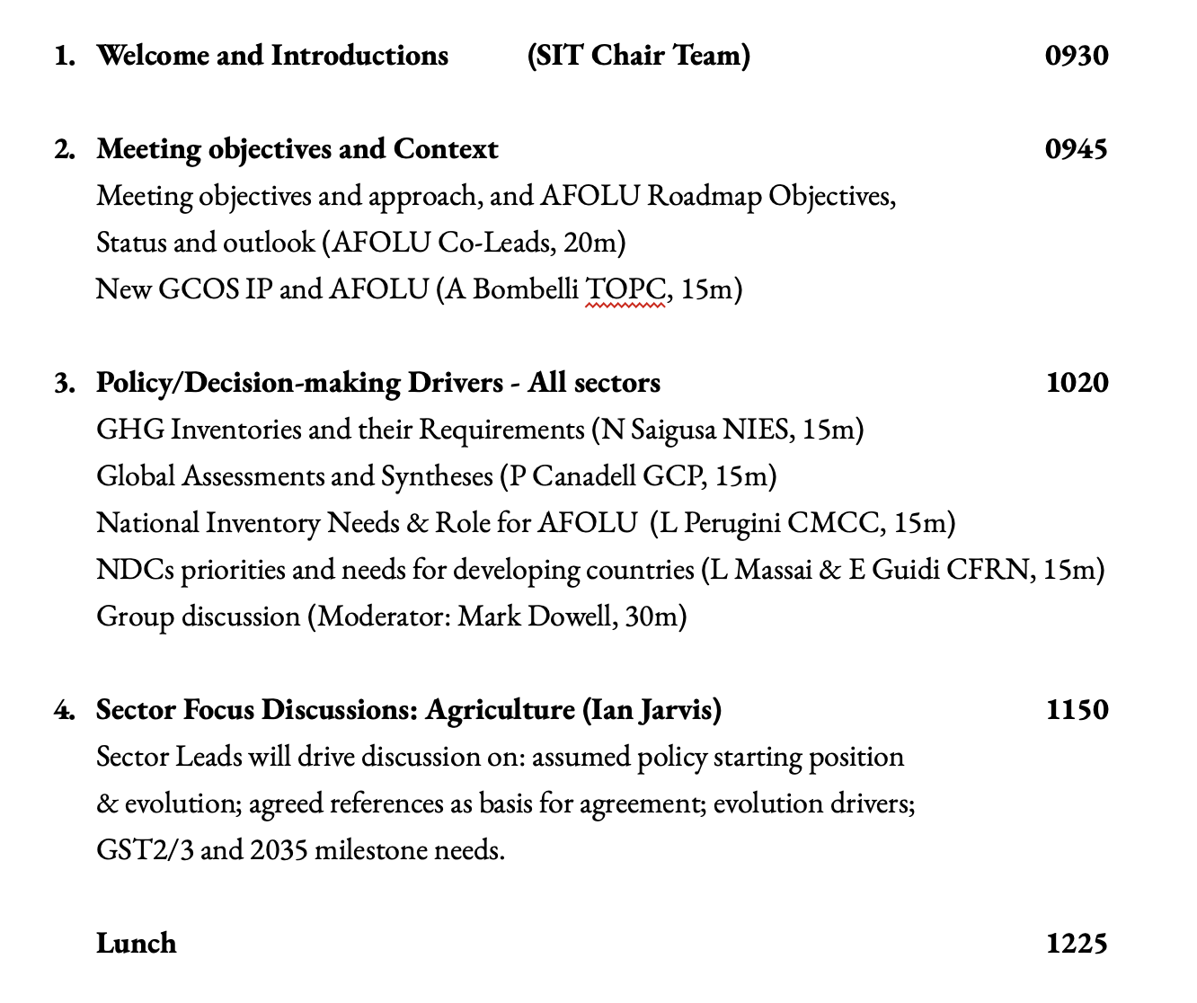
Agenda

Slide 58
Workshop outcomes
Affirmed that an AFOLU Roadmap is a generational challenge that CEOS and public EO programmes must rise to!
Provide a framework for long-term (~ 15+ years) coordination of CEOS agency observing programmes in support of the needs of society for AFOLU-related information, with a focus on (but not limited to) the needs and ambition cycle of the Global Stocktake of the Paris Agreement.
A guiding vision for long term space agency coordination around AFOLU. Characterises the needs, the services and applications required, the products and observing systems that can support. Explain the need to plan for ground segment, space segment and services.
Confirmed horizon of 2035 and interim milestones of GST1, GST2 and GST3.
Seeking to re-engage the key agencies and individuals using increased intensity process and individual assignments - ideally under a lead author.

Slide 59
Workshop outcomes
Thematic teams are already doing important relevant work (eg GEOGLAM for Ag) that we must harness for efficiency
End 2023 (GST1) is assumed to be the latest sensible delivery for the Roadmap
Primarily an internal document but also communicates our intent for public EO to serve society and these policy processes
A step up in capacity needed to realise the ambition now. We welcome support from:
NASA
USGS
EC/JRC
ESA
JAXA
GEOGLAM team, GFOI team, SilvaCarbon, LPV - Biomass, LSI-VC
and more …

Slide 60
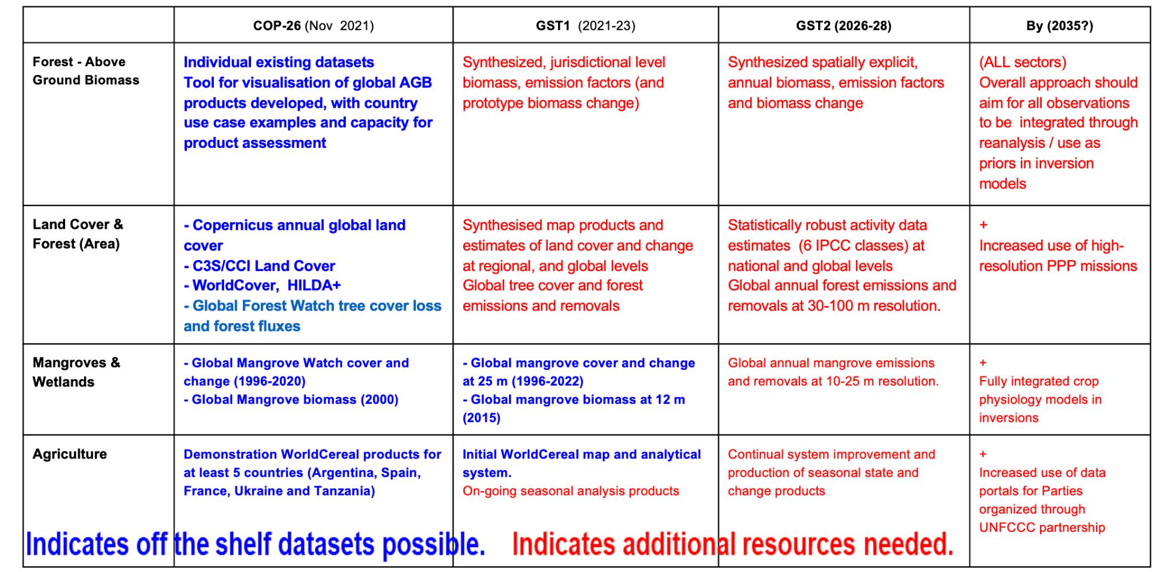
CEOS AFOLU Data Strategy (TBC!)

Slide 61
Next Steps
Reworked report skeleton and writing assignments with annotated guidance, around a structure of:
A projection of policy needs through 2035
A projection of EO capabilities in this timeframe
An adequacy assessment and implications for evolution
A framework for CEOS agency actions
Ideally identify a lead author to streamline management
And work through section assignments and their confirmation
Report to Biarritz Plenary on any capacity gaps and request Principals to address them
Agencies with active interest in land surface observations strongly encouraged to sponsor participation of suitable experts in support of the Roadmap development

Slide 62
JRC GHG AFOLU Workshop Report
15 Mins
Mark Dowell, JRC
Agenda item 3.5
SIT TW 2022, ESA/ESRIN
14th - 15th September 2022

Slide 63
GHG-AFOLU Workshop Context
GHG Constellation paper & EC CEOS Chair 2018
Developments in Copernicus (+ research projects CHE, VERIFY, CoCO2, REDDCopernicus)
CEOS GHG roadmap development & initial efforts on AFOLU Roadmap
GST Strategy
Systematic Observation Adhoc group on support to GST
GEO new CC WG (Mitigation SG)

Slide 64
GHG-AFOLU Workshop
Workshop on Systematic Observation contributions and synergies for GHG & AFOLU in support of UNFCCC
Started dialogue between the different Earth Observation communities addressing the needs of UNFCCC
In particular, atmospheric GHG monitoring and those addressing aspects of the AFOLU sector
15th, 18th,19th November 2021 CET pms
Involved many relevant International coordination mechanisms
Addressed the "soft" coordination and stakeholder engagement aspects i.e. interface with the Convention, the UNFCCC Secretariat and Party user groups, but also more technical aspects of reporting, outputs datasets, formats, avoiding "double - accounting" and the longer-term ambition of using diverse earth observation datasets in the modelling and MVSs being developed
Topic => Questions => Discussion => Recommendations (report)

Slide 65
Evolving policy needs
A global (data assimilation) system supporting monitoring and verification Paris Agreement should be able to rely on earth observation data for a comprehensive picture for the decades to come.
Assuming that the proposed legislative efforts are implemented as planned such an integrated observation and modelling capacity should be able to discern fossil GHG emission plumes reduce (and disappear) over the next 15-30 years
But also monitor the remaining emissions, in a regime where unavoidable sources (e.g. from agriculture) are compensated by critical carbon sinks of the global biosphere.
Thus, it is fundamentally important to address both GHG and AFOLU and their synergistic and integrated use in this MVS capacity (also implications for satellite constellation planning and development)

Slide 67
Policy Need and Overall comments
So far a lot of focus on “F” in AFOLU, more effort/development on A & OLU. Agriculture: managed/unmanaged,
EAV developments and implementation could be useful, World Cereal needs to be transitioned to operations. A consistent Landcover Framework bringing together different land characteristics
We should think of how product/services requirements will change (over next 20 yrs) if emission reduction policies are successful. Spatialised inventories.
Translate Guiding Questions
The guiding questions for the GST on mitigation are:
1. What is the collective progress in terms of the current implementation of, and ambition in, mitigation actions towards achieving the goals defined in Articles 2.1(a)1 and 4.12 of the Paris Agreement?
2. Taking into account nationally determined contributions, long-term low GHG emission development strategies and relevant commitments and initiatives, what are the projected global GHG emissions, and the emission reductions still needed, in 2030 and 2050 in order to achieve the goals defined in Articles 2.1(a) and 4.1 of the Paris Agreement?
3. What efforts are being undertaken to plan, implement and accelerate mitigation action towards achieving the goals defined in Articles 2.1(a) and 4.1 of the Paris Agreement?
4. How adequate and effective are the current mitigation efforts and support provided for mitigation action towards achieving Articles 2.1(a) and 4.1 of the Paris Agreement?
5. In order achieve the goals defined in Articles 2.1(a) and 4.1 of the Paris Agreement:
a) What further action is required?
b) What are the barriers and challenges, and how can they be addressed at national, regional and international levels?
c) What are the opportunities, good practices, lessons learned and success stories?
The answers to these questions should be considered in the light of equity and the best available science, including the latest reports of the Intergovernmental Panel on Climate Change.”
The contributions of Parties, observer organizations and non-Party stakeholders are made available on the Global Stocktake Information Portal.

Slide 68
Select outcomes (1/2)
Data and Standards:
Consistency of products over time back to 1990 (at least)
New Products (land management disturbance)
Additional emphasis on Agriculture (incl. livestock) and OLU
Hamonisation e.g. biomass towards
Improved Emission Factors
Engaging Carbon Cycle Community
(Internal) consistency of products (GHG & AFOLU) and within AFOLU
Cooperation with DGVM community
Lateral flow issues
Model developments e.g. CO2 fertilization / photsynthesis
IMBIE type experiments (Eastern Amazonia, West Africa, and Southeast Asia…)

Slide 69
Select outcomes (2/2)
Prioritizing Research Needs:
forward-looking research towards an independent “verification” systems
EO involvement in lateral flow studies
CO2 Fertilization
Hamonisation of data records (e.g. biomass, land cover)
Addional AFOLU products e.g. Soil Carbon, Peatlands
Towards common System
Ultimate ambition should be a a fully integrated system
Need to ensure internal consistency, avoid double accounting and ensure seamless interface to user
… but need stepwise approach, near to mid-term parallel activities but with periodic joint discussions to check interfaces

Slide 70
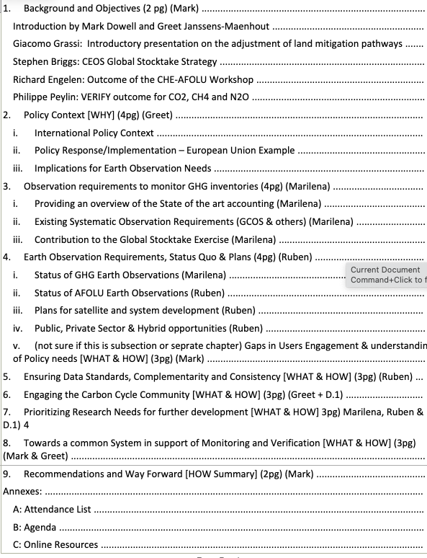
Report Outline
Around 50 pages
JRC finalising first draft
Should be sent to attendees in October

Slide 71
GCOS Implementation Plan Update
15 Mins
Anthony Rea, WMO (Webex)
Agenda item 3.6
SIT TW 2022, ESA/ESRIN
14th - 15th September 2022

Slide 72
GCOS Implementation Plan
Produced every 5-6 years, GCOS Implementation Plans:
Are submitted to UNFCCC and the GCOS sponsors.
Provide recommendations for a sustained and fit for purpose Global Climate Observing System.
Cover climate monitoring needs over the entire Earth system from the atmosphere to the oceans, from the cryosphere to the biosphere.
Encompass the water, energy and carbon cycles.
This 2022 GCOS Implementation Plan has a different form to earlier plans, it has:
Fewer, more focused, and integrated actions.
Clearer means of assessment.
Clearer identification of the stakeholders who need to respond to the actions.
The updated ECVs requirements are presented in a separate document - The 2022 GCOS ECVs Requirements (GCOS 245).

Slide 73
Producing the plan
GCOS has a cycle or monitoring the climate observing system → status reports → implementation plans
based on extensive consultation and public review
drafted by expert panels and drafting team, overseen by editorial board and GCOS Steering Committee
GCOS Status Report
2021
Consultations
GCOS expert Panels get inputs from their communities
Preparation of supplements for specific communities.
Drafting
Led by a writing team
Panels identify main actions needed in next 5-10 years
2022 GCOS Implementation Plan
2021 Status report
GCOS monitors performance of global climate observing system
2016 Implementation Plan
2015 Status Report
Publication
Published by GCOS
Submitted to Sponsors and UNFCCC
Revision
all comments addressed
final checks by panels, writing team, and GCOS Steering Committee
Review
Public review as broad as possible
Earlier Status Reports and plans

Slide 74
Wide range of views and inputs condensed into 6 themes
Ensuring Sustainability
Addressing in situ and satellite observations that are currently at risk.
Consultations with observing community
Filling Data Gaps
Observations are consistently deficient in parts of Africa, South America, Southeast Asia, the deep oceans and polar regions.
The GCOS 2021 Status Report
The UNFCCC Paris Agreement
Improving data quality, availability and utility, including reprocessing
Improvements in transforming observations into user-relevant information
Drafting by GCOS
Managing Data
Ensuring data is well-curated, discoverable, open and freely available and permanently archived
Implications of the IPCC 6th Assessment Report and Special Reports
Scientific studies of the climate cycles of carbon, water and energy
Engaging with Countries
Coordinating national efforts with global systems and support, understanding national needs.
Public Review
Other Emerging Needs
Some new needs can already be identified and adressed (e.g. for adaptation and mitigation)
Main Inputs → Broad Engagement → Themes for Action

Slide 75
Themes
A: ENSURING SUSTAINABILITY
Ensure long-term support for in situ networks
Address gaps is satellite observations likely to occur in near future – prepare follow-on plans
B: FILLING DATA GAPS
Development of reference networks: in situ and satellite
Implement GBON
Global reporting of hydrological observations,
Implement trace gas and aerosol, ocean biological, biogeochemical, CO₂ and N₂O observations
Improve estimates of latent and sensible heat fluxes and wind
Identify gaps in monitoring of climate cycles
C: IMPROVING DATA QUALITY, AVAILABILITY AND UTILITY, INCLUDING REPROCESSING
Develop standards and best practices
Improvements to satellite and in situ products
New and improved reanalysis products
D: MANAGING DATA
Define governance and requirements of data centre
Ensure in situ data centres exist for all ECV
Improve discovery and access
Data rescue
E: ENGAGING WITH COUNTRIES
Improve regional and national engagement in GCOS
Enhance support for national climate observations
F: OTHER EMERGING NEEDS
Higher resolution real time data
Improvements in urban, polar, coastal regions and EEZ
Develop operational Global GHG Monitoring System

Slide 76
Next Steps
Who has to act?
GCOS will
WMO
NMHS
Space agencies
GOOS
Reanalysis Centres
Global Data Centres
Research organizations
National Agencies
Parties to UNFCCC
Academia
Funding Agencies
GCOS
Prepare supplements for several of these groups summarising the important relevant actions.
Address actions allocated to it in Implementation Plan.
Identify additional needs arising from Paris Agreement (i.e. adaptation & mitigation).
Continue to monitor performance of global climate observing system.
Facilitate reviews of observations of climate cycles.
Review adequacy of ECV requirements.
Promote national engagement in GCOS.

Slide 77
Theme A: Ensuring Sustainability
IP Actions with relevance for Space Agencies
Action A2: Address gaps in satellite observations likely to occur in the near future
Action B3: New Earth observing satellite missions to fill gaps in the observing systems
Action B7: Augmenting ship-based hydrography and fixed-point observations with biological and biogeochemical parameters
Action A3: Prepare follow-on plans for critical satellite missions
Action B5: Implementing global hydrological networks
Action B9: Improve estimates of latent and sensible heat fluxes and wind stress
Theme B: Filling Data Gaps
Action B10: Identify gaps in the climat observing system to monitor the global energy, water and carbon cycles
Action B1: Development of reference networks (in situ and satellite Fiducial Reference Measurement (FRM) programs)
Action B6: Expand and build a fully integrated global ocean observing system
Action B10: Identify gaps in the climate observing system to monitor the global energy, water and carbon cycles
Notes:
Space agencies are involved in actions for most of the themes (except in Country engagement, theme E). In several cases, they are the only implementers (e.g. A2, A3. B3…)

Slide 78
Theme D: Managing Data
IP Actions with relevance for Space Agencies
Action C1: Develop monitoring standards, guidance and best practices for each ECV
Action D4: Create a database of co-located in situ cal/val observations and satellite data for quality assurance of satellite products
Action F1: Responding to user needs for higher resolution, near real time data
Action F2: Improved ECV satellite observations in polar regions
Action C2: General Improvements to Satellite Data Processing Methods
Theme C: Improving Data Utiliy
Theme F: Emerging needs
Action F3: Improve monitoring of coastal and Exclusive Economic Zones
Action F5: Develop an Integrated Operational Global GHG Monitoring System
Action C5: ECV-specific Satellite Data Processing Method Improvements

Slide 79
IMEO Update & Technical Needs
30 Mins
Luis Gaunter, IMEO
Agenda item 3.7
SIT TW 2022, ESA/ESRIN
14th - 15th September 2022

Slide 80
Ocean Carbon Special Report
15 Mins
OCR-VC
Agenda item 3.8
SIT TW 2022, ESA/ESRIN
14th - 15th September 2022

Slide 81
SIT Technical Workshop 2022
Ocean Carbon Special Report
Marie-Helene RIO, ESRIN-ESA
Agenda Item 3.8
SIT TW 2022, ESA/ESRIN
13th - 15th September 2022

Slide 82
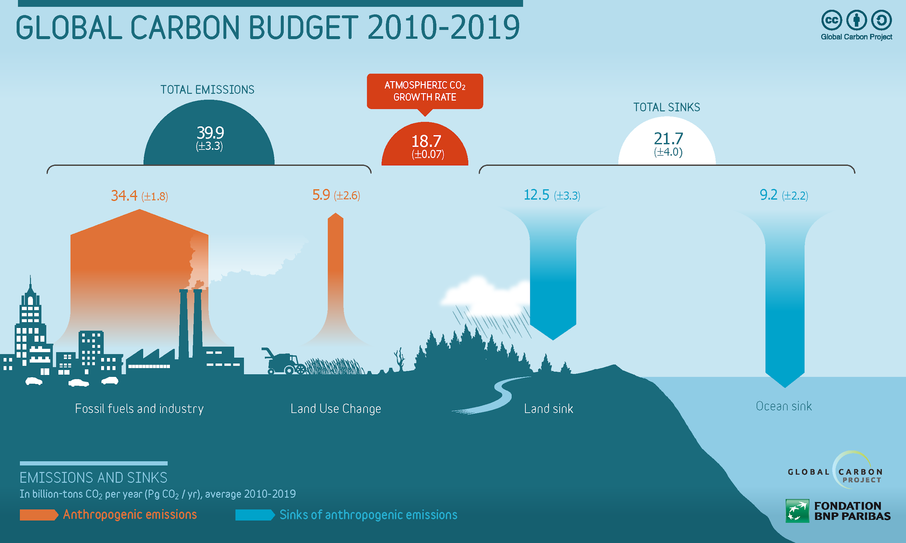
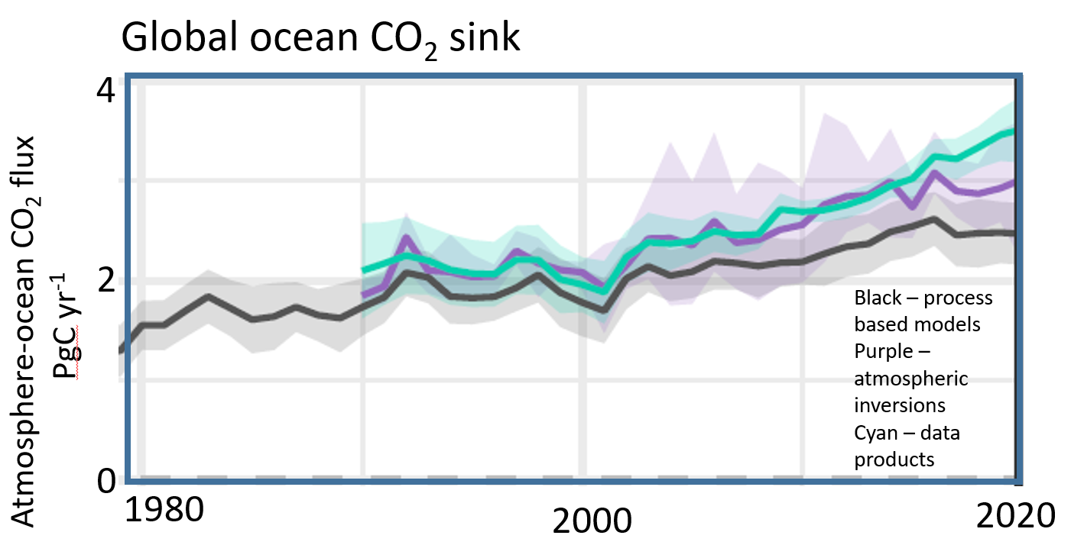
Ocean carbon: a key constraint to the Global Carbon Budget
Oceans play a major role in the Global Earth Carbon Cycle
25% of the CO2 released in the atmosphere from human activities is absorbed into the Oceans.
As the total global Land sink is difficult to measure accurately, it is often computed indirectly from the ocean carbon sink.
Ocean is a key constraint on global carbon
Improving ocean carbon estimates will improve the land carbon budget and global carbon assessment!
Despite the GCB ocean component now has a greater reliance on observations than models, discrepencies exist between observations and model
good estimates
poor estimates
good observations
Modelled or calculated using all other components
measured
Friedigstein et al, 2022
Notes:
Each year, the global carbon budget is assessed to track how well, or not, humanity is achieving any reductions in greenhouse gas emissions.
The huge variations in land cover, vegetation, terrain and their year-to-year variations mean that it is currently very difficult to measure the total global land sink accurately. Solving this issue is complex and complicated. However, it can be estimated indirectly.
By absorbing increased carbon dioxide from the atmosphere, the ocean reduces the warming impact of these emissions were they to remain in the atmosphere. However, carbon dioxide dissolved into the ocean causes seawater to acidify,

Slide 83
OCR-VC contribution to the CEOS 2020-2022 Workplan
CEOS GHG (Green House Gas ) Roadmap
CEOS AFOLU (Agriculture, Forestry and Other Land Uses) Roadmap
CEOS Aquatic Carbon Roadmap ?
CEOS Global Stocktake strategy paper
-> demonstrate the value of Earth Observation satellite datasets to support the Global Stocktake process
Notes:
The global stocktake of the Paris Agreement (GST) is a process for taking stock of the implementation of the Paris Agreement with the aim to assess the world’s collective progress towards achieving the purpose of the agreement and its long-term goals (Article 14).
The 2015 UNFCCC Paris Agreement came into force in November 2016. It provides a framework to achieve ambitious aims through financial flows, capacity building, mitigation and adaptation. The first Global Stocktake will take place in 2023, and on a five-year basis thereafter. Member States (MS) have also agreed to commit to nationally determined contributions (NDCs) that they intend to achieve regarding their future greenhouse gases (GHG) emissions reductions and activities to enhance climate adaptation. To monitor their progress towards reducing emissions, Member States to the Paris Agreement will also be submitting national inventories at two-year intervals, as part of their Biennial Transparency Reports (BTRs) Unfccc.int

Slide 84
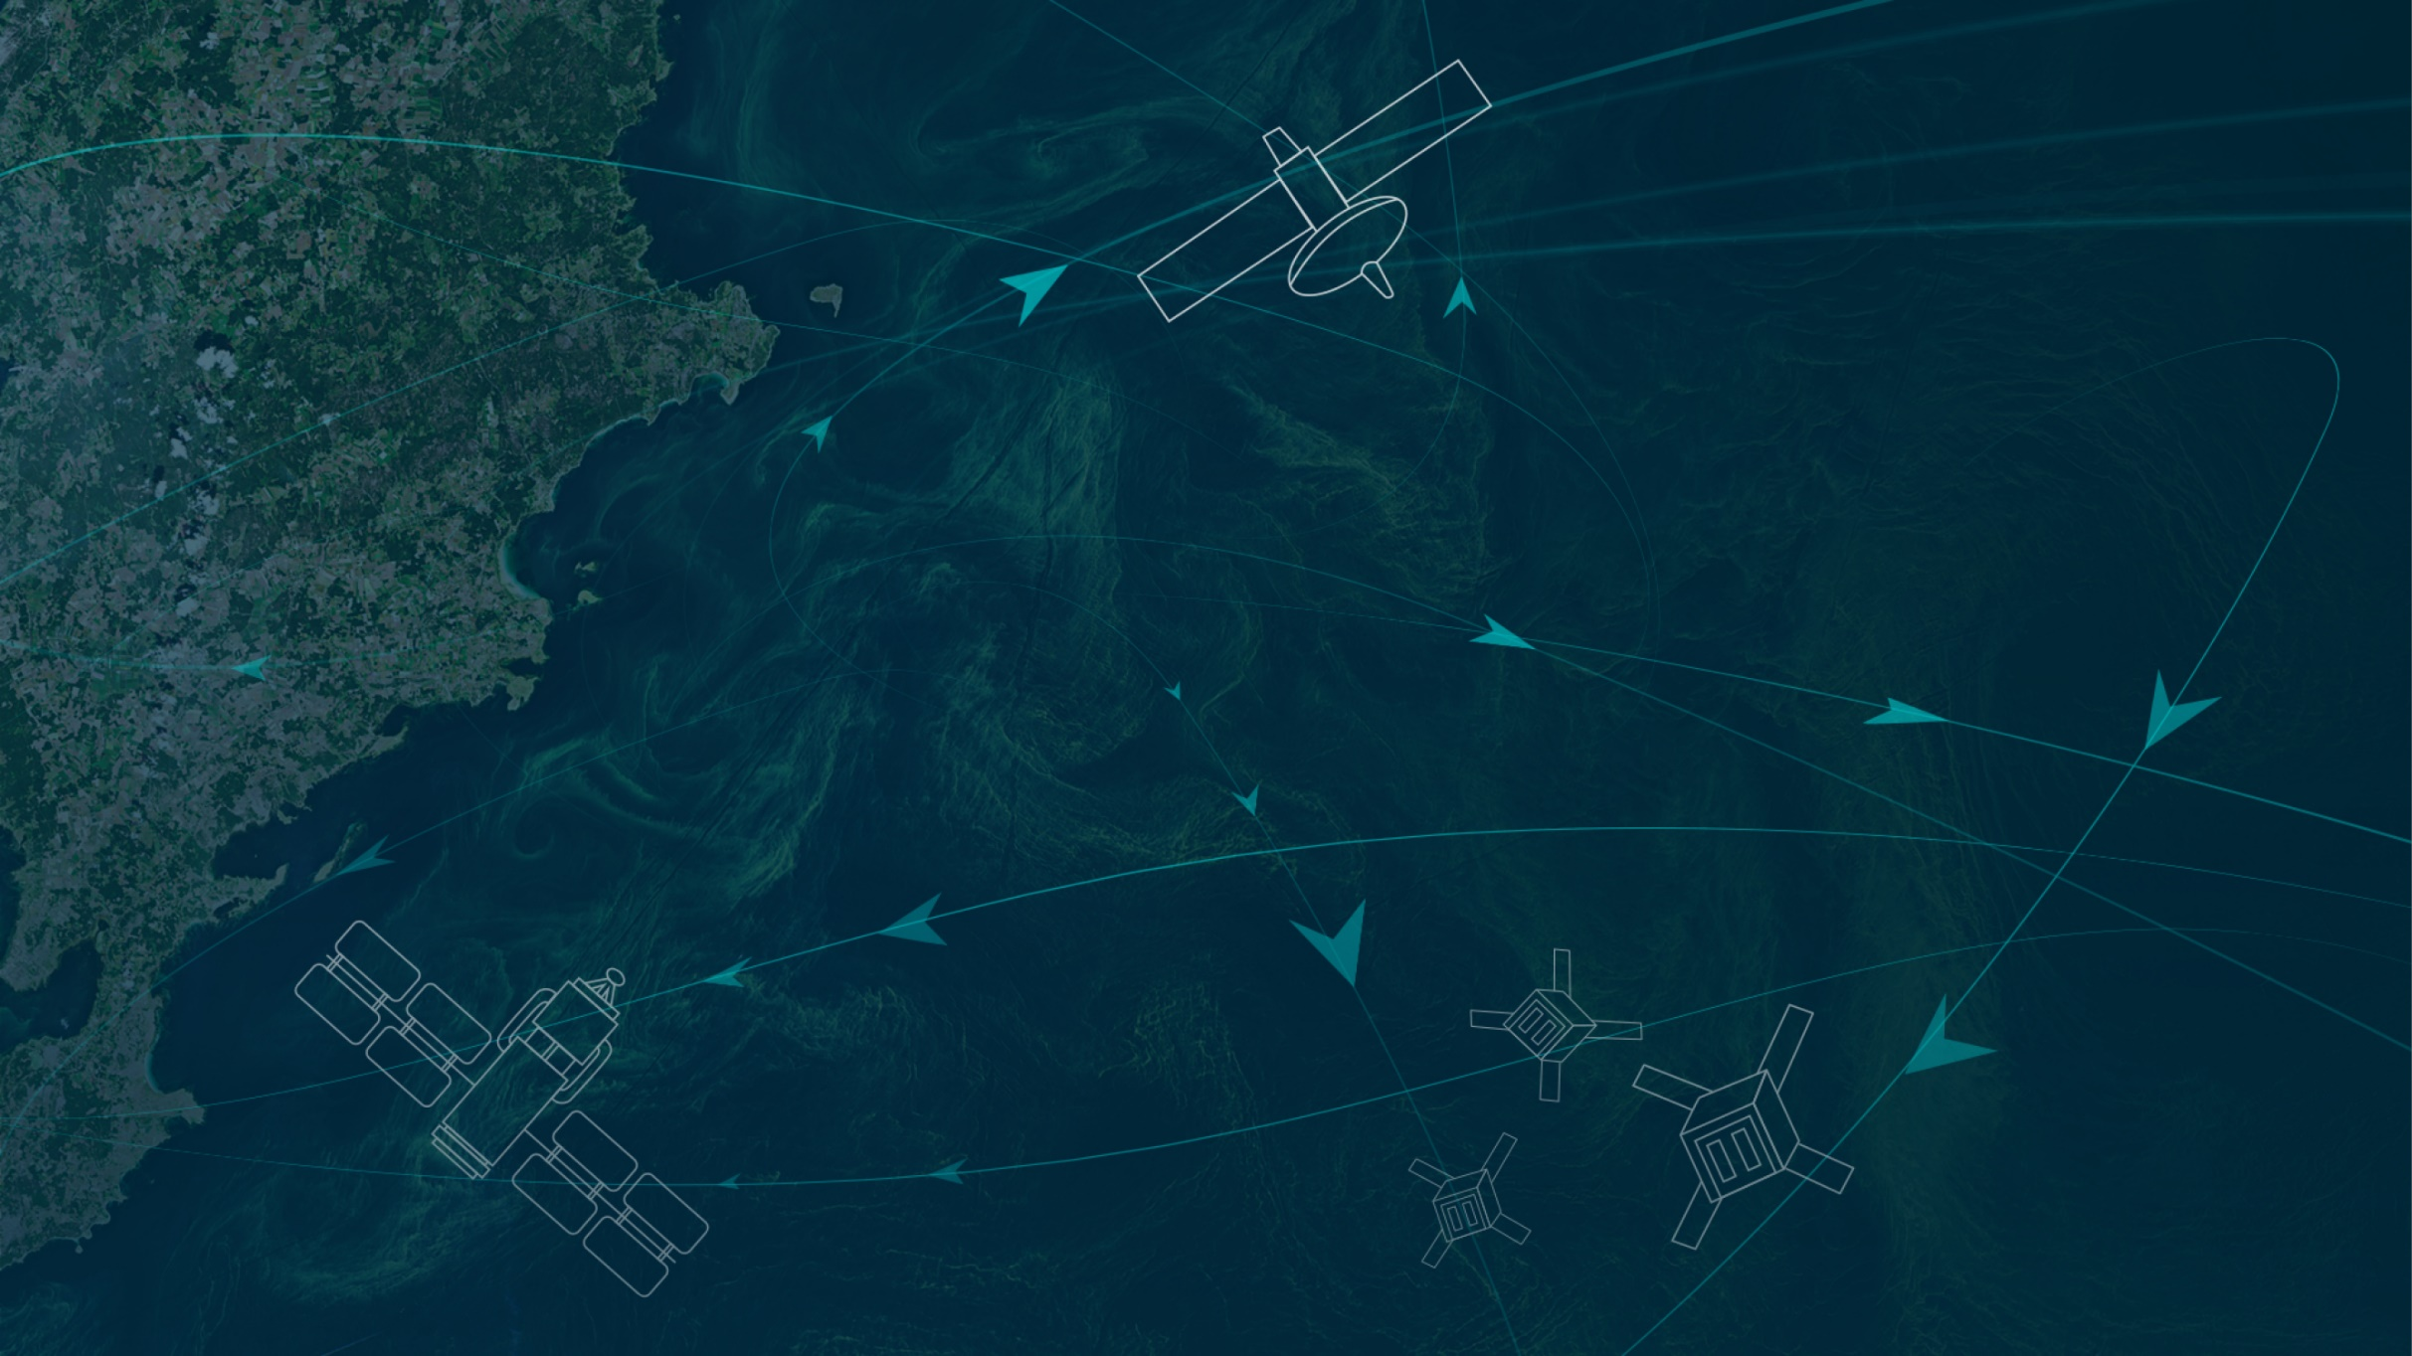
https://oceancarbonfromspace2022.esa.int/

Slide 85
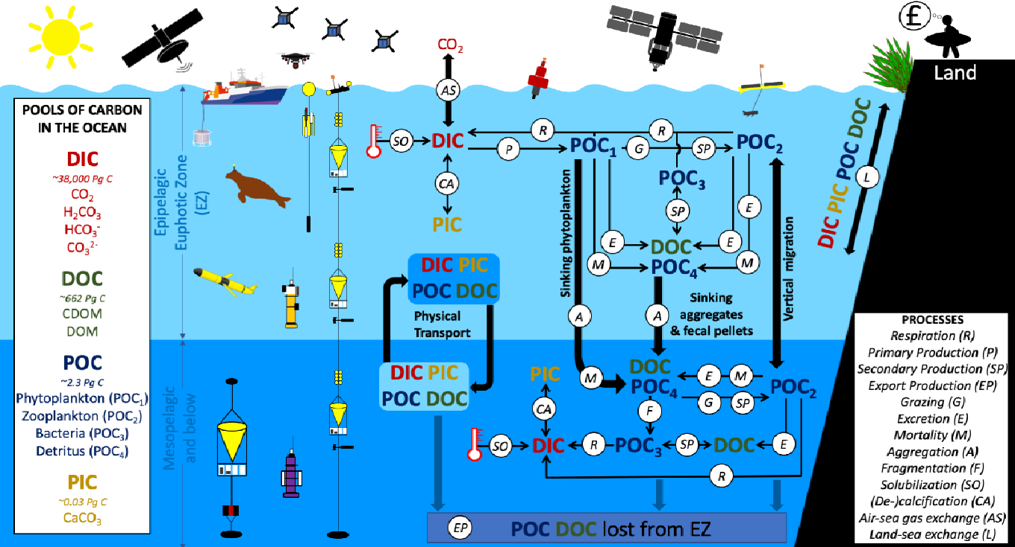
The BICEP (Biological Pump and Carbon Exchange Processes) ESA project (2020-2022)
Pools, fluxes and processes that form the ocean solubility and biological carbon pump
From Brewin et al, 2021. Sensing the ocean biological carbon pump from space: A review of capabilities, concepts, research gaps and future developments, Earth-Science Reviews 217 (2021) 103604.
Notes:
This holistic picture of the carbon cycle from an ocean perspective is from Brewin et al. (2021).
But at the moment, the Global Carbon Budget assessments focus on just the Dissolved Inorganic Carbon (DIC) component, ignoring how everything can, and will be, changing DIC through time.

Slide 86
Ocean Carbon From Space 2022 Workshop

Slide 87
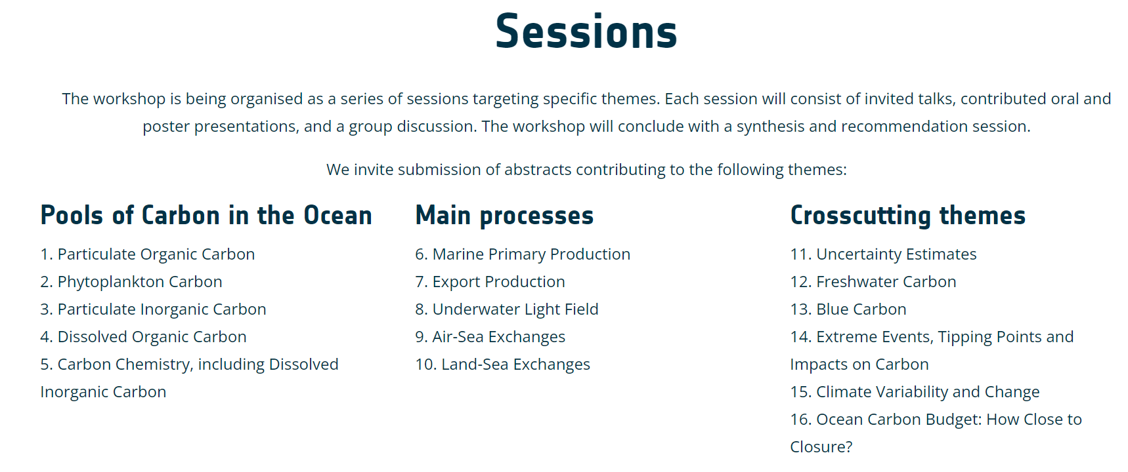
Ocean Carbon From Space 2022 Workshop
100 abstracts submitted

Slide 89
https://padlet.com/JavierAlonsoConcha/OceanCarbonFromSpace

Slide 90
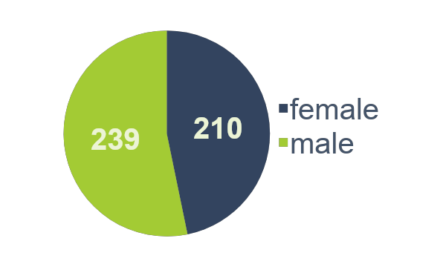
The Workshop in Numbers
Gender Distribution
Prepared by: Javier Alonso Concha and Sabrina Lodadio

Slide 91
Workshop Outcomes
All presentations and posters are available on the workshop website, together with the synthesis, by every chairs of their session’s discussion outcomes.
https://oceancarbonfromspace2022.esa.int/
Challenges
Gap
Opportunities
Community white paper gathering the workshop’s outcome and recommendations
Submitted for publication to the Earth System Reviews Aquatic Carbon From Space Special Issue <-> VC-20-24

Slide 92
Community white paper outline
1- Introduction
2- Workshop details and approach to capture collective view of the status of the field
3- Session-specific theme outcomes
In the following sections, we begin by providing a brief description of each session-specific themes, briefly highlight the current state of the art, then focus on a number of priorities for which scientific challenges, gaps and opportunities are identified, to be targeted over the next decade.
3.1 Particulate Organic Carbon (POC)
3.2 Phytoplankton Carbon (C-phyto)
3.3 Phytoplankton and Primary Production
3.4 Dissolved Organic Carbon (DOC)
3.5 Dissolved Inorganic Carbon (DIC)
3.6 Particulate Inorganic Carbon (PIC)
3.7 Fluxes at the Ocean Interface
3.8 Cross-cutting activities: Blue Carbon
3.9 Cross-cutting activities: Extreme Events
3.10 Cross-cutting activities: Carbon Budget Closure
4- Common outcomes
5- Emerging concerns and broader thoughts
6- Summary
3.1.1 State of the art in POC
3.1.2 POC Priority 1: In situ POC measurement methodology
Challenges, Gaps, Opportunities
3.1.3 POC Priority 2: In situ data compilation
Challenges, Gaps, Opportunities
3.1.4 POC Priority 3: Satellite retrieval of POC
Challenges, Gaps, Opportunities
3.1.5 POC Priority 4: Partitioning of POC into components
Challenges, Gaps, Opportunities
3.1.6 POC Priority 5: Vertical Profiles of POC
Challenges, Gaps, Opportunities
3.1.7 POC Priority 6: Biogeochemical processes and the biological carbon pump
Challenges, Gaps, Opportunities

Slide 93
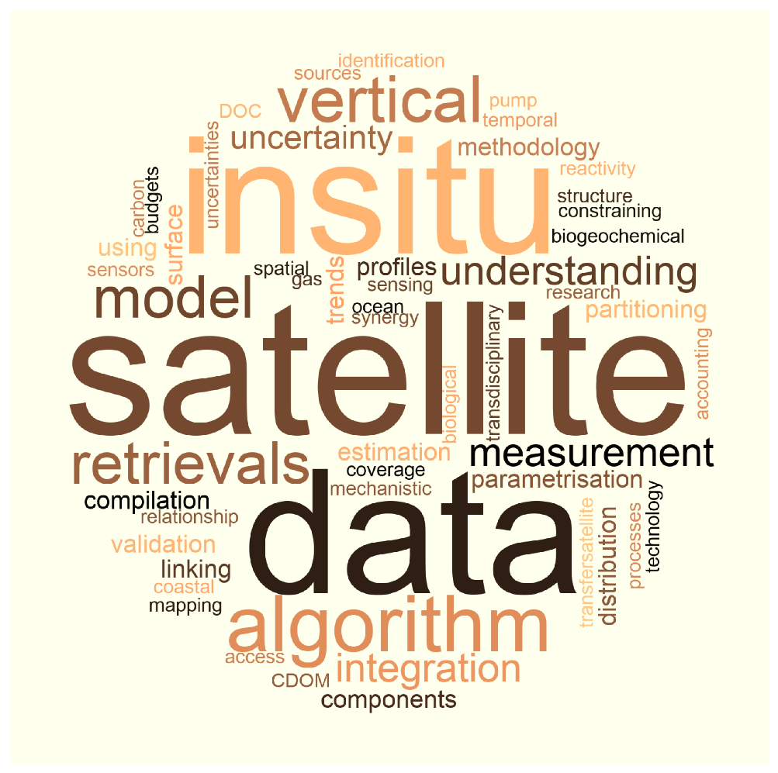

Slide 94
In-situ data. It is strikingly clear from this analysis the importance of in-situ data, for algorithm development and validation, for extrapolation of surface satellite fields to depth, for parametrisation and validation of ESMs, and for constraining estimates of the carbon budget. It is important that the in-situ, satellite and modelling community communicates prior to collecting data, to ensure the data collected will be useful for the entire community.
Satellite algorithm retrievals. For all pools and fluxes of carbon, continued development of satellite algorithms and retrieval techniques is critical to maximise the use of satellite data in carbon research. New satellites are being launched in the near future, with new capabilities and improved spatial, temporal and spectral resolution. Continued investment is required into basic and mechanistic understanding of the retrieval process, and improvements in retrievals in coastal and shelf sea environments and other optically complex waters. This is crucial for monitoring trends in satellite-based carbon products.
Uncertainty in data. There is a clear requirement across all themes to provide uncertainty estimates with satellite, in-situ and model products. Continued investment in methods to quantify uncertainty is vital for quantifying carbon budgets and change.
Vertical distributions. One of the major limitations of satellites, is that they only view the surface layer of the ocean. Sub-surface measurements are required to extrapolate the surface fields to depth.
Ocean models. Many components of the ocean carbon cycle are not directly observable through satellite, and some are even inherently difficult or expensive to measure in situ. Exploring synergy between satellite observations and models is clear priority for future ocean carbon research.
Integration of data. It is challenging to find an optimal way of combining satellites, models and in-situ observations, to produce best-quality data products. Continued efforts are required to develop methods to bridge the spatial and temporal scales of the different datasets, and statistical methods like machine learning may help in this regard.
Understanding. Continued investment is required into improving our fundamental understanding of the ocean carbon cycle, and on the interaction between pools of carbon and light. The latter is critical for the development of satellite carbon products.

Slide 95
Bringing carbon communities together. there is a strong requirement to bring different communities together working on different aspects of the ocean carbon cycle, that can often operate in a disparate fashion, including those working in different zones of the ocean, on the inorganic and organic sides, field and laboratory scientists, remote sensing scientists and modellers.
Working with satellite carbon experts in different planetary domains. More emphasis should be placed on harmonising satellite carbon products across different planetary domains (ocean, land, ice and air).
The need to maximise use of limited resources to support adequate monitoring of core ocean carbonvariables in addition to supporting innovative blue skies science
Improved distribution of satellite and model carbon products. Although satellite-based carbon products are becoming available, more emphasis is needed to integrate satellite carbon products, as well as model products, into operational satellite services to ensure end-user access, and make products more user friendly. This requires close dialogue with the user communities.
Carbon and environmental footprints of research. Our communities need to start taking more responsibility to monitor and minimise the carbon and environmental footprints of scientific research, and improve how this is managed and controlled.
Carbon and environmental footprints of space technology
Use of satellite products for informing ocean carbon dioxide removal (CDR) studies. Satellites can play a role in future monitoring of potential implementations of CDR, for understanding the consequences that some of these proposed mechanism would have on the marine ecosystem
Need to consider how satellites can be used to help monitor cycles of other important climatically-relevant compounds and elements.

Slide 96
Conclusion and perspectives
Conclusion:
The Ocean Carbon From Space Workshop (OCR-VC-20-25 deliverable of the CEOS workplan) has been successfully organised and has led to the writing of a community review white paper and a special issue in Frontiers in Marine Science.
The Aquatic Carbon From Space Special Issue in Earth Science Reviews special issue (OCR-VC-20-24) is on-track, and should be finalised by Q1-2023.
Both activities have contributed creating a strong momentum around the Aquatic carbon from space topic, a key component of the Global Carbon Budget.
Perspectives: Building on the workshop outcomes and further Aquatic Carbon related activities in the Space Agencies to further advance toward an OCR-VC led CEOS Aquatic Carbon Roadmap, as the Aquatic leg of the CEOS GHG and AFOLU roadmaps
Summarize what is known right now about the Aquatic Carbon and its role in the global carbon cycle,
Identify which variables can be provided in the context of global integrated carbon monitoring,
Provide a roadmap towards filling the main knowledge gaps, focusing on a few major gaps to which all agencies can contribute.
Slide ‹#›

Slide 97
GEO-TREES Update
15 Mins
Klaus Scipal, ESA
Agenda item 3.9
SIT TW 2022, ESA/ESRIN
14th - 15th September 2022

Slide 98
The Global Forest Biomass Reference System
Iris-Amata Dion took up duty as GEO-TREES executive as of 15th June.
The position is funded for two years by CNES.
Hosted by Jérôme Chave’s Evolution et Diversité Biologique Lab at CNRS.
GEO-TREES Governance and Implementation Plan
Draft documents ready
Due for revision and acceptance by the GEO-TREES steering board.
GEO-TREES Trust Fund
The process to set up has been started with the GEO secretariat.
TOR have been drafted and discussed with GEO.
The trust fund will be managed by GEO and audited by WMO.
Funding situation
Engagement of a first private funding partner is in the starting blocks and is pending the setup of the Trust Fund.
But in general the funding situation and especially the engagement of national Agencies is still arduous.
www.Geotrees.cnrs.fr

Slide 99
Workshop Outcomes published in
Special Issues
Aquatic Carbon From Space Special Issue in Earth Science Reviews special issue <-> VC-20-24
All but one of the invited papers have been received and are undergoing peer review.
-> first manuscripts to be published by the end of 2022 and the issue completed by the end of Q1 of 2023 (or Q2 at the latest). On track!
Special Issue in Frontiers in Marine Science:
Colour and Light in the Ocean from Earth Observations (CLEO) Volume 2
Deadline for submission of manuscripts: December 2022
26 abstracts submitted
5 manuscripts submitted
1 manuscript accepted
1 manuscript rejected

Slide 100
WMO GHG Monitoring System
15 Mins
Lars Peter Riishojgaard, WMO
Agenda item 3.10
SIT TW 2022, ESA/ESRIN
14th - 15th September 2022

Slide 101
Adaptation item
15 Mins
Sara Venturini, GEO Secretariat
Ian Jarvis, GEOGLAM Secretariat
Agenda item 3.11
SIT TW 2022, ESA/ESRIN
14th - 15th September 2022

Slide 102
GEO Climate Change Working Group - Adaptation
14 September 2022
CEOS SIT TW Session 3: “Climate and Carbon"
CC-WG Co-chairs:
Virginia Burkett, USGS
Mark Dowell, EC JRC
Lucia Perugini, CMCC
Angel Valdiviezo, ESPOL
GEO Secretariat:
Sara Venturini

Slide 103
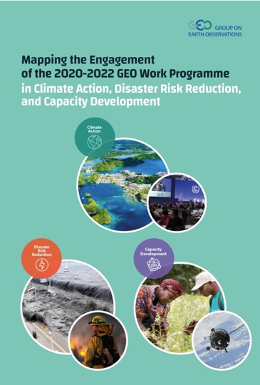
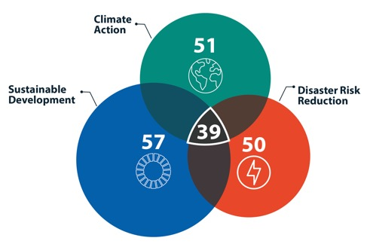
GEO Work Programme mapping report published in May 2022
GEO activities supporting global policy drivers

Slide 104
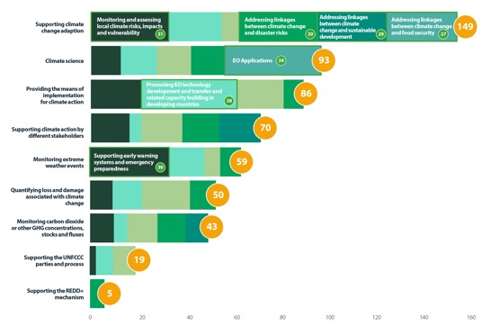
GEO Work Programme is strongly aligned with Paris Agreement workstreams – Adaptation is the most addressed but delivery needs improving
More numerous but less mature/less operational activities on Adaptation (50), Means of Implementation (43), Loss and Damage (41)
Fewer Mitigation activities including REDD+ (37) but provide more concrete contribution
GEO activities mostly involve:
climate science and developing EO applications
promoting EO technology development and transfer and capacity building in developing countries
monitoring and assessing local climate risks, impacts and vulnerability
supporting early warning systems and emergency preparedness
Sub-areas of work under climate action
across GEO activities

Slide 105
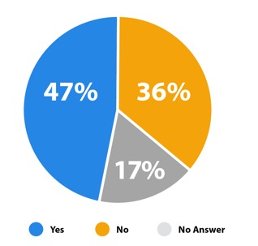
GEO activities are suitable to integrate EO into National Adaptation Plan (NAP) processes
Suitability of GEO activities
for EO guidance on NAP
High number of GEO activities work in the domain of climate adaptation, about 50% state suitability of work/contributions for supplementary technical guidance for developing countries to integrate EO into NAP processes
Key sectors for supplementary technical guidance: agriculture, food security, land (6); marine, coastal and riverine hazards (4); urban areas (3); renewable energy (2); health (2); industrial applications (1); and mountains (1)
Creating leverage: focus on data to address multiple sectors or topics (6) and on-the-ground implementation through local and regional partners (4)

Slide 106
Supporting NAPs via the UNFCCC
GEO supplemental technical guidance helps LDCs and other developing countries to integrate climate science Earth observation information, data, tools into their NAPs
Multiple challenges and sectors for NAPs: coastal zones, water management, health, etc… GEO guidance will cover different sectors based on the experience of GEO initiatives
First guidance by GEOGLAM, followed by other GEO initiatives – launch at GEO Week and COP27
Collaborating with UNFCCC LEG on NAP Expo, Open NAP, establishing technical assistance to countries…
Exploring linkages with implementation with partners WMO, UNDP, UNEP - via the Green Climate Fund

Slide 107
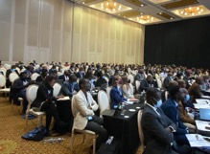
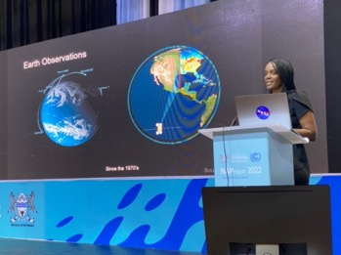
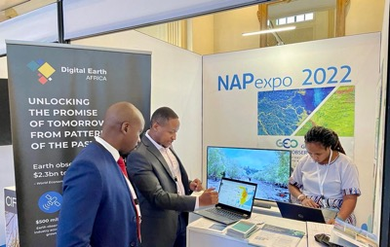
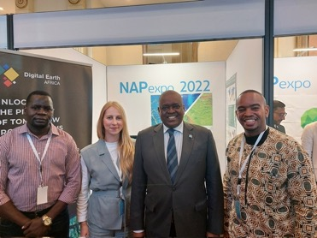
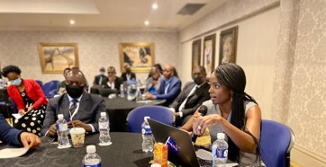
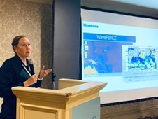
Gaborone, Botswana
22-26 August 2022

Slide 108
Towards COP27: Adaptation
Contribution on Adaptation, Loss and Damage, and other cross-cutting themes via joint submission for Global Stocktake, participation in UNFCCC SB June 2022
Member of Scientific Committee for GCOS Climate Observation Conference (Darmstadt, 17-19 Oct) - input to statement for COP27
Contribution to WMO Global Framework for Climate Services report 2022 (Energy) with 2 case studies: Solar Atlas in Egypt by GEO CRADLE, and GEO VENER work with French government - launch in October and side event at COP27
Contribution to COP27 Presidency high-level initiative “FAST” Food and Agriculture for Sustainable Transformation led by FAO – launch at COP27 (12 November)
Participation in Earth Information Day 2022 with GEO initiatives (9 November - tbc)
Launch of GEOGLAM NAP guidance - side event at COP27 (tbc)
GEO COP briefings addressing SB agenda items: RSO, Adaptation /NAP, Loss and Damage – to be submitted to GEO principals, UNFCCC delegates - recognition of GEO’s work in SB conclusions

Slide 110
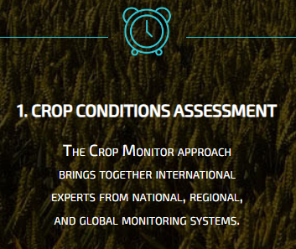
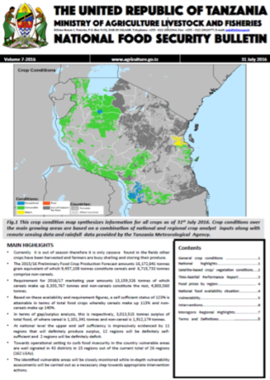
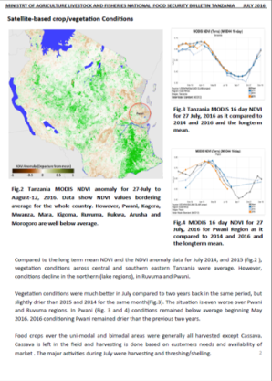
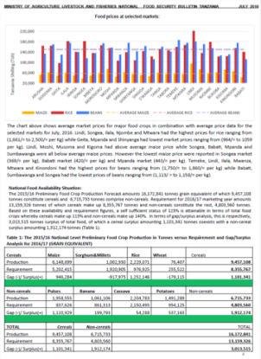
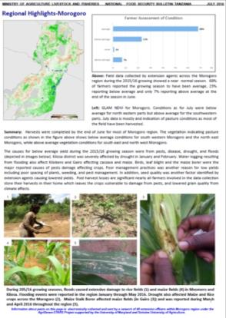
Tanzania
Track Record of Co-Developed
National Crop Monitors
Kenya
Mozambique
National Food Security Bulletin, published by the Tanzania Ministry of Agriculture Food Security, National Food Security Division
Notes:
The crop monitoring system relies on strong collaboration, open discussion and consensus making.
Resulting summary reports are a communal effort, high quality, no discrepancies and thus authoritative and reliable.

Slide 111
National Impact Stories, Food Security Africa- Uganda
Karamoja Uganda, 2017
Crop Monitor
August 2017 for Uganda
GEOGLAM worked with the Ugandan Office of the Prime Minister to develop a crop monitor in 2016
In 2017 the crop monitor provided 3 months early warning of a likely crop failure due to drought, time to proactively mitigate loss and damage
Monitoring triggered the Disaster Risk Financing (DRF) fund to scale-up public works projects in Karamoja, off-setting agricultural losses
End result: USD 2.6 million saved, 150k people helped
Pasture Conditions
“In the past we always reacted to crop failure, spending billions of shillings to provide food aid in the region.
2017 was the first time we acted proactively because we had clear evidence from satellite data very early in the season”
Martin Owor, Commissioner Office of the Prime Minister (OPM)
Notes:
In 2016 GEOGLAM worked with Uganda to develop an early warning crop monitor within the Prime Ministers office and this is now part of their disaster warning system
Government realized a saving of UGX 9.6bn ($2.5M) (51%) against an overall emergency fund of UGX 19bn ($5M) in the FY 2016/17 as a result of a decline in emergency food aid for Karamoja.
Resilience – is realized with smoothened food consumption and reduction in negative coping mechanisms by households.
Household livelihood improvement is reported in the acquisition of productive assets notably livestock, increased expenditures on school fees and medical needs.

Slide 112
Summary, Outlook, & Coordination
Session 3
SIT TW 2022, ESA/ESRIN
14th - 15th September 2022

Slide 113
GEO Supplemental NAP Guidance / Agriculture
EO in Agriculture & Food Security
What questions can EO answer
What is required to implement crop monitoring system
Institutional framework
Technical framework
How can GEO/GEOGLAM help
What open science resources are available
UNFCCC direction: Provide Green Climate Fund proposal “ready” language
NAP Expo Outcomes:
Several new countries have come forward
Botswana, Lesotho, Bhutan, Djibouti, Benin,
Sierra Leone, Malawi, Sao Tome and Principe,
Central African Republic, Sudan, Burundi
In response GEOGLAM is looking for support to work with countries to develop GCF proposals
Regional basis
UNFCCC NAP Guidance
To be launched at GEO Week 2022 and COP27
Notes:
The supplemental guidelines are geared towards provision of in-depth knowledge and skills to enhance implementation of adaptation measures at all/different levels of national development, starting with agriculture and food security.
Other sectors to follow.

Slide 114
Any summary points..
WGClimate continues its excellent long-term systematic work around partnership with GCOS/UNFCCC through GCOS IPs etc.
GHG-AFOLU Workshop covered many topics of interactions not addressed elsewhere
AFOLU work is newer but has made good progress
Excellent progress has been made in many areas of climate/carbon, with good coordination between diverse groups working on support to UNFCCC in particular
Partnerships among CEOS agencies and with eg UNFCCC, GEO, GCOS, WMO, and other players (IMEO, science community, private sector) etc are key to success
Engagement with individual countries critical to demonstrate practical value of EO in AFOLU process for LDCs
Importance of SO process in UNFCCC

