Slide 1
SIT Technical Workshop 2022
Ocean Carbon Special Report
Marie-Helene RIO, ESRIN-ESA
Agenda Item 3.8
SIT TW 2022, ESA/ESRIN
13th - 15th September 2022

Slide 2
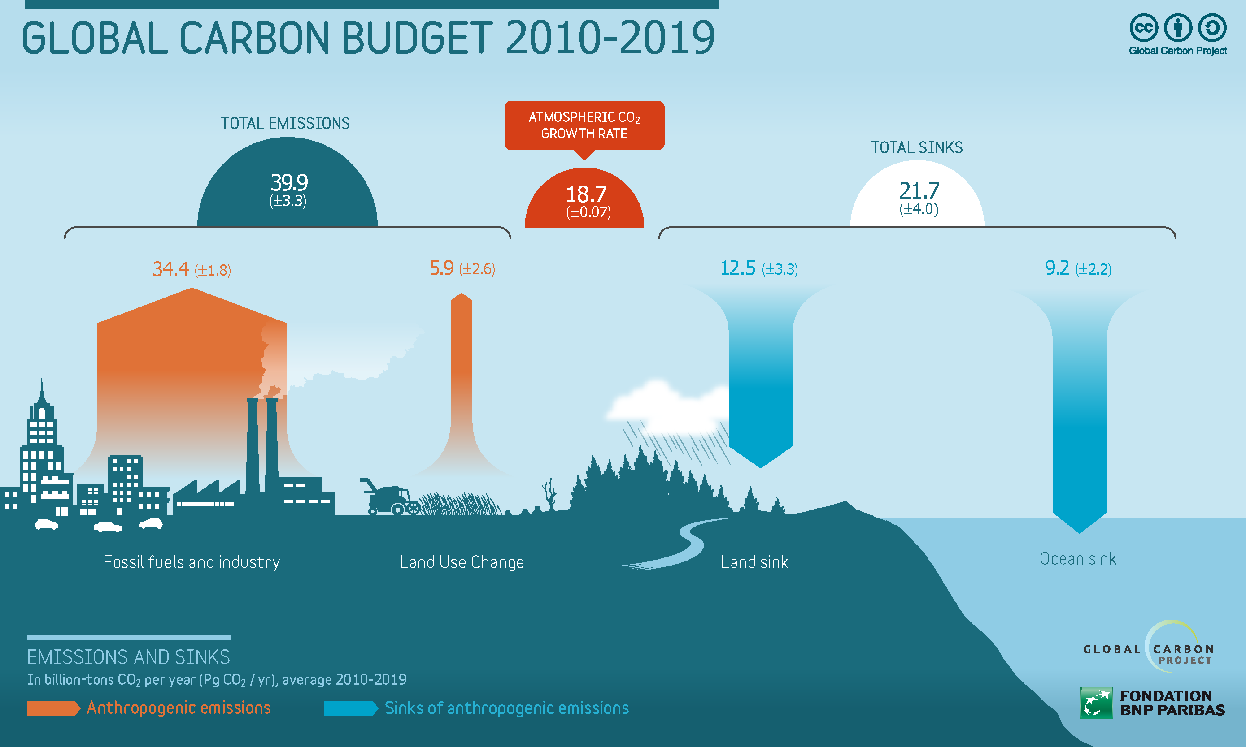
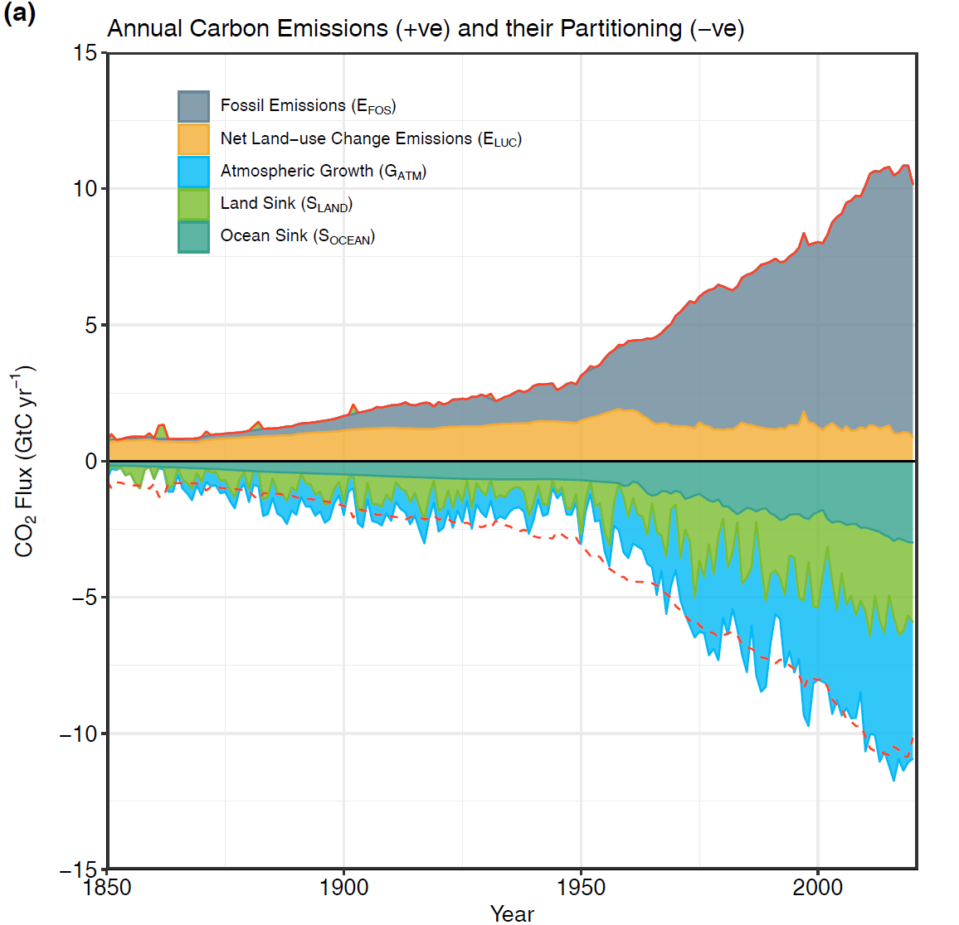
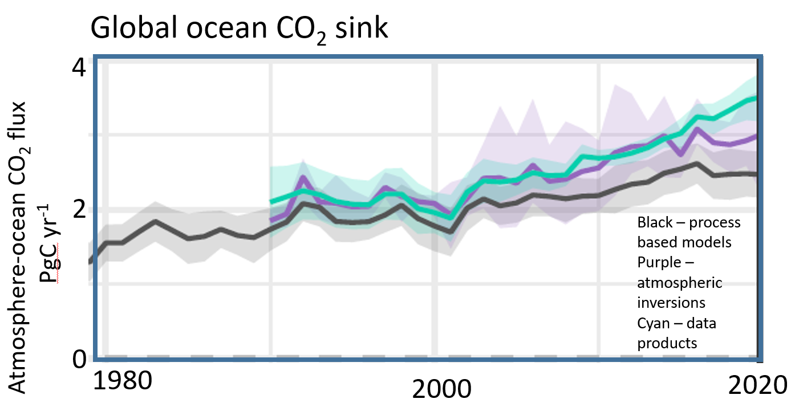
Ocean carbon: a key constraint to the Global Carbon Budget
Oceans play a major role in the Global Earth Carbon Cycle
25% of the CO2 released in the atmosphere from human activities is absorbed into the Oceans.
As the total global Land sink is difficult to measure accurately, it is often computed indirectly from the ocean carbon sink.
Ocean is a key constraint on global carbon
Improving ocean carbon estimates will improve the land carbon budget and global carbon assessment!
Despite the GCB ocean component now has a greater reliance on observations than models, discrepencies exist between observations and model
good estimates
poor estimates
good observations
Modelled or calculated using all other components
measured
Friedigstein et al, 2022
Notes:
Each year, the global carbon budget is assessed to track how well, or not, humanity is achieving any reductions in greenhouse gas emissions.
The huge variations in land cover, vegetation, terrain and their year-to-year variations mean that it is currently very difficult to measure the total global land sink accurately. Solving this issue is complex and complicated. However, it can be estimated indirectly.
By absorbing increased carbon dioxide from the atmosphere, the ocean reduces the warming impact of these emissions were they to remain in the atmosphere. However, carbon dioxide dissolved into the ocean causes seawater to acidify,

Slide 3
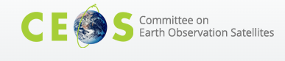
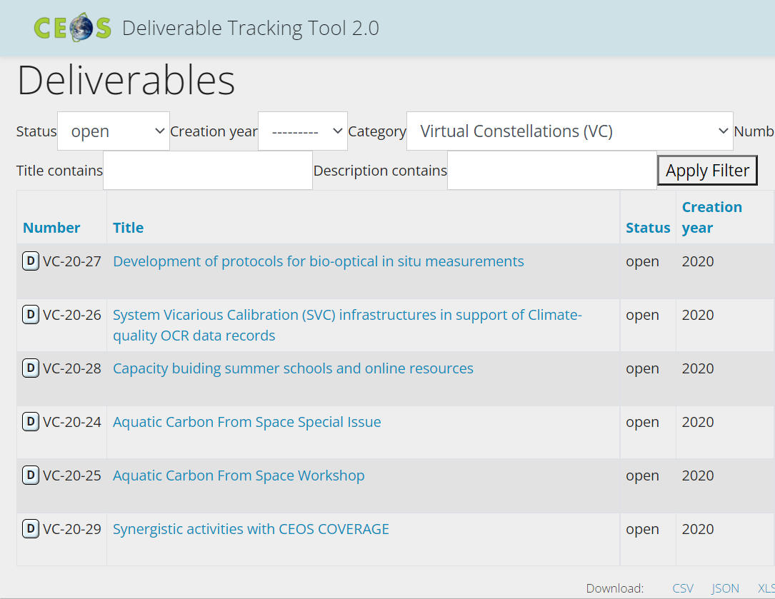
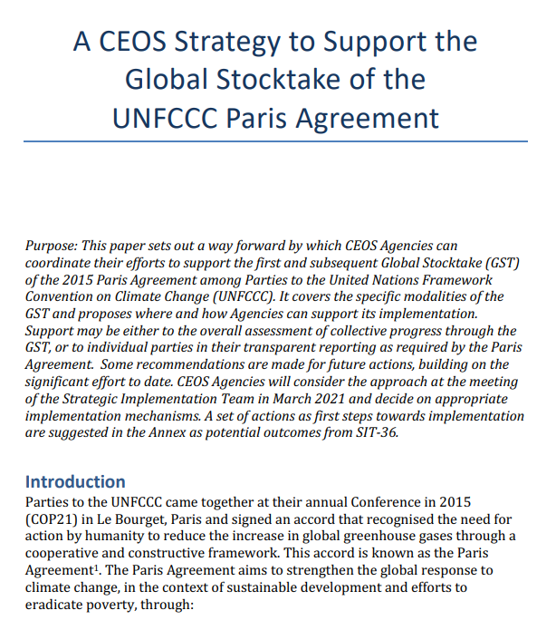
OCR-VC contribution to the CEOS 2020-2022 Workplan
CEOS GHG (Green House Gas ) Roadmap
CEOS AFOLU (Agriculture, Forestry and Other Land Uses) Roadmap
CEOS Aquatic Carbon Roadmap ?
CEOS Global Stocktake strategy paper
-> demonstrate the value of Earth Observation satellite datasets to support the Global Stocktake process
Notes:
The global stocktake of the Paris Agreement (GST) is a process for taking stock of the implementation of the Paris Agreement with the aim to assess the world’s collective progress towards achieving the purpose of the agreement and its long-term goals (Article 14).
The 2015 UNFCCC Paris Agreement came into force in November 2016. It provides a framework to achieve ambitious aims through financial flows, capacity building, mitigation and adaptation. The first Global Stocktake will take place in 2023, and on a five-year basis thereafter. Member States (MS) have also agreed to commit to nationally determined contributions (NDCs) that they intend to achieve regarding their future greenhouse gases (GHG) emissions reductions and activities to enhance climate adaptation. To monitor their progress towards reducing emissions, Member States to the Paris Agreement will also be submitting national inventories at two-year intervals, as part of their Biennial Transparency Reports (BTRs) Unfccc.int

Slide 4
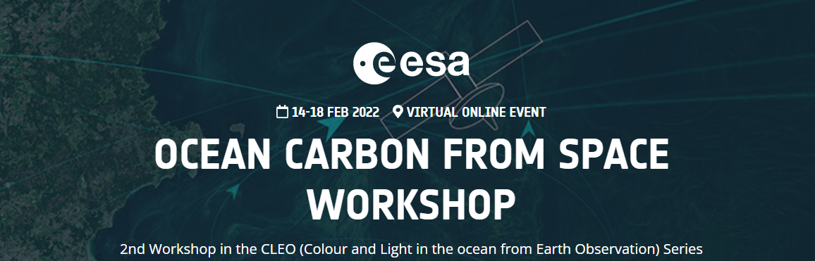
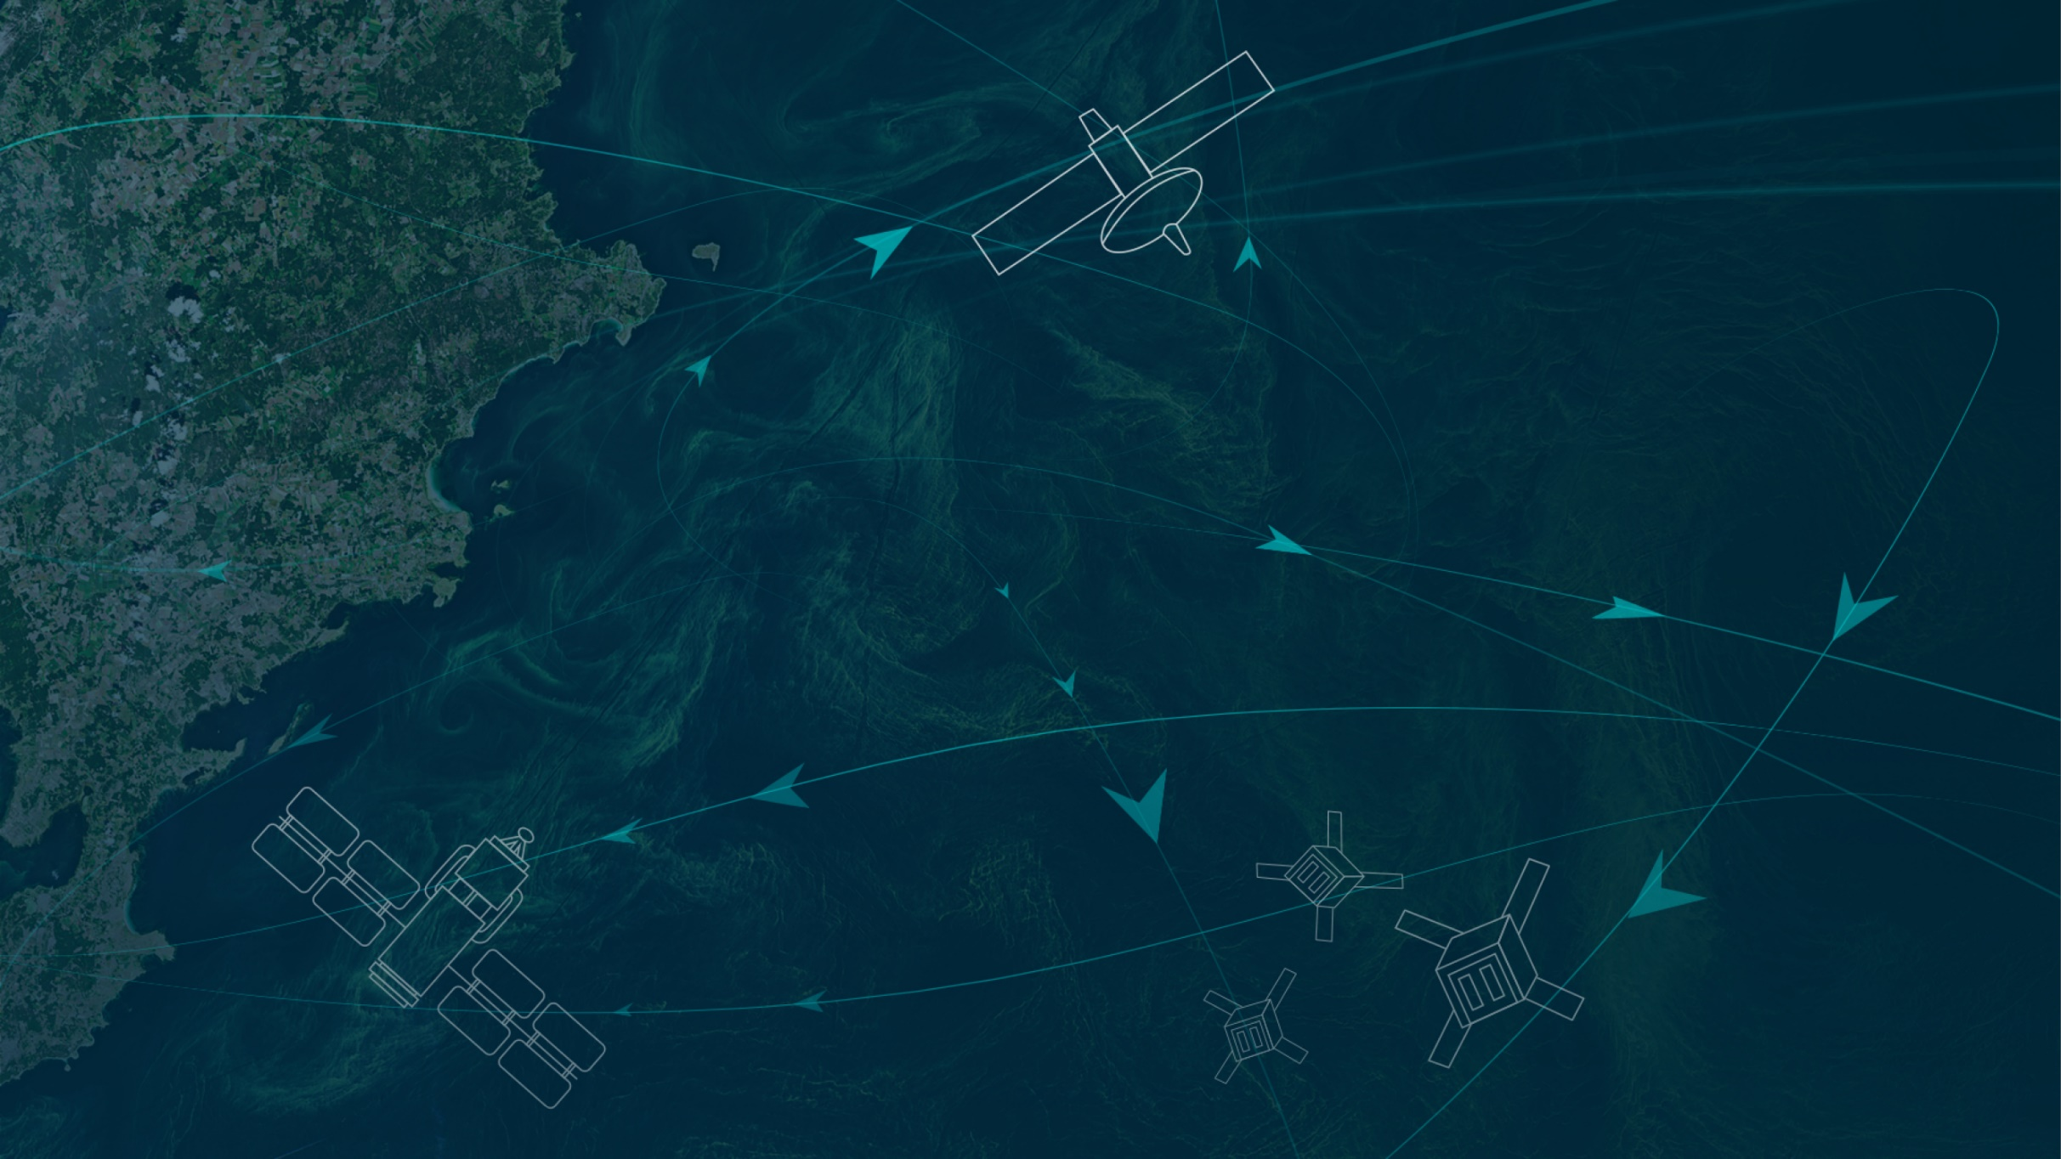
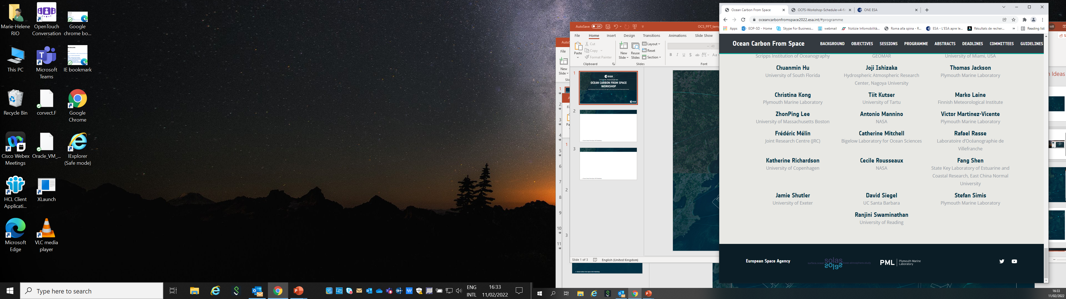

https://oceancarbonfromspace2022.esa.int/

Slide 5
The BICEP (Biological Pump and Carbon Exchange Processes) ESA project (2020-2022)
Pools, fluxes and processes that form the ocean solubility and biological carbon pump
From Brewin et al, 2021. Sensing the ocean biological carbon pump from space: A review of capabilities, concepts, research gaps and future developments, Earth-Science Reviews 217 (2021) 103604.
Notes:
This holistic picture of the carbon cycle from an ocean perspective is from Brewin et al. (2021).
But at the moment, the Global Carbon Budget assessments focus on just the Dissolved Inorganic Carbon (DIC) component, ignoring how everything can, and will be, changing DIC through time.

Slide 6
The BICEP (Biological Pump and Carbon Exchange Processes) ESA project (2020-2022)
Pools, fluxes and processes that form the ocean solubility and biological carbon pump
OceanSODA
Ocean Health - Acidification
BICEP
Aeolus+
S5P+OC
ARI-EBUS-PRIMUS
Physioglob
AMT4OceanSatFlux
OceanFlux-ghg
SeaLaBio
From Brewin et al, 2021. Sensing the ocean biological carbon pump from space: A review of capabilities, concepts, research gaps and future developments, Earth-Science Reviews 217 (2021) 103604.
Notes:
This holistic picture of the carbon cycle from an ocean perspective is from Brewin et al. (2021).
But at the moment, the Global Carbon Budget assessments focus on just the Dissolved Inorganic Carbon (DIC) component, ignoring how everything can, and will be, changing DIC through time.

Slide 7
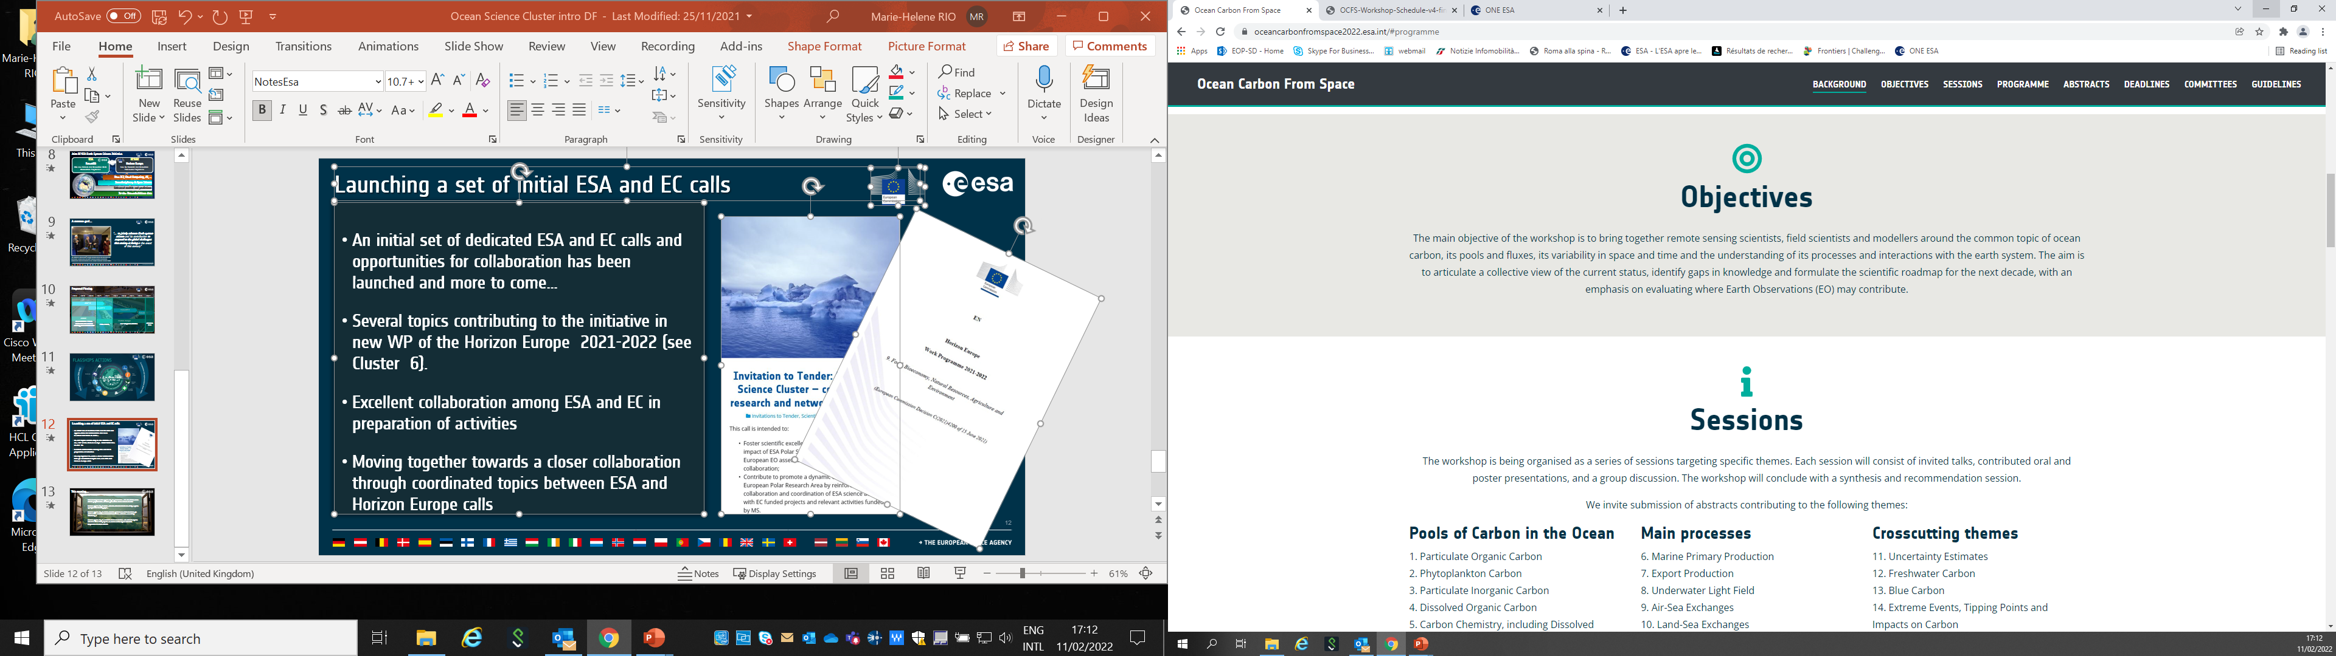
Ocean Carbon From Space 2022 Workshop

Slide 8
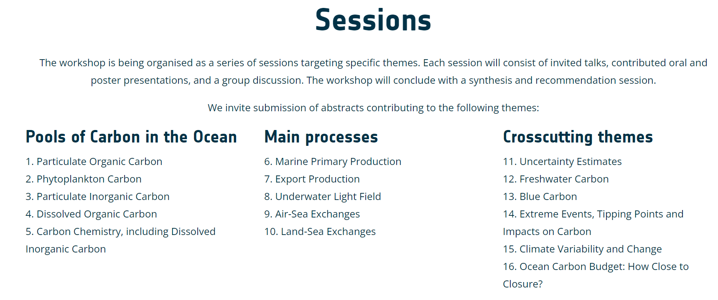
Ocean Carbon From Space 2022 Workshop
100 abstracts submitted

Slide 9
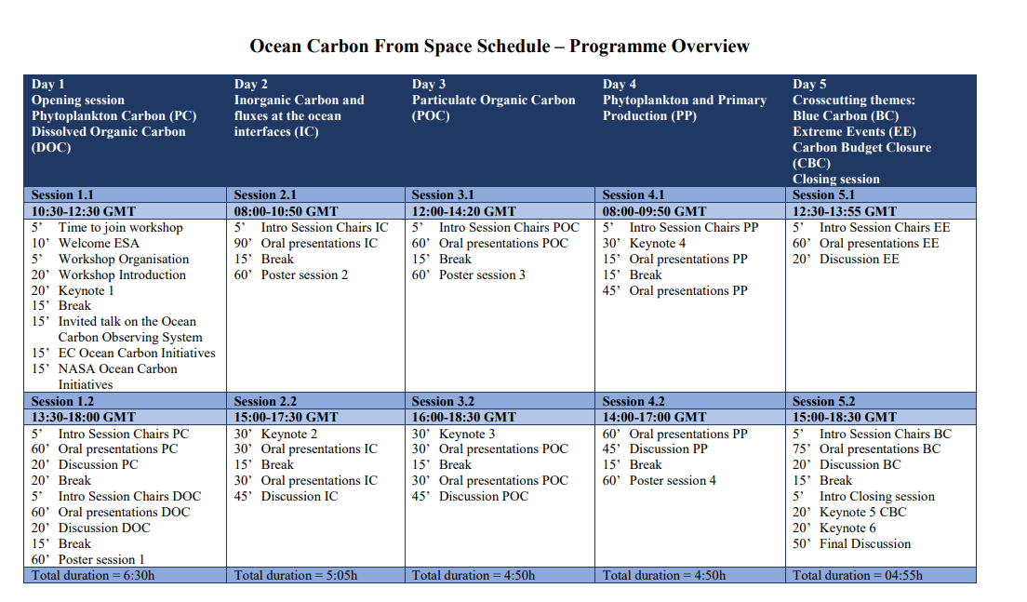

Slide 10
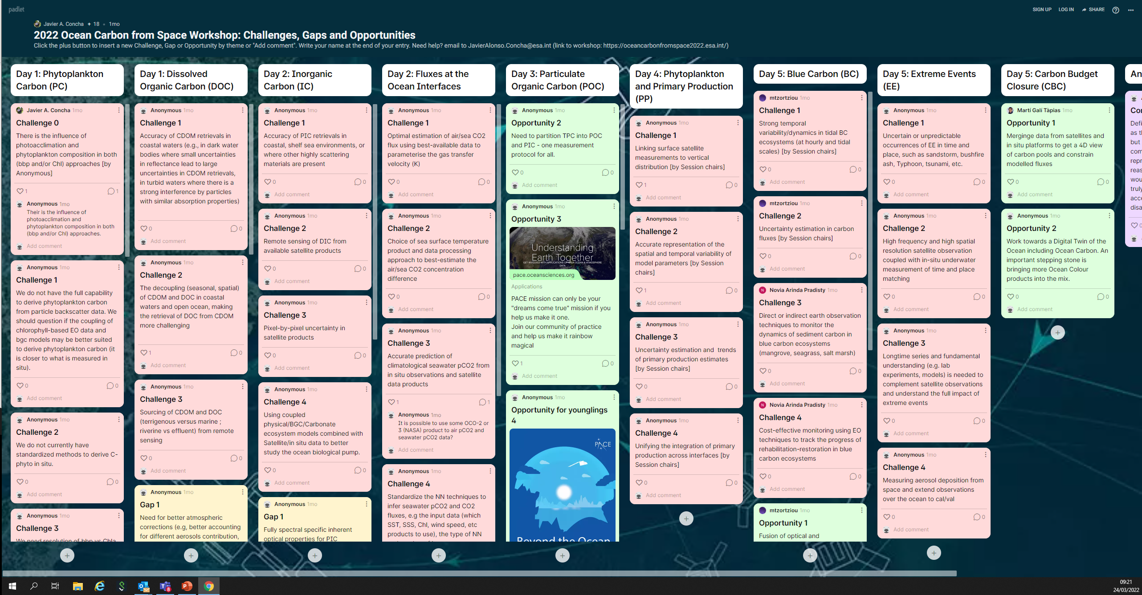
https://padlet.com/JavierAlonsoConcha/OceanCarbonFromSpace

Slide 11
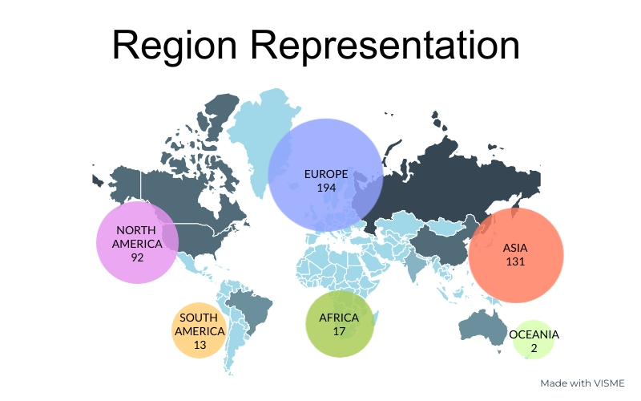
The Workshop in Numbers
Total Registration: 449
Gender Distribution
Prepared by: Javier Alonso Concha and Sabrina Lodadio

Slide 12
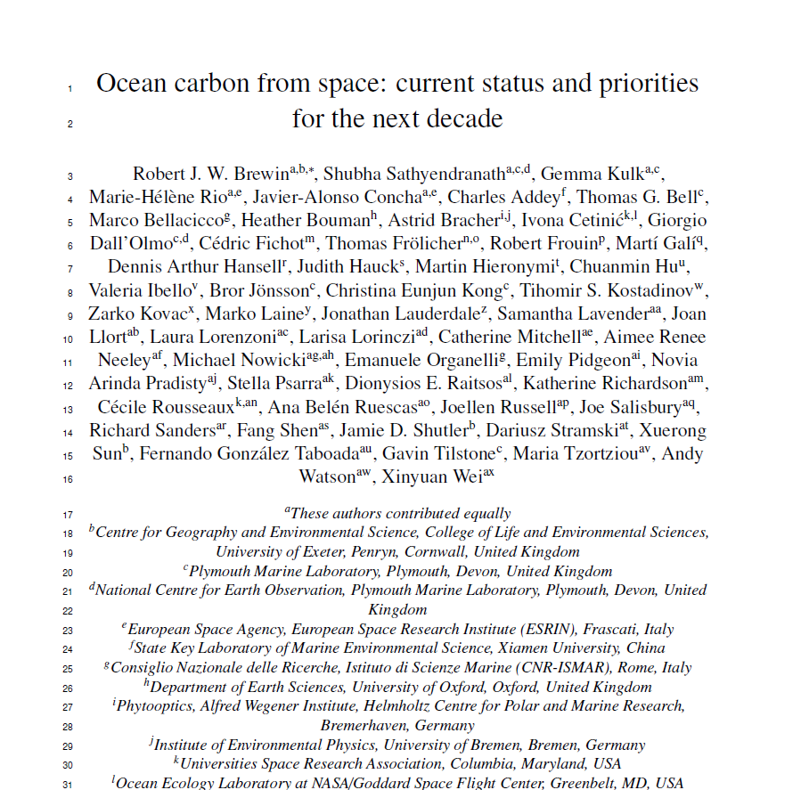
Workshop Outcomes
All presentations and posters are available on the workshop website, together with the synthesis, by every chairs of their session’s discussion outcomes.
https://oceancarbonfromspace2022.esa.int/
Challenges
Gap
Opportunities
Community white paper gathering the workshop’s outcome and recommendations
Submitted for publication to the Earth System Reviews Aquatic Carbon From Space Special Issue <-> VC-20-24

Slide 13
Community white paper outline
1- Introduction
2- Workshop details and approach to capture collective view of the status of the field
3- Session-specific theme outcomes
In the following sections, we begin by providing a brief description of each session-specific themes, briefly highlight the current state of the art, then focus on a number of priorities for which scientific challenges, gaps and opportunities are identified, to be targeted over the next decade.
3.1 Particulate Organic Carbon (POC)
3.2 Phytoplankton Carbon (C-phyto)
3.3 Phytoplankton and Primary Production
3.4 Dissolved Organic Carbon (DOC)
3.5 Dissolved Inorganic Carbon (DIC)
3.6 Particulate Inorganic Carbon (PIC)
3.7 Fluxes at the Ocean Interface
3.8 Cross-cutting activities: Blue Carbon
3.9 Cross-cutting activities: Extreme Events
3.10 Cross-cutting activities: Carbon Budget Closure
4- Common outcomes
5- Emerging concerns and broader thoughts
6- Summary
3.1.1 State of the art in POC
3.1.2 POC Priority 1: In situ POC measurement methodology
Challenges, Gaps, Opportunities
3.1.3 POC Priority 2: In situ data compilation
Challenges, Gaps, Opportunities
3.1.4 POC Priority 3: Satellite retrieval of POC
Challenges, Gaps, Opportunities
3.1.5 POC Priority 4: Partitioning of POC into components
Challenges, Gaps, Opportunities
3.1.6 POC Priority 5: Vertical Profiles of POC
Challenges, Gaps, Opportunities
3.1.7 POC Priority 6: Biogeochemical processes and the biological carbon pump
Challenges, Gaps, Opportunities

Slide 14
Community white paper
A word cloud designed to show the dominant themes and subthemes emerging from all priorities identified

Slide 15
Community white paper
Commonalities among the nine themes of the workshop include:
In-situ data. It is strikingly clear from this analysis the importance of in-situ data, for algorithm development and validation, for extrapolation of surface satellite fields to depth, for parametrisation and validation of ESMs, and for constraining estimates of the carbon budget. It is important that the in-situ, satellite and modelling community communicates prior to collecting data, to ensure the data collected will be useful for the entire community.
Satellite algorithm retrievals. For all pools and fluxes of carbon, continued development of satellite algorithms and retrieval techniques is critical to maximise the use of satellite data in carbon research. New satellites are being launched in the near future, with new capabilities and improved spatial, temporal and spectral resolution. Continued investment is required into basic and mechanistic understanding of the retrieval process, and improvements in retrievals in coastal and shelf sea environments and other optically complex waters. This is crucial for monitoring trends in satellite-based carbon products.
Uncertainty in data. There is a clear requirement across all themes to provide uncertainty estimates with satellite, in-situ and model products. Continued investment in methods to quantify uncertainty is vital for quantifying carbon budgets and change.
Vertical distributions. One of the major limitations of satellites, is that they only view the surface layer of the ocean. Sub-surface measurements are required to extrapolate the surface fields to depth.
Ocean models. Many components of the ocean carbon cycle are not directly observable through satellite, and some are even inherently difficult or expensive to measure in situ. Exploring synergy between satellite observations and models is clear priority for future ocean carbon research.
Integration of data. It is challenging to find an optimal way of combining satellites, models and in-situ observations, to produce best-quality data products. Continued efforts are required to develop methods to bridge the spatial and temporal scales of the different datasets, and statistical methods like machine learning may help in this regard.
Understanding. Continued investment is required into improving our fundamental understanding of the ocean carbon cycle, and on the interaction between pools of carbon and light. The latter is critical for the development of satellite carbon products.

Slide 16
Community white paper
Emerging concerns and broader thoughts
Bringing carbon communities together. there is a strong requirement to bring different communities together working on different aspects of the ocean carbon cycle, that can often operate in a disparate fashion, including those working in different zones of the ocean, on the inorganic and organic sides, field and laboratory scientists, remote sensing scientists and modellers.
Working with satellite carbon experts in different planetary domains. More emphasis should be placed on harmonising satellite carbon products across different planetary domains (ocean, land, ice and air).
The need to maximise use of limited resources to support adequate monitoring of core ocean carbonvariables in addition to supporting innovative blue skies science
Improved distribution of satellite and model carbon products. Although satellite-based carbon products are becoming available, more emphasis is needed to integrate satellite carbon products, as well as model products, into operational satellite services to ensure end-user access, and make products more user friendly. This requires close dialogue with the user communities.
Carbon and environmental footprints of research. Our communities need to start taking more responsibility to monitor and minimise the carbon and environmental footprints of scientific research, and improve how this is managed and controlled.
Carbon and environmental footprints of space technology
Use of satellite products for informing ocean carbon dioxide removal (CDR) studies. Satellites can play a role in future monitoring of potential implementations of CDR, for understanding the consequences that some of these proposed mechanism would have on the marine ecosystem
Need to consider how satellites can be used to help monitor cycles of other important climatically-relevant compounds and elements.

Slide 17
Workshop Outcomes published in
Special Issues
Aquatic Carbon From Space Special Issue in Earth Science Reviews special issue <-> VC-20-24
All but one of the invited papers have been received and are undergoing peer review.
-> first manuscripts to be published by the end of 2022 and the issue completed by the end of Q1 of 2023 (or Q2 at the latest). On track!
Special Issue in Frontiers in Marine Science:
Colour and Light in the Ocean from Earth Observations (CLEO) Volume 2
Deadline for submission of manuscripts: December 2022
26 abstracts submitted
5 manuscripts submitted
1 manuscript accepted
1 manuscript rejected

Slide 18
Conclusion and perspectives
Conclusion:
The Ocean Carbon From Space Workshop (OCR-VC-20-25 deliverable of the CEOS workplan) has been successfully organised and has led to the writing of a community review white paper and a special issue in Frontiers in Marine Science.
The Aquatic Carbon From Space Special Issue in Earth Science Reviews special issue (OCR-VC-20-24) is on-track, and should be finalised by Q1-2023.
Both activities have contributed creating a strong momentum around the Aquatic carbon from space topic, a key component of the Global Carbon Budget.
Perspectives: Building on the workshop outcomes and further Aquatic Carbon related activities in the Space Agencies to further advance toward an OCR-VC led CEOS Aquatic Carbon Roadmap, as the Aquatic leg of the CEOS GHG and AFOLU roadmaps
    Summarize what is known right now about the Aquatic Carbon and its role in the global carbon cycle,
Identify which variables can be provided in the context of global integrated carbon monitoring,
Provide a roadmap towards filling the main knowledge gaps, focusing on a few major gaps to which all agencies can contribute.
Slide 18

