Slide 1
NASA Commercial Smallsat Data Acquisition (CSDA) Program
Alfreda Hall, NASA
Agenda Item #2.2
SIT TW 2022, ESA/ESRIN
13th - 15th September 2022

Slide 2
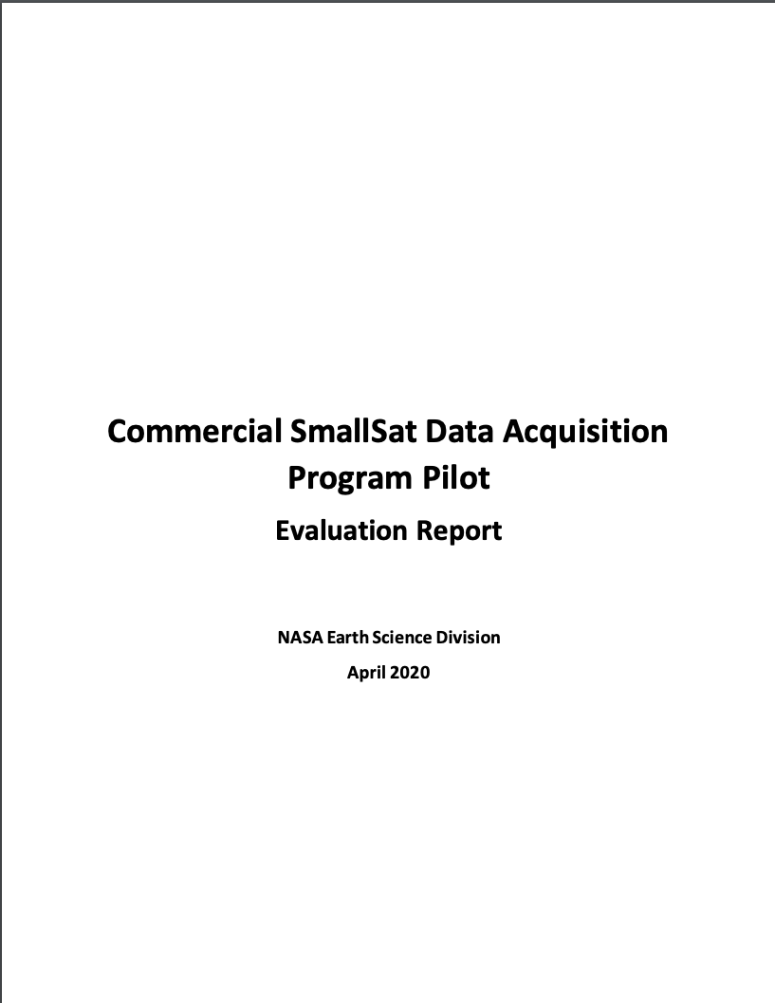
Commercial Smallsat Data Acquisition (CSDA) Program
Pilot initiated in November 2017 to evaluate data from operating commercial small-satellite constellations for research and applied science activities
Augment and/or complement NASA Earth observations
Cost effective means to advance/extend research and applications
Blanket Purchase Agreements (BPAs) were awarded in September 2018 to Maxar (DigitalGlobe) Inc., Planet Labs Inc., and Spire Global
Pilot successfully ended early 2020 → sustained program - CSDA Program
Restrictive nature of the End User License Agreements (EULAs) made standard scientific collaboration difficult and must be addressed in future data purchases

Slide 3
Commercial Smallsat Data Acquisition (CSDA) Program Objectives
Establish a continuous and repeatable process to on-ramp new commercial data vendors.
Enable sustained use of purchased data for broader use and dissemination by Earth scientific community.
Ensure long-term data preservation, access and distribution of purchased data and long-term access for scientific reproducibility.
Coordinate with other U.S. Government agencies and international partners on the evaluation and scientific use of commercial data.
https://earthdata.nasa.gov/csdap

Slide 4
End User License Agreements (EULAs) Summary
Authorized User Community | Type of EULA
 | Public Release | U.S.G. Plus | U.S.G.
U.S. Federal Government including: U.S. State/Local/Tribal Government; Academia; Contractors and Grantees associated with Government Agency |  |  | X
U. S. Federal Government, Foreign Civil Partners |  | X | X
Public Release | X | X | X
Scientific Non-Commercial Use License
Tiered EULA approach is modeled after National Reconnaissance Office’s (NRO’s) family of EULAs.

Slide 5
CSDA Program License Uplifts
In 2021, CSDA licensing agreements expanded to broaden the applicability for scientific applications across the U.S. Government
Spire Global, Inc.: Available to Federal/State/Local/Tribal Governments & funded research
Full GNSS Science Data Catalog
Planet Labs: Available to Federal Civilian Agencies, National Science Foundation (NSF), and their funded research
Full PlanetScope and RapidEye archive
Other licensing details remain similar:
30-day latency; scientific use only
On-ramp #2 and beyond vendors– utilize the broaden licenses: USG, USG Plus, and Public Release
These licensing uplifts will make the data more readily-available across the government and improve both value and interagency collaboration.

Slide 6
Upcoming On-ramps and Evaluations
On-ramp #3: On-ramp of qualified vendors from third RFI (December 2020) is underway. Sole source synopsis posted for Capella Space, ICEYE U.S., Inc, GeoOptics, Inc, and GHGSat, Inc.
Selection of Principal Investigators (PIs) for evaluations via ROSES 2022 (A. 43); Proposals Due: July 21, 2022; Review panels being assembled
Procurements are underway
Future On-ramp Plans
Moving from BPAs to Multiple-Award Indefinite-Delivery, Indefinite-Quantity (IDIQ) contract with Firm-Fixed-Price (FFP) task orders, FY2023
On-ramp new vendors for evaluation of new commercial Earth observing data products
Sustained use and dissemination of previously CSDA evaluated data products
NASA will continue to require End User License Agreements (EULAs) to enable broad levels of dissemination and shareability of the commercial data with the US government agencies and partners.
Pre-solicitation Synopsis released April 12, 2022

Slide 7
ESA-NASA New Space Collaborations
ESA/NASA Joint Program Planning Group Sub-Group 3: Ground Segments and Data: Coordinated evaluation of commercial Third Party mission data
Elaborated common data assessment guidelines to be used to support future NASA and ESA evaluation of commercial missions
Drafted Joint ESA-NASA Earth Observation Mission Quality Framework Guidelines for Optical and Synthetic Aperture Radar (SAR)
Performed cross-assessment of some commercial missions, in particular Planet constellations (PlanetScope and SkySat constellations), exchanging information on the evaluation before publication
Coordinated participation in data quality workshops related to Very High Resolution EO (VH-RODA, JACIE)
Initiate discussions on coordination data licenses for data purchased and related issues for facilitating data use, where permissible

Slide 8
Opportunities for Collaboration
Data Evaluations
Mechanisms to share preliminary and final results and understand the commonalities as well as the differences among the results
Share final evaluation reports across CEOS
Data Quality Assessments
Collaborate on the development of common data quality assessment guidelines
Great start: Joint Draft ESA-NASA Earth Observation Mission Quality Framework Guidelines for Optical and Synthetic Aperture Radar (SAR). Briefed and well received at the CEOS Working Group on Calibration & Validation (WGCV) Infrared and Visible Optical Sensors (IVOS) 34 Meeting held August 31, 2022
End User Licenses
Have discussions on coordination data licenses for data purchased and related issues for facilitating data use, where permissible

