Slide 1
New Space & Future CEOS
Session 2
SIT TW 2022, ESA/ESRIN
14th - 15th September 2022

Slide 2
Scene-setting
And discussion to date..
SIT Chair Team Agenda Item 2.1
SIT TW 2022, ESA/ESRIN
14th - 15th September 2022

Slide 3
Session objectives & decisions
Objectives:
Continuation of the thread started at SIT-37, but in person!
Namely…reflection on the new geometries in the satellite EO sector, including increasing proportion of commercial missions, and CEOS agency arrangements for commercial data buy and partnerships - hearing agency experiences and examples and strategising how public programmes and CEOS must adapt in the decade ahead with this new context.
The background paper first distributed ahead of SIT-37 has further context and objectives.
Slide ‹#›

Slide 4
SIT-37 highlights
At SIT-37:
We highlighted the trends in the sector impacting CEOS agency programmes
We heard from 3 CEOS agencies on their relevant strategies and activities
CNES: initiatives with industry
NOAA: new architectures, joint ventures, and commercial data buys
EC: strategies for COPERNICUS + New Space
Recognised risks and opportunities for public EO, and challenges in formulating a productive cooperation strategy for CEOS that supports both public and private ambitions
Slide ‹#›

Slide 5
Space Market Segments

Slide 6
Investment opportunities across entire value chain

Slide 7
Context
The share of on-orbit EO satellites belonging to public EO programmes is shrinking rapidly
10 years ago, CEOS agencies launched 14 EO missions during 2012 calendar year (MIM)
5 from China
Some with commercial data aspects
SPOT-6 and Pleiades 1B the only identified commercial sector launches that year
By 2020, more than 50 private companies have announced their intention to develop Earth observing missions or constellations, representing roughly 1,800 small satellites, the majority of which are under 50kg
Eg Planet already has ~ 200 active EO satellites in orbit
8 CEOS launches in 2021 (5 from China)
MIM activity shows 80+ commercial EO missions in 2021 (mostly Planet)
These companies raised ~$US 5Bn in each of 2020 and 2021, up from $1Bn in 2019
Slide ‹#›

Slide 8
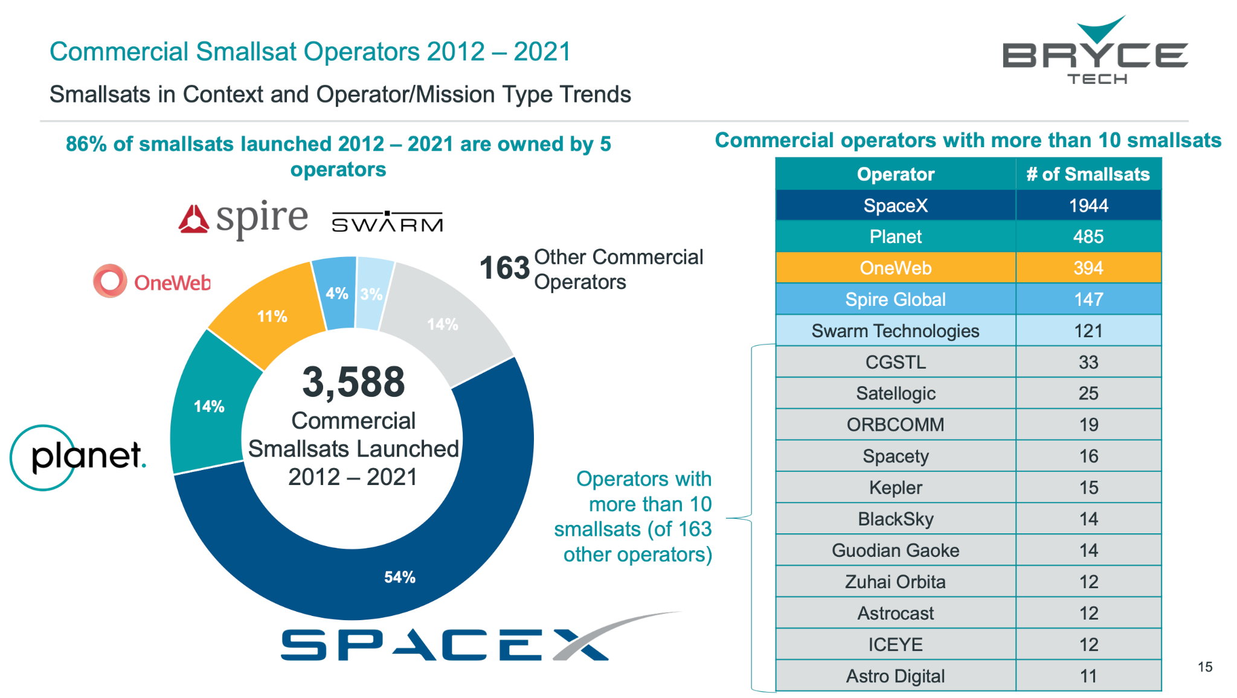
Context
EO missions
Slide ‹#›

Slide 9
Investment opportunities across entire value chain

Slide 10
Context
Slide ‹#›

Slide 11
Context
The space value chain is evolving, with the traditional upstream driven technology push transitioning into a market demand pull.
Space has attracted an important number of actors in the past decades, with New Space and non-space companies entering the different streams of the value chain
Several space agencies have established partnership with New Space companies
Generally EO domain remains geared towards defence and security markets, but an increasing demand from a diversified pool of customers is leading a rapid evolution - with more supply from new entrants, and innovative delivery models for data and analytics to support situational awareness
Cloud computing is bypassing the need for hardware and software ownership, opening up the market to startups and allowing companies to provide ground stations as well as full turnkey solutions as a service (GSaaS concept - allows satellite operators to focus on the core of their business: data)
Machine learning is facilitating the extraction of actionable insights from large amounts of data, automation of repetitive processes, and extending the use of space-based applications to new markets
Slide ‹#›

Slide 12
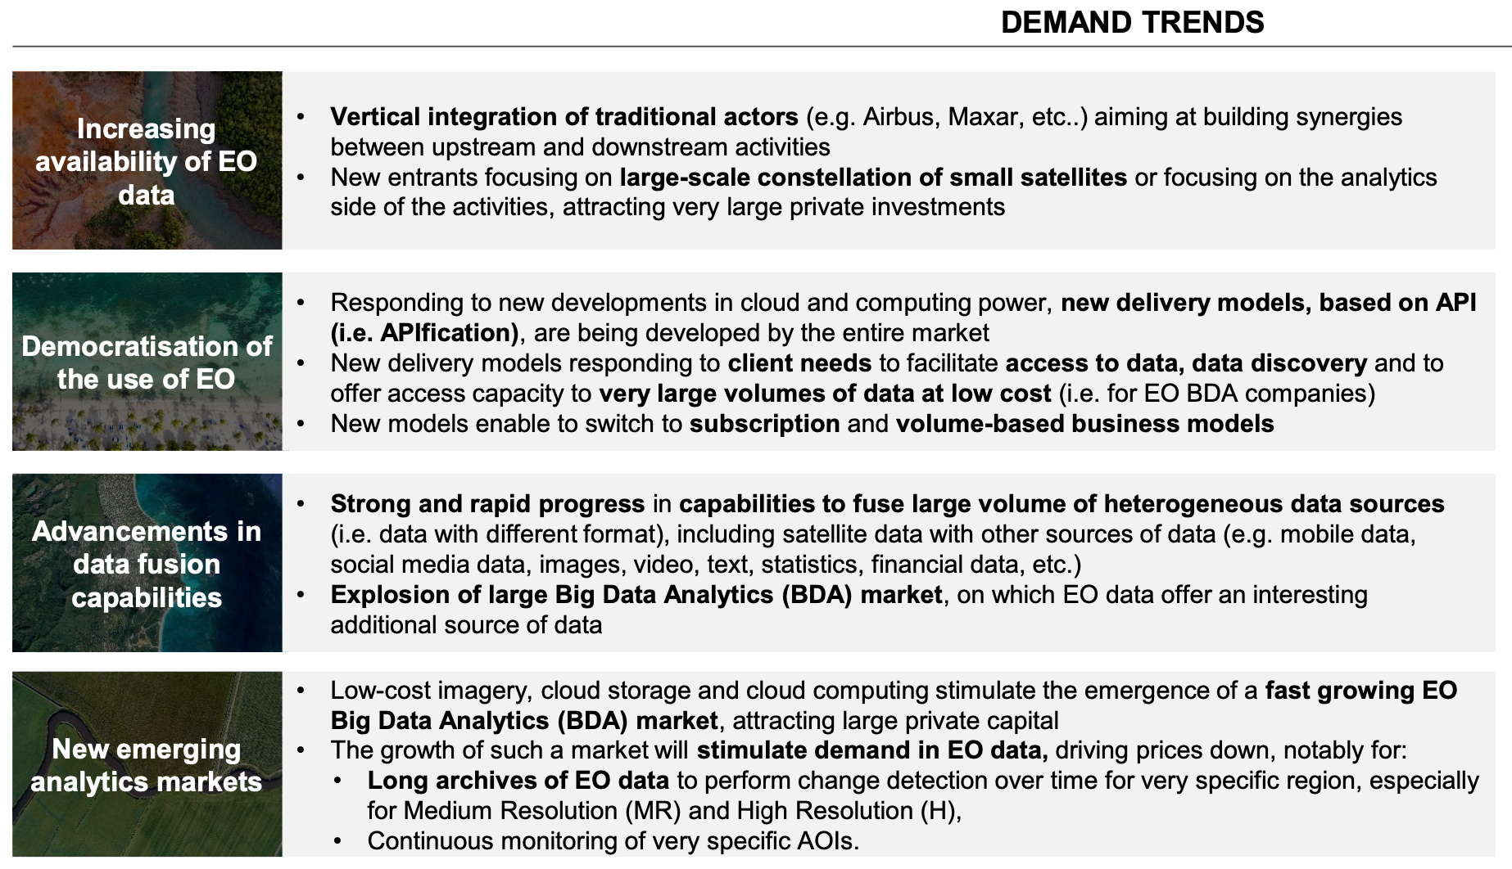
Important trends supporting growth in EO data products & services
Slide ‹#›

Slide 13
ESA and New Space
Main expected ESA’s role (from the point of view of New Space EO companies):
New Space companies working with ESA (i.e. not developing satellites for ESA, but ESA’s role as anchor customer or as co-funding the development):
through the EU Copernicus Contributing Missions activity for operational purposes
through the ESA Earthnet Third Party Missions activity for scientific purposes
through the ESA InCubed Public Private Partnership co-funding development programme
EOP performs technical and business case assessment of new commercial initiatives
Commercial EO
New Space companies working for ESA (i.e. developing satellites for ESA, role is identical to that of established companies but with new development methods):
FutureEO Scout missions (managed as an EOP-P project
PhiSats missions (managed as an EOP-ΦM project)
PROBA-V Cubesat companion (managed as TEC GSTP project)
AWS prototype (managed as an EOP-P project)

Slide 14
ESA and New Space
Finnish satellite imagery specialist ICEYE - commercial constellation of 14 small SAR satellites (18 by mid-2022).
Average access time: 3 hours anywhere on Earth.
Monitoring floods and mining activities, marine vessel detection and iceberg monitoring.
Copernicus Contributing Mission
Notes:
All current ICEYE imaging modes are offered through this programme. Users get access to the very high-resolution Spot imaging mode covering areas of 25 km², the high-resolution Strip and the recently launched Scan imaging mode covering areas of 10,000 km², respectively. It is possible to obtain archive data or request new image acquisitions.\
ICEYE builds and operates a commercial constellation of small synthetic aperture radar satellites. So far, 14 satellites have been launched and ICEYE and plans to expand its constellation up to 18 satellites by mid-2022, with the objective of reaching an average access time of three hours anywhere on the globe. The mission is used in many sectors, from monitoring floods and mining activities, to marine vessel detection and iceberg monitoring.
The ICEYE satellite constellation is a Copernicus Contributing Mission, complementing existing synthetic aperture radar missions in the Copernicus programme.
Read full story: ICEYE commercial satellite
at COP26, more than 100 countries have just signed up to the Global Methane Pledge, which aims to limit emissions by 30% compared with 2020 levels.
With both public and commercial satellite data playing key roles in assessing progress on climate action, ESA and GHGSat are supporting the United Nations Environment Programme’s new International Methane Emissions Observatory, also announced at COP26.

Slide 15
Session Agenda
2.1 Scene-Setting [15 mins]
2.2 Further Case Studies from CEOS Agencies [40 mins]
USGS, ESA, GISTDA, NASA, CSA (max 10 mins each)
2.3 Other Examples from across CEOS structure [50 mins]
Elevator pitches on New Space engagement or issues:
CEOS-ARD Oversight Group: CEOS-ARD supporting new space (Ferran Gascon)
LSI-VC (A Siqueira, S Labahn): Data Standards
WGCV (Kuze-san, Philippe): Supporting smallsat data quality
Other interventions as time permits
GROUP PHOTO & BREAK [20 mins]
2.4 Discussion on CEOS Strategy for New Space [45 mins]
Issues and ideas arising
Candidate measures and directions
Findings and recommendations - what next?
Slide ‹#›

Slide 16
Case Studies from CEOS Agencies
40 Mins total
Agenda Item 2.2
SIT TW 2022, ESA/ESRIN
14th - 15th September 2022

Slide 17
USGS
10 Mins
Tim Stryker, USGS Agenda Item 2.2
SIT TW 2022, ESA/ESRIN
14th - 15th September 2022

Slide 18
ESA
10 Mins
TBD Agenda Item 2.2
SIT TW 2022, ESA/ESRIN
14th - 15th September 2022

Slide 19
GISTDA
Watanyoo Suksa-ngiam, GISTDA Agenda Item 2.2
SIT TW 2022, ESA/ESRIN
14th - 15th September 2022

Slide 20
Global New Space Economy Trends
01
Decline in cost of launchers
Reduce in satellite size
Decline in manufacturing cost
Opportunities:
New technology wave for economic growth
Resources for humanity: energy and mining
Strengthening several industries (e.g., digital, electronics, aviation, autonomous vehicles,and telecommunication)
Tools for sustainable development goals
Challenges:
Inclusion of developing economies in space activities
Fair shares in space resources utilization
Space debris mitigation and removal
Cost reduction
02
Digital transformation
Big Data/A.I./IoT/Metaverse
Increase in demands
03
More than 500 startups worldwide
New hybrid public-private enterprises
Increase in entrepreneurs

Slide 21
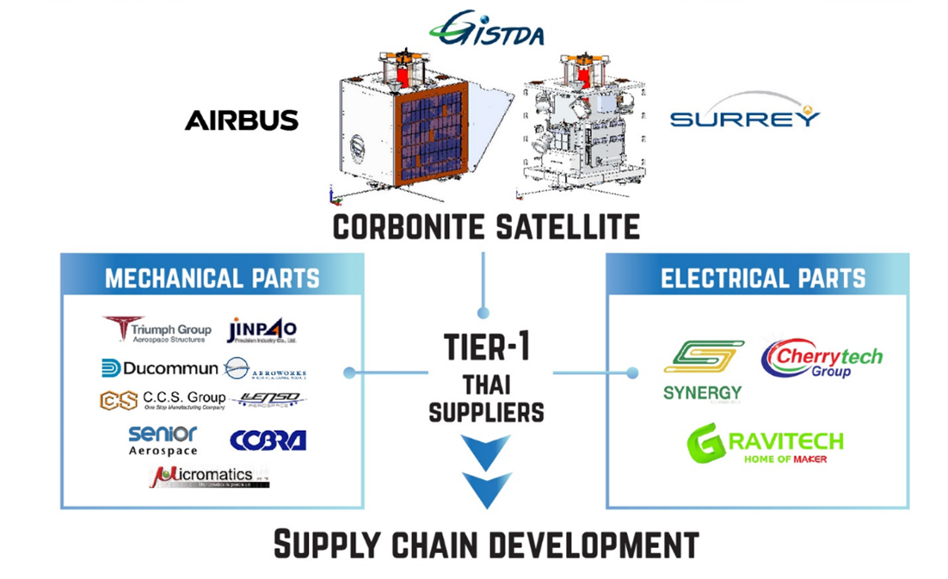
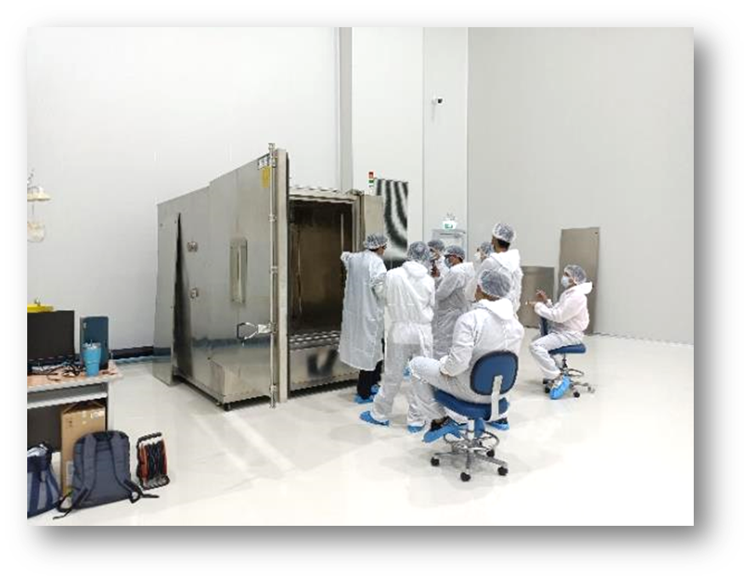
New Space Economy in Thailand
GISTDA as a New Space enabler:
Promoting private enterprises throughout the supply chain
Developing space infrastructure
Foundation for space enterprises
Developing National Space Master Plan (2023 - 2037)
The blueprint of Thailand’s new space economy
Drafting first Thailand’s space law as the implementation of international space laws

Slide 22
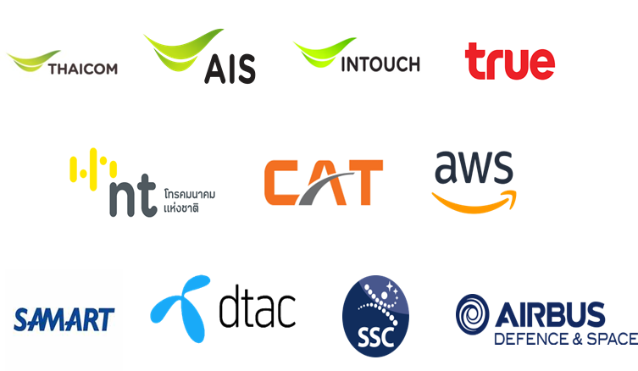
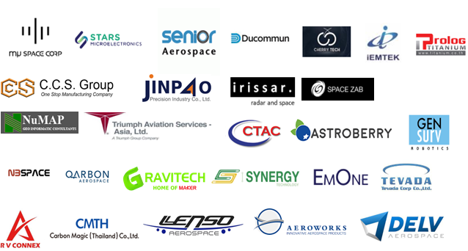
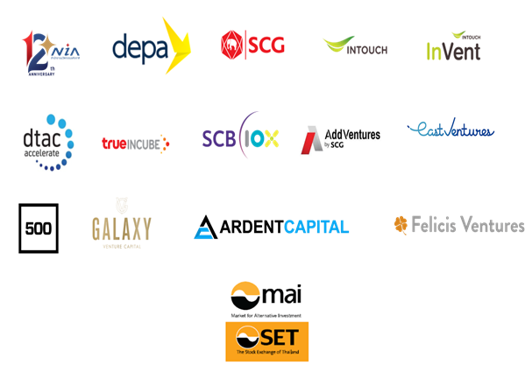
Thailand’s Space Economy Stakeholders
Education, Research, and Innovation Systems
Big Corporations
Entrepreneurs
Funders
Notes:
https://techsauce.co/report/thailand-tech-startup-ecosystem

Slide 23
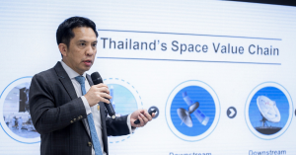
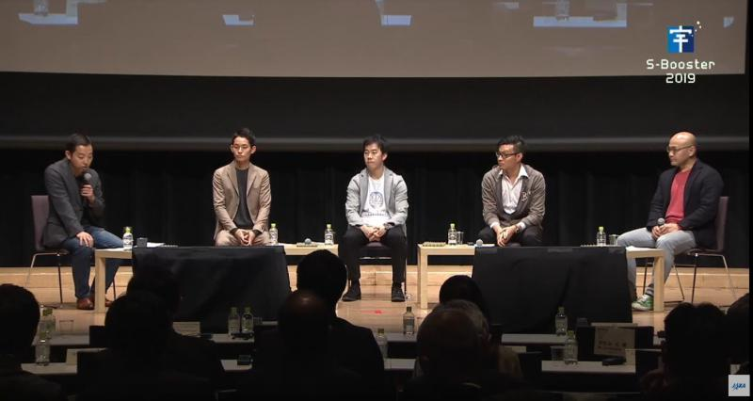
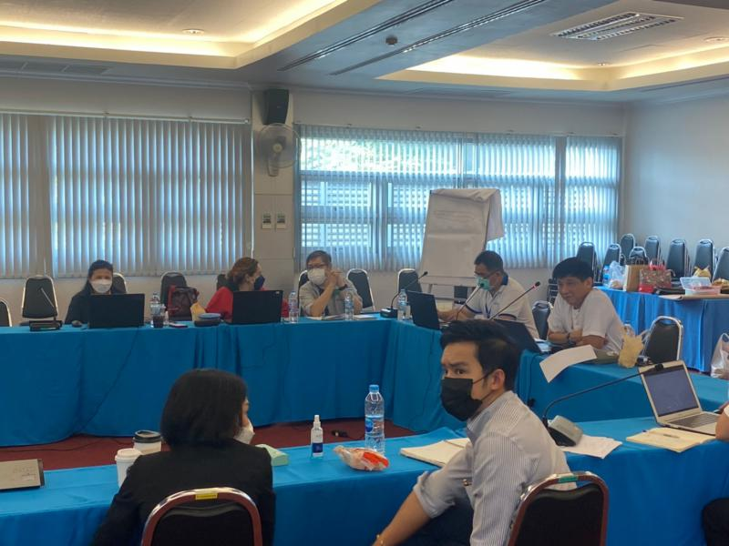
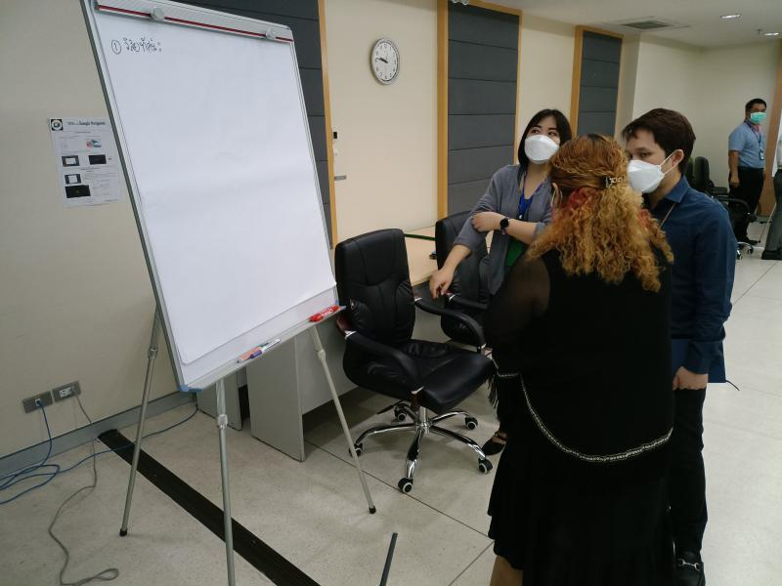
CEOS Mechanism for New Space Economy
In collaboration with CEOS:
GISTDA to support Strategic Implementation Team (SIT) to develop policy guidelines
To develop a mechanism for sharing experiences among CEOS agencies and stakeholders
Workshops (online, onsite, or hybrid)
Guest lectures
Panel discussion
Brainstorming
Interviews
Networking
Side meetings (e.g., 37th CEOS Plenary, 2023)

Slide 24
Outcome:Policy Guidelines
CEOS as a think tank for new space
Topics for examples:
Laws and regulations
Utilization of space resources
Commercialization of space
International market development
Industry development
Investment opportunities
Technology transfer
Space for sustainable development
Roles of public and private sectors
New Space Economy
Guidelines for Public Policy
By
SIT Technical Workshops
Committee on Earth Observation Satellites
2023
Notes:
https://www.publicdomainpictures.net/en/view-image.php?image=31051&picture=space

Slide 25
NASA
Commercial Smallsat Data Acquisition (CSDA) Program
10 Mins
Alfreda Hall, NASA Agenda Item 2.2
SIT TW 2022, ESA/ESRIN
14th - 15th September 2022

Slide 26
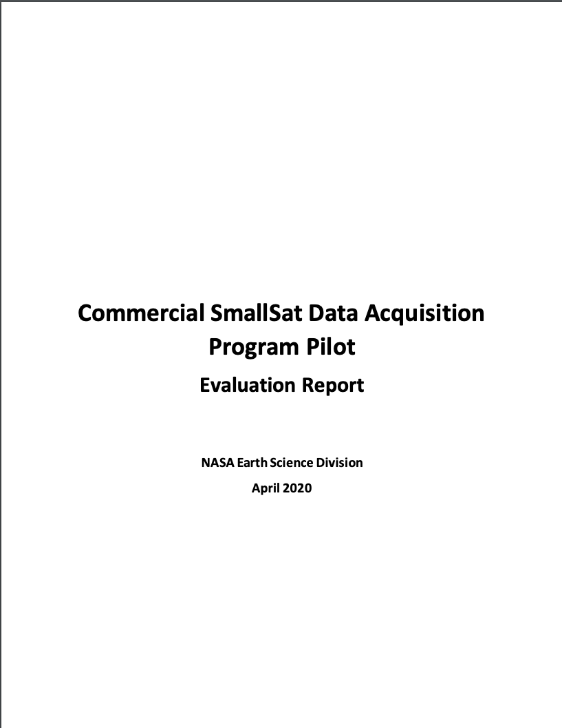
Commercial Smallsat Data Acquisition (CSDA) Program
Pilot initiated in November 2017 to evaluate data from operating commercial small-satellite constellations for research and applied science activities
Augment and/or complement NASA Earth observations
Cost effective means to advance/extend research and applications
Blanket Purchase Agreements (BPAs) were awarded in September 2018 to Maxar (DigitalGlobe) Inc., Planet Labs Inc., and Spire Global
Pilot successfully ended early 2020 🡪 sustained program - CSDA Program
Restrictive nature of the End User License Agreements (EULAs) made standard scientific collaboration difficult and must be addressed in future data purchases

Slide 27
Commercial Smallsat Data Acquisition (CSDA) Program Objectives
Establish a continuous and repeatable process to on-ramp new commercial data vendors.
Enable sustained use of purchased data for broader use and dissemination by Earth scientific community.
Ensure long-term data preservation, access and distribution of purchased data and long-term access for scientific reproducibility.
Coordinate with other U.S. Government agencies and international partners on the evaluation and scientific use of commercial data.

Slide 28
End User License Agreements (EULAs) Summary
Authorized User Community | Type of EULA
 | Public Release | U.S.G. Plus | U.S.G.
U.S. Federal Government including: U.S. State/Local/Tribal Government; Academia; Contractors and Grantees associated with Government Agency |  |  | X
U. S. Federal Government, Foreign Civil Partners |  | X | X
Public Release | X | X | X
Scientific Non-Commercial Use License
Tiered EULA approach is modeled after National Reconnaissance Office’s (NRO’s) family of EULAs.

Slide 29
CSDA Program License Uplifts
In 2021, CSDA licensing agreements expanded to broaden the applicability for scientific applications across the U.S. Government
Spire Global, Inc.: Available to Federal/State/Local/Tribal Governments & funded research
Full GNSS Science Data Catalog
Planet Labs: Available to Federal Civilian Agencies, National Science Foundation (NSF), and their funded research
Full PlanetScope and RapidEye archive
Other licensing details remain similar:
30-day latency; scientific use only
On-ramp 2 and beyond vendors– utilize the broaden licenses: USG, USG Plus, and Public Release
These licensing uplifts will make the data more readily-available across the government and improve both value and interagency collaboration.

Slide 30
Upcoming On-ramps and Evaluations
On-ramp #3: On-ramp of qualified vendors from third RFI (December 2020) is underway. Sole source synopsis posted for Capella Space, ICEYE U.S., Inc, GeoOptics, Inc, and GHGSat, Inc.
Selection of Principal Investigators (PIs) for evaluations via ROSES 2022 (A. 43); Proposals Due: July 21, 2022; Review panels being assembled
Procurements are underway
Future On-ramp Plans
Moving from BPAs to Multiple-Award Indefinite-Delivery, Indefinite-Quantity (IDIQ) contract with Firm-Fixed-Price (FFP) task orders, FY2023
On-ramp new vendors for evaluation of new commercial Earth observing data products
Sustained use and dissemination of previously CSDA evaluated data products
NASA will continue to require End User License Agreements (EULAs) to enable broad levels of dissemination and shareability of the commercial data with the US government agencies and partners.
Pre-solicitation Synopsis released April 12, 2022

Slide 31
ESA-NASA New Space Collaborations
ESA/NASA Joint Program Planning Group Sub-Group 3: Ground Segments and Data: Coordinated evaluation of commercial Third Party mission data
Elaborated common data assessment guidelines to be used to support future NASA and ESA evaluation of commercial missions
Drafted Joint ESA-NASA Earth Observation Mission Quality Framework Guidelines for Optical and Synthetic Aperture Radar (SAR)
Performed cross-assessment of some commercial missions, in particular Planet constellations (PlanetScope and SkySat constellations), exchanging information on the evaluation before publication
Coordinated their participation to data quality workshops related to Very High Resolution EO (VH-RODA, JACIE)
Initiate discussions on coordination data licenses for data purchased and related issues for facilitating data use, where permissible

Slide 32
Opportunities for Collaboration
Data Evaluations
Mechanisms to share preliminary and final results and understand the commonalities as well as the differences among the results
Share final evaluation reports across CEOS
Data Quality Assessments
Collaborate on the development of common data quality assessment guidelines
Great start: Joint Draft ESA-NASA Earth Observation Mission Quality Framework Guidelines for Optical and Synthetic Aperture Radar (SAR). Briefed and well received at the CEOS Working Group on Calibration & Validation (WGCV) Infrared and Visible Optical Sensors (IVOS) 34 Meeting held August 31, 2022
End User Licenses
Have discussions on coordination data licenses for data purchased and related issues for facilitating data use, where permissible

Slide 33
CSA
10 Mins
Frederic Fournier, CSA Agenda Item 2.2
SIT TW 2022, ESA/ESRIN
14th - 15th September 2022

Slide 34
Recurring topics of interest
Feedback Frequency | Topic
High | Access to data and open data Collaboration and relationship between academia and research, industry and the public sector.
Moderate | Development of the EO strategy (must be tailored to the needs of EO actors) International branding and collaboration Long-term strategy for training highly-qualified personnel (HQP) Mission Launch
Low | How to create Value-added products Improving internal processes in Government agencies Data comparability (by year, or with int’l sources)
Community Guidance
Industry (27)
Academia and Research (28)
Public sector (27)
Slide ‹#›
Notes:
The overall objective of the 2022 Earth Observation Forum (EO Forum) is to present a joint positioning of the Government of Canada on Earth Observation initiatives by taking into consideration the needs and requirements of other key Earth Observation communities (namely industry, Academia, Indigenous communities and public sector) as they all have to be involved in the development of a roadmap of EO initiatives.
To obtain community guidance, positioning and feedback from Canadian satellite EO stakeholders, and in preparation for the EO Forum, preparatory sessions were held in June 2022 and reached the following groups : Academia and Research (28 participants), Public sector (26 participants) and Industry (27 participants).
Session 1: Academia and Research
There were 28 participants :
● Canadian EO strategies should have a longer time horizon, more consistent mission
planning, and provide more regular funding to facilitate academic planning and linkages
between research and public funding. (6 times)
● Have a long-term vision for the training of highly qualified personnel and facilitate their
integration across the different sectors in EO (6 times).
● Launching missions by the Canadian Space Agency to meet Canadian needs in EO or
to fill knowledge gaps in EO (5 times)
● Open data, open data policies or simplified access to data (5 times)
● How to foster collaboration and relationships between industry, academia and the public
sector (5 times)
● Having space missions that address climate or climate change themes (4 times)
-------------------------------------------------
Session 2: Public sector (Fed/prov)
There were 26 participants :
● How to set up collaboration between industry, academia and the public sector which are
mutually beneficial for the various parties to create new products, build efficiencies and
leverage expertise. (8)
● Open data access, open data policies and creation of an open data platform (6)
● How to create new EO value-added products that respond to the industry’s needs (5)
● Canada international leadership and brand in the international EO community and how
Canada can be better involved in international projects such as data sharing (4)
● Have trainings or well-trained and available people to help implement the SEO data or
work with data (e.g., data entry, data processing) (4)
----------------------------------------
Session 3: Industry
There were 27 participants :
● Ways to offer access to various data (ex. Climate data, international data) through a
platform, data-sharing initiative or an open data solution. (11)
● Canada international collaboration to integrate other international initiatives, give access
to data or better support the industry, share data in EO and how Canada can improve its
own branding internationally (7)
● Develop better collaboration and relationships between academia, industry and the
public sector so the Government can better support the industry, have a better insight
from each stakeholders need or create new technologies. (5)
● Satellites launches to monitor Canada or the Earth (4)

Slide 35
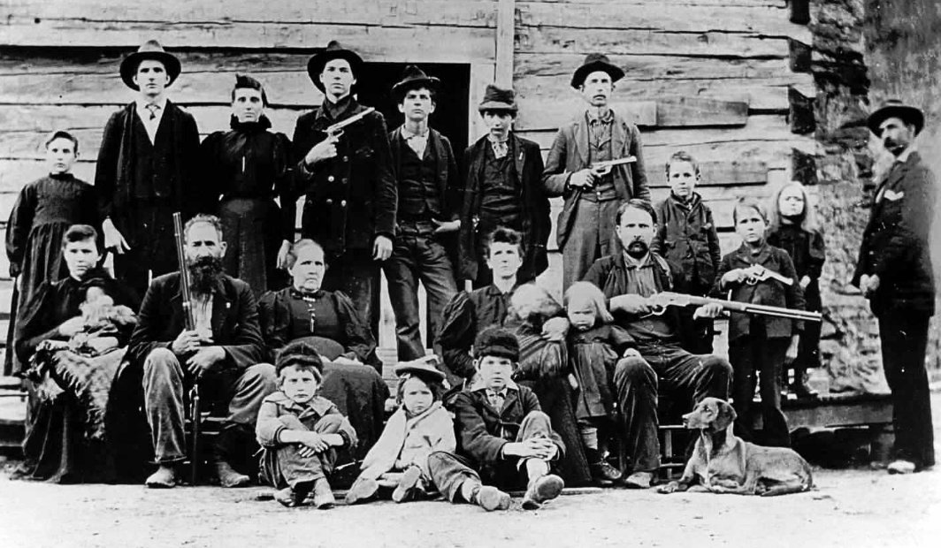
Group Photo & Break!
20 Mins
SIT TW 2022, ESA/ESRIN
14th - 15th September 2022

Slide 36
CEOS Team Elevator Pitches
50 Mins
Agenda Item 2.3
SIT TW 2022, ESA/ESRIN
14th - 15th September 2022

Slide 37
Elevator pitches
10 minute slots from volunteers across the CEOS structure - explaining how their work may benefit CEOS and space agency engagement with New Space for the greater good.
Volunteers:
CEOS-ARD Oversight Group (Ferran Gascon): CEOS-ARD supporting new space
LSI-VC (A Siqueira, S Labahn): Data Standards
WGCV (Kuze-san, Philippe Goryl): Supporting smallsat data quality
Others inspired to contribute are welcome as time permits
DISCUSS!
Slide ‹#›

Slide 38
CEOS-ARD Supporting New Space
Ferran Gascon, ESA
CEOS-ARD Oversight Group Lead
Agenda Item #2.3
SIT TW 2022, ESA/ESRIN
13th - 15th September 2022

Slide 39
Background
CEOS-ARD (CEOS Analysis Ready Data)
Specifications for key data products
To ease data analysis
To minimize additional user effort
CEOS-ARD is a key step within the ‘interoperability spectrum’:
From WGISS & LSI developed CEOS Interoperability Terminology Report (2020)

Slide 40
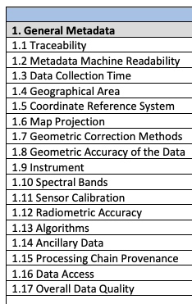
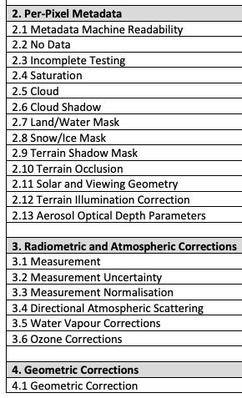
Background
The CEOS-ARD Product Family Specifications (PFS) define parameters which facilitate interoperability
A subset of what is needed to achieve full interoperability

Slide 41
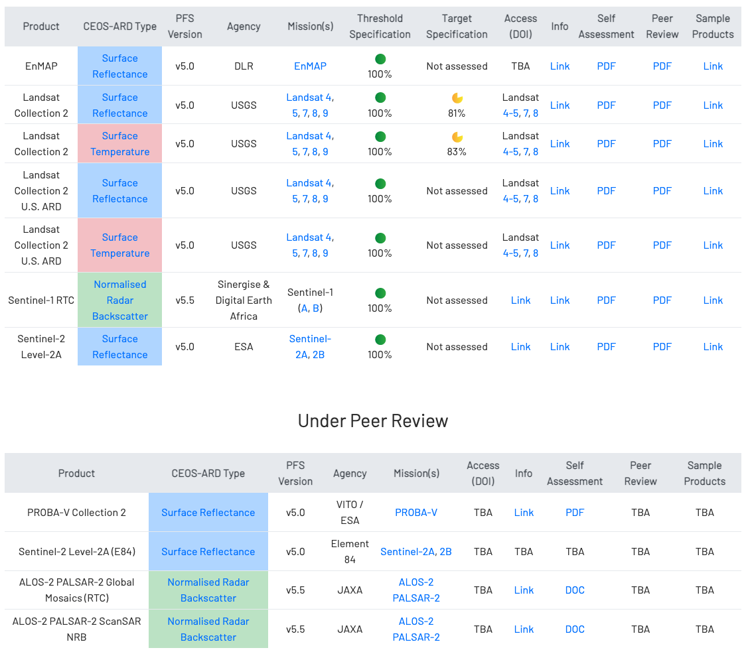
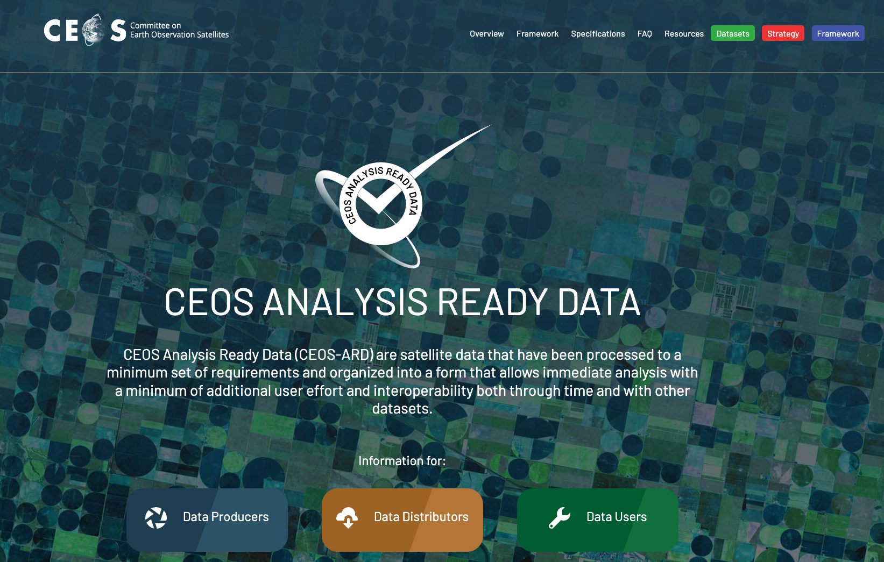
CEOS-ARD Products
https://ceos.org/ard

Slide 42
CEOS-ARD Vision / Motivation
Move CEOS agencies and other data providers' land surface imaging datasets along the interoperability spectrum, with a view to a future of sensor agnostic land surface data from all missions
Maximise the uptake and impact of all data sources for societal benefit
Reduce data processing burden on users
Products assessed as CEOS-ARD are known by the community to meet the high standards set by CEOS space agencies, can be branded as such with the CEOS-ARD logo, and will be listed on ceos.org/ard. Assessments increase confidence and expand the reach and uptake of datasets.

Slide 43
CEOS Role
Much activity and talk in the community around ‘Analysis Ready Data’
Term ‘ARD’ is inherently subjective
CEOS, with its long heritage, experience and expertise has a key role to play in defining ARD for the community
Incl. ‘New Space’
Led the way with Land Surface Imaging
CEOS-ARD Oversight Group now looking at other domains

Slide 45
Motivations
Enabling interoperability of all these (+ CEOS!) datasets
In an ‘open’ way, i.e., direct from the data providers – not relying on others downstream to do the interoperability steps
Maximimise impact for all users, avoid platform dependency
Avoid unsuitable downstream handling of data / different approaches
Undermines idea of interoperability!
CEOS-ARD concepts are the first key step, but also need:
Gridding
Cloud-optimisation
Discoverability (STAC)
Consistent terminology
Consistent radiometric & geometric references and traceability
➤ CEOS Interoperability Framework

Slide 46
ARD Standards
Overwhelming feedback from industry: formal standards are needed for ‘ARD’
Without a standard: difficult to implement CEOS-ARD into operational workflows and to ensure products interoperability.
Government and commercial sectors will likely not reference documents unless they have gone through an open standard process.
Standards built on the foundation of CEOS-ARD would be helpful
Increase reach of the concepts of CEOS-ARD
Two avenues explored:
ISO-OGC
IEEE/GRSS
Discussed further in following presentation…

Slide 47
‘New Space’ Engagement so far…
Increasing engagement with private sector/new space on CEOS-ARD
Sinergise: Produced the first Normalised Radar Backscatter CEOS-ARD – Sentinel-1 RTC for Digital Earth Africa
Satellogic: Presented to LSI-VC, will consider CEOS-ARD PFS, currently developing their Surface Reflectance product – potential for CEOS-ARD from outset
Capella: Free SAR imagery via the Registry of Open Data on AWS, CEOS-ARD Oversight Group engaged with them on possibility of CEOS-ARD assessment of products.
Earlier CARD4L PFS dialogue w/ Planet, PCI Geomatics, and Maxar in 2020
All ad hoc, past relationships, engagement of opportunity, etc.
Proposed update of Commercial (incl. New Space) Engagement Strategy in LSI-VC – increase engagement coordination

Slide 48
CEOS Support
CEOS should consider:
Promote CEOS-ARD from its own missions
Fully resource effort to move to routine production of CEOS-ARD for all missions, from the outset
Look at reprocessing campaigns for older missions.
Resource Commercial Engagement Strategy (incl. New Space)
Take the lead in standardisation effort of ARD
Ensure sufficient resources to engage
CEOS-ARD as basis

Slide 49
CEOS Support
CEOS should consider:
Work with commercial sector incl. New space to promote datasets in line with CEOS-ARD specifications
Provide support to commercial and new space sector to meet specifications
Seek to evolve CEOS datasets along the interoperability spectrum - working on the additional components needed
CEOS Interoperability Framework
Data quality and Cal-Val
Support CEOS-ARD OG investigation into ARD for other domains
New applications and users of more niche datasets - moving beyond land

Slide 50
Data Standards
10 Mins
A Siqueira & S Labahn, LSI-VC Agenda Item 2.2
SIT TW 2022, ESA/ESRIN
14th - 15th September 2022

Slide 51
Supporting smallsat data quality
10 Mins
A Kuze & P Goryl, WGCV Agenda Item 2.3
SIT TW 2022, ESA/ESRIN
14th - 15th September 2022

Slide 52
Discussion on CEOS Strategy
10 Mins
45 Mins
Agenda Item 2.4
SIT TW 2022, ESA/ESRIN
14th - 15th September 2022

Slide 53
SWOT for CEOS & Sectoral Changes
 |  | Positive |  | Negative
Internal |  | Strengths Long heritage of well characterised and long life EO missions Existing international collaboration on major challenges such as ECVs & SDGs Connected to policy communities (eg UNFCCC) Long term observing programmes Public data policies trend towards free & open Innovative sensors for improved contribution to science Already engaged with private sector data management |  | Weaknesses Best efforts Slow relative to non-traditional systems History of awkwardness when national industry benefits enter conversation Institutional mechanisms reduce flexibility Cooperations between national agencies are slow to implement
External |  | Opportunities Engage $Bns for new EO infrastructure on our big challenges like climate & disasters Support the utility of and combine with New Space to improve ability of satellite EO to address challenges - New Space data as a complement to public EO data Harness our decades of standards work to support data mixing and interoperability Harness our cal-val legacy infrastructure and expertise (including CEOS agency SITSAT projects) to ensure quality of New Space outputs <strength of public missions in cal/val starts with onboard capabilities that new space satellites often lack> Multiple win-win mechanisms possible e.g. long-term institutional support to the sustained growth of New Space sector |  | Threats Erosion of public EO programmes from pressure to support New Space & improved cost-benefit from New Space approaches Loss of trust and confidence in EO if the New Space infrastructure output quality is poor or claims are inflated Strengths of traditional approach in quality and programme management etc not appreciated Space environment congestion/debris
Slide ‹#›

Slide 54
Candidate measures
Examples to leverage our long technical heritage:
CEOS has spent decades investing in data standards for interoperability, ARD, catalogues etc. If we anticipate an explosion in diversity of datastreams and sources, including through space agency data buys, is NOW not the time to seek uptake of those standards?
For maximum benefit across the whole sector
To allow public EO programmes to be bigger than the sum of their parts
Ensure all our good work is not lost in the noise of a rapidly expanded sector
Likewise we have huge investment by CEOS agencies in legacy infrastructure for cal-val
Supporting easier access and application of the legacy infrastructure for New Space would increase utility and value of the commercial data. Regarding commercial data buy: mostly by national space agencies - could national arrangements made such CEOS WGs and VCs can benefit from this data ?
Australia and UK discussion of Data Integrity Framework for that purpose
Open Source Toolkit for use of CEOS agency cal-val sites
SITSAT (SI Traceability Satellites) efforts by ESA/UK (TRUTHS), NASA (CLARREO), GA (SCR). Not only: large “public” satellites carry onboard calibration capabilities and benefit from an excellent attitude control
DISCUSS!
Slide ‹#›

Slide 55
Next steps
Principals discussion at CEOS Plenary - New Space session volunteered by CEOS Chair, CNES
Looking for concrete actions in 2023 for our 2nd year as SIT Chair Team
Slide ‹#›

