Slide 1
3.2 Update on COAST: Coastal Observations, Applications,
Services & Tools
Paul M. DiGiacomo, NOAA/NESDIS
Co-Lead of CEOS-COAST
CEOS SIT Technical Workshop
16 September 2021

Slide 2
CEOS-COAST Progress Since SIT 36
CEOS-COAST endorsed as a ‘UN Ocean Decade’ Contribution, 8 June 2021
Significant progress in Product Development and Stakeholder Engagement for the first 2 COAST Pilot Regions (Bay of Bengal and Chesapeake Bay) with 5 thematic product areas now in development; 5 pilot regions for 2022
Extensive COAST Outreach: ECO magazine, e-brochure, video et al.
Preparing for 2022 ½ day Regional User Engagement Workshops in 2022
Co-Design and Co-Development of products
5 Oct 2021 GEO/CEOS Engaging Users Event: COAST Product Showcase
Coordinated with CEOS and GEO, 90 minute demo & discussion
See next slides for further details...
For discussion: proposal for an overarching CEOS Ocean Strategy for 2022

Slide 3
12 PM UTC

Slide 5
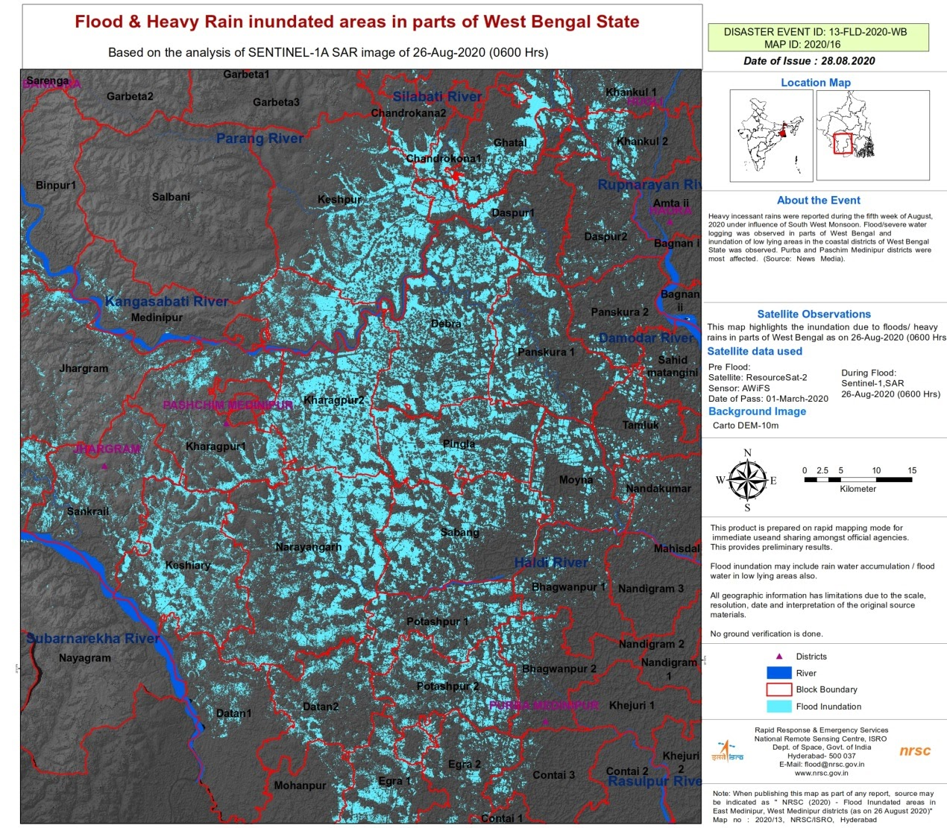
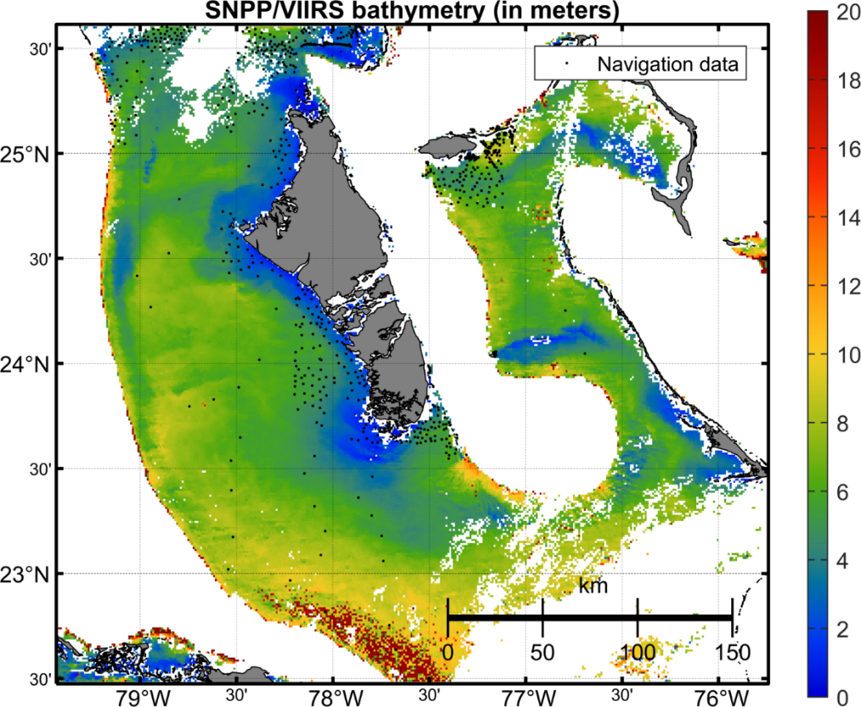
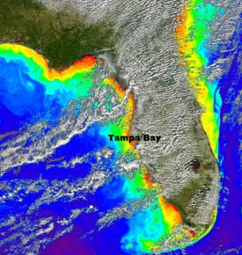
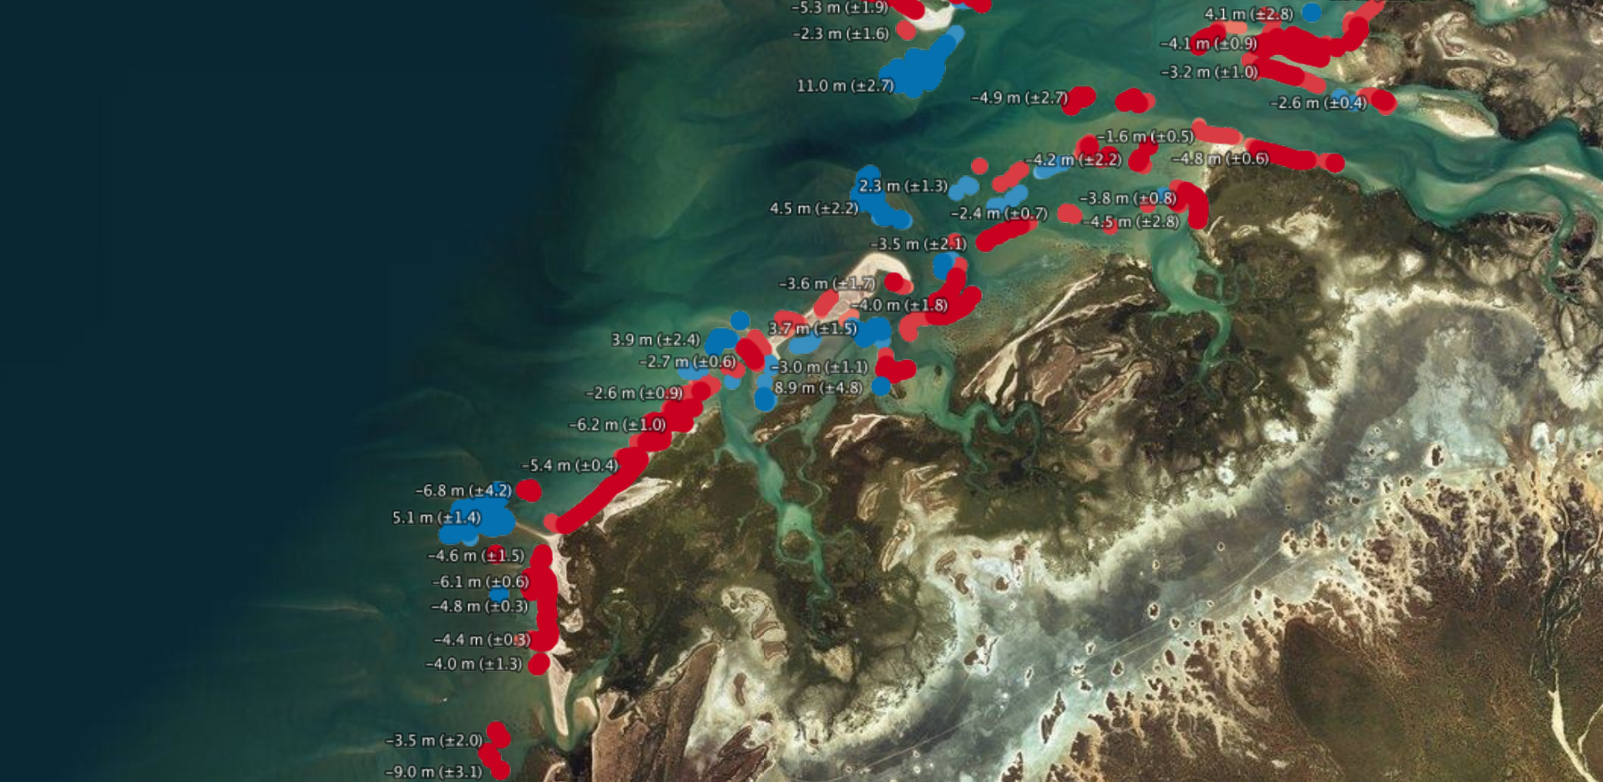
Initial COAST Pilot Locations
Continental:
Odisha/Bay of Bengal
Chesapeake Bay (USA)
West Coast of Africa
Rio de la Plata region (Latin America)
Small Island Nations:
Caribbean: USVI
Pacific: Marshall Islands
Initial COAST Products:
Flooding Inundation, Bathymetry,
Shoreline mapping, Water Quality:
Sediments, Eutrophication et al.

Slide 6
Schedule (90 mins):
Welcome Statements by Yana Gevorgyan (GEO Director) and Adam Lewis (CEOS Strategic Implementation Team Co-Chair) - 5 mins
COAST Intro/Overview and Opportunities by COAST Co-Leads Paul DiGiacomo (NOAA) and Raj Kumar (ISRO) - 10 mins
Deeper dive - users, regions, and products (pre recorded talks):
Pilot Exemplars: Bay of Bengal User Needs/Stakeholders (Rashmi Sharma, ISRO) and Chesapeake Bay User Needs/Stakeholders (Nicole Bartlett, NOAA)
Products: 1) physical oceanography – Jerome Benveniste, ESA 2) coastline mapping - Stephen Sagar, Geoscience Australia 3) bathymetry – Ratheesh Ramakrishnan, ISRO 4) sediments/turbidity - Steve Greb, GEO AquaWatch 5) eutrophication – Emily Smail, GEO BluePlanet
Q&A and Discussion (moderated by Raj and Paul) – up to 45 minutes
Closing - Doug Cripe (GEO, Sr. Scientific Advisor) and Marie-Claire Greening (CEOS CEO)

