Slide 1
WGCV
Committee on Earth Observation Satellites
Akihiko KUZE and Philippe GORYL
CEOS SIT Technical Workshop 2021
Session and Agenda Item 3.1.2
Virtual Meeting
7-9 and 14-16 September 2020

Slide 2
Report from WGCV
<Meetings>
(1) WGCV-49 virtual meeting between June 29- July 1
Revisited the WGCV CARD4L review process to improve timeliness and efficiency.
Odele Codington presented “TSIS solar reference spectra”
David Crisp presented “WGCV Support to the CEOS Strategy for the Global Stocktake of the UNFCCC Paris Agreement”
Intercomparisons: BRIX-2 and DEMIX, Organization: of ACIX3 (with focus on Hyperspectral) and CMIX2
(2) WGCV members joined the ISO 19124 meeting on Aug 30.
Discussed topics: Maturity Matrix (MM) stage, Data Product Level Definitions
Draft technical standard deadline is end of December 2021.
(3) WGCV-50
Proposing a hybrid and joint meeting with WGISS between March 21-24, 2022 in Tokyo.

Slide 3
Report from WGCV
<WGCV Topics> (today’s presentation)
(1) Total and Spectral Solar Irradiance Sensor-1 (TSIS-1)
(2) Vicarious calibration (VCAL) Portal for Spaceborne GHG sensors

Slide 4
TSIS Solar Irradiance dataset for GHG SWIR spectrometers
<TSIS Objective>
The accurate measurement of total and spectral solar irradiance to improve understanding of solar variability and Earth’s climate response to solar variability.
<TSIS-HSRS>
TSIS-1 HSRS high-accuracy (0.3-1.3%), high-resolution (0.01 nm or better), solar reference spectrum
Uncertainty in SWIR irradiance (8-10%) was much reduced
User friendly data base with various spectral resolutions from radiometers to high resolution spectrometers.
<CEOS WGCV Action>
To recommend TSIS-1 HSRS as the new CEOS solar irradiance reference spectrum (one year).
To assess consistency between GHG sensors; OCO, TROPOMI, GOSAT, extending 2.3 micron for CH₄ and CO.

Slide 5
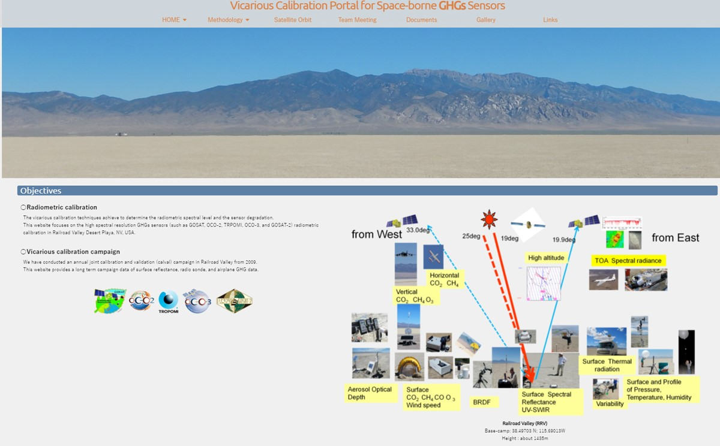
VCAL portal for GHG sensors
GHG sensors have wide swath with larger footprints and SWIR channels at CO₂ and CH₄ bands.
Radiometric calibration is required to estimate the light path modification by aerosol and clouds, which is one of the largest error sources in GHG column density retrieval.
The VCAL Portal site provides
Methodology of vicarious calibration for various size footprint and off-nadir data.
13-year annual joint campaign data for CAL-VAL
Dataset for analysis
Analytical results from various type of spectrometers: GOSAT FTS, OCO, S5P TROPOMI
https://www.eorc.jaxa.jp/GOSAT/GHGs_Vical/index.html

Slide 6
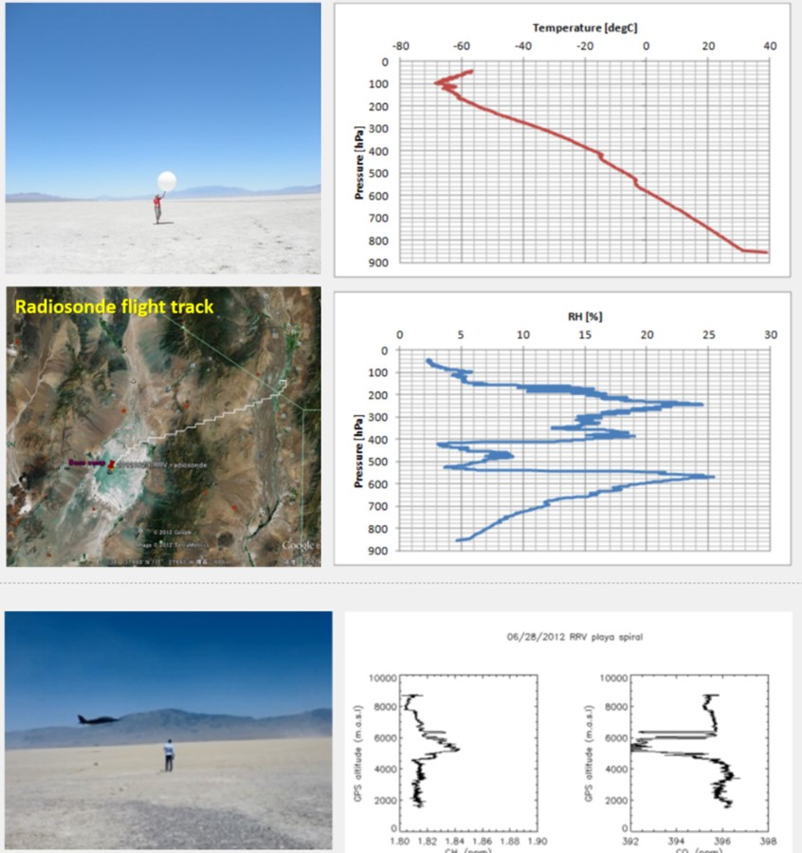
VCAL portal for GHG sensors
Annual campaign data
13-year annual campaign data at railroad Valley, NV, U.S.A.
Intense measurements at the time of satellite overpass.
(1) Surface reflectance (350-2500 nm, 1 nm)
Both nadir and off nadir
BRDF and reflectance changes after rain.
(2) Radio Sonde
During the campaign, T and RH each day
H₂O profile is needed for forward calculation in SWIR
(3) AJAX vertical spiral flight (more than 50 profiles)
CO₂, CH₄, O₃ (surface to 8km)
(4) Ground based EM27 FTS
(5) Others (AOD, surface pressure)

Slide 7
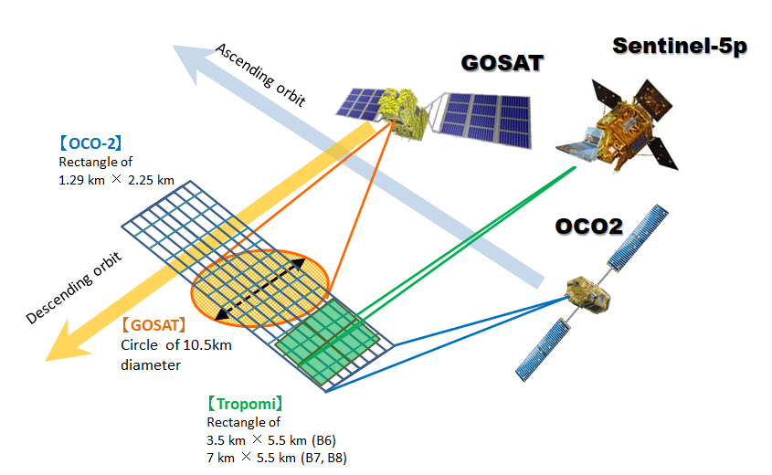
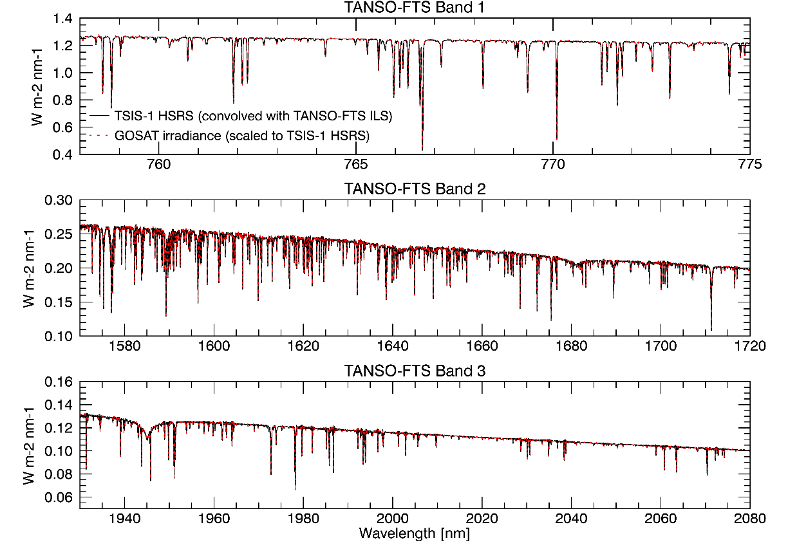
VCAL portal for GHG sensors
Database for Analysis
(1) MODIS Bidirectional Reflection Distribution Function (BRDF) database for bright surface
OCO-3 targeting
S5P has wide swath
GOSAT and GOSAT-2 targeting, large footprint
University Massachusetts Boston provides a special product for the GHG VCAL.
New MODIS MCD43A1-061 product are suitable for large footprint (extrapolation) and BRDF correction.
(2) Solar Reference Data
Collaborating with TSIS science team led by LASP, U. Colorado to provide accurate solar irradiance data base at NIR and SWIR with high spectral resolution.
Assessing consistency with GOSAT solar calibration data.
The portal links the database and provide recent reports.

