Slide 1
ESA SIT Chairmanship Priorities
SIT Technical Workshop
Sep 2021

Slide 2
SIT Term Priorities
WHAT do we want to do?
Focus on global challenges with strong UN mandates, GEO support, and high relevance for satellite EO
HOW do we want to do it?
Exploring how CEOS can employ new geometries with industry, new missions, and new data and analysis techniques for maximum impact and continued relevance in a changing sector

Slide 3
Thematic Priorities
Strong UN mandates, GEO support, and high relevance for EO
Climate & Carbon (UNFCCC, Paris Agreement and the GST)
Sustainable Development Goals (2030 Agenda)
Disaster Risk Reduction (Sendai Framework)
We will track the emerging (4th) GEO priority
Resilient Cities & Human Settlements (New Urban Agenda 2016, SDG #11)
And ensure support for ongoing CEOS thematic observing strategies, such as COVERAGE, COAST and our VCs (e.g. GEO Blue Planet & SDG 14.1 eutrophication)
Outcome focused term with SIT and TW agendas supporting our 2-year targets
Success in these thematic priorities will translate into opportunities for engaging new users not familiar with EO from space, on these and other themes
Notes:
Potential future users: international, regional and national organisations such as UN agencies (incl. SDG Indicator Custodian Agencies), National Statistical Offices, and the Financial Institutions (e.g. World Bank)

Slide 4
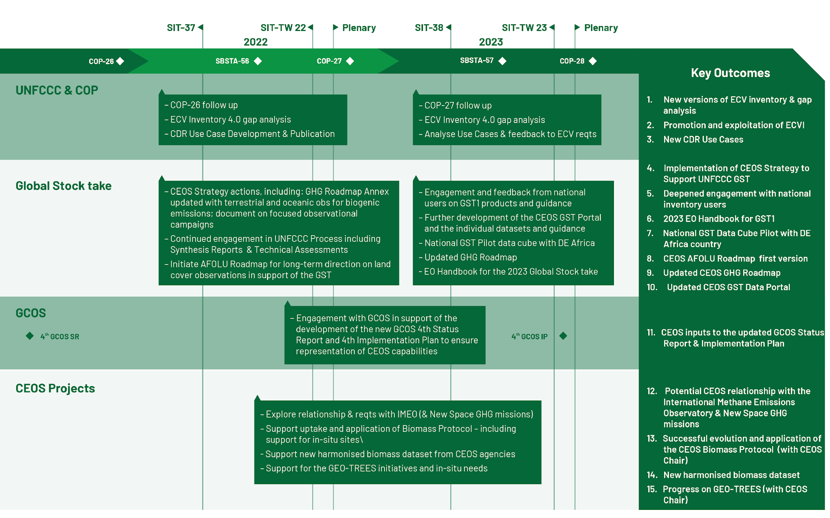
Support to Global Challenges –
Climate & Carbon
Notes:
UN Environmental Programme (UNEP) on 2 March 2021 officially announced the creation of the International Methane Emissions Observatory (IMEO).

Slide 5
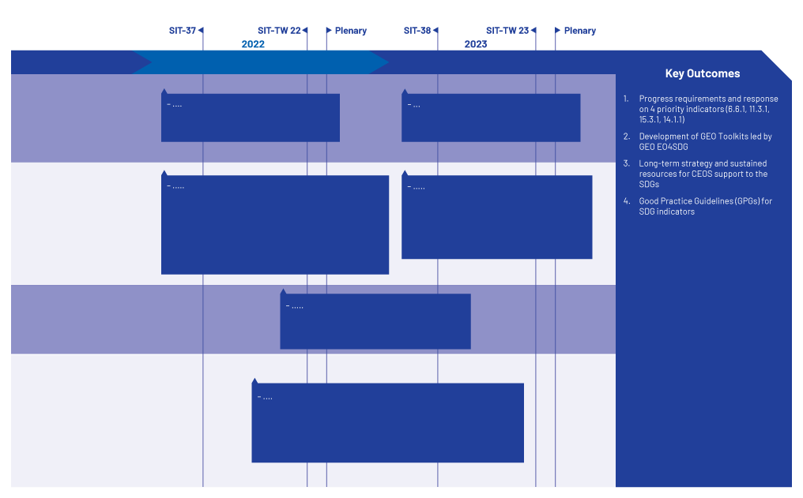
Support to Global Challenges – SDGs
Notes:
A new indicator (5th one ) is going to appear at SIT TW: 2.4.1 (proposed by SEO)

Slide 6
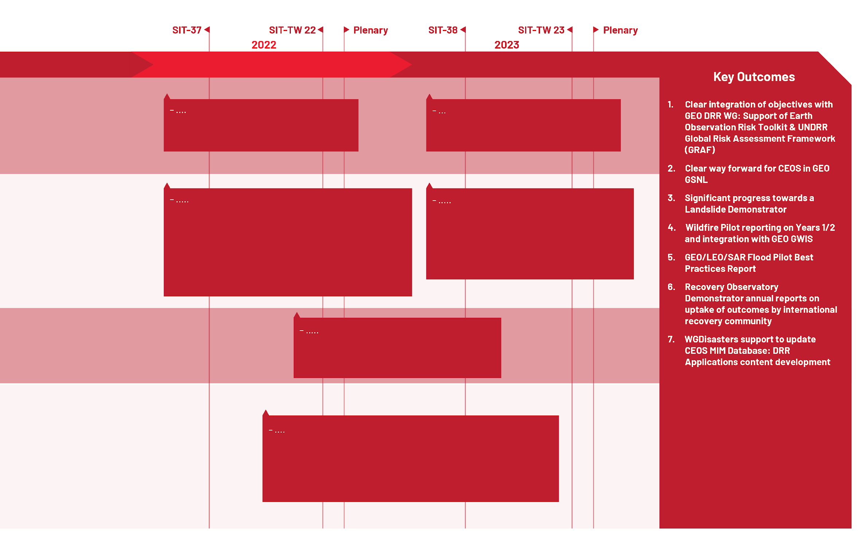
Support to Global Challenges – Disasters

Slide 7
SIT Term Priorities – Forward looking!
Improve CEOS support to global challenges with 3 lines of action:
New geometries for space agencies and CEOS with New Space companies
New mission needs and users
New data techniques

Slide 8
New geometries with New Space
Governments are integrating new arrangements with Space 2.0 firms into their satellite EO programme planning
Expected mutual benefits, added-value and the duality / complementarity of the missions operated by both New Space and Space Agencies.
CEOS must keep up and consider implications for its thematic observation strategies
Opportunity for GEO role
Exchange of experience and ideas, lessons learned
International Methane Emissions Observatory (with GHGSat/EDF) invited to TW 2021 by Australian SIT Chair Team
Notes:
EDF: Environmental Defense Fund (ww.edf.org)

Slide 9
New mission needs and users
CEOS agency programmes and EO technologies continue to evolve in order to improve the service to the user community.
We would like to provide greater opportunities for agencies to report on and seek feedback on their candidate missions and concepts
ESA would like to explain the Copernicus missions (Expansion, Extension, Contributing) to CEOS Working Teams and agencies to seek feedback on their utility for the CEOS thematic observing strategies
And explore potential new collaborations

Slide 10
New data techniques
Significant CEOS investment already in Future Data Architectures (FDA), Open Data Cube, Analysis Ready Data
New platforms, new software tools (e.g. AI, Machine Learning), more cloud storage on the cards for both public and private EO programmes
New opportunities for new applications and new users
CEOS agencies can reflect on opportunities for maximum interoperability and user ease for space agency data and analytics in the cloud
Forward thinking to ensure continued competitiveness and relevance

Slide 11
2022 Dates for your Calendars
SIT-37 (ESRIN): 28 March – 1 April
SIT-TW-22 (ESRIN): 12 – 16 September
Both dates and format are TBC

