Slide 1


International Methane Emissions Observatory (IMEO)
Opportunity to catalyze and accelerate emissions reductions
Steven Hamburg
Chair, IMEO Science Oversight Committee

Slide 2


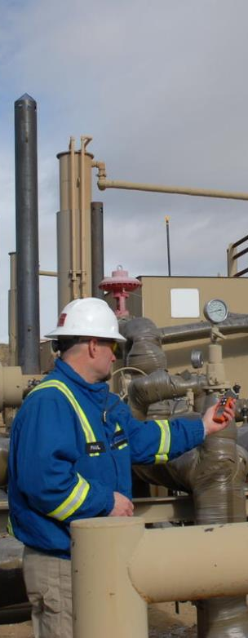
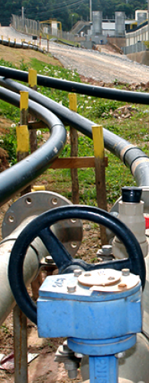
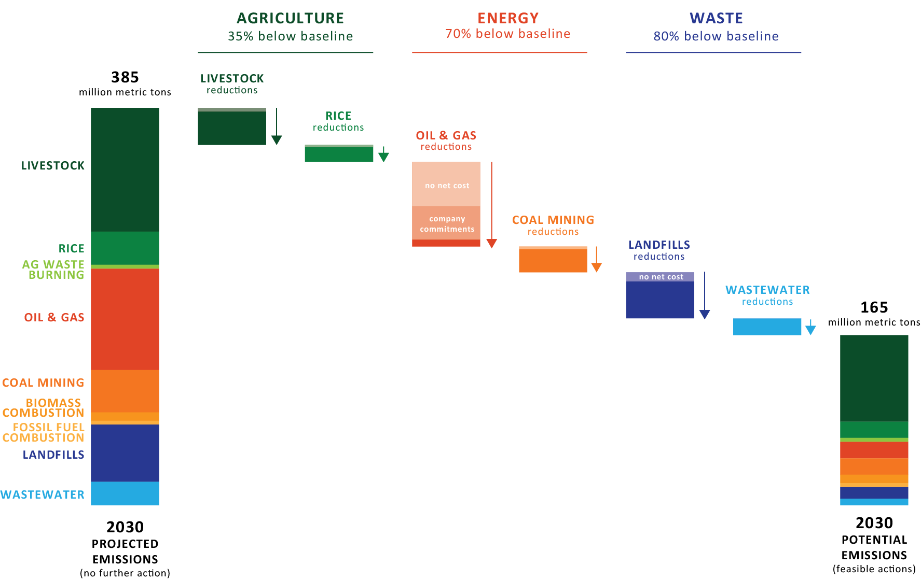

We have tools to cut global methane emissions in half within 10 years
55% below baseline
Source: Ocko et al. ERL 2021

Slide 3
Targeted measures are needed to realize the full potential of methane mitigation in the fossil fuel sector
Methane Emissions Scenarios
According to the International Energy Agency
1. Methane emissions from the oil and gas sector could be reduced with technologies that exist today
by 75%
NO ACTION
DECARB ONLY
2. The measures pay for themselves quickly by saving money:
~ 50%
3. Available targeted measures have
negative costs
DECARB +
DIRECT CH4
MITIGATION
Ocko et al., Acting rapidly to deploy readily available methane mitigation measures by sector can immediately slow global warming, 2021.
Source: IEA

Slide 4
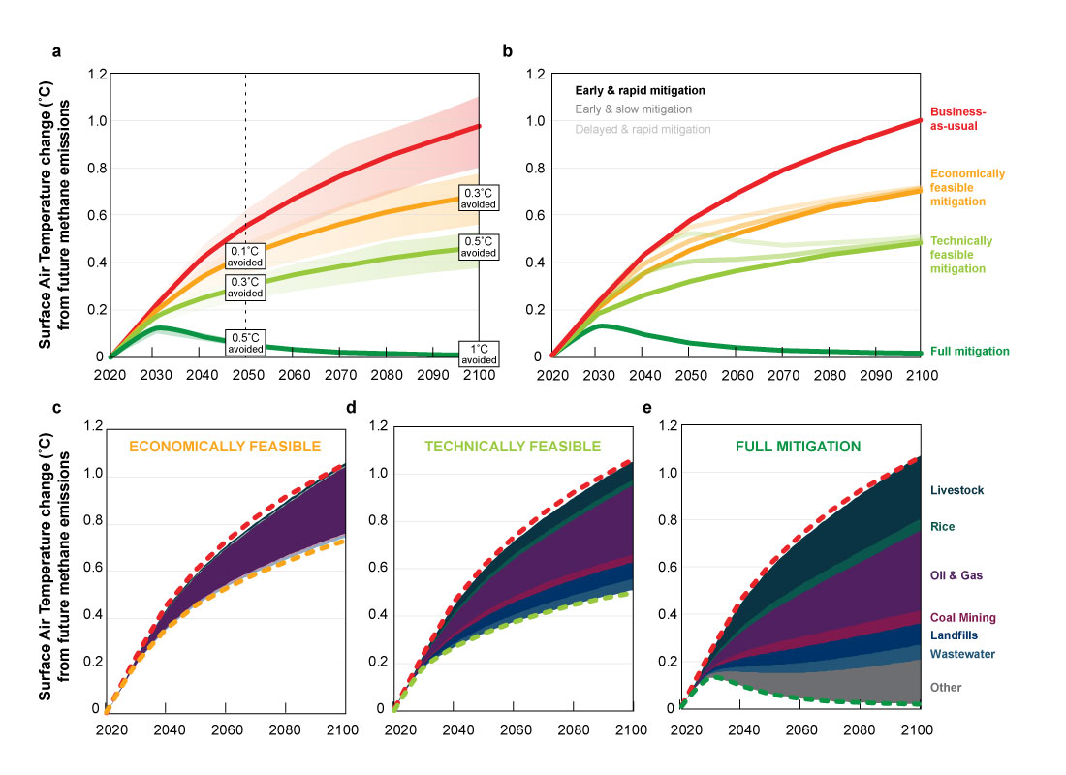
Reducing methane
emissions has the potential to reduce
the rate of warming significantly
Ocko et al. ERL 2021

Slide 5
Accelerating emissions reductions requires knowing:
What is being emitted
Where it is being emitted
How much is being emitted
This is role of IMEO

Slide 6



Better data is needed to enable targeted methane mitigation strategies and policies
Sample Measurement Data in Alberta, Canada
Data Landscape Today
Accuracy of data
Most methane emissions data is from emissions factors
Studies show that these underestimate observed emissions levels
Action enabled by better data:
- Targeted emissions reduction plans
- Identification of super-emitters
- Set and track ambitious methane
reduction targets
(Johnson, et al. ES&T 2017)
Notes:
Emphasize clearly that while we don’t know everything we know enough to act today

Slide 7
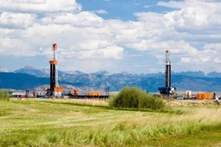
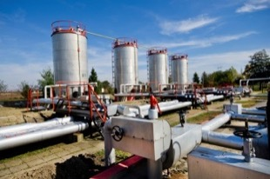
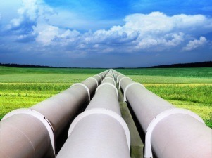
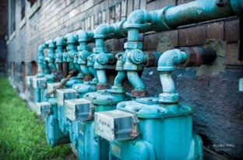
U.S. oil and gas supply chain emissions
Drilling & Production
Gathering &
Processing
Transmission
& Storage
Local Distribution
7.6 Tg
1.3%
3.5 Tg
0.6%
3.3 Tg
0.6%
2.7 Tg
0.5%
1.8 Tg
0.3%
1.4 Tg
0.2%
0.44 Tg
0.1%
0.44 Tg
0.1%
Methane Synthesis Alvarez et al 2018
2017 EPA GHG Inventory (For year 2015)

Slide 8
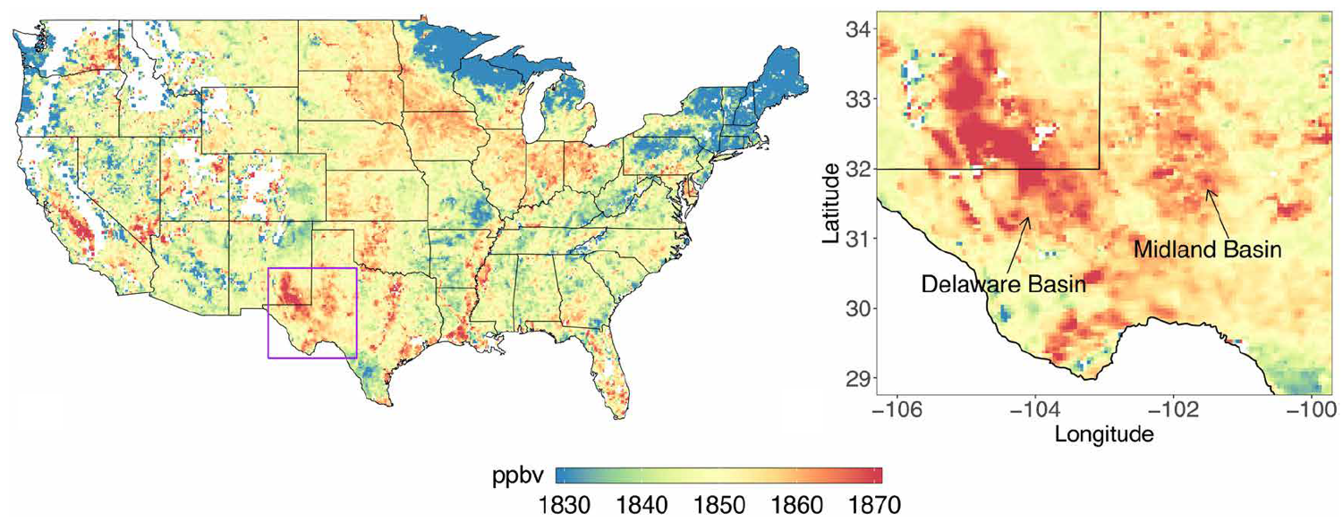
Recent satellite observations reveal high Permian methane emissions TROPOMI methane data averaged from May 2018 – March 2019
Zhang et al. (2020) Science Advances. 6: eaaz5120

Slide 9
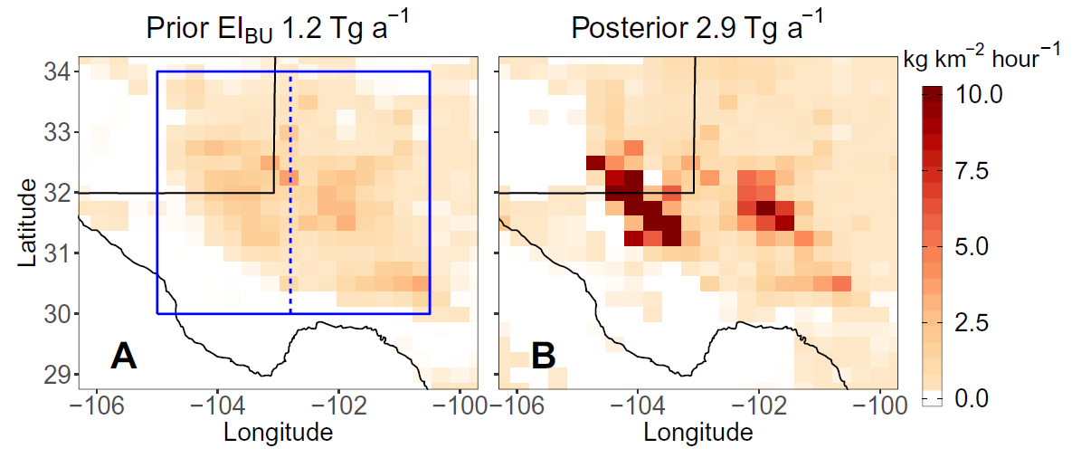
TROPOMI data reveal highest methane emissions from the Permian Basin ever measured from any U.S. oil and gas basin
Zhang et al. (2020), Science Advances. 6: eaaz5120

Slide 10
Satellites Are Complementary
For Tackling Global Methane Emissions
Instrument | Dates operational | Grid size (subgrid pixel) (km2) | Swath (km) | Precision (ppbv)
MethaneSAT | 2022 | 1.4 × 1.4 (< 1 km raw) | 200± | 2-3*
GOSAT | 2009 - | 10 km dia., single | Sparse | ~13
GHGSat | 2016 - | 0.05 x 0.05 | 12 x 12 | ~50
TROPOMI | 2017- | 7 × 7 | 2600 | ~11
GOSAT-2 | 2018 - | 10 km dia., single | Sparse | ~8
GeoCARB | 2022 - | 3 × 6 | 2800 | ~18
Carbon Mapper | 2023 - | 0.03 x 0.03 | 18km | ~30
* Gradient measured over 10 – 100 km length scales.
* Gradient measured over 10 – 100 km length scales.
Notes:
The main differences are scale, precision, and data usage
GHGSat’s small swath is well-suited to allow governments or companies to monitor specific facilities for compliance
TROPOMI has a large swath, but less resolution and a higher detection limit; useful for data on large emissions sources
MethaneSAT combines a wide swath with a low resolution limit so that we can capture almost all emissions specific to oil and gas operations, allowing us to see the full picture of global emissions

Slide 11
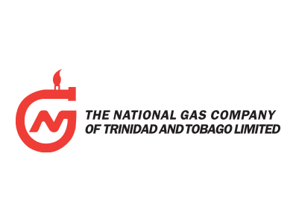
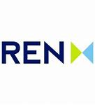

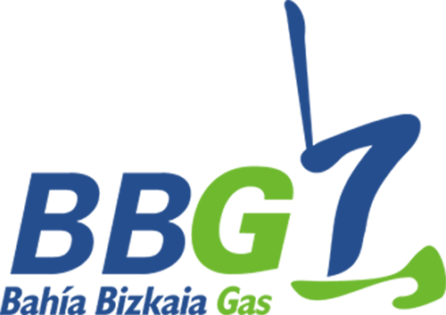




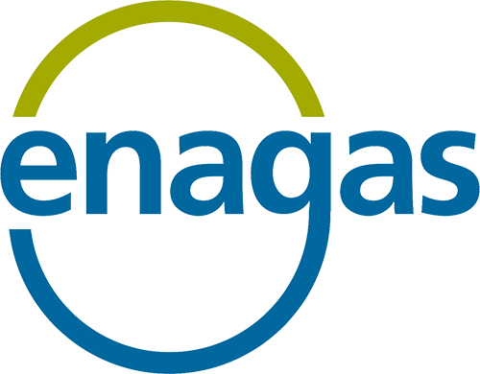




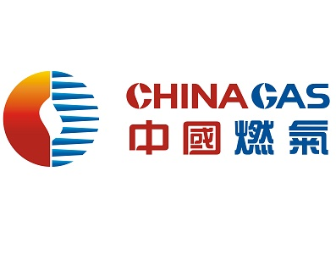




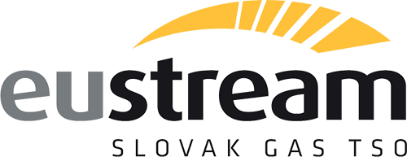


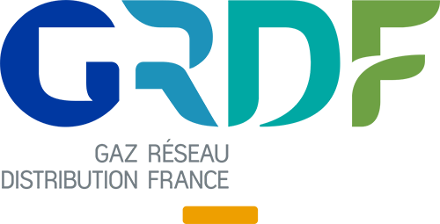
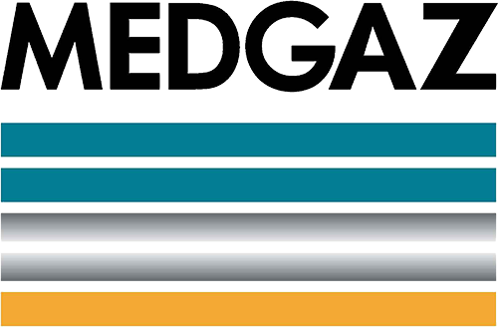








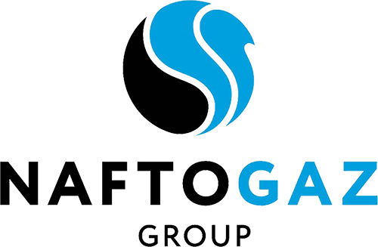


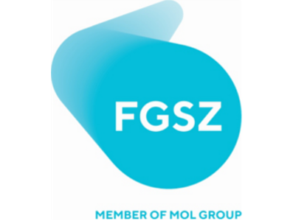







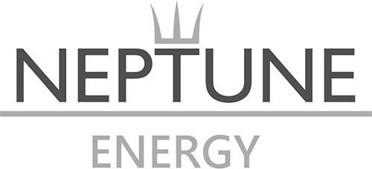

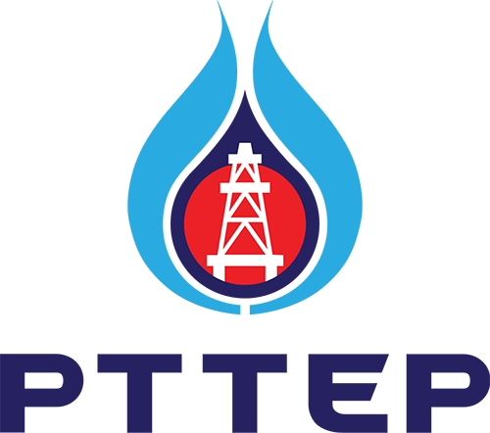




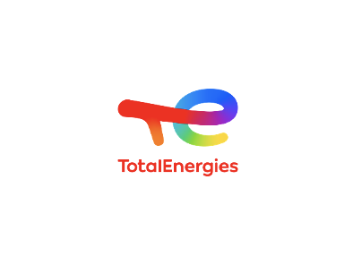























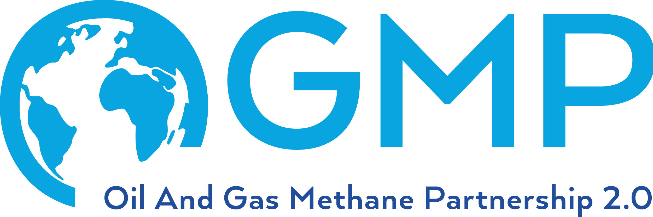




OGMP Timeline
The Oil & Gas Methane Partnership was launched at the UN Secretary General’s Climate Summit in New York
in September 2014
OGMP 2.0 launched on 23 November 2020
6 companies
USA
Norway
and
UK joined
European Commission joined
74 companies
Notes:
We have new company logos to add – would be good to create a bigger slide that we can then screenshot and add here
Replace Obama with Ban Ki Moon?

Slide 12
OGMP 2.0 will improve methane reporting around the world
Countries in which OGMP member companies have operated and non-operated assets
Countries in which OGMP member companies have non-operated assets

Slide 13

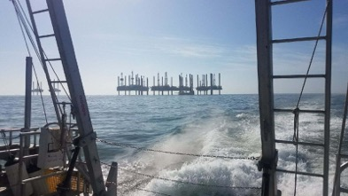
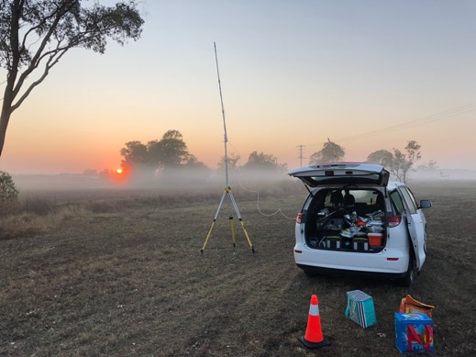
Direct measurement studies help better understand where and how much methane is leaking
Rod Arnold, BAS
Complete - ground
Complete - aerial
In progress
Exploring possibilities
Notes:
Speaking Points:
Early-stage work has started on other regions with limited data and high production (i.e., West Africa, Caspian Sea) as well as global sources with significant uncertainty such as abandoned wells. The Observatory will expand this work and will start sponsoring studies over the next six months. IMEO is currently scoping projects in South America Middle East, North and West Africa, and South East Asia. As well as looking at sectors (e.g., urban methane budget) and sources (e.g., flaring) with high uncertainty.

Slide 14
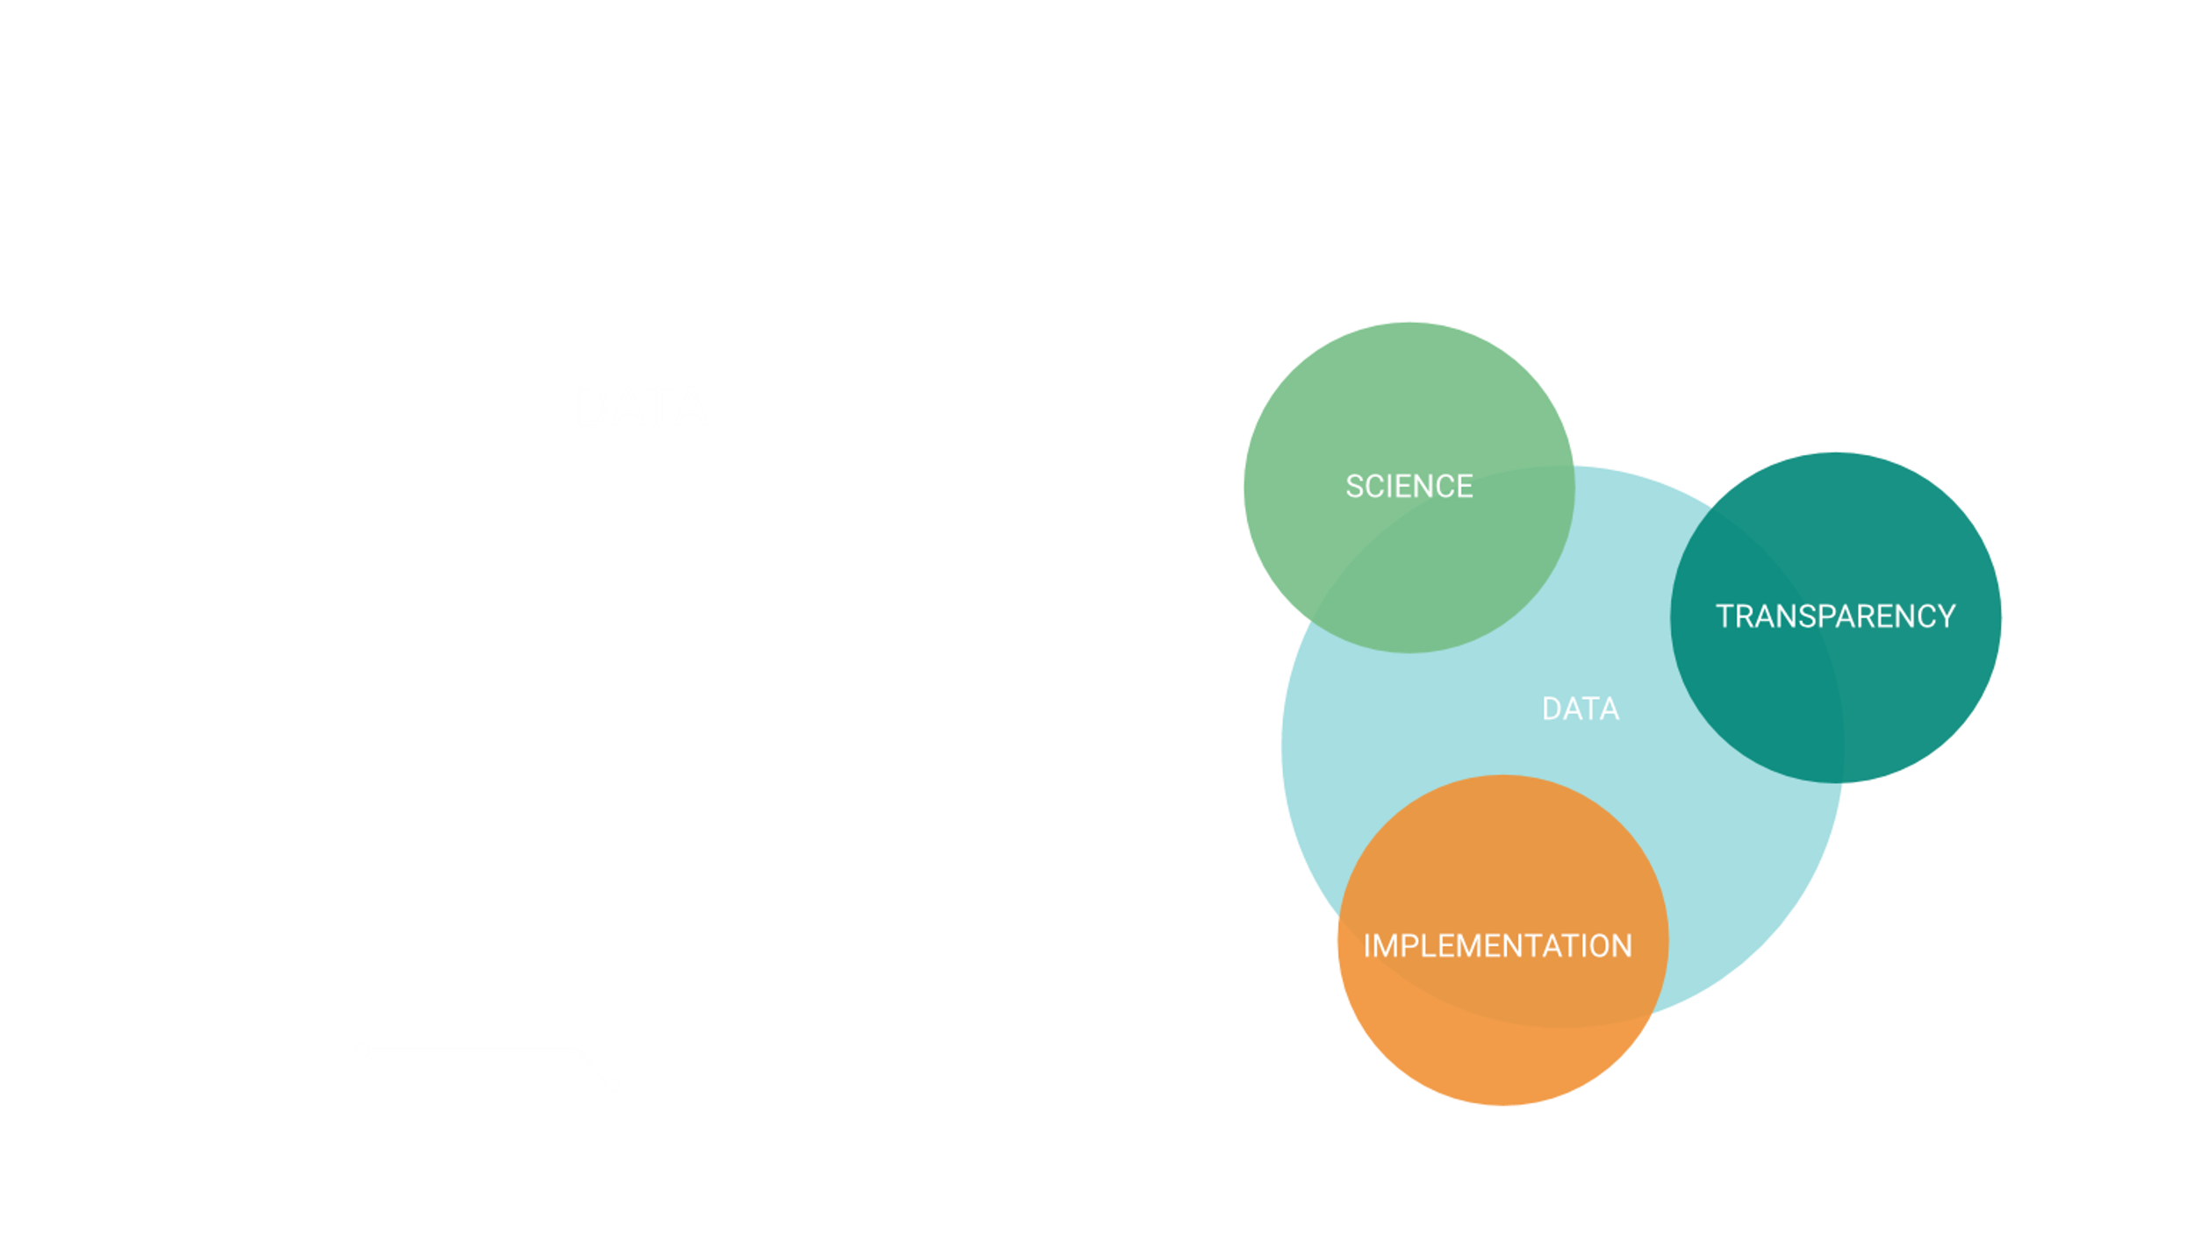
Oil and Gas Consumption and Production in G20 and in the World
(million tonnes oil equivalent)
The International Methane Emissions Observatory will
revolutionize the global methane emissions approach
6,000,000
World Total(2018)
G20 Total(2018)
Each element is necessary, but not sufficient to drive change
5,000,000
5022632
4984459
4,000,000
IMEO interconnects activities across the methane ecosystem
3,000,000
3904112
2,000,000
3148099
1,000,000
Production
Consumption
Source: EIA

Slide 15






How will IMEO answer the methane emissions data problem?
Data flow of the IMEO
Collect data
OGMP companies’ assets data
Science measurements studies
Satellite data
National inventories

Slide 16
How will IMEO answer the methane emissions data problem?
Data flow of the IMEO
Generate final products
Reconcile inconsistencies and identify gaps
Collect data
Apply Big Data, data science, and machine learning
OGMP companies’ assets data
Science measurements studies
National inventories
Satellite data
Full methane emissions dataset
Annual methane report
Direct measurement studies
Science-based implementation support

Slide 17
Thank you
September 2021

Slide 18
The oil and gas sector has the greatest potential for methane mitigation at no net cost
Marginal abatement cost curve for oil- and gas-related methane emissions, 2020 (at higher gas prices)
10
Replace existing devices
Early device replacement
8
Early device replacement
USD/MBtu
Pumps
6
Pumps
Compressor seal or rod
Compressor seal or rod
4
Instrument air systems
Instrument air systems
Electric motor
2
Electric motor
0
Install
new devices
Vapour recovery units
Vapour recovery units
- 2
Blowdown capture
Blowdown capture
Flares
- 4
Flares
Plungers
- 6
Plungers
Leak detection and repair
- 8
Upstream
Upstream
Downstream
- 10
Downstream
0
10
20
30
40
50
Other
Other
Mt CH₄
Based on prices seen in recent years, about 40% of total emissions (30 Mt CH₄) could be abated at no net cost
Source: IEA Methane Tracker

Slide 19
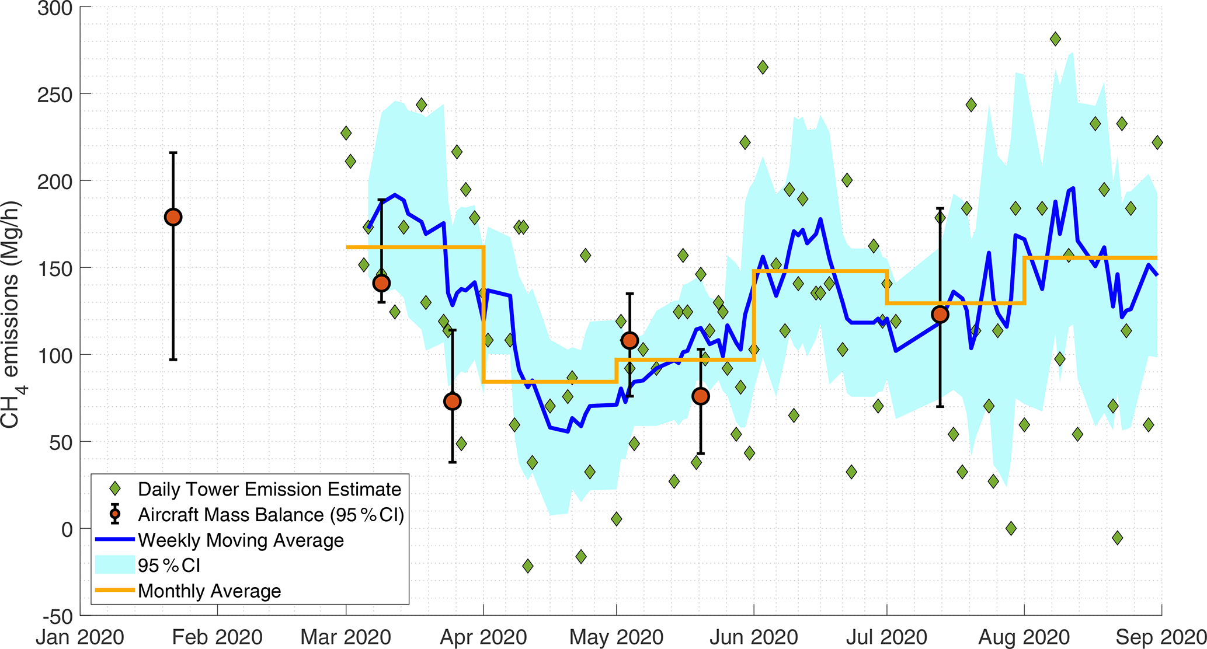
Permian Basin Methane Emissions Trends in 2020
Lyon et al. 2021. Concurrent variation in oil and gas methane emissions and oil price during the COVID-19 pandemic.
Atmospheric Chemistry and. Physics 21: 6605–6626, https://doi.org/10.5194/acp-21-6605-2021

Slide 20
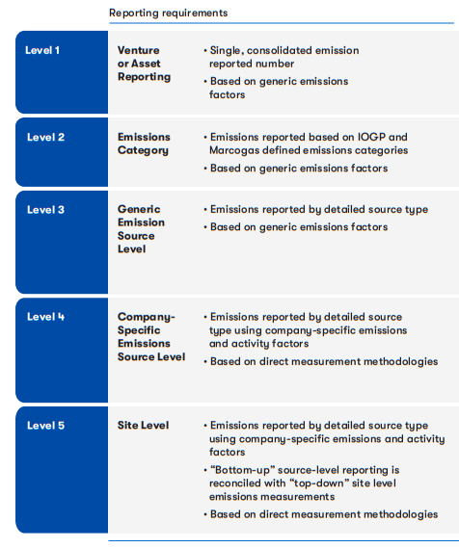
The Oil and Gas Methane Partnership (OGMP) is the leading methane reporting framework for the O&G industry
OGMP is a comprehensive, measurement-based reporting framework for oil and gas
Member companies report on all material sources of methane from both operated and non-operated assets across all segments of the value chain
Companies commit to achieving Gold Standard reporting within three years for operated assets and five years for non-operated assets.
“Gold Standard” = both the highest reporting levels and companies’ plans to achieve this level.
Gold Standard pathway: a credible and explicit path towards Level 4/5 reporting
Gold Standard Reporting: empirical reconciliation measurements at source (Level 4) and site (Level 5) level
Notes:
Speaking Points:
One of the most important components of this year’s annual report is the analysis of the first year of OGMP 2.0 reporting.
This was the first year member companies reported in the new framework through the new reporting levels on the way to achieving Gold Standard.
Companies achieve Gold Standard reporting when the majority of their assets are reported at Level 4/5 (INCORRECT – THIS NEEDS TO BE UPDATED).
This year, member companies submitted implementation plans to detail how they will reach Gold Standard Reporting. A Gold Standard pathway status was awarded to companies that submitted a credible and explicit path.

