Slide 1
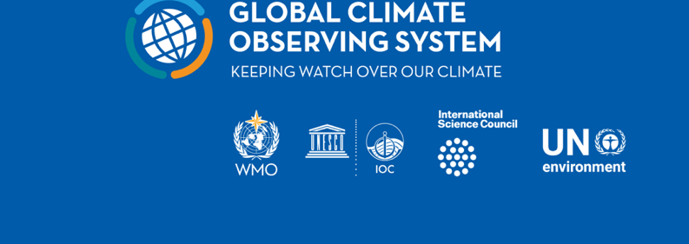
~
The Global Climate Observing System 2021:
The GCOS Status Report
Notes:
ECMWF, OBSERVATIONS MONITORING PLOTS

Slide 2
demand for information about climate and its impacts is increasing and changing
Understanding and predicting global climate change
Attributing Climate Change to Human Activities
Supporting Climate Services, Adaptation and Mitigation
Climate monitoring
The Global Climate Observing System has been very sucessful in allowing the IPCC to idenitfy and project climate change and attribute this to human activities
Now that
the frequency of extreme weather events is increasing
the vulnerability of people living in high-risk areas is growing.
Concerns are increasing about issues such as food security and migration
UNFCCC Paris Agreement focuses on adaptation and mitigation
This leads to demands higher resolution climate observations
Notes:
WMO/Weather/FAQ
Wildfire, Sakha Republic, Siberia, Russian Federation, EU Sentinel 2 via Paul Markuse
IMOP GAW Station , Zongshan China

Slide 3
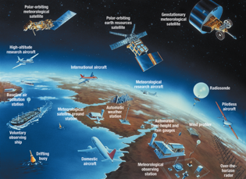
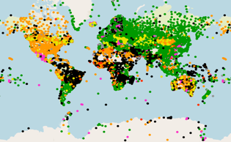
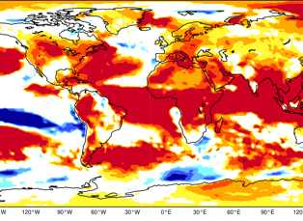
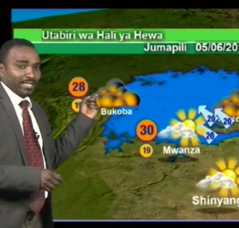
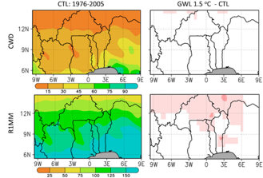
Successful delivery and use of climate services depends on all elements in the value chain working properly
Climate-related infrastructure – must be designed and managed globally
GCOS addresss
observations and
data exchange but is
informed by the
needs of the whole
value chain
Observations from the entire globe
International exchange of observations
Global climate modelling
GLOBAL ACTIVITIES
LOCAL ACTIVITIES
Effective decision making and action
Delivery of climate services
Local Data Processing, forecast, warning and advisory products
Last-mile activities undertaken at regional, national and local level

Slide 4
Producing the GCOS Status Report
ECV Stewards monitor how well each ECV is monitored and if the requirements are practical and meet user needs
GCOS Expert Panels
National Meteorological & Hydrological Services
Global Ocean Observing System (GOOS)
Satellite Agencies – CEOS and CGMS
Global Terrestrial Networks
Academia
Implementation Plan Action Rapporteurs monitor progress on each action
Preparation of draft with contributions from ECV Stewards, IP Action Rapporteurs and other experts
Public review and revision by experts
Publish report following approval by Steering Committee and Writing Team
Task Team on Climate Cycles
Task Team on Adaptation
Joint CEOS/CGMS Working Group on Climate reporting on satellite observations

Slide 5
The Report
The Global Climate Observing System 2021:
The GCOS Status Report
GCOS-240
Executive Summary
Translated into the 6 UN languages
Body of report.
Introduction
Observations of the Earth System Cycles
Status of the GCOS ECVs
Satellite Observations
Status of Actions from the 2016 IP
Adaptation, Extremes & Mitigation
Implications
Appendices:
Acronyms, References, Contributors
Annex A:
Detailed assesment of each ECV
Annex B:
Assessment of IP Actions
Annex C:
Networks

Slide 6
Many Improvements since 2016 including
Satellite observations have improved their coverage spatially, temporally and in terms of observed variables. Satellite data are accessible and well curated.
WMO and its Members ensure the required long-term monitoring, with established practices and instruments, for many ECVs.
Most ground-based networks are well managed and archives appropriately stewarded.
GCOS and WMO are now working together to establish a reference network for atmospheric and land surface observations
It was decided to expand the Argo program to the full water column and under sea ice, including biogeochemical variables.
Observations of atmospheric variables have further improved in the past decade thanks to new in situ observations from the ground and from commercial aircraft.
The ocean observing community is working on best practices for observations and data and metadata standards.
Technological innovations have contributed to expanding the ocean observing system and its capability

Slide 7
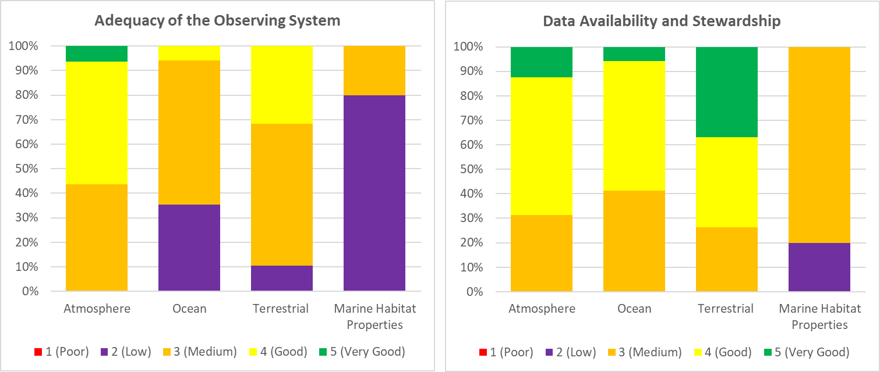
Summary of Adequacy of ECV Observations and Data Availability and Stewardship

Slide 8
Areas for improvements identified in the GCOS Status Report
Sustainability
The report identifes four key areas where improvements are needed
The GCOS Implementation plan to be published in 2022 will address these four areas.
Areas for improvements in global climate observations
Gaps in geographical coverage
Data Stewardship, Archiving and Access
Supporting the Paris Agreement
Adaptation and Mitigation

Slide 9
Sustainability
Long-term continuity of some satellite observations is not assured. While satellite observations have been a major success, there are gaps and some observations are from research missions
Sustained funding is needed. Most ocean and terrestrial observations are supported through short-term funding with a typical lifetime of a few years leaving the development of long-term records vulnerable.
Many otherwise successful projects have not led to long-term sustained improvements. - most of the projects in developing countries with a component on observations have not led to sustainable long-term improvements in the observational capacity of these countries due to lack of resources and planning.

Slide 10
Specific satellite related issues
Gaps in the satellite-based observations include:
Lower tropospheric ozone.
An instrument that measures stratospheric CH4 profiles globally.
In high mountain areas satellite data acquisition of cryospheric observations is poor.
For certain atmospheric ECVs in polar regions satellites have poor or no coverage. e.g. atmospheric variables such as precipitation, wind stress, radiation budget etc
Long-term continuity of some satellite observations is not assured. While satellite observations have been a major success, there are gaps:
No follow up mission for Aeolus (wind profiles) is planned.
No continuity is assured for cloud radar and lidar on research satellites.
Only one limb sounder with similar capabilities to the Aura Microwave Limb Sounder (MLS) is planned.
Measurements of vertical profiles hVEnow exceeded its expected lifetime.
High-inclination altimetry is still problematic with only two research satellites flying (CryoSAT2 and ICESat2).
In the future, European missions CRISTAL & CIMR would extend operational monitoring capabilities to the late 2020s (if confirmed). Likewise, Sentinel-3A/B altimeter data could be optimised for sea ice in the future.
High-latitude sea-ice thickness monitoring is at risk (when CryoSat and ICESat2 stop working) and a gap might occur if CRISTAL is delayed.

Slide 11
Data Stewardship, Archiving and Access
Satellite data and most ground-based networks have well managed data archives with long term support
This is not true for all ECV. Data Archives are needed for all ECV that
have sustainable, long-term, adequate funding.
have clear requirements that to ensure a consistent approach among the data centres.
should be open and freely available to all users.
perform quality monitoring
allow reprocessing of data when new techniques or observations become available.
support data rescue that allows data series to be extended into the past and provide open access to this data

Slide 12
Supporting the Paris Agreement
Mitigation
Atmospheric concentrations of GHG can be used to support emission inventories, detect sources, validate national emissions and removals and monitoring the complete carbon cycle.
Satellite observations are a vital part of this effort
Will support reporting to the UNFCCC Global Stocktake of mitigation progress
Will improve national reporting to the UNFCCC
GCOS is developing requirements for GHG atmospheric compositions
GCOS is also developing requirements for Greenhouse Gas Fluxes (currently)
High-resolution footprint around point sources
Total Estimated fluxes by coupled data assimilation/ models with observed atmospheric
National and Continental scales
Anthropogenic
F-gas, N₂O and CH₄ emissions
CO₂ emissions/ removals by land categories
CO₂ emissions from fossil fuel use, industry, agriculture, waste and products use
Measurements can also support some mitigation efforts, particularly those of forests and land use

Slide 13
Supporting the Paris Agreement
Adaptation
With current capabilities in relation to its ECVs and ECV products,
the global climate observing system could provide indicators for adaptation that could be used in the global stocktake.
With modest enhancement of products or new products,
could be used at national level to add value to National Adaptation Plans, through
assessment of climate hazards and vulnerabilities,
assisting in identification of adaptation options and implementation,
management, monitoring and evaluation of adaptation actions.
Climate Science
Improving our understanding of climate cycles of carbon, water and energy will improve our projections of future climate

Slide 14
2022 Implementation Plan
To address these issues and build on existing sucesses:
GCOS is preparing its next Implementation Plan for publication in mid-2022
Currently we are collecting contributions
There will be a public review in early 2022 – all interested parties should contribute
This report should be
More focussed on implementing organisations
Indicate main priority areas
Emphasise support for the Paris agreement, Adaptation and Mitigation

Slide 15
Conclusions
GCOS recognises and apreciates the large contribution of the satellite communty to climate observations and for making the data freely available.
This has transformed many observations, particularly of the land surface
Many of these should be exploited to support climate adaptation
Not all useful observations have a long term commitment – particularly reseach missions.
A few gaps in coverage remain
A major effort in the near future will be on cabon fluxes, supporting and verifying national emission reporting and improving the monitoring of the while carbon cycle
This is needed to support the UNFCCC Global Stocktake
Will also support national reporting to the UNFCCC
Satellites are vital
GCOS is looking to CEOS and CGMS for inputs into the next GCOS Implementation Plan.

Slide 16
Joint Study Group (JSG)-GCOS
GCOS programme 30y old + WMO major constituent reform in 2019
JSG stablished to review GCOS governance and structure
JSG-GCOS Activity
15 members representing current GCOS co-sponsors and other GCOS stakeholders.
Work organised around subteams looking into different aspects (e.g. GCOS mandate, finance, value chain)
Regular meetings since January 2021
One Interim Report in April 2021
Distinguish between the programme ambition (long-term) and its technical execution (short-term, more flexible)
Clarify the functions and responsibilities of the MoU signatories/GCOS sponsors
MoU revised to:
Reflect the link between GCOS and UNFCCC including support of the Paris agreement and its global stocktake
Ensure a proper engagement of GCOS stakeholders (including satellite agencies)
Final report with recommendations delivered in October-November 2021
Notes:
OCTOBER?

Slide 17
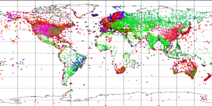
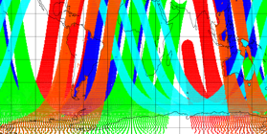
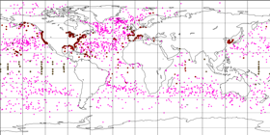
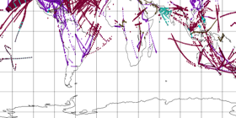
Thank you
https://gcos.wmo.int/en/gcos-status-report-2021

