Slide 1
1.5 Sustainable Development Goals Ad hoc Team (SDG AHT)
Committee on Earth Observation Satellites
Alex Held, CSIRO, SDG AHT co-lead & SIT Co-chair
Marc Paganini, ESA, SDG AHT co-lead
With contributions from Brian Killough (SEO/NASA), SDG sub-teams leads,
Flora Kerblat (CSIRO, SIT Chair team) and George Dyke (SIT Chair team),
CEOS SIT Technical Workshop 2021
Virtual Meeting - 14 September 2021 - Session #1.5

Slide 2
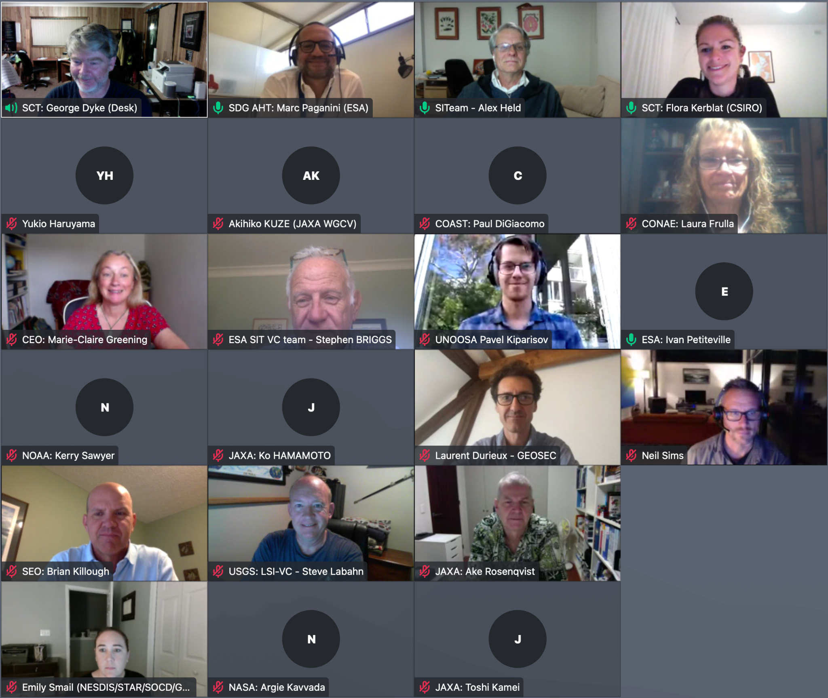
Welcome & objectives
Thanks for joining us today, and welcome to this session #1.5 on the SDG Ad hoc team
Successful side-meeting held last week with ~25 attendees (CEOS and external)
Agenda
Today, we’ve decided to first report on the sub-teams progress, and then discuss about the governance
AHT Sub-Teams progress [20 min]
Brief summary from SDG AHT Co-Chairs AHT Sub-Teams Progress + Questions?
Future Governance [50 min]
Brief review of SDG AHT governance process and reminder of the two options presented at SIT-36: “Option 1 Full Scale” (i.e. Working Group); and, “Option 2 Federated”.
Discussion of the preferred option & actions to Plenary.
Today’s objectives
Review of the two options identified for the SDG Ad Hoc Team governance, noting the preferred one;
Discussion of governance in support of delivering a final recommendation to Plenary.
Notes:
Where are we today?
Where and how do we want to move forward?

Slide 3
SDG AHT Work Plan 2020-2021
Objectives
Coordinate the efforts of the CEOS agencies to facilitate the use of satellite data in the implementation of the 2030 Agenda on sustainable development.

Slide 4
SDG AHT Work Plan 2020-2021
Work organisation
Starting with an analysis of the satellite data needs and use for 4 SDG Indicators :
6.6.1 (water-related ecosystems) in partnership with GEO Wetlands, GEO AquaWatch, GEO GLOWS
11.3.1 (urban land consumption) in partnership with GEO HPI, GEO GUOI
14.1.1 (coastal eutrophication) in partnership with GEO Blue Planet GEO AquaWatch
15.3.1 (land degradation) in partnership with GEO LDN
Selected by SDG-AHT because:
need to focus on a limited number of SDG indicators. “Start small, Think big”
selected by UN IAEG-SDGs WGGI as primary indicators for EO uptake. “Use SDG channels to maximise Impact”
EO recognised as data sources by UN custodian Agencies in the indicator monitoring guidelines. “Build on proven EO technologies”
Water
sub-team
Urban
sub-team
COAST
Land degradation sub-team

Slide 5
1. AHT Sub-teams progress

Slide 6
SDG AHT Work Plan 2020-2021
Deliverables
Number | Objective / Deliverable | Completion | Responsible Entity
SDG-19-02 | Open Data Cube algorithms for the SDGs | 2022 Q4 | SEO
SDG-20-01 | GEO Federated Approach on SDGs | 2020 Q1 | SDG AHT
SDG-20-02 | SDG EO Toolkit Specification | 2020 Q1 | SDG AHT
SDG-20-03 | Satellite data requirements for SDG Indicator 6.6.1 (Water-related ecosystems) | 2021 Q4 | SDG AHT (Water Sub-team)
SDG-20-04 | Satellite data requirements for SDG Indicator 11.3.1 (Sustainable urbanization) | 2021 Q4 | SDG AHT (Urban Sub-team)
SDG-20-05 | Satellite data requirements for SDG Indicator 14.1.1 (Marine Pollution) | 2021 Q4 | COAST (with the support of SDG AHT)
SDG-20-06 | Satellite data requirements for SDG Indicator 15.3.1 (Land Degradation) | 2021 Q4 | SDG AHT (Land Degradation Sub-team)
SDG-20-07 | EO Enabling Infrastructures for SDGs (for SDG EO Toolkits) | 2022 Q4 | SDG AHT| (with support of WGISS, SEO)
SDG-20-08 | EO Good Practice Guidance (for SDG EO Toolkits) | 2022 Q4 | SDG AHT
SDG-20-09 | EO Demonstration Cases for SDGs (for SDG EO Toolkits) | 2022 Q4 | SDG AHT, SEO
SDG-20-10 | Data Supply Analysis and Strategy Document | 2020 Q2 | SDG AHT, SIT Chair

Slide 7
SDG AHT Overview
3 sub-teams + 14.1.1 indicator through COAST
All have made progress on EO requirements and improved their connections with GEO relevant activities
Deliverables: EO Requirements reports are all in progress and likely not finalised before next year (except 11.3.1) – external engagement, and constantly evolving environment (e.g. on Land degradation: Global Practice Guidance review to be released soon… EO requirements to be updated)
Side-meeting: we heard from the 4 sub-teams co-leads about their team, most relevant work, deliverables status, as well as their aspirations for their group in CEOS/GEO
Future governance: No one objected to the preferred “Federated option” but all agreed that an update to the CEOS WP will be required (based on available resources)
Strategy: The sub-teams will need strategic guidance, especially if/when more teams (indicators) were to be taken on board

Slide 8
SDG Sub-teams summary (1/2)
 | WATER (6.6.1) | URBAN (11.3.1)
Team’s organisation | 14 members + experts from GEO Aquawatch, Wetlands and GLOWS Stakeholders: UNEP, Ramsar and Countries | 13 members + experts from GEO and more Stakeholders: UN Habitat Countries and Cities
2021 Highlights | Review of the UNEP 6.6.1 monitoring methodology and Freshwater Ecosystems Explorer Analysis for 2 SDG pathways: production of global datasets (top down from UNEP) and development of national capacities (bottom up from Ramsar). More on Slides 26-27 | Contributed to the launch of the EO Toolkit for Sustainable Cities and Human Settlements, eotoolkit.unhabitat.org Summary inventory of EO data, tools, and use cases More on Slides 28-29
Deliverables | “Satellite data for SDG 6.6.1” Technical Report with outreach to custodian agencies (UNEP and Ramsar). In progress – To be finalised in 2022 | “Satellite data for SDG 11.3.1” Technical Report to be included in ‘EO Toolkit for Sustainable Cities and Human Settlements’ ‘Learn Path’ hosted by UN Habitat (eotoolkit.unhabitat.org) In progress – To be finalised by end of 2021
Future & aspirations | Willing to continue its work in 2022 in collaboration with LSI-VC experts (e.g. in water leaving radiance ARDs) and others | More collaborations with Esri and UN Habitat to develop 11.3.1 Learn Path (Toolkit); WGCapD in multi-part Toolkit training; LSI-VC (e.g., development of new CARD4L data pipelines like VIIRS Nightlights, Landsat-Sentinel Harmonized dataset)

Slide 9
SDG Sub-teams summary
 | Marine Pollution (14.1.1) via COAST | Land Degradation 15.3.1
Team’s organisation | Led by CEOS COAST team -> GEO Blue Planet WG that collaborates with CEOS on space data needs for specific projects .(see slide 30) | ~10 members + GEO LDN experts Close collaboration with UNCCD (see slide 31)
2021 Highlights | Satellite chlorophyll sub-indic data included in 2020 SDG report Working with regional UN Environment leads to bring together the national statistical offices, scientists and CEOS agencies to improve the utility of indicators and develop useful tools | Decision trees and updating of Good Practice Guidance Reference to ARD, CEOS
Deliverables | Satellite data requirements for 14.1.1 (marine pollution) Status to be clarified (updates) | Satellite data requirements for 15.3.1 In progress – to be completed in 2022 + Revised GPG for 15.3.1 due for release imminently (Updated dataset recommendations Data quality decision trees for Indicator and sub-indicators)
Future & aspirations | GEO Blue Planet & AquaWatch Initiatives will continue to work with CEOS on pilots; More merged/gap-free coastal ocean colour products (chlorophyll-a et al.) at highest possible spatial resolutions; CEOS-COAST & Blue Planet/AquaWatch to pursue AI/ML approaches | Reviewing data needs after SDG reporting period Data collated by UNCCD Connecting GEO LDN activities to CEOS Potential elevation of GEO LDN

Slide 10
2. Future Governance

Slide 11
SDG-AHT Transition Roadmap from Plenary to Plenary
SDG AHT Future Workshop (1/2 day)
Review and discuss the future options, reduce to 2 scenarios (including variants if needed)
Extended discussions in CEOS and GEO
Develop the 2 scenarios in the synthesis paper, identifying resources
34th Plenary Approval of SDG AHT extension until end 2021 (with Transition Roadmap) by CEOS Principals
35th Plenary
Seek CEOS Principals endorsement of the recommended permanent mechanism
Transfer Documentation V1
Draft the documentation
for the transfer to the permanent structure (ToRs, work plan and strategy outline)
Final round for comments + consolidation of the V2 documentation
OCT
NOV
DEC
JAN
FEB
MAR
APR
MAY
JUN
JUL
AUG
SEP
OCT
NOV
Synthesis Paper V1 substantive analysis of the pros and cons of the different future options (at least 4 options), recalling the results of the AHT survey (Sept. 2020)
Synthesis Paper V2 incl. compelling justifications for the selection of the 2 best scenarios
SIT-36
SDG AHT side meeting
Present conclusions of the extended discussions and choose the best scenario to be recommended to SIT-36
Liaise with relevant CEOS/GEO entities to finalize arrangements for
the recommended option
Transfer Documentation V2
Develop a V2 documentation on the future permanent structure
SIT TW
Present and review details of the recommended option and relevant documentation
SIT-36 SDG session
seek CEOS Principals recommendation to Plenary

Slide 12
SDG AHT Future Options
February workshop
# | Future Options | Description | Coordination | Work
OPTION 1 | Full-scale option | Create a new CEOS Working Group on SDGs. | The Working Group would perform the full coordination function for CEOS support to GEO on SDGs, including the supervision of the CEOS Work Plan Deliverables and the detailed work plans of the new Working Group | The new Working Group would have its own capacity and resources to perform SDG tasks, in coordination with other CEOS bodies when specific competencies are required and available.
OPTION 2 | Federated option | Transfer the CEOS work on SDGs into existing CEOS entities under an internal CEOS coordination mechanism. | There would be an identified SDG Coordinator or Coordination Team (single individual or group of persons) to which the CEOS coordination role on SDGs would be delegated. | CEOS work in support of the SDGs would be fully decentralised and performed across existing CEOS working teams and entities.
OPTION 3 | On-demand option | Reduce the scope of CEOS support to GEO on SDGs to a responsive model, in line with CEOS External Request process. | The response coordination will be provided by CEOS, in accordance with the CEOS External Request Process Paper. | CEOS would only take action if requested by GEO or by the SDG community (e.g. UN agencies) and essentially for activities in line with the work plans of existing CEOS entities.
Ç√

Slide 13
SDG AHT Future Options
Results of discussions
Decision 03 | CEOS SIT agreed to focus on the development of two options for the future of the SDG Ad Hoc Team for presentation at Technical Workshop and then Plenary: “Option 1 Full Scale” (i.e. Working Group); and, “Option 2 Federated” (i.e. coordination of existing entities).
At SIT-36, all CEOS Agencies confirm their willingness for CEOS to continue playing an active and prominent role on SDGs.
Some Agencies expressed strongly their reluctance to the creation of a new working group, and
No agencies stepped up to lead a new Working Group to start in 2022, which is required for the full-scale option.
So we did not develop further Full-scale option
The ‘Federated option’ seems the best one, allowing a seamless continuation of the SDG AHT work, while keeping the possibility of becoming a WG later.
Several variations of the Federated option were considered and discussed to lead the coordination team.
In July, SEO team made an offer following the Federated option: lead an SDG coordination team to oversee the SDG sub-teams work, liaise with existing CEOS entities (LSI-VC, WGCapD and more), and externally (e.g. GEO).

Slide 14
Federated Option
pros and cons
Transfer the SDG work into existing CEOS entities under CEOS coordination
Pros | Cons
Can be the most flexible, cost-effective and practicable solution, allowing CEOS to stay responsive, while best using resources and expertise available within existing CEOS bodies. Could be considered as a transition solution towards the creation of a working group on SDGs (option 1), should the interests grow within CEOS agencies. The need for additional resources to be assigned by CEOS Agencies will be limited since the work will be essentially done within existing CEOS entities, except for the coordination task. The CEOS Work Plan will still reflect SDG deliverables and activities and will still be managed through the CEOS annual processes. | Existing CEOS bodies (WGs and VCs) may be overcommitted already and adding extra activities and deliverables on SDGs may be an unacceptable additional burden. Need to restrict the CEOS activities to a number of prioritized deliverables achievable with the limited resources available to coordinate and perform the work. The CEOS Governance and Processes paper does not address the concept of a coordination mechanism which will need to be embedded in the CEOS processes. Requires a commitment from CEOS Agencies to nominate an individual or a team of individuals to be the SDG coordinator within CEOS. There is a risk that limited resources will be made available by the CEOS existing bodies to do the SDG activities in addition to their existing Work Plan responsibilities.

Slide 15
3. The Federated Approach proposal (SEO)

Slide 16
SEO proposal
(‘Federated approach’)
The SEO has proposed to lead the coordination team of the ”federated option” for the future management of SDG work.
Governance
The current SDG AHT would be dissolved.
The SEO would host and lead the “SDG Coordination” activities, with support from the SIT Team, the GEO EO4SDG representative, and others (total of ~5 max individuals).
No changes should be needed to the SEO Terms of Reference as this leadership role is consistent with other SEO coordination and leadership efforts (e.g. Data Cube, CEOS Self Study). The sub-teams would continue as either a “self-organized team of experts” or “absorbed within a CEOS entity”.
Governance & strategic direction will be more explicitly developed by the Plenary, in particular around its relationship to GEO
Approach
The SEO will be the responsible CEOS entity for current and future SDG deliverables in the CEOS work plan.
Regular (e.g. monthly) meetings will be held with the ”SDG Coordination Group” to review deliverable status and discuss new internal or external requests.
The existing sub-teams, made of individuals from CEOS Agencies, CEOS entities (e.g. WGISS, LSI-VC, COAST) and GEO initiatives would still be responsible for completing the deliverables.
Expectations
The SEO provides an overall “coordination” effort with the support of the SIT Team and the GEO EO4SDG representative.
The SEO would ensure the deliverable is lead and resourced, but the SEO does NOT lead or resource the work.
If more effort and scope are needed in the future, there would always be a path toward an SDG Working Group if proposed by CEOS Agencies.

Slide 17
A Federated option
for the CEOS SDG AHT
CEOS SDG
Coordination Team
Team includes SEO (lead), SIT-Chair Rep, Member of GEO EO4SDG, others (TBD)
Supports internal-CEOS communication, reporting, sharing, and issue resolution
Supports external-CEOS communication, reporting, and assessment of SDG-specific activities and pending needs
Tracks progress on CEOS Workplan deliverables related to SDGs
Supports assessment of external requests and works with internal CEOS entities on accepted commitments
LSI VC (GFOI Subgroup)
SDG 6.6.1
Sub-Team
SDG 15.3.1
Sub-Team
SDG 11.3.1
Sub-Team
HPI GUOI
SDG 2.4.1
No SDG Sub-Team
COAST
SDG 14.1.1
Sub-team
already
in COAST
Internally:
The SDG Coordination Team shares information and confers with CEOS entities to facilitate a federated approach and supports the assessment of new work requests and tracks progress of the associated deliverables in the CEOS Work Plan.
Externally:
The SDG Coordination Team, WGs, VCs, and AHTs, work directly with respective GEO Flagships and initiatives and relevant outside groups (e.g., U.N. Custodian Agencies) on SDG-specific activities that CEOS entities have resources and capacity to support.

Slide 18
Connections to other CEOS groups
Discussions were held with both LSI-VC and COAST concerning the proposed SDG federated option. Both groups support the proposal, but it was agreed further discussion is needed to define detailed roles and responsibilities.
LSI-VC has existing work that is closely connected to SDGs ... Landsat-Sentinel Harmonized dataset for 15.3.1 (land degradation), Aquatic Reflectance ARD for 6.6.1 (water) and provisional Landsat products, Radar Backscatter ARD and Sentinel-1 CARD4L pipeline in Africa, development of new CARD4L data pipelines (e.g. VIIRS Nightlights) that could be relevant to SDG 11.3.1 urbanization.
COAST has existing work that is closely connected to SDGs ... Linked to AquaWatch and a desire to be more involved in SDG 6.6.1, desire to include SDG 6.3.2 (water quality), connection to LSI-VC and the development of the Aquatic Reflectance ARD.
More internal connections
WGISS has existing work that is closely connected to SDGs ... Moving more data to the cloud and creating enabling infrastructures for easier data access by SDG users.
WGCapD ... future training or capacity building links?
SEO ... future communications articles on the CEOS website to increase visibility?

Slide 19
Feedback & discussion
Feedback & discussion
Governance and sustainability
SDG strategy in CEOS
SDG across CEOS groups
Links with GEO and external partners

Slide 20
Conclusion & next steps
SDG AHT Co-chairs would like to congratulate and thank all SDG AHT members (in particular with the new sub-teams) for their efforts and contributions over the last few years: all the outcomes and activities have been beneficial to the EO community, and will continue to be useful
SDG AHT Co-chairs recommend to propose the Federated approach, through a new SDG Coordination team led by SEO, at the Plenary
Strategic decisions, politics and guidance on SDG are not to be taken through this team solely, but will require CEOS leadership and SEC guidance and validation
Importance and proximity with GEO to be reflected in the new governance
Noting that ESA also selected the SDGs as a priority for their next SIT Chairmanship
Governance documents will be prepared over the next few weeks

Slide 21
Thank you all Questions? Please reach out…
Alex Held alex.held@csiro.au
Marc Paganini marc.paganini@esa.int
Flora Kerblat flora.kerblat@csiro.au
Brian Killough (SEO) brian.d.killough@nasa.gov

Slide 22
Additional information

Slide 23
SDG AHT Work Plan 2020-2021
Objectives
Coordinate the efforts of the CEOS agencies to facilitate the use of satellite data in the implementation of the 2030 Agenda on sustainable development.
Support GEO efforts to advance the uptake of EO in the implementation of the 2030 Agenda on Sustainable Development, acting as a “Space Enabler” to facilitate access and use of satellite data.
Participate to the GEO federated approach on SDGs that aims at harnessing all expertise inside and outside GEO Work Programme (including CEOS) in order to maximize impact.
Contribute to the development of the GEO Toolkits on SDGs coordinated by GEO EO4SDG, which will package all available EO assets in practical guidelines for easy appropriation by countries.
Analyze, in cooperation with GEO, the “satellite data needs” for four selected SDG indicators: 6.6.1 on water-related ecosystems; 11.3.1 on urban land consumption, 14.1.1 on coastal eutrophication, and 15.3.1 on land degradation.
Liaise with other CEOS entities (VCs, WGs, SEO) to harness CEOS collective expertise and maximize benefits.

Slide 24
34th CEOS Plenary Outcome
Decision 34-15 | Plenary agreed to extend the SDG-AHT for one year, with direction for the SDG-AHT to plan a transition of SDG activities to internal (within CEOS) and/or external entities by the 2021 CEOS Plenary.
CEOS-34-16 | CEOS Sustainable Development Goals Ad Hoc Team (SDG-AHT) to prepare inputs (according to the Roadmap proposed) to the 2021 CEOS Plenary outlining the proposed new permanent mechanism. | CEOS Plenary 2021

Slide 25
Full Scale Option
pros and cons
Create a new CEOS Working Group on SDGs
Pros | Cons
CEOS will keep an important role in the 2030 Agenda, with high visibility for CEOS and its Agencies. Maximises the impact on SDGs for CEOS and its Agencies. A Working Group on SDGs would be the 3rd thematic WG on the GEO Engagement Priorities. The WG membership can be built with the right experts (from both CEOS and non-CEOS agencies) to properly address each specific SDG target and indicator. Dependencies on other CEOS entities would be less important, limiting the risk that some key SDG activities may not be addressed with the highest priorities. | More sustained investment and efforts are required by CEOS agencies, with a firm commitment to actively contribute to the WG work plan. Requires a solid governance structure (including Lead and co-Lead and executive secretariat), an ambitious work plan and regular reporting mechanisms. The high level of resources needed from CEOS agencies might be seen too premature to have a fully operational WG starting in 2022. SDGs are very broad and cross-cutting, requiring a large range of EO competences. The new WG on SDGs would need many experts to cover all the issues that the WG will address. The new WG on SDGs will still need to work closely with the other CEOS entities (VCs, WGs, SEO) to benefit from their expertise.
Notes:
R

Slide 26
WATER sub-team
Water-related ecosystems (6.6.1): M. Paganini/ESA, A. Carbonniere/CNES
in partnership with GEO Wetlands, GEO Aquawatch and GEO GLOWS
Sub-Team members: M. Paganini/ESA, A. Carbonnière/CNES, Alice Andral/CNES, A. Kavvada/NASA, Nima Pahlevan/NASA, B. Killough/NASA, Luca De Felice/COM JRC, C. Ishida/JAXA, K. Hamamoto/ JAXA, Norman Muller/GA, F. Kerblat/CSIRO, E. Smail/NOAA, H. Kim/WMO, D. Cripe/GEO, GEO Wetlands (9 experts), AQUAWATCH (2 experts), GEO GLOWS (1 expert)
Stakeholders
SDG 6.6.1 co-custodian agencies: UNEP and Ramsar
Countries (NSOs and line ministries and support agencies in charge of water-related ecosystems)
Deliverable Status
“Satellite data for SDG 6.6.1” Technical Report with outreach to custodian agencies (UNEP and Ramsar). In progress – Report to be finalised in 2022
Notes:
(1 expert_

Slide 27
WATER sub-team
Water-related ecosystems (6.6.1): M. Paganini/ESA, A. Carbonniere/CNES
2021 Highlights
Review of the UNEP 6.6.1 monitoring methodology and Freshwater Ecosystems Explorer and associated methodologies, as a basis to identify areas of use and better uptake of satellite observations within current methodologies.
Participate in discussions with Ramsar on EO approaches to wetland inventories and EO inclusion in the Ramsar Toolkit for National Wetlands Inventories.
Analysis done for 2 SDG pathways: production of global datasets (top down from UNEP) and development of national capacities (bottom up from Ramsar).
CEOS Agencies are producing global EO datasets for many 6.6.1 sub-indicators and associated variables (GSWE, GMW, CLMS). Identification of areas of dataset improvements.
Multi-sensor approaches needed for all sub-indicators (e.g. water, wetlands, mangroves, WQ) to address limitation of single sensor approaches and better capture temporal dynamics.
Round Robin intercomparison of Surface Water Detection algorithms at 10m based on Sentinel 1 and Sentinel 2, organised by the ESA WordWater project.
Analysis of advances in WSE from RA to infer changes in lake volumes and river discharge.
Initiate a stronger collaboration with GEO GLOWS (e.g. HydroSpace-GEOGloWS WS 2021).
Post 2021 aspiration:
Willing to continue its work in 2022 with the support of LSI-VC experts (e.g. in water leaving radiance ARDs). No objection to an integration of the sub-team in a “water” subgroup of LSI.
Notes:
(1 expert_

Slide 28
URBAN sub-team
Sustainable Urbanization (11.3.1): A. Kavvada/NASA, N. Mudau/SANSA
in partnership with GEO HPI, GEO GUOI
Sub-Team members: A. Kavvada/NASA, N. Mudau/SANSA
Brian Killough/NASA & CEOS SEO, Garik Gutman/NASA, Bob Chen/CIESIN and GEO Human Planet, Greg Yetman/CIESIN , Peter Caccetta/CSIRO, Flora Kerblat/CSIRO, Alexander Baklanov/ WMO,Thomas Kemper/JRC and GEO Human Planet, Yifang Ban/KHT and GUOI, Mattia Marconcini/DLR, Marc Paganini/ESA
Stakeholders
SDG 11.3.1 co-custodian agency: UN Habitat
Countries and Cities (NSOs, line ministries, city authorities and support agencies in charge of SDG 11)
Deliverable Status
SDG-20-07 “Satellite data for SDG 11.3.1” Technical Report to be included in ‘EO Toolkit for Sustainable Cities and Human Settlements’ ‘Learn Path’ hosted by UN Habitat (eotoolkit.unhabitat.org) In progress – Report to be finalised by end of Q4/ 2021.

Slide 29
URBAN sub-team
Sustainable Urbanization (11.3.1): A. Kavvada/NASA, N. Mudau/SANSA
2021 Highlights
Contributed to the launch of the Earth Observations Toolkit for Sustainable Cities and Human Settlements, eotoolkit.unhabitat.org (UN Statistical Commission side event, 25 February 2021).
Strong collaboration with EO4SDG, UN Habitat, GEO Human Planet, GUOI and over 30 organizations from national statistical offices, national mapping agencies, city authorities, academia, research institutions, non-governmental organizations, space agencies, and the private sector.
Summary inventory of EO data, tools, and use cases (e.g., derived urban extent products based on EO and open source processing tools, such as GHSL, Trends.Earth Urban Mapper, U-TEP, ODC from CEOS agencies) included in the Toolkit.
Degree of Urbanization as method to delineate cities, urban and rural areas (approved by the UN Statistical Commission for international comparison).
Need for more rigorous validation or inter-comparison to evaluate the usefulness of global public datasets and tools for national and sub-national reporting (SDGs, NUA)
Contributing to development of 11.3.1 one-pager as well as ‘ease of use’, ‘FAIRness’, and ‘authoritative data’ frameworks to be integrated into the Toolkit.
Q4 2021 & Post-2021 aspiration:
Collaboration with Esri and UN Habitat to develop 11.3.1 Learn Path as part of the Toolkit
Collaboration with WGCapD in multi-part training on the Toolkit
Collaboration with LSI VC (e.g., development of new CARD4L data pipelines (e.g., VIIRS Nightlights), Landsat-Sentinel Harmonized dataset)

Slide 30
14.1.1 in COAST
Coastal eutrophication (14.1.1): E. Smail/NOAA/CEOS-COAST
in partnership with GEO Blue Planet & GEO AquaWatch
Team’s organisation: Led by CEOS COAST team -> GEO Blue Planet working group that collaborates with CEOS on space data needs for specific projects.
Deliverables Status SDG-20-05 Satellite data requirements for 14.1.1 (marine pollution)
To be discussed and clarified
2021 Highlights
Satellite chlorophyll sub-indicator data included in 2020 SDG report
Working with regional UN Environment leads to bring together the national statistical offices and the national scientists and CEOS agencies to improve the utility of indicators and develop useful tools for member countries
Post 2021 aspiration:
GEO Blue Planet & AquaWatch Initiatives will continue to work with CEOS-COAST on pilots to develop new and improved national/regional indicator approaches for eutrophication implemented using fit for purpose OCR products (existing & emerging) from CEOS agencies;
Further development is needed of merged/gap-free coastal ocean colour products (chlorophyll-a et al.) at highest possible spatial resolutions; CEOS-COAST & Blue Planet/AquaWatch interested in working with OCR-VC on emerging approaches/solutions for global & regional/national needs;
CEOS-COAST & Blue Planet/AquaWatch to pursue AI/ML approaches that provide an integrated, trans-boundary approach for an improved coastal eutrophication indicator using both land/sea data.

Slide 31
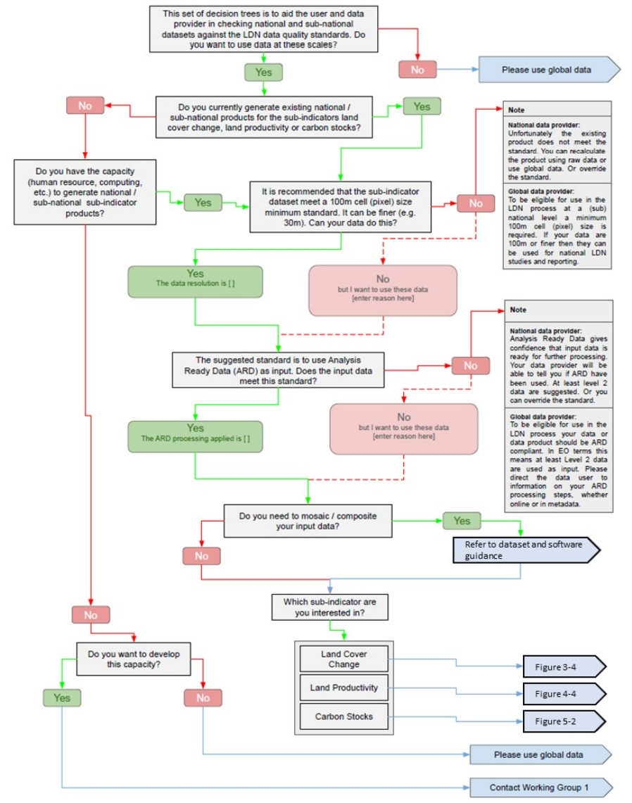
15.3.1. Land degradation
Land degradation (15.3.1): N. Sims/CSIRO, U. Heiden/DLR
Sub-team members
N. Sims/CSIRO, U. Heiden/DLR, F. Kerblat/CSIRO, B. Killough (NASA), N. Mueller (GA), M. Paganini (ESA), C. Ishida (JAXA), K. Hamamoto (JAXA)
Deliverables
SDG-20-06: Satellite data requirements for SDG Indicator
15.3.1 In progress – to be completed in 2022
Revised GPG for 15.3.1 due for release imminently
Updated dataset recommendations
Data quality decision trees for Indicator and sub-indicators
2021 Highlights
Decision trees and updating of GPG
Reference ARD, CEOS
Post 2021: visions and aspirations
Reviewing data needs after SDG reporting period
Data collated by UNCCD
Connecting GEO LDN activities to CEOS
Potential elevation of GEO LDN

Slide 32
15.3.1 Land degradation
CEOS an important support and feedback process for LDN
Need improved coverage in mountainous and cloudy regions
Higher resolution for SIDS and to improve assessment precision
Harmonisation of time-series for baseline (1 Jan 2000 to 31 Dec 2015) and monitoring periods to 2030
Improved C stocks datasets
SOC an important component
Support production of national LC/LM datasets
Implementation of latest LDN analytics
ODC, AWS etc.
GPG for SDG Indicator 15.3.1 due for release imminently
Includes improvements to methods and pointers to new recommended datasets
Increased Capacity Building activities by GEO LDN
LUP4LDN, updated Trends.Earth
Initial pilot sites in Tunisia, Burkina Faso, Turkmenistan
SDG reporting process (Q4 2021) will provide new information on data and analytics needs for countries
Established feedback mechanisms through UNCCD
Action for LDN Initiative leads to feed information back to CEOS

