Slide 1
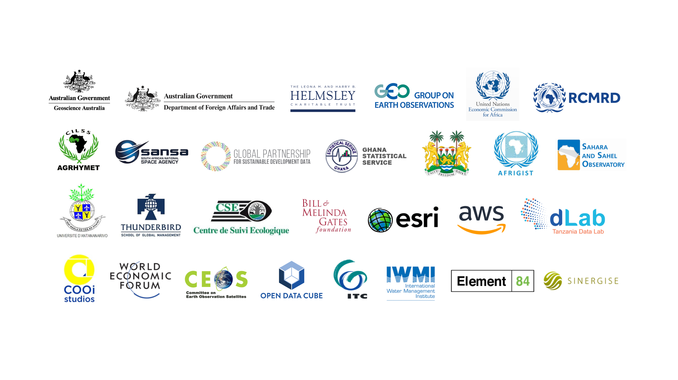
CEOS Impact of CEOS on Open Science – Case Study : Digital Earth Africa
Committee on Earth Observation Satellites
Adam Lewis (GA) on behalf of Digital Earth Africa Establishment Team
2021 CEOS Technical Workshop
Agenda Item 1.3
14th – 16th September 2020

Slide 2
CEOS Open Science
CEOS is a global leader in open science
Advanced space instruments gather systematic observations on a global scale. This sets the stage for equitable access to EO, for all countries
CEOS agencies are providing free and open data, removing barriers to access to large quantities of data across all sectors. Academia, (non/)government, and the private sector can cooperate freely!
The data are being processed, by CEOS agencies & others, to be more analysis ready – consistent with CEOS’ ARD Specifications
CEOS working team initiatives (CARD4L, Future Data Architectures, Interoperability Spectrum, the ODC/CEOS Data Cube/African Regional Data Cube & etc.) are pathfinders to exploit EO data
Open science is exponentially increasing the reach of CEOS data, and by extension, the impacts that EO can have for society

Slide 3
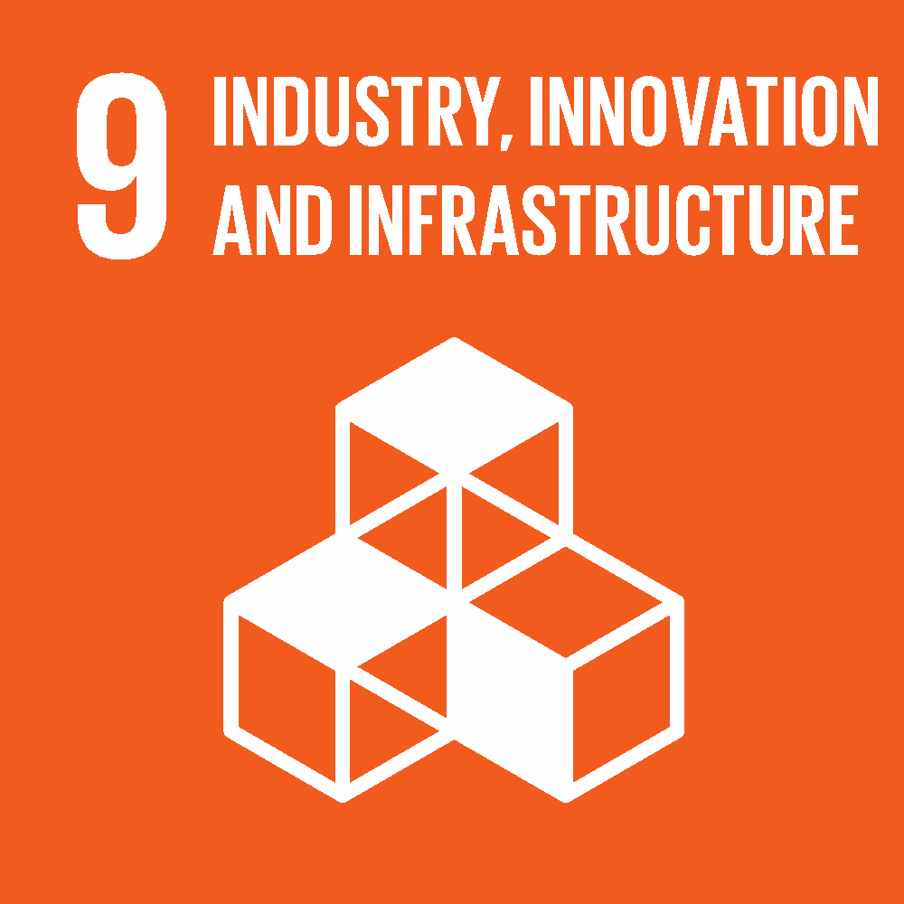
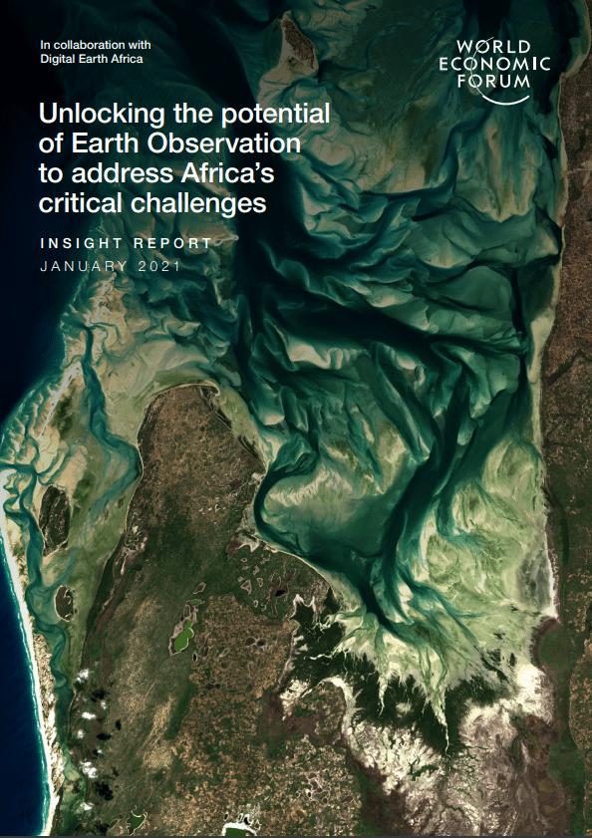
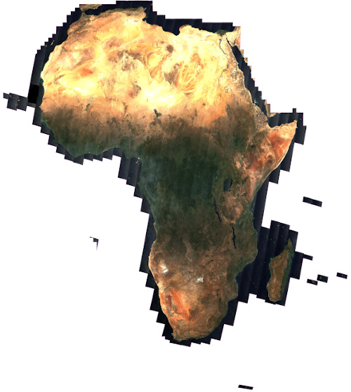
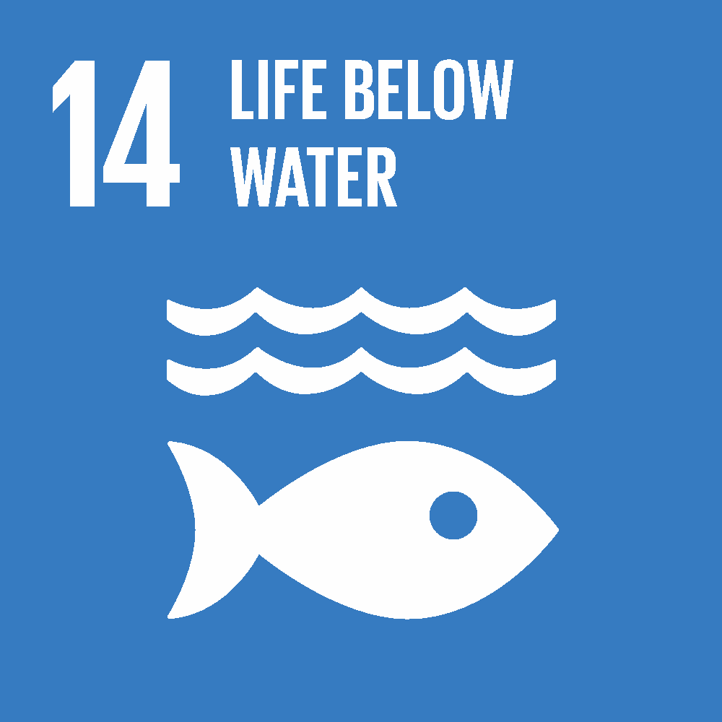
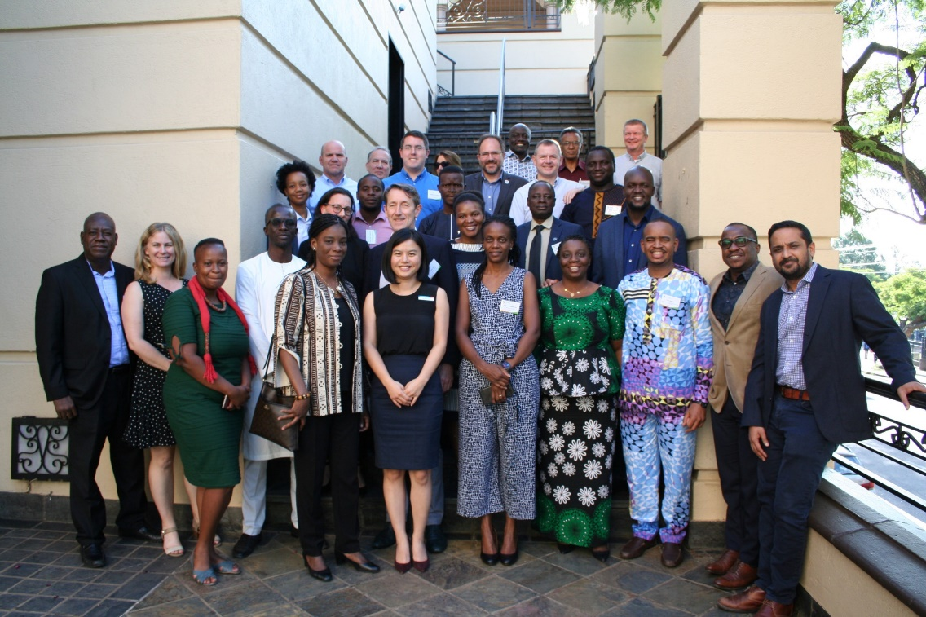
Africa, a continent in need of information
POWERED BY:
Vision: Provide a routine, reliable and operational service, using Earth observations to deliver decision-ready products enabling policy makers, scientists, the private sector and civil society to address social, environmental and economic changes on the continent and develop an ecosystem for innovation across sectors.
Governance and Leadership:

Slide 4
Analysis Ready Data pipelines for Africa
We have established ‘pipe-lines’ of ARD to Africa
2.7 Pb data
Updated daily
Latency depends on the data provider (from one to many days)
Aiming for CEOS ARD compliance
Contributors include USGS, EC/ESA, JAXA, Sinergise, Element-84, AWS, GA and all the people who help with the ARD specifications!
ARD processing should happen as close to the source as possible!

Slide 5
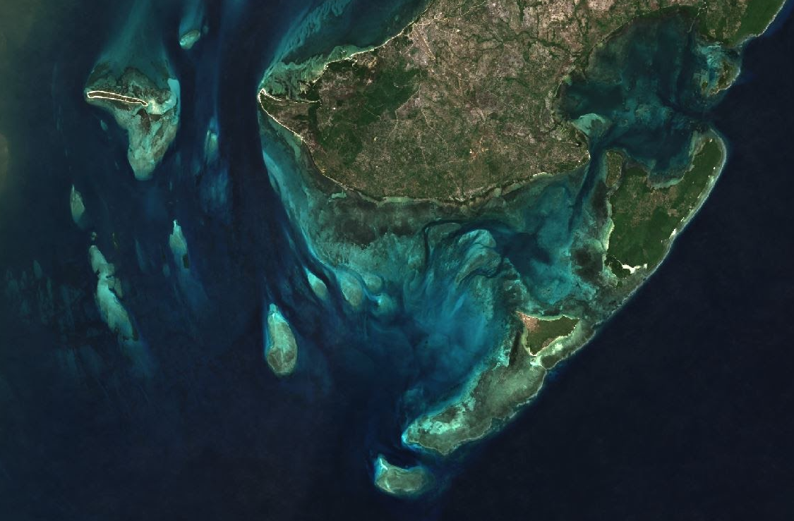
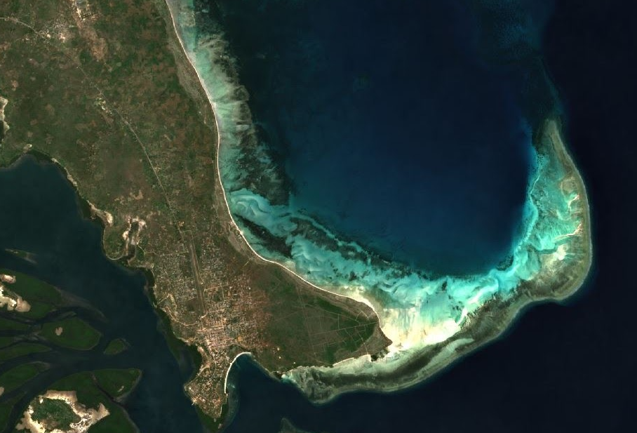
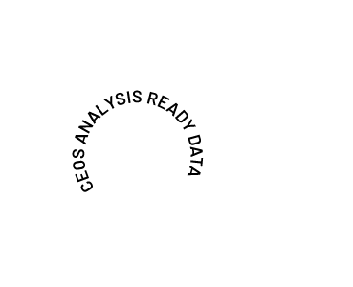
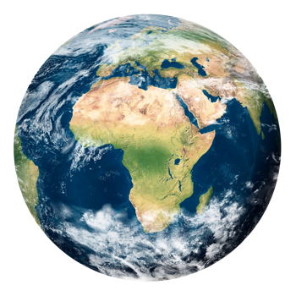
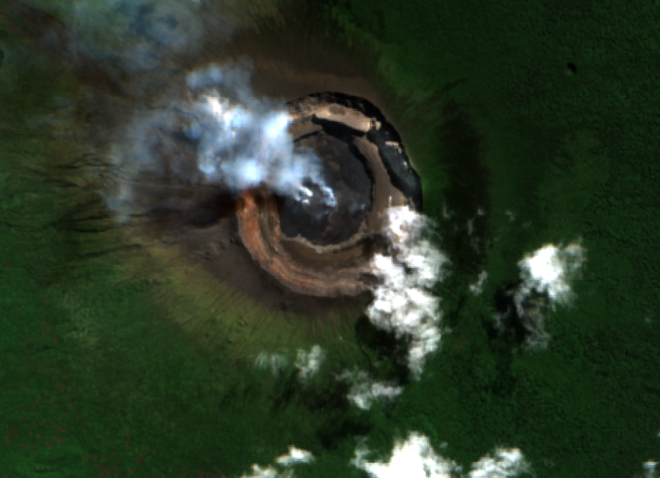
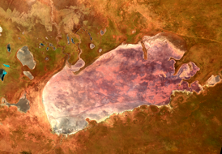
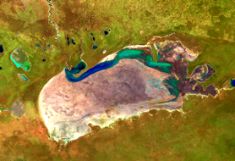
Analysis Ready Data pipelines for Africa
Space Agencies
Analysis Ready Data
Studying the Tanzanian Coastline with GeoMAD, 2019, RGB
p
COGS/STAC AWS S3 Cape Town
Monitoring crops in Egypt 2001-2020, Landsat, RGB
Monitoring Mount Nyiragongo, 2018 Sentinel-2 RGB and 2021 Sentinel-1
Explorer
Jupyter Sandbox
Map
Find out more technical detail in Digital Earth Africa Docs​
Measuring water extent on rangelands in Etosha National Park, Namibia 1992-2021, Landsat, False Colour

Slide 6
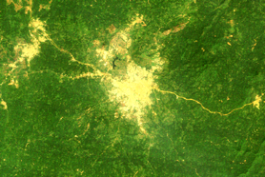
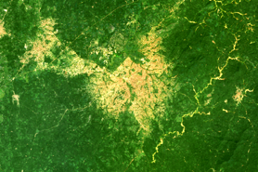
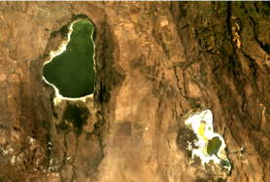
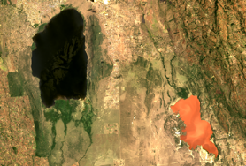
Landsat Collection-II
2013 Landsat 8
USGS Collection 2 – CARD
Urbanisation in Ife, Nigeria from 1986 - 2020, Landsat, RGB
2021
540 terabytes of data
p
COGS/STAC AWS S3 Cape Town
1984 Landsat 5
Monitoring crops in Egypt 2001-2020, Landsat, RGB
1999 Landsat 7
Measuring water quality and extent in Lake Elmenteita and Lake Nakuru, Kenya 1985-2021, Landsat, RGB
Explorer
Jupyter Sandbox
Map
Find out more technical detail in Digital Earth Africa Docs​
Measuring water on rangelands in Etosha National Park, Namibia 1992-2021, Landsat, False Colour

Slide 7
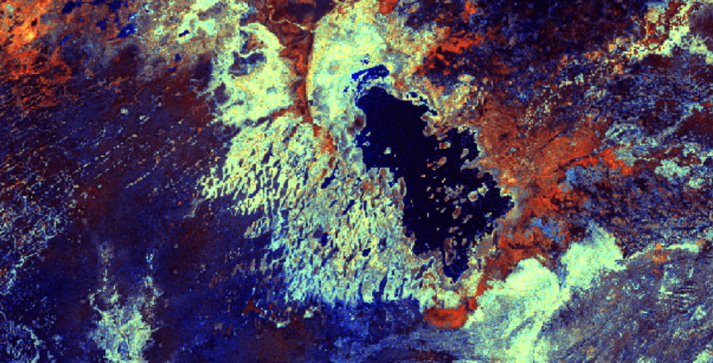
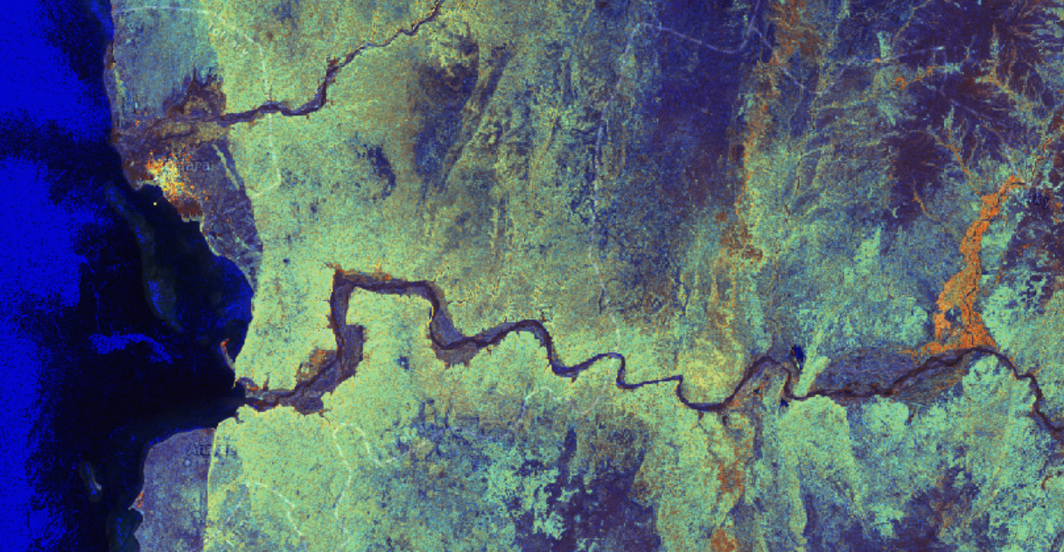
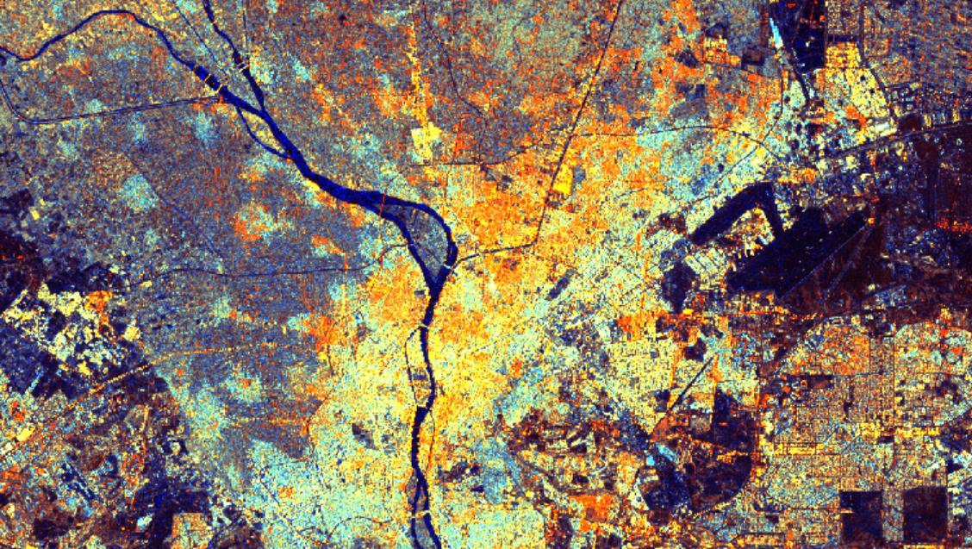
Sentinel-1 Normalised Backscatter (interim solution)
European Space Agency
Sinergise CARD4L Tool
p
Studying Lake Fitri , Chad, Sentinel-1 showing false color composite generated from VV, VH, VH/VV backscatter.
COGS/STAC AWS S3 Cape Town
Onilahy River, Madagascar, Sentinel-1 showing false color composite generated from VV, VH, VH/VV backscatter.
Explorer
Jupyter Sandbox
Map
Find out more technical detail in Digital Earth Africa Docs​
River Nile through Cairo, Sentinel-1 showing false color composite generated from VV, VH, VH/VV backscatter.

Slide 8
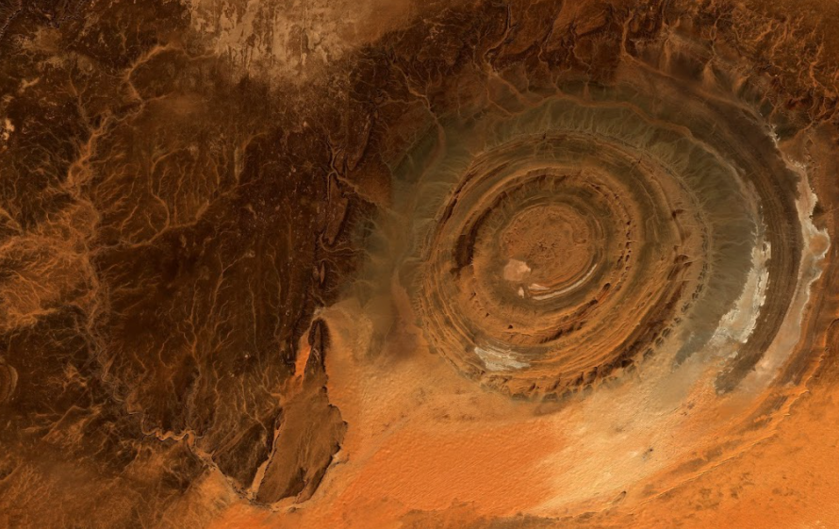
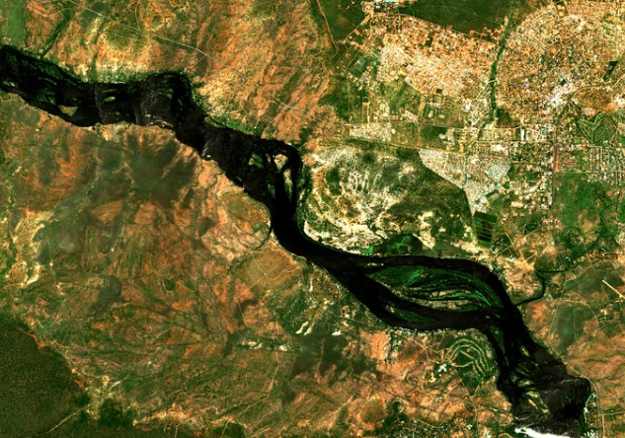
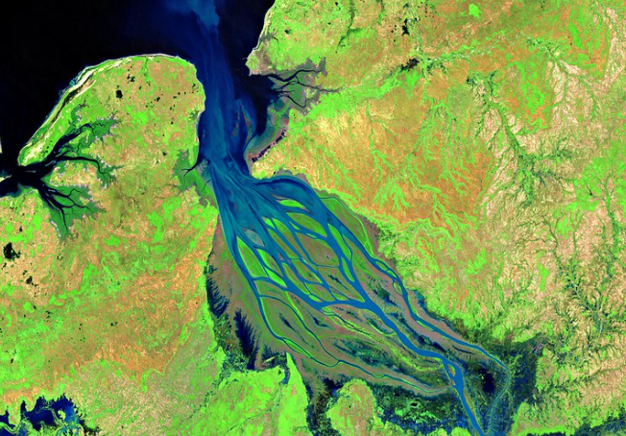
Sentinel-2 Surface Reflectance
European Space Agency ARD
Sinergise ARD
Element 84
p
The Eye of the Sahara, Sentinel-2, RGB
COGS/STAC AWS S3 Cape Town
Victoria Falls, Sentinel-2, RGB
Explorer
Jupyter Sandbox
Map
Find out more technical detail in Digital Earth Africa Docs​
Betsiboka Estuary, Madagascar, Sentinel-2, SWIR/NIR

Slide 9
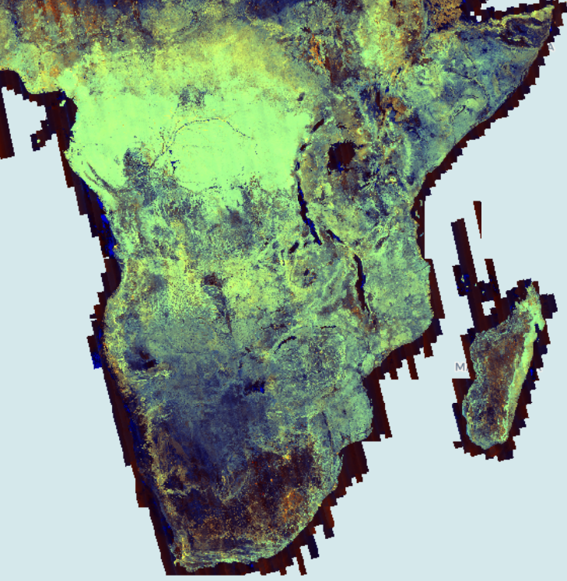
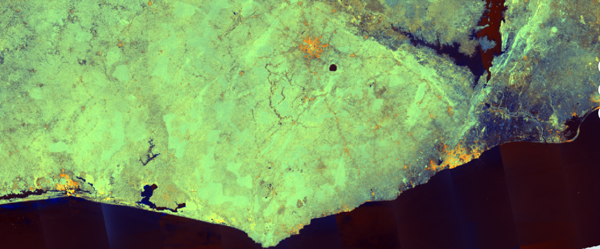
ALOS continental mosaics
Japan Aerospace Exploration Agency Annual Mosaic
Digital Earth Africa Mosaic
p
COGS AWS S3 Cape Town
ALOS PALSAR 2015, HH, HV, HV/HH
Explorer
ALOS PALSAR 2015, HH, HV, HV/HH
Jupyter Sandbox
Map
Find out more technical detail in Digital Earth Africa Docs​

Slide 10
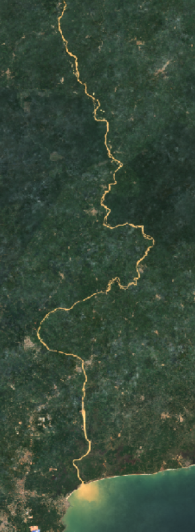
From PetaBytes to Products & Opportunities
Continental products with full resolution:
Surface Water (1983-present, per image and annual summaries) (30m)
Annual and semi-annual Geomedians (Sentinel-2) (10m)
Cropped land (10m)
Fractional Cover (all Landsat) (30m)
NDVI Anomaly
Widespread opportunities:
1000+ users of a sandbox environment
‘000s of users of the map environment
Geoportal users
Direct data access
Government, private sector, NGOs, regional institutes, academia
Africa : Geomedian, Sentiunel-2 2020
Ghana : water turbidity due to mining. Geomedian, Sentinel-2 July-Dec 2021

Slide 11
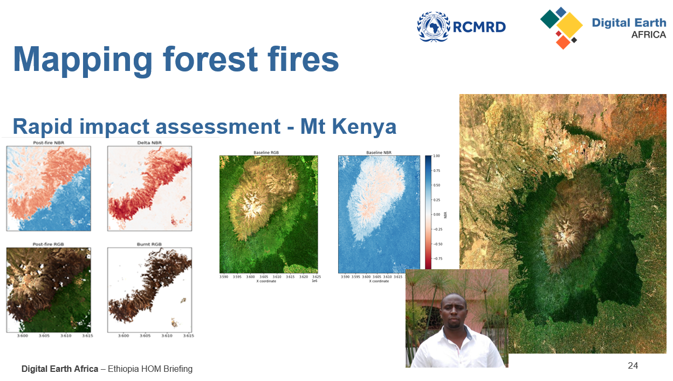
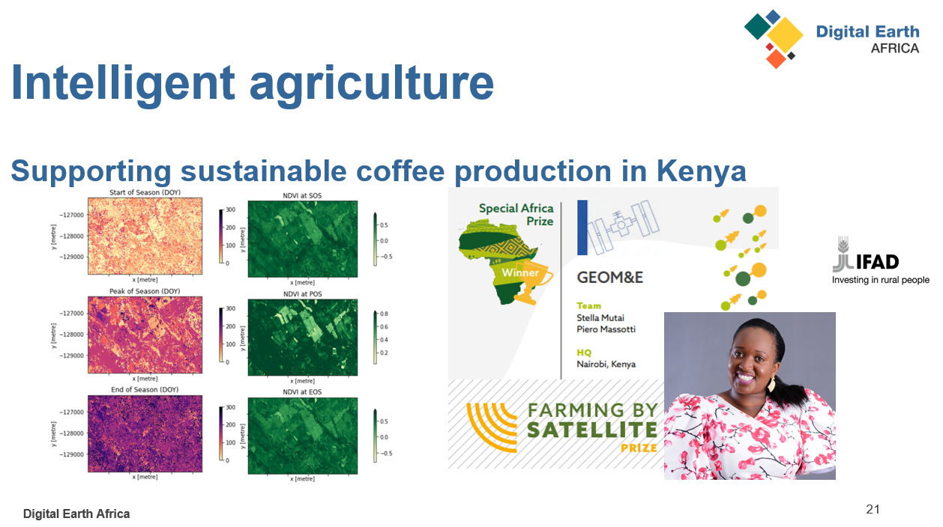
From Products to People

Slide 12
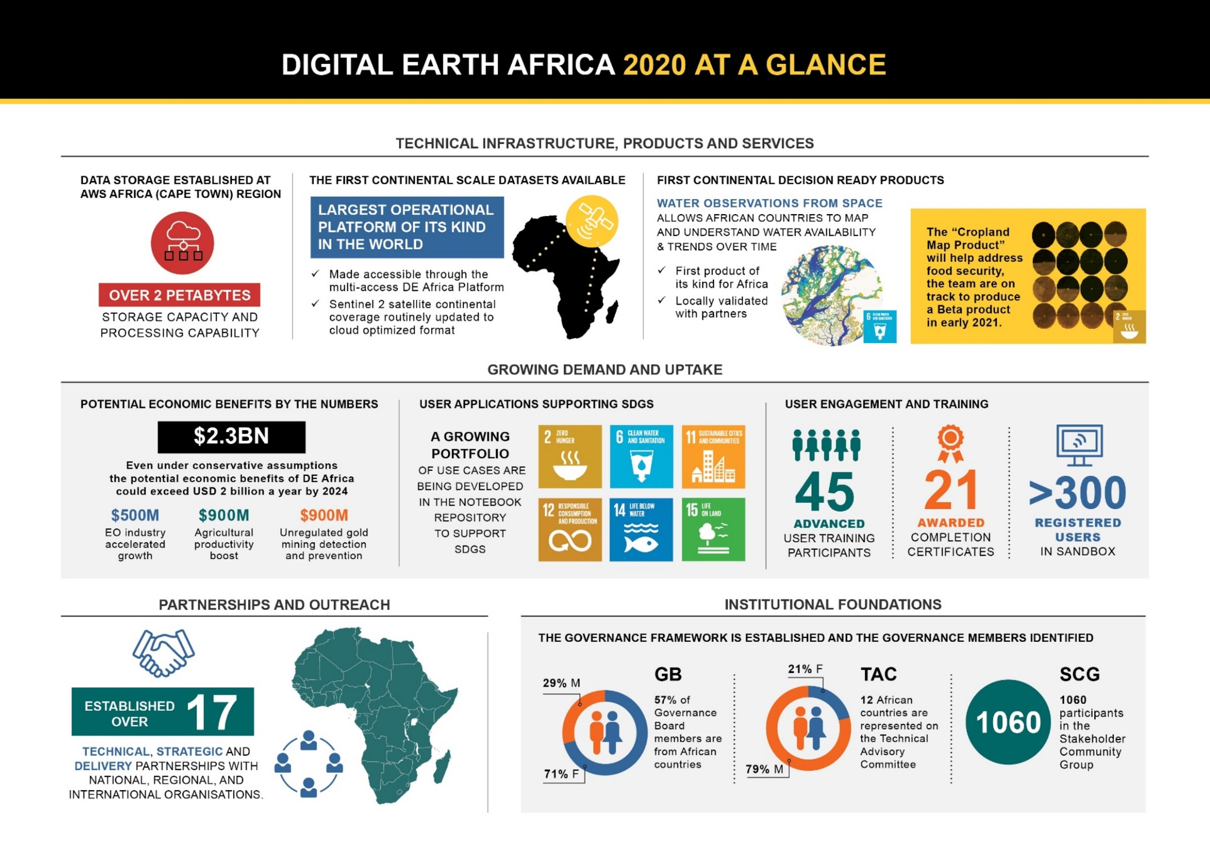
Open science supports success
>30
>125
>960

Slide 13
With thanks to CEOS!

