Slide 1

Carbon & Biomass Session
Committee on Earth Observation Satellites
CEOS SIT Technical Workshop 2020
Session 4, Agenda Item # 4.1 & 4.2
Virtual Meeting
15 September 2020

Slide 2
Presenters
In part 1, please keep talks to 5-10 minutes, we aim to maximise discussion time
  1 minute warning will be given. Please conclude on time.
In part 1, SIT Chair team will advance the slides on your cue
In part 2, presenters have more time and will be assigned presenter status in GTM to advance their own slides
Notes:
Despite not being together in Hobart we still hope to address 3 of the 4 objectives for the session we originally planned. We will not feature the user voices segment which had a national inventory user and the Global Carbon Project both explain their perspectives on the use of EO satellite data and how CEOS agencies might seek to optimise its future relevance to their work.

Slide 3
Carbon & Biomass Session - Part 1
Introduction & Objectives
Australian SIT Chair Team
5 mins
Committee on Earth Observation Satellites
CEOS SIT Technical Workshop 2020
Notes:
Welcome to the Carbon and Biomass session. This was intended to be the largest of our sessions in Hobart auss how CEOS might consider strengthening the policy relevance of our datasets with the main UN and national stakeholders that use our data to make and manage policy. We still have a substantial agenda with significant points for discussion by Principals.
nd featured a number of external speakers to bring some alternative perspectives to our work and to equip us to disc

Slide 4
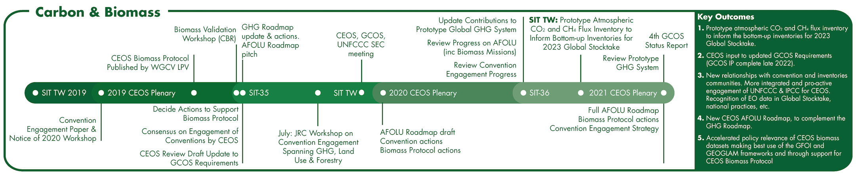
A SIT term priority
Supporting the GHG Roadmap process – escalating, elevating, and accelerating progress towards major milestones, including for the 2023 Global Stocktake. 2021 prototype flux products.
Encouraging stronger and more systematic CEOS engagement with convention frameworks – building on IPCC outreach
  And national inventory communities as our future users
Reflecting large investment (2018-2024) in Above-Ground Biomass missions and seeking to accelerate the policy relevance of these new data (GFOI, GEOGLAM…)
Promote uptake of biomass datasets beyond science community – forest monitoring, inventories…
Notes:
You all know that Carbon and Biomass was identified as one of our 3 priority themes. We felt this was important given the scale of investment by the largest of our agencies in this area and given the important technical work underway across the CEOS structure - such as in the GHG Roadmap team and in the WGCV on the Biomass Protocol, as well as activities such as our GFOI engagement. This is our prospectus chart you are all familiar with - updated to reflect some schedule changes and with our goals identified.

Slide 5
What do we hope to achieve?
(Very) big picture… an optimally efficient and effective partnership between space data providers and the main UN and national stakeholders that use our data to make and manage policy.
CEOS exploring more integrated and pro-active relationships with major stakeholders in conventions and national inventories - to accelerate the policy impact and application of our data
Shine a light on the underlying technical work underway in the organisation and agencies and advocate for support from Principals for it to realise its full potential. Elevate, escalate, accelerate.
Notes:
Despite not being together in Hobart we still hope to address 3 of the 4 objectives for the session we originally planned. We will not feature the user voices segment which had a national inventory user and the Global Carbon Project both explain their perspectives on the use of EO satellite data and how CEOS agencies might seek to optimise its future relevance to their work.

Slide 6
Specific objectives/agenda today
Session 1
Convene with key partners in the major requirements and policy processes
  UNFCCC SEC (Joanna & Florin)
  GCOS (Anthony & Han)
  GFOI (Nikki & Maria)
  GEO (Sara)
Brief updates from UNFCCC & GCOS and key CEOS activities
  AFOLU & GHG Roadmaps status
  GHG-AFOLU synergies
Moderated (by Mark & Jörg) discussion with the theme of…
Climate Data Requirements & Policy processes - optimising the space agency contribution
Global Stocktake process
GCOS Requirements process
5 - 10 mins each
90 mins
Add comments and questions via GTM chat at any time in the session
Notes:
Here are our specific objectives and the supporting agenda items. Talk through briefly…
Q&A break after Biomass on any topics that featured prior. And again after the UNFCCC/policy discussion. Please keep to time. We wish to cover all ground even if this format is more of a preliminary discussion than we would have liked. Use sli.do to input comments and questions that arise and we will moderate those for an efficient Q&A.

Slide 7
Specific objectives/agenda today
Session 2
Preparation of our relevant agenda items for CEOS Plenary
  CEOS Biomass Protocol and implementation support (Laura)
  WGClimate: ECVI 3.0 and Use Case activity (Jörg)
  GHG Roadmap (Mark)
  White Paper to AFOLU Roadmap (Osamu)
15 mins wrap (SIT Chair Team)
  Plenary readiness actions
  2021 outlook
All Session 1 participants very welcome to stay - or feel free to leave @ break (15 mins)
30 mins
20 mins
15 mins
20 mins
Add comments and questions via GTM chat at any time in the session
Notes:
Here are our specific objectives and the supporting agenda items. Talk through briefly…
Q&A break after Biomass on any topics that featured prior. And again after the UNFCCC/policy discussion. Please keep to time. We wish to cover all ground even if this format is more of a preliminary discussion than we would have liked. Use sli.do to input comments and questions that arise and we will moderate those for an efficient Q&A.

Slide 8
Key Updates & Context
CEOS-CGMS WGClimate (Jörg Schulz, WGClimate)
  Heritage and context
UNFCCC SEC (Joanna Post & Florin Vladu)
  Latest on Global Stocktake processes
  Emphasis on SO and CEOS engagement
GCOS (Anthony Rea & Han Dolman)
  Latest on key GCOS documents, processes and reorganisation
AFOLU Roadmap (Osamu Ochiai, JAXA)
  Objectives, status and relevance for the GST SO Synthesis Report
GHG Roadmap (Mark Dowell, EC)
  Objectives, status and relevance for the GST
  GHG-AFOLU synergies and suggested actions
Notes:
First we will hear from GCOS. Many of you will have heard that WMO has been doing major cost-cutting and reorganisation and that GCOS has been impacted by that. Anthony Rea from WMO is here to provide an update and explain the outlook.
Mark Dowell will update us on the GHG Task Team and Roadmap.
And Jorg will provide a brief report on CEOS-CGMS WGClimate efforts since Plenary, including COP

Slide 9
Heritage and Context
CEOS-CGMS WGClimate
Jörg Schulz
10 mins
Committee on Earth Observation Satellites
CEOS SIT Technical Workshop 2020
Notes:
Welcome to the Carbon and Biomass session. This was intended to be the largest of our sessions in Hobart auss how CEOS might consider strengthening the policy relevance of our datasets with the main UN and national stakeholders that use our data to make and manage policy. We still have a substantial agenda with significant points for discussion by Principals.
nd featured a number of external speakers to bring some alternative perspectives to our work and to equip us to disc

Slide 10




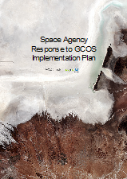


Addressing Observational Needs of UNFCCC
COP-21 Paris Agreement: Adaptation (Article 7(c)):
Strengthening scientific knowledge on climate, including research, systematic observation of the climate system and early warning systems, in a manner that informs climate services and supports decision-making.
Reports on Progress
@ SBSTA/COP
Earth Info Day
Needs and Requirements
Coordinated Response

Slide 11
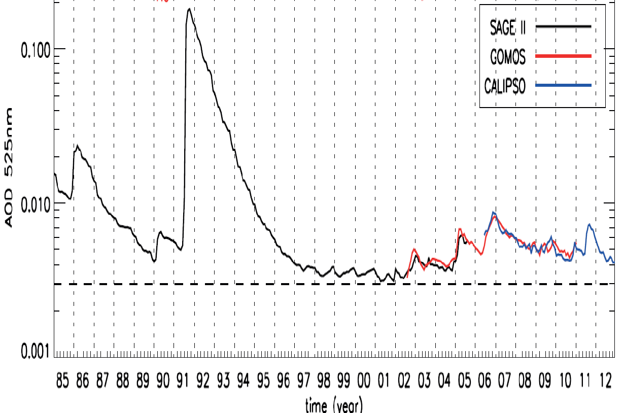
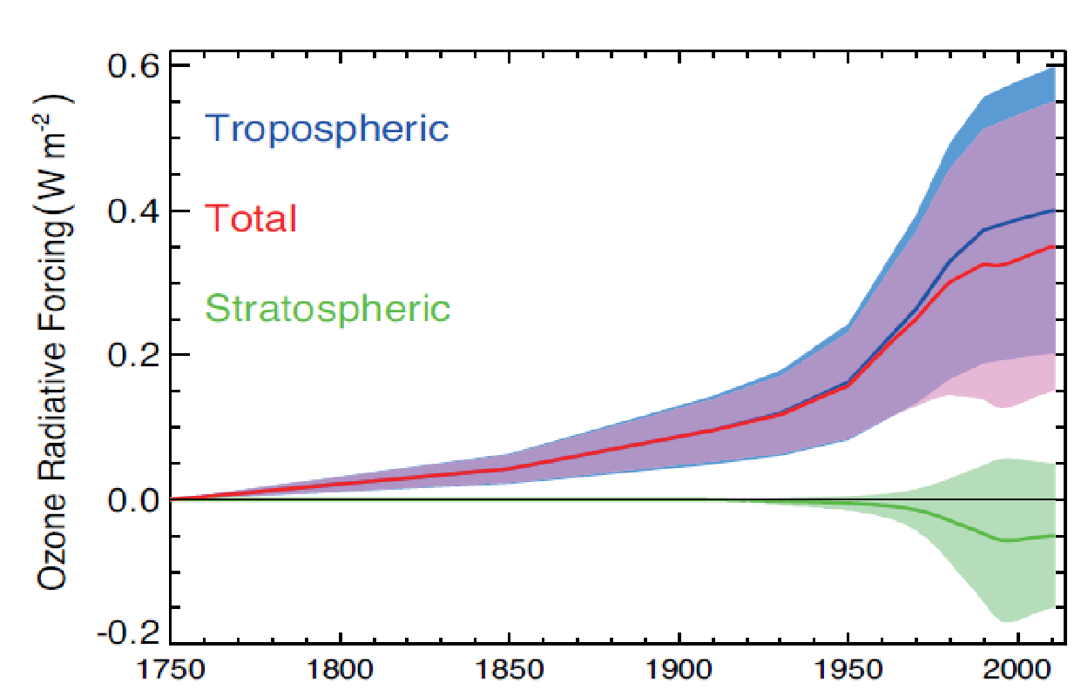

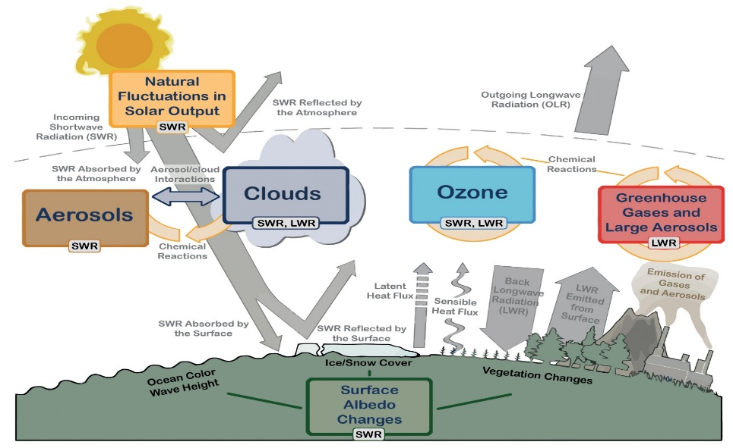
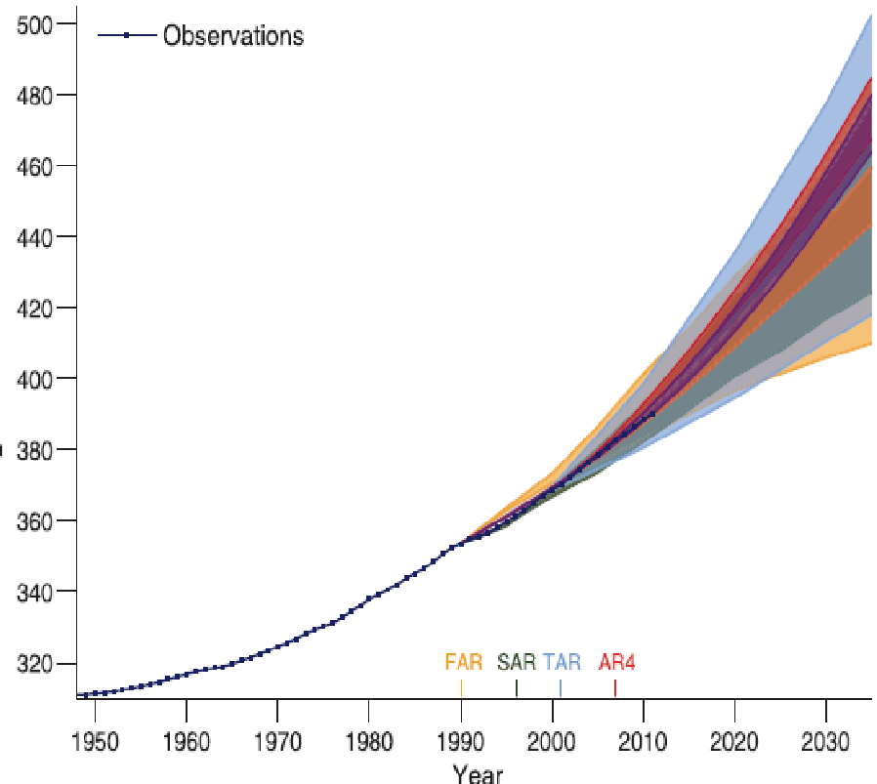





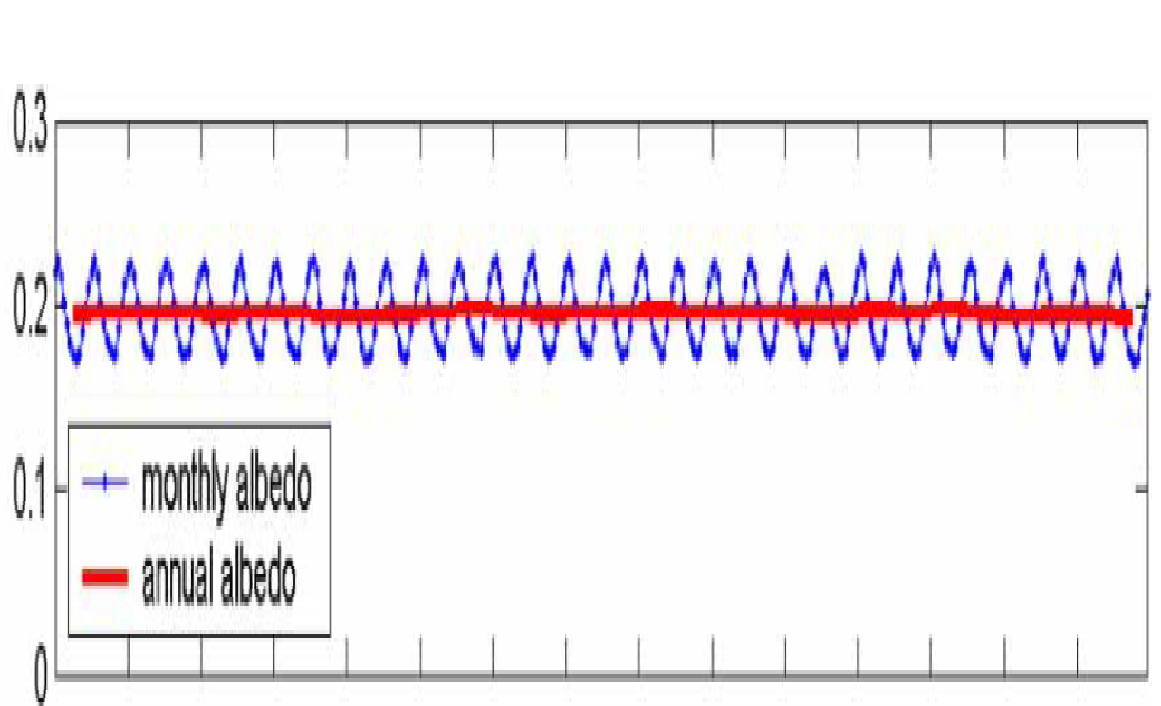

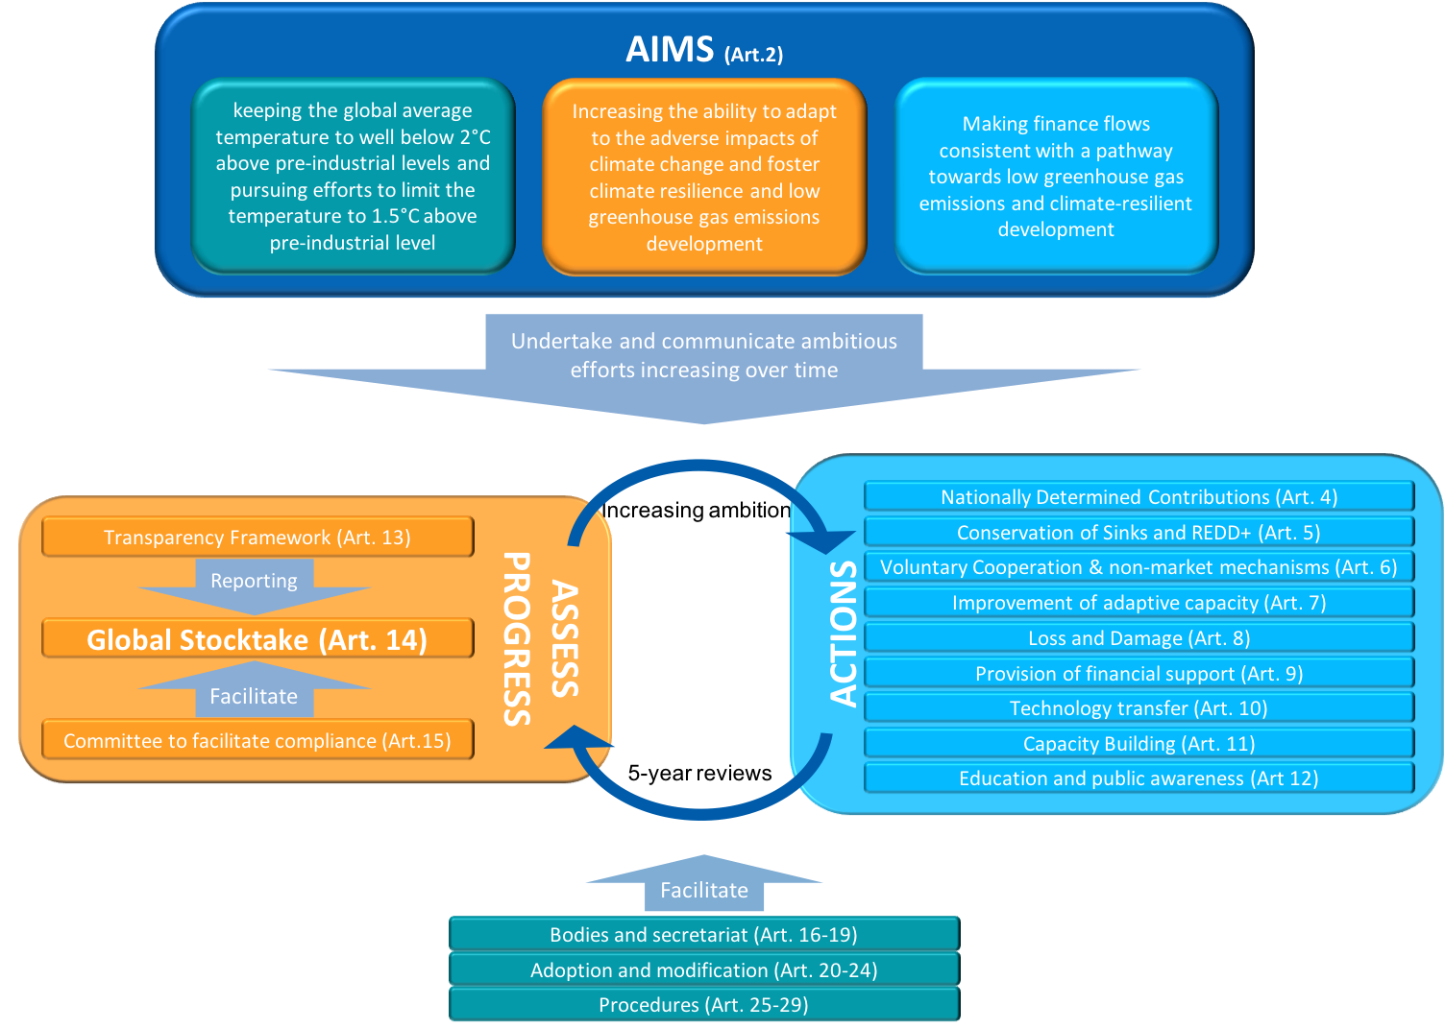
The Paris Agreement
Contributions from Space
Potential for satellite data
NDC: Global and regional constraints on GHG sources and sinks;
Adaptation, loss & damage: forestation, changes in disaster impacts (storms, floods, drought), sea level rise, evolution of urban areas, etc.
Aerosol Optical Depth
O₃ Radiative forcing
239
(236, 242)
340
(340,341)
100
(96, 100)
CO₂ Concentration
Units (W.m⁻² )
IPCC reports
SBSTA reports
Agency reports
79
(74, 91)
185
(179, 189)
24
(22, 26)
84
(70, 85)
398
(394, 400)
20
(15, 25)
Global Land Surface Albedo
161
(154, 166)
342
(338, 348)
Synthesis Report for GST

Slide 12
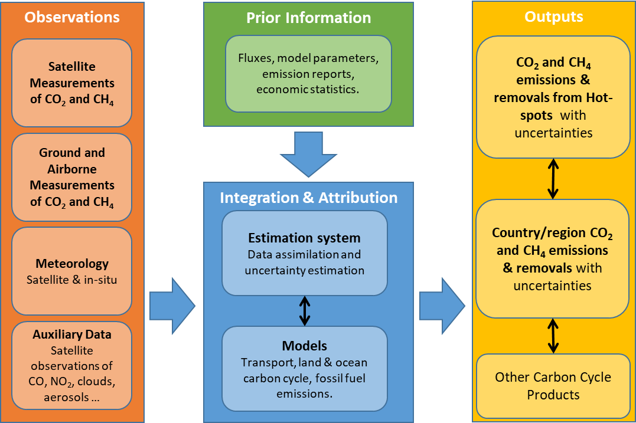
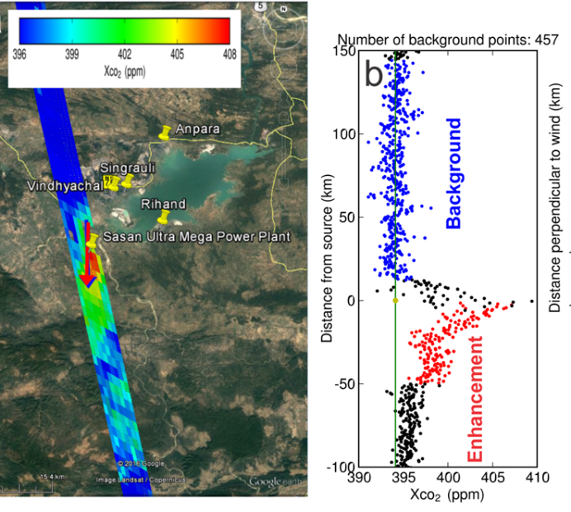
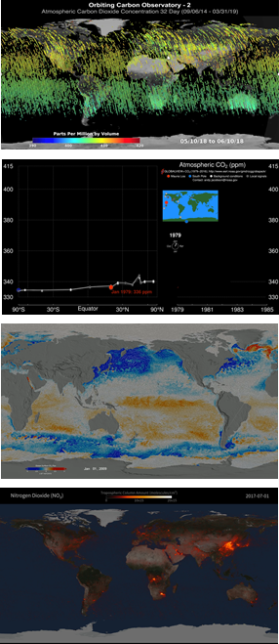
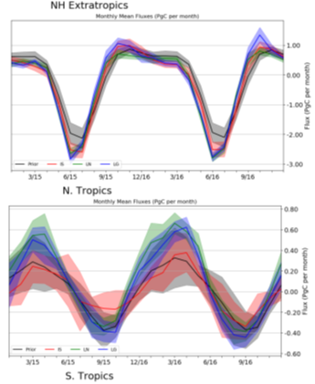
A System Approach is Adopted to Deliver Atmospheric CO₂ and CH₄ Inventories

Slide 13
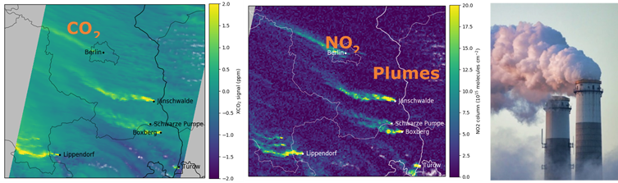
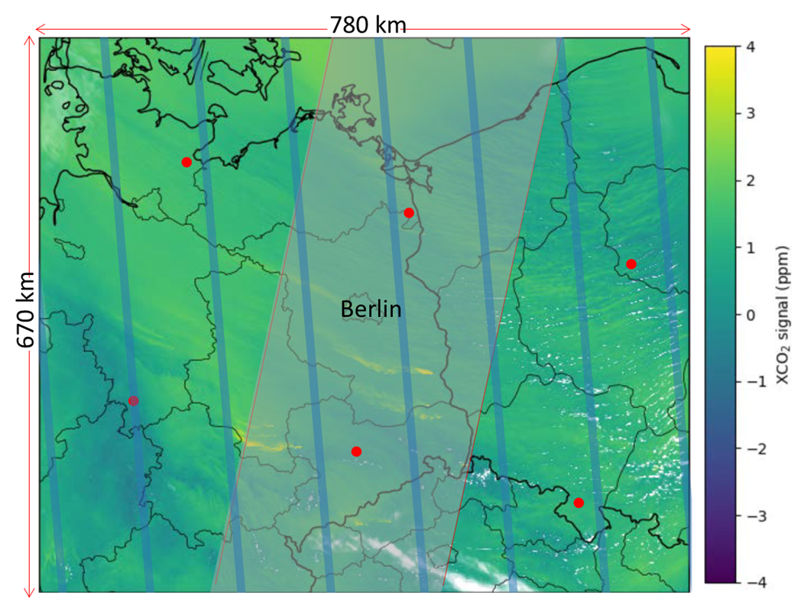
Emission Source Detection?
Requirements are changing – need to reflect this in GCOS IP
Figure: Simulated XCO₂ and NO₂ plumes originating from power plants and other emission sources in a larger area around Berlin. Simulated data come from the COSMO-GHG model as used in the SMARTCARB study simulating a swath width of 250 km. (credit: ESA SMARTCARB).
Figure: The XCO₂ distribution over 780 km by 670 km region centered over Berlin, Germany (adapted from Kuhlmann et al. 2018) is shown along with the spatial coverage and resolution for GOSAT (red dots), OCO-2 (blue tracks) and a proposed CO₂ Sentinel mission with a 250 km-wide swath (light grey region). Credit: ESA SMARTCARB.
Notes:
Figure: The XCO₂ distribution over 780 km by 670 km region centered over Berlin, Germany (adapted from Kuhlmann et al. 2018) is shown along with the spatial coverage and resolution (roughly to scale) for GOSAT (red dots), OCO-2 (blue tracks) and a proposed CO₂ Sentinel mission with a 250 km-wide swath (light grey region), drawn approximately to scale. GOSAT collects soundings with ~10.5 km footprints, separated by ~260 km cross-track and ~280 km down-track. OCO-2 collects soundings continuously along a 10.3 km swath. The wide swath of the CO₂ Sentinel is much better at capturing the CO₂ plumes from Berlin and the large power plants southeast and south of Berlin (Jänschwalde, Schwarze Pumpe, Turów, Boxberg, and Lippendorf; credit: ESA SMARTCARB).

Slide 14
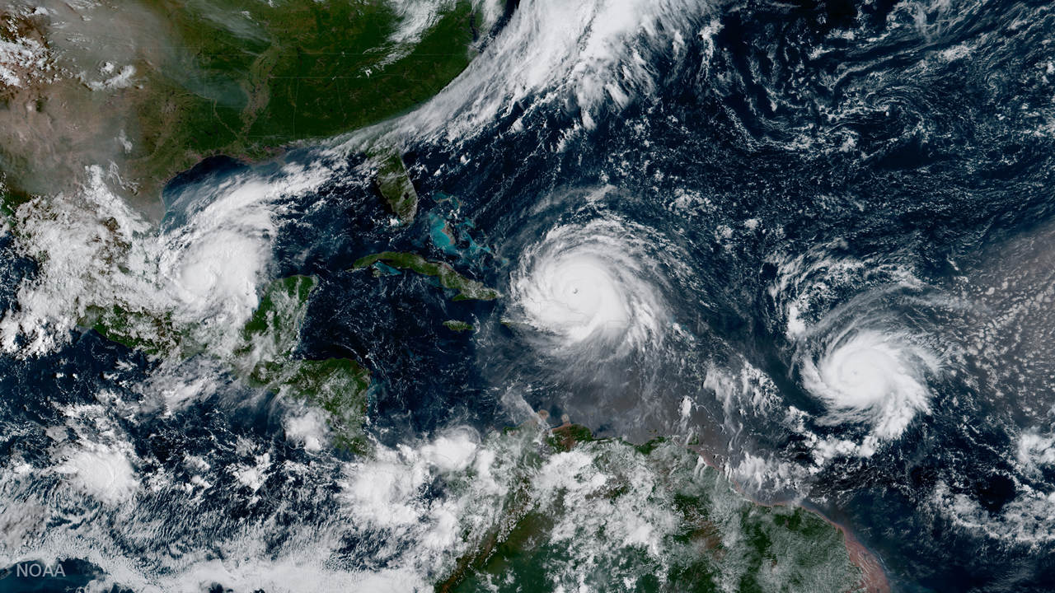
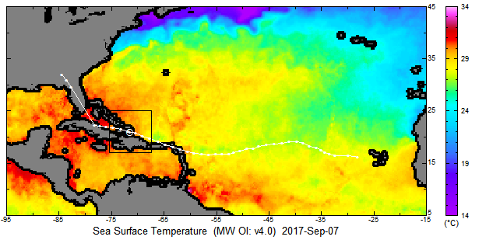
Loss & Damage - Intensity of Cyclones and Upper Ocean
IRMA
September 2017
Florida alone:
6.5 Million people evacuated
~50-100 fatalities
$50 Billion damage
By NOAA National Environmental Satellite, Data, and Information Service (NESDIS) - https://www.nesdis.noaa.gov/content/goes-16-sees-three-hurricanes-atlantic, Public Domain, https://commons.wikimedia.org/w/index.php?curid=67039446

Slide 15
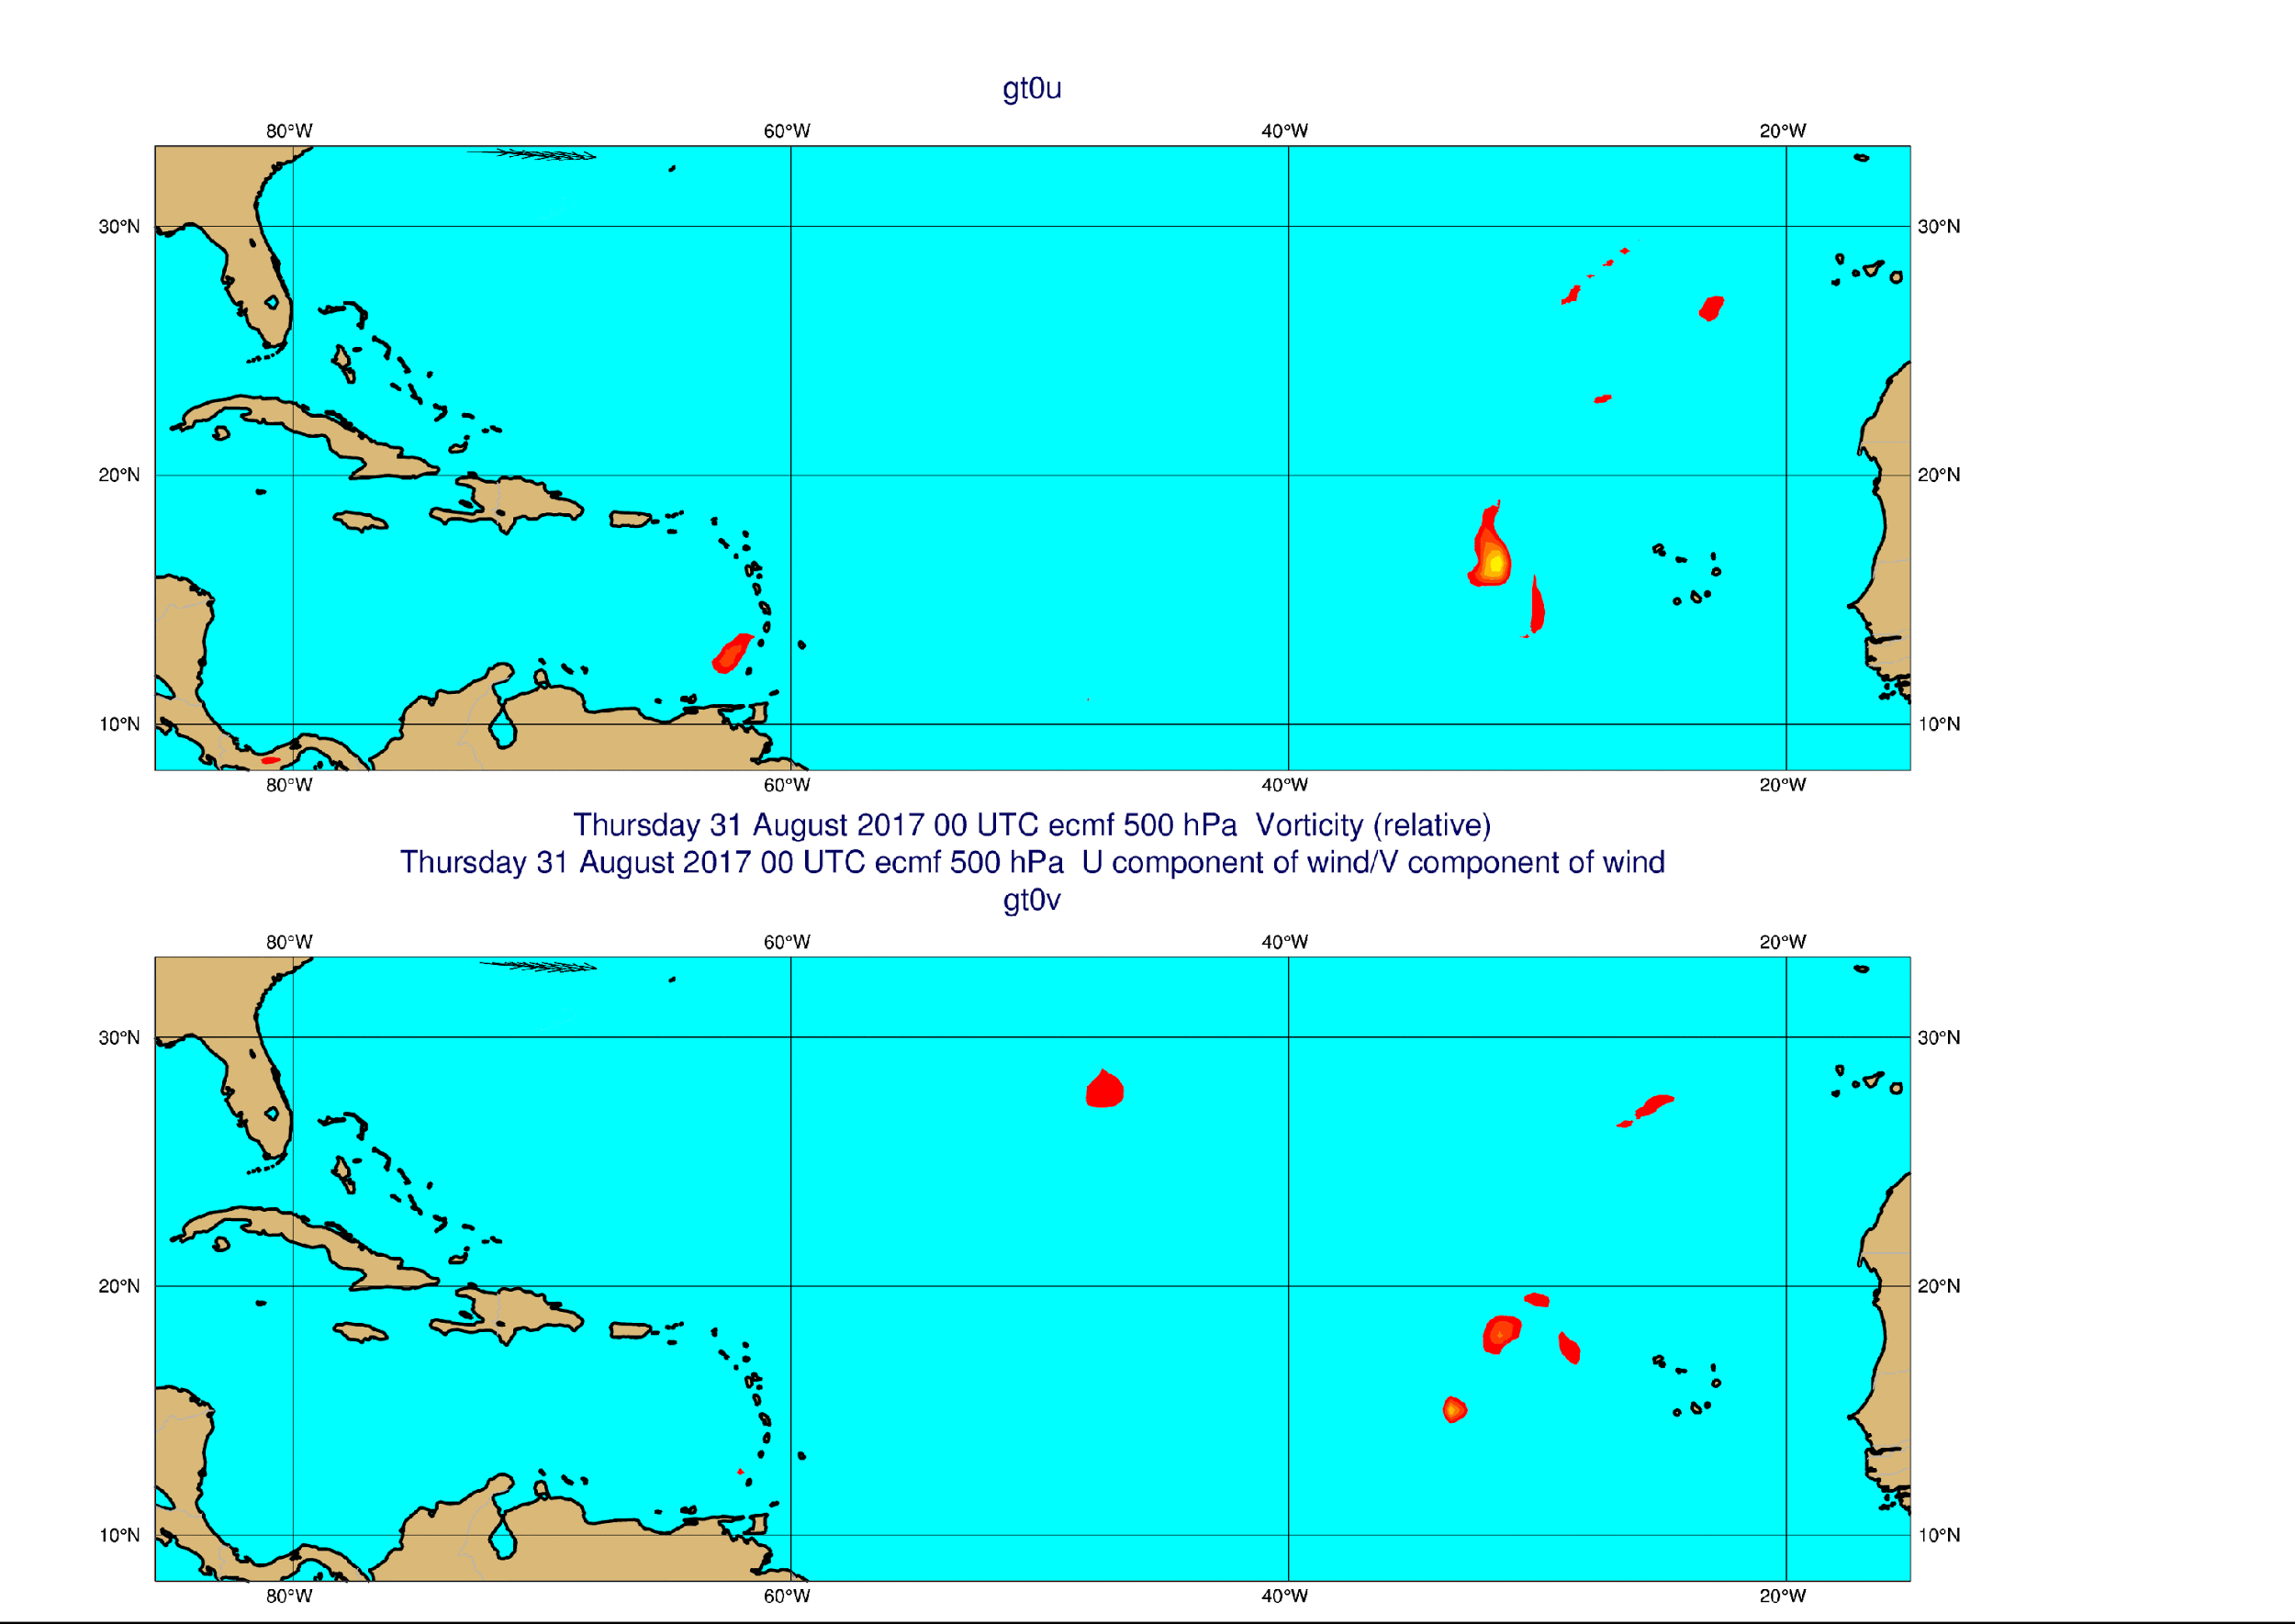
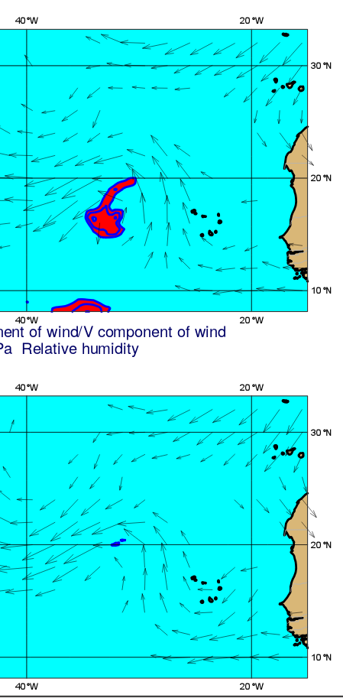

Loss & Damage: Weather Impacts and Preparedness
IRMA forecast with satellites
700hPa initial conditions with satellites
Red shading humidity > 95%
IRMA forecast without satellites
700hPa initial conditions without satellites
Good understanding of storms and good prediction links event causing loss and damage to climate variability and change. Operational attribution systems will become part of climate services in the future.
Notes:
Figure: 500 hPa Velocity on 31 August 2017 00 UTC – 8 September 00 UTC
If we examine the initial conditions of the failed forecast we see the cause is an absence of humidity around 700hPa …humidity which is critical for enhancing convection and TC development.
Good understanding of storms and good prediction links event causing loss and damage to climate variability and change. Operational attribution systems will become part of climate services in the future.

Slide 16
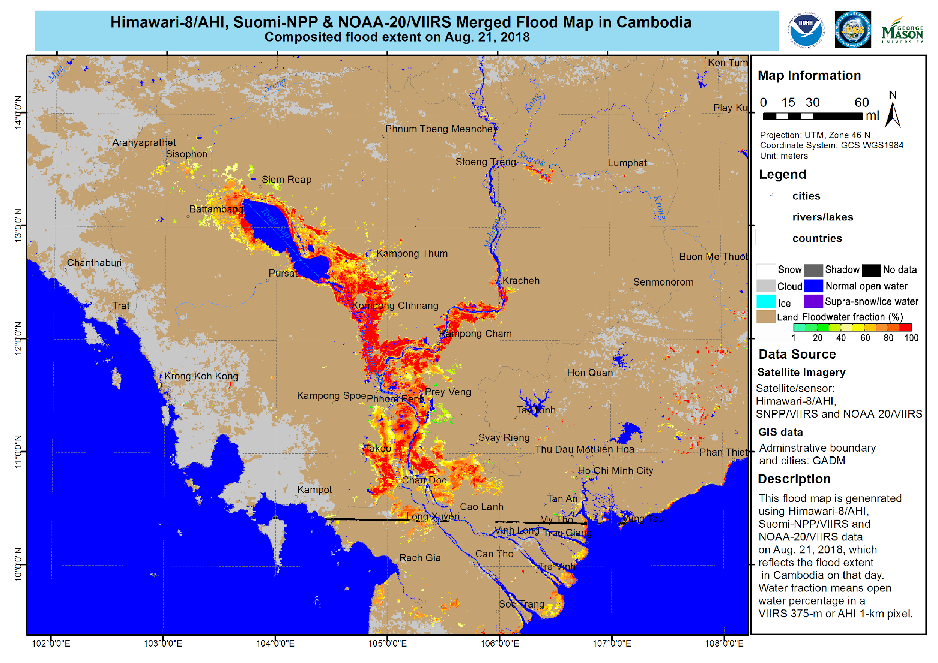
Loss & Damage: Floods
Combined use of satellite data from geostationary and polar orbit;
Enables disaster responders to act;
Analysis of past events enables risk assessment as function of time as climate changes.
Courtesy, Mitch Goldberg, NOAA, USA

Slide 17
Broadening and Consolidating UNFCCC engagement (1/2)
CEOS & CGMS has been very effective over last 8 years in establishing a positive and proactive dialogue with UNFCCC/SBSTA
  This is in large part due to the to the symbiotic relationship we have established with the Global Climate Observing System (GCOS) and the Climate Monitoring Architecture, which has been our guiding framework
The creation of the Joint WGClimate established an unambiguous entry point for the discussion between SBSTA and the Space Agencies
  To date, this engagement, through the SBSTA Research and Systematic Observation (RSO) subgroup has largely focused on our support on Climate Data Records for GCOS ECVs
  GHG Monitoring
In recent years, our support has been visibly expanding: CEOS Carbon Strategy, CEOS GFOI support and evolution to biomass, other AFOLU, Climate Services and support to Climate Adaptation etc. so…

Slide 18
Broadening and Consolidating UNFCCC engagement (2/2)
CEOS needs a long-term strategy accounting for the multitude of contributions it and its member Agencies can make to the Convention
  Maintaining the effective focal point established through WGClimate
  Increasing communication on contributions from other parts of CEOS (in statements, SBSTA Briefings etc.)
Use, and re-enforce, CEOS Carbon Strategy as framework for carbon relevant aspects.
Give greater visibility to GFOI/Biomass aspects as well as Agriculture, not only through REDD+ but also RSO
In the short/mid term:
  Build on priorities of SIT Chair (AUS) on Carbon and Biomass, as well as current visibility on GHG Monitoring
  Initiate dialogue between GHG and AFOLU communities – Workshop hosted by EC June 2021
  Dedicated discussion at SIT TW with all CEOS entities, GCOS and UNFCCC Secretariat

Slide 19
Global Stocktake Update
UNFCCC SEC
Jo Post & Florin Vladu
10 mins
Committee on Earth Observation Satellites
CEOS SIT Technical Workshop 2020
Notes:
Welcome to the Carbon and Biomass session. This was intended to be the largest of our sessions in Hobart auss how CEOS might consider strengthening the policy relevance of our datasets with the main UN and national stakeholders that use our data to make and manage policy. We still have a substantial agenda with significant points for discussion by Principals.
nd featured a number of external speakers to bring some alternative perspectives to our work and to equip us to disc

Slide 20
2020 CEOS Strategic Implementation Team Technical Workshop
4.1 and 4.2: Carbon and Biomass
Supporting the UNFCCC and the Global Stocktake

Slide 21








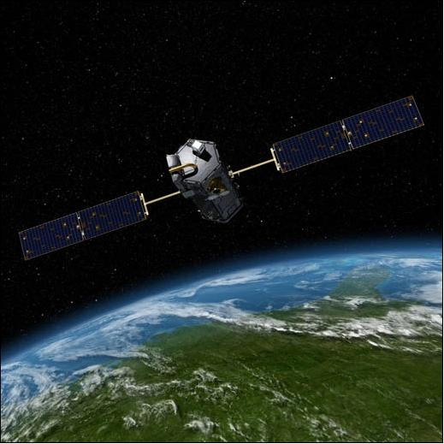
Observations - the foundation for commitments and decision making on climate change
Observations
Research
Assessment
Policy
PARTIES
SBSTA / SBI
COP/ CMA/ CMP
WMO
Article 4.1(g) Commitments
Article 5
Research and systematic observation
SBSTA Research and systematic observation agenda item
Notes:
In 1992 The UNFCCC called on all Parties to achieve stabilization of GHGs in the atmosphere without impacting on the climate system
The Convention included commitments including in regards to scientific information
Article 5 identified the need to promote and cooperate in observation of the climate system to support and strengthen observation and exchange of data
AND Take into account the particular concerns and needs of developing countries and cooperate in improving their endogenous capacities and capabilities
Systematic observation, research, data provision as well as climate services are considered by the Subsidiary body for scientific and technological advice (SBSTA) .
Information is provided to SBSTA in the forms of reports, statements at the SBSTA plenaries, as well as during mandated events including the research dialogue and the Earth information day.
The Convention
Article 4 Commitments
Promote and cooperate in scientific, technological, technical, socio-economic and other research, systematic observation and development of data archives related to the climate system and intended to further the understanding and to reduce or eliminate the remaining uncertainties regarding the causes, effects, magnitude and timing of climate change and the economic and social consequences of various response strategies
Article 5 RSO
Promote and cooperate in SO of the climate system and exchange of information
Support and strengthen SO
Improve capacity for SO
…particularly in developing countries
Earth Observation plays a key role in addressing climate change and as a foundation to the work of the UNFCCC through a value chain which includes observations, research and the IPCC assessments
The products of this value chain support action taken under the Convention by Parties as well as for direct inputs into decision making under the Convention. The data and information for action including, on adaptation and mitigation and on reporting can be better optimized through applied climate services

Slide 22
Paris Agreement | Science – Policy interface
Climate system and climate change
Policy
Workstreams
Mitigation Adaptation
Loss & Damage
NDCs
NAPs
Reports
Observation
WMO
GCOS
CEOS
GEO
Research
WCRP
IAMC
Future Earth
ISC
Assessment
IPCC
SBSTA
(Science & Review)
Systematic observation
(Earth Information Day)
Research
(Research dialogue)
Ensure consistency between observations, reanalyses, and future projections
Climate services
GFCS
GEO
Copernicus
COP/CMA
2nd Periodic review (UNFCCC)
(2020-2022)
Global stocktake
(Paris Agreement)
(2023, 2028 …)
Carbon, energy, water cycles, Biosphere
Global carbon budget, SLR, EEI
Reports
ECVs, Climate data records, climate indicators
SBSTA inputs
Statements at SBSTA (WMO, CEOS, GCOS, GOOS …)
Update Reports for SBSTA (WMO, GCOS, CEOS)
GCOS – status of observations
GCOS IP
WMO Statement on the state of the global climate & GHG bulletin
GST synthesis report??
The systematic observation community will contribute to the GST – indirectly, through Parties, constituted bodies, IPCC, UN Agencies. Can it contribute directly?
Notes:
The Paris Agreement provided a new paradigm for the role of the scientific community dealing with climate change.
This brings both challenges and opportunities.
It is worth emphasizing that action under the Paris Agreement, as stated in its pre-ambular, – must be carried out based on the best available science.
We need to think in the paradigm of how to build connections, support, communication, opportunities so that science can drive policy and in turn policy can drive science. We need connection and circularity.
Policy relies on the excellent value chain already in existence.
Earth Observation play a key role in addressing climate change and supporting the work of the UNFCCC: We work closely with the observation community, particularly GCOS, CEOS and WMO.
Research helps understand and predict changes - and we work closely with WCRP and others.
The IPCC plays an important role in the UNFCCC providing an assessment of the scientific research.
Climate services are also invaluable to support Parties.
The products of all this value chain all feed into the policy – the point of entry for negotiations is under the Subsidiary Body for Scientific and Technological Advice (SBSTA).
As many of you know, I lead the work on RSO – research and systematic observation.
Other important agenda items this year at SBSTA 50 will be the restart of negotiations on the adequacy of the long-term global goal as well as discussions to increase understanding of the SR1.5 report (as mandated in the COP decision from Katowice)
Normally under the RSO negotiations – systematic observation is discussed during COP, and research is discussed in the Summer subsidiary body session.
This year, both research and systematic observation will be discussed at SBSTA50 in June
Under RSO – the research Dialogue provides updates and guidance on priority research (e.g., for implementing the Paris Agreement, for filling in the gap on 1.5°C)
We also planning, depending on the outcomes of SBSTA 50, for an Earth Information Day at COP this year – but more on that later.

Slide 23

The “ambition” cycle of the Paris Agreement
Take action to implement Paris Agreement
At national and international level
Limit global warming to < +2/1.5° C
Enhance adaptive capacity, resilience, & low-emissions development
Finance compatible with resilient development and low emissions
Report individual efforts (backward looking)
Biennial transparency reports (BTRs): 2024, every 2 years after Includes information necessary to track progress made in implementing and achieving NDCs
Communicate individual efforts (forward looking)
NDCs: 2020, 2025, 2030 … Adaptation Communication: … Long-term low GHG development strategies: 2020
5 years cycle
Take stock of implementation of the Paris Agreement and assess collective progress towards its purpose and long-term global goals
Global stocktake (GST) (2023, 2028, 2033) Comprehensive: mitigation, adaptation and means of implementation and support
Informs Parties in:
Updating NDCs in a nationally determined manner (progression clause)
Enhancing international cooperation for climate action
🡪 Key to catalyze progress
IPCC assessments
Constituted Body reports
Secretariat synthesis reports
UN agencies
…
The global stocktake – an anchor for the ambition cycle to bring it all together

Slide 24
Recent RSO conclusions
SBSTA 51 (2019) FCCC/SBSTA/2019/5 Earth Information Day 2019
35. The SBSTA welcomed the work of the scientific community, Parties, climate service providers, and space agencies in collecting, managing and openly sharing data and processed data products for addressing climate change and current and future climate risk.
The SBSTA urged Parties and relevant organizations to continue to establish and support open data sharing, and the development of openly available, relevant and accessible data products, particularly for supporting and monitoring adaptation and mitigation.
40. Recalling the conclusions of SBSTA 47, the SBSTA welcomed the continued work of the Joint CEOS/CGMS Working Group on Climate in response to the GCOS implementation plan.
It recognized the systems approach of the constellation architecture, which combines satellite, in-situ and modelling components for emission estimates, for monitoring CO₂ and CH₄ from space.
It encouraged meaningful engagement among the space agencies, modellers and Parties in the implementation and use of the system.
Constellation architecture recognized by the SBSTA

Slide 25
Reporting under the Enhanced Transparency Framework
A common framework with embedded flexibilities for developing countries that need it in the light of their capacities
National communications (NCs), Biennial update reports (BUR), and REDD+ Forest Reference Emission Level and/or Forest Reference Level
Biennial Transparency Report
National communications, GHG Inventories, and Biennial Reports (BRs)
Technical assessment of BURs and
Technical assessment of REDD+ FREL/FRL
Technical Expert Review
Reviews of national communications, GHG inventories, and Biennial reports
Facilitative Sharing of Views
Facilitative Multilateral Consideration of Progress
Multilateral Assessment
Reporting requirements are changing and synergizing under the Paris Agreement
NB 2019 refinement to IPCC guidelines not (yet) acknowledged by Parties as the resource to use for inventories
Notes:
2020 marks the start of the Paris Agreement and reporting under the Convention is now being streamlined in response.
The ETF is an enhanced reporting process; it builds on the existing systems but offers a common sets of modalities, procedures and guidelines.
It introduces flexibilities to take into account that countries are at different starting points and have different capacities.
But it also treats all Parties as equal (with some flexibility for SIDS and LDCs)
So, what are we building on?
Shall: CO₂, CH₄, N₂O, HFCs, PFCs, SF₆, NF3 (with flexibility)
Should: pre-cursor gases (CO, NOx, NMVOCs and SO₂)
May report indirect CO2 from atmospheric oxidation of CH₄, CO and NMVOCs; if choose to, report total GHG emissions with and without indirect CO₂
Should report indirect N₂O other than ag/LULUCF as a memo item (not included in national totals)
May report other substances that have an impact on climate
IPCC Guidelines
In May 2019, the IPCC Plenary approved a Refinement to the Guidelines, which outlines the important role of atmospheric observations and analysis to improve estimations of national GHG emissions
The 2019 Refinement describes key components and steps to be applied when using atmospheric measurements and inverse models for comparison with inventory estimates (Chapter 6, Quality Assurance/Quality Control and Verification)
BUT – although refinement noted in SBSTA conclusions it is not (yet) acknowledged by Parties as the resource to use for inventories

Slide 26
Standing reporting requirements on top of the Enhanced Transparency Framework
Annual GHG inventory by developed countries (in BTR-years, may be stand-alone or part of BTR)
National communications
  Parties may submit their national communication and BTR as a single report, in accordance with the ETF MPGs for information also covered by the national communication reporting guidelines.
  In addition, Parties shall include in the report:
    a) Supplemental chapters on research and systematic observation and on education, training and public awareness, in accordance with NC guidelines;
    b) For those Parties that have not reported adaptation in BTRs, an additional chapter on adaptation, in accordance with the NC relevant guidelines.
REDD+ Forest Reference Emission Level and/or Forest Reference Level may be submitted; and the technical annex on REDD+ for those Parties seeking results-based payments (as annex to the BTR)
Notes:
Requirements for non-PA Parties
(1/CP.24, para. 44)
Must continue meeting reporting obligations under Articles 4 and 12 of the Convention
(i.e. NC, GHG, BR/BUR)
May choose to use MPGs to enhance comparability; if not, apply the latest guidelines under the Convention (e.g. currently 17/CP.18, 24/CP.19, 6/CP.25)

Slide 27
Global stocktake - components
Information collection and preparation 2021/2022 - 2023
    SBSTA/SBI joint contact group
    Sources of input (inc. synthesis reports)
Technical assessment 2022 - 2023
    Technical dialogue guided by 2 co-facilitators
    Consider IPCC assessments
    Separate SBSTA-IPCC special events
Consideration of outputs 2023
    identify opportunities for enhancing efforts, challenges,
    good practices, and political messages
    HL events to communicate messages
  SB Chairs were invited to provide guiding questions for each of the 3 stages above
  Decision for GST modalities: Decision 19/CMA.1 https://unfccc.int/documents/193408
  In para 15 – After each GST – COP can refine logistical and procedural elements
Notes:
Information for the GST to be collective/aggregate (synthesis reports) – no individual/group of Parties information
Both backward (reported) and forward (communicated) looking
Tied to the GST thematic areas:
36a: State of GHGs incl. Art 13. 7a and Art 4.7, 15 and 19
36b: Overall effect of NDCs and progress made towards achieving them (Art 13.7b)
36c: State of adaptation efforts …info of climate impacts (Art 13.8)
36d: Finance flows, … and info on MOI provided by dev’d C. (Art. 13.9) & Dev’g C. MOI needs (13.10)
36e: Efforts to enhance action and support on loss and damage 🡪 BTRs
36f: Barriers and challenges, incl. CF, Tech and C.B. gaps faced by developing countries 🡪 BTRs
36g: Good practices, experiences, opportunities to enhance action and support, int’l cooperation on Mit and Adp …Purpose of ETF (13.5)
36h: Fairness considerations 🡪 BTRs based on 13.7b (progress on NDCs)
Info providers to include:
Reports and communications from Parties (voluntary and mandated)
IPCC
SB reports
CBs/forums SYRs (10 reports)
Synthesis reports by sec (4 reports)
UN agencies and other int’l orgs
NPS and other UNFCCC observers organizations
Regional groups and institutions

Slide 28
Global stocktake – thematic areas
Mitigation
  Overall effect of NDCs
  State of GHG emissions and removals and mitigation efforts undertaken by Parties
Adaptation
  State of adaptation efforts, support, experiences and priorities
Finance flows and means of Implementation and support
  Finance flows and financial support
  Technology
  Capacity-Building
Efforts on:
  Social and economic consequences of response measures (under mitigation)
  Adverting, minimizing and addressing loss and damage (under adaptation?)
Inputs on equity
  Fairness consideration including equity as communicated by Parties in their NDCs
GST has a thematic approach

Slide 29
What are the modalities of the GST and the timeline?
 |  | 2021 |  |  |  | 2022 |  |  |  | 2023
 | COP26/CMA3 |  | SB54 |  | COP27/CMA4 |  | SB56 |  | COP28/CMA5 |  | SB58 |  | COP29/CMA6
Information collection and preparation
1
Preparatory work
SBSTA: Update info sources
SB Chairs: Develop guiding questions
Constituted Bodies/ Secretariat:
Prepare synthesis reports
  CBs x9
  Secretariat x4
Organize webinar (methodologies + assumptions)
Participate in technical dialogue
Support development of guiding questions
High level event(s)
0
Guiding questions
Synthesis reports + addenda
webinars
TD1
Technical Assessment
TD3
2
TD2
Mitigation
Adaptation
MoI
Synthesis report
JCG1
JCG2
JCG3
JCG4
Consideration of outputs
3
IPCC AR6
WG I (Jul 2021)
WG II (early 2022)
WGIII (early 2022)
IPCC AR6
SYR (2023)
Notes:
Sec reports
The state of greenhouse gas emissions by sources and removals by sinks and mitigation efforts undertaken by Parties, including the information referred to in Article 13, paragraph 7(a), and Article 4, paragraphs 7, 15 and 19, of the Paris Agreement;
The overall effect of Parties’ nationally determined contributions and overall progress made by Parties towards the implementation of their nationally determined contributions, including the information referred to in Article 13, paragraph 7(b), of the Paris Agreement ;
The state of adaptation efforts, support, experience and priorities, including the information referred to in Article 7, paragraphs 2, 10, 11 and 14, of the Paris Agreement, and the reports referred to in Article 13, paragraph 8, of the Paris Agreement;
The finance flows, including the information referred to in Article 2, paragraph 1(c), and means of implementation and support and mobilization and provision of support , including the information referred to in Article 9, paragraphs 4 and 6, Article 10, paragraph 6, Arti cle 11, paragraph 3, and Article 13, in particular paragraphs 9 and 10, of the Paris Agreement . This should include information from the latest biennial assessment and overview of climate finance flows of the Standing Committee on Finance
Currently, the constituted bodies and forums are the
Adaptation Committee,
Least Developed Country Expert Group,
Technology Executive Committee,
Standing Committee on Finance,
Paris Committee on Capacity - building ,
Executive Committee of the Warsaw International Mechanism for Loss a nd Damage associated with Climate Change Impacts ,
Consultative Group of Experts,
Forum on the impact of the implementation of response measures ,
Local Communities and Indigenous Peoples Platform Facilitative Working Group.

Slide 30
Contribution of EO community to assess collective progress under the first GST
Approach:
Ad-hoc coordination group on systematic observation and collective progress
to better enable support by the EO community for Parties and the GST
(supported by the UNFCCC secretariat) – first meeting held Aug 2020
Possible activities
Support at global level to the GST AND at country-level
Synthesis report – EO community provide a consolidated contribution to the GST
Can be produced in 3 parts corresponding to themes and guiding questions for the 3 technical dialogues
Preliminary scope of contribution:
Develop possible guiding questions (information collection, technical assessment, consideration of outputs; where are we? where we need to be? how to get there?)
Aggregate information and identify indicators of progress and baselines
focus on the outcomes in terms of mitigation and adaptation
(e.g. outcomes of supporting Parties to reduce uncertainties in GHG inventories, identify mitigation opportunities, and using climate services to adapt to climate change)
Identify information gaps and good practices and lessons learned
CEOS can contribute to the GST indirectly AND directly
Notes:
Some possible examples…
Where are we?
Which countries are using EO for GHG inventories and in which way?
Which countries are using EO for adaptation and in which way?
Which EO agencies/ communities are providing capacity building, technology, finance?
Where can Parties access key data / information / services? What can be provided?
Where do we want to go? The EO community aims to support:
All countries with open access (FAIR) data and knowledge products
All/ a certain number of Party GHG inventories under the UNFCCC
Track adaptation
Track biomass including afforestation/ reforestation, bioenergy
Fully implement GCOS IP
How to we get there?
FAIR data access via…
Capacity building
Case studies can be shown to highlight the work above giving examples of options/opportunities

Slide 31
Way forward – Pledge and review approach
  CEOS can support Party reporting - including for
    Methodological support
      GHG inventories – emissions estimates
      IPCC methodology
    Review process / Refine data
      Including as reviewers
    Support developing countries
  CEOS can support the Global Stocktake
    On Party-level to improve accuracy / detail
    Provide advice to Constituted Bodies
    Collaborate on synthesis report at global level (GST 2023 …)
  CEOS can support the needed integrated systems approach for MRV and GST
    CO₂ and CH₄
    Other atmospheric GHGs
    AFOLU/ Biomass
    …
Systems approach to support at national and international level

Slide 32
Thank you
jpost@unfccc.int

Slide 33
Update on key documents & processes
GCOS
Anthony Rea & Han Dolman
10 mins
Committee on Earth Observation Satellites
CEOS SIT Technical Workshop 2020
Notes:
Welcome to the Carbon and Biomass session. This was intended to be the largest of our sessions in Hobart auss how CEOS might consider strengthening the policy relevance of our datasets with the main UN and national stakeholders that use our data to make and manage policy. We still have a substantial agenda with significant points for discussion by Principals.
nd featured a number of external speakers to bring some alternative perspectives to our work and to equip us to disc

Slide 34
GCOS
Governance
  Currently GCOS is led by a steering committee guided by its four sponsors (WMO, IOC of UNESCO, UNEP and ISC). This will continue.
  A WMO study group including the four Co-sponsors and major partners will consider the future governance arrangements and make proposals in 2023
  The GCOS secretariat will be based in the Infrastructure Department reporting to its director at WMO (previously it was in the Climate and Water Department)
GCOS and WMO
  WMO is strongly committed to GCOS and its continuing work, including
    Reviewing and reporting on the needs for, and state of, climate observations
    The GCOS Panels
    The ongoing review of the ECVs, updates to the Status Report & Implementation Plan
    The operation and integration of the GCOS networks
    Regional activities and national support
  WMO would also like to strengthen
    The input of GCOS into WMO regulatory and guidance activities
    Its consideration of ocean climate needs
  WMO recognises the range of organisations GCOS cooperates with and the importance of this approach
Notes:
4th GCOS Review Cycle
GCOS regularly reviews the status of monitoring of Essential Climate Variables (ECV) and user needs. It produces a series of Status Reports and Implementation Plans that describe the observations that are needed and actions required to improve the observational systems and networks.
GCOS is now starting its 4th cycle by launching a public consultation on the ECV requirements in January 2020 followed by a Status Report in 2021 and Implementation Plan in 2022. All these outputs will be publicly reviewed to ensure that they capture as many views and needs as possible. The time line is shown below.
The revision will not aim to make radical changes, most will be minor, but in some areas clarification of the definitions and feedback form monitoring systems on what is feasible will need to be accounted for. Rather than a single value to be met this revision will present a range form the minimum needed to be useful for climate issues to the maximum resolution beyond which no benefits are expected. Intermediate values may also be presented which may be useful for specific applications.

Slide 35
GCOS Timeline
SEPTEMBER 2021: 4th Status Report published
OCTOBER 2021:
Climate Observation Conference
11-15 October
OCTOBER: SC Meeting: 4th Implementation Plan published
Jan 2020
Jan 2021
Jan 2022
Jan 2023
panels draft SR4
Review SR4 & finalise
Public consultation
Panels consider comments on requirements
panels draft IP4
Review IP4 & Finalise
Mar
Aug
Oct
Feb
Feb
Input from other groups, e.g. CEOS/CGMS WG Climate, on ECV Requirements, contributions to the Status Report and Implementation Plan and review comments.

Slide 36
Status Report
STATUS OF THE GCOS ESSENTIAL CLIMATE VARIABLES (Adequacy of the Observing System and Data Stewardship)
STATUS OF THE OBSERVING NETWORKS
  2.1 Satellite Observations
  2.2 GCOS Networks
  2.3 Ocean Networks
  2.4 Terrestrial Networks
STATUS OF THE IMPLEMENTATION OF ACTIONS FROM THE 2016 IMPLEMENTATION PLAN
OBSERVATIONS OF AND FOR ADAPTATION, AND EXTREMES
OBSERVATIONS OF THE EARTH SYSTEM CLIMATE CYCLES
CONCLUSIONS
Adequacy of the Observational System | Availability and Stewardship
(5) Very Good: Meets requirements. | (5) Very Good: Data available worldwide, with high standards of data stewardship
(4) Good: Generally, meets requirements, provides reliable global trends. | (4) Good: Data available but not meeting the highest standards of data stewardship
(3) Medium: Does not meet requirements: while observations are useful and reliable from a user’s perspective, they have significant issues at a regional level. | (3) Medium: Most regions have available data but there may be stewardship issues, however the data are useful and reliable from a user’s perspective
(2) Low: Can only produce datasets with limited reliability from a user’s perspective at global and regional levels. | (2) Low: Some data is available but of limited utility
(1) Poor: Do not meet requirements and does not provide reliable trends. | (1) Poor: Useful data is not available at a global or regional level.
ECV |  | Adequacy of the Observational System Assessment |  | Availability and Stewardship Assessment
River Discharge | 3🡺 | In-situ observations with gaps and highly variable Satellite data: measure water elevations, no direct measurement of discharge. Global monitoring but weak temporal resolution depending on the satellite orbit cycle (several days). The use of constellations (with 10 satellites or more) could improve the temporal resolution. | 3🡺 | In-situ data quality and availability dependents on national hydrological service Satellite data: all freely available, long-term monitoring foreseen with the Copernicus program, QA/QC but dependant on in-situ data, and adequate metadata. Water elevation accuracy less precise than in situ (few decimetres accuracy).
Soil Moisture | 3🡽 | Meeting requirements in semi-arid regions and crop lands, issues still in dense vegetation, organic soils, and regions of strong topography | 5🡽 | Most datasets are open access, including doi and validation reports and many are produced operationally
Glaciers | 3🡺 | Very limited glaciers have in-situ observations. Satellite data is globally covered but has too low spatial resolution to extract useful data with sufficient time resolution. | 5🡽 | In-situ data and remote sensing data is collected and published by prevailing networks with high quality and efficacy. Users can access and use most data easily.
Ice Sheet and Ice Shelves | 4🡽 | Great achievements cover vast and ca. inaccessible area. | 4🡽 | Data product efforts were done, and information was compiled, and dissimilation have been progressing.
Contribution from WGClimate to 1, 2.1 and 3 is critical

Slide 37
GCOS routinely maintains, reviews and revises ECV requirements
GCOS Implementation Plan (GCOS-200, Annex A) gives requirements for each ECV product.
Process for Updating Requirements
Two public reviews
Greater involvement of stakeholders
More detailed information and definitions required
More specific consideration of different users (e.g. adaptation and extremes)
Timeline for next update
2018-2019: ECV stewards, in consultation with their community, updated the existing ECV requirements
  January-February 2020: 1st public review of ECV requirements
2020 - Panels review comments and agree on ECV requirements. Identified issues taking into account into Status Report
2021: additional meetings for ECV requirements (if needed)
  January-February 2022: 2nd public review of requirements as part of the new IP

Slide 38

Implementation Plan
Update of the GCOS IP: input from status report and climate observations conference
Timeline: Published by October 2022
shorter than earlier Implementation Plans
Integrative actions
  Consider benefits of synthesis and consideration of activities across ECVs
Actionable actions
  Things that are actionable by GCOS / GCOS sponsors
Priority actions
  Select what is critical
Update of requirements

Slide 39
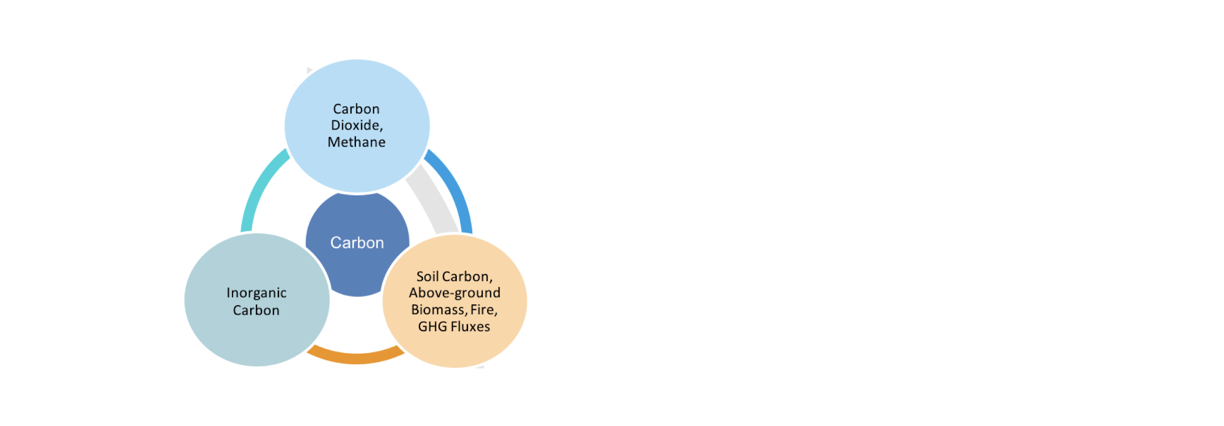
GCOS IP
Current GCOS ECVs are focused on mostly on the physical and biological aspects of the carbon cycle
We see after the Paris agreement, increased attention to anthropogenic emission monitoring
This calls for a re-evaluation of the ECVs and possible enhanced requirements specification.

Slide 40
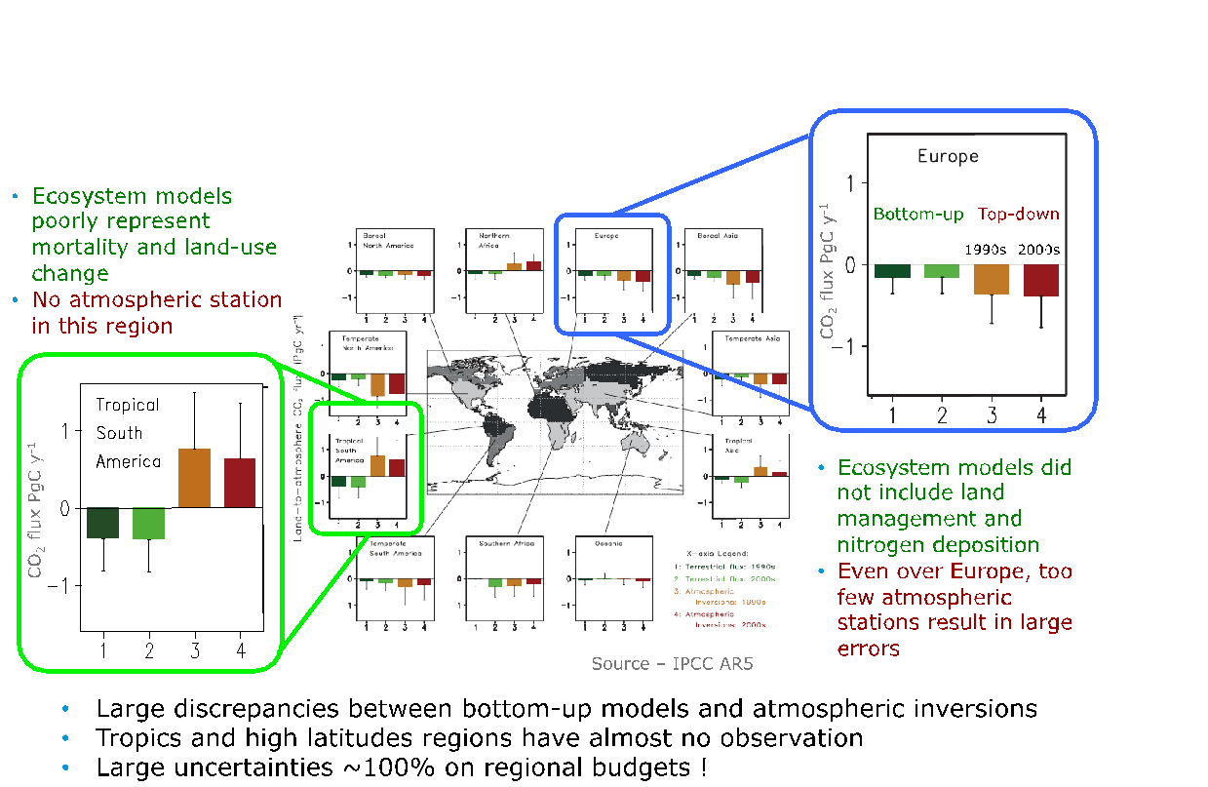

How good are we in closing the continental scale budgets?
Ciais et al., 2020

Slide 41
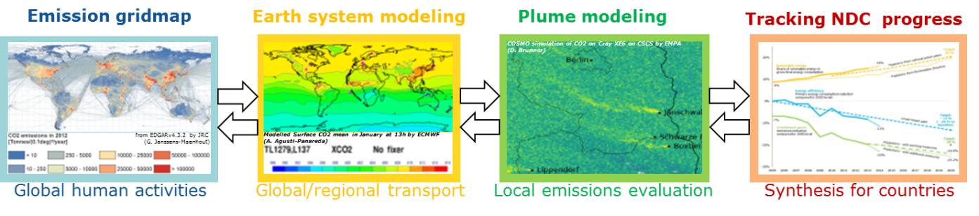
From ad hoc to systematic observations…
The current closing of top down and bottom up budgets is unsatisfactory, particularly at country reporting level
CO₂ from space is possible, and has detected peculiarities in the natural C-cycle, CH₄ hot spot monitoring works well
To make CO₂ monitoring from space useful for Paris agreement reporting, stocktake etc., attention is required to the full system of in situ, space based and analysis capabilities

Slide 42
A Systematic Approach for Atmospheric Inventories

Slide 43
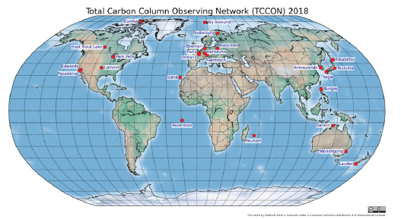
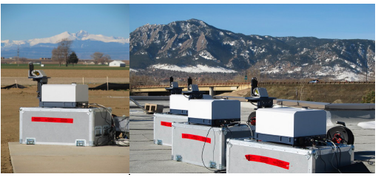
Role of GCOS
Review current ECVs related to carbon cycle (in progress)
Define new requirements for satellite and in situ data from the user (UNFCCC) perspective at a range of spatial scales, taking their temporal variability into account.
Distinguish between fluxes and stocks, making the link explicit
What do we need to do?
  Engage in discussion with space agencies (through CEOS
  task force)
  Engage with in situ community (through GAW, ICOS etc)
  Include ocean, land and atmosphere expert in one group
Arrive at a new, relevant set of GHG requirements in the new IP (2022)

Slide 44


Climate Observation Conference
Sponsored by EUMETSAT
2nd Climate Observation Conference
12–14 October 2021, Darmstadt, Germany
This conference follows on from the first climate observations conference, Global Climate Observation: The Road to The Future held on 2–4 March 2016 in Amsterdam.
AIM: assess how well the current global climate observing system supports current and near-term user needs for climate information. In particular the meeting will examine how well observations of the global Earth cycles (the global energy balance, global water and carbon cycles, and explaining changing conditions of the biosphere) support users’ needs for climate data.
The outputs will provide inputs into the next GCOS implementation plan which will make recommendations to meteorological networks, major observing systems and satellite agencies and will be presented to the UNFCCC in 2022 as a contribution towards the UNFCCC’s Global Stocktake.
Opportunity for experts dealing with climate observations and other key stakeholders to review and give input to and feedback on the production of the Implementation Plan.
Invitation for papers and posters in the autumn 2020.

Slide 45
CEOS AFOLU Roadmap
Task Team
Osamu Ochiai (JAXA) &
Frank Martin Seifert (ESA)
10 mins
Committee on Earth Observation Satellites
CEOS SIT Technical Workshop 2020
Notes:
Welcome to the Carbon and Biomass session. This was intended to be the largest of our sessions in Hobart auss how CEOS might consider strengthening the policy relevance of our datasets with the main UN and national stakeholders that use our data to make and manage policy. We still have a substantial agenda with significant points for discussion by Principals.
nd featured a number of external speakers to bring some alternative perspectives to our work and to equip us to disc

Slide 46
Overview
The importance of NDCs to Paris Agreement, and specifically the Global StockTake (GST), raises new challenges around country needs and implications for using EO data with greater emphasis on mitigation and adaptation, and national-level datasets.
“...if Land Use, Land Use Change and Forestry targets involved in the initial NDCs were implemented in full, this would represent approximately a quarter of pledged mitigation efforts up to 2030 “
JAXA and ESA explore the development of a CEOS AFOLU Roadmap. The aim of the Roadmap is to assess the will, direction and capability of the relevant CEOS Agencies, with the SIT Chair team supporting communications with Principals and identifying team nominees.

Slide 47
AFOLU Team (so far)
Osamu Ochiai, JAXA & GFOI (Co-Lead)
Frank-Martin Seifert, ESA & GFOI (Co-Lead)
Stephen Ward, JAXA
Ake Rosenqvist, JAXA
Takeo Tadono, JAXA
Richard Lucas, ESA/CCI
Shaun Quegan, UK
Heather Kay, UK
Ian Jarvis, GEO-GLAM
Alyssa Whitcraft, GEO-GLAM
Steven Labahn, USGS
Michael Falkowski, NASA
Laura Duncanson, UMD
Brad Doorn, NASA
Christine Mcmahon-Bognor, NASA
Brian Killough, NASA
Team building up and monthly call meeting since SIT-35

Slide 48
Context
Title: A CEOS Roadmap for AFOLU Inputs to the UNFCCC Global Stocktake Process
(A Discussion Paper for CEOS Plenary)
Context:
Introduction
Opportunity of the Global Stocktake
EO Capabilities in support of AFOLU
Deployment of Capabilities
Potential Roadmap Actions
Summary and Next Steps
References
Appendices

Slide 49
Objectives
Provide the case to CEOS and its agencies for investing in development of such a Roadmap
Ensure a coordinated and comprehensive response from CEOS and space agencies to policy process
Provide a clear statement of the technical capabilities of CEOS agency EO satellite data and their characteristics
Provide a mechanism for further engagement and iteration between CEOS and the GST processes, including in support of the synthesis reports, and with UNFCCC SEC

Slide 50
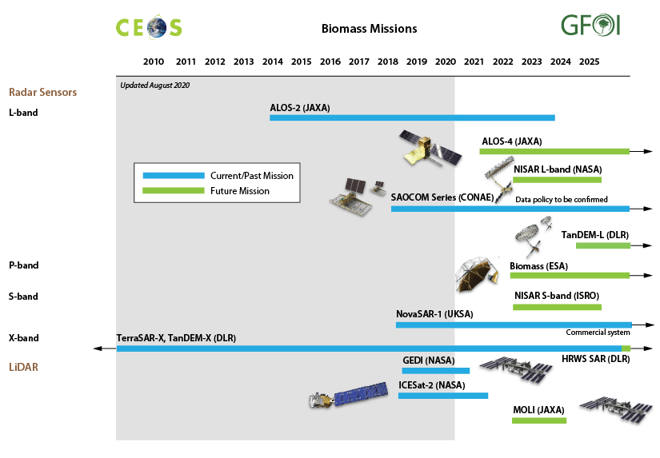
CEOS Agencies' Capabilities
Biomass
GST1

Slide 51
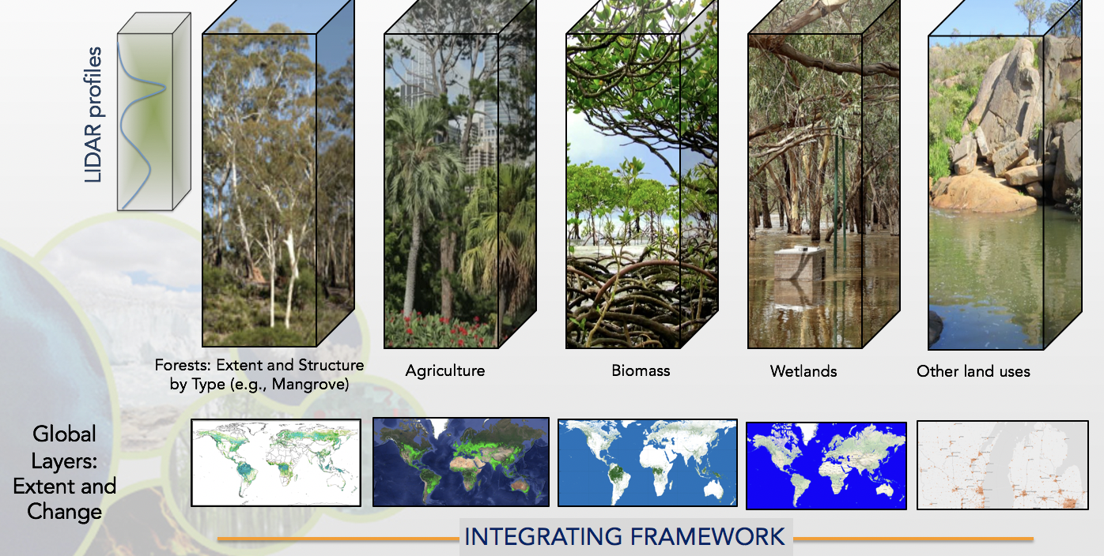
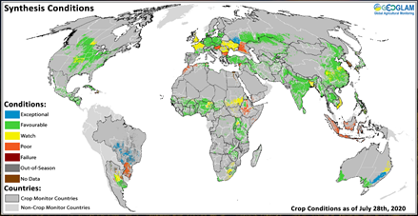
CEOS Agencies' Capabilities
AFOLU
Lays out the range of
capabilities of EO satellites for
  Agriculture
  Forest (extend and structure)
  Biomass (AGB)
  Other Land Use
Identifies the main deployment of these capabilities as datasets available to support both convention and national level
  Agriculture, Forest, Biomass, OLU also

Slide 52
Potential Roadmap Actions
Improving EO capabilities to better meet the needs of the Convention or Parties, globally and on national level
Providing new measurements that do not currently form part of CEOS
Engaging with countries and stakeholders (such as GFOI and GEOGLAM) in case studies to improve understanding and uptake of EO data by countries
Taking actions to assure the policy relevance of new capabilities (e.g., through measures such as the CEOS Biomass Protocol)
Increasing efficiencies and effectiveness in the process by which climate data requirements are set (e.g., by GCOS) and to which CEOS and CGMS space agencies respond.
Pragmatic focus for delivery to GST1 and GST2 like GHGs
Notes:
Despite not being together in Hobart we still hope to address 3 of the 4 objectives for the session we originally planned. We will not feature the user voices segment which had a national inventory user and the Global Carbon Project both explain their perspectives on the use of EO satellite data and how CEOS agencies might seek to optimise its future relevance to their work.

Slide 53
Next steps
Reflect on SIT TW discussions
Engage with UNFCCC SEC offline re the SO Synthesis Report
Solicit support from CEOS Principals on the case for an AFOLU Roadmap
Prepare CEOS Plenary decision
  seeking approval (& resources) to proceed
  will need large AFOLU investor agencies on board to be viable
Notes:
Despite not being together in Hobart we still hope to address 3 of the 4 objectives for the session we originally planned. We will not feature the user voices segment which had a national inventory user and the Global Carbon Project both explain their perspectives on the use of EO satellite data and how CEOS agencies might seek to optimise its future relevance to their work.

Slide 54
GHG Roadmap & AFOLU synergies
WGClimate Task Team
4.1.6 & 4.1.7
Mark Dowell
15 mins
Committee on Earth Observation Satellites
CEOS SIT Technical Workshop 2020
Notes:
Welcome to the Carbon and Biomass session. This was intended to be the largest of our sessions in Hobart auss how CEOS might consider strengthening the policy relevance of our datasets with the main UN and national stakeholders that use our data to make and manage policy. We still have a substantial agenda with significant points for discussion by Principals.
nd featured a number of external speakers to bring some alternative perspectives to our work and to equip us to disc

Slide 55

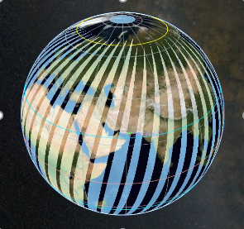
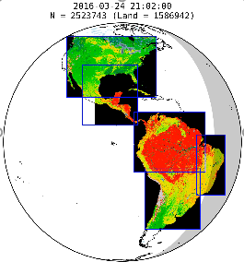
The CEOS Architecture for Monitoring Atmospheric CO₂ and CH₄ Concentrations
The CEOS Atmospheric Composition Virtual Constellation (AC-VC) white paper defines a global architecture for monitoring atmospheric CO₂ and CH₄ concentrations from instruments on space-based platforms
166-page document, 88 authors from 47 organizations
Executive Summary (2 pages)
Body of report (75 pages)
Technical Appendices (42 pages)
http://ceos.org/document_management/Virtual_Constellations/ACC/Documents/CEOS_AC-VC_GHG_White_Paper_Publication_Draft2_20181111.pdf

Slide 56
A System Approach is Adopted to Deliver Atmospheric CO₂ and CH₄ Inventories

Slide 57
GHG Roadmap Objectives
The GHG Roadmap was established to coordinate ongoing and planned greenhouse gas measurement and analysis activities across space agencies and foster the development of interfaces with stake holders and users.
The GHG Roadmap (v2.4) describes an approach for implementing the GHG Strategy and specifies resource needs
  Maintained by the WGClimate GHG Task Team
  Considered to be a living document whose Actions (Annex C) provide a snapshot of the work plan, which will be updated over time

Slide 58
Expected Outcomes of the Roadmap Activities
The delivery of pilot datasets of CO₂ and CH₄ fluxes to enhance the uptake of Earth Observation satellite data sets in support of the Global Stocktake 2023;
The delivery of an operational system for producing future atmospheric CO₂ and CH₄ flux products to support the Global Stocktake 2028; and
The refinement of user requirements in preparation of the implementation of the operational system.
The delivery of each system version is accompanied by a requirements refinement process leading to the additional objective:
Establishing the end-to-end requirements for a system that delivers atmospheric CO₂ and CH₄ flux products for use in stocktakes (with requirements apportioned to each system version).

Slide 59


High Level GHG Roadmap Timeline
Global Stock
Take 1
Global Stock
Take 2
using inventories through 2021
using inventories through 2026
2015
2017
2019
2021
2023
2026
2028
CEOS GHG Whitepaper
Pilot
atmospheric
CO₂/CH₄
Data sets
Atmospheric
GHG data sets
from operational system
Initial
Operational
GHG
Constellation
Deployment
Consultation
of
Inventory
requirements
Refined
atmospheric
GHG
requirements

Slide 60
Interface to and Feedback from External Communities
Engagement with external stakeholders and end users is fundamental to the success of the implementation of the system approach:
Engagement with the emission inventory community is critical to the iterative feedback approach, both:
  Through existing international coordination mechanisms (e.g. Global Emissions InitiAtive - https://www.geiacenter.org )
  Through working with champion users on real applications – «beta testers»
Continued engagement with international policy frameworks, i.e. UNFCCC/SBSTA, IPCC TFI
Engagement with technical implementing entities at international level, i.e. WMO IG³IS and Joint Programmes supporting the Convention, i.e., GCOS, as well as the broader modelling community.

Slide 61
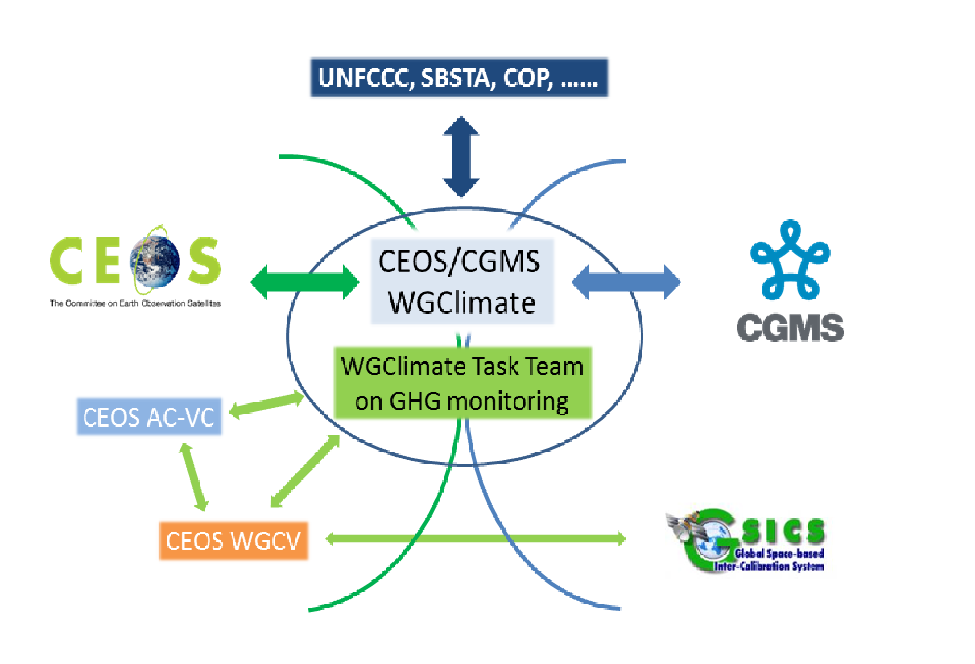


Multiple Contributors and Roles

Slide 62
Status of GHG Task Team Activities and next Steps
Maturing GHG Roadmap and Project Plan specifying deliverables, responsible organizations, schedules and resources
Establishing interfaces with National Inventory community
  Worked with the Copernicus H2020 VERIFY Project to organize an atmospheric inventory workshop @ Global Emissions IniAtive (GEIA) (still delayed due to COVID-19)
Establishing interfaces with stakeholders (UNFCCC/SBSTA & GCOS)
  Supported UNFCCC/SBSTA & GCOS at COP-25 & Earth Information Day
  Support to the UNFCCC Secretariat and the Parties in the Synthesis and Assessment phase of the first Global Stocktake process
  Engaged in the newly established adhoc group on Systematic Observations to support of the Global Stocktake.
  Planning workshop on synergies and opportunities between GHG and AFOLU Earth Observation communities working in support of UNFCCC
Engaging the Atmospheric GHG Community
  Presented Roadmap to workshop@AGU, 12/2019; AC-VC, 06/2020; CGMS 08/2020
Progressing in Atmospheric Inventory Development and identification of GHG validation capabilities

Slide 63
GHG-AFOLU Synergies
Parallel Roadmaps
Global Stock
Take 1
Global Stock
Take 2
using inventories through 2021
using inventories through 2026
2015
2017
2019
2021
2023
2026
2028
CEOS GHG Whitepaper
Pilot
atmospheric
CO₂/CH₄
Data sets
Atmospheric
GHG data sets
from operational system
Initial
Operational
GHG
Constellation
Deployment
Consultation
of
Inventory
requirements
Refined
atmospheric
GHG
requirements
AFOLU Roadmap

Slide 64
AFOLU in the System

Slide 65


Starting Discussion
GHG-AFOLU Workshop
Workshop on synergies and opportunities between GHG and Agriculture Forestry and Other Land Use (AFOLU) Earth Observation communities working in support of UNFCCC
  [Postponed] Originally planned July 9-10th 2020 Varese-Italy
  Start dialogue between the different Earth Observation communities addressing the needs of UNFCCC.
  In particular, atmospheric GHG monitoring and those addressing aspects of the AFOLU sector (incl. REDD+).
  Co-organised, based on an identified gap, both at the European level through discussions in Copernicus as well as at the international level CEOS, GEO

Slide 66
GHG-AFOLU Workshop
The workshop plans to address:
  both the "soft" coordination and stakeholder engagement aspects of the interface with the Convention, the UNFCCC Secretariat and,
  Parties (including through their inventory agencies/compilers) but also more technical aspects of reporting, outputs datasets, formats, avoiding "double-accounting" and the longer-term ambition of using diverse earth observation datasets in the modelling and data integration systems being developed.
Now postponed till ~Q2 2021, but plan:
  initial discussion at CEOS SIT Technical Workshop [TODAY]
  European discussion in context of CHE-VERIFY Q4 2020 (organised by ECMWF).
  International meeting in 2021 should include CEOS/CGMS, GFOI, GEO, UNFCCC Sec, GCOS, GOFC-GOLD etc.

Slide 67
GHG-AFOLU Synergies
Open questions (examples)
Should we foresee points of intersection (milestone checkpoints) and maybe a future merging of the GHG and AFOLU Roadmaps?
Are the respective communication lines on EO support on GHG and AFOLU to UNFCCC and SBSTA adequate and consistent?
Is there coherence in terminology and definitions used for EO data (GHG, AFOLU etc.) so as to not confuse “users”?
Are the EO Guidance (reports etc.) for both GHG and AFOLU, e.g. though IPCC TFI, compatible ?
Should our long term view include dedicated efforts to include AFOLU EOs explicitly in the “system” approach being implemented?
Are there dedicated investments on products, modelling data assimilation which could be made to enable greater consistency/integration?
Could we conceive a “closure” experiment (maybe in a specific region e.g. tropics) bringing together the different EO datasets (an IMBIE for carbon)?

Slide 68
Workshop Discussion Time
Moderators:
Mark Dowell & Jörg Schulz
Committee on Earth Observation Satellites
CEOS SIT Technical Workshop 2020
Notes:
Welcome to the Carbon and Biomass session. This was intended to be the largest of our sessions in Hobart auss how CEOS might consider strengthening the policy relevance of our datasets with the main UN and national stakeholders that use our data to make and manage policy. We still have a substantial agenda with significant points for discussion by Principals.
nd featured a number of external speakers to bring some alternative perspectives to our work and to equip us to disc

Slide 69
Broadening and Consolidating UNFCCC engagement (1/2)
CEOS & CGMS has been very effective over last 8 years in establishing a positive and proactive dialogue with UNFCCC/SBSTA
  This is in large part due to the to the symbiotic relationship we have established with the Global Climate Observing System (GCOS) and the Climate Monitoring Architecture, which has been our guiding framework
The creation of the Joint WGClimate established an unambiguous entry point for the discussion between SBSTA and the Space Agencies
  To date, this engagement, through the SBSTA Research and Systematic Observation (RSO) subgroup has largely focused on our support on Climate Data Records for GCOS ECVs
  GHG Monitoring
In recent years, our support has been visibly expanding: CEOS Carbon Strategy, CEOS GFOI support and evolution to biomass, other AFOLU, Climate Services and support to Climate Adaptation etc. so…

Slide 70
Broadening and Consolidating UNFCCC engagement (2/2)
CEOS needs a long-term strategy accounting for the multitude of contributions it and its member Agencies can make to the Convention
  Maintaining the effective focal point established through WGClimate
  Increasing communication on contributions from other parts of CEOS (in statements, SBSTA Briefings etc.)
Use, and re-enforce, CEOS Carbon Strategy as framework for carbon relevant aspects.
Give greater visibility to GFOI/Biomass aspects as well as Agriculture, not only through REDD+ but also RSO
In the short/mid term:
  Build on priorities of incoming SIT Chair (AUS) on Carbon and Biomass, as well as current visibility on GHG Monitoring
  Initiate dialogue between GHG and AFOLU communities – Workshop hosted by EC June 2021
  Dedicated discussion at SIT TW with all CEOS entities, GCOS and UNFCCC Secretariat

Slide 71
Topics
1.CEOS/CGMS contributions to the Global Stocktake process
2.Efficiencies in GCOS Requirements process

Slide 72
Discussion 1: CEOS-CGMS contributions to the Global Stocktake process
Contribution to UNFCCC Sec adhoc group on Systematic Observation support to Global Stocktake
Contributions to first GST: products (also beyond GHG), user engagement (GHG Roadmap)?
Realistically what contributions on AFOLU can we expect for first GST?
What are our contributions to synthesis and technical assessment phases?
What links should we establish to other “contributors” e.g. WMO, GEO Climate Change WG?
Should we plan for Guidance documents, case studies, interpretation/analysis tool development?

Slide 73
Discussion 2: Efficiencies in GCOS Requirements process
GCOS has been an effective partner, and the GCOS IP and requirements are the primary framework against which agencies make substantial investments in the space segment for climate and climate data record production
There is increasing need for application specific requirements (e.g. for GHGs)
Would make the space agency coordination, as well as individual agency investment more efficient. Our preference is to maintain GCOS as primary “source” of EO requirements.
Can we define a typology of requirements for ECV products in all domains, i.e., linking the requirements with the GCOS objectives?
Can we use the WGClimate Case Study Exercise to emerge some additional and refined requirements?
What are opportunities for gathering requirements, e.g., for adaptation through other initiatives e.g. WMO GFCS, GEO Climate Change WG?
Can the envisaged GCOS study team help in this process? What could be realistically achieved for next GCOS IP?
What are the implications for ECV Inventory, Gap Analysis, and Action Plan process?

Slide 74
Carbon & Biomass Session -
15 minutes break (UTC 1300 restart)
2nd half is prep for CEOS plenary
Committee on Earth Observation Satellites
CEOS SIT Technical Workshop 2020
Notes:
Welcome to the Carbon and Biomass session. This was intended to be the largest of our sessions in Hobart auss how CEOS might consider strengthening the policy relevance of our datasets with the main UN and national stakeholders that use our data to make and manage policy. We still have a substantial agenda with significant points for discussion by Principals.
nd featured a number of external speakers to bring some alternative perspectives to our work and to equip us to disc

Slide 75
Carbon & Biomass Session - Part 2
Committee on Earth Observation Satellites
CEOS SIT Technical Workshop 2020
Notes:
Welcome to the Carbon and Biomass session. This was intended to be the largest of our sessions in Hobart auss how CEOS might consider strengthening the policy relevance of our datasets with the main UN and national stakeholders that use our data to make and manage policy. We still have a substantial agenda with significant points for discussion by Principals.
nd featured a number of external speakers to bring some alternative perspectives to our work and to equip us to disc

Slide 76
A SIT term priority
Supporting the GHG Roadmap process – escalating, elevating, and accelerating progress towards major milestones, including for the 2023 Global Stocktake. 2021 prototype flux products.
Encouraging stronger and more systematic CEOS engagement with convention frameworks – building on IPCC outreach
  And national inventory communities as our future users
Reflecting large investment (2018-2024) in Above-Ground Biomass missions and seeking to accelerate the policy relevance of these new data (GFOI, GEOGLAM…)
Promote uptake of biomass datasets beyond science community – forest monitoring, inventories…
Notes:
You all know that Carbon and Biomass was identified as one of our 3 priority themes. We felt this was important given the scale of investment by the largest of our agencies in this area and given the important technical work underway across the CEOS structure - such as in the GHG Roadmap team and in the WGCV on the Biomass Protocol, as well as activities such as our GFOI engagement. This is our prospectus chart you are all familiar with - updated to reflect some schedule changes and with our goals identified.

Slide 77


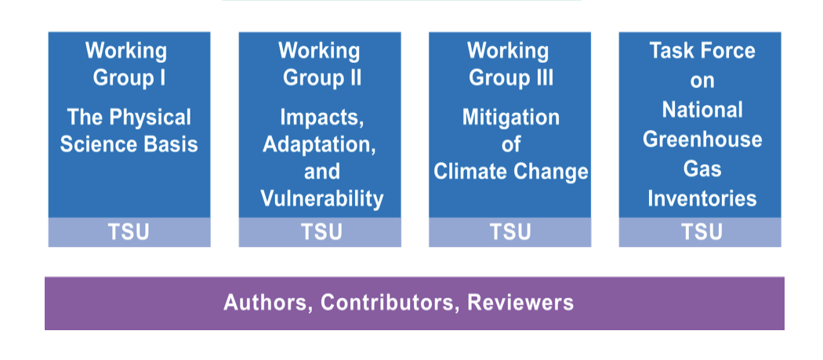

Science Adaptation Mitigation
Paris Agreement
Adaptation
Capacity Development / Technology transfer
Mitigation
Loss & Damage
National Reporting /
Global Stocktake
GST emphasises country reports, NDCs, mitigation
and adaptation?
CEOS-CGMS
WGClimate
- GCOS Response
- ECVs
- Inventory
WGClimate GHG Roadmap starts support to inventories from GST1
Transparency Framework
GFOI brought country focus for forest reporting
Global Stocktake
New GEO WG?
- SG2 proposes a focus on IPCC
WGII & III
AFOLU Roadmap adds biomass, agriculture and OLU for reporting & NDCs
Systematic Observations
Earth Observation

Slide 78
Specific objectives/agenda today
Session 2
Preparation of our relevant agenda items for CEOS Plenary
  CEOS Biomass Protocol and implementation support (Laura)
  WGClimate: ECVI 3.0 and Use Case activity (Jörg)
  GHG Roadmap (Mark)
  AFOLU Roadmap (Osamu)
15 mins wrap (SIT Chair Team)
  Plenary readiness actions
  2021 outlook
30 mins
20 mins
15 mins
20 mins
Add comments and questions via GTM chat at any time in the session
Notes:
Here are our specific objectives and the supporting agenda items. Talk through briefly…
Q&A break after Biomass on any topics that featured prior. And again after the UNFCCC/policy discussion. Please keep to time. We wish to cover all ground even if this format is more of a preliminary discussion than we would have liked. Use sli.do to input comments and questions that arise and we will moderate those for an efficient Q&A.

Slide 79
CEOS Biomass Protocol
and Implementation Support
WGCV LPV Team
Laura Duncanson
30 mins
Committee on Earth Observation Satellites
CEOS SIT Technical Workshop 2020
Notes:
Welcome to the Carbon and Biomass session. This was intended to be the largest of our sessions in Hobart auss how CEOS might consider strengthening the policy relevance of our datasets with the main UN and national stakeholders that use our data to make and manage policy. We still have a substantial agenda with significant points for discussion by Principals.
nd featured a number of external speakers to bring some alternative perspectives to our work and to equip us to disc

Slide 80
CEOS Biomass Protocol
Refer to separate slide deck - Laura will present
Notes:
Despite not being together in Hobart we still hope to address 3 of the 4 objectives for the session we originally planned. We will not feature the user voices segment which had a national inventory user and the Global Carbon Project both explain their perspectives on the use of EO satellite data and how CEOS agencies might seek to optimise its future relevance to their work.

Slide 81
CEOS Biomass Protocol
Points to address - SIT team list
Availability of Protocol document
Desired outcome from CEOS Plenary
  Endorsement?
Ground Reference Network
  Space agencies
  User groups, inc GFOI
  GST relevance
Notes:
Despite not being together in Hobart we still hope to address 3 of the 4 objectives for the session we originally planned. We will not feature the user voices segment which had a national inventory user and the Global Carbon Project both explain their perspectives on the use of EO satellite data and how CEOS agencies might seek to optimise its future relevance to their work.

Slide 82
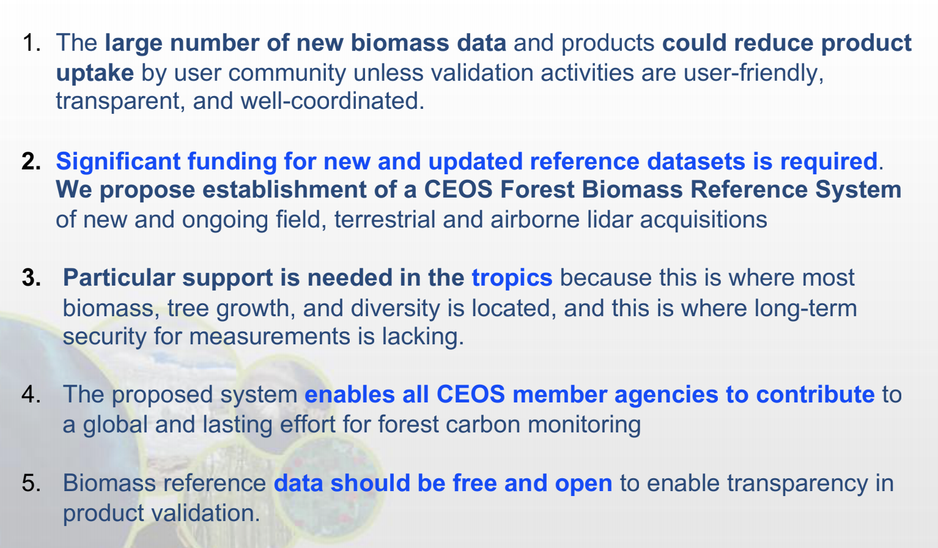
CEOS Biomass Protocol
Revisit Laura’s slide...
Notes:
Despite not being together in Hobart we still hope to address 3 of the 4 objectives for the session we originally planned. We will not feature the user voices segment which had a national inventory user and the Global Carbon Project both explain their perspectives on the use of EO satellite data and how CEOS agencies might seek to optimise its future relevance to their work.

Slide 83
ECVI 3.0 & Use Case Development
WGClimate
Jörg Schulz
20 mins
Committee on Earth Observation Satellites
CEOS SIT Technical Workshop 2020
Notes:
Welcome to the Carbon and Biomass session. This was intended to be the largest of our sessions in Hobart auss how CEOS might consider strengthening the policy relevance of our datasets with the main UN and national stakeholders that use our data to make and manage policy. We still have a substantial agenda with significant points for discussion by Principals.
nd featured a number of external speakers to bring some alternative perspectives to our work and to equip us to disc

Slide 84
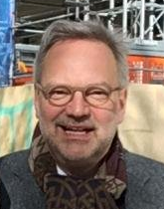


JWG Climate Leadership
Until October 2020 (CEOS Plenary)
Chair: Jörg Schulz (EUMETSAT)
Vice Chair: Albrecht von Bargen (DLR)
October 2020 – October 2022
Chair: Albrecht von Bargen
Vice Chair: Nomination Proposal at WGCL#12
WGClimate received nomination letter from NOAA for Jeff Privette;
WGClimate #12 in May 2020 has unanimously recommended Jeff Privette as next WGClimate Vice Chair becoming Chair in November 2022;
CGMS-48 Plenary has endorsed this proposal;
CEOS Plenary is asked to endorse the proposal as well.

Slide 85
CEOS Plenary is invited to endorse:
Leadership proposal as on slide 1
Gap Analysis report v 3.0 on ECV Inventory #3 and updated coordinated action plan. CGMS Plenary is asked for virtual endorsement in parallel
The GHG Roadmap document (v2.4)
  describing an approach and resource needs for the implementation of the GHG Constellation Strategy.
  This is to be considered a living document and the Actions in Annex C provide a current snapshot of the work plan definition which will be updated over time.
  CEOS Agencies will provide the identified resources for the specific activities and entities (i.e. CEOS WGs and VCs as well as the GHG Task Team).
  The GHG roadmap (v2.4) has been endorsed by CGMS-48 Plenary.

Slide 86
Plenary is invited to take note:
CEOS agencies are requested to continue and strengthen their contribution to the WG Climate, in particular by participation in WGClimate regular meetings, planned ECV Inventory gap analysis workshops, the GHG Task Team, and other specific activities of their interest.
The ECV Inventory V3 has been published in August 2020.
​Work on the ECV Inventory gap analysis needs further be rationalised to ensure long term affordability. The 12th session of WGClimate in April 2020 made the proposal to host specific workshops starting in 2021.
​​WGClimate sees an improved approach for GCOS ECV requirements as essential for GCOS. The pathway to a new approach is under discussion with GCOS but should be effective for the next GCOS Implementation Plan. CEOS entities (WGs, VCs, SHTs) should support this discussion when requested.
​WGClimate has published a call for use cases for climate data records https://climatemonitoring.info/use-cases. CEOS agencies are requested to organise submission of use cases for climate data records within your area.

Slide 87
ECV Inventory, gap analysis, coordinated action plan
ECV Inventory v3 published July 30, 2020 on https://climatemonitoring.info/ecv_inventory. Big THANKS to all agencies and involved people!
The delivery of the Gap Analysis and Coordinated Action Plan has moved to autumn 2020 (due to COVID-19 impact), but should be ready for Plenary approval
Dialogue and action with CMA and JAXA on providing input has intensified, raising hopes to have more completeness in V4
Gap analysis process will be further rationalised to ensure affordability. It will involve an annual workshop to which agencies are requested to send experts on ECVs

Slide 88
Gap Analysis Topics
Related to the objectives of the WG Climate the gap analysis addresses three topics:
    Existence of Climate Data Records
    Analysis of Inventory Entries against GCOS Criteria
    Analysis for specific ECVs
      An analysis as to whether the ECV inventory misses a known existing or planned climate data record;
      An analysis of missing measurements in the future that would be required to continue existing and planned data records or to establish new ones with enhanced quality;
      An analysis of the missed opportunities for creating a climate data record from existing past and planned future measurements from space.
Notes:
An assessment of ECVs and their ECV Products where no data records exist or are not planned. ECV Products provide further detail of specific geophysical quantities that can be derived from satellite measurements;
An assessment of the existing and planned climate data records with respect to the fulfilment of that criteria, published by GCOS, that provides guidance to climate data record providers on the sustainable process to generate CDRs, and on the quality required to be able to serve known climate applications. The analysis has been performed for all GCOS ECVs and their ECV Products. The ECV Inventory was designed to assess against GCOS criteria in [RD-1], [RD-2] and [RD-8], but not systematically against [RD-7];
An assessment of 8 ECVs (Carbon Dioxide, Methane, Precipitation, Sea Surface Temperature, Sea Surface Salinity, Land Surface Temperature, Leaf Area Index, and Above-ground Biomass) and their associated ECV Products with respect to a more optimised use of past and current satellite measurements and an analysis of missing measurements in the future, which would prevent the generation of CDRs for specific ECV Products.

Slide 89
General Status
Existence of Climate Data Records – done
GCOS criteria analysis – significant amount of data sets not assessed but statistics very stable
Progress on already assessed ECVs – 40%
Individual ECVs – New ECVs assessed with various degree of information

Slide 90
ECV Inventory Content
Domain | Existing | Planned | Total
Atmosphere | 535 | 266 | 801
Ocean | 90 | 43 | 133
Land | 141 | 62 | 203
Total | 766 | 371 | 1037
  GCOS IP space-observables: 37 ECVs (13 Atmosphere, 15 Land, and 9 Ocean) – 35 ECVs covered with some contribution in Inventory V3
  ECVs Lightning, Permafrost, and Above-ground Biomass represented for the first time
  From current ECVs only Ocean Surface Currents and Anthropogenic GHG fluxes appear as gaps
Notes:
Talking points:
ECV Inventory #2 has 913, so we have 124 more in total
The ratio of existing to planned was changing from 1.2 to 2.0 (a fair share of this is due to a different treatment of ICDRs in the Inventory which all belong to the exisiting)
Rest as on slide.

Slide 91
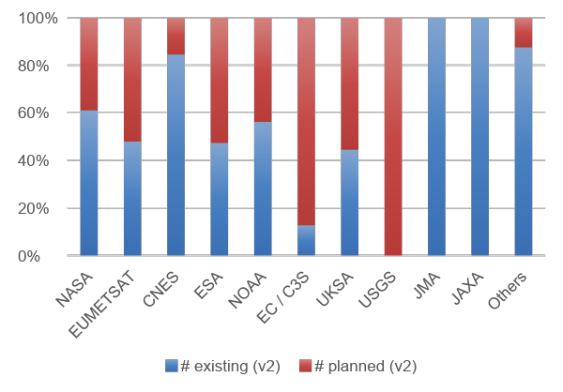
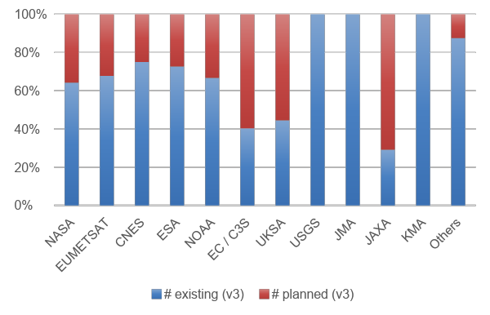
Relative number of existing and planned data records per agency
ECV Inventory #2
ECV Inventory #3
Notes:
Talking points:
In comparison to the ECV Inventory #2 we see:
KMA as a new contributor
Agencies made progress in realising their plans, e.g., EC/C3S and USGS and others
That we have better coverage of agency plans, e.g., JAXA

Slide 92
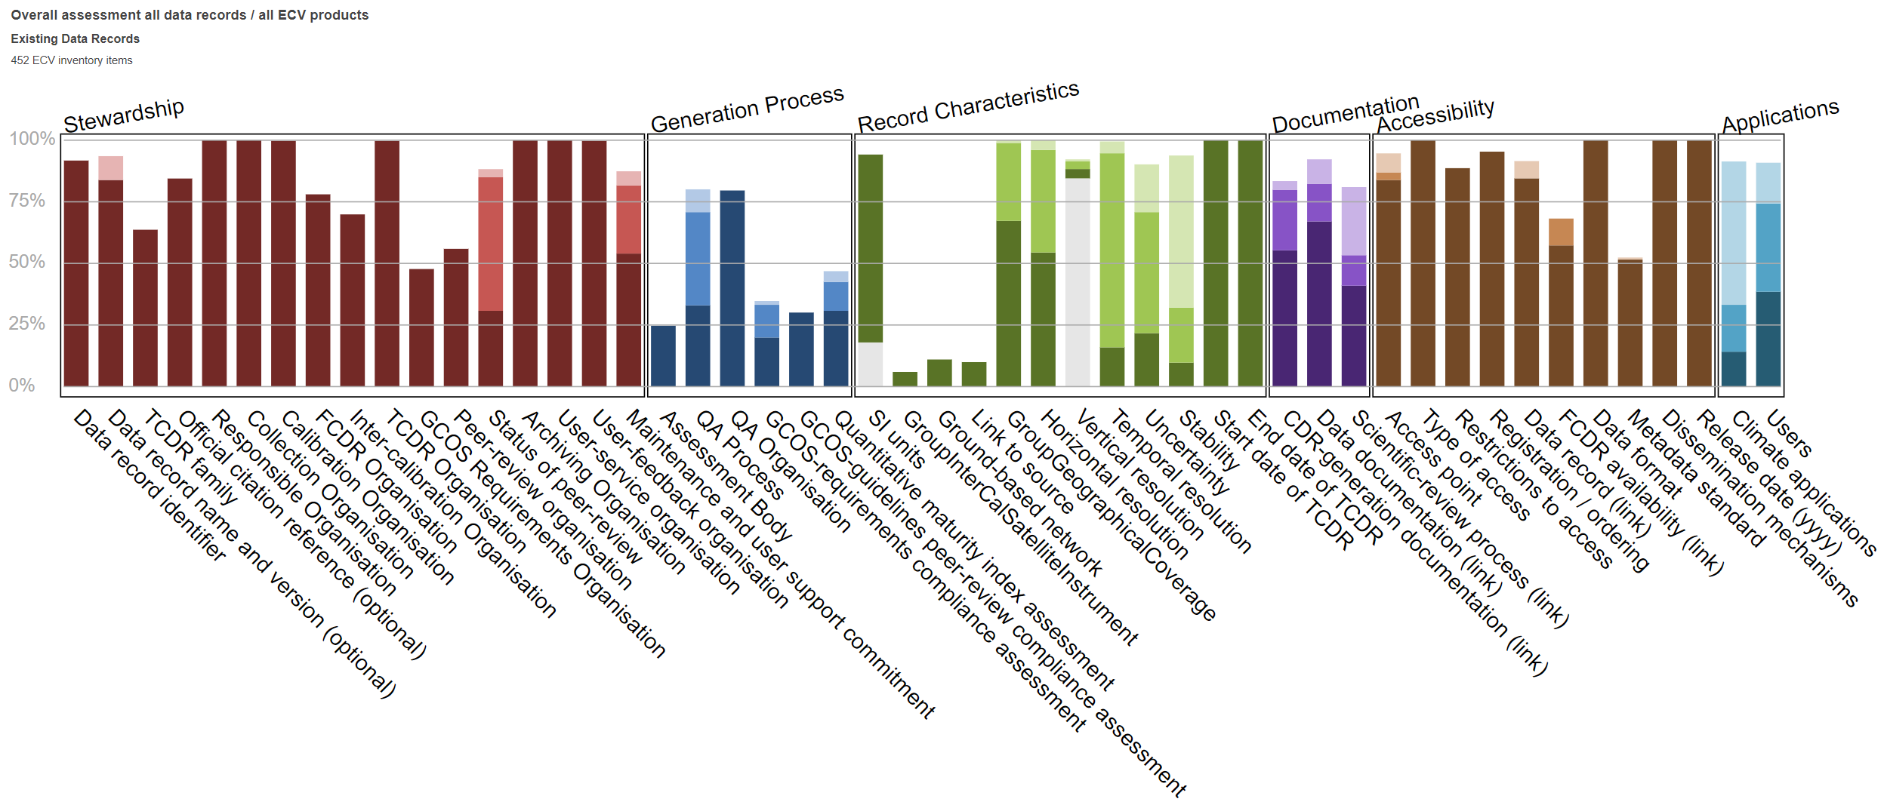
Assessment of GCOS Criteria for existing data records
x
x
x
x
x
x
x
x
x
Notes:
Talking points:
Assessment of GCOS criteria reveals improvements for new data records:
Awareness of FCDR needs are increasing, with no change in FCDR availability
The peer review of underlying science and the quality of the data records is addressed by more data providers.

Slide 93
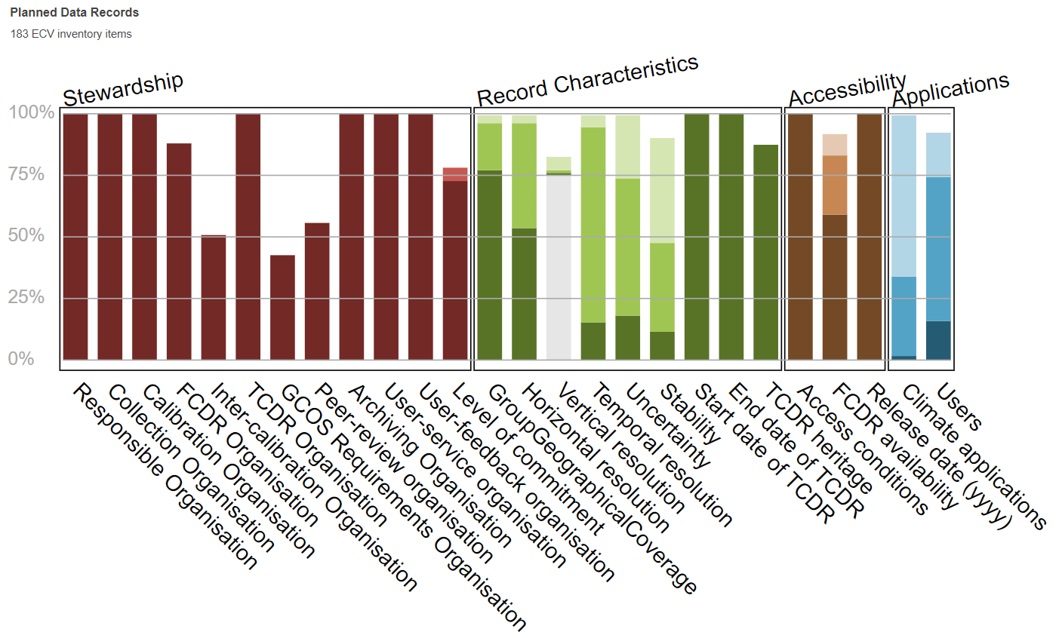
Assessment of GCOS Criteria for planned data records
x
x
x
x
x

Slide 94
Issues observed in the process
Observed decline in support to population, verification and gap analysis for ECV Inventory #3 within CEOS/CGMS agencies and bodies
Gap analysis Topic 2 on GCOS criteria was hardly to finish, committed contributions were not realised in some cases;
Gap analysis Topic 3:
  Quality of expert contributions varies strongly
  WMO and CEOS relevance estimates of missions seems not useful in many cases
  Some experts seem not to understand the gap analysis procedure, others do very well
  There is a danger of biased assessment by experts, seemingly trying to generate funding for specific activities

Slide 95
Gap Analysis Rationalisation
Reduce number of data records for analysis in the ECV Inventory, .e.g., if they differ only by time and space sampling
Decouple in time ECV Inventory update from gap analysis, i.e., ECV Inventory #4 published in 2021 – gap analysis report published in 2022
Reformat gap analysis work into one workshop event per year collating experts on ECVs to perform the gap analysis. (First was planned for 31/08-04/09/2020@EUMETSAT but was cancelled due to COVID-19)
Schedule 2021:
  Concentrate on chasing identified missing data records and add contributions from CMA and JAXA for ECV Inventory #4
  Start analysis of ECV Inventory #4 in Q3/4 2021 with a gap analysis workshop
  Publish gap analysis report on Inventory #4 in 2022

Slide 96

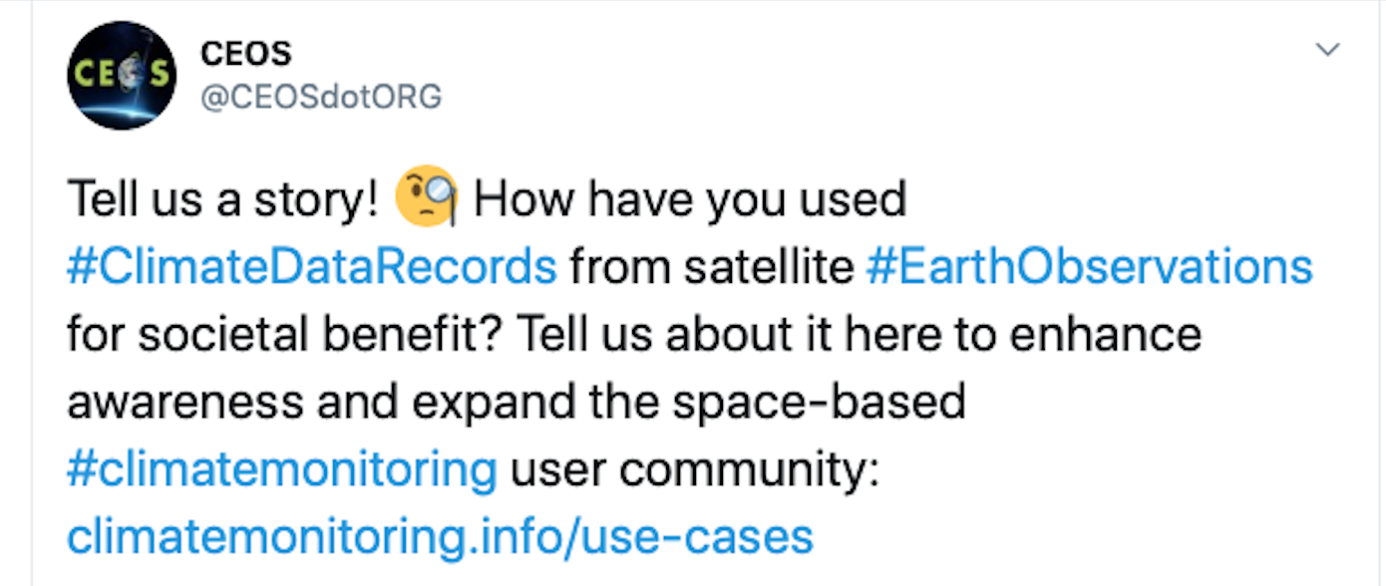
Use Cases for Climate Data Records
WGClimate#12 in May 2020 decided to start a new routine activity on collecting use cases for climate data records.
Use Case gathering tool has been integrated into climate “Use Cases” web page (https://climatemonitoring.info/use-cases), which was opened on July 27, 2020 for submission with widespread distribution on social media.
Use cases will be published on the web and selected use cases will become part of a special report issued by WMO in 2021/22.

Slide 97
Use Cases for Climate Data Records: Major Objectives
Demonstrate the value of climate data records for decision/policy making, e.g., usage of satellite data in a use case with UNFCCC Parties to support the Global Stocktakes
Optimize the use of climate data records in applications relevant for climate services and science
Understand the application needs to provide feedbacks towards quality improvements for the ECV requirements defined by GCOS
Validate the top-down architecture for climate monitoring from space with a down-top approach ensuring traceability from usage to space-based observing system
Support capacity building by providing/receiving use cases for/from training activities, e.g., for developing countries (link to CGMS and CEOS capacity building activities)
Take Earth observations from space
Decision Making
Sensing
Create Climate Data Records/
Indicators
Use Climate Data Records
Use information derived from Climate Data Records
CDR Making
Application
Tailored information (Reports)
Tailored Data
Observations

Slide 98
Two Use Cases Received
Coastal Risk Information Service (C_RISe) https://www.des.nh.gov/organization/divisions/water/wmb/coastal/c-rise.htm
  Satellite-derived sea-level record, ocean surface wind speed/direction, currents and wave height are used to provide coastal risk information service for countries on the east coast of Africa.
  Information on sea level rise and storm surge can help reducing the social and economic impact of coastal inundation and extreme weather through coastal zone management, infrastructure protection and development, operational planning, fishery support, etc.
Parametric insurance for agricultural communities using weather and climate information
  Satellite-derived precipitation, temperature, land cover, soil moisture, and leaf area index are used to provide real-time risk assessment profiles to deliver insurance policies that are designed to protect individual farmers and agribusinesses against drought, flood, excess rainfall, heatwave, hail, cyclone, etc.

Slide 99

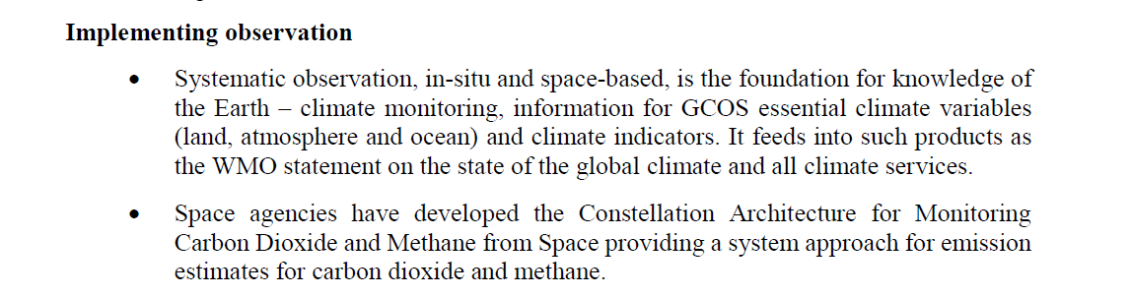
WGClimate and UNFCCC
Provided full reporting including a CEOS/CGMS statement to SBSTA-50 in Bonn, Germany in June 2019 and SBSTA-51 in Madrid, Spain in December 2019.
Participated in Earth Info Day and received good recognition for space agency contributions, full report: https://unfccc.int/sites/default/files/resource/EarthInformationDay2019.SummaryReport.pdf
SBSTA-52/COP-26 has been postponed to 2021 due to the COVID-19 pandemic. No formal statements will be made in 2020, but plan to participate in Earth Info Day in November 2020.
The CEOS/CGMS WGClimate will further provide support to the UNFCCC Secretariat and the Parties in the Synthesis and Assessment phase of the first Global Stocktake process and will actively engage in the newly established adhoc group on Systematic Observations on support of the Global Stocktake.
Notes:
Specific activities will be further codified as additional specific Action as they become better defined, but in broad terms these should address:
CEOS and CGMS entities (GHG TT, AC-VC, WGCV etc.) will support the secretariat in preparing the first Synthesis Report providing baseline space-based earth observation datasets for regional and global scale analysis , as well as guidance for their interpretation and comparison (Q1-Q2 2022)
CEOS and CGMS entities will support the Secretariat and Parties in the technical assessment of the first GST, with guidance documents, reference datasets and tools for data integration and hotspot identification as well as uncertainty assessment. (Q1-Q2 2023)
Based on the lessons learned in the context of the Synthesis and Technical Assessment phases of the first GST, CEOS and CGMS will prepared adapted input to those activities in the 2nd and subsequent Global Stocktakes.

Slide 100
WGClimate
Points to address - SIT team list
ECVI 3.0 desired outcome from Plenary
Use Case Development…
Plenary inputs on SBSTA/COP statements?
Actions in relation to GCOS or GST processes?
  Plenary discussion on space agency scope & emphasis
Notes:
Despite not being together in Hobart we still hope to address 3 of the 4 objectives for the session we originally planned. We will not feature the user voices segment which had a national inventory user and the Global Carbon Project both explain their perspectives on the use of EO satellite data and how CEOS agencies might seek to optimise its future relevance to their work.

Slide 101
GHG Roadmap
15 mins
Committee on Earth Observation Satellites
Mark Dowell, COM, WGClimate GHG Task Team
CEOS SIT Technical Workshop 2020
Session 4.1 Agenda Item #4.1.11
Virtual Meeting
7-11 and 14-18 September 2020

Slide 102
GHG Roadmap Objectives and Status
The GHG Roadmap was established to coordinate ongoing and planned greenhouse gas measurement and analysis activities across space agencies and foster the development of interfaces with stake holders and users.
The GHG Roadmap (v2.4) describes an approach for implementing the GHG Strategy and specifies resource needs
This version of the Roadmap was submitted to the 2020 CGMS Plenary for endorsement.
At this meeting, we seek feedback in preparation for endorsement of the GHG Roadmap at the CEOS Plenary and the provision of the resources identified for the specific activities and entities

Slide 103
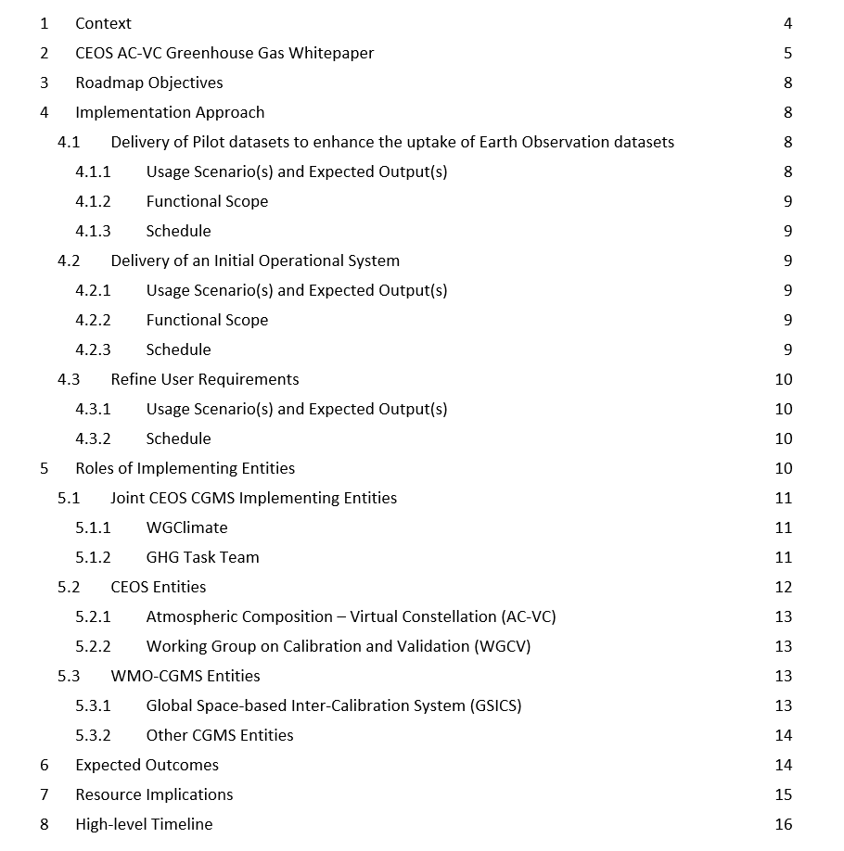
Roadmap Table of Contents

Slide 104
Interface to and Feedback from External Communities
Engagement with external stakeholders and end users is fundamental to the success of the implementation of the system approach:
Engagement with the emission inventory community is critical to the iterative feedback approach, both:
  Through existing international coordination mechanisms (e.g. Global Emissions InitiAtive - https://www.geiacenter.org )
  Through working with champion users on real applications – «beta testers»
Continued engagement with international policy frameworks, i.e. UNFCCC/SBSTA, IPCC TFI
Engagement with technical implementing entities at international level, i.e. WMO IG³IS and Joint Programmes supporting the Convention, i.e., GCOS, as well as the broader modelling community.

Slide 105
Making inroads in GEIA
1. GEIA Meeting (154 participants) on 24 June 2020. The polls have identified the following research priorities:
    a. How do we best facilitate the information flow between global and local scale?
    b. How can we best use satellite observations to constrain emissions in regions with less available/reliable information bottom-up?
    c. How tackling energy sources in local/urban pollution (not only from transport, but also small scale industry, fugitive dust, waste, agriculture)?
    d. How do we facilitate and guide the use of uncertainty information in models and inventories?
    e. How to better deal with source apportionment for emissions of natural sources, dust, fires, agriculture?
2. More specific on the GEIA working group monitoring GHGs:
Call for collaborating in Working Group for Monitoring GHGs & Co-emitted Species Across Scales with:
    a. Global scale information is feeding into local scale, but how can we go back from the local scale and using the detailed information for a revision of global scale databases in a systematic way?
    i. GHG emission gridmaps near real time
    ii. Co-emitted species
    iii. Use of atmospheric measurements in situ and space-borne
    iv. Focus: 2019-2020, to prepare for 2021 = base year for Paris’ Global Stocktake
    b. We call for BRIDGING COMMUNITIES AND EXCHANGING PRACTICES to demonstrate GHG monitoring and verification in- and outside EU.
    c. A follow-up meeting will be organized in Autumn 2020. In case of interest, please contact: greet.maenhout@ec.europa.eu
3. Upcoming GEIA Steering Committee meeting will try to progress on the WG for monitoring GHGs

Slide 106
Expected Outcomes of the Roadmap Activities
Roadmap Products
The delivery of pilot datasets of CO₂ and CH₄ fluxes to enhance the uptake of Earth Observation satellite data sets in support of the Global Stocktake 2023;
The delivery of an operational system for producing future atmospheric CO₂ and CH₄ flux products to support the Global Stocktake 2028; and
The refinement of user requirements in preparation of the implementation of the operational system.
Progress
Established critical interfaces with the UNFCCC SBSTA and GCOS.
Made progress pilot atmospheric CO₂ and CH₄ inventory
  Delivery of the OCO-2 version 10 XCO₂ and SIF data products
  Advances in GHG flux inversion models by the NASA OCO-2 and CMS and Copernicus CAMS

Slide 107
High Level GHG Roadmap Timeline
Global Stock
Take 1
Global Stock
Take 2
using inventories through 2021
using inventories through 2026
2015
2017
2019
2021
2023
2026
2028
CEOS GHG Whitepaper
Pilot
atmospheric
CO₂/CH₄
Data sets
Atmospheric
GHG data sets
from operational system
Initial
Operational
GHG
Constellation
Deployment
Consultation
of
Inventory
requirements
Refined
atmospheric
GHG
requirements

Slide 108
Resource Implications and Needs from CEOS/CGMS
Three broad categories of resources are envisaged and requested for consideration by Agencies (introduced at CEOS Plenary 2019):
  Dedicated human resources supported through Agency programmes & grants :
  Agencies are asked to provide support to the WGClimate Task Team (~17 PM/yr)
  Assumption: 15 members with 1PM/yr effort per member & 2 PM/yr effort for the two leads
  Agencies are asked to continue, and in some cases increase support to the GHG relevant staff (time & travel) contributing to the technical implementation tasks in CEOS and CGMS
  Support for travel and hosting of workshops and networking with:
      National inventory community
      Atmospheric GHG measurement and modelling communities
      Stakeholders (GCOS, UNFCCC/SBSTA)
  [On longer-term] Through internal funding mechanisms support research, development and infrastructure for priorities identified by GHG Task Team and Roadmap Implementation (annual updates will be provided to Agencies)

Slide 109
GHG TT Skill Request
For WGClimate GHG Task Team, the following “profiles” are needed:
    Core team ensuring linkages to internal CEOS/CGMS entities (i.e., WGClimate – Dowell/von Bargen, AC-VC – Crisp, WGCV – Kuze)
    CEOS and CGMS Agency staff representing GHG missions/programmes
    Agency staff from “operational” agencies to ensure operational transition
    Agency Staff/Experts with links to Inventory Community
    Agency Staff/Experts involved in modelling aspects

Slide 110
CGMS involvement in the GHG Task Team
Working Group I: Ensuring that the implementation of the GHG roadmap addresses the objectives of the WIGOS vision
Working Group II: Facilitating the definition and application of standards for operational GHG constellation products and operational aspects of the satellite data production systems at international level
Working Group III: Mapping the CGMS agency plans for CO₂ and CH₄ relevant measurements onto the CGMS baseline, identifying continuity issues and proposing contingency planning
Working Group IV: Addressing operational access and end user support as well as training for GHG constellation products in cooperation with CEOS WGISS and WGCapD
As reported by Jörg Schulz: [The CGMS] Plenary endorsed the GHG roadmap version 2.4 and welcomed the proposal to have dedicated Points of Contacts (PoCs) for the JWG Climate GHG Task Team identified in all CGMS Working Groups (I - IV). The lead of the GHG Task Team is requested to define priorities for CGMS WG contributions

Slide 111
Agencies who have offered resources
Mark Dowell (EC, WGClimate, Task Team lead)
Albrecht von Bargen (DLR, WGClimate Vice-chair, deputy Task Team lead ex officio)
Frederic Chevallier (LSCE/IPSL)
David Crisp (NASA, CEOS AC-VC)
Carole Deniel (CNES)
Richard Engelen (ECMWF)
Hiroshi Suto (JAXA)
Akihiko Kuze (JAXA, CEOS WGCV)
Rüdiger Lang (EUMETSAT)
Yaska Meijer (ESA)
Paul Palmer (UKSA)
Hiroshi Tanimoto (NIES)
Alisa Young (NOAA)
N.N. (agency representative)
N.N. (CGMS WG representative)
N.N. (CGMS WG representative)
N.N. (GSICS representative)

Slide 112
CEOS Plenary will be invited to endorse:
.
The GHG Roadmap document (v2.4), describing an approach and resource needs for the implementation of the GHG Constellation Strategy. This is to be considered a living document and the Actions in Annex C provide a current snapshot of the work plan definition which will be updated over time. CEOS Agencies will strive to provide the identified resources for the specific activities and entities.

Slide 113
AFOLU Roadmap
Task Team
Osamu Ochiai & Frank Martin Seifert
20 mins
Committee on Earth Observation Satellites
CEOS SIT Technical Workshop 2020
Notes:
Welcome to the Carbon and Biomass session. This was intended to be the largest of our sessions in Hobart auss how CEOS might consider strengthening the policy relevance of our datasets with the main UN and national stakeholders that use our data to make and manage policy. We still have a substantial agenda with significant points for discussion by Principals.
nd featured a number of external speakers to bring some alternative perspectives to our work and to equip us to disc

Slide 114
Items for discussion
and Plenary
The opportunity for space agencies - and the resources needed
Pragmatic deliverables for GST1 and beyond
AFOLU (Land) focal point to UNFCCC Secretariat
Notes:
Despite not being together in Hobart we still hope to address 3 of the 4 objectives for the session we originally planned. We will not feature the user voices segment which had a national inventory user and the Global Carbon Project both explain their perspectives on the use of EO satellite data and how CEOS agencies might seek to optimise its future relevance to their work.

Slide 115
Opportunity & Resources
The GST is a major new dimension to the UNFCCC and both an opportunity and challenge for space agencies and CEOS
Land sector issues are a major part and proposed AFOLU Roadmap offers a structured response and approach
CEOS agencies have many relevant assets and programmes - not necessarily all within current CEOS coordination scope
Long term and complex process (GST every 5yrs) and wide variety of areas (AFOLU) - supporting national-scale reports is a major task but one we are uniquely capable of supporting
Current AFOLU document is a “White Paper” - highlighting our capabilities and the opportunity in front of us. It aims to support Plenary discussion among Principals to launch a strategic initiative, starting with Roadmap
Roadmap team would need the big AFOLU investor agencies to be viable and relevant (NASA, ESA, JAXA, USGS, amongst others)
  current team of volunteer experts, many non-agency
Notes:
Despite not being together in Hobart we still hope to address 3 of the 4 objectives for the session we originally planned. We will not feature the user voices segment which had a national inventory user and the Global Carbon Project both explain their perspectives on the use of EO satellite data and how CEOS agencies might seek to optimise its future relevance to their work.

Slide 116
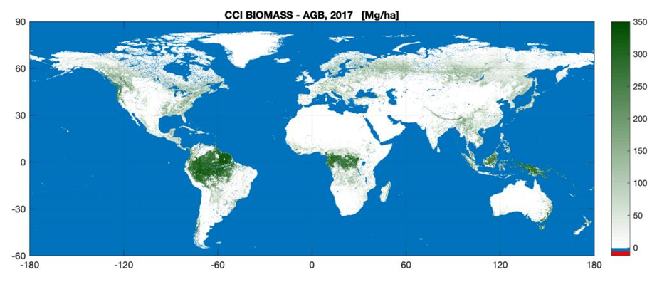
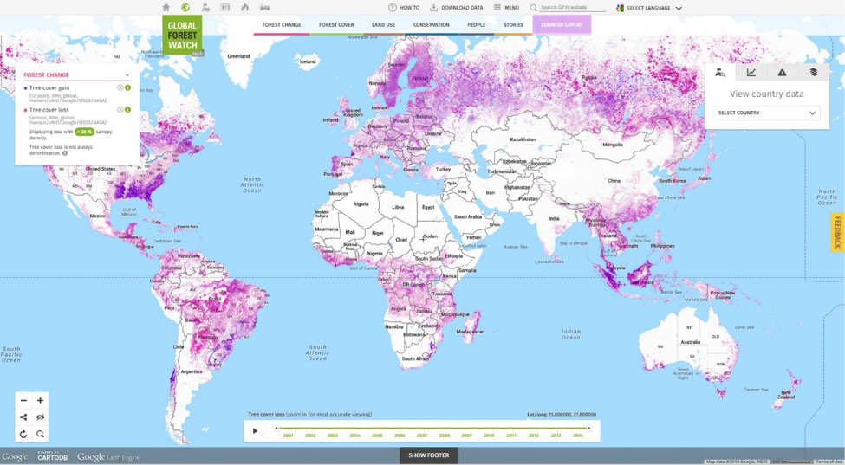
2. Pragmatic deliverables for GST1
Aggregate potential inputs (Datasets at Global and Country levels) from Space Agency (Agriculture, Forest, Biomass, OLU)
Discuss how to input to the UNFCCC synthesis report
Synergy and alignment with GHG Roadmap for GST1 and GST2
Further discussion needed for consolidation - hopefully at the GHG and AFOLU workshop in 2021
Global Biomass Map (ESA CCI)
Global Forest Watch
Notes:
Inputs from the inventory and systematic observations communities are due in calendar 2021?
What existing or near-term space-based AFOLU products would be of greatest value for supporting AFOLU inputs to GHG emissions estimates?
Are we focusing on AFOLU products that quantify
Carbon pools (Living biomass, dead organic matter, soil carbon)
Processes that emit CO2, CH4, or N2O
Are we also including other land use activities/concerns
Deforestation and forest degradation (REDD REDD+), Desertification, Biodiversity?
The CEOS AFOLU Roadmap does not have to do everything in 2021, but it should strive to contribute to the systematic observation community for the GST recognized by the UNFCCC

Slide 117
3. Land sector focal point for the UNFCCC Sec process
Given its significance to NDCs, we think we should confer to identify a focal point for EO land sector issues to the Ad-hoc WG
Potential list of representatives for Land
  GEO (GFOI, GEO-GLAM, GEO-BON, GEO-Wetland, GEO-LDN,,,)
  GCOS (Land ECVs)
  CEOS (AFOLU, LSI-VC)
  GOFC-GOLD
  FAO
  ,,,
CEOS is well placed given broad scope of member programmes
Notes:
Despite not being together in Hobart we still hope to address 3 of the 4 objectives for the session we originally planned. We will not feature the user voices segment which had a national inventory user and the Global Carbon Project both explain their perspectives on the use of EO satellite data and how CEOS agencies might seek to optimise its future relevance to their work.

Slide 118
Next steps
Reflect on x xxxxççç ∫∫∫ ∫∫∫∫˜˜˜˜≈≈≈≈
Engage with UNFCCC SEC offline re the SO Synthesis Report (through focal point of Ad-hoc WG)
Solicit support from CEOS Principals on the case for an AFOLU Roadmap
Prepare CEOS Plenary decision seeking approval (& resources) to proceed
  will need large AFOLU investor agencies to be viable
Notes:
Despite not being together in Hobart we still hope to address 3 of the 4 objectives for the session we originally planned. We will not feature the user voices segment which had a national inventory user and the Global Carbon Project both explain their perspectives on the use of EO satellite data and how CEOS agencies might seek to optimise its future relevance to their work.

Slide 119
Wrap up
SIT Chair
Alex Held
20 mins
Committee on Earth Observation Satellites
CEOS SIT Technical Workshop 2020
Notes:
Welcome to the Carbon and Biomass session. This was intended to be the largest of our sessions in Hobart auss how CEOS might consider strengthening the policy relevance of our datasets with the main UN and national stakeholders that use our data to make and manage policy. We still have a substantial agenda with significant points for discussion by Principals.
nd featured a number of external speakers to bring some alternative perspectives to our work and to equip us to disc

Slide 120
Wrap up
Points to address
Do we have clarity on each agenda item for Plenary?
  desired outcome
  preparation
  actions from today
SIT Chair Team will follow up with each Topic Lead to craft a single slide that will feature in a summary reel during Thursday’s SIT TW session
Biomass protocol & implementation
WGClimate ECVI & Use Cases
GHG Roadmap
AFOLU Roadmap
GHG-AFOLU integration
GCOS & UNFCCC GST engagement
Notes:
Despite not being together in Hobart we still hope to address 3 of the 4 objectives for the session we originally planned. We will not feature the user voices segment which had a national inventory user and the Global Carbon Project both explain their perspectives on the use of EO satellite data and how CEOS agencies might seek to optimise its future relevance to their work.

Slide 121
Wrap up
WGClimate
CEOS Plenary desired outcomes
  Endorse leadership continuity
  Endorse ECVI 3 gapa analysis report and action plan
  Endorse GHG Roadmap v2.4
Issues raised
Actions and Decisions recorded
  Plan to discuss requirements with GCOS
Recap of key points for Plenary
  ?

Slide 122
Wrap up
CEOS Biomass Protocol & Ground Network
CEOS Plenary desired outcomes
  Endorse the CEOS Biomass Protocol
  Discuss the CEOS (GEO/GFOI?) Forest Biomass Reference System
Issues raised
  Framework/partners for the Biomass Reference Systems
  GEO & GFOI collaboration
Actions and Decisions recorded
  Follow up with GEO and GFOI
  Side chat confirmed presentation to GFOI Leads Team in 2 weeks
Recap of key points for Plenary
  Framing the business case (staged, prioritised….)
  Progress the support and collaboration discussions prior

Slide 123
Wrap up
GHG Roadmap
CEOS Plenary desired outcomes
  Endorse the GHG Roadmap
  Confirm actions towards GST1
Issues raised
  GHG Roadmap resources and skills
Actions and Decisions recorded
Recap of key points for Plenary
  Principal engagement on...

Slide 124
Wrap up
AFOLU Roadmap
CEOS Plenary desired outcomes
  Determine support for strategic engagement by CEOS in GST Process
  Determine support & resources to launch (begin work toward?) AFOLU Roadmap
Issues raised
  Land sector EO representation (focal point) in GST process
  Institutional home in CEOS to be addressed
  GST1 deliverables need to be considered
Actions and Decisions recorded
Recap of key points for Plenary
  Principals prepared for support for full roadmap effort

