Slide 1
2020 OSVW Activities
Raj Kumar, Paul Chang, Stefanie Linow
Indian Space Research Organisation
CEOS SIT Technical Workshop 2020
Session 3.3, Virtual Constellation Showcase
Virtual Meeting
7-11 and 14-18 September 2020

Slide 2
Objectives
Improve coordination, consolidation, and development of the collective OSVW capability
Achieve a more active engagement by nations operating or preparing satellite ocean surface vector winds sensors with the international wind vector community
Maintain a strong and mutually supportive relationship with the IOVWST
Provide an interface to CEOS for the IOVWST
Develop recommendations on the driving requirements to create, validate, and sustain the development of an international ensemble of Essential Climate Variable (ECV) measurements
Provide advice on and advocate to the international community for the importance of OSVW measurements
Develop and consolidate training on the use of scatterometer winds for different applications as well as outreach to the general public to demonstrate the societal benefit of these data

Slide 3
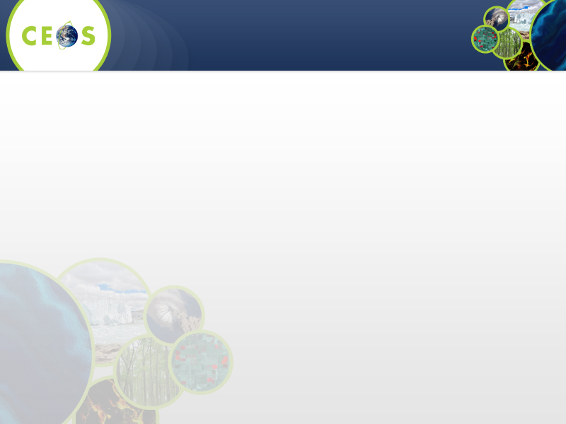
CURRENT STATUS
• ASCAT (METOP-A, B and C)
  – Open and near real-time data access
  – METOP-C launched on 7 November 2018
  – SCA (ASCAT Follow-On with improvements, EPS-SG, from ~2024)
  – ASCAT available through the EPS-SG/SCA launch
  – Orbit phasing of METOP-B and METOP-C unfortunately results in overlapping coverage
  in the tropics (larger gaps between passes)
• SCATSAT Sept 2016 (injected ~9:45 local crossing time presently 8:45 am)
  – Open and near real-time data access (since April 24, 2017)
• OceanSat-3 ?
• CMA will be providing OSVW measurements starting with their FY-3E launch (early 2021?)
• NSOAS HY2 series: first tests to provide NRT data via EUMETCast,
HY2B launched 25 Oct 2018
• CFOSAT (launched on 29 October 2018), data distribution pending agreements

Slide 4
Importance
Scatterometers are the proven technology for Ocean Surface Vector Winds
Additionally provide measurements of ice extent, icebergs, large water bodies
Applications:
  Satellite OSVW Impact on NWP Models
  Forecast error reduction by data assimilation
  Tropical cyclone position improvement
  Monitoring of seasonal to interannual changes
  Marine Weather Warnings
  Ice motion, changes
As per WMO WIGOS 2040 Vision, Scatterometers are part of the “Backbone System with specified orbital configuration and measurement approaches”
  Required Sun-synchronous in three orbital planes
IOVWST Recommendations : At least 3 Scatterometers to meet WMO requirements (observations every 6 hours or better)

Slide 5
Local time coverage assessment (ground track)
 | 16 | 17 | 18 | 19 | 20 | 21 | 22 | 23 | 24 | 25 | 26 | 27 | 28 | 29 | 30
00:00
01:00
02:00
03:00
04:00
05:00
06:00
07:00
08:00
09:00
10:00
11:00
12:00
Operational
Approved
Developed
Planned
HY-2A
  HY-2B / E
  HY-2H
Considered
WindRad / FY-3E
WindRad / FY-3H
SWIM+SCAT / CFOSAT
SWIM+SCAT / CFOSAT follow-on
descending node crossing time
Source: CEOS /WMO OSCAR database, 08/2018
  Scatsat-1
ASCAT / Metop-A
ASCAT / Metop-C
SCA / Metop-SG B1 + B2 + B3
ASCAT / Metop-B
Drifting Orbits:
ASCAT-A (since 2018)
HY-2C (2019-2024)
HY-2D (2020-2025)
HY-2F/G (2022-2027)
Oceansat-3
6 hour WMO minimum observation cycle requirement. Note: OSCAT and ASCAT with only 2.5 hour separation shown to have impacts in NWP data assimilation

Slide 6
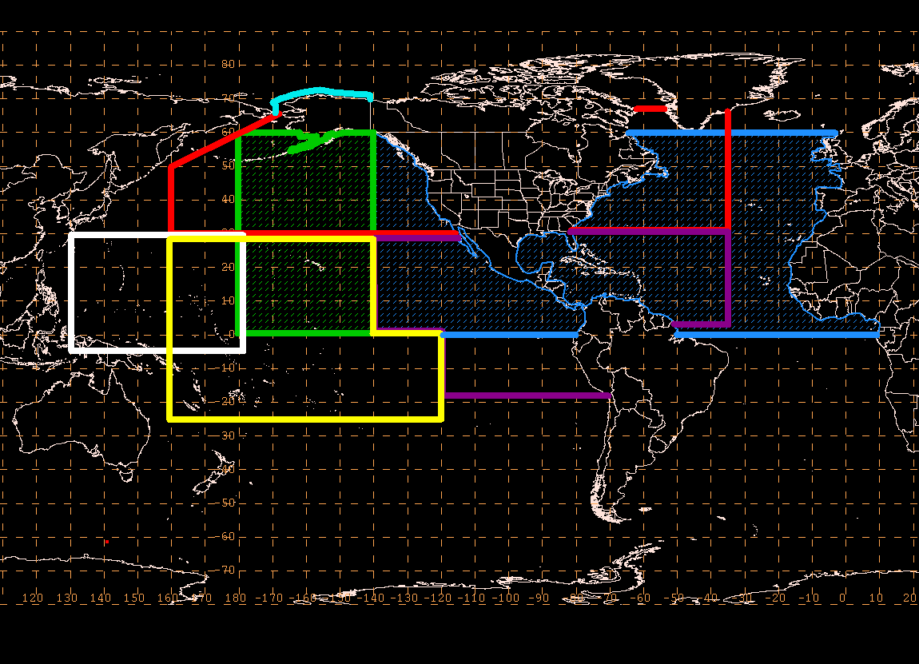
Satellite OSVW Supports a Wide Variety of NOAA’s National Weather Service (NWS) Marine Services & Products
Marine Weather Warnings and Forecasts
  High Seas (HSF), Offshore (OFF), Coastal Waters (CWF), Surf Zone (SZF)
  Marine Weather Discussions, Marine Weather Statements (for hazardous conditions)
  Area Forecast Discussions (local WFOs)
  Data use:
    Intensity, structure and movement of extratropical cyclones
    Issue, continue, terminate warnings
    Short term - adjust conditions
    Strength, coverage of winds
    Swell generation areas
Ocean Prediction Center
Fairbanks WFO
TPC - TAFB
Guam WFO
Honolulu WFO
47 Coastal and Great Lakes WFOs
Central Pacific Hurricane Center
TPC-National Hurricane Center
Tropical Cyclone Warnings and Forecasts
  Tropical Cyclone: Marine Advisories (TCM) , Discussions (TCD), Public Advisories (TCP),
  Tropical Weather Outlook (TWO), Tropical Weather Discussions (TCD)
  Data use:
    Estimate intensity (maximum wind) for TC’s but not major hurricanes
    Improved analysis of 34 kt and 50 kt wind
    radii (critical for ship avoidance, refined coastal warning areas)
    Detect and locate surface circulation centers, incipient cyclones (especially critical for areas not supported by aircraft, Pacific and eastern Atlantic)

Slide 7
Satellite OSVW Impact on NWP Models
Observed forecast error reduction due to OSVW
data assimilation spans between 2-8% (GEOS-5,
ECMWF,UK-Met, ARPEGE)
• The average influence of individual observations
can be expressed in terms of the average
reduction in the error measure per observation.
– With roughly 52% of these data improving the 24-h forecast
on average ASCAT winds provide one of the largest positive
impacts per observation in GEOS-5 system
• 6h tropical cyclone position improvement at 60h
forecast observed in South Indian Ocean due to
OSCAT assimilation in ALADIN regional model

Slide 8
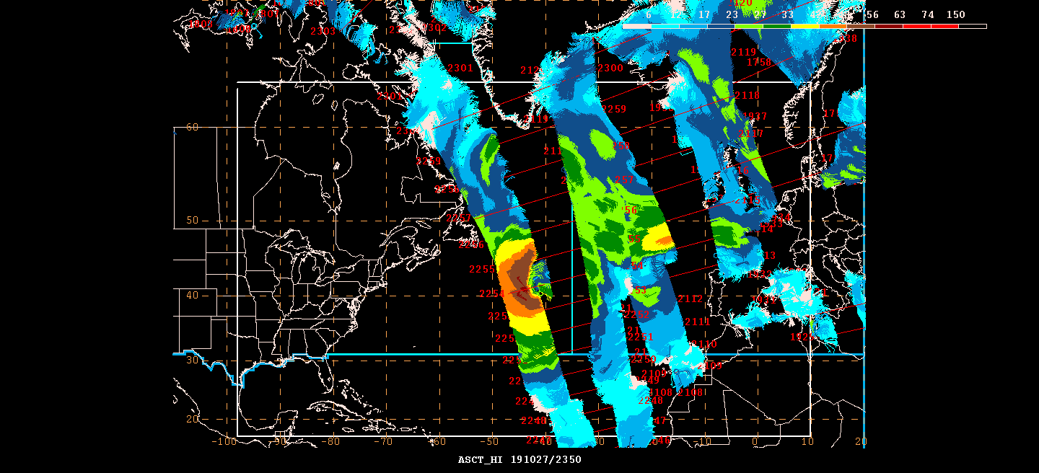
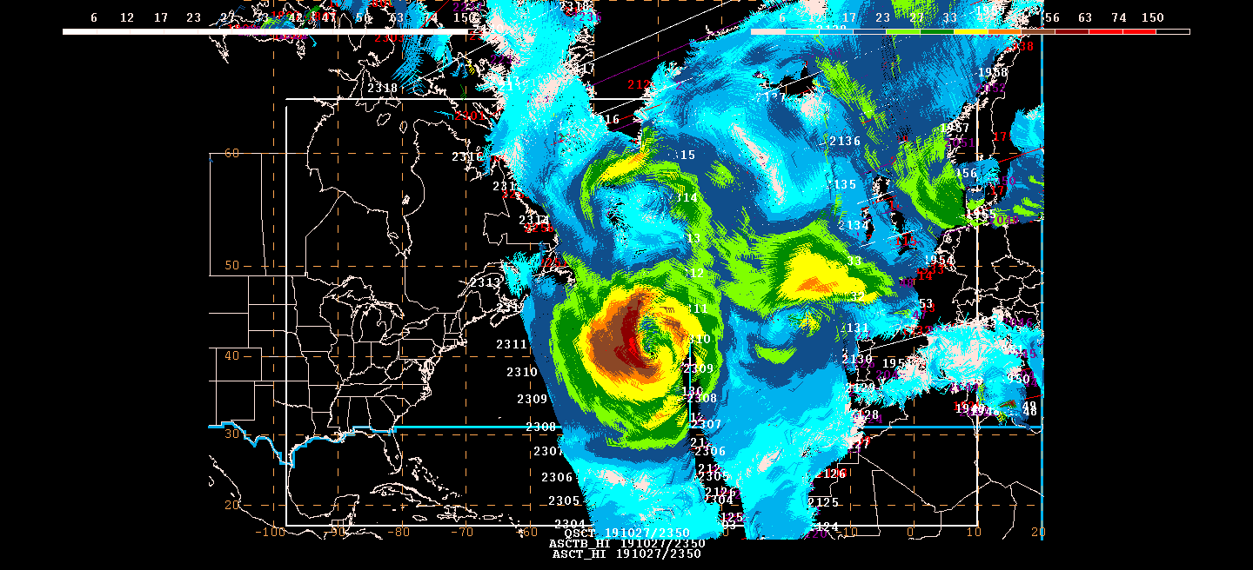
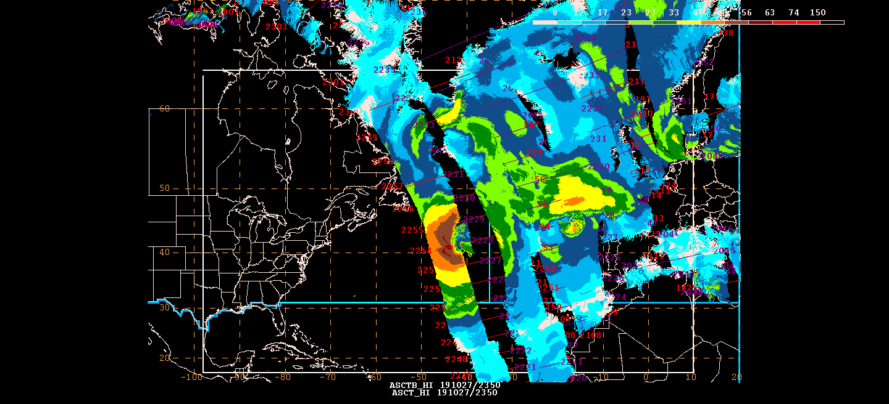
Surface Analysis
ASCAT-A/B Scatsat 27 Oct 2019 23Z
Surface Analysis
ASCAT-A 27 Oct 2019 23Z
Surface Analysis
ASCAT-A/B 27 Oct 2019 23Z

Slide 9
Work Plan Deliverables
VC-14-15 | OSVW Standards and Metrics | 2020 Q4 | WGCV OSVW-VC
VC-14-14 | Vision for an OSVW Constellation | 2021 Q4 | OSVW-VC

Slide 10
Actions Taken:
Discussions with CEOG WGCV
  WGCV (Microwave) shown interest in working with OSVW-VC
  Meeting was organised between OSVW-VC and WGCV on April 21
  Discussions on Standard and Metrics for Scatterometery
  Meeting was held on June 15 with OSVW-VC, WGCV and others
  Draft of the work plan discussed
  Work components also identified
  Team members identification

Slide 11
Actions Taken:
Organised Special Session on Satterometery in CGMS
  With an Objective “Coordination of global scatterometer constellation including coverage optimisation and data sharing in response to WIGOS 2040”
  Participation from NOAA, EUMETSAT, CMA, NSAOS, ISRO
Resolved to form a Working Team to discuss the present issues, future scatterometer missions and Gap analysis
Team will be formed by CGMS
Suggestion to have coordinated CEOS-CGMS team to take into account the user requirement from CGMS and missions feasibility by CEOS

Slide 12
Actions Taken:
Working Team being formed to prepare comprehensive document to
  Identify and recommend validation sources and metrics
  Inter-calibration of the backscatter data from different sensors
  Generate climate quality products
  Development of unified GMFs and retrieval algorithms for all space-borne scatterometers
  Algorithms for extreme wind cases and impact of other environmental parameters
  Identification of the global scatterometer constellation to monitor extreme events, diurnal variability, improvement in NWP forecast, climate products

Slide 13
Future plans and key issues
Optimization of orbits to improve temporal sampling (at a minimum to achieve the 6 hour WMO minimum observation cycle requirement)
Sharing of information (sensor and measurements) sufficient for independent validation and verification
Open and near real-time data access to support the marine weather mission
Systematic and sustained high quality and consistent observations of the ocean surface vector wind field at sufficient temporal and spatial resolutions to support the application
  Example: To properly sample the intensity of a tropical cyclone at any instant in time requires a spatial resolution of less than 5k
  Need to better understand and validate what remote sensing is really responding too at the extreme winds
Support end user training and outreach activities

Slide 14
THANK YOU

