Slide 1

Sustainable Development Goals (SDG)
Committee on Earth Observation Satellites
Alex Held, CSIRO, SDG-AHT Co-lead
Marc Paganini, ESA, SDG-AHT Co-lead
Flora Kerblat, CSIRO, SDG-AHT Executive Secretary
CEOS SIT Technical Workshop 2020
Session and Agenda Item #2.1
Virtual Meeting
9 September 2020

Slide 2



1. Welcome and overview of the SDG session
Welcome everyone – feel free to introduce yourself in the CHAT
Further documentation available on the SIT TW website (Data Supply Analysis and Strategy, Information note on AHT future, sub-teams TORs)
Housekeeping:
  Presenters: please respect your time allocation
  Ensure you’re muted when you’re not presenting
  Feel free to speak during the Q&A section
  Use the CHAT for any comments or questions during the session
  Don’t wait for the break in 1h50 if you need
MAIN OBJECTIVES
Update on each sub-team progress
Showcase SDG monitoring applications
Refine the CEOS list of data, guides and tools for GEO SDG Toolkits
Agree on a preferred option about to be proposed at the Plenary

Slide 3
Agenda
Welcome and overview of the session [10’, session co-leads]
Progress reports from each sub-team [5’ each]
  Water (6.6.1): M. Paganini/ESA, A. Carbonniere/CNES
  Urbanization (11.3.1): A. Kavvada/NASA, N. Mudau/SANSA
  Marine pollution (14.1.1): E. Smail/NOAA/CEOS-COASTS
  Land degradation (15.3.1): N. Sims/CSIRO, U. Heiden/DLR
Questions & Answers [15’]
Showcase of SDG applications (algorithms) using ODC technology [10’, B. Killough/SEO]
CEOS contributions to SDG Toolkits [15’, A. Kavvada/NASA]
Continuity of the SDG AHT ? [30’, SDG AHT co-leads]
Please contribute to the discussions: it’s a workshop, and we want to hear from you! If time is too tight for your Q, please contact us after the session.

Slide 4




2. Progress reports from each sub-team
5 minutes each, then Q&A
Water (6.6.1): M. Paganini/ESA, A. Carbonniere/CNES
Urbanization (11.3.1): A. Kavvada/NASA, N. Mudau/SANSA
Marine pollution (14.1.1): E. Smail/NOAA/CEOS-COAST
Land degradation (15.3.1): N. Sims/CSIRO, U. Heiden/DLR

Slide 5
3. Questions & Answers

Slide 6
4. Showcase of SDG applications (algorithms) using ODC technology

Slide 7
5. CEOS contributions to SDG Toolkits

Slide 8
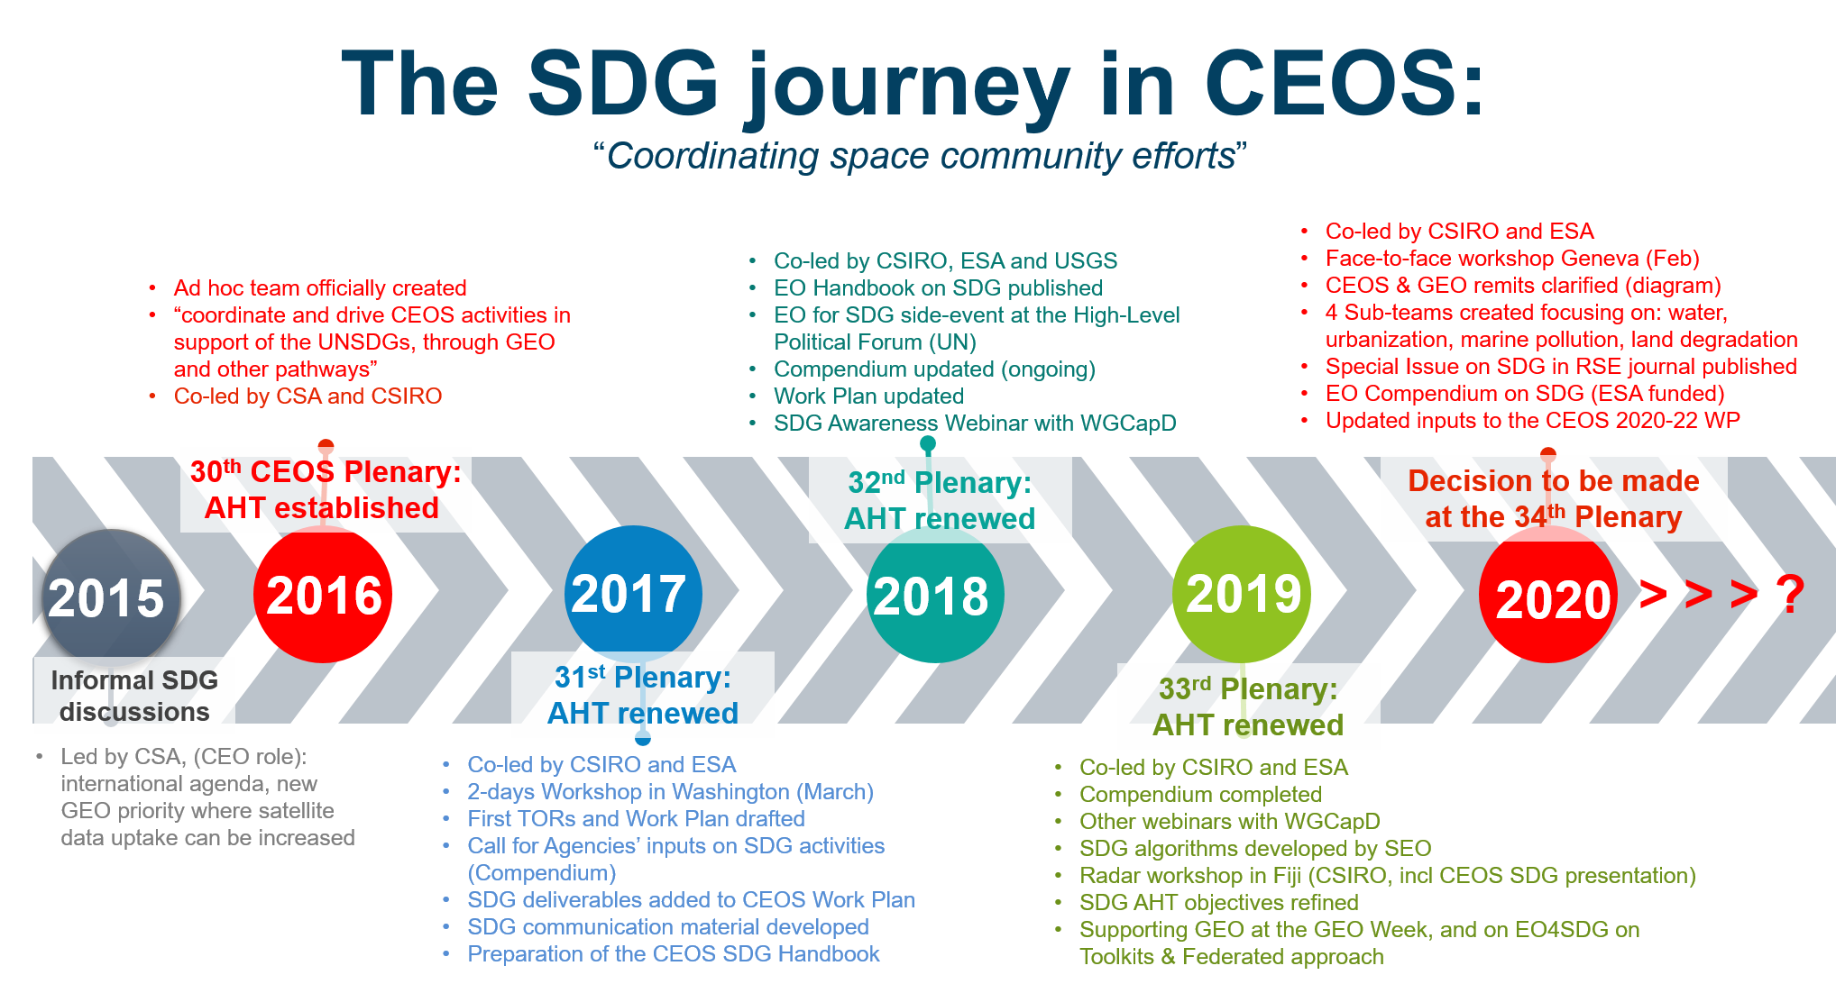
6. Continuity of the SDG AHT ?

Slide 9
6. Continuity of the SDG AHT ?
We asked … and you (AHT members) told us (SURVEY sent 27/8)
10 responses from CNES, CSIRO, ESA, DLR, JAXA, NOAA, NASA
9 out of 10 agreed to propose the 3 options as proposed by the co-leads in the survey
slight changes proposed included: for option 1, leave the door open for next year (say “renew the AHT” only) or either “CEOS or external to CEOS”
Main messages:
  the AHT has made significant progress this year (sub-teams, requirements and EO support sheets)
  SDG critical for GEO and CEOS
  still need to reassess AHT trajectory in future, after 2021: 3 are in favour of a new WG; 2 of transferring all to GEO; 1 to another CEOS body; 4 have no preference or opinion
Information note about the options also made available on the CEOS SIT TW website

Slide 10
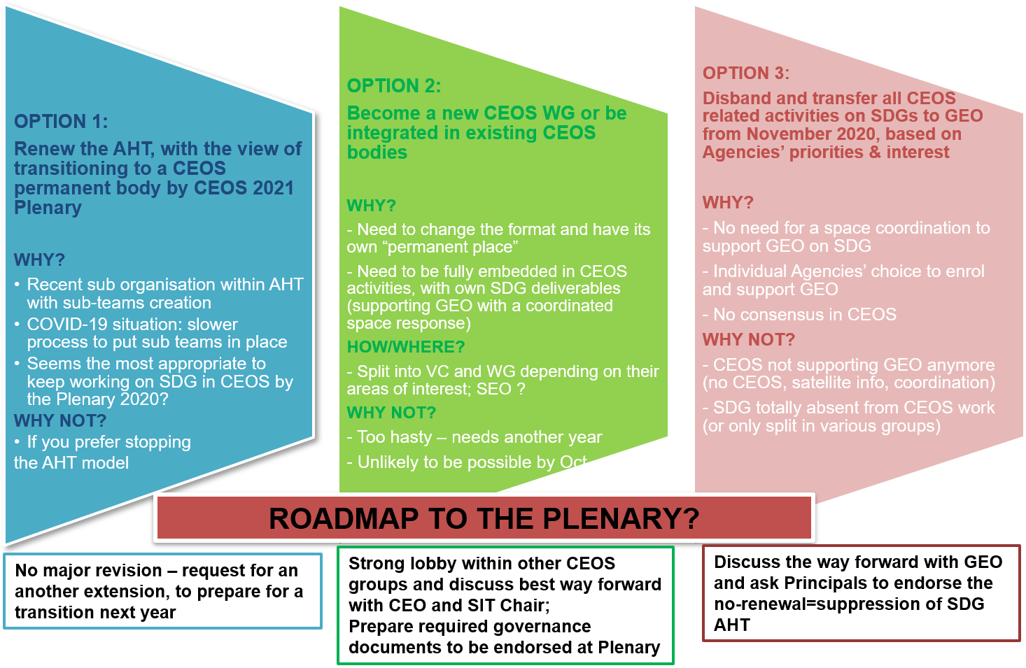
6. Continuity of the SDG AHT ? as of 7/9/20

Slide 11
Options for discussion today
Other questions, comments and thoughts to consider (Based on comments received so far):
Is this new format (sub-teams focusing on SDG indicators) going to the right direction?
Do you (or your Agency) have a preferred option?
Should we keep “in the view of” for Option 1? (highlighting our longer-term view)
Do you think it’s 1) desirable 2) possible to become a WG next year ?
In which existing CEOS body do you see the SDG activities?
How can we ensure a coordinated satellite-based SDG approach is well represented in GEO (=small task team under EO4SDG)?

Slide 12

Thank you for joining us today… Croatia would have been nicer, but great to have you all online, thanks for your support!
Alex Held: alex.held@csiro.au
Marc Paganini: marc.paganini@csiro.au
Flora Kerblat: flora.Kerblat@csiro.au

