Slide 1
COVID and EO from Space
Committee on Earth Observation Satellites
Astrid – Christina Koch, European Commission
DG DEFIS
CEOS SIT Technical Workshop 2020
Session and Agenda Item # 1.3
Virtual Meeting
8 September 2020

Slide 2
EU Space Programme
Copernicus ecosystem response
A EU Space webpage gathering initiatives launched by the Commission, but also by its partners and members of the Copernicus ecosystem is online :
www.euspace-programme.eu/coronavirus
The Copernicus Services C3S and CAMS have developed dedicated products to help with the current virus crisis. These products were presented to an international audience in several international fora:
United Nations Office for Outer Space Affairs “Space4Health” Webinar
https://www.unoosa.org/oosa/en/ourwork/space4health/2020/summary.html
GEO Health Community of Practice http://www.geohealthcop.org/
GEO Virtual Symposium – COVID-19 session https://earthobservations.org/symposium2020.php

Slide 3
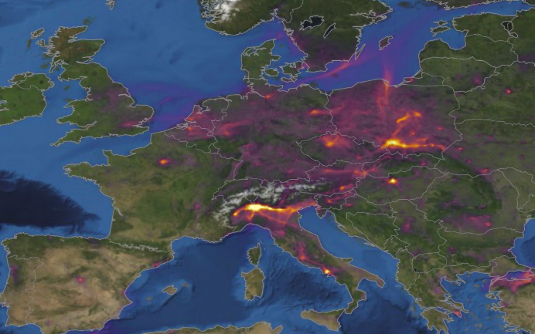
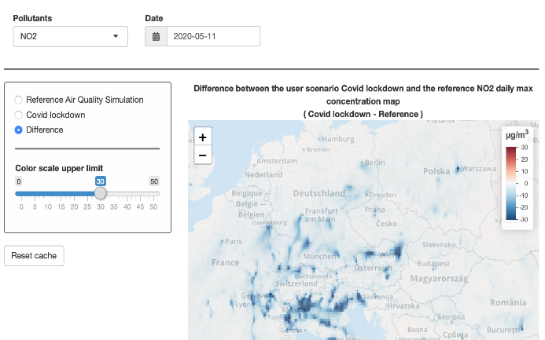
Copernicus Atmosphere Service activities
https://atmosphere.copernicus.eu/european-air-quality-information-support-covid-19-crisis
Maps and animations of the latest situation in Europe.
Air pollution across Europe compared to 2017-2019 and as a function of lockdown measures.
Forecast model estimate of reduction in air pollution is expected on a daily basis accounting for weather effects.
How consistent are surface and satellite measurements?
CAMS currently contributes to a number of epidemiological studies trying to evaluate the links between air pollution and COVID-19 (effects of long- and short-term exposure; fine particulate matter as a potential vector in air for the virus?...)
CAMS regional air quality forecasts: Météo-France, Ineris (FR)
CAMS COVID-19 scenario forecasts: Ineris (FR)
CAMS website: ECMWF

Slide 4
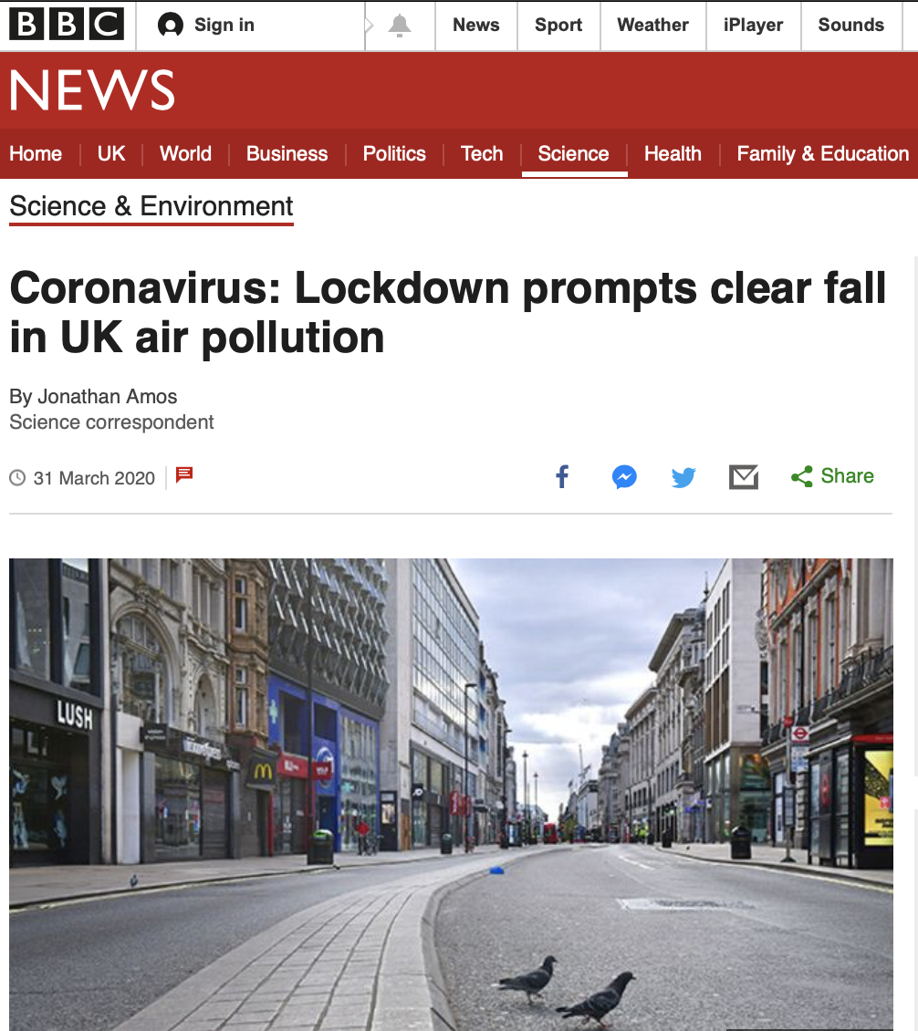
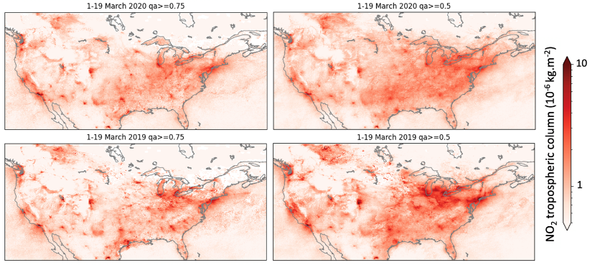
SENTINEL-5P: AIR QUALITY FROM SPACE
NO₂ Total Column
Mid-March to mid-April 2019
Mid-March to mid-April 2020
S-5P is the 1st satellite to provide credible measurements of air quality.
CAMS also showed that erroneous use of S-5P data led to think that effect of restriction measures on US air quality were earlier and stronger than in reality.
S-5P NO₂ total column provision: ESA, KNMI (NL)
S-5P NO₂ total column processing: ECMWF

Slide 5
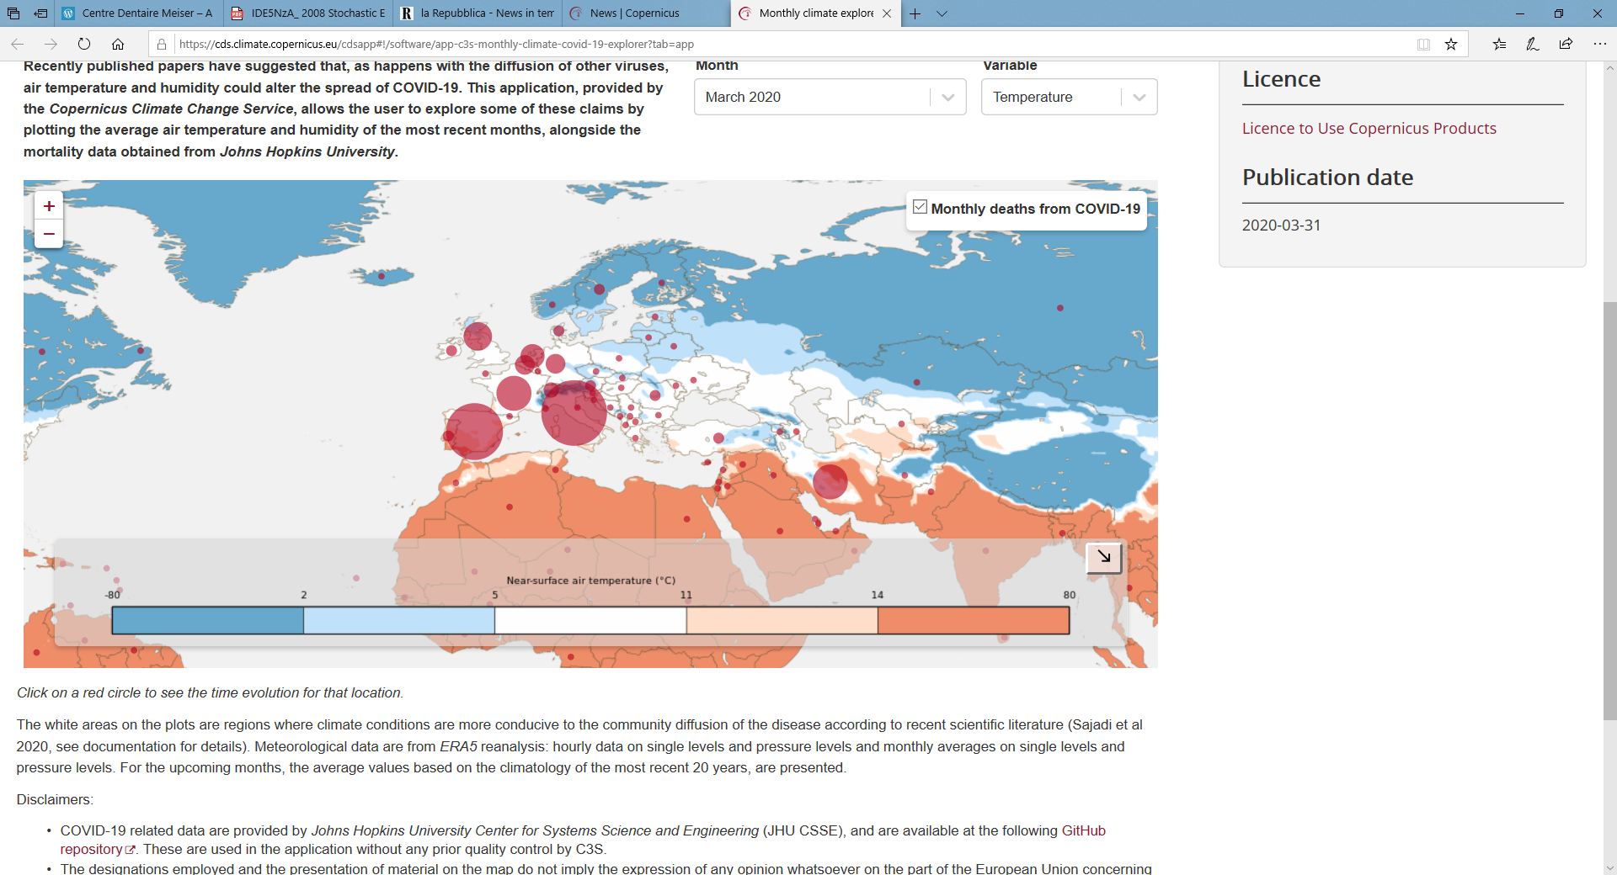
Copernicus Climate Change Service Activiies
C3S helps health experts explore how temperature and humidity affect virus spread
https://climate.copernicus.eu/c3s-helps-health-experts-explore-how-temperature-and-humidity-affect-virus-spread
Recent research suggests that the spread of the new coronavirus (SARS-CoV-2) could be affected by temperature and humidity, so the C3S has worked with environmental software experts B-Open to develop an application that maps mortalities against temperature and humidity data. The application allows health authorities and epidemiology centres to explore the claims that temperature and humidity could affect the spread of coronavirus
Notes:
Access to observations and climate reanalyses, to monitor climate change
Reanalysis: combines observations with models to give a complete picture of how the climate has evolved during the last few decades

