Slide 1
2020 CEOS Chair Priorities
Raj Kumar, CEOS Chair Team
Indian Space Research Organisation
CEOS SIT Technical Workshop 2020
Session 1.2, CEOS Chair Session
Virtual Meeting
7-11 and 14-18 September 2020

Slide 2
CEOS Chair 2020 Objectives
ISRO is pursuing the following initiatives:
Focus on Virtual Constellation (VC) with regard to EO satellites - Gap analysis in priority areas, global studies….
Applications focus on SDGs for BIMSTEC Region - Vegetation, LULC, Water etc.
Renewable energy assessment (Solar & Wind) from Space
Explore new tools for disasters management: Geo-Leo based solution !

Slide 3
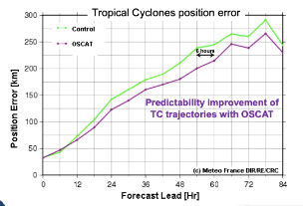
Focus on Virtual Constellation (VC)
Scatterometers are the proven technology for Ocean Surface Vector Winds
Additionally provide measurements of ice extent, icebergs, large water bodies
Applications:
  Satellite OSVW Impact on NWP Models
  Forecast error reduction by data assimilation
  Tropical cyclone position improvement
  Monitoring of seasonal to interannual changes
  Marine Weather Warnings
  Ice motion, changes
As per WMO WIGOS 2040 Vision, Scatterometers are part of the “Backbone System with specified orbital configuration and measurement approaches”
  Required Sun-synchronous in three orbital planes
IOVWST Recommendations : At least 3 Scatterometers to meet WMO requirements (observations every 6 hours or better)

Slide 4
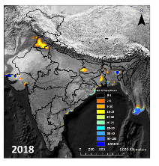
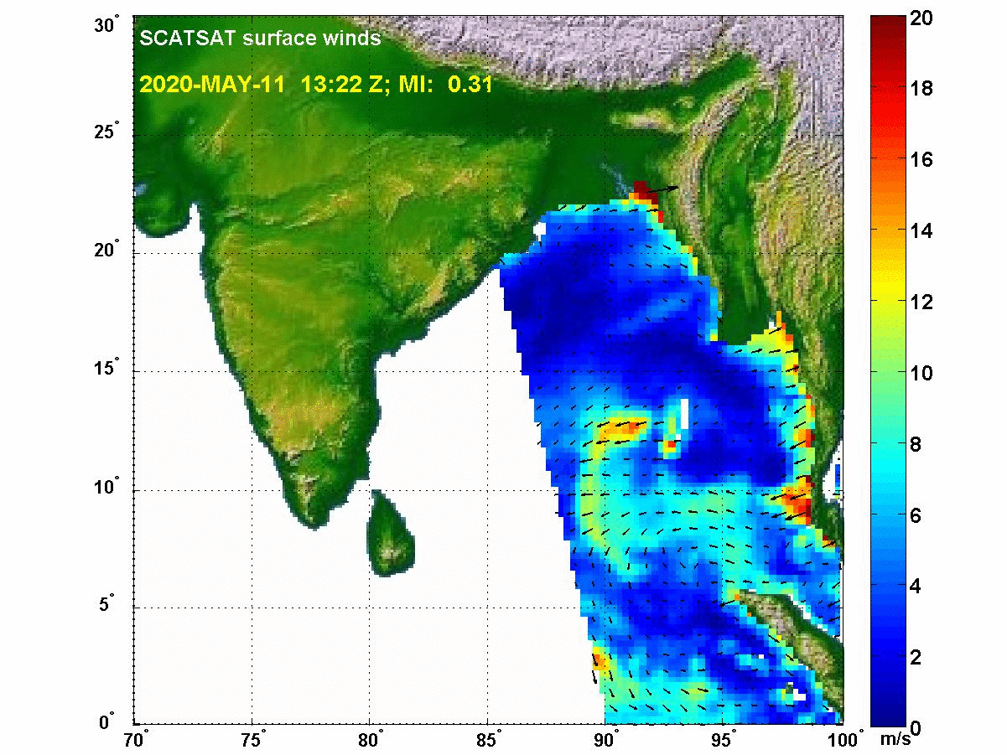
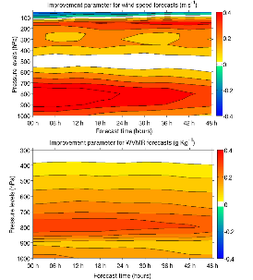
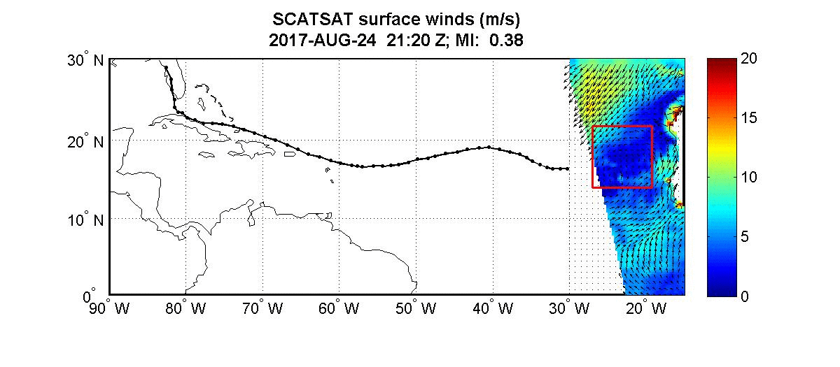
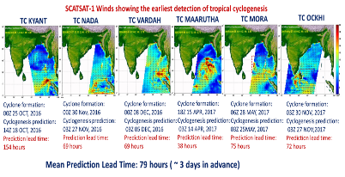
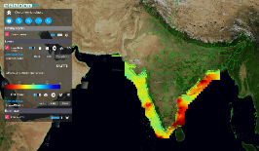
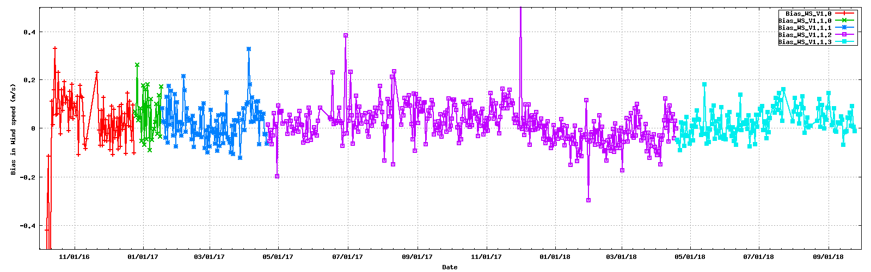
Focus on Virtual Constellation (VC)
Applications
Inundation
Impact on extreme weather
Impact on short-range weather f/c
Positive number indicates positive impact
Coastal upwelling
Time series of Scatsat-1 wind speed bias (±0.1 m/s)

Slide 5
Focus on Virtual Constellation (VC)
Various LEO satellites are presently – operational & planned
  ASCAT, SCATSAT, HY2 Series, CFOSAT, FY3,Oceansat
Discussions on optimum coverage and observing system requirements
Observation requirements may vary depending on the phenomena
Need for Study teams to regularly analyse Operational / Approved / Planned missions, as part of Gap Analysis
Sharing of information (sensor and measurements) sufficient for independent validation and verification
Open and near real-time data access to support the marine weather mission
Systematic and sustained high quality and consistent observations

Slide 6

Focus on Virtual Constellation (VC)
Status of the work
Actions Taken:
Discussions happened with CEOG WGCV
  WGCV (Microwave) shown interest in working with OSVW-VC
  Meeting was organised between OSVW-VC and WGCV on April 21
  Discussions on Standard and Metrics for Scatterometery
  Meeting was held on June 15 with OSVW-VC, WGCV and others
  Draft of the work plan discussed
  Work components also identified
  Team members identification

Slide 7
Focus on Virtual Constellation (VC)
Status of the work
Actions Taken:
Organised Special Session on Satterometery in CGMS
  With an Objective “Coordination of global scatterometer constellation including coverage optimisation and data sharing in response to WIGOS 2040”
  Participation from NOAA, EUMETSAT, CMA, NSAOS, ISRO
Resolved to form a Working Team to discuss the present issues, future scatterometer missions and Gap analysis
Team will be formed by CGMS
Suggestion to have coordinated CEOS-CGMS team to take into account the user requirement from CGMS and missions feasibility by CEOS

Slide 8
Focus on Virtual Constellation (VC)
Status of the work
Actions Taken:
Working Team being formed to prepare comprehensive document to
  Identify and recommend validation sources and metrics
  Inter-calibration of the backscatter data from different sensors
  Generate climate quality products
  Development of unified GMFs and retrieval algorithms for all space-borne scatterometers
  Algorithms for extreme wind cases and impact of other environmental parameters
  Identification of the global scatterometer constellation to monitor extreme events, diurnal variability, improvement in NWP forecast, climate products

Slide 9
Applications focus on SDGs for BIMSTEC
Potential Applications
Application Categories | Application Types | Linkages
Land Use Land Cover (LULC) | Level – 1 & Level-2 LULC mapping & Change detection with special reference to Urban sprawl & snow cover mapping | SDG 2, 3, 6, 7, 11, 12, 13 Sustainable Land management (SLM), Land Degradation Neutrality (LDN)
Water | Water quality (e.g. turbidity) assessment for Case 2 & Case 3 water, Water spread area, PFZ & coastline change detection | SDG 6 Global Water Watch
Agriculture | Mapping annual & seasonal-scale net cultivated / sown area Dominant crop type mapping and condition assessment | SDG 2, GEOGLAM
Forest | Forest cover monitoring and change /loss assessment (e.g. Deforestation alert, degradation, burnt area) | UN Strategic Plan for Forests (UNSPF) Aichi Biodiversity targets SDG 13
 | Mapping forest phenological metrics (SOS: Start-Of-Season, MOS: Maximum-Of-Season, EOS: End-Of-Season)

Slide 10
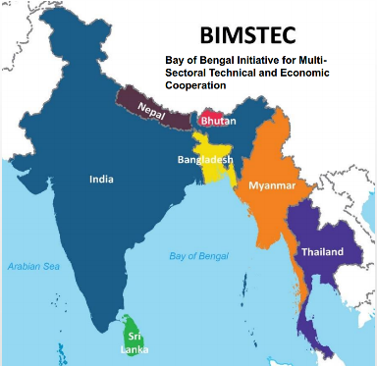
Applications focus on SDGs for BIMSTEC
Data population progress
Present Infrastructure Target Satellites
Future Infrastructure Target Satellites
IRS-R2A
IRS-R2
Landsat-8
Oceansat-2
Sentinel
Landsat-4,5,7
Bhutan
Duration – 2012 - 2019
Total Count – 280 and counting
Nepal
Duration – 2012- 2019
Total Count – 1860 and counting
Myanmar
Duration – 2012 - 2019
Total Count – 1200 and counting
Bangladesh
Duration – 2012 - 2020
Total Count – 2700 and counting
Sri Lanka
India
Thailand
to be initiated
soon

Slide 11
Applications focus on SDGs for BIMSTEC
Data Description
Satellite Name | Resourcesat - 2 | Resourcesat – 2A | Landsat - 8
Payload | LISS-3 | LISS-3 | OLI
Data Processing Level | Level-2 Optical Surface Reflectance | Level-2 Optical Surface Reflectance | Level-2 Optical Surface Reflectance
Data Resolution | 24m | 24m | 30m
Grid Specification | BIMSTEC LCC, EPSG:4326 | BIMSTEC LCC, EPSG:4326 | BIMSTEC LCC, EPSG:4326
Temporal Duration | 2012 – 2020 | 2017 – 2020 | 2013 – 2020
Data format | COG (indexed) & netCDF CF1.6 (ingested) | COG (indexed) & netCDF CF1.6 (ingested) | COG (indexed) & netCDF CF1.6 (ingested)
BIMSTEC Lcc Parameters
Latitude of Projection Origin 21.5
Longitude of Central Meridian 88.0
Standard Parallel 1 13.5
Standard Parallel 2 29.5
Datum WGS84

Slide 12
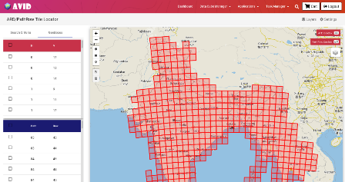
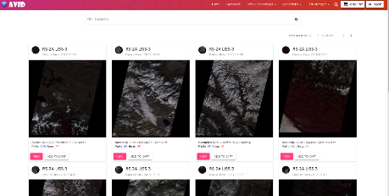
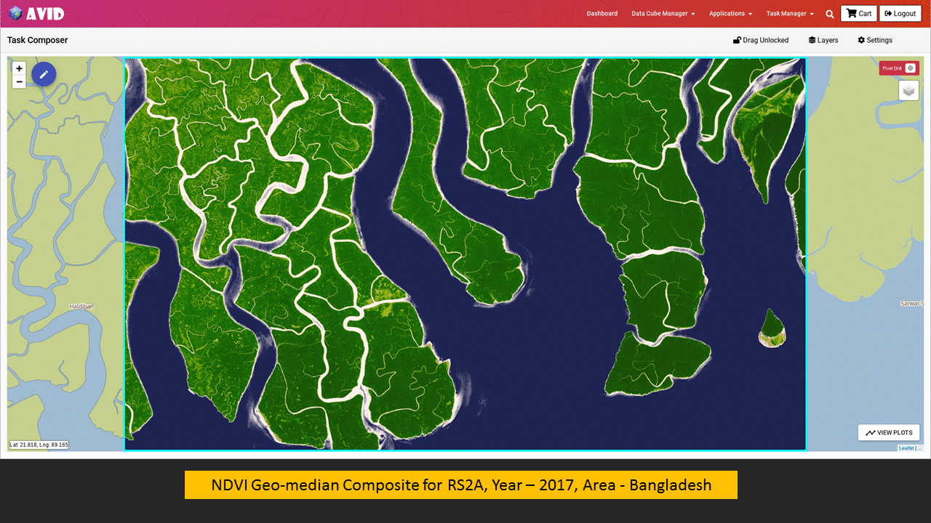
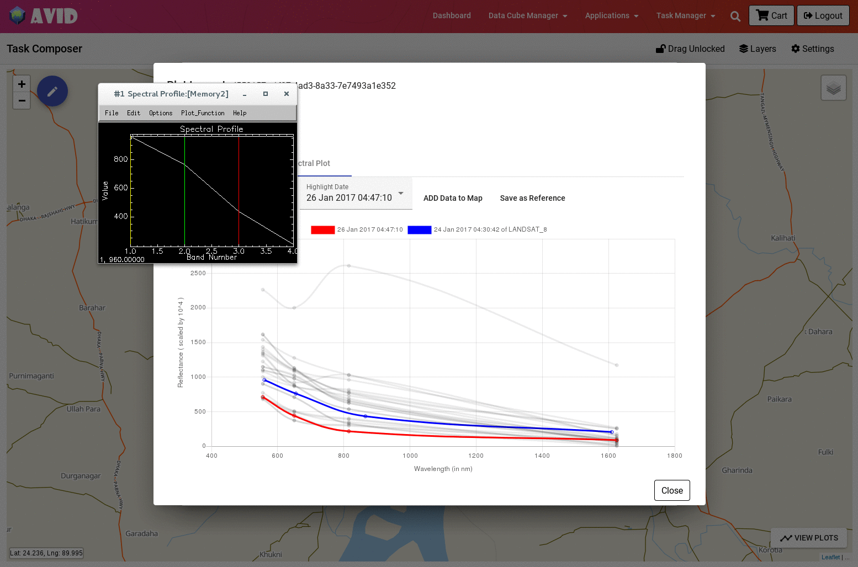
Applications focus on SDGs for BIMSTEC
AVID (Analytics & Visualization for ISRO Datacube )

Slide 13
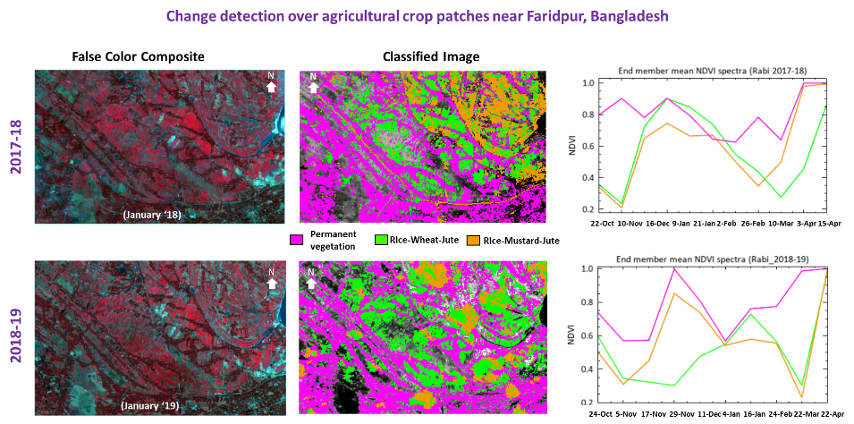
Applications focus on SDGs for BIMSTEC
Examples of Agricultural Applications over
Bangladesh

Slide 14
Applications focus on SDGs for BIMSTEC
Implemented, Remaining & On-Going
Action Remaining
Applications development in consultation with BIMSTEC and integrated with AVID
Discussions with SIT Chair Team & WGISS
CARD4L self-assessment and compliance
Features
Advanced ARD search, visualization and ordering based on GEOJSON features.
Direct visualization of product at native resolution without downloading.
On-the-fly channel selection while viewing dataset for user defined colour composites and Band Math.
Data swipe functionality. Time series animation builder.
Single Task Processing Page which allow process, visualize, analyse, manage on a single map page.
Layer Management, allow user to add their shape files, geojson feature collections, WMS, WCS & WFS Layer on map.
Customization of Pixel Drill Plots directly in browser, allowing user to analyse and plot time series data
Comprehensive Comparative analysis between RS-2/2A LISS-3 OSR Product and Landsat-8 OLI Data
On-Going Activities and Meetings
Meeting conducted in regard to BIMSTEC Data cube development, deployment and co-operation.
Consolidation of specific application requirements for individual countries in terms of their expectations from deployed Datacube setups.
Target sites identification for ARD evaluation.
ARD consistency checking for similar target types.
Training for usage, focused themes of applications
Scientific exchanges for making application-wise execution plan, schedule

Slide 15
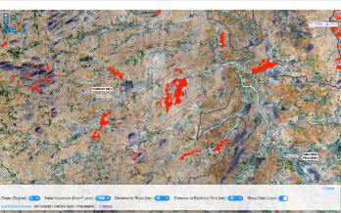
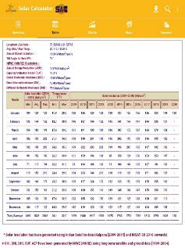
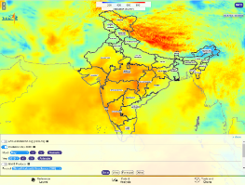
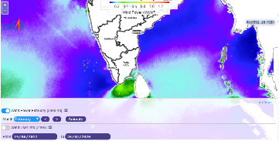
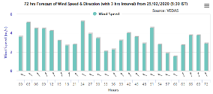
Renewable energy assessment from Space
(Solar and Wind)
Web Application and Mobile app for monthly and yearly Solar energy potential.
Solar site selection tool for identification of potential areas based on multi-parameter filters including: slope, distance to grid, roads and landuse type.
Offshore monthly Wind energy Potential.
Next 72 hours Solar and Wind forecast at 15 minutes interval.
Solar Site Selection tool
Solar Calculator Mobile app
Next 72 Hours Wind forecast
Solar Energy Potential
Wind Energy Potential (Offshore)

Slide 16
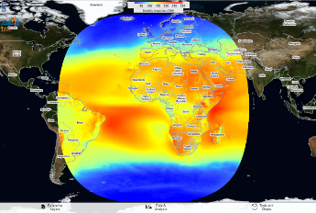
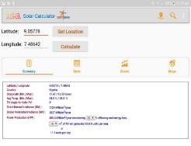
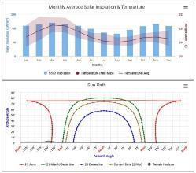
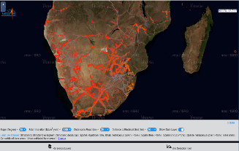
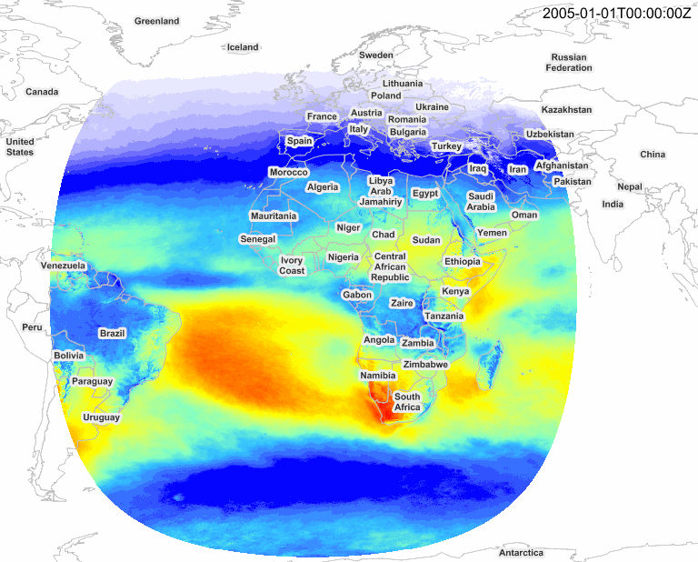
Renewable energy assessment from Space
Solar Insolation over Africa
Web Application is developed for monthly and yearly Solar energy potential of Africa Continent.
Mobile app is developed for calculating solar energy potential and related parameters at any given location (entered Longitude and Latitude value).
Solar Site Selection tool for Africa
Future Work
Solar Energy Potential
WebGIS application for Global Solar and Wind Energy Potential Visualisation.
Global Solar and Wind Energy forecast.
Site Selection tool for identifying Solar and Wind energy potential sites for entire World.
Solar and Wind Calculator Mobile App for selected location on World Map.
Month
Solar Site Selection tool

Slide 17
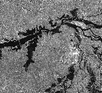
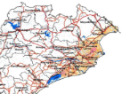
Disaster Management –GEO-LEO Tools
Proposed Contributions – CEOS WGDisasters
Satellite Data
ISRO has launched several Geo-Leo Satellites and a few Satellites are proposed
GEO Satellites - INSAT-3D / 3DR; GISAT-1,
LEO Satellites-ResourceSat-2 / 2A; RISAT-1A/1B, NISAR, (DMC-SAR), ResourceSat-3, …
DEM – CartoDEM, …
Disaster Applications
Improved Flood Monitoring using GEO-LEO-SAR
Flood Risk Assessment
Forest Fire Danger Index
On-line Processing Tools
Online satellite data processing tools
Proto-type initiative for International Charter

Slide 18
Disaster Management –GEO-LEO Tools
Status
Discussions during CEOS WGDisasters
Based on ISRO proposed activities, following points were discussed
ISRO’s proposal for Flood Pilot was appreciated.
Possibility of initiating a Pilot on Forest Fire Danger Index was discussed. Needs to be discussed further.
CEOS WGDisasters Chair suggested other members to explore the utility of ISRO strengths and integrating the on-line tools in CEOS WGDisasters.

Slide 19
Disaster Management –GEO-LEO Tools
Flood Pilot – Proposal – Flood Mapping
Daily estimation of flood inundation extent is very important for effective monitoring
LEO-Optical-SAR sensors, though useful, have limitations wrt revisit, swath cloud
GEO-Sensors have advantages wrt revisit, swath, though coarse in resolution
DEMs are useful in in improving the resolution of water theme in the Coarser Grids of GEO / Passive Microwave Sensors.
Integration of GEO-LEO-SAR-DEM, improve the flood monitoring capabilities, substantially
Discussions initiated with NOAA
Discussions initiated with NOAA
Broad Methodology
1
LEO
Optical
SAR
2
High Res.Water
Index
GEO Optical
Passive
Microwave
Low Res.Water
Index
Model
Model
3
DEM
Flood
Susceptibility
Index
4
Model
Integrate
Flood
Extent

Slide 20
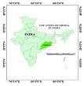

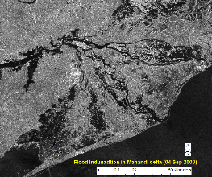
Disaster Management –GEO-LEO Tools Flood Pilot – Proposal – Flood Risk
Objectives:
To map the flood hazard and depth using time series of SAR & optical datasets and DEM
Vulnerability Assessment through field survey
To create flood risk maps
To prepare best practices and training document.
Support from CEOS :
Vulnerability Assessment - Very high resolution satellite data over the study area
Hydro-Dynamic Modelling – High resolution DEM (at present CartoDEM-10m posting is proposed to be used)
Study Area
Mahanadi River Delta
Approach

Slide 21
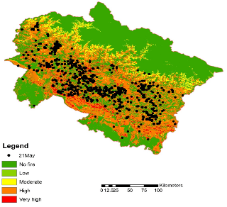
Disaster Management –GEO-LEO Tools Forest Fires Pilot – Proposal
Decision Support System for forest fire danger
Inputs: Temperature, relative humidity, fuel characteristics, topographic conditions, vegetation type, edaphic conditions.
Two biophysical components:
  STATIC INDEX: based on the constant parameters such as fuel characteristics, topographic conditions, vegetation type, edaphic conditions.
  DYNAMIC INDEX: based on weather parameters such as air temperature, relative humidity, wind speed and rainfall;
  INTEGRATED INDEX: Static & Dynamic Indices are integrated to provide the fire danger rating
Western
Himalaya
  Indexing into different classes of fire danger viz. No danger, Low, Moderate, High and very High for rapid characterization.
  Validation based on Active fire points from SNPP-VIIRS

Slide 22
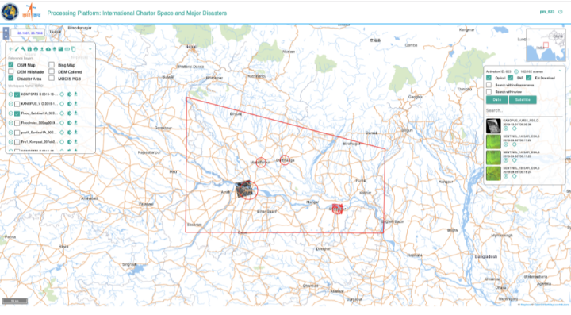
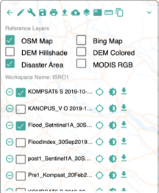
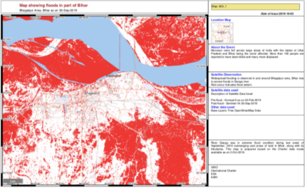
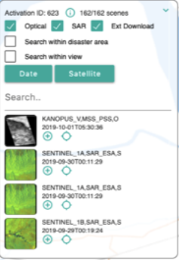
Disaster Management –GEO-LEO Tools
On-line Processing Tools
Need for Online Tool for
    Selection of Satellite Data
    Visualization of full resolution Satellite Data
    Sub-setting / Extraction of required area
    Extraction affected area – Flood, Fire, …
    Generation of Value-Added Products – Flood Maps, …
Ex: Bihar Floods – Sep, 2019
Final Product
Specific requirements to be obtained from CEOS
Data
Products

Slide 23
Discussions during CEOS WGDisasters
THANK YOU

