Slide 1

Data Exploitation/Use and Architecture
Committee on Earth Observation Satellites
Mirko Albani, ESA, WGISS Chair
Cindy Ong, CSIRO, WGCV Chair
CEOS 2019 SIT Technical Workshop
VC/WG/AHT Working Day
Session 2, Agenda Item #2.1
Fairbanks, Alaska, USA, 9 September 2019

Slide 2
4 Discussion Topics
#1: CEOS data discovery, access and stewardship
#2: Data exploitation tools, future Data Architectures and Technologies
#3: WGCV product validation
#4: How these activities can support VCs and AHT, including end user access to VC data

Slide 3
#1: CEOS data discovery, access and stewardship
Background and status
WGISS Connected Data Assets (relying on CWIC/IDN/FedEO), provides a single entry point for external clients to discover and access CEOS agencies data
  Search over 33,000 collections in the IDN, access over 5,000 collections with associated over 300+ million granules (granule search).
  Being enlarged with new partners and continuously populated with additional data collections also focusing on CEOS WG/AHT needs and results (e.g. ECV inventory)
  Client Portals: GEOSS Platform, Carbon Portal
WGISS drafted a Data Stewardship Reference Model and several supporting best practices addressing data and information management and stewardship
Questions
How can we make sure all VCs data are discoverable/accessible through WGISS CDA?
How to ensure application by CEOS agencies of Data Stewardship approaches?
Any opportunity/synergy/need from VCs and AHT leading to the development of thematic portals providing discovery/access to relevant data and exploitation tools/services?

Slide 4
#2: Data Exploitation Tools, Future Data Architectures & Technologies
Background and Status
Due to the increase in open data, open source software and cloud computing, there are many new “data exploitation” tools and services available to the world. Concept of “bring the user to data” lead to the development of several thematic/application environments:
  The Open Data Cube (ODC), Thematic Domain or Mission Exploitation Platforms (e.g. GEO Hazards, BIOMASS/NISAR), Copernicus Data and Information Access Services (DIAS), etc.
WGISS has produced inventories of OSS and Tools available at CEOS agencies and of existing Future Data Architecture Elements and is implementing a mechanism to facilitate discovery and access for users in cooperation with SEO through the WGISS web-site, and as second step through the WGISS Connected Data Assets (link to CEOS Agencies data).
WGISS:
  Is establishing a common description of Future Data Architectures functional blocks to better identify interfaces and interoperability approaches;
  Started looking into interoperability between FDA elements with initial focus on interoperability/connection between Data Cubes (ODC / HMDC / DCFS) and with DIAS, with potential follow-up standardization activities in the frame of OGC;
  Supporting outreach and awareness raising on FDA in cooperation with WGCapD;
  Exploring Artificial Intelligence and other technologies that can be of help for EO.

Slide 5
#2: Data Exploitation Tools, Future Data Architectures & Technologies
Questions
How can we exploit at best current FDA elements and existing tools at CEOS agencies?
Are the existing tools / FDA elements / platforms meeting the needs of a broad set of global users? What other data exploitation tools / FDA elements should CEOS consider?
How to identify most relevant and suitable concepts and guide future evolutions?
How to facilitate use of existing AI and ML technologies in EO?
How can we improve connection/links and support to GEO activities/initiatives through the use of these elements?
How can the work of FDA across the VC/WG be coordinated? Is coordination between LSI-VC, WGISS and SEO good enough? Need to reinforce? How?

Slide 6
#3: WGCV Product Validation
Background
WGCV has 6 sub-groups, all of which could support product validation.
Validation is the process of assessing, by independent means, the quality of the data products derived from EO system outputs.
Status
With the current focus on land products the WGCV SGs which are best placed and will likely to be contributing to supporting the ARD specifications development & peer review assessments are Infrared Visible Optical Sensors (IVOS), Land Product Validation (LPV), Synthetic Aperture Radar (SAR) and Terrain Mapping (TMSG). Peer review panel have already been selected and are ready to start and SAR SG supporting specifications;
WGISS and WGCV cooperating on the use of Data Cubes to support CAL/VAL activities through providing access to EO and concurrent reference data for ACIX (16 sites), LPV (3 sites) and RadCalNet (4 sites) sites cal/val data, quality indicators and maturity matrix.
Questions
Are there specific tasks that we need WGCV to address?

Slide 7
#4: Support to VC+AHT
Background and Status
There is a need to discuss how ARD and data stewardship, discovery, access and exploitation tools / FDA elements can support VCs and Ad-Hoc Teams (AHT) including end-user access to data and information.
There is no/limited formal discussion of end-user data and tools access among the VCs, AHT and WGs.
Questions
Do the VCs, WGs and Ad-Hoc Teams have a need and proposed way forward for:
  ARD?
  One-stop-shop data discovery and access for relevant data sets and tools?
  Coordinated approach for data and information stewardship?
  Data exploitation tools and FDA elements for their end-users?
If so, what should CEOS do to address these needs?
What could be specific high priority activities to be conducted in coordination between WGs and VCs?

Slide 8
Back-up slides

Slide 9
Data Stewardship Best Practices
Document Tree
EO Data Stewardship
Cooperative Framework
Policy Documents
CEOS Agencies EO Space Data Sets
Applied to
Recommended for
application
Data Purge Alert Procedure & White Paper
Recommended / Reference
Individual organizations'
policies (stewardship, access, ...)
Recommended /
Reference
Technical Documents
Reference Model for Data Stewardship
Glossary of Acronyms and Terms
General guidelines and best practices
Input to GEO Data
Management Principles
Support
Preservation Workflow
EO Data Preservation Guidelines
Preserved Data
Set Content
Associated Knowledge Preservation
WGISS Maturity Matrix
Persistent Identifiers Best Practice
Guidelines and best practices on specific topics
Technical implementation procedures
EO Data Set
Consolidation Process
…
Image Source: http://eastenders.wikia.com/wiki/File:Under-construction.png

Slide 10
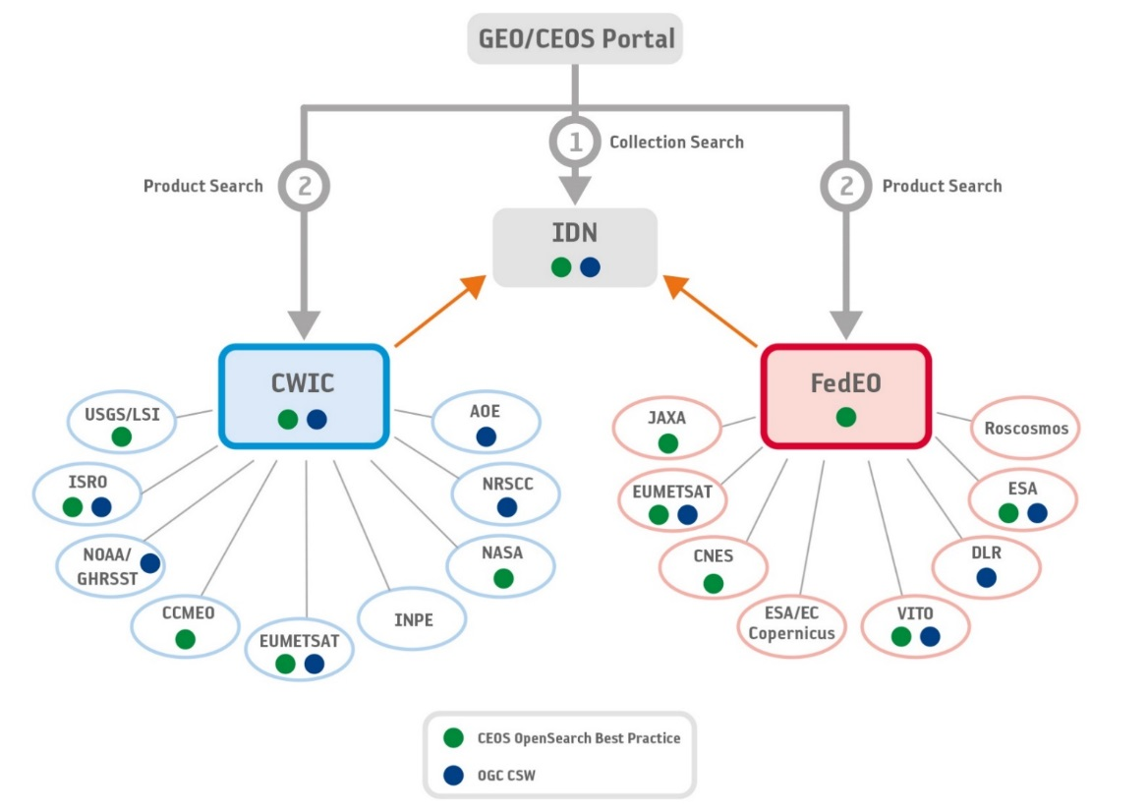
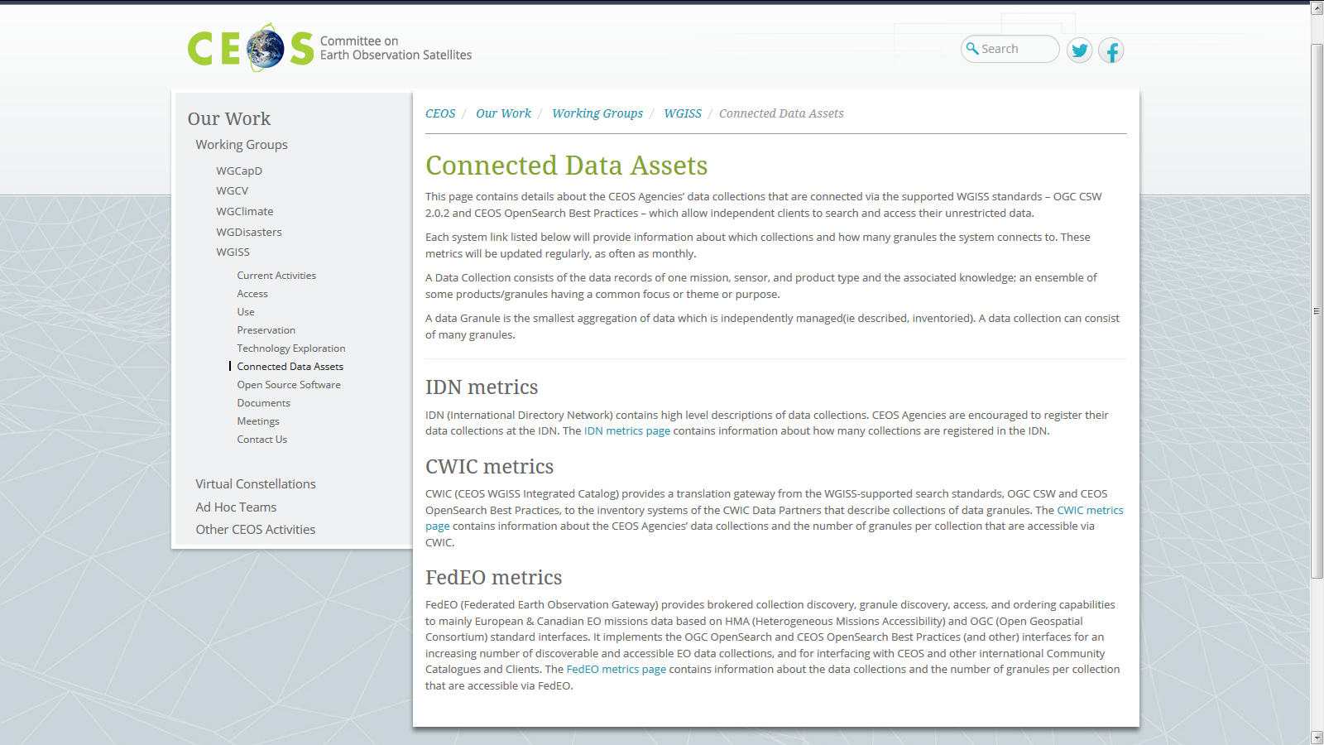

WGISS Connected Data Assets (CDA)
Relying on IDN/CWIC/FedEO components, provides a single entry point for external clients to discover and access CEOS agencies data
Search over 33,000 collections in IDN & Access over 5,000 collections with associated over 300+ million granules (granule search)
Harmonized CEOS Branding
CEOS Service
    DATA-2: Full representation and accessibility of CEOS Agency datasets through WGISS Standards and Connected Data Assets Infrastructure (i.e. IDN, CWIC, FEDEO). Q2 every year

Slide 11
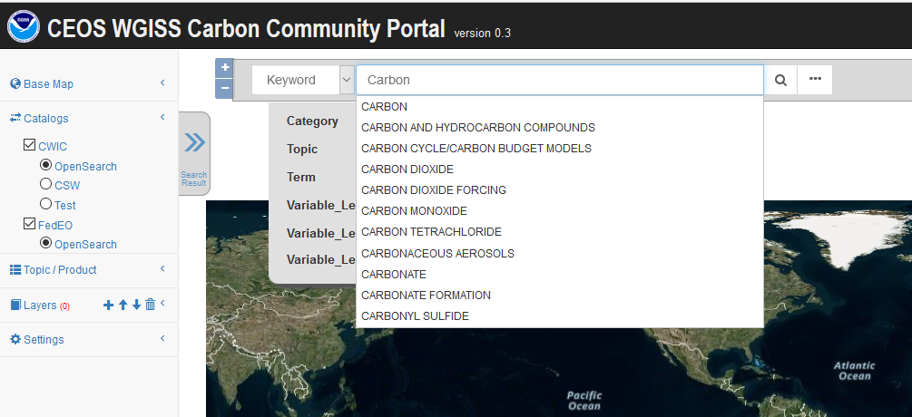
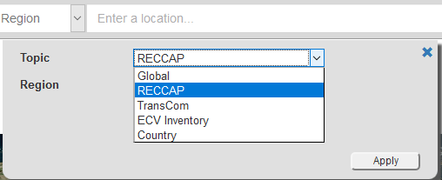
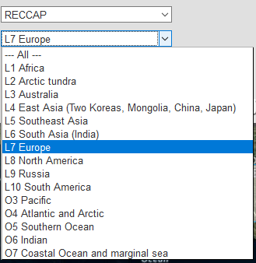
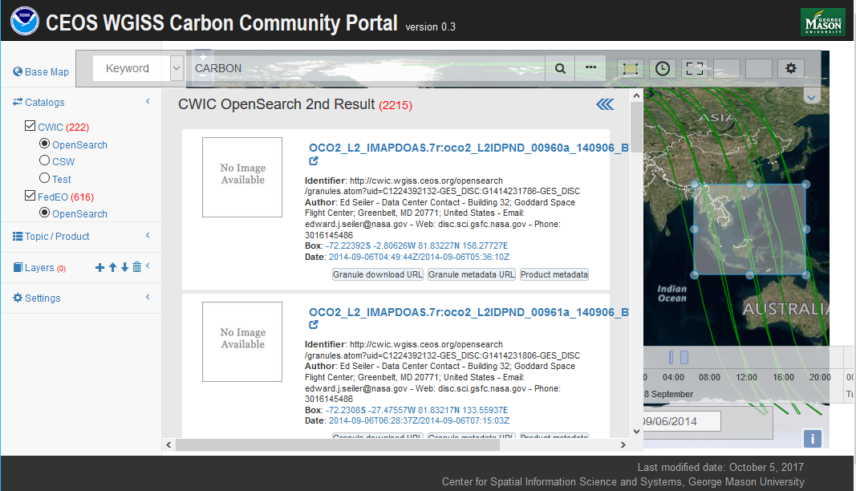
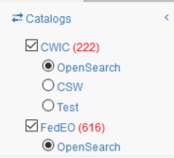
WGISS Carbon Community Portal
Led by NOAA and GMU
Search: Special Regions, Temporal, Pre-defined Carbon topics/datasets, Keywords
Returns records from both CWIC and FedEO
Issued in Q2 2019 and available on-line for users. Next release at WGISS-48.
https://gis.csiss.gmu.edu/carbon/cwicport
  CARB-15: Carbon Data Portal prototype. Q2 2019
Notes:
The goal of the CEOS WGISS Carbon Science Community Portal (called the Carbon Portal, or simply the Portal hereafter) is to support Carbon Science Mission in CEOS and other communities/organizations and demonstrate the usage of CEOS WGISS Connected Assets by providing easy discovery of and access to carbon-related data resources in CEOS member agencies.
Search in Special Regions: Global, RECCAP, TransCom, Country Names, ECV Inventory)
Temporal Searches: support for time range and specific date
Pre-defined Carbon topics/datasets: (Atmospheric, Ecosystem, Ocean, Mixed-Theme)
Keywords (auto-completion with IDN Science Keywords)
Return records from both CWIC and FedEO

Slide 12
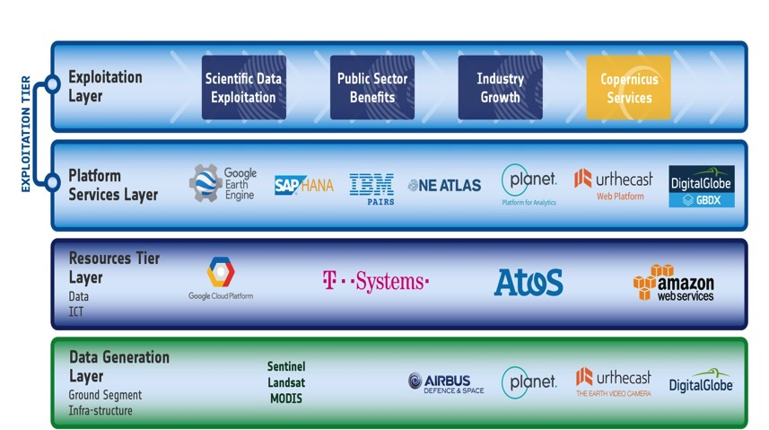
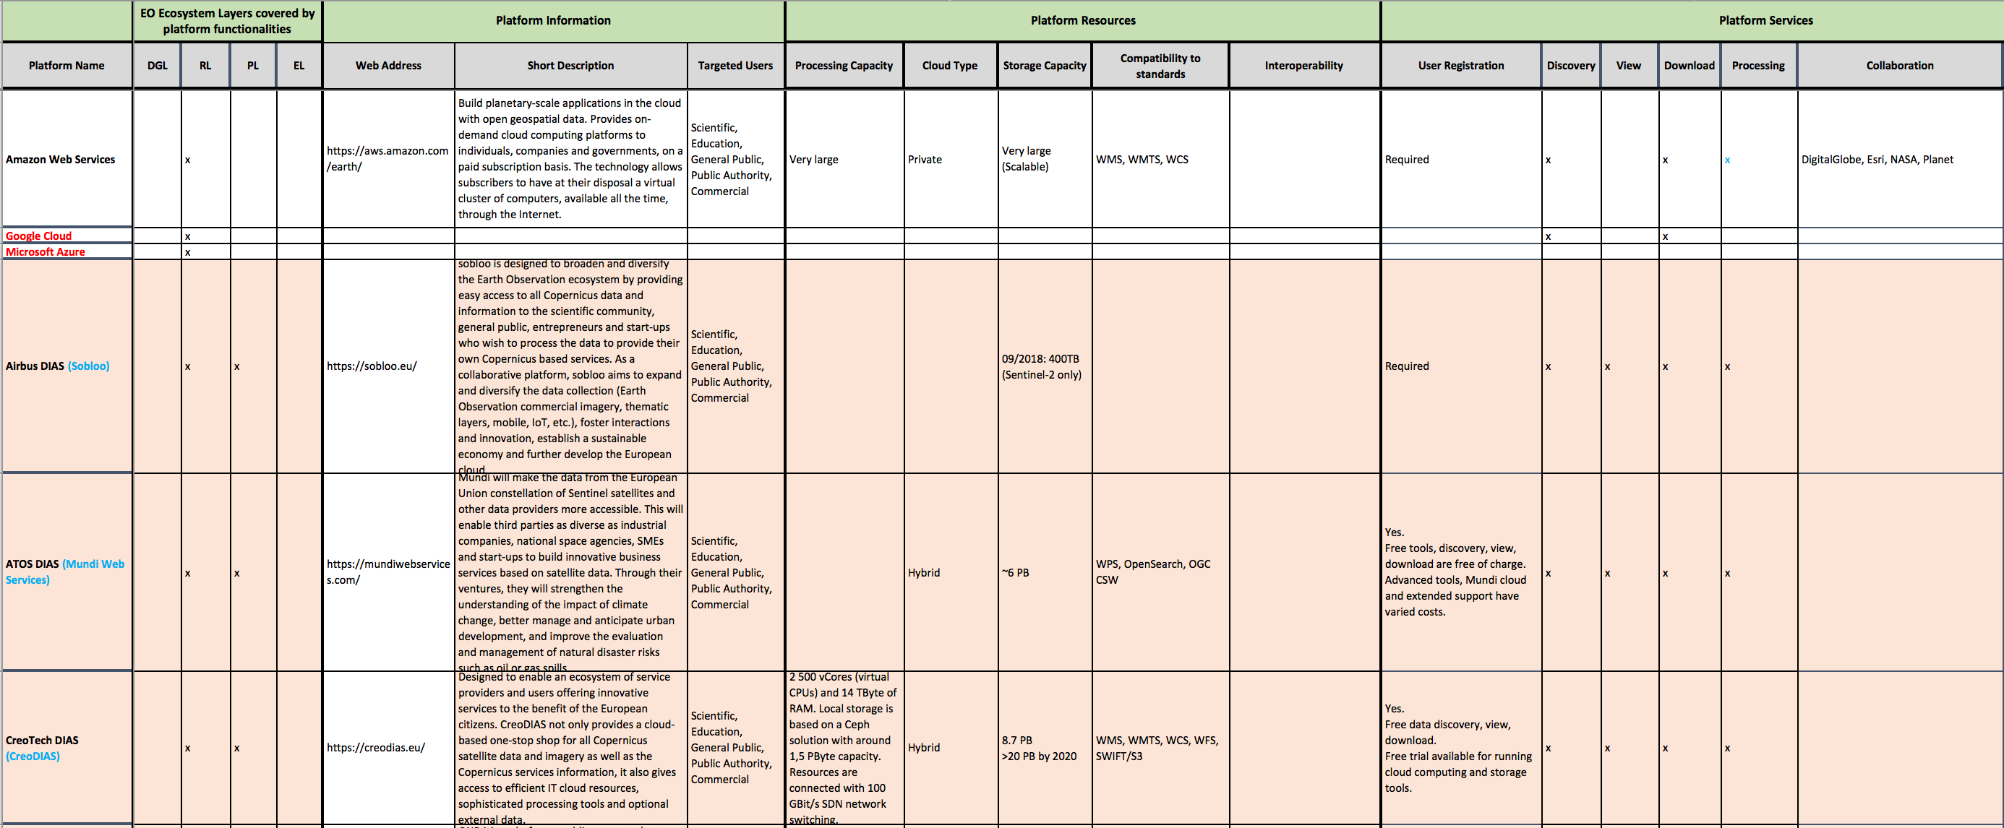
Future Data Architectures (FDA)
  FDA-8: Establish a common description of Future Data Architectures functional blocks and identify interfaces and interoperability approaches. Q3 2019
  FDA-9: Inventory and characterize existing FDAs operated by both public and private entities. Q4 2019
FDA Elements inventory V1 finalized and circulated in WGISS; it will be maintained up to date and used as input for further FDA related activities in WGISS (e.g. action FDA-14).
First draft of common description and building blocks document under finalization

Slide 13
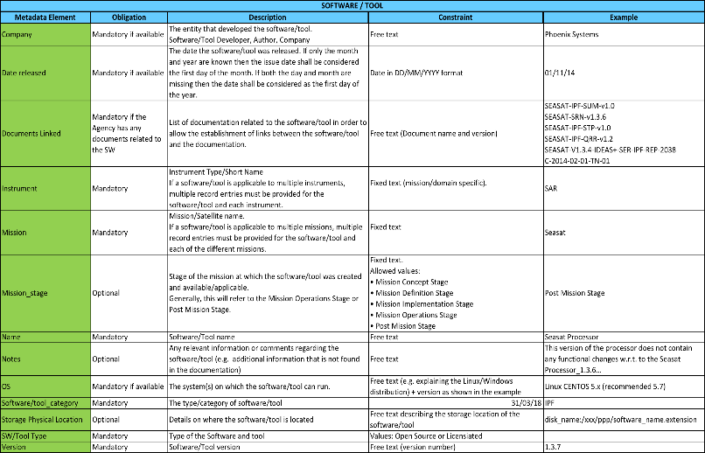
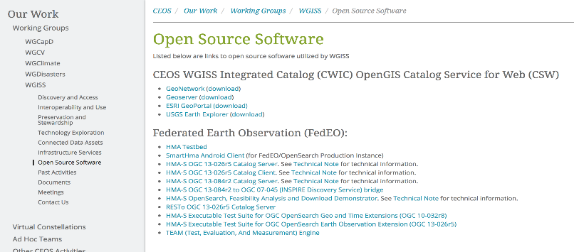
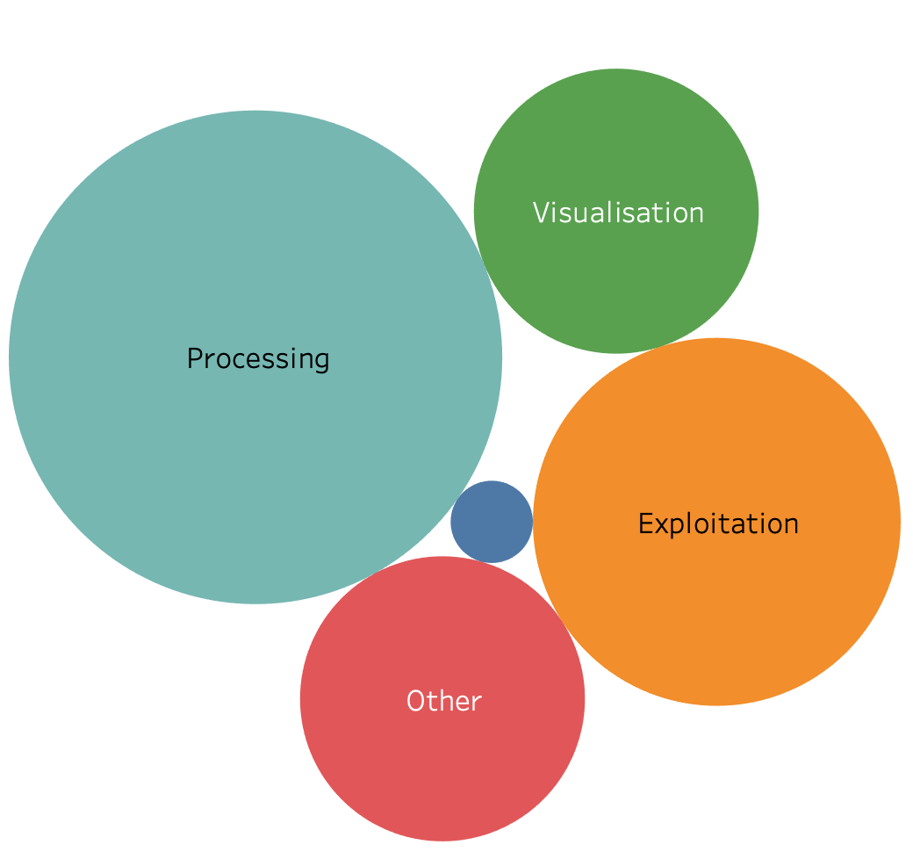
SW Tools and Services Discovery and Access through WGISS CDA
Finalized inventory of Open Source SW and Tools (V1) available at CEOS agencies;
Discovery/access through web page in WGISS web-site being implemented in cooperation with SEO team.
  FDA-10: Finalize inventory of CEOS agencies (Open Source) Software and Tools and implement a mechanism for discovery and access. Q3 2019
Discovery/access of FDA elements available at CEOS agencies through:
              Step 1: web page on WGISS web-site by Q4 2019
          Step 2: WGISS Connected Data Assets (linked to CEOS Agencies data) by Q4 2020
    FDA-14: Facilitate discovery and access for end users to data analytics and processing tools and services through WGISS Connected Data Assets Infrastructure. Q4 2020

Slide 14
FDA Elements Demonstration Workshop
11 FDA elements presentations and demonstrations, FDA-08 and FDA-09 actions addressed
GEO AquaWatch
CEOS SEO Client Interfaces and Open Data Cube
USGS Architecture for Services in the Cloud
ESA PDGS Data Cube
European Data Cube Service
GEOhazard Thematic Exploitation Platform
Copernicus Data & Exploitation Platform – Deutschland (CODE-DE)
Food Security Thematic Exploitation Platform with Demo
Plateforme d’Exploitation des Produits Sentinel (PEPS)
JASMIN Super Data Cluster
Big Data Approaches Supporting Market Growth in EO at the Satellite Applications Catapult

Slide 15


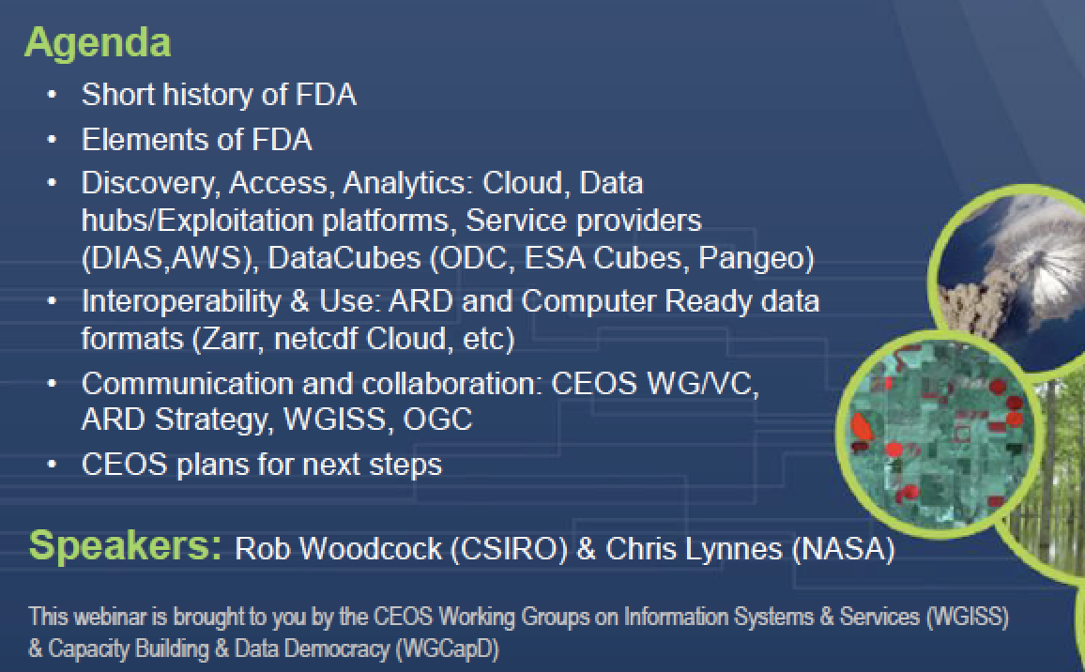
Technology Webinars
Joint webinars and advertising with:
  WGCapD
  GEO (e.g NextGEOSS, GEOSS Evolve)
  Federation of Earth Science Information Partners (ESIP)
http://ceos.org/ourwork/workinggroups/wgiss/technology-exploration/
  DATA-11: Data and Technology Exploration webinars and workshops. Q4 2019
FDA-5: Promote awareness of FDAs (with SEO and WGCapD). Q3 2019
Notes:
Relevancy Ranking of Data Search Results
14th of March 2017
Stefano Nativi (GEOSS EVOLVE)
Chris Lynnes and James Norton (NASA)
Data Cubes for Large Scale Data Analytics
19th of June 2017
Rob Woodcock (CSIRO)
Brian Killough (CEOS SEO)
Burgeoning Role of Python for Earth Observation Data Analysis
22nd of August 2017
Syed Rizvi (Open Data Cube)
Rich Signell (USGS)
Alber Sanchez (INPE)
The OGC Coverage Standards Suite: Introduction and Overview
19th of January 2018
Dr Peter Baumann (Rasdaman)
Scrum and scale agile methods
31st of July 2018
Ms. Dana Shum (Raytheon NASA)

Slide 16
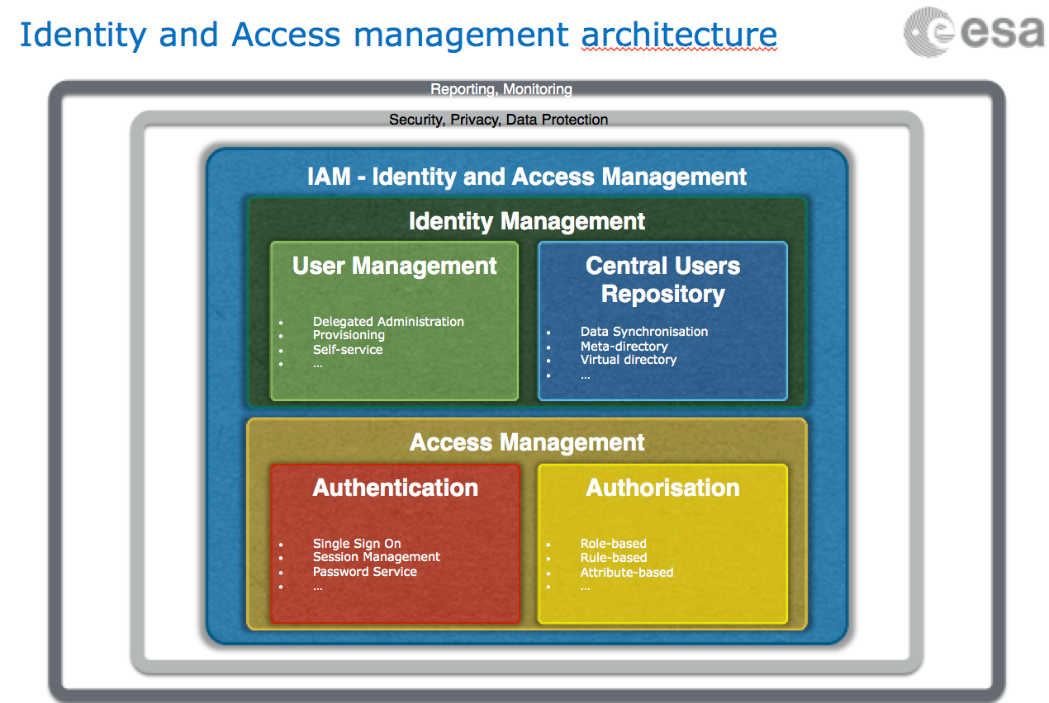

Technology Exploration
Draft Single Sign-On white paper generated and currently being reviewed by WGISS
Ad-hoc sessions on Artificial Intelligence and Machine Learning held at WGISS-46 and WGISS-47
  DATA-13: Develop a White Paper on Single Sign-On (SSO) authentication. Q2 2019
  DATA-15: Explore emerging trends and disrupting technologies for adoption in EO. Summarize as white papers. Q4 2020

