Slide 1
CEOS SIT Term 2020-21 Prospectus
Committee on Earth Observation Satellites
SIT Vice-Chair
SIT TW Fairbanks, USA
Sep 2019

Slide 2
Introduction
CSIRO and GA will take on Chairmanship of the CEOS Strategic Implementation Team (SIT) at CEOS Plenary in October 2019 for a 2-year term
SIT “..provides strategic guidance on the direction, progress, and status of implementation activities in relation to the established priorities, commitments, and partnerships of the CEOS organization”.
ESA anticipated to serve as SIT Vice-Chair during this term and to take on SIT Chair in late 2021
SIT Vice-Chair Team has been consulting broadly across the organisation to set outcomes and milestones that are significant and reflect societal needs and CEOS agency priorities (and therefore resources).

Slide 3
SIT 2020-21 Approach
Evoking the original vision for SIT – making best use of Principals’ time in SIT meetings to address significant challenges to be addressed by coordination and observing system harmonisation across space agencies
Focused: a few priorities – reflecting major thrusts across civil EO programmes and priority needs
Reflecting existing important CEOS WP activities that will benefit from being escalated, elevated and expedited
In general, a focus on outcomes
Effective use of the different meetings
SIT: Significant debate and decision - for Principals
TW: Working Teams reporting, interaction, and prep for Plenary
All meetings cannot accommodate reporting of all CEOS business
Ensure effective intersection between CEOS management and working teams

Slide 4
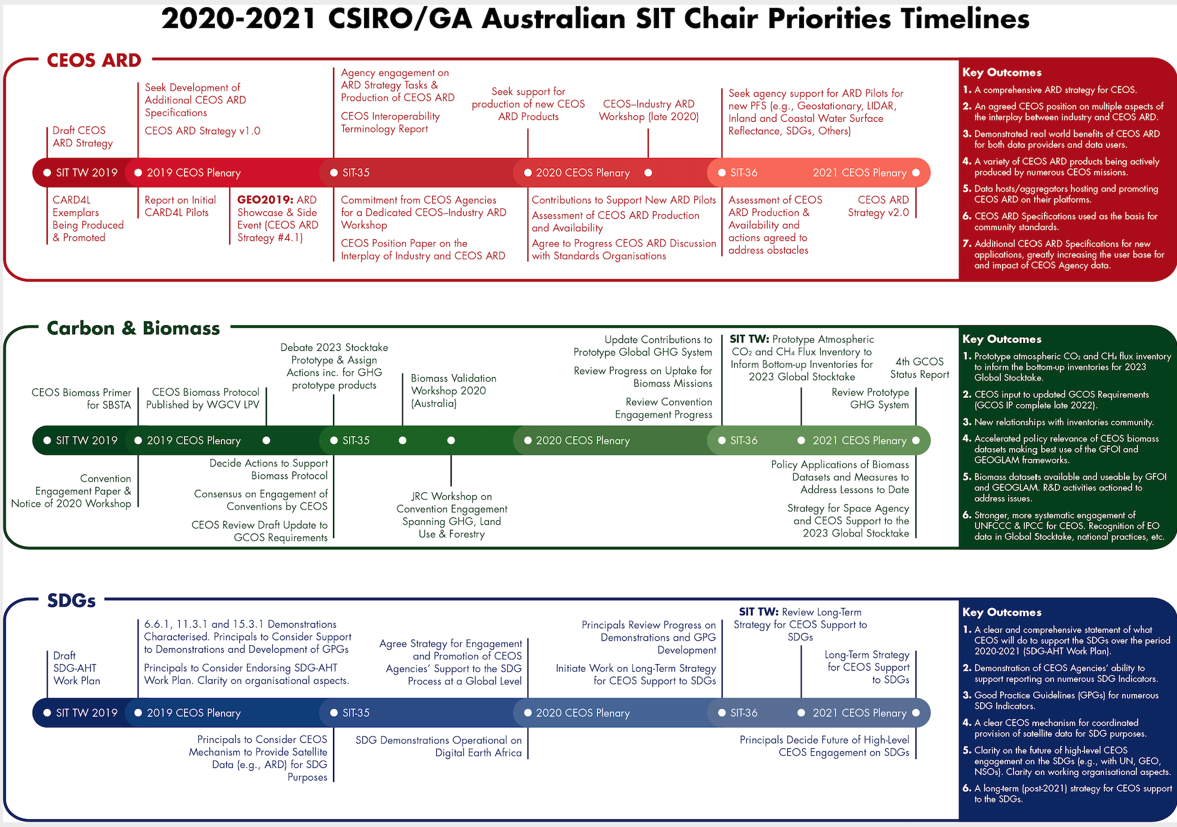
Prospectus

Slide 5
CEOS ARD Strategy
Implementation of the ARD Strategy (the Strategy is in development)
Production, promotion, demonstration, uptake of CARD4L data
Engagement with Industry on the concept and practice of ARD
Building on CARD4L foundation and expanding the range of CARD4L data types

Slide 6
Carbon & Biomass
Supporting the GHG Roadmap process – escalating, elevating, and accelerating progress towards major milestones, including for 2023 Global Stocktake. 2021 prototype flux products.
Encouraging stronger and more systematic CEOS engagement with convention frameworks – building on IPCC outreach
And national inventories communities as our future users
Reflecting large investment (2018-2024) in Above-Ground Biomass missions and seeking to accelerate the policy relevance of these new data (GFOI, GEOGLAM…)
Promote uptake of biomass datasets beyond science community – forest monitoring, inventories…

Slide 7
SDGs
Ensuring efficiency in delivering CEOS SDG outcomes, as well as clarity between CEOS & GEO (EO4SDG) activities
Focusing on a few specific indicators and deliver
Good Practice, Methods
Demonstrations
ARD products (TBD)
Encouraging stronger CEOS Agencies involvement and support Ad Hoc team traction
Establishing longer-term strategy for CEOS support to SDGs

Slide 8
Meetings and Processes
SIT meetings: focused on Principals and strategic implementation discussions
TW meetings: reporting and interaction with CEOS working teams to prepare Plenary
Proposing 3-4 all-hands calls in each calendar year for CEOS working teams to provide essential reporting and seek feedback/support on obstacles, resourcing etc
CEOS Working Teams Day prior to SIT TW
Use new CEOS Deliverables site to keep current tasks updated – in lieu of an active CEO maintaining the CEOS WP document
No plans to directly absorb workload of CEO – CEOS to continue to seek candidates
Plan to consult directly with working teams to ensure efficient interaction between CEOS working processes and the Principals
SIT-35: Hobart, Tasmania in week of 30th March 2020 (UNDER REVIEW!)
SIT-TW 2019: Zagreb, Croatia in week of 7th September 2020

Slide 9
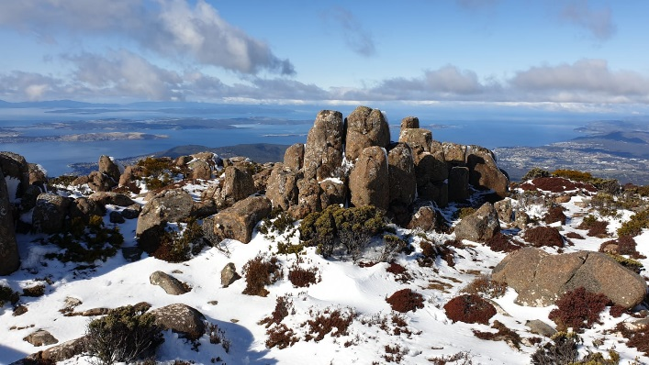
SIT-35 in Hobart, Australia
SIT-35: 1st – 2nd April 2020 (with side-meetings on Tuesday 31st March) TBD
Main meetings and reception venues selected (booking process)
CSIRO & GA invite you to join us and experience HOBART, the capital and most populous city of the Australian island state of Tasmania …
A unique Australian place where
you can walk through snow* while
contemplating at ocean views !
*won’t be guaranteed in March though
CEOS SIT-35, Hobart

Slide 10
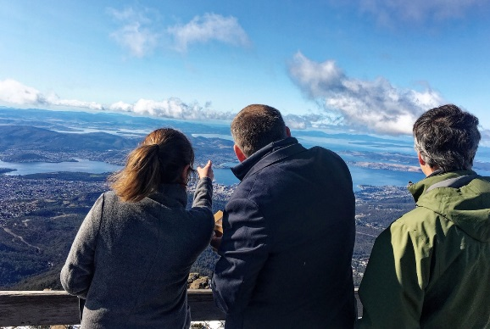
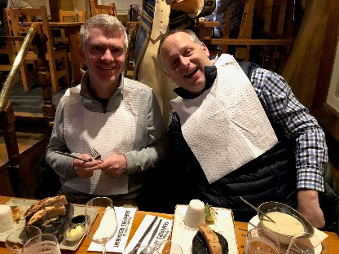
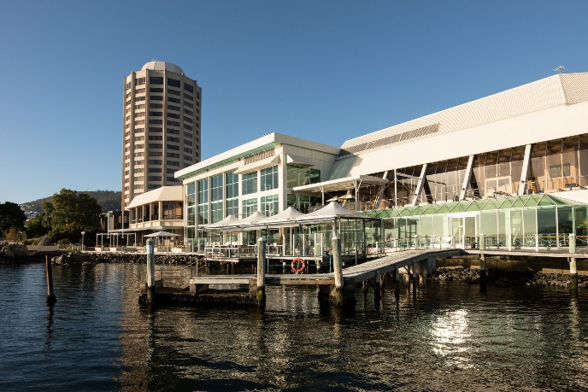
Main Venue
We have been scoping out venues….
For our next SIT meeting,
and the winner is….
WREST POINT Hotel
Fulfil our meeting’s requirements
Conveniently located on waterfront with great mountain and ocean views (only 5-10min drive from the town centre)
Offers various accommodation room options, with a special discounted rate until 31 Jan 2020: more info soon
+ several dining options onsite

Slide 11
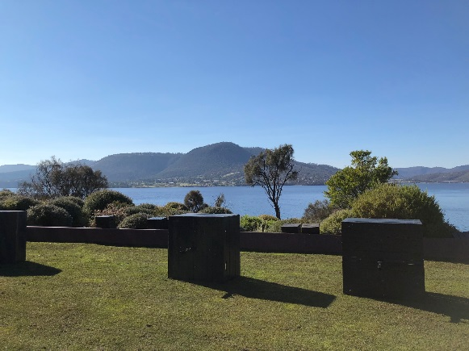
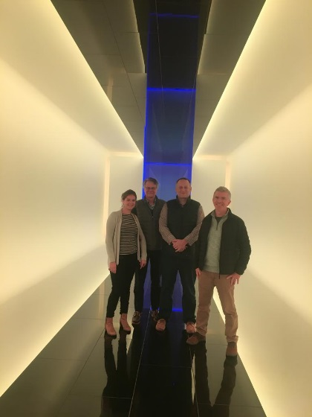
Social: exceptional evening at MONA
Brace yourselves for a MONA (Museum of Old and New Art) experience Wednesday 1st April (TBD)
including an exclusive visit of the Museum and a cocktail/dinner reception
More information soon…
we look forward to welcoming you in Tassie next year!

Slide 12
Don’t forget : Tassie has a lot to offer
Friday 3/4: free so you can explore a bit more around Hobart incl.:
Mount Wellington
Hastings Caves and thermal hot springs
Mount Field National Park and Russell Falls
Port Arthur
Cascades Brewery co
Salamanca Markets
Vineyards
Bruny Island
Field trips and excursions options are being discussed – we’ll be happy to help you organise something so you make the most of your trip Down Under…. and even stay longer to explore the rest of the island!

Slide 13
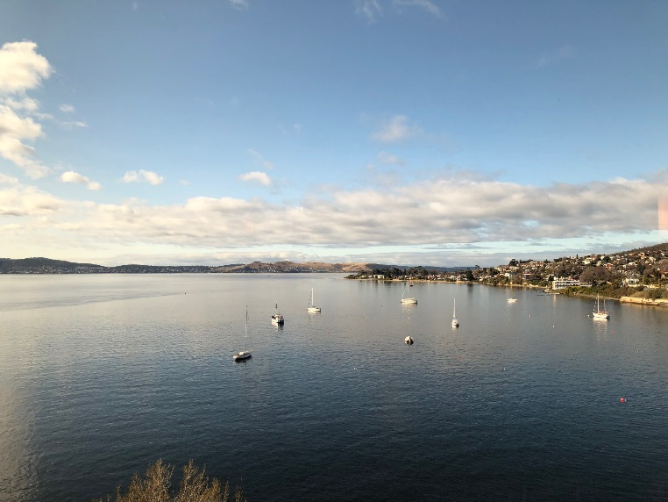
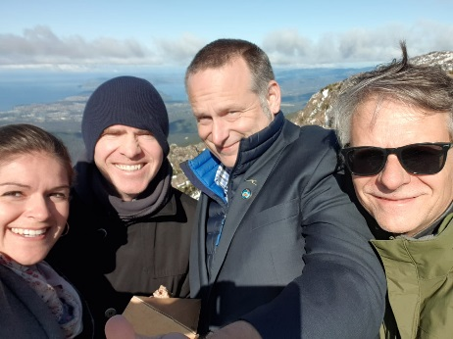
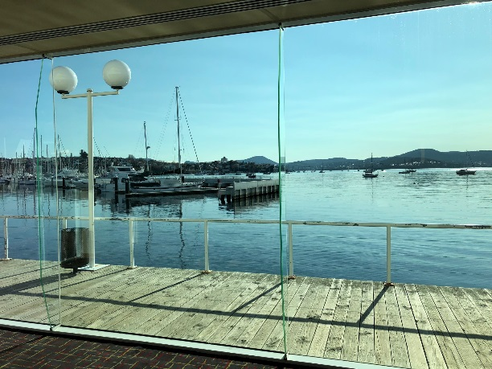
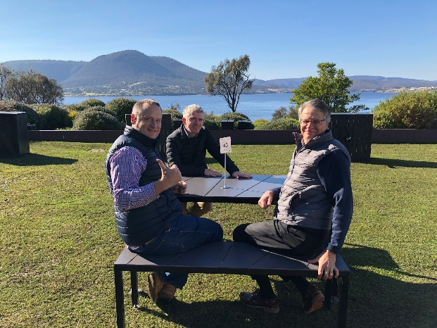
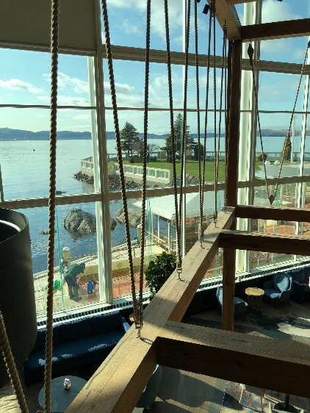
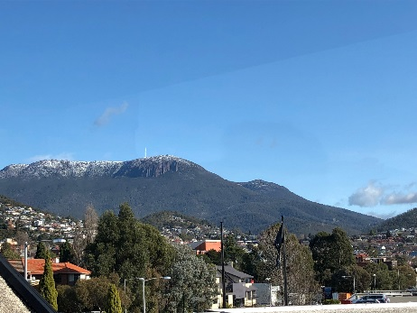
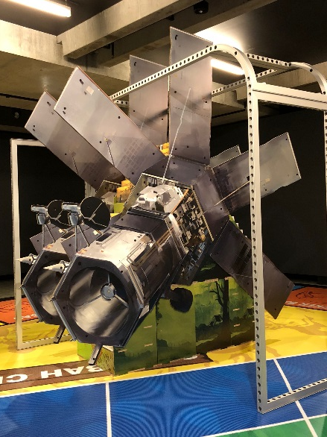
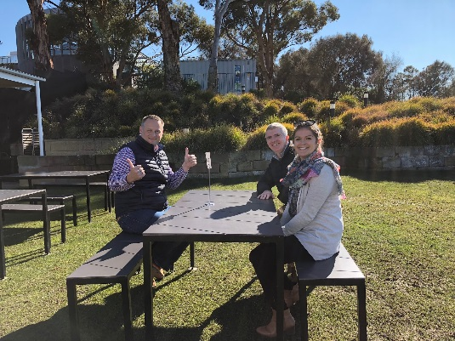

Slide 14
Feedback
…. is most welcome.
We look forward to serving CEOS and advancing its important work.

