Slide 1
GFOI-SDCG
Osamu Ochiai & Stephen Ward: CEOS lead & alternate
CEOS 2019 SIT Technical Workshop
Session and Agenda Item 6.1
Fairbanks, Alaska, USA
11 – 12 September 2019

Slide 2
GFOI
The Global Forest Observations Initiative (GFOI) is an informal partnership to help coordinate international support to developing countries on forest monitoring and greenhouse gas (GHG) accounting for REDD+ and related activities.
One of GEO Flagships since 2011
Phase 2 has continued emphasis on Capacity Building aspects & country engagement to develop NFMS and MRV
GFOI-UNFCCC meeting in Bonn September 24-25 for discussing “Policy Mandate” associated with Paris Agreement (i.e. NDC, Global Stocktake)
GFOI Plenary will be at FAO in Rome, 9-13 March 2020, CEOS is one of Organizing members

Slide 3
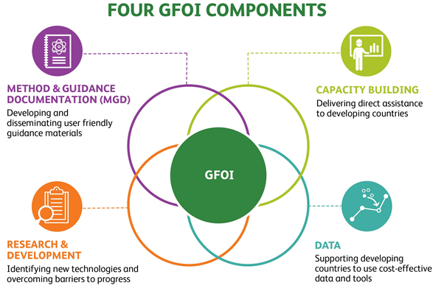
GFOI
GFOI Lead Team
  Australia, CEOS, ESA, FAO, Germany, Norway, UK, US and the World Bank
GFOI Office (FAO)
4 Components
  Capacity Building (FAO and SilvaCarbon)
  MGD (Australia)
  R&D (ESA)
  Data (CEOS, FAO and the World Bank)
SilvaCarbon/USGS/USAid volunteered new Data Component Manager(s)
  Chris Barber (space - USGS/EDC), Sara Geoking (insitu - USFS)

Slide 4
GFOI
Data Component – current activities
  Registry of Tools
    34 tools registered – CALM level 6 (INPE, EC/JRC and SEO (COVE, ODC))
    CEOS agencies and partners welcome to submit their preferred systems
  EO data acquisition and availability (SDCG)
    Baseline space data somewhat taken for granted but need to assure GFOI advocates for free and open & CEOS data
    SDCG still has plenty ideas of mutual benefit
  Ground data review
    To be Planned
  Action panel integration
    To be Planned

Slide 5
SDCG
Reduced agency attendance through personnel changes, budgets, natural evolution
Work Plan updated to reflect slimmer profile
Continued focus on the core business of assurance of data suitable for annual NFMS reporting
Healthy supply allows time to focus on additional value
  data access, formats, ARD
  support to LSI-VC on ARD pilots with thematic communities
  working with FAO to link their SEPAL with Open Data Cube (Digital Earth Africa)
  working through new USGS Co-chair (Chris Barber) to SilvaCarbon (eg ARD feedback)

Slide 6
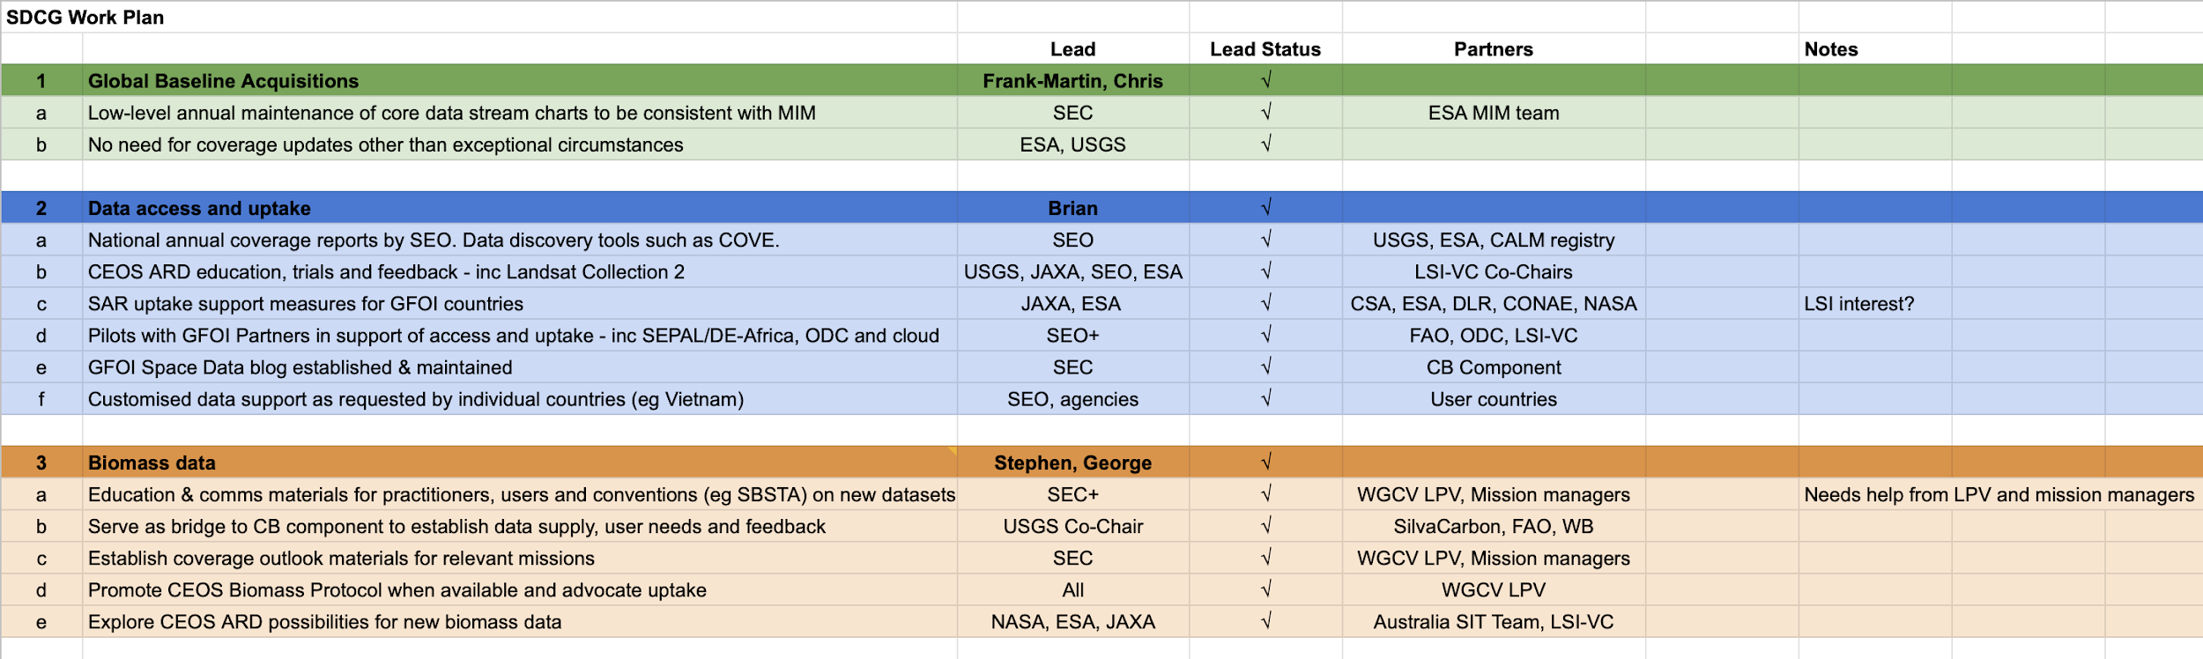
SDCG WP

Slide 7
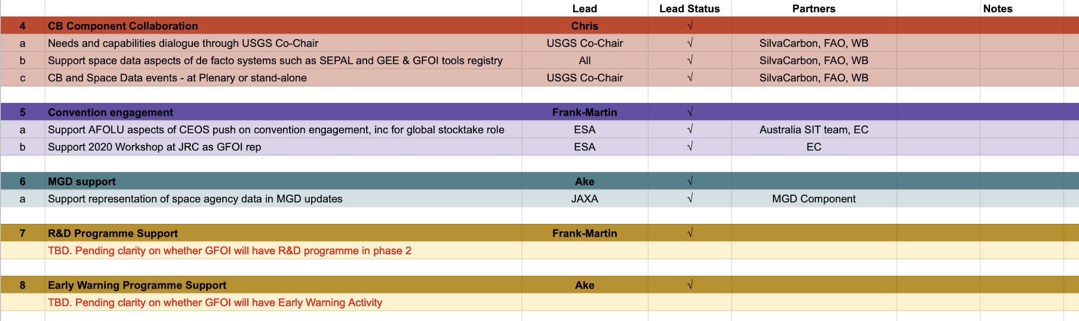
SDCG WP

Slide 8
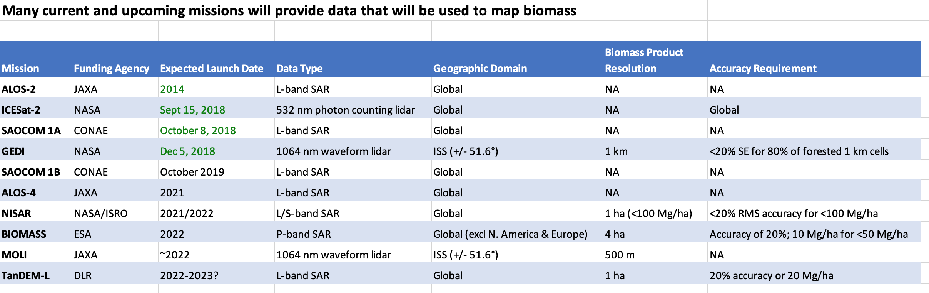
Biomass data

Slide 9
IPCC GPG (AFOLU)
Chapter 2, Volume 4 (AFOLU), Page 2.20
BOX 2.0D (NEW) REMOTE SENSING TECHNOLOGIES
Optical, Synthetic Aperture Radar (SAR) and Light Detection and Ranging (Lidar) sensors are available currently as remote sensing data sources for producing biomass density maps. Data from optical satellite sensors are classified into three types on the basis of their spatial resolution; coarse resolution data with a pixel size greater than about 250 m (e.g., MODIS), medium resolution data with a pixel size of 10-80 m (e.g., Landsat and Sentinel 1 and 2), and fine resolution data with a pixel size smaller than 10 m (e.g., Rapideye or SPOT and ALOS 2). SAR and LiDAR are active sensors available as air borne and space borne instruments whose derived metrics are used to predict height, volume or biomass of woody plants and trees. SAR emits microwave pulses obliquely and measures attributes of the pulses that are reflected back from the Earth’s surface towards the sensor. In forest land, emitted pulses reflect from the ground, or canopy or trunk of woody plants and trees. Using the strength of the signal of the reflected pulses, volume or biomass of woody plants and trees can be predicted as demonstrated for satellite data from ALOS-PALSAR and Sentinel 1 (Santoro and Cartus, 2018). LiDAR emits laser pulses and measures the traveling time from the sensor to the target which can be converted to distance. When the LiDAR emitter is aimed at woody plants and trees, these laser pulses can be reflected by the woody components, the leaves within the canopy, or the ground surface. Using the difference of a laser pulse reflected from canopy and ground surface, the height, volume or biomass of woody plants and trees can be predicted (Næsset 1997a,b, Lim et al 2003). Starting in 2019, a series of targeted space-based missions will improve the capabilities for forest biomass predictions from LiDAR (e.g. GEDI, ICESAT-2) and SAR (e.g. BIOMASS, NISAR), that might be found useful for national purposes (Herold et al. 2019).

Slide 10
Discussions in CEOS
Anchorage meeting revisited and reaffirmed conclusions of 2018 joint LSI/SDCG/GEOGLAM meeting in Ispra – SDCG AHT proposes to become thematic subgroup within LSI-VC
Biomass, will potentially become an increasingly important topic for CEOS to address from multiple points-of-view in the forthcoming years.
  No formal home in CEOS structure. Within WGCV/LPV there is a CEOS Biomass Protocol team. There is an informal multi-mission group on Biomass mission validation (mainly NASA & ESA).
  Worth discussing whether those agencies see value in more formal CEOS engagement. Biomass links to GHG Roadmap and Global Stocktakes a high-level and worthy goal.
  Encourage CEOS agencies to consider how to form the best and comprehensive structure in CEOS and send specialists.
  Meanwhile, seeking action for NASA and ESA to nominate a working contact to engage with forthcoming SIT Chair team (and SDCG) on their proposed Carbon and Biomass Thread
  To be continue to discuss at Plenary and also Biomass validation workshop –likely 4-5 March 2020, Brisbane

Slide 11


Questions?

