Slide 1

CEOS
Work Planning
Steven Hosford, ESA/CNES, CEOS Executive Officer
CEOS 2019 SIT Technical Workshop
Agenda Item # 1.7
Fairbanks, Alaska, USA
11 – 12 September 2019

Slide 2
Summary
Work Plan reporting – getting ready for Plenary
CEOS-GEO WP cross-analysis

Slide 3
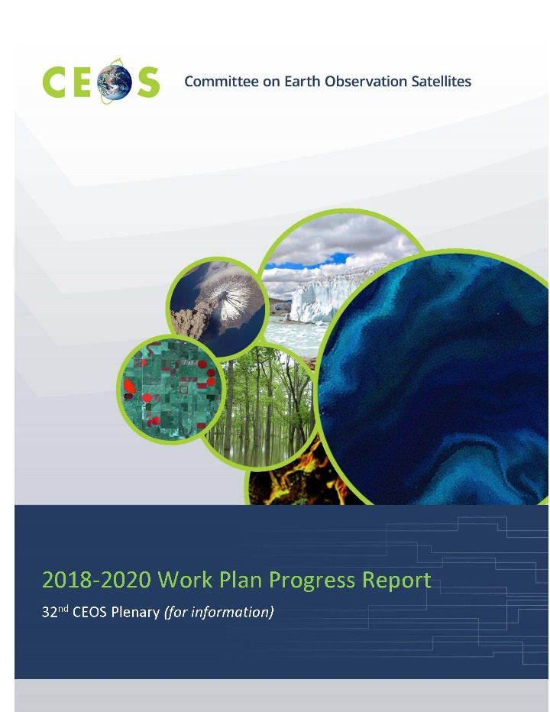
CEOS 2019-2021 Work Plan Status
No exhaustive WP report at this meeting
To enable Plenary reporting, CEOS 2019-2021 Work Plan updates should be provided by all CEOS entities by 30th Sept to
  deliverables.ceos.org
CEOS 2019-2021 WP reporting at 33rd Plenary:
  Written “2019-2021 Work Plan Progress Report”
  & Oral summary report focusing on
    WP overview and statistics
    WP deliverables
      For which no update has been provided by 30th
      Contain significant modifications in contents/scheduling

Slide 4
CEOS WP Annual Cycle
July
June
August
May
SIT TW
April
Deliverable
Updates
September
SIT
WP Progress
Report (CEO)
March
2019-2021
CEOS Work Plan
ENDORSED 22nd
March
October
CEOS
Plenary
November
February
December
January
Work Plan development

Slide 5
CEOS 2020-2022 Work Plan
CEO emails CEOS entities requesting updates
?^{th} November
Deadline for updates
?^{th} November + 10 days
Work Plan V0 released
?^{th} January
Work Plan V0 comments by
?^{th} January + 14 days
Work Plan V1 released
?^{nd} February
10 days for
CEOS Entity inputs
2 weeks for
CEOS Entity feedback

Slide 6


CEOS (still) needs you!
July
June
August
May
April
September
SIT-34, TBD, USA,
1st-5th Oct
March
CEOS 32nd Plenary, Brussels, 16th-18th Oct
October
November
February
GEO-XV Plenary, Kyoto, 31st-1st Nov
CEOS needs you!
December
January
CEOS Work Plan
inputs from CEOS entity leads

Slide 7
Summary
Work Plan reporting – getting ready for Plenary
CEOS-GEO WP cross-analysis

Slide 8
GEO – CEOS cross-analysis - method
Analysis of GEO Work Programme (v2.2) and CEOS Work plan for:
GEO work programme elements that cite CEOS (not individual space agencies or « satellite data »)
CEOS Work plan deliverables that cite GEO work programme elements
Characterisation of the “level” of links and the “likely clarity of requirements”
GEO work programme links to CEOS
CEOS links to GEO work programme elements
Estimation of “likely clarity of requirements” from GEO work programme elements to CEOS

Slide 9
GEO – CEOS cross-analysis summary
16 GEO Work programme elements identified
11 GEO Work Programme elements have explicit links to CEOS
  These links are reciprocated in 8 CEOS WP deliverable
  3 GEO Work Programme Elements have no explicit CEOS WP deliverable: SCO – too recent?; GEO LDN – too recent?; EO4DRM – not explicitly mentioned in CEOS WP but closely tied to DRM pilots
5 additional domains where CEOS contributions to GEO are identified in the CEOS 2019-2021 Work plan
  GEO-Carbon. Referenced in section header, but no specific deliverables
  Water. GEO referenced in WAT-4
  Regional GEOs (AFRIGEO, AMERIGEO, AOGEO). Training contributions through CB-35 and CB-36
  Coverage initiative. References GEO marine applications such as Blue Planet and MBON
  GEO BON. Cited in deliverables BON-6 and BON-7.
The GEO activities cited above do not explicitly reference CEOS for inputs in the GEO Work Programme.

Slide 10
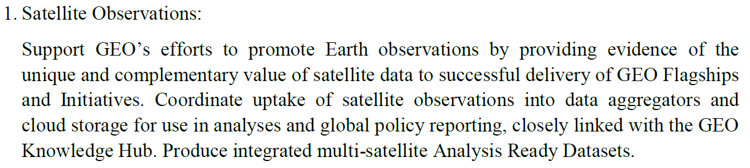
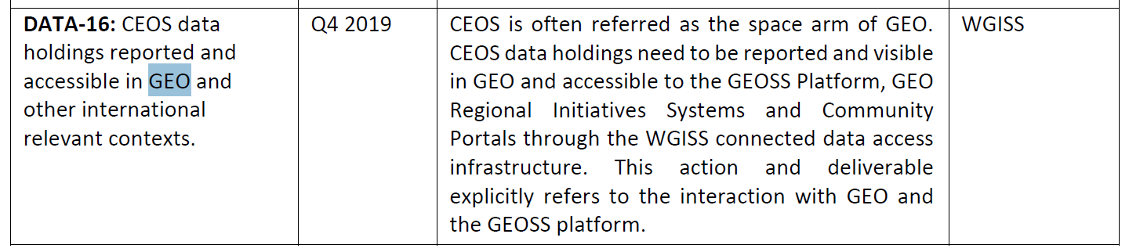
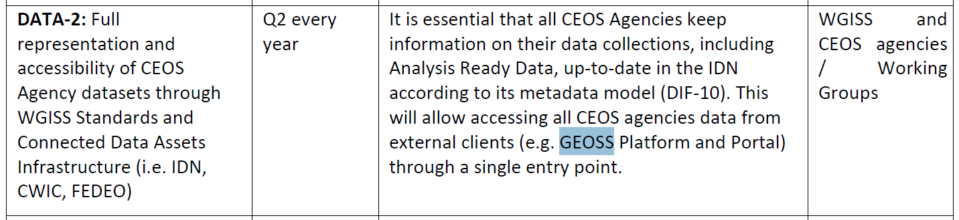
Analysis of GEO Work Programme
Flagships and initiatives
GEOSS Data, Information and Knowledge Resources
  Specific component on “Satellite Observations” and CEOS is cited as an “Implementing Body”
  CEOS Work plan deliverables:

Slide 11







GEO – CEOS cross-analysis
The 16 Flagships/Initiatives/subjects/domains identified
GEO Land Degradation Neurality – GEO LDN
Earth Observations for Disaster Risk Management – EO4DRM
GEOSS Data, Information and Knowledge Resources
Data Access for Risk Management – GEO-DARMA
GEO Carbon and Greenhouse Gas Initiative
“GEO-identified water observation requirements”
Regional GEOs (AFRIGEO, AMERIGEO, AOGEO)
GEO BON
CEOS Ocean Variables Enabling Research and Applications for GEO - COVERAGE

Slide 12
CEOS needs expressed by GEO
  4. CEOS is listed as the “implementing body”
  3. CEOS is cited in the description of the activity
  2. CEOS is listed as a “contributor”
  1. CEOS is not cited

Slide 13
GEO contributions expressed by CEOS
  1. GEOxxx is cited in CEOS WP
  0. GEOxxx is not cited

Slide 14
Likely clarity of requirements to CEOS
Ability for GEO initiatives to express their
requirements (CEO guess)
  3. Expert
  2. Some knowledge
  1. Little knowledge

Slide 15

Questions?

Slide 16
BACK-UP

Slide 17
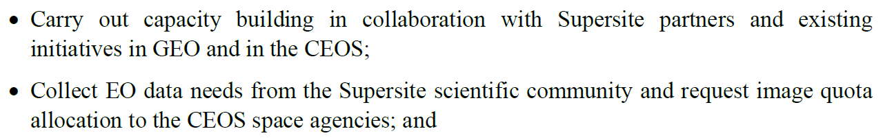
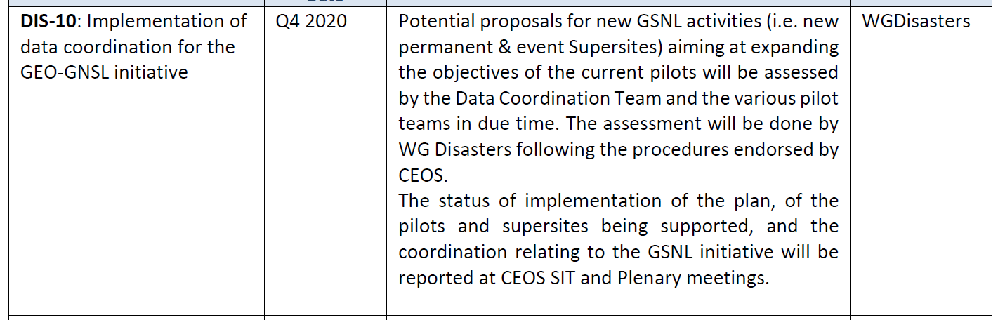
GEOHAZARD Supersites and Natural Laboratories
  CEOS is cited in the description of the activity
  CEOS Work plan deliverable:

Slide 18
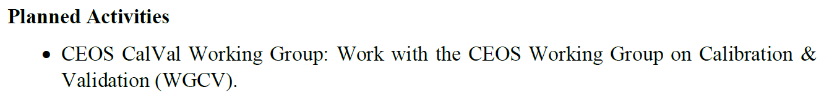
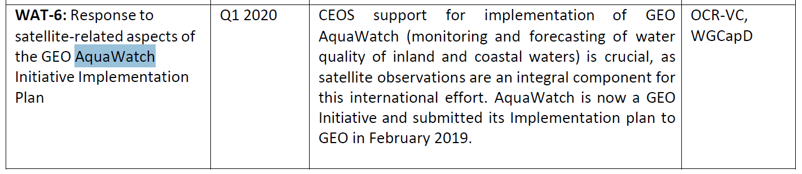
  CEOS is cited in the description of the activity
  CEOS Work plan deliverable (not CalVal)

Slide 19
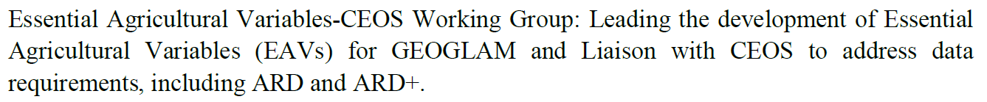
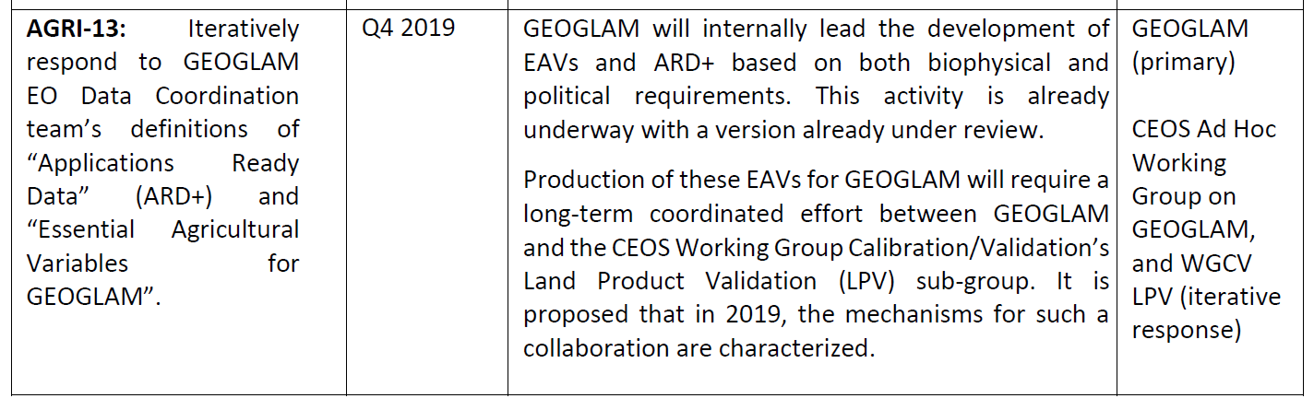
  CEOS is cited in the description of the activity
  CEOS Work plan deliverable:

Slide 20
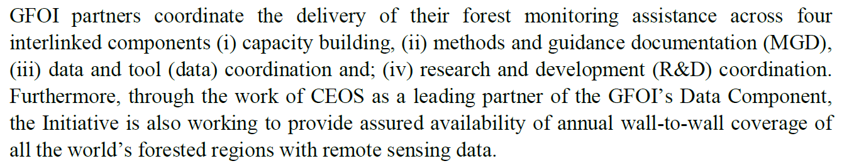
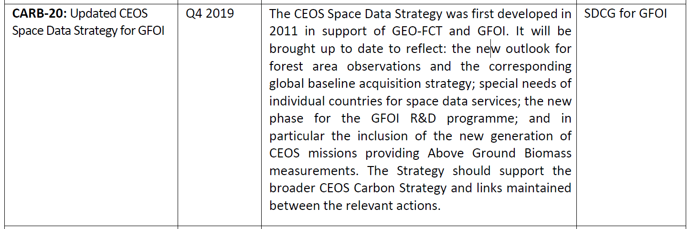
Global Forest Observing Initiative - GFOI
  CEOS is cited in the description of the activity
  CEOS Work plan deliverable:

Slide 21
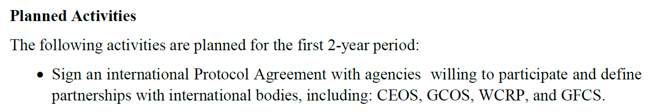
Space Climate Observatory - SCO
  CEOS is cited in the description of the activity
  No CEOS deliverables on SCO in 2019-2021 Work Plan

Slide 22
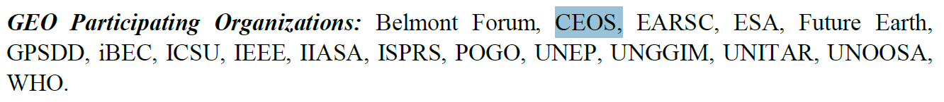
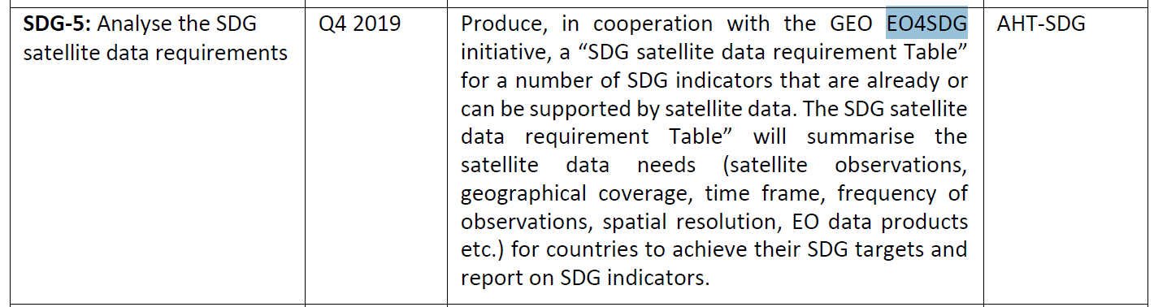
Earth Observations for the Sustainable Development Goals - EO4SDG
  No specific reference in the description of the activity, but CEOS is cited as a Contributor
  CEOS Work plan deliverable:

Slide 23
Analysis of GEO Work Programme
Flagships and initiatives
GEO Land Degradation Neurality – GEO LDN
  No specific reference in the description of the activity, but CEOS is cited as a Contributor
  No CEOS deliverables on GEO LDN in 2019-2021 Work Plan

Slide 24
Analysis of GEO Work Programme
Flagships and initiatives
Earth Observations for Disaster Risk Management – EO4DRM
  No specific reference in the description of the activity, but CEOS is cited as a Contributor
  No explicit mention of EO4DRM in the CEOS 2019-2021 Work Plan (but many deliverables on the DRM pilots etc.)

Slide 25
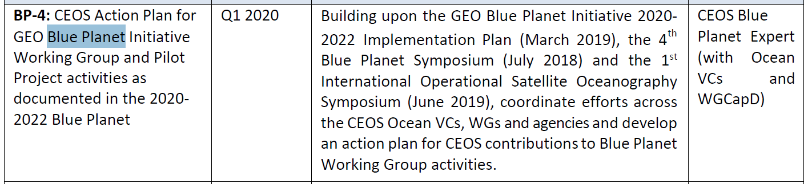
Oceans and Society: Blue Planet – GEO Blue Planet
  No specific reference to CEOS in the description of the activity, but CEOS is cited as a Contributor
  CEOS Work plan deliverable:

Slide 26
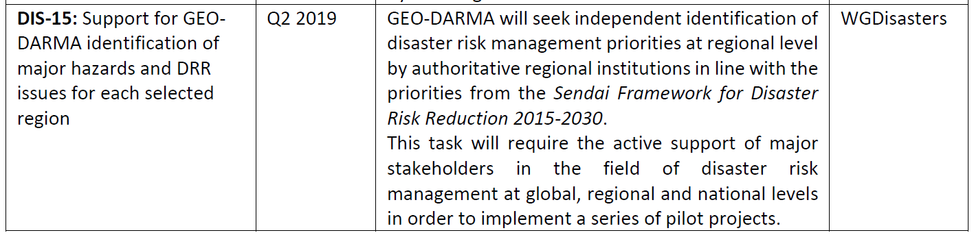
Analysis of GEO Work Programme
Flagships and initiatives
Data Access for Risk Management – GEO-DARMA
  No specific reference to CEOS in the description of the activity or contributors
  CEOS Work plan deliverable:

Slide 27
Summary of GEO to CEOS links
CEOS is cited in the description
CEOS is cited as an « implementing body »
CEOS is cited as a contributor
CEOS is not cited
GEO
11 GEO Flagships and initiatives have explicit links to CEOS
  Aquawatch, GEOGLAM, GSNL, GFOI, SCO, EO4SDG, GEO LDN, EO4DRM, GEO-DARMA, GEO Blue Planet, GEOSS Data, Information and Knowledge Resources
These links are reciprocated in 8 CEOS WP deliverable
3 GEO FI’s have no explicit CEOS WP deliverable
  SCO – too recent?
  GEO LDN – too recent?
  EO4DRM – not explicitly mentioned in CEOS WP but closely tied to DRM pilots

Slide 28
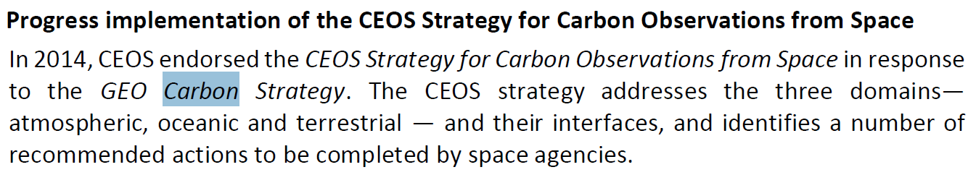
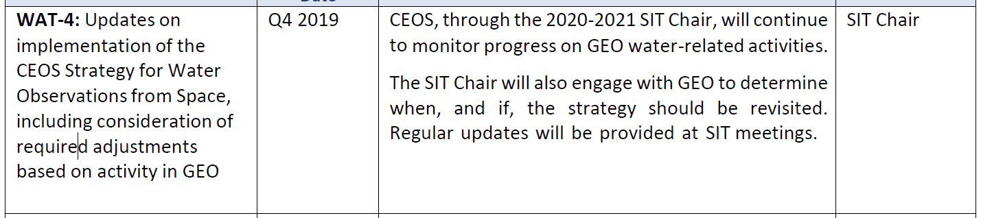
CEOS links to GEO
Only listed here are those that are not discussed previously
GEO Carbon strategy and GEO Carbon and Greenhouse Gas Initiative « GEO-C»
« GEO-identified water observation requirements »

Slide 29
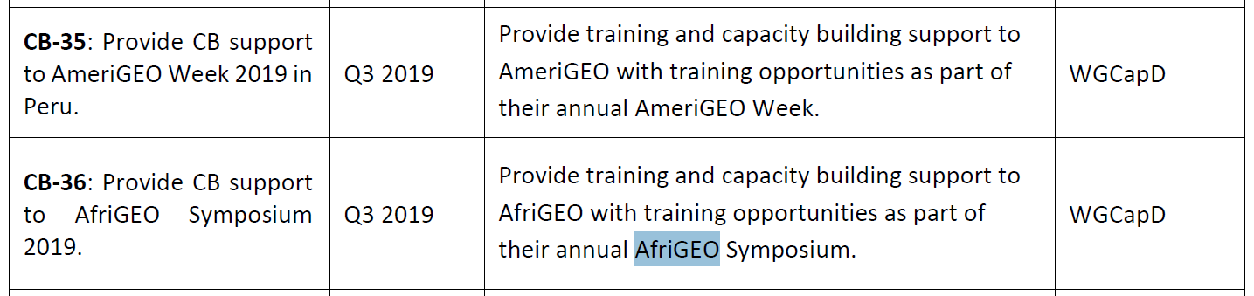
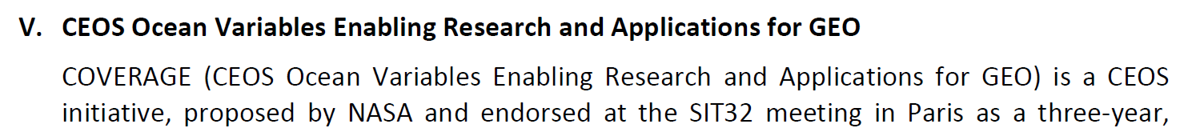
CEOS links to GEO
WGCapD links with AfriGEO, AMERIGEO, AOGEO
CEOS Ocean Variables Enabling Research and Applications for GEO - COVERAGE

Slide 30
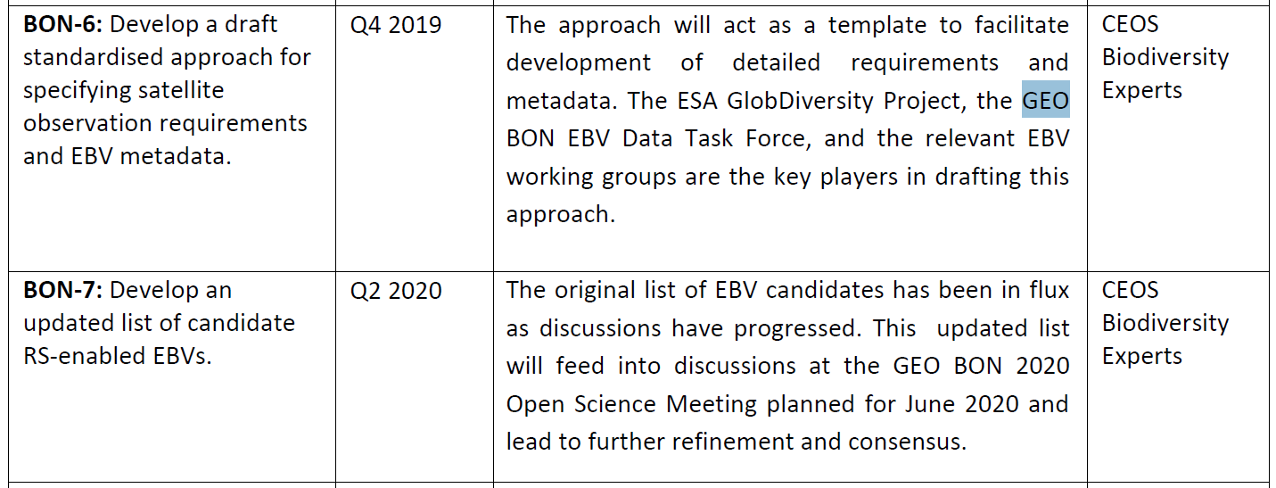
CEOS links to GEO
GEO BON

