Slide 1
Recent activities of the OSVW-VC
Committee on Earth Observation Satellites
Paul Chang (NOAA), Rashmi Sharma (ISRO), and Stefanie Linow (EUMETSAT)
CEOS 2018 SIT Technical Workshop
Session: Oceans and Water Cycle, Agenda item: 5.5
EUMETSAT, Darmstadt, Germany
13 – 14 September 2018

Slide 2
Introduction
The Ocean Surface Vector Wind Virtual Constellation (OSVW-VC) fosters the availability of best quality ocean surface vector wind data for applications in short, medium, and decadal time scales in the most efficient manner through international collaboration, scientific innovation, and rigor.
[OSVW-VC Terms of Reference]

Slide 3
OSVW-VC Strategic Objectives
Improve coordination, consolidation, and development of the collective OSVW capability
Achieve a more active engagement by nations operating or preparing satellite ocean surface vector winds sensors with the international wind vector community
Maintain a strong and mutually supportive relationship with the International Ocean Vector Winds Science Team (IOVWST)
Provide an interface to CEOS for the IOVWST
Develop recommendations on the driving requirements to create, validate, and sustain the development of an international ensemble of Essential Climate Variable (ECV) measurements
Provide advice on and advocate to the international community for the importance of OSVW measurements
Develop and consolidate training on the use of scatterometer winds for different applications, as well as outreach to the general public to demonstrate the societal benefit of these data

Slide 4
OSVW-VC Summary
Currently, the OSVW Constellation is mainly anchored by the scatterometer missions of EUMETSAT and ISRO, with a large number of upcoming Chinese scatterometer missions.
The CEOS OSVW-VC advocates:
Open and near real-time data access
Coordination of orbits to optimize temporal sampling
Cross calibration of missions
Cal/Val and data product standards
Outreach and education
Additional information including Terms of Reference can be found at http://ceos.org/ourwork/virtual-constellations/osvw/

Slide 5
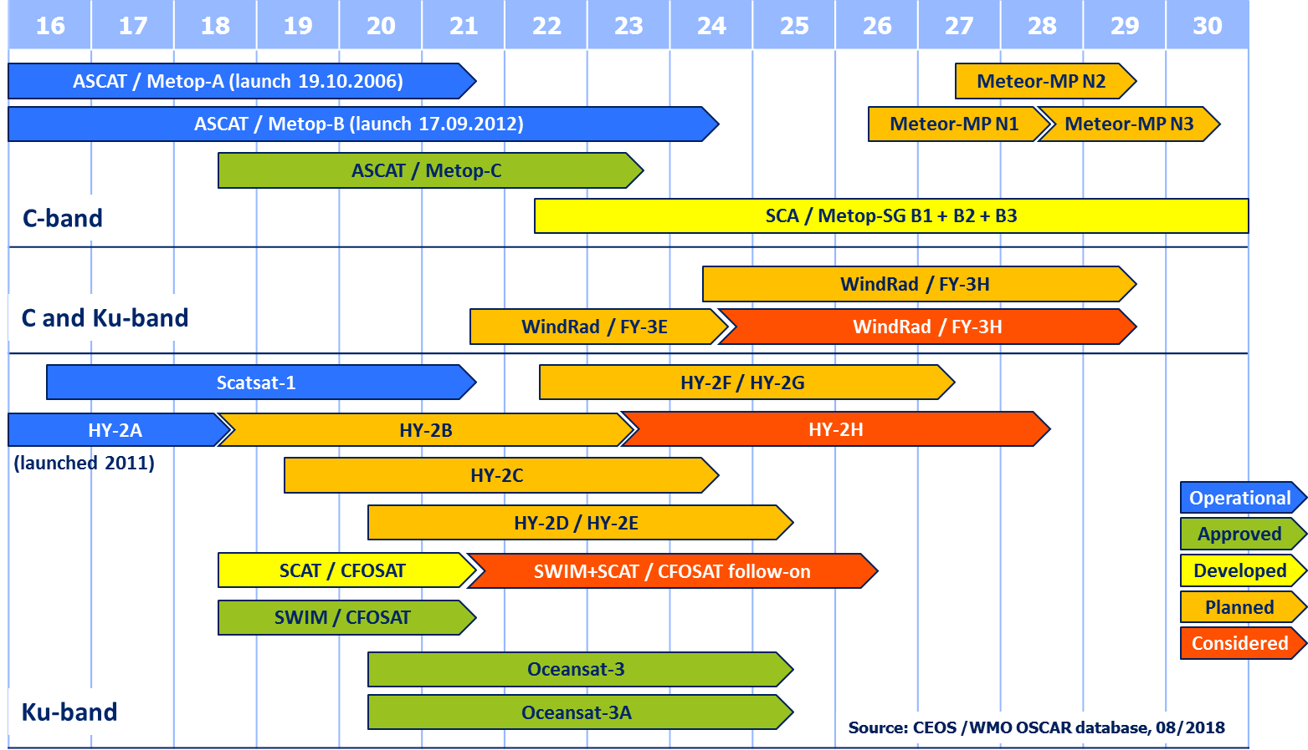
CEOS OSVW-VC current status and outlook
Note: Near real-time and open data access not assured for all missions listed

Slide 6
OSVW Constellation Status
ASCAT (METOP-A&B)
Open and near real-time data access
METOP-C scheduled for a November 2018 launch
SCA (ASCAT Follow-On, EPS-SG, from ~2022 / 23)
ASCAT available through the EPS-SG/SCA launch
SCATSAT September 2017 (injected into ~9:45 am local crossing time and drifting to ~8:45 am)
Open and near real-time data access (since April 24, 2017)
OSCAT follow-on (OceanSat-3&3A) ~2018/2019
CMA will be providing OSVW measurements starting with their FY-3E launch (late 2018)
NSOAS HY2 series: first tests to provide NRT data via EUMETCast, HY2B planned for launch in Oct 2018
CFOSAT (launch planned for Nov 2018), data distribution pending agreements

Slide 7
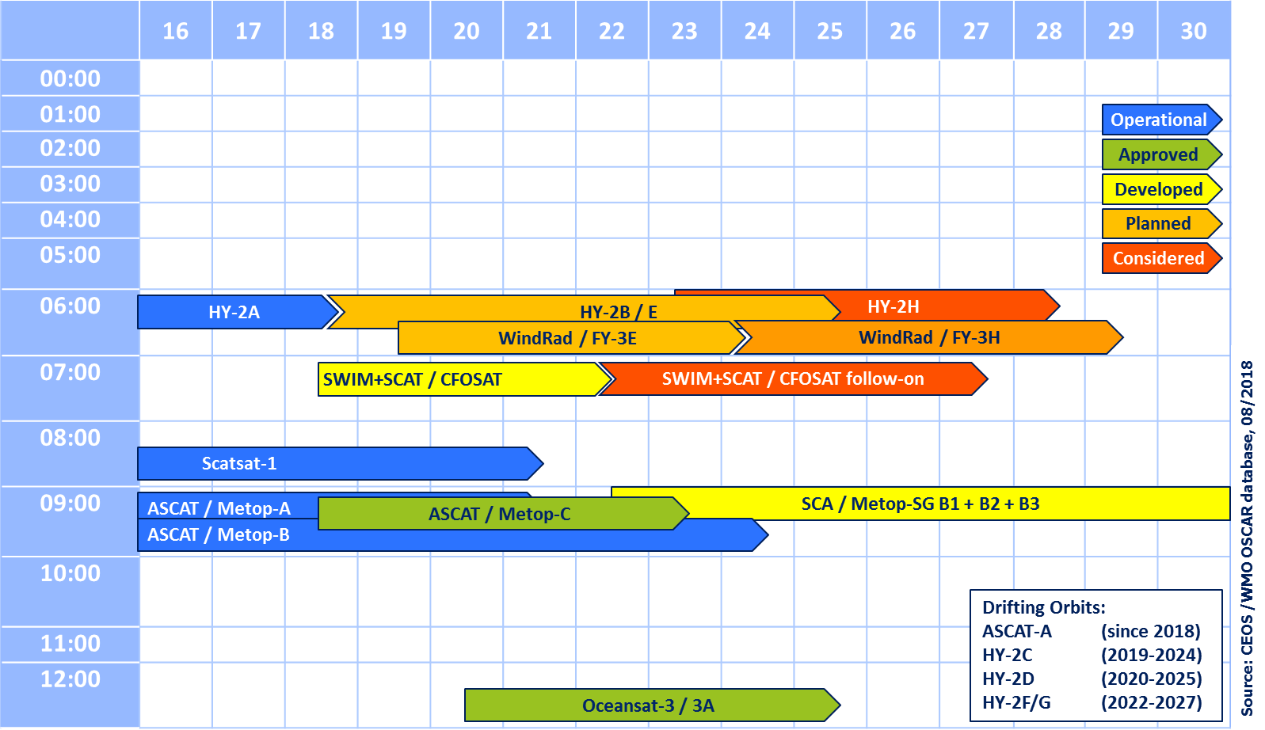
Local time coverage assessment (ground track)
descending node crossing time
WMO observation cycle requirement: 6 h

Slide 8
Optimum (minimum) OSVW constellation
2015 IOVWST meeting recommendation
At least 3 scatterometers in orbits designed to roughly meet WMO requirements (observations every 6 hours)
One instrument in a non-sun-synchronous orbit for sampling the diurnal cycle, better mid-lattitude sampling and provide inter-calibration

Slide 9
Cross-calibration of missions,
Cal/Val and data product standards
There are ongoing discussions on the quality assessment of data products and wind retrievals within the context of IOVWST. To name just a few:
GMF* development and validation
Comparison of wind retrieval algorithms
Assessment of rain effects in the tropics (particularly relevant for Ku-band instruments / radiometers)
Spatial scaling effects
Generation of a quality-controlled wind reference dataset linking dropsondes / buoys / SFMR (plane-based measurements) / SAR data
* Geophysical Model Function; relates scatterometer measurements to wind

Slide 10
Interactions: Microwave Sensors Subgroup (MSSG) @ WGCV
Focus group meeting on calibration/cross-calibration of radar scatterometers for ocean surface wind vectors
Date: August 27 1:00-5:30pm
Presenting Organizations: EUMETSAT, KNMI, ICM-CSIC, ISRO, NMSC/CMA, NSOAS, NOAA/NESDIS & CEOS OSVW VC
Missions related: METOP, SCATSAT, HY-2, CFOSAT, FY-3 (all current and future scatterometer missions)

Slide 11
Interactions: Microwave Sensors Subgroup (MSSG) @ WGCV
Meeting objective:
Identify requirements for calibration/cross-calibration of scatterometers for OSVW
Identify priorities for future work, organize the focus group, workplan for future
Outcomes:
Status of scatterometers for OSVW
Summary of current practices and recommendations
Requirements for guidelines for Calibration/Cross-calibration

