Slide 1

The CEOS Ocean Variables Enabling Research and Applications for GEO (COVERAGE) Initiative:
Committee on Earth Observation Satellites
Status Update
Drs. Eric Lindstrom, Vardis Tsontos & Jorge Vazquez
NASA
CEOS SIT 2018 Technical Workshop
Agenda Item #5.2
EUMETSAT, Darmstadt, Germany
13 – 14 September 2018

Slide 2
The CEOS COVERAGE Initiative
CEOS endorsed COVERAGE initiative at SIT-32 (April 2017, Paris) as a 3 year pilot project
Cross-cutting, collaborative effort within CEOS relevant to the 4 Ocean Virtual Constellations (SST, OST, OCR, OSVW) and GEO projects (MBON, Blue Planet) to enable more widespread use of ocean satellite data in support of applications
Response to known needs of the ocean community for improved, more integrated data access for societal benefit in support also of SDGs (14 in particular) relating to marine biodiversity & sustainable/ecosystem-based resource management
COVERAGE aims to develop a data rich Tech. platform for more seamless delivery of analysis ready ocean data to demonstrate the value added of multivariate ocean data integration in support of science, applications, and public engagement
- “Fusion environment” leveraging emerging cloud-based infrastructure & open source
- Curated aggregation of high quality, interagency multi-parameter observations
- Near real-time, collocated to a common grid, thematically organized
- Access via value-added data services (data discovery, visualization, subsetting, analytics)
- Illustrated in the context of demonstration applications
Stakeholder Beneficiaries:
Internal: Ocean VCs, WGISS External: GEO-Blue Planet, GEO-MBON, GOOS

Slide 3

COVERAGE Project Plan
COVERAGE has a 4-part development concept
  Reflected in COVERAGE inputs to CEOS 2017-2020 Work Plan
  Phases:
    Scoping (9 mo)
    Prototype Development/Evaluation (1yr)
    Full system development (1yr)
    Testing/Evaluation & transition to operations (6mo)
Project Initiation – November 2017
  COVERAGE Phase A project with NASA support
  Project core team @JPL assembled & Project infrastructure in place
Phase A work plan key elements (ongoing)
  Stakeholder engagement & collaborative efforts
  Identification of specific GEO-BP/MBON applications COVERAGE would support
  Inventory of target datasets, providers, interfaces
  Use case gathering & requirements
  COVERAGE system technical architecture, including CEOS and data provider interoperability considerations

Slide 4
COVERAGE Activities & Progress
Stakeholder Engagement
Advisory Board developed with cross-agency and stakeholder representation
  Participants include:
  NASA, NOAA, CNES, EUMETSAT, Copernicus-CMEMS, Australian Bureau Meteorology, Integrated Marine Ocean Observing System, Sargasso Sea Commission, CEOS Ocean VCs, & WGISS
  3 productive quarterly Board meetings were conducted (November, April, August) with excellent participation & discussion (https://drive.google.com/open?id=0B0PmOKvabo8lTUstdkp0OS12UVk)
Presentations & Outreach Efforts since SIT-32 (April 2017)
  Conference presentations:
  3rd & 4th BP symposium, Copernicus Marine Week-2017, GHRSSTXVII & XVIII,AGU & Ocean Sciences-2018
  Meetings/Teleconferences
  IMOS, CNES, NOAA-OceanWatch, IOOS, MBON, SSC, NASA/ESDIS, NASA/PODAAC, BP/UNDP-4M initiative
  SIT-TW
  COVERAGE Workshop Side-Meeting
  VC presentation

Slide 5
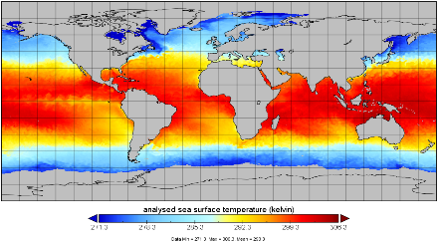
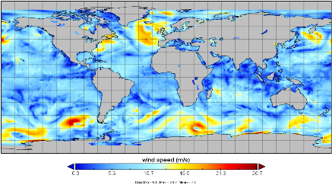
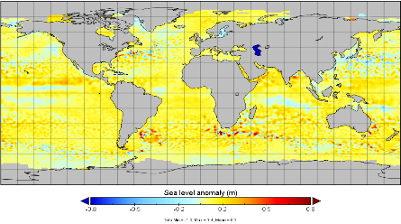
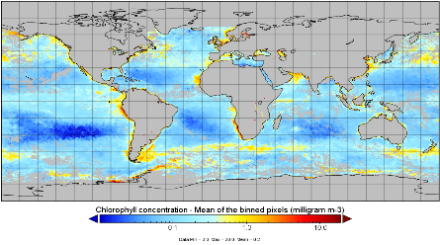
COVERAGE Activities & Progress
Data Inventory Work
Completed a review of candidate interagency satellite data products across the 4 ocean VC parameters (SST, Winds, SSH, Ocean Color) for inclusion as a coherent set of 0.25 degree, global baseline products for COVERAGE
Selection considerations: highly curated, highest quality, add-value to each other
COVERAGE satellite data profile: 0.25’, global, NRT, multi-year, gap free/L4, interoperable formats
Documentation of data search/access mechanisms, formats, volumes
Shared for comment with Board, VCs, agency experts
Conclusions
Manageable number of good options for all parameters
Ocean Color: apparent paucity of L4 gap-free products
Some heterogeneity in Data Search/Access mechanisms across agencies (NASA, Copernicus-CMEMS, NOAA)
Importance of consideration of higher resolution products as well where applicable
Examine added value of common gridding/interpolation methods to improve coherence in feature resolution
SST
Surface Winds
SLA
CHL-A
Product
temporal
coverage
comparisons

Slide 6
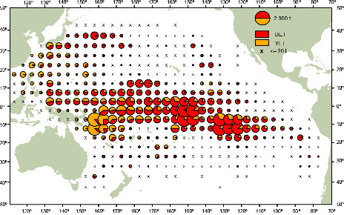
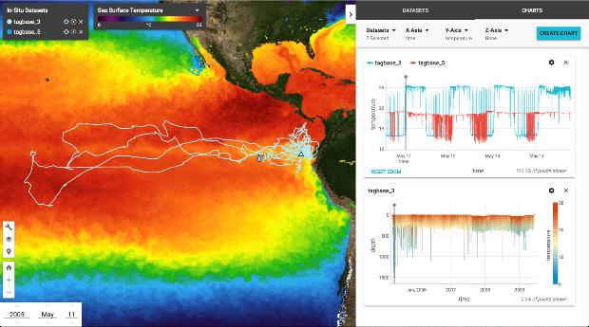
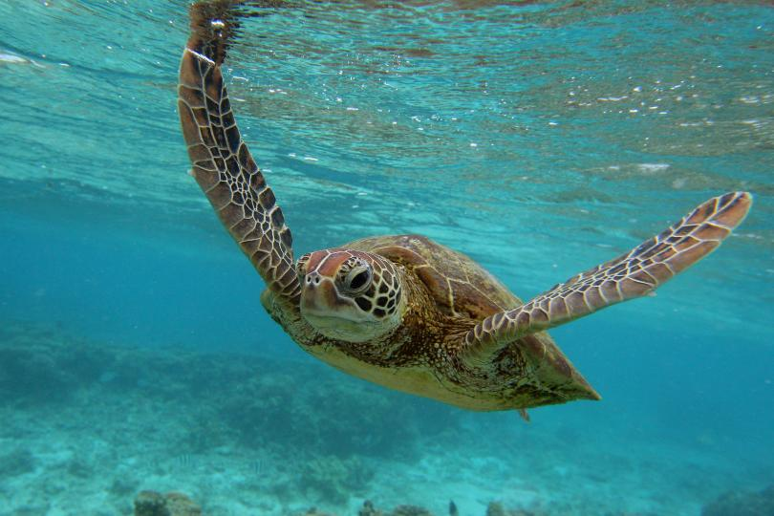

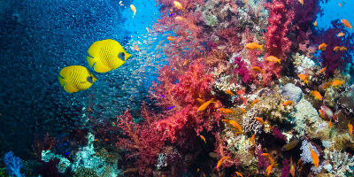
COVERAGE Pilot Applications in Support of GEO-MBON & Blue Planet
  Pilot application concepts developed, shared and associated supporting in-situ datasets identified
  Focus on Biological & Resource Management Communities – interest in application of EO data but limited expertise/capacity
  Support: UN-SDG 14 related to marine biodiversity, ecosystem based management & sustainable fisheries, UN marine biodiversity treaty under negotiation for areas beyond national jurisdiction (ABNJ)
High Seas & Regional Fisheries Applications involving integration of ocean remote sensing, physical model and in-situ datasets for operational decision support and research investigations (eg. spatial catch forecasting
Stakeholder agencies: RFMOs, National Fisheries Agencies
Supporting Data: spatial catch/effort series, AIS, electronic tagging
SEASCAPES
biodiversity mapping & habitat modelling in relation to environmental dynamics
Access to ocean remote sensing data (Sea level Anomaly, SST, Winds, and CHL-A and derived products) and services via COVERAGE
Connectivity to OBIS centralized repository of marine biogeographic data

Slide 7
Overall Status of COVERAGE CEOS Work-plan Items
Completed
COV-1: Collaborative framework for COVERAGE | Establish advisory board and collaborative framework describing how CEOS Agencies, CEOS Entities and stakeholder groups intend to (VCs, GEO-MBON, GEO-Blue Planet) participate in COVERAGE
COV-2: COVERAGE use cases & focal pilot application | Determine priority application for COVERAGE via stakeholders engagement and compile use cases/requirements
Ongoing COVERAGE Phase-A Work (COV-3)
Phase B-D project implementation planCOVERAGE system Requirements compilation
System design & architecture specification
Future Work:
COV-4 to 6 relate to Phase B – D (prototype & finalized COVERGE system, evaluation)

