Slide 1
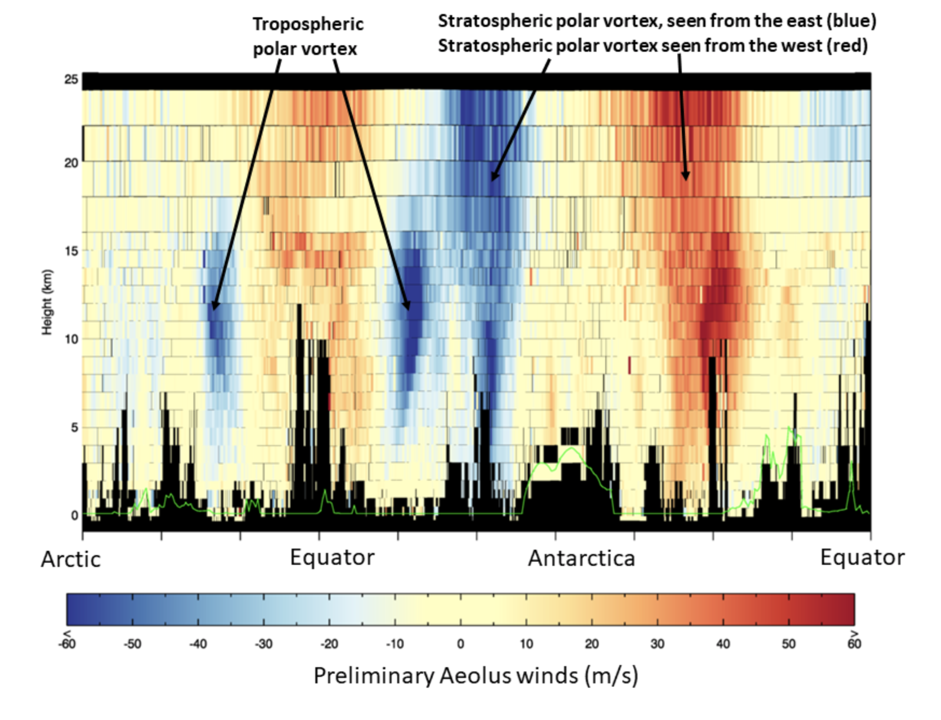
Aeolus
first data
release 12.9.2018

