Slide 1

Climate & Carbon Session – WG/VC day
Committee on Earth Observation Satellites
Pascal Lecomte
Joerg Schulz
Mark Dowell
Dave Crisp (remote)

Slide 2
Carbon and Climate Session
Items for discussions
WGClimate GCOS IP response
ECV Inventory and Gap Analsis
Space Agency Statement to SBSTA/COP-23
Carbon Strategy Implementation
AC-VC GHG Whitepaper/Report

Slide 3
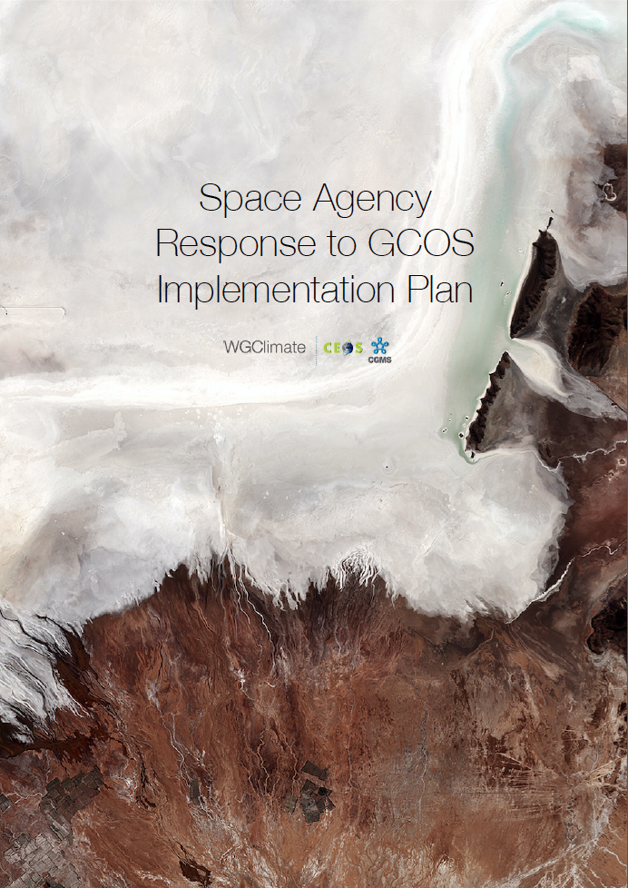
Space Agency Response Response to the GCOS IP
Introduction
What is expected by GCOS
Why is the response crucial to WGClimate
When should our response be ready
Where are we now
  Inputs received.
  Consolidated into SARGIP Version 0.111
  Some points to consolidate (in due course).

Slide 4
Introduction
(Writing Team – WGC#7)
Broad Context – Pascal Lecomte (ESA)
  ESA Pascal Lecomte
  EUMETSAT Jörg Schulz
  EUMETSAT Robert Husband
  EC Mark Dowell
  ESA Ed Pechorro
Atmospheric Chapter – Stephan Bojinski (WMO)
  CNES Carole Deniel
  NOAA Steven Goodman
  DLR Albrecht von Bargen
  INPE Daniel Vila
  Rainer Hollmann
  NOAA Jeff Privette
  EUMETSAT Kenneth Holmlund
  NOAA Mitch Goldberg
  METEO FRANCE Pierre Tabary
  NASA Wenying Su
  JAXA Misako Kachi
Oceanic Chapter – Chris Merchant (UKSA)
  ESA Craig Donlon
  EUMETSAT Hans Bonekamp
  JAXA Hiroshi Murakami
  NASA Paula Bontempi
  NOAA Paul DiGiacomo
  NOAA Eric Leuliette
  INPE Milton Kampel
Terrestrial Chapter – John Dwyer (USGS)
  ESA Simon Pinnock <simon.pinnock@esa.int>
  ESA Stephen Plummer <stephen.plummer@esa.int>

Slide 5
Schedule
• 07/02/2017 1st Face to Face meeting (São Jose dos Campos - Brazil)
• 01/03/2017 Verify feasibility of a high level report
• 22/03/2017 Report to WCRP Council (Frascati – Italy)
• 25/04/2017 CEOS SIT (Paris – France)
• 08/06/2017 SBSTA-46 – Status report (Bonn – Germany)
• 12/06/2017 CGMS plenary (Seoul – Korea)
• 01/08/2017 Gap Analysis report ready
• 11/09/2017 2nd Face to Face meeting (Frascati – Italy)
• 12/09/2017 WGClimate #8 (Frascati - Italy)
• 13/09/2017 CEOS SIT Workshop (Frascati – Italy)
• 01/10/2017 Coordinated Action Plan ready
• 06/10/2017 Draft response sent to SBSTA-47
• 18/10/2017 CEOS plenary (Rapid City – USA)
• 06/11/2017 SBSTA-47 and COP-23 (Bonn – Germany)

Slide 6
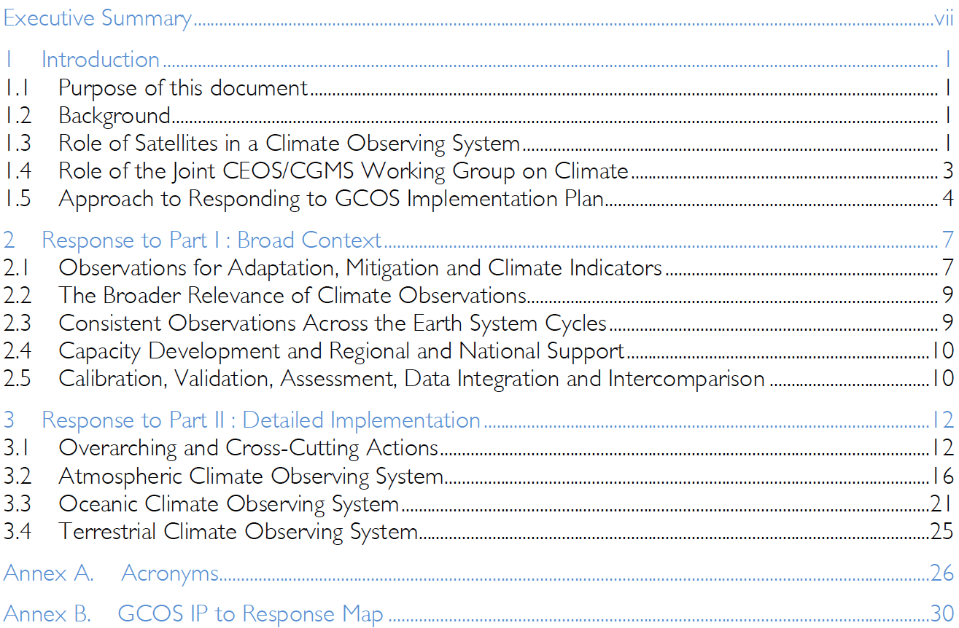
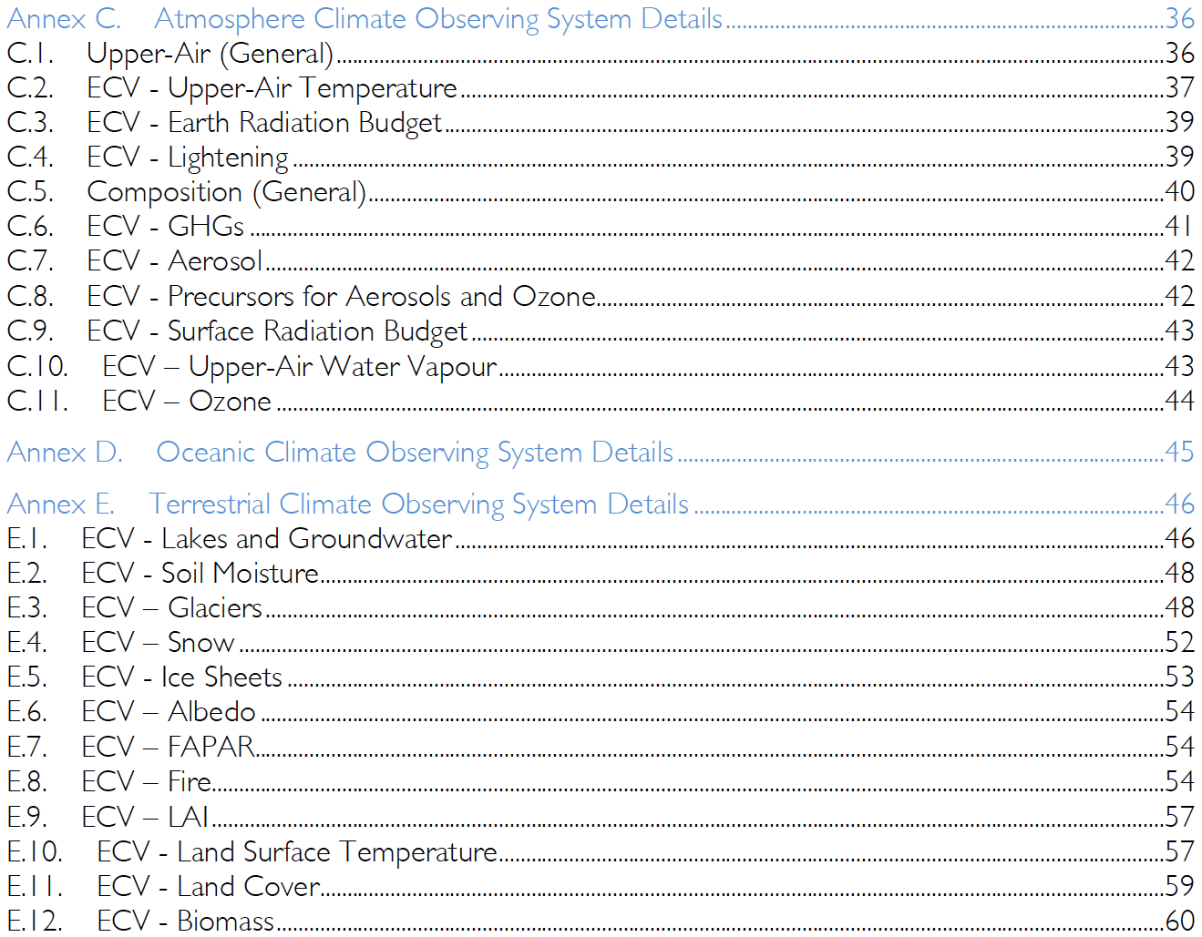
Final Review of Structure
(Table of Contents)
1. SARGIP -

Slide 7
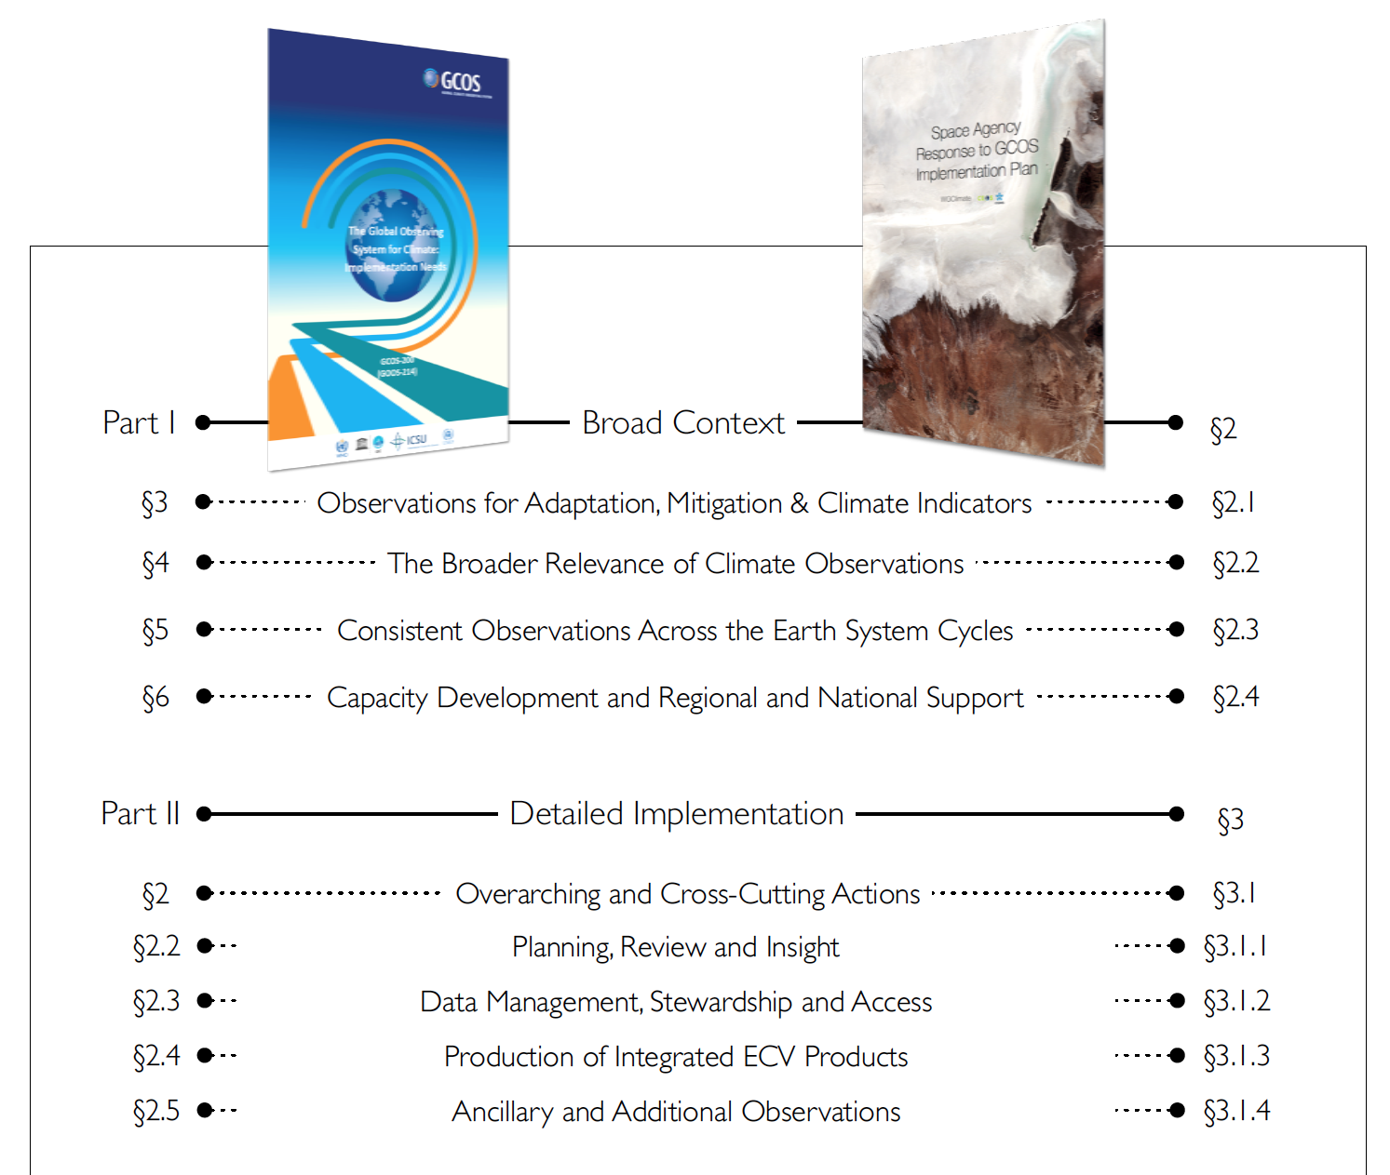
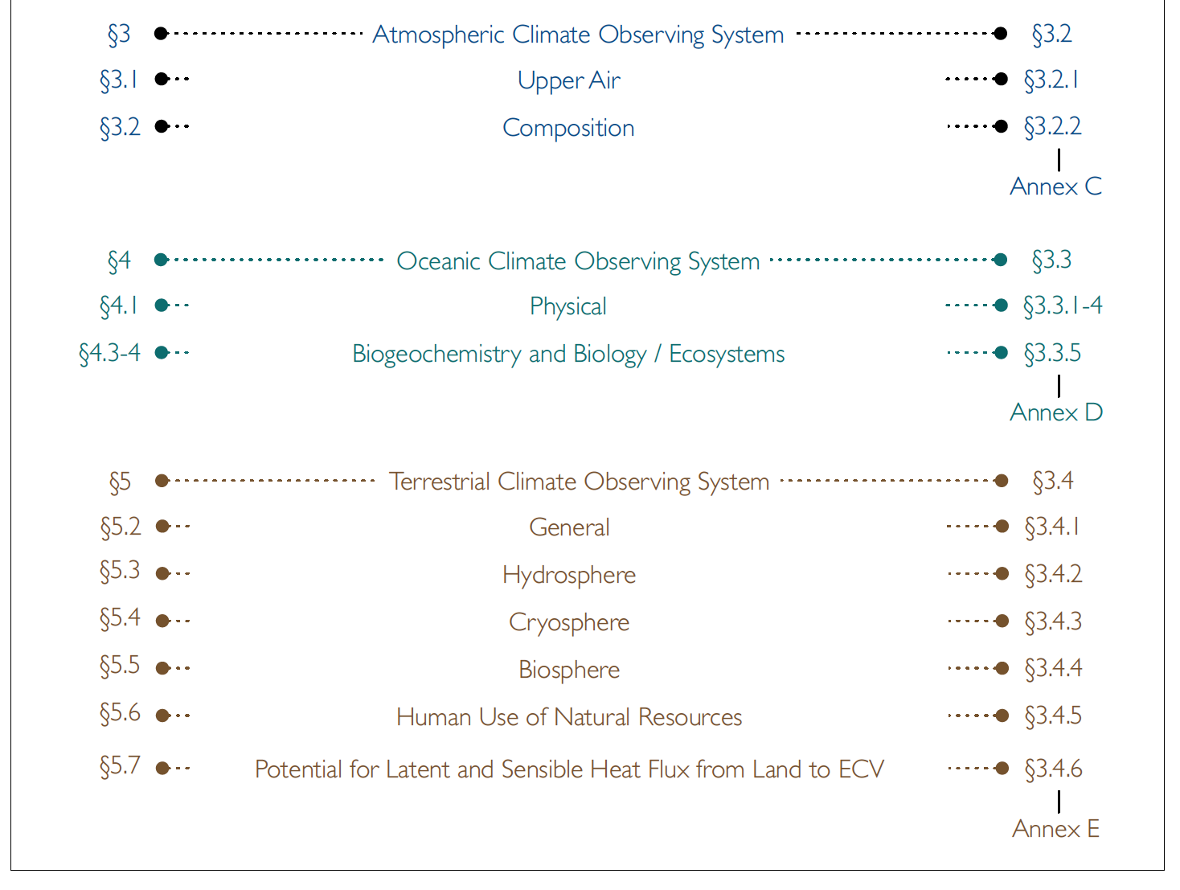
Final Review of Structure #1
(Mapping to GCOS IP)
1. SARGIP -

Slide 8
ECV Inventory Current Status
  Population and verification of web-based Inventory of Climate Data Records (CDRs) of ECVs observable from space completed. Note: Completed verification means > 95% “verified” for Gap Analysis Process [because of non responsiveness to the verification process the final count will never reach 100%).
  Entries from 10 CEOS/CGMS Agencies (100 experts involved as responders
  Number of entries higher than expected
    913 entries
    496 for existing CDRs, 417 for planned CDRs
  27/29 (GCOS-154, 2011) and 30/35 (GCOS-200, 2016) ECVs covered
  The ECV Inventory will be published in September 2017.

Slide 9
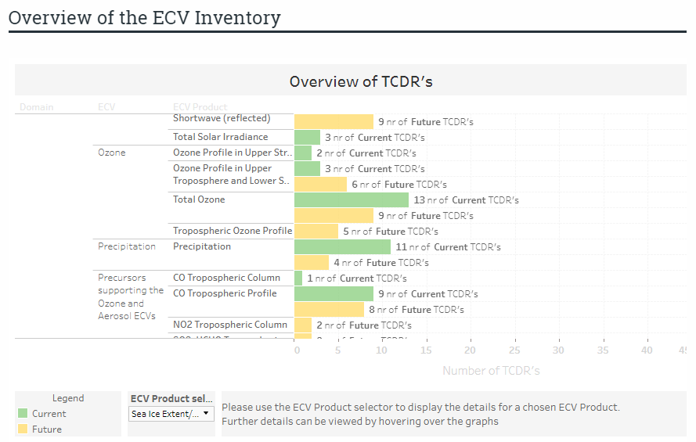
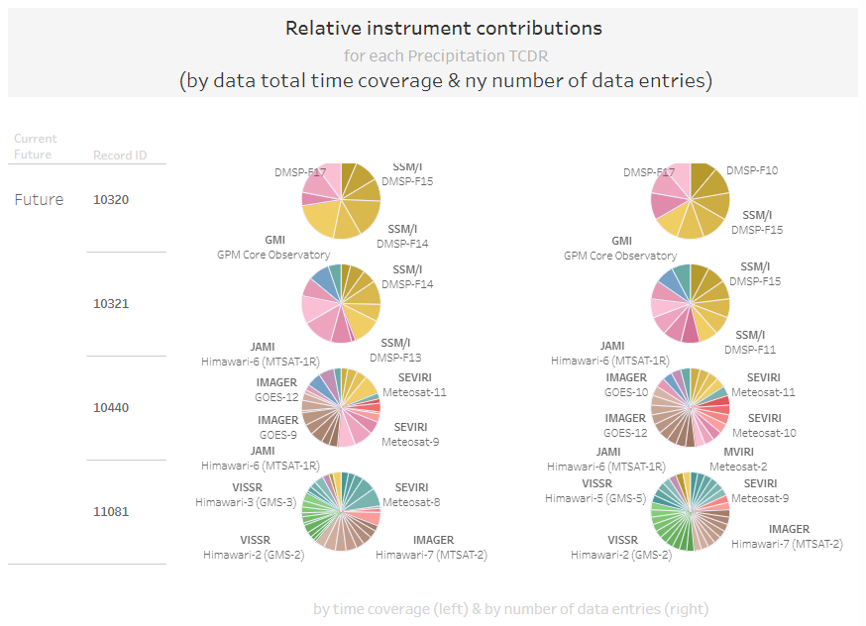
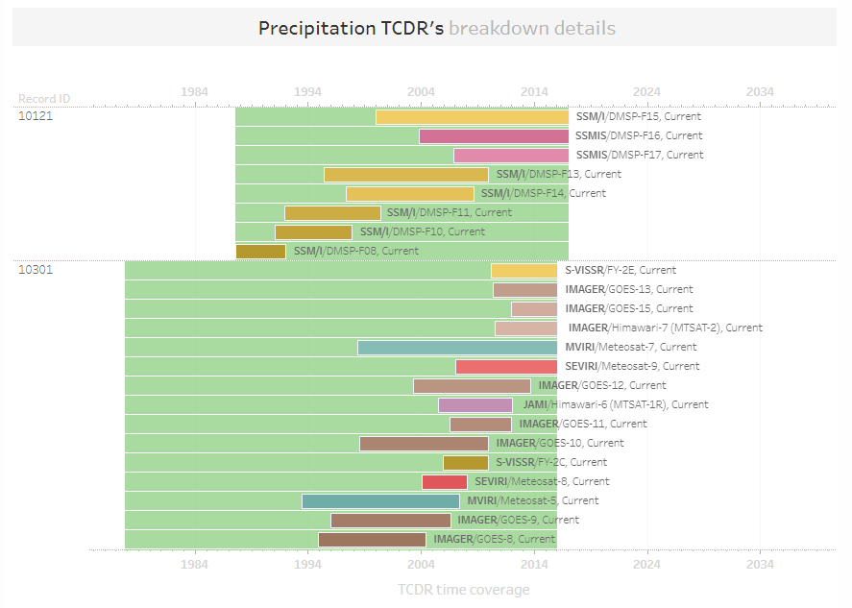
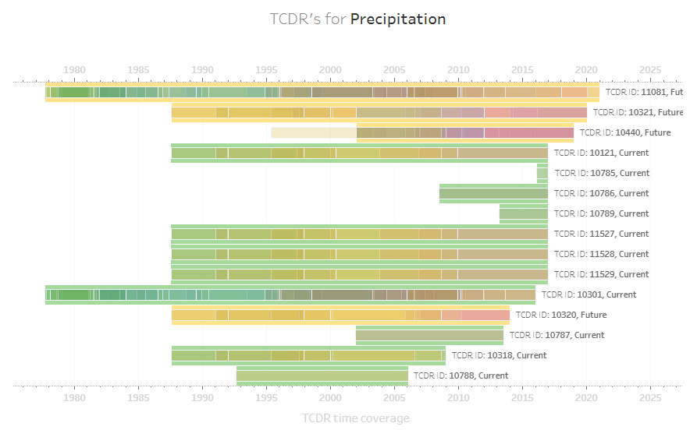
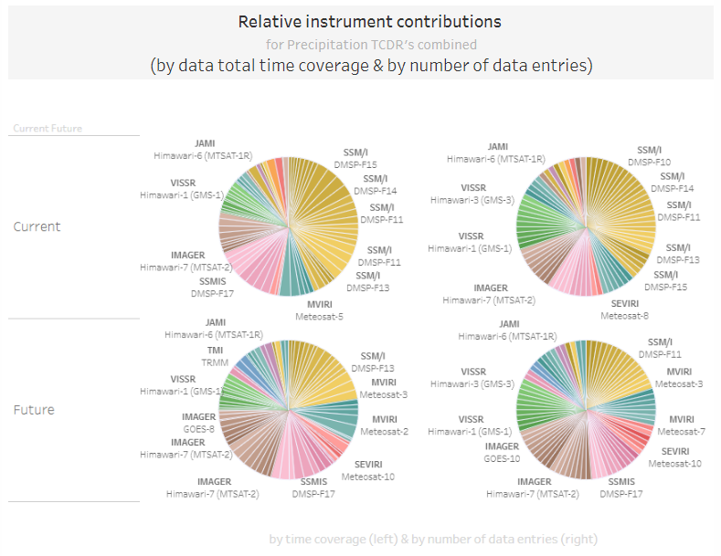
Publication of the ECV Inventory #2

Slide 10
CEOS/CGMS Statement to SBSTA-47
STATEMENT TO THE UNITED NATIONS FRAMEWORK CONVENTION ON CLIMATE CHANGE SBSTA 47/COP 23 06-xx/11/2017
“The consolidation of space agency efforts through the establishment of the joint CEOS/CGMS Working Group on Climate has resulted in a significant increase in efficiency in responding to the needs of Systematic Observations as required by the Convention. This is manifested in part by considerable increase in the quantity of climate data records (factor 3) submitted by agencies to the Essential Climate Variable (ECV) Inventory with respect to the first exercise implemented in 2015.”
…
“The synergistic relationship with the UN’s GCOS Programme continues to strengthen. Here, CEOS and CGMS present a response to the 2016 GCOS Implementation Plan reiterating their commitment to address the Actions required for the implementation of the global observation system for climate.”

Slide 11
Carbon Strategy Implementation
Committee on Earth Observation Satellites
Mark Dowell – European Commission
SIT Tech Workshop 2017 Agenda Item #
CEOS Strategic Implementation Team Tech Workshop
ESA/ESRIN, Frascati, Italy
13th-14th September 2017

Slide 12

CEOS Carbon activity - history and Background
GEO Carbon Report developed in June 2010 by team led by Ciais et al. (GCP).
CEOS Strategy for Carbon Observations from Space – written in response to above, completed in March 2014 – Wickland et al.
42 Actions identified in the report for specific response– first discussed at SIT Technical Workshop in September 2013

Slide 13


COP-21: Paris Agreement Article 7 (7c)
Strengthening scientific knowledge on climate, including research, systematic observation of the climate system and early warning systems, in a manner that informs climate services and supports decision- making
Developing the Transparency Framework (the need to promote transparency, accuracy, completeness, consistency, and comparability, and environmental integrity) & Global Stock-take
SBSTA Conclusions:
Noted with appreciation the [Status] report by GCOS
Encouraged GCOS to consider the outcomes of the twenty-first session of the Conference of the Parties when preparing the GCOS IP 2016
Invited GCOS to collaborate with relevant partners to continue enhancing access to, and understanding and interpretation of, data products and information to support decision-making on adaptation and mitigation at national, regional and global scales
@
Notes:
These requirement on Carbon are not going away – if anything they will become greater
Paris agreement not prescription on how but provides process
Transparency Framework will substitute MRV

Slide 14
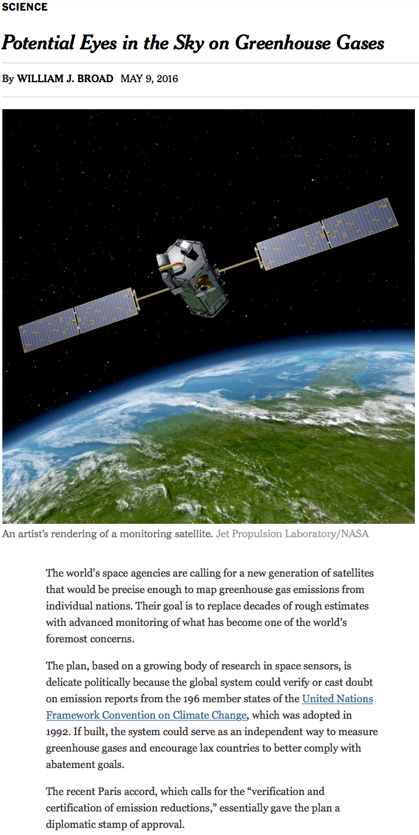
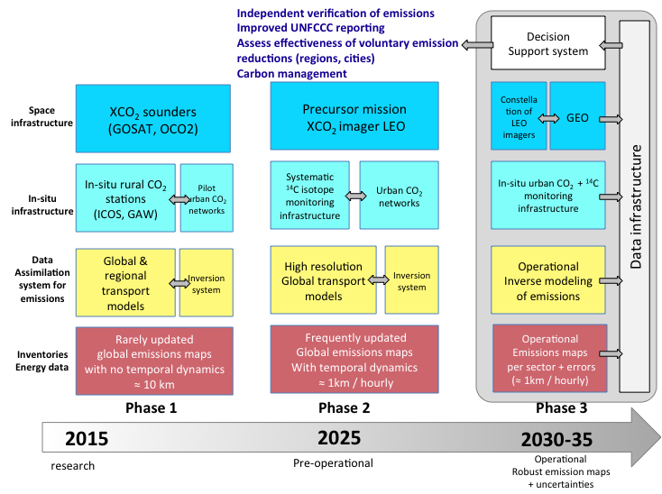
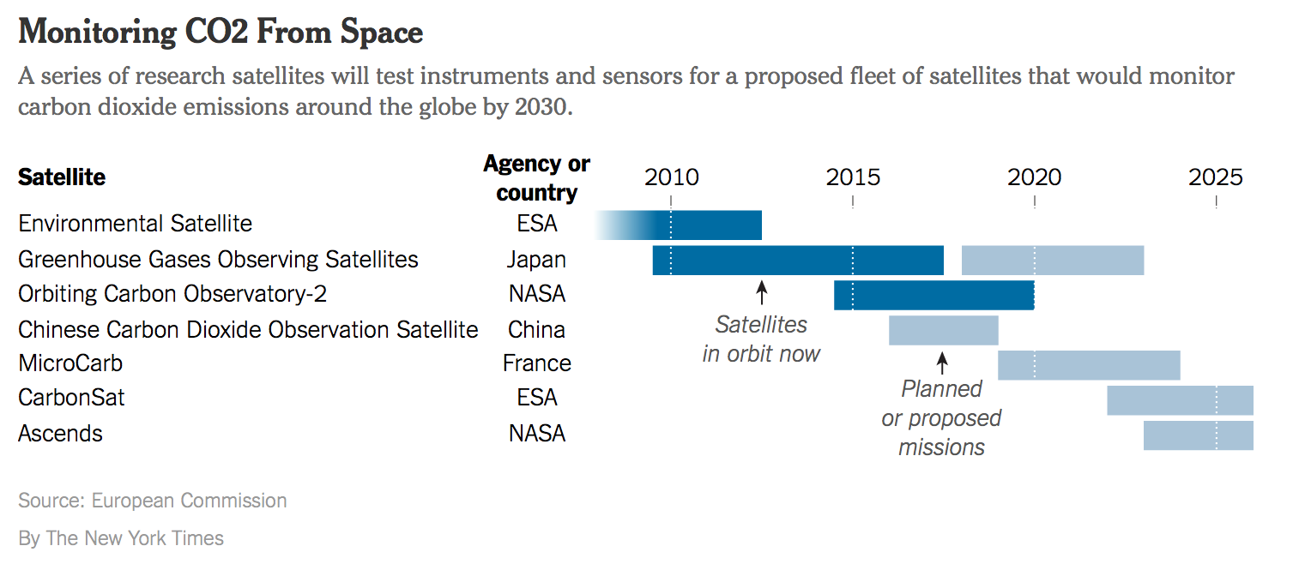
Systems Approach
International effort and coordination

Slide 15
Truly cross-cutting within CEOS
Spreadsheet identified lead CEOS “Entity” as:
    Atmospheric Chemistry-VC: 6 Actions
    Land Surface Imaging-VC: 4 Actions
    Working Group Climate: 7 Actions
    Working Group Calibration/Validation: 11 Actions
    Strategic Implementation Team: 7 Actions
    N/A: 2 Actions
    Many other WGs and VCs named as contributing

Slide 16
Some Actions have been undertaken…(from LSI-VC)
CARB-08-03: CEOS Agencies with historical moderate-resolution (~250 m - 1 km) satellite data records will strive to ensure these data are publicly available …
CARB-08-04: CEOS Agencies with historical medium-resolution (~30 m -100 m) satellite data records will strive to ensure these data are publicly available …

Slide 17
Deliverable from SEO/LSI-VC
As these actions are closely related, the SEO has developed this consolidated report as a response to both of these Carbon actions. It is assumed that “publicly available” means the datasets are free/open for public use and there are no restrictions. The tables below summarize the known (current and future) moderate and medium resolution satellite data records measuring land properties relevant to carbon science. Also included in these tables are data policies, measurement type, revisit, swath and resolution. The data for these tables is taken from the CEOS Mission/Instruments/Measurements (MIM) database (http://database.eohandbook.com/).
The tables below reflect a number of missions that could likely contribute to long-term climate data records and specifically measurements of land-based carbon. The following summary of missions reflects known historical satellite "series" that could likely contribute to long-term data records in support of Carbon science:

Slide 18
Initial Proposed Initiatives
ACC: white paper on a GHG constellation;
LSI-VC: adopt GEOGLAM requirement process & gap analysis
WGClimate: focus gap analysis work on carbon-specific ECVs;
WGISS: on a carbon data portal to facilitate the discoverability and accessibility of ECV products and space-borne CDRs relevant for the carbon actions.;
NASA-ESA: cal/val and production of biomass products from CEOS missions – based on previous bi-lateral NASA/ESA initiative
WGCV: Shorter term activities - Summarize current list of validated land data products relevant to Carbon Strategy.
JAXA: on the opportunity to engage with IPCC TFI guideline process, promoting satellite EO
These address a good cross-section of Actions across the Carbon Strategy

Slide 19
14 February 2017 Letter from the CEOS SIT
In February 2017, the AC-VC received a formal request from the CEOS Chair, Frank Kelly
  Included specific guidance on the content of the GHG White Paper
  Requests interim reports be provided at forthcoming CEOS SIT meetings, SIT Technical Workshops, and the 2017 CEOS Plenary
  Requests a final report to be provided at the 32nd CEOS Plenary to be held in the 4th quarter of 2018
  Invited CGMS asking them to nominate, if they wish, additional people to participate in development of the report

Slide 20
Mandate for Satellite Carbon report content, undertaken by AC-VC
Based on existing requirements, define the key characteristics of a global architecture for carbon (CO₂, CH₄) measurements from space.
Consider observational needs for both composition and fluxes, natural and anthropogenic
Include known plans and considerations from space agencies worldwide in overall system architecture to ensure global consistency of design
Incorporate potential observations from both GEO and LEO potential missions in an optimal system, and consider optimal acquisition strategies across the system including orbits, equator crossing times, sensor characteristics etc.
Include instrument on-orbit calibration and geophysical validation aspects
Build on work already undertaken by AC-VC in response to the CEOS Carbon Strategy
Provide a reference architecture against which individual agencies can develop their plans to optimise joint implementation.
Report at Plenary 2018, with interim report Plenary 2017

Slide 21
Overview of AC-VC GHG Activities
The primary focus of the AC-VC Greenhouse Gas (GHG) effort since the CEOS SIT-32 meeting has been the development of the GHG White Paper.
Contributions to the White Paper were solicited at the following meetings:
6-8 June: IWGGMS-13, Helsinki, Finland
11-16 June: CGMS WG-II/WG-III GHG joint session and the CGMS Plenary in Jeju Korea
28-30 June: CEOS he AC-VC-13 in Paris, France
  Represented OCO-2, OCO-3, GOSAT, and GeoCarb Missions
  Devoted the afternoon for a discussion of the AC-VC GHG White Paper
Other activities since SIT-32 include:
Committed to review JAXA-led report to refine the IPCC GHG Inventory Guidelines to include satellite-based GHG data (due end of September)
Contributed to the NASA’s comments on the European Commission’s Proposed 2018 CEOS Chair Initiatives
Formulated plans and presentation materials to support the SIT Technical workshop

Slide 22
GHG White Paper Status and Plans
Contributions from participants at the CGMS and CEOS AC-VC meeting were incorporated into the White Paper structure:
  Chapter 1: Need for space-based measurements of CO₂ and CH₄
  Chapter 2: Existing space-based GHG Satellites and near term plans
  Chapter 3: Lessons Learned from GOSAT and OCO-2
  Chapter 4: Integrating Near-term Missions into a Virtual Constellation
  Chapter 5: Defining GHG Constellation Requirements
  Chapter 6: Candidate Constellation Architectures
  Chapter 7: EC CO₂ Sentinels: Ongoing studies of operational GHG constellations
  Chapter 8: The Transition from Science to Operations
  Chapter 9: Conclusions
Vacations and other commitments have reduced progress over July and August, but we have maintained the goal of producing and end-to-end draft before the end of the calendar year

Slide 23
Advantages of GHG Constellations
A multi-satellite GHG constellation could
Exploit the benefits of observations from low Earth orbit (LEO), geostationary orbits (GEO), and Highly Elliptical Orbits (HEO) vantage points
Reduce revisit times in the presence of clouds
Improve spatial coverage without requiring very broad swaths that
  are technically difficult and expensive to implement, and will limit sensitivity (spectral resolution, SNR, low scattered light …)
  Introduce larger atmospheric path lengths at the edges the swath that are more likely to be contaminated by clouds
Collect coincident observations of proxies (CO, NO₂, SIF) to facilitate the interpretation of the measurements
Provide redundancy in the case of the loss of a single satellite
Provide opportunities for cross calibration and cross validation
Partnerships will help realize this objective

Slide 24
LSI-VC Inititiave - Requirements Approach
LSI-VC exploring adoption and generalization of the CEOS ad hoc Working Group on GEOGLAM approach to apply to other thematic areas
Ensuring capture of both observational requirements and downstream product/service requirements
Utilize existing ad hoc teams for eliciting requirements from communities of practice and augment as needed
Look at CEOS Carbon Strategy for pilot implementation

Slide 25
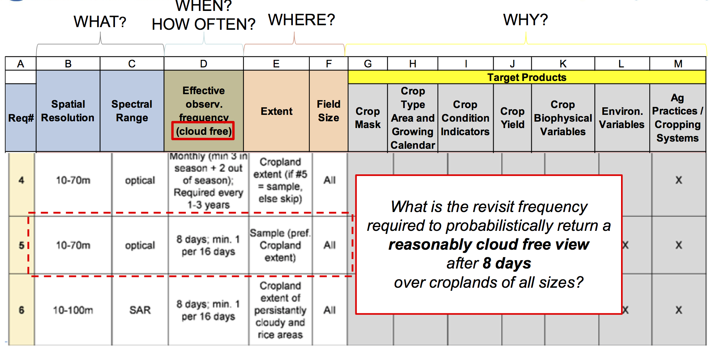
LSI-VC – Requirements Analysis

Slide 26
WGClimate Initiative
For consistent ECV Carbon products take advantage of Inventory output to produce subset of ECV Products contributing to Carbon Strategy
Space Based GCOS ECVs in Inventory
      Products requested in Carbon Strategy

Slide 27
Carbon: WG-Climate
ECV Inventory
Defining Essential Climate Variables for Carbon and Beyond
(minimum five-year data record)
Tropospheric CO₂ column
  13 current ECVs derived from SCIAMACHY, GOSAT, and AIRS
  13 future ECVS planed using GOSAT, IASI, and AIRS
Tropospheric CH₄ column
  8 current ECVs derived from SCIAMACHY, GOSAT, IASI, and AIRS
  7 future ECVs planned using GOSAT
Tropospheric CH₄ profile
  10 current ECVs derived from IASI and AIRS
  8 future ECVs planned using AIRS
Stratospheric CH₄ profile
  1 current ECVs derived from IASI

Slide 28
LAI, FAPAR, Land cover
LAI:
  1 current ECVs derived from AVHRR/MODIS (NOAA CDR)
  4 future ECVS planed using Meteosat-8-SEVIRI, SPOT-4/5-Vegetation, PROBA-V-Vegetation, AVHRR
FAPAR:
  1 current ECVs derived from AVHRR/MODIS (NOAA CDR)
  4 future ECVs planned using Meteosat-8-SEVIRI, SPOT-4/5-Vegetation, PROBA-V-Vegetation, AVHRR
Land cover
  1 current ECVs derived from Envisat-MERIS and SPOT-4-Vegetation
  1 future ECVs planned using Envisat-MERIS, AVHRR, SPOT-4-Vegetation, PROBA-V-Vegetation

Slide 29
Actions assigned to WGClimate
Encourage the production and availability of high-quality, consistent long time series data products based on multiple sensors and missions for carbon and climate science and for model-data and data-data intercomparison exercises. | WGCV AC-VC LSI-VC OCR-VC
Make publicly available all information necessary to document the accuracy, clarity, and traceability of the satellite data and data products they produce. | WGCV VCs
Coordinate efforts to develop compatible (e.g., temporal and spatial resolution, grids, data formats, common auxiliary data, units) carbon data products from multiple missions | OCR-VC AC-VC LSI-VC WGCV
Ensure the long-term accessibility of satellite data and data products for carbon cycle science and policy. This must include arrangement for secure archives, documentation, and metadata as well as for provisions for easy discovery and access | WGISS
Serve as a point-of-contact for appropriate satellite products for major model-data intercomparison exercises related to the carbon cycle. | WGClimate chair membership on WDAC
Notes:
Activation highlighted in red consistent with WGClimate Inventory-Gap Analysis process

Slide 30
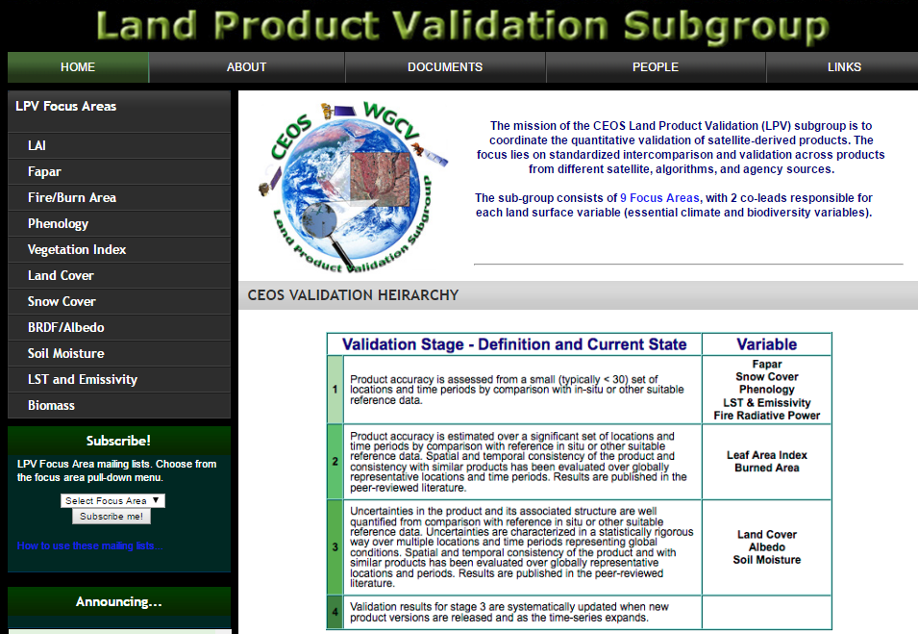
Recent CARB-19 : Land Product Validation Listing –
Summarizing current list of validated land data products relevant to Carbon Strategy - Validation according to CEOS LPV standards and documented on the CEOS LPV website
CEOS/WGCV/LPV has completed listing of 11 carbon-focused variables, totaling 138 land products from 11 CEOS Agencies.
https://lpvs.gsfc.nasa.gov/
9 of these product categories are listed as GCOS Essential Climate Variables (ECVs*)
2 of these products categories are listed as GEOBON Essential Biodiversity Variables (EBVs*).
*
*
*
*
*
*
*
*
*
*
*

Slide 31
WGISS Activities for
CEOS Carbon Initiatives
(CARD-15)
WGISS will begin facilitating discoverability and accessibility of ECV Products and space-born CDRs relevant for the CEOS Carbon Action via WGISS Interoperability Systems & Standards (FedEO/CWIC/IDN, OpenSearch) once WGClimate has completed their (meta) gap-analysis across the Carbon ECVs.
In response to the CEOS Carbon Strategy, WGISS and the CEOS Carbon Team are exploring the idea and approach of collaboratively developing a Carbon Portal to discover and access relevant CEOS data products available via the WGISS infrastructure components.
  The teams are beginning to develop requirements and success criteria based on the extent it provides discoverability of the products of value to the carbon cycle community.
  As success development of a Carbon Portal is likely a multi-year effort, the teams will begin with a demonstration project focused on delivering selected products of value to the carbon community.

Slide 32
WGISS
WGISS – Working Group on Information Systems and Services
Objective / Deliverable | Projected Completion Date | Background Information
CARB-15: Carbon Data Portal | Q4 2017 | Implement a carbon data portal to facilitate the discoverability and accessibility of ECV products and space-borne CDRs. The portal is designed with service-oriented architecture and follows the principles outlined by the GEOSS Community Portal white paper. The portal will seamlessly access data both in CWIC and FedEO to provide necessary data and services to the carbon science community of both CEOS and GEOSS.
WGISS is working with WGClimate and CEOS Carbon Leads. Held the initial WGISS Carbon Portal telecon with Mark Dowell and Stephen Plummer on March 28th to begin defining requirements for facilitating discoverability and accessibility of ECV Products and space-born CDRs relevant for the CEOS Carbon Action via WGISS Interoperability Systems & Standards (FedEO/CWIC/IDN, OpenSearch).
Defining initial search and access functions to be provided by the portal prototype and documenting initial science-discipline use cases to search and access particular collections (possibly Land-Carbon, Ocean-Carbon and/or an Atmosphere-Carbon case). Developing Carbon Portal Project Plan.

Slide 33
WGCV
2017-2019 Work Plan
3.2 Progress on the implementation of the CEOS Strategy for Carbon Observations from Space
CARB-19: Land product validation listing and framework | Q4 2017 | Summarize current list of validated land data products relevant to Carbon Strategy. Document validation framework and protocols Provide guidance for online platform for intercomparison of terrestrial carbon products. | WGCV

Slide 34
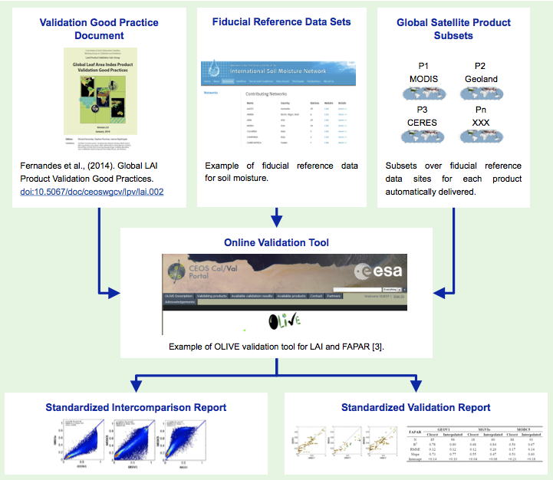





CARB-19: CEOS Land Validation Framework
Schaepman-Strub et al., (2017) submitted
CEOS LPV has established a framework with the aim of independent validation and consistent uncertainty reporting across products as main output.
Multiple agencies are coordinating five actionable tasks:
        [NASA] Develop best practice validation protocols for Albedo and Land Surface Temperature ECVs, where validation methods are sent through rigorous peer-review (Q4-2018).
        [NOAA/ESA/EUMETSAT] Ensure access to processed fiducial reference data (ongoing).
        [USGS/NOAA/NASA] Support automated subsets of global satellite products (LPCS; Q2-2017.)
        [NASA] Implement data analysis tools (Q2-2018).
        [NASA/ESA] Deliver standardized intercomparison and validation reports (Q4-2018)
1. 2. 3.
4.
5.

Slide 35

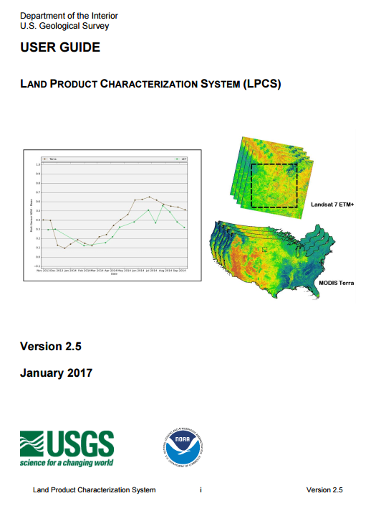
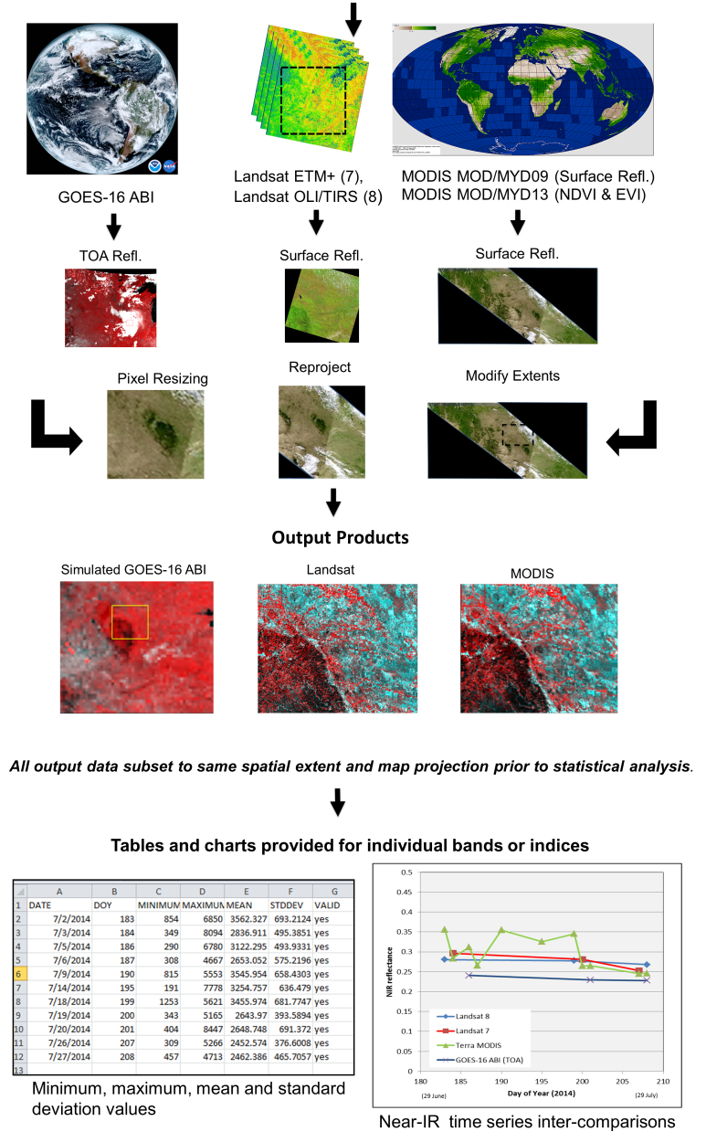

CARB-19: Online Platform for Intercomparison -
Land Product Characterization System (Q2-2017)
At WGCV-42, LPV announced the launch of the Land Product Characterization System (LPCS). LPCS is a web-based system designed to facilitate intercomparison of higher-level, satellite-derived, global land products. Key features include:
Analysis functions that permit data to be identified, retrieved, co-registered, and compared statistically through a single interface.
Access to the latest data collections of Landsat 4 through 8, Terra and Aqua MODIS, Suomi-NPP VIIRS and GOES-16 ABI.
Future products will include ESA Sentinel-2 and -3 series.
LPCS User Guide provides detailed information related to system features and functionality.
https://landsat.usgs.gov/lpcs

Slide 36
Aboveground Biomass Protocol Development
Timeline
September, 2017: Writing committee formed, protocol structure drafted
October, 2017: Writing committee assigned draft tasks
November, 2017: Meeting at ISSI in Bern to flush out draft
2018: Protocol editing & peer review
The LPV focus area on biomass is developing a good practices guide to biomass model calibration and product validation at a global (or near global) scale, including:
Good practices for biomass estimation in the field
  Required measurements at tree and plot scales
  Allometric equation selection
  Error/uncertainty estimation and reporting
  Data standards: what are ideal, what are acceptable (e.g. repeatability)
  Terrestrial Laser Scanning
Linking remote sensing observations to field estimates
  Geolocation good practices
  Application of TLS and/or ALS to scale from field plots to spaceborne measurements
Biomass model calibration accuracy reporting
  Statistical recommendations for product inter-comparability, e.g. Cross validation
Global Product Validation Protocol
  Recommended independent datasets for validation
  Recommended sample design for plot selection
  Assessment of global representativeness of validation plots
  Statistical recommendations for error reporting

Slide 37

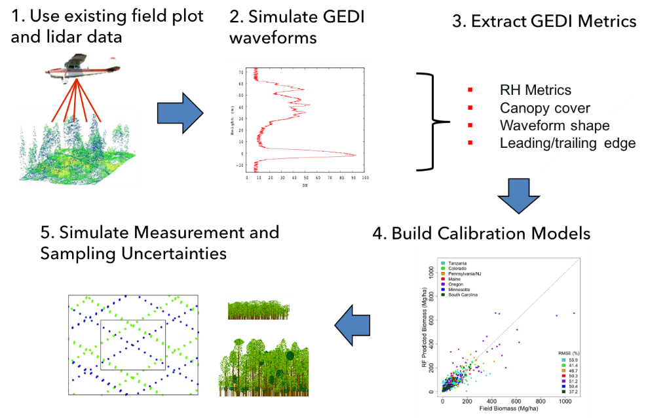
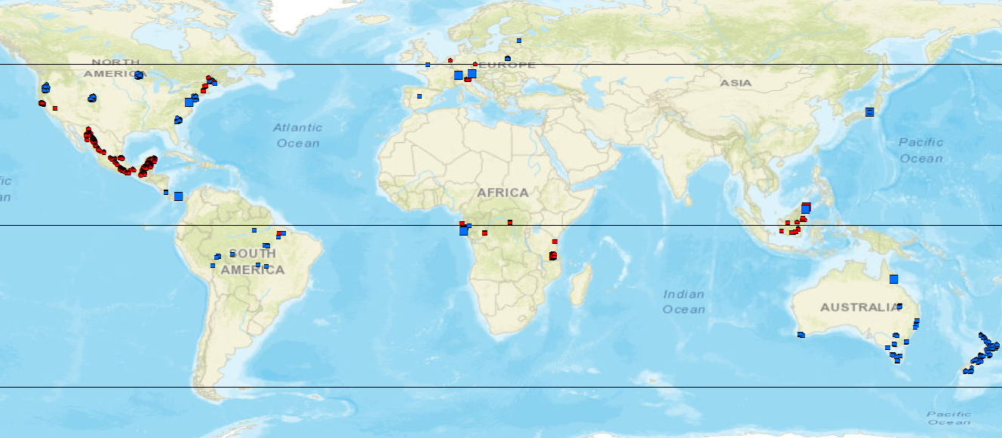
CEOS-LPV Biomass Focus Area Activities
NASA-GEDI Science Team is compiling a global dataset of coincident field and airborne lidar.
Reference archive includes ~4,000 plots (0.0625-0.25 ha), and 18,500 simulated footprints (25m) over ~100 corresponding field sites.
Next steps: CEOS-LPV Biomass team (NASA/ESA) will work to determine which GEDI reference sites can fill the needs of all missions (including data access) (Q2-2018).
GEDI collaborations on data sharing and processing include projects relating to the ESA’s Forest Observation System (FOS) and the pre-proposal research for the ESA-NASA Mission Exploitation Platform (MEP).
GEDI will launch in December, 2018, producing ~12 billion lidar observations and associated forest height and biomass measurements
 | Projects Ready | Project in Progress | Projects Identified | Total by Region
Australia | 6 | 10 | 0 | 16
Asia | 11 | 0 | 4 | 15
Europe | 8 | 1 | 8 | 17
North America | 14 | 4 | 13 | 41
Africa | 8 | 0 | 2 | 10
Central America | 5 | 2 | 0 | 7
South America | 12 | 3 | 4 | 19
Total by Status | 64 | 20 | 31 | 115

Slide 38
GEO Carbon and GHG Initiative
Accepted as a GEO Initiative at 3rd GEO Programme Board 2016
The GEO C and GHG initiative provides cross integration and coordination of the interfaces (between: atmosphere, ocean and terrestrial domains; space-based, air-borne and in-situ monitoring systems;). It builds on existing strategies, initiatives, networks and infrastructures, and integrates them with the missing pieces to obtain a comprehensive globally coordinated GHG observation and analysis system.
Key Elements
  Task 1: User needs and policy interface (policy and science requirements)
  Task 2: Data access and availability (CEOS)
  Task 3: Optimization of observational networks (CEOS)
  Task 4: Budget calculation consistency (Global, Regional, sub-Regional, National, Local) (CEOS Carbon Strategy)
CEOS POC: Stephen Plummer, ESA – member of Executive Committee
Potential for this to be integrator for global in-situ networks

