Slide 1

Report from the VC-WG Day
Jean-Louis Fellous, SIT Chair Team
Committee on Earth Observation Satellites
with concurrence of the session moderators
O. Ochiai and P. Chang
A. Lewis, A. Mitchell and K. Casey
M. Dowell, P. Lecomte and D. Crisp
SIT Technical Workshop, Agenda Item #21
ESA/ESRIN, Frascati, Italy
13th-14th September 2017

Slide 2
VC/WG Day Organization
Following the first VC/WG Days successfully held in Montpellier on September 16, 2014, September 16, 2015 in Darmstadt and 13 September, 2016 in Oxford, it was now common practice to hold a 4th VC/WG Day on September 12 in Frascati.
The format and topics for this 4th VC/WG Day were discussed during the June-July 2017 tag up teleconferences.
  Preference was maintained for a meeting “by invitation only” in order to facilitate exchange and discussion among VCs and WGs – it being understood that the door remained open to anyone interested
  Three topics were discussed, each being allocated 1.5 hour and moderated by volunteers
We are extremely grateful to the moderators for their assistance in leading the VC/WG Day to significant outcomes, and I shall now report to the SIT Technical Workshop on these outcomes

Slide 3
VC/WG Day Agenda
 | Topic | Moderators | Contributors
09:00-10:30 | Water | O Ochiai(P-VC) and P Chang (OSVWVC) | All VCs & WGs
10:30-11:00 | Coffee/tea break
11:00-12:30 | Extension of ARD concept to Atmosphere and Ocean Status of COVERAGE | A Mitchell (WGISS), A Lewis (LSI-VC) and K Casey (SST-VC) V. Tsontos (NASA) | All VCs & WGs
12:30-13:30 | Lunch
13:30-15:00 | Climate/Carbon | M Dowell (Carbon Strategy Team), P Lecomte (WGClimate) and D Crisp (AC-VC) | All VCs & WGs
15:00 | End of meeting

Slide 4
Water Session Report
The session was moderated by Osamu Ochiai (representing Steven Neeck, P-VC) and Paul Chang (OSVW-VC)
  The discussion started from the recognition that CEOS was unsuccessful over the past decade to sort out observation and product requirements and priorities from the diverse “water” communities
  Several (new) projects are flourishing, dealing with different segments of “water” from various perspectives: salted water, freshwater, coastal waters, quality and availability of water, physical oceanography, etc.
  These projects – GEOGLOWS, AquaWatch, COVERAGE, Blue Planet, others – seem to work at clarifying their common and specific requirements and priorities
  This opportunity should be seized

Slide 5
Water Session Report (cont’d)
The proposal to hold a dedicated workshop in 2018 was approved
  The goal of the workshop will be for CEOS to understand how best its observations may be organized in order optimally to serve the various water community initiatives, and to encourage a coherent response from among them
  A small committee should be tasked to prepare the workshop and to develop a short document spelling out this goal in a clear manner
  The composition and mandate of the task group and the above-mentioned document should be ready for presentation and endorsement by CEOS Plenary in October

Slide 6
ARD Extension Session Report
The session was moderated by Adam Lewis (LSI-VC), Andy Mitchell (WGISS) and Ken Casey (SST-VC)
  The discussion started from the recognition that the ARD approach successfully developed by the LSI-VC (CARD4L) had the potential to be extended as appropriate to other domains (atmosphere, ocean)
  It was recognized that there are also mature similar activities (e.g. GHRSST), but also unmet aspirations (e.g. Ocean Surface Vector Winds), and that WGISS has developed tools and friendly working environment in support of such ARD activities
  There is a need to demonstrate and emphasize the benefits of ARD in order to counterbalance the extra efforts and resources associated with their development
  The importance of data assimilation was also noted and the idea was expressed that the overall topic is an FDA issue

Slide 7
ARD Extension Session Report (cont’d)
In conclusion, the following outcomes were agreed:
  VC’s are kindly asked to review the CARD4L framework developed by the LSI-VC to identify any components that would be of wider value. Feedback to LSI-VC would also be welcome.
  The FDA-Ad Hoc Team is kindly asked to include in its report a recommendation that CEOS take appropriate (and moderate) steps to progress a CEOS-wide ARD strategy.

Slide 8
Climate/Carbon Session Report
The Carbon/Climate session was moderated by Mark Dowell (Carbon Strategy Team), Pascal Lecomte and Joerg Schulz (WGClimate), with the remote participation of David Crisp (AC-VC)
  Lecomte presented the status of the space agency response to the GCOS-IP.
  Dowell and Schulz reported on the ECV Inventory activity.
  Dowell gave a short presentation of the CEOS report to SBSTA.
    Comments urgently welcome. Approval needed before Plenary
  Dowell discussed the Carbon Strategy initial initiatives.
  Crisp reported on status of the satellite carbon report (White Paper on GHG observation) requested from the AC-VC.
All were commended for their excellent work and very good progress in this critically important – but very heavy – activity
VCs were encouraged to continue their effort in support of the Carbon Strategy action items.

Slide 9
Summary of IPCC side event discussion
CEOS should understand the timeline for the IPCC Guidelines Refinement.
  The 1st order draft will be released by end of Nov. 2017
  Expert Review for the draft in Dec. 2017 - Jan. 2018.
NIES will publish the GHG Guidebook by Mar. 2018
  CEOS AC-VC to review the Guidebook in Oct.- Nov. 2017.
CEOS AC-VC white paper could also be input to IPCC authors.
  The draft will be available by end of 2017.
Recognizing the importance of agency comments on the 1st order draft of the IPCC Guidelines during Expert Review, JAXA proposes CEOS and individual Agencies submit comments such as achievements of space-based GHG measurements.
This is a long term process, recognizing the respective process of IPCC guidelines update. Topics such as mitigation and adaptation can be next steps
CEOS AC-VC asked to input ideas for EC Chair follow-up

Slide 10
VC Issues for consideration by the SIT
AC-VC (J. Al-saadi/B. Veihelman and D. Crisp)
  AQ/GHG constellation coordination; Unmet measurement goals; Data access policies
    Ref.: CEOS-WP: Section 3.8, VC-2, VC-3
SST-VC (A. O’Carroll and K. Casey)
  Passive Microwave Radiometer Continuity
OSVW-VC (P. Chang)
  Building a strong case for operation continuity
    Ref.: CEOS-WP: Section 3.8, VC-14
Leadership changes and issues
  WGDisasters (S. Chalifoux)
  WGISS (A. Mitchell)
  OST-VC (J.-L. Fellous)
Review of key issues for coordination before CEOS Plenary (as required)

Slide 11
Issues and potential resolutions that may require SIT Chair support: AC-VC
Committee on Earth Observation Satellites
Jay Al-Saadi, Ben Veihelman and David Crisp,
Atmospheric Composition Virtual Constellation
SIT Technical Workshop, Agenda Item #21
CEOS WP Section 3.8, VC-2, VC-3
ESA/ESRIN, Frascati, Italy
13th-14th September 2017

Slide 12
AC-VC Issue: Data Access Policies
Enabling the Air Quality (AQ) Constellation objectives for open data exchange now relies on data access policies for the Asian missions to be established by their organizations
  CEOS-endorsed AQ constellation position paper (2011) recommended “establishing protocols for mutual open and timely data distribution” to collaboratively enhance the quality of data products from all missions, thereby extending a global focus to the observations
  Initial missions include Europe’s S4 and S5P, USA’s TEMPO, Korea’s GEMS, and potentially China’s Gaofen-5
  NASA and the EU now have open data policies including L-1b and L-2
Request CEOS actively engage (or continue) conversations with appropriate agencies in Republic of Korea and China to facilitate open sharing of satellite data between all partner space agencies
Notes:
This slide expresses known near-term AC-VC needs. Looking to future developments, including GHG constellations, it would be helpful to also consider India in this conversation.

Slide 13
AC-VC Recommendation:
Unmet Air Quality Measurement Goals
Though the emergent AQ constellation is a success story, two measurement goals remain unmet: extending hourly AQ observations to the rest of the world and providing hourly CO vertical profile measurements with near-surface sensitivity
  The emergent AQ constellation includes hourly geostationary (GEO) observations over Europe, East Asia, and North America
  Requisite CO measurements are not currently planned anywhere; MTG IRS (Europe) and GeoCARB (US) will provide limited capability
  Air quality in the developing world is a growing societal challenge (increasing industrialization and population) with global impact
  Extending GEO observational capability to the southern hemisphere and tropics will leverage experience and capabilities from the emergent missions to be an effective capacity-building activity
Encourage agencies to identify strategies to meet remaining AQ measurement goals, possibly including innovative funding and partnership approaches to build capacity in the developing world
Notes:
The emergent AQ constellation will measure trace gases relevant to ozone pollution (O3, NO2, HCHO) and aerosol pollution. The goal to provide hourly CO measurements that can distinguish between free-tropospheric and near-surface abundances is currently unmet worldwide. Multispectral measurements of CO, as provided approximately daily from low Earth orbit by MOPITT and potentially being continued into the future by e.g. combined retrievals from CrIS and TROPOMI, provide vertical profile information with near-surface sensitivity. The near-surface sensitivity is critical for distinguishing between locally-produced and externally-transported pollution. None of the emergent geostationary missions have this capability to distinguish between free-tropospheric and near-surface CO. The IRS on MTG will resolve the free troposphere at hourly repeat cycle over Europe, albeit with limited sensitivity to near surface concentrations. GeoCARB will resolve the free troposphere at up to 3 times per day over North America.

Slide 14
AC-VC Recommendation:
Enable Joint AQ/GHG Constellations
Constellations for observing air quality (AQ) and greenhouse gases (GHG) have developed separately but are highly interdependent
  Similar emission sources (i.e., combustion) control AQ and GHG
  AQ affects natural carbon cycles, modulating net GHG abundances
  Simultaneous AQ and GHG observations provide better constraints on emission fluxes and transformation, critical for policy strategies
Atmospheric composition Observing System Simulation Experiment (OSSE) capability has matured rapidly
  AC-VC is fostering AQ and GHG OSSE development with involvement of ECMWF, ESA, Copernicus, NASA, JAXA, NIER, and others
  International objectives for both AQ and GHG observations could be achieved more effectively through coordinated planning
Agencies should be encouraged to coordinate existing AQ and GHG OSSE capabilities to efficiently enable joint AQ/GHG satellite constellation studies

Slide 15
Issues and potential resolutions that may require SIT Chair support: SST-VC
Committee on Earth Observation Satellites
Anne O’Carroll and Ken Casey, co-Chairs,
Sea Surface Temperature Virtual Constellation
SIT Technical Workshop, Agenda Item #21
ESA/ESRIN, Frascati, Italy
13th-14th September 2017

Slide 16
SST-VC – Passive Microwave Radiometer Continuity
The SST-VC continues to stress the need for passive microwave (PMW) based SST observations:
  Highlighting the importance of PMW SST observations in the
  ~7 GHz band, especially in high latitudes, regions of persistent cloudiness, and aerosol-impacted areas
  Illustrating the current fragile state of the SST constellation to continue delivering those measurements into the future
  Updating the community on the current status of coordinating through the SST-VC to enable greater data sharing and scientific exchanges to fill the coming gaps in PMW-based SSTs
CEOS is requested to coordinate and encourage its agencies to ensure the continuation of the existing capability and to facilitate the coordination of agencies to ensure continuity and redundancy of PMW for SST
16

Slide 17
The Case for Satellite OSVW Continuity – Is it Sufficient?
Committee on Earth Observation Satellites
Paul Chang, co-Chair, OSVW-VC
SIT Tech Workshop 2017 Agenda Item # 21
CEOS-WP: Section 3.8, VC-14
ESA/ESRIN, Frascati, Italy
13th-14th September 2017

Slide 18
OSVW Constellation Status and Health
ASCAT (METOP-A&B)
  Open and near real-time data access
  ASCAT available through EPS-SG(SCA)
  METOP-C scheduled for a October 2018 launch
SCA (ASCAT Follow-On, EPS-SG) ~2022/23
ScatSat September 2017 (Injected into ~9:45 am local crossing time and drifting to ~8:45 am)
  Open and near real-time data access (April 24, 2017)
OSCAT follow-on (OceanSat-3&3A) ~2018/2019
CMA will be providing OSVW measurements starting with their FY-3E launch
18

Slide 19
CEOS Ocean Vector Surface Winds Virtual Constellation (OSVW-VC) Current Status and Outlook
Launch
10
11
12
13
14
15
16
17
18
19
20
21
22
23
24
10/06
METOP-A Europe
METOP-C Europe
C-band
METOP-B Europe
Post EPS Europe
06/99
Oceansat-3A India
QSCAT USA
03/14
Oceansat-2 India
Oceansat-3 India
ScatSat India
HY-2A China
HY-2B China
CFOSAT China/France
Ku-band
RapidSCAT USA
HY-2C China
Meteor-M N3 Russia
Meteor-MP 3 Russia
FY-3E China
Combined C- and Ku-band
FY-3G China
Advanced Scat series India?
Design Life
Extended Life
Design Life
Extended Life
Proposed
Operating
Approved
Note: Near real-time and open data access not assured for all missions listed
19

Slide 20
Optimum (minimum) OSVW constellation
2015 IOVWST meeting recommendation
At least 3 scatterometers in orbits designed to roughly meet WMO requirements (observations every 6 hours)
One instrument in a non-sun-synchronous orbit for sampling the diurnal cycle, better mid-latitude sampling and provide inter-calibration
A white paper describing and justifying the oceanography and climate requirements for the optimum OSVW constellation is being developed through the IOVWST.
20

Slide 21
The OSVW Constellation Future?
Questions posed at the 2017 OSVW-VC meeting
Is the “business” case for satellite OSVW strong enough?
Satellite SSH, SST(IR), rain/TPW, visible/IR imagery, and microwave soundings appear to be considered core measurement capabilities, but is this the case for satellite OSVW?
What needs to be done to improve the chances of realizing the optimum (minimum) satellite OSVW constellation?
21

Slide 22
Do We Have a Sufficient Business Case?
Some Random Thoughts
Who “owns” satellite OSVW? – Oceanography? Meteorology?
Three use categories
  To monitor and understand climate scale phenomenon (NWP reanalysis fields tend to be used still)
  To monitor and understand short time scale weather/phenomena (operational weather monitoring and forecasting
  To further our understanding of basic physical processes (scientific research)
The two current anchors in the OSVW constellation are ISRO and EUMETSAT
  EUMETSAT – operational satellite agency – justification is mainly NWP
  ISRO – research agency with some operational components
22

Slide 23
Do We Have a Sufficient Business Case?
Some Random Thoughts (cont’d)
CMA (operational agency) will launch its first OSVW instrument on FY-3E
The OSVW Constellation is relatively healthy in the short term. What happens if budgets become tight?
Passive microwave is in a similar predicament – touches many observing system requirements but a potential gap still looms ahead
Is operational weather forecasting enough of a justification? If not, why not?
  Operational weather forecasting continues regardless of whether data is available or not
Altimeter – synonymous with sea level rise but the operational weather forecasting/monitoring value is SWH

Slide 24
Do We Have a Sufficient Business Case?
Some Random Thoughts (cont’d)
Vis/IR imagery – self explanatory
SST – fisheries and climate but focus is on IR and microwave SST (all-weather) struggles
Do we need to build a stronger business case for agencies to help justify current and future missions
  Concern that operational weather monitoring and forecasting may not be sufficient by itself in the future
Does CEOS have a document that lists the essential (critical) satellite observations?
An agency needs to be responsive to its own political and fiscal environment, but perhaps providing supporting material of the economic and security benefits of core observing system capabilities would be helpful?

Slide 25
Leadership changes and issues – WGDisasters
Committee on Earth Observation Satellites
Stéphane Chalifoux, WG Disasters Chair
SIT Technical Workshop, Agenda Item #21
ESA/ESRIN, Frascati, Italy
13th-14th September 2017

Slide 26
WGDisasters – Accomplishments
Three thematic pilots completed
RO was triggered for Hurricane Matthew in Haiti and demonstrator to showcase/validate applications are completed; RO Operational Plan developed.
Landslide Pilot started and data starting to be collected.
Data flowing well for all existing pilots and supersites (including from the International Charter)
GSNL (new and reporting)
Awareness and Communications regarding pilots, including up-to-date website information and glossy report
26

Slide 27
WGDisasters – Decisions at CEOS Plenary 2017
DIS-10 - GEO GSNL Proposal (Southern Andes Supersite) and Biennial Reports (Ecuador and New-Zealand Supersites).
DIS-12 - Recovery Observatory Operational Plan.
DIS-13 - Disaster Risk Management pilot initiative final reports.
DIS-13 - Report on follow-on actions to DRM Pilots Volcano and Seismic (Flood could be part of GEO-DARMA).
DIS-13 - Geohazards Lab Implementation Plan.
New Vice-Chair/Chair: NASA.
27

Slide 28
WGDisasters – Reporting at CEOS Plenary 2017
DIS-12 - Recovery Observatory Malawi and Nepal demonstrators final reports.
DIS-12 - Recovery Observatory status update.
DIS-13 - Landslide Pilot status update.
DIS-15 - GEO-DARMA concept phase summary.
28

Slide 29
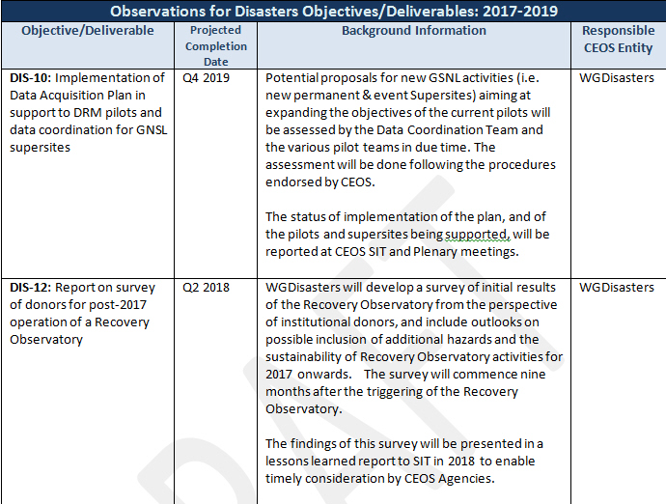
CEOS Work Plan 2017-2019
Disasters Objectives

Slide 30
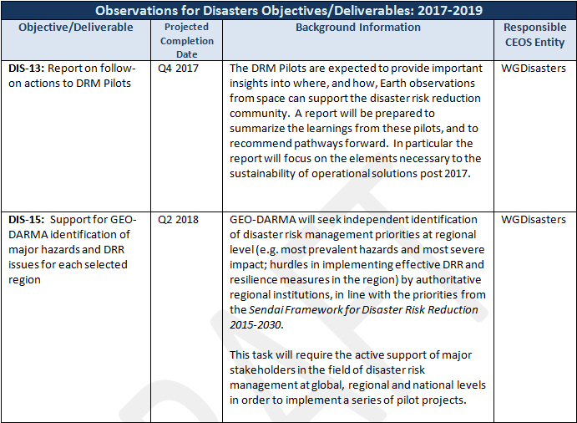
CEOS Work Plan 2017-2019
Disasters Objectives

Slide 31
WGDisasters – Reporting at CEOS Plenary 2017
CEOS Work Plan Milestones and Deliverables
  DIS-10: Implementation of Data Acquisition Plan in support to DRM pilots and data coordination for GSNL supersites Will be amended in next round of CEOS WP Updates
  DIS-12: Report on survey of donors for post-2017 operation of a Recovery Observatory (commences 9 months after Recovery Observatory triggering? Delayed: This will start in Spring 2018
  DIS-13: Report on follow-on actions to DRM Pilots (already listed above)
  DIS-15: Support for GEO-DARMA identification of major hazards and DRR issues for each selected region Update

Slide 32
Committee on Earth Observation Satellites
Leadership changes and issues – WGISS
Andrew Mitchell, WGISS Chair
SIT Technical Workshop, Agenda Item #21
ESA/ESRIN, Frascati, Italy
13th-14th September 2017

Slide 33

WGISS – Missing Vice Chair
WGISS Vice Chair Nomination – Awaiting response from the CEOS agency which expressed interest in putting forward a nominee. They are considering the four-year commitment which would begin in Nov 2017.

Slide 34
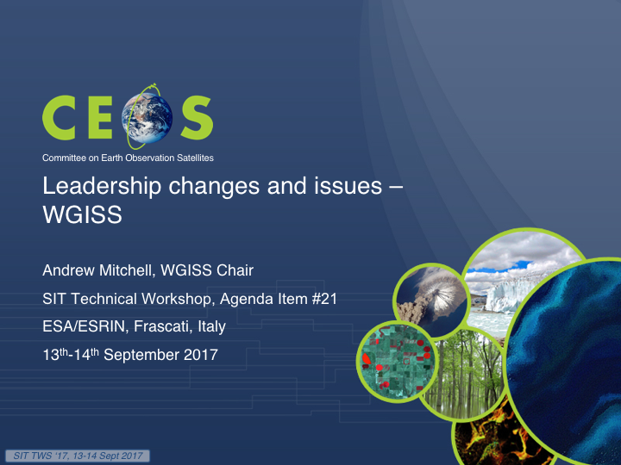

Committee on Earth Observation Satellites
Leadership changes and issues –
OST-VC
Jean-Louis Fellous, SIT Chair Team
SIT Technical Workshop, Agenda Item #21
ESA/ESRIN, Frascati, Italy
13th-14th September 2017

Slide 35
OST-VC – Leadership issue
The leadership issue that affects the otherwise very active OST-VC was put to the attention of SIT-32
  This leadership issue was related to the change of position of both former co-Chairs Philippe Escudier (CNES) and Hans Bonekamp (EUMETSAT)
  It resulted in the lack of reporting to the SIT Chair Team and lack of participation in tag up telecons from the OST-VC co-chairs since June-July 2016
This spring, EUMETSAT informed of the nomination of Remko Scharroo as their new co-chair for the OST-VC
However the OST-VC did not report nor participate in the tag up telecon in June-July 2017
35

Slide 36
OST-VC – Current situation
Last week, Juliette Lambin, a former CNES co-chair of the OST-VC and the successor of Pascale Ultré-Guérard, sent a message informing us that:
  “CNES has a strong interest in OST-VC activities” and “understands the inconvenience caused by the lack of reporting to CEOS”
  “Cooperation among space agencies in altimetry is very active (OSTST/OST-VC meeting in November 2016, inter-agency discussion on constellation user requirements, Cal/Val facilities, involvement in COVERAGE, common work on Jason(s), HY-2(s), SARAL, CryoSat, Sentinel(s) and SWOT.”
  [She is] “in the process of finding a new ‘ocean program manager’, who will come up soon, but not in time for the SIT TW”
On Thursday, 7 September, I attended in Toulouse a celebration by CNES of the 25th anniversary of the launch of Topex-Poseidon, also attended by NASA, ESA, EUMETSAT and other agency leaders, demonstrating the vitality of the OST-VC
This leadership issue should be resolved before next SIT meeting
36

Slide 37
Review of key issues for coordination before CEOS Plenary
Committee on Earth Observation Satellites
J.-L. Fellous, SIT Chair Team
SIT Technical Workshop, Agenda Item #21
ESA/ESRIN, Frascati, Italy
13th-14th September 2017

Slide 38
Key issues for coordination before CEOS Plenary
Preparation of the “Water” workshop
  Composition and mandate of a workshop task group
  Outline of a workshop planning document
Leadership issues
  WGISS Vice-Chair?
  WGDisasters new Vice-Chair approval
Finalizing the CEOS report to SBSTA – comments urgently required
Other?
38

Slide 39
Thank you for your kind attention…
… GOOD BYE and GOOD LUCK!
39

