Slide 1
International Financing Institutions (IFI) Engagement
Committee on Earth Observation Satellites
S Briggs, ESA
SIT Tech Workshop 2017 Agenda Item #23
CEOS SIT Tech Workshop
ESA/ESRIN, Frascati, Italy
13th-14th September 2017

Slide 2
Item Overview
Background – Strategic Partnerships discussion
SIT-32 Action Review
Outcomes of Monday IFI Session
Discussion on way forward

Slide 3
Background (1)
SIT Chair Team Theme
Maintain and improve effectiveness of our strategic partnerships, including with UN agencies, Development Banks, international programmes and agencies; the effective functioning of GEO, and CEOS within it, is a high priority
Key Partnership Trends
UN agencies …
Internet giants …
Development finance (from IFIs and national Aid agencies) sustainable and structured alignment of resources which do not finance space programs directly, but support through their own financing, activities, and competencies (e.g. capacity-building activities) in areas where EO already, or should, play a major role

Slide 4
Background (2)
GEO: Status of involvement with IFIs
GEO has recognised IFIs as critical partner, with special panel at upcoming GEO Plenary to discuss
Need to ensure coherent approach between CEOS and GEO in dealing with IFIs
Key mechanisms
IFIs and National Development Agencies support majority of geospatial activities in developing countries
Different modelities: how can IFIs:
Improve what is already being implemented?
Improve proposed delivery of planned projects?
Inform possibilities of innovative new policy decisions based on better knowledge of new technologies

Slide 5
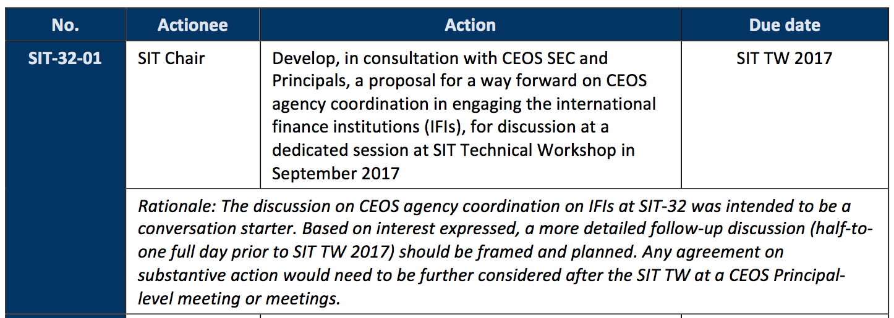
SIT-32 Discussion and Actions
Main discussion points from SIT-32 (Apr 2017)
Partners and Partnerships:
Follow-up at the SIT Technical Workshop on the potential for space agencies to collectively engage with development finance institutions was agreed.
SIT-32-01

Slide 6
Monday IFI Session
Session Objectives:
Understand the opportunity from the perspective of the IFIs
Understand the opportunity from the perspective of CEOS and CEOS Agencies
Consider the approach and process by which the activity could be taken forward
Review the draft white paper prepared by the SIT Chair Team and other contributors
Review the recommendations for CEOS Plenary (via SIT TW)

Slide 7
Monday IFI Session Outcomes - Overview
Principle objective agreed: to develop a coherent, consistent, and compelling set of materials to promote the ‘mainstreaming’ of EO for ODA
Need to address the Banks at three separate levels:
Improving ongoing implementation
Defining improved new implementation, further
New strategic policy opportunities afforded by EO information
Overall intention is for CEOS and its agencies to help build the case for EO at the policy level and with policymakers
Maximise the societal value of EO by reaching new domains
Make information and tools available to support IFI policies
Donor countries are the core funders - either bilaterally or via IFIs - and ultimate customers

Slide 8
Monday IFI Session Outcomes – Experiences and Activities
Main activities of CEOS, NASA, JAXA, ESA, DG-DEVCO, UKSA, NSO presented at the last SIT 32
In addition, short interventions given by GEO and seconded ESA staff providing resident on-site EO support in WB HQ and ADB HQ, main points:
Increasing interest in using geo-spatial information by IFIs as part of ‘How to better serve the Client State’ (i.e. improve lending operations)
Both WB and ADB are now initiating new activities to provide harmonised storage and access to geo-spatial information for Bank internal use,
Capacity-building (i.e. knowledge of how to use EO-based information) is a key element in uptake for both Bank staff and Client States,
EO represents only part of the solution and usually needs to be combined with other wider digital solutions,
Increasing trend to use ‘Open Data’ for transparency / accountability.
Language an issue, need to use terminology of Development community.

Slide 9
Monday IFI Session Outcomes - Approaches
Start with support to Bank policies, rather than capabilities
Translate the value of EO into language that the Banks can understand and incorporate into their decision making processes
Accessible data is not sufficient – certified methodology that produces transparent results is also required
OECD Development Assistance Committee sets the guidelines for development aid implementation – further opportunity to promote EO
CEOS agencies have invested in demonstration projects in order to help the IFIs understand EO capabilities
Possible European meeting of national development agencies to be convened by ESA
Include discussion of potential access to private sector (commercial) data

Slide 10
Monday IFI Session Outcomes – Next Steps for Discussion
Two outputs proposed
A Statement (one page) of the CEOS commitment to support the expanded use of EO in Development, highlighting the role and benefits that EO can deliver, and
A supporting document (10-12 pages) consisting of key summary information (based on the White Paper, 3-4 pages) to substantiate the Statement, followed by examples (8-10 pages) that illustrate the benefits and use of EO drawn from across the CEOS agencies.
Plenary to be asked to endorse the Statement on EO and ODA
Engage at the highest levels of IFIs using materials
Plan to make the most of GEO Plenary opportunity – Panels, and DC location with IFIs present: CEOS as the ‘space arm’ of GEO
Informally, NASA, JAXA, ESA, GEOSEC all indicated early interest in contributing to the proposed materials

Slide 11
SIT-32 Materials as Background

Slide 12
Strategic Partnerships
Committee on Earth Observation Satellites
SIT Chair Team
SIT-32 Agenda Item #4
CEOS Strategic Implementation Team
ESA Headquarters, Paris, France
26th-27th April 2017

Slide 13
Session objectives
Revisiting SIT Chair Team Theme
Maintain and improve effectiveness of our strategic partnerships, including with UN agencies, Development Banks, international programmes and agencies; the effective functioning of GEO, and CEOS within it, is a high priority
Take stock of trends and future directions within partner organisations so that CEOS can best serve needs of its membership and support future role of government EO programmes in service of society
Identify opportunities and challenges that need strategic attention
Focus on a sustainable and structured alignment of roles and resources between Development/Aid Finance and space agencies

Slide 14
Contents
Recap – evolution of CEOS partnerships, trends
SIT Chair Team survey and research into partnerships
Mature example of ESA – International Financial Institutions (IFI) partnerships
Discussion

Slide 15
Evolution of CEOS Partnerships for EO data uptake and benefits
80s
mid 90s
mid 00s
mid 10s
late 10s?
Major science programmes as Associates: WCRP, IGBP etc
Major users gradually introduced as Associates – WMO, GCOS, FAO…
Broadened with thematic studies/alliances under IGOS-P umbrella – effective in establishing requirements and observing strategies in major areas
Alliances merged into GEO (2003+). Decreasing prominence of Communities of Practice
New relations with thematic science communities via VC mechanism
Mature partnership with GCOS in support of UNFCCC/Parties
IGOS tradition continued via new CEOS Water, Carbon Strategies
Extended reach to individual govts and key intermediaries through thematic GEO programmes like GFOI and GEOGLAM – bringing CEOS and agencies closer to linking space data with societal benefits
Common role for UN agencies but complex in some cases
GEO role evolving, and hence CEOS partnerships
Much broader, less sophisticated user base for especially land surface imagery: users more policy and issue driven
Financing institutions becoming important partners (WB, ADB,..)_

Slide 16
Several key partnership trends
UN agencies have strong presence and country interface role in many of the thematic areas of active CEOS interest
Disasters, agriculture / food security, forests, climate
And supporting Conventions, Treaties (UNFCCC, WCDRR…)
Internet giants have changed expectations around ease of data access and application and are ‘stages’ for vast amounts of CEOS agency data. They also increasingly provide both conventional and machine learning processing capability
Development finance (from IFIs and national Aid agencies) sustainable and structured alignment of resources which do not finance space programs directly, but support through their own financing, activities, and competencies (e.g. capacity-building activities) in areas where EO already, or should, play a major role

Slide 17
Development Finance Partnerships
Committee on Earth Observation Satellites
SIT Chair Team
SIT-32 Agenda Item #5
CEOS Strategic Implementation Team
ESA Headquarters, Paris, France
26th-27th April 2017
Notes:
Several important partnership trends identified, one of which is partnerships with development finance organisations.
These partnerships have the potential directly support the improvements in the effectiveness of both CEOS activities, and help CEOS support the effective functioning of GEO, and CEOS within it.

Slide 18
Proposition
That alignment with development finance is an essential ingredient in ensuring sustained success for CEOS/GEO programmes which engage countries in the uptake and application of EO satellite data
Complementarity; IFI priorities are linked to societal issues & needs – space agencies have no such explicit links
Increase understanding within IFIs about how better to manage their projects using EO starting during design and implementation
CEOS, through GEO, could work better with IFIs, and agencies learn from each other:
Many GEO projects have implicit links to funding from IFIs in the target countries which are not visible
In addition to establishing a formal link with IFIs, GEO should also engagement at working level of IFI staff in GEO projects
Notes:
The basic proposition is that CEOS and GEO could help to make the case supporting the ‘mainstreaming’ of the use of EO-based information into international development projects and activities.
This includes the prospect of long-term, sustainable transfer into the working processes of the main International Financing Institutions.
This alignment is an essential ingredient to ensuring CEOS/GEO success.
Realising this potential will require maximum complementarity, and a space agency understanding of IFI priorities, how they are linked to societal needs, and how this can help address a space agency knowledge gap.
Will require increased understanding of how IFIs manage and implement their projects, and the role of EO therein.
There appears as well to be an opportunity for CEOS to work with GEO in this area.

Slide 19
Contents of topic
Examples of national development finance partnerships
UKSA-DFID
NASA-SERVIR
Example of the significance of development finance in sustaining CEOS/GEO programmes
GFOI
SIT Chair Team survey of partnerships
ESA-World Bank partnership (Stephen Coulson)
Discussion
Notes:
The next few slides will summarise an information gathering process undertaken by the SIT Chair Team to help inform this discussion.
Inputs were received from many organisations and individuals via an online survey, as well as direct follow-up via interviews and email.
Will cover examples of programmes in the UK and USA, IFI funding support to GFOI, and then a brief summary of the results of the survey.
We will then have an overview of some of ESA’s recent activities in the IFI space from Stephen Coulson.
And followed by a discussion on possible follow-ups, including the potential for a dedicated session (half day / day) in conjunction with the SIT TWS in September.

Slide 20
National example: UK IPP: International Partnership Programme IPSP: International Partnership Space Programme
UK Govt increased aid budget and UKSA/DFID cooperated in the definition of the IPP programme (and pilot precursor IPSP) to utilise UK space capabilities in support of development goals
IPSP: $US 46Mn over 2 years
IPP: $US 220Mn over 5 years
Partnering with developing countries and using space solutions to solve their specific challenges, and increase their capacity to respond to challenges
Notes:
UK’s IPSP and IPP are aimed at demonstrating and utalising the UK’s space capabilities in support of development goals.
The scale of finance gives you some sense for the resources involved here, and this is partially motivated by the UK’s goal of meeting the global benchmark of 0.7% of GDP being contributed to overseas aid (which few countries currently meet).
You can see the projects in IPP Call 1 are distributed globally, with a focus on Africa.
The thematic areas are diverse, including land and agriculture, disasters, marine, health, and education.

Slide 21
National Example: NASA-SERVIR
Joint venture between NASA and USAID since 2003
Sr. leadership support secured: high level MOU in 2011 (renewed 2016)
Resources
Annual budget: $US 5-10M annually plus commensurate USAid investment
Hubs: Amazonia, 2 x Africa, 3 x Asia
Supported directly by USAID missions in country
NASA MSFC: 22 member Science Coordination Office
ROSES supports via Applied Sciences Team for dev.
Cross Management and implementation based on relative strengths
Weekly joint Program Committee meetings – USAid + NASA/SERVIR
Theory of change culture adopted by NASA from USAid - entirely focused on hub-driven service consultation and definition
Hubs draw interest from a broad number of communities in country
Interest in non-NASA datasets;
Clear opportunity for optimisation by CEOS agency coordination
Notes:
Information on SERVIR was gathered largely through an interview with Dan Irwin and MSFC who is SERVIR Program Director for NASA.
This program is anchored with both strong top-down, and bottom-up support, including an MOU and annual senior leadership meetings between NASA and USAID (e.g. with Mike F).
The programme is built on a hubs model, with six globally, directly linked to the USAID missions in country.
According to the USAID ‘theory of change’, the priority activities are defined in the hubs through consultation with end users.
Application development is supported centrally through the Science Coordination Office at MSFC, and via a number of Applied Sciences Team grants – but applications are developed at the hubs with countries.

Slide 22
GFOI example
Core funding from the outset by Australia and Norway – with in-kind contributions from USA (SilvaCarbon), CEOS and FAO
Australia
Approx $US 750k per annum since 2011
100% development assistance funding (AusAid/DFAT)
Norway
From $US500k - $1.1Mn per annum
100% development assistance funding (NORAD)
USA
SilvaCarbon budget $US24.5Mn since 2011 ($4.0-6.1Mn pa)
100% development assistance funding (USAid & State Dept)
World Bank Forest Carbon Partnership Facility (FCPF) oversees $US billions of funds targeted for REDD+ support
GFOI is built & runs on development finance
Notes:
Core funding for GFOI, which CEOS supports directly by managing the Space Data Component via the SDCG for GFOI, from the outset as come from Australian and Norwegian aid resources.
SilvaCarbon also provides a large in-kind contribution to the capacity building component of GFOI, and is funded by USAID and the State Department.
The contribution of SilvaCarbon by USAID is a good demonstration of the role fit that can exist, where development finance play their role in supporting investment in capacity development.
At present, GFOI is built and runs on development finance.

Slide 23
CEOS Agency Survey
Surveys
8 responses received,10 projects detailed
Small sample size, but some useful information
Interviews: In depth feedback and discussion
ESA: Stephen Coulson
NASA: Dan Irwin (SERVIR), Brad Doorn (NASA HQ)
JAXA: Shizu Yabe (email)
Program Examples
UK: IPP
ESA: ODA (Official Development Assistance)
NASA/SERVIR
GFOI
Notes:
Survey response sample size was not large, but some useful information was gathered, and some follow-up discussions were initiated based on it.
As mentioned, we spoke with reps at ESA, NASA, and with JAXA via email.
And also gathered information on program examples directly.
The survey provided a partial snapshot, and is not comprehensive.

Slide 24
Agency Commitments
Agencies who responded: JAXA, CSA, NASA, ESA, GA, Mexican Space Agency, EC, NOAA, DLR + GFOI
Duration of Development Finance Interaction
1-2 years: 3
2-10 years: 2
> 10 years: 4
All reported currently ongoing
Rough Scale of Total Finance Value
More than $US 100 million over the periods reported
Plus > $US1 billion for WMO contributions (cumulative)
Notes:
The typical duration of interactions with development finance organisations varies greatly, and includes some sustained engagements of more than 10 years – this may be the timescale required to realise significant outcomes.
Significant finance amounts were reported, though this is only a partial snapshot and is not comprehensive.

Slide 25
Agency Activity
Projects in all major regions and the poles
Main organisations cited:
The World Bank [14]
Asian Development Bank [4]
Inter-American (IDB/IADB) [4]
Others: IFAD [2], EIB [2], EBRD [2], AfDB [1]
Significant interactions with UN Agencies reported
FAO, WMO, UNESCO, WHO
Plus UN-SPIDER, UN Habitat, GOOS, UNOSAT, UN-ISDR
Notes:
The agency activity with development finance reported was global.
Most of the efforts reported were in support of World Bank efforts, but a number of other development banks were mentioned.
There was also significant engagement with the UN system reported.

Slide 26
Project Activity
Project funding size reported varied widely
Major initiatives on the order of $US 50M/year (e.g. contributions to WMO)
To $US 5 - 10M/year (e.g. ESA ODA, NASA/SERVIR)
To $US 10’s – 100’s of thousands per year (e.g. individual projects)
Many subjects and products
Training and capacity building
Water
Environmental monitoring
Imagery and classification
Notes:
The size of individual funding allocations varied widely in the groups reporting, ranging from 10’s to 100’s of thousands, up to major sustained funding allocations.
Not surprisingly, a wide range of subjects were reported, including a focus on training and capacity building, and environmental monitoring.

Slide 27
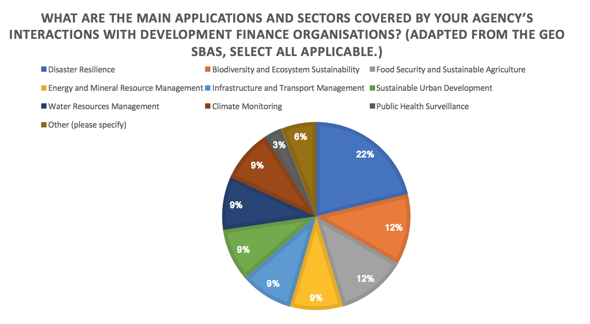
Survey Summary
Top Three Application Areas: Disaster Resilience, Biodiversity and Ecosystem Sustainability, Food Security and Sustainable Agriculture
Notes:
The top three application areas were disaster resilience, biodiversity, and food security.

Slide 28
Other Inputs Received
CSA and EC reported they are currently reviewing policy in this area
Space agency / aid agency co-funding and collaboration is desirable in many cases, but not yet the structural norm
Often funding is 100% from space agencies
Multiple references to projects with national aid agencies and activities
NOAA’s response highlighted contribution to weather forecast
Contributions already ‘mainstreamed’
CEOS SEO has been engaging World Bank and SERVIR on the working level
Notes:
Several other points of interest were raised in discussion, including that two of the agencies are actively reviewing their approach in this area.
At present, much of these efforts are funded 100% by space agencies, where a co-funding model is the goal.
There were a number of space agencies supporting their own national aid agencies directly.
Brian Killough has been engaging on the working level with the World Bank, and also with SERVIR.
Also of note that ESA has a secondee to the World Bank, and JAXA has one in place at the ADB with ESA adding an ADB secondee soon.

Slide 29
Interview: ESA IFI: International Finance Institution Partnerships
IFI are likely to be more open to 'alignment of resources' and support through (e.g.) financing capacity-building activities.
Default sentiment within the dev finance community is against spending money on technologies outside countries that will benefit.
Loans and finances intended to achieve economic growth in country, and tech can be seen to distract from this.
Main need that satellites address differentially is consistent and transparent environmental monitoring of projects.
CEOS and GEO should consider making the case for ‘mainstreaming’ EO in support of development bank activities and investments.
Notes:
We conducted an interview with Stephen Coulson on some of ESA’s activities.
He will present in more detail next, but we wanted to share some of the main points we took away from discussing with him.
The language and approach of the space agencies here is important; we should not assume that we have the technology, and therefore they will naturally want to engage.
There is a ‘default sentiment’ in the development finance community against spending money outside of countries on technology solutions.
The objectives of development finance should be understood, and are ultimately intended to achieve economic growth in countries.
There may be a need and an opportunity for the ‘observations community’, CEOS and GEO, to help construct the case of the mainstreaming of EO in support of development bank activities and investments.

Slide 30
ESA-IFI Partnerships
Committee on Earth Observation Satellites
Stephen Coulson, ESA
SIT-32 Agenda Item #6
CEOS Strategic Implementation Team
ESA Headquarters, Paris, France
26th-27th April 2017

Slide 31
Discussion
Committee on Earth Observation Satellites
SIT Chair Team
SIT-32 Agenda Item #7
CEOS Strategic Implementation Team
ESA Headquarters, Paris, France
26th-27th April 2017

Slide 32
Seed Questions
Should and could space agencies do more through CEOS and GEO to work more effectively with IFIs?
How should we work with GEO?
And might we use GEO convening power to facilitate the cooperation?
structured engagement around the grand challenges we share in common
GEO partnerships with the banks:
how to engage the WB to address the 3 GEO priorities (SDG, Disasters and Climate Change).
are there any plan from GEO to extend that relationship with other major development banks e.g. ADB ?
How to build on existing agency expertise and experience?

Slide 33
Potential Outcomes
Further dedicated session around SIT-TW (Sept) at ESRIN
CEOS initiative from 2018 in cooperation with GEO?

