Slide 1

Ad Hoc Team on the Sustainable Development Goals (AHT SDG)
Committee on Earth Observation Satellites
Co-leads (CSIRO, ESA, USGS)
SIT Technical Workshop 2017, Agenda Item 22
CEOS Strategic Implementation Team
Technical Workshop
ESA/ESRIN, Frascati, Italy
13th-14th September 2017

Slide 2
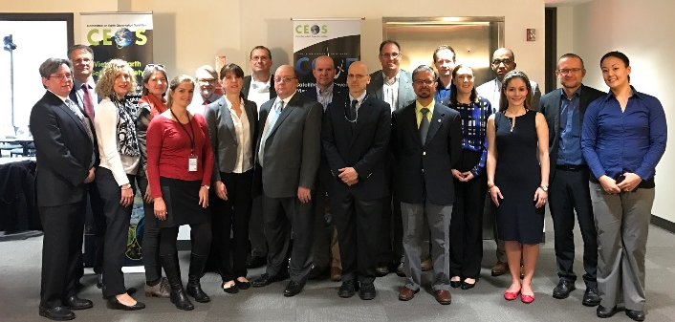
CEOS AHT SDG
Background
CEOS 30th Plenary (Brisbane, 2016) decided the creation of an Ad Hoc Team on SDGs (AHT SDG) until next plenary (CEOS 31st Plenary, 18-20 Oct 2017)
3 current co-leads : CSIRO (A. Held), ESA (M. Paganini), USGS (E. Wood)
Today ~30 members (mailing list)
AHT SDG face-to-face meetings in 2017:
Strategic meeting in Washington DC, 8-9 March
(+ external stakeholders on day 2, ~25 people)
Side-meeting in Paris, CEOS SIT-32 on 25th April
Side-meeting in Frascati, CEOS 2017 TW on 11th September
AHT SDG Terms of Reference produced for noting at SIT-32 (Paris, April 2017)
CEOS 30th Plenary, Brisbane, 2016:
“In 2017, the team will develop recommendations for CEOS Principals
on how CEOS should organise itself beyond 2017
to support CEOS engagement on the SDG agenda, including its relationship with GEO”

Slide 3

CEOS AHT SDG:
Terms of Reference (ToR)
In the complex and evolving SDG environment,
the AHT SDG must
take stock of the UN processes in place for the SDG implementation and of the existing SDG stakeholders (including GEO),
focus its activities around the unique role that CEOS should play as a coordination body of the Space community efforts to support the integration of satellite EO in support to the full realisation of the SDGs.
The AHT SDG can’t progress alone but relies on existing networks/partnerships:
AHT SDG aligns its engagement in the context of
(Programme Board, Engagement Strategy, GEO EO4SDG initiative)
AHT SDG builds on established relationships CEOS Agencies have with the UN agencies (custodians), individual countries (eg. national statistics), and other SDG stakeholders (eg. foundations, universities, development banks).

Slide 4
CEOS AHT SDG:
Terms of Reference (ToR)
The AHT SDG will assess, showcase and promote EO contribution
to SDG Targets and Indicators
CEOS AHT SDG – ToRs (summary):
Coordinate the efforts of CEOS agencies and channel CEOS support to the SDG process (EO showcases, communication material, etc.) through GEO.
Provide a forum for sharing/communicating EO best practices in support to the SDGs (in collaboration with GEO).
Analyse new opportunities for satellite-based EO to support SDGs Targets and Indicators (methods, data, indicators), in part via enhanced engagement of CEOS agencies within the GEO initiatives and flagships.
Engage with relevant authoritative SDG stakeholders inside (e.g., IAEG-SDGs/UNSD, UN GGIM, WGGI, Custodian agencies) and outside the UN system (e.g., GPSDD, IISD, WBG, Foundations).
Use CEOS assets and bodies (WGCapD, AHT FDA, SEO, etc.) to build and strengthen EO capacities at all levels of the UN SDGs implementation.

Slide 5
CEOS AHT SDG
Key activities until CEOS 31st Plenary
Develop a compendium of existing CEOS Agencies engagement and activities in the SDG framework.
Organize a discussion at SIT TW to review CEOS current engagement and identify gaps and opportunities.
Identify key components of an implementation plan to present at CEOS 31st Plenary in October 2017.

Slide 6
AHT SDG Implementation Plan
Key elements
Compile a compendium of CEOS Agencies’ engagement on SDGs.
Define a coherent CEOS engagement plan on SDGs.
Coordinate CEOS support to GEO-led SDG activities.
Review and assess the contribution of EO to the SDG Targets and Indicators.
Foster the added-value of EO data in the SDG monitoring and reporting process.
Facilitate uptake of EO by SDG stakeholders.
Conduct impactful Communication & Outreach activities on EO for SDGs.

Slide 7

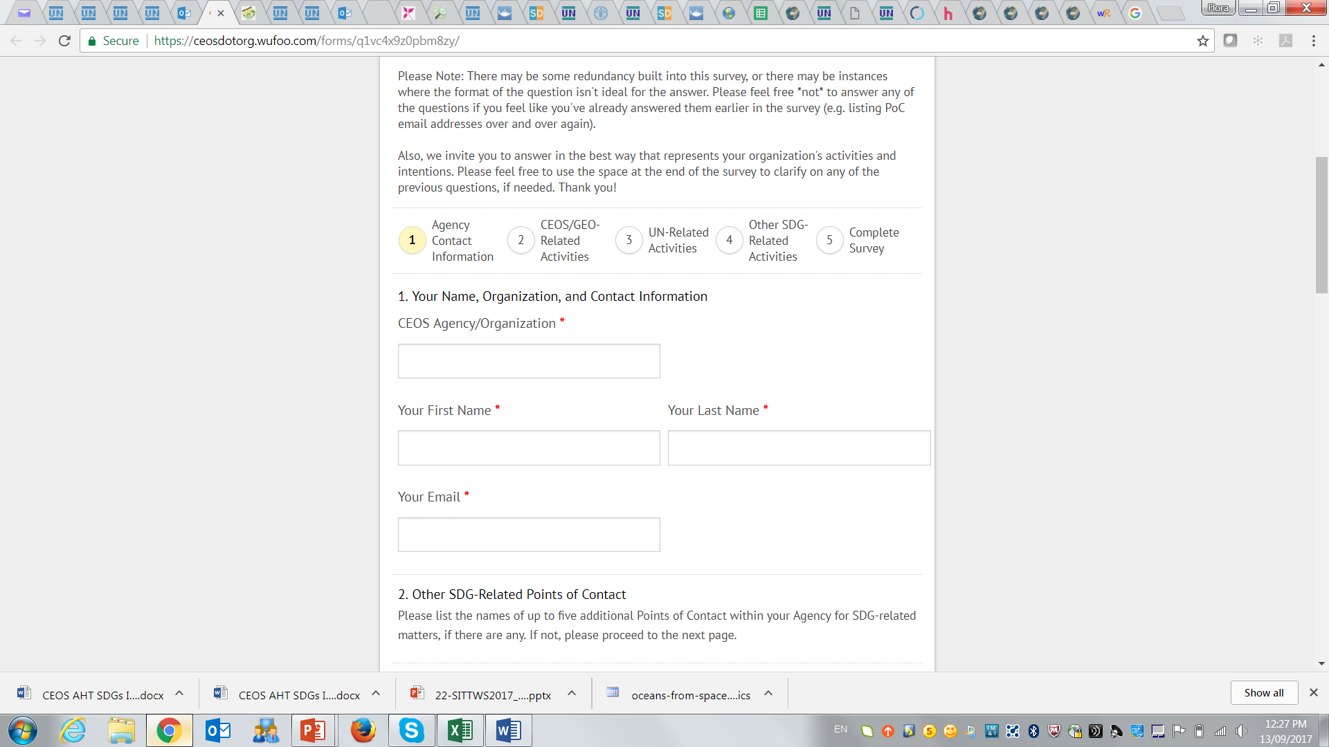
AHT SDG Implementation Plan
1. Compendium of Agencies’ engagement
Objective: Collect and centralize information across CEOS Agencies on their SDG engagement and related activities, through online surveys and other consultation channels.
Why? For CEOS internal use, to collect main points of contacts, identify strengths and weaknesses in CEOS collective engagement, and better coordinate / align / optimize CEOS agencies' engagement on SDGs..
2018+ activities:
Maintain and centralize the CEOS Engagement Compendium on SDGs as a living database, with up-to-date information, for consultation by all CEOS Agencies.
2017 activities:
A simple online survey was circulated to get basic information on Agencies’ engagement: PoCs, GEO/CEOS activities on SDGs, UN system on SDGs, international/regional initiatives, national agencies (NSOs), internal projects related to SDGs, global/regional datasets
      Only a few agencies responded: Purpose of survey needs to be well communicated. Survey needs also to be improved for more effective, constructive responses from CEOS Agencies.
  Engagement Compendium will be consolidated for CEOS 31 Plenary

Slide 8

AHT SDG Implementation Plan
2. CEOS engagement on SDGs
With GEO
Objective: Develop a consistent and coherent CEOS engagement strategy on SDGs.
Why? To identify, maximize CEOS efforts and available resources on SDGs for a higher impact (on the use of EO in SDGs) and tangible benefits for CEOS agencies.
2018+ activities:
In-depth analysis of CEOS Agencies’ engagement on SDG Targets and Indicators with identification of strengths and weaknesses (gap analysis).
Define an effective engagement strategy (in partnership with GEO) with:
  GEO (EO4SDGs initiative, GEO Program Board, GEO initiatives & flagships)
  UN system/International organizations: UN-GGIM, GPSDD, S&T Innovation Forum; Custodian Agencies IFIs, Foundations… (participation of CEOS associate members to be better encouraged & strengthened)
  Countries: National Statistical Offices, government authorities, technical institutes.
2017 activities:
Attained a firm grasp on the SDGs landscape and identified key SDG stakeholders.
Analysis of CEOS Agencies’ engagement on SDGs.

Slide 9
AHT SDG Implementation Plan
3. CEOS support to GEO-led SDG activities
With GEO
Objective: Coordinate CEOS support to GEO-led SDG activities, through the 3 GEO complementary channels (Program Board, EO4SDG and GEO initiatives/flagships)
Why? To optimize the development and maximize use of EO solutions (methods, tools and products) in GEO SDG-related activities, and their uptake by SDG stakeholders.
2018+ activities:
Strategic: support CEOS representative to the GEO Programme Board to ensure GEO's Work Program aligns with SDG priorities, identifying gaps and proposing additions/modifications to the GEO Work Program.
Tactical: coordinate the CEOS agencies’ contribution to the GEO EO4SDG initiative.
Implementation : strengthen CEOS agencies’ involvement in GEO community activities, initiatives and flagships (with EO relevance for SDGs), promoting an adaptation/tailoring of existing EO methods/products/tools to SDG Targets and Indicators.
2017 activities:
Started to review the GEO work program and identify key EO-related activities missing in the program OR where CEOS Agencies should be more actively involved.
Participated in EO4SDG conference calls, and international events to showcase the value of EO for SDGs (e.g. ISRSE-37, GEO/CEOS side event on SDGs at GEO XIV Plenary)

Slide 10
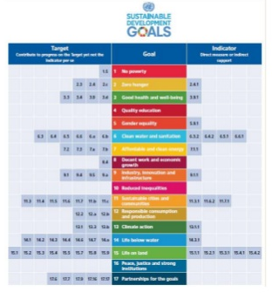
AHT SDG Implementation Plan
4. EO contribution to SDG targets and indicators
With GEO
Objective: Assess the current and potential contribution of EO to the SDG Targets and Indicators (through the lenses of space-based EO) and identify areas of better EO uptake.
Why? To increase the effective use of space-based Earth Observations in the overall SDGs process (targets achievement and indicators’ monitoring) and by all key players (global to local)
2018+ activities:
Conduct an in-depth analysis of the use of EO in the IAEG-SDGs Metadata Repository (SDG Indicators) and as a source of information for countries to better achieve their targets.
Communicate the result of the analysis - through the GEO EO4SDG initiative - to the IAEG-SDGs Working Group on Geospatial Information (WGGI) and contribute to the program of work of the WGGI (supporting GEO EO4SDG members)
2017 activities:
Analyzed and reviewed the global Indicators framework
(consolidated tables have been circulated)
Initiated an ESA-funded project on EO4SDGs that includes a thorough study of the current and potential contribution of EO the SDG Targets and Global Indicator Framework (call issued in August, start in 2018 Q1).

Slide 11
AHT SDG Implementation Plan
5. Forster added value of EO for the SDGs
With GEO
Objective: Showcase the value of EO for achieving the SDG targets and monitoring progress (indicators) though selected pilots that can lead to wide adoption by SDG stakeholders
Why? To increase the use of Earth Observations in the overall SDGs landscape (targets and indicators) and by all actors (from global to local levels)
2017 activities:
Initiated SDG pilot projects in partnership with GEO (e.g. CEOS/GEO SELIS proposal to the GPSDD-WB Call on “collaborative data innovation for SD” on the use of data cube technology for SDGs).
2018+ activities:
Compile EO best case practices for SDGs starting with the 5 SDGs where GEO is the most actively involved: Zero Hunger (SDG 2), Water and sanitation (SDG 6), Sustainable urbanization (SDG 11), Life below water (SDG 14), Life on land (SDG 15).
Launch one or two national/regional large-scale SDGs pilot projects (in partnership with GEO EO4SDG and relevant GEO activities), starting from the methodological guidelines provided by the custodian agencies and engaging with key players (incl NSOs)
Develop EO capacity building / training in countries: online courses and webinars on the integration of EO in the SDGs monitoring (in partnership with GEO, custodians and NSOs)

Slide 12
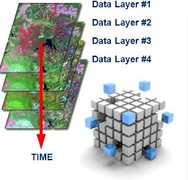
AHT SDG Implementation Plan
6. Facilitate uptake of EO by SDG stakeholders
With FDA and SEO
With GEO
Objective: Review availability and demonstrate utility of Big Data tools and
infrastructures to facilitate uptake of satellite-based EO data by SDG stakeholders
Why? Facilitate the discovery, access, processing and analysis of EO data and
information by all SDG actors (from global to local levels)
2017 activities:
Initiated, in partnership with GEO, a number of national demonstrations on the utility of the CEOS data cubes for SDG monitoring and reporting (e.g. Colombia, Balkans)
2018+ activities:
Analyze the capacity of existing and under-development “EO Computing Tools” (Online platforms, Toolboxes and Big Data analytics tools) to serve the SDG stakeholders, addressing both global and national needs.
Conduct a number of pilot country cases to demonstrate the value of big data analytics tools (e.g. CEOS Datacube) with a particular focus to the developing countries (leaving no one behind).
Demonstrate the up-scale potentials of EO approaches for SDG monitoring and reporting:

Slide 13

AHT SDG Implementation Plan
7. Communication & Outreach activities
With SEO
With GEO
Objective: Promote the value EO for SDGs at international, regional and national levels
Why? Raise awareness of the value of EO amongst SDG community and showcase benefits.
2018+ activities:
Finalize the CEOS Handbook on SDGs for distribution at UNSC-49 (March 2018), 7th IAEG-SDGs meeting (March 2018), HLF (July 2018) and UN GGIM Plenary (August 2018)
Participate in the SDG-related events (in partnership with GEO) to continue raising awareness and informing SDG stakeholders on the value of EO for the SDGs.
Contribute to the development of a GEO Portal on SDGs (EO4SDG website) as an EO Knowledge Hub for SDGs, with the provision of EO best case practices, demonstration products, global/regional data sets, Toolboxes.
Develop Primers/flyers on the importance of EO for SDGs (with GEO)
2017 activities:
Contributed to the production of a GEO-CEOS joint report on “EO in service of the 2030 agenda for SD” (distributed at UNSC-48).
Started to contribute to a number of GEO Primers on EO for SDGs.
Started the production of a CEOS Handbook on SDGs

Slide 14
CEOS AHT SDG
what next up to CEOS Plenary?
Streamline and simplify the survey on the CEOS Agencies’ engagement to collect more
responses, and prepare a first Compendium on CEOS engagement on SDGs.
Compile the content (first draft) of the CEOS Handbook for SDGs.
Develop an Implementation plan with key activities, for endorsement at the Plenary
(to be shared with CEOS Principals prior to submission to Plenary).
Prepare the CEOS/GEO side-meeting at the GEO XIV plenaries next October.
THANK YOU FOR YOUR ATTENTION
Recommend an extension of 1 year (more?) for the AHT SDG
Call for CEOS Agencies to actively participate to the work of the AHT
(eg. as IP Task leader)
CEOS contacts:
Eric Wood (USGS, co-lead of the AHT SDG) woodec@usgs.gov
Marc Paganini (ESA, co-lead of the AHT SDG) marc.paganini@esa.int
Alex Held (CSIRO, CEOS Chair 2016 & co-lead of the AHT SDG) alex.held@csiro.au
And Flora Kerblat (CSIRO, AHT SDG team) flora.kerblat@csiro.au
CEOS web pages on SDGs:
http://ceos.org/ourwork/ad-hoc-teams/sustainable-development-goals/

