Slide 1

Incoming CEOS Chair Carbon Coordination Activities
Committee on Earth Observation Satellites
Mark Dowell
European Commission
CEOS Strategic Implementation Team Tech Workshop
ESA/ESRIN, Frascati, Italy
13th-14th September 2017

Slide 2
Copernicus Context: CO₂ Report –November 2015
'Towards a European Operational Observing System to Monitor Fossil CO₂ Emissions'
Emphasis on systems: inventories, space-borne and in-situ observations, data assimilation framework, inversion system, transport models, decision support system
Emphasis on operational intent – from the outset
Fundamentally underpinned by strong user requirements based on international commitments and corresponding EU Policy implementation
Fundamental added value of international engagement on multiple aspects of system implementation/development

Slide 3

CO₂ Monitoring Task Force Status
Sub-task A (lead by EC-GROW & ESA):
  Group of experts focusing on the space component
  4 meetings since June 2016
  Output: Mission Requirements Document & Supporting Studies
Sub-task B (lead by EC-GROW & EC-JRC):
  Group of experts focusing on the end-to-end monitoring system
  Output: user requirements and preliminary high-level system architecture
  Output #1: Report on “Baseline requirements, model components and functional architecture for an operational Anthropogenic CO₂ Emission Monitoring & Verification Support Capacity”

Slide 4
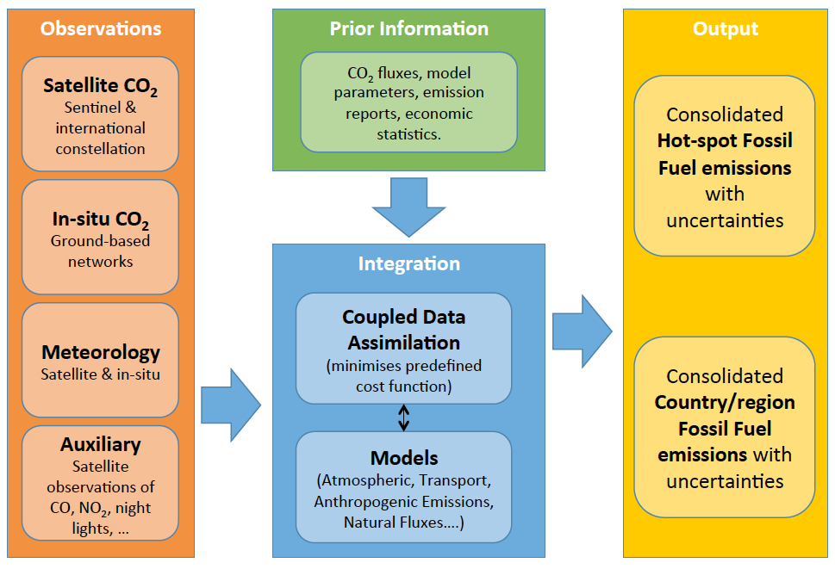
Overview of the Core Elements of the Anthropogenic CO₂ Emission Monitoring & Verification Support (MVS) capacity

Slide 5
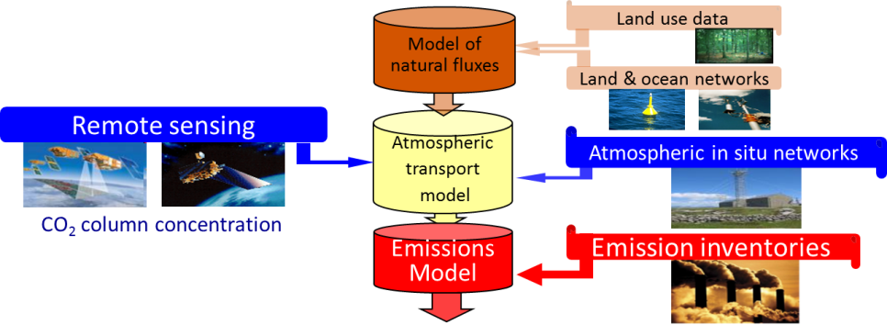

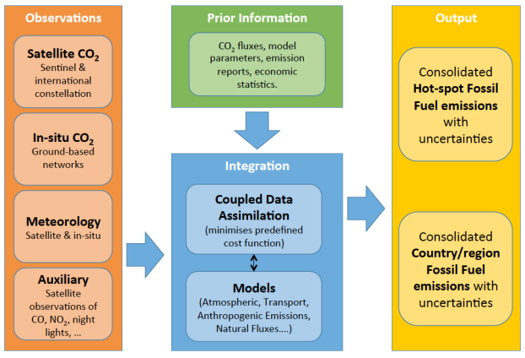
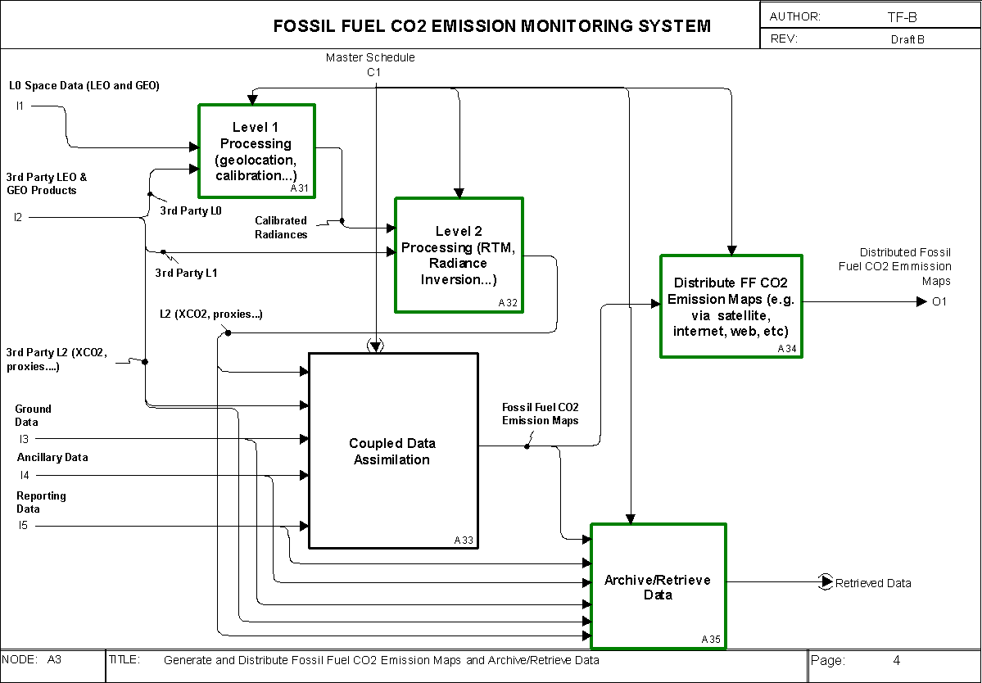
Functional Architecture –
Basis for Future Implementation
2015
2017

Slide 6
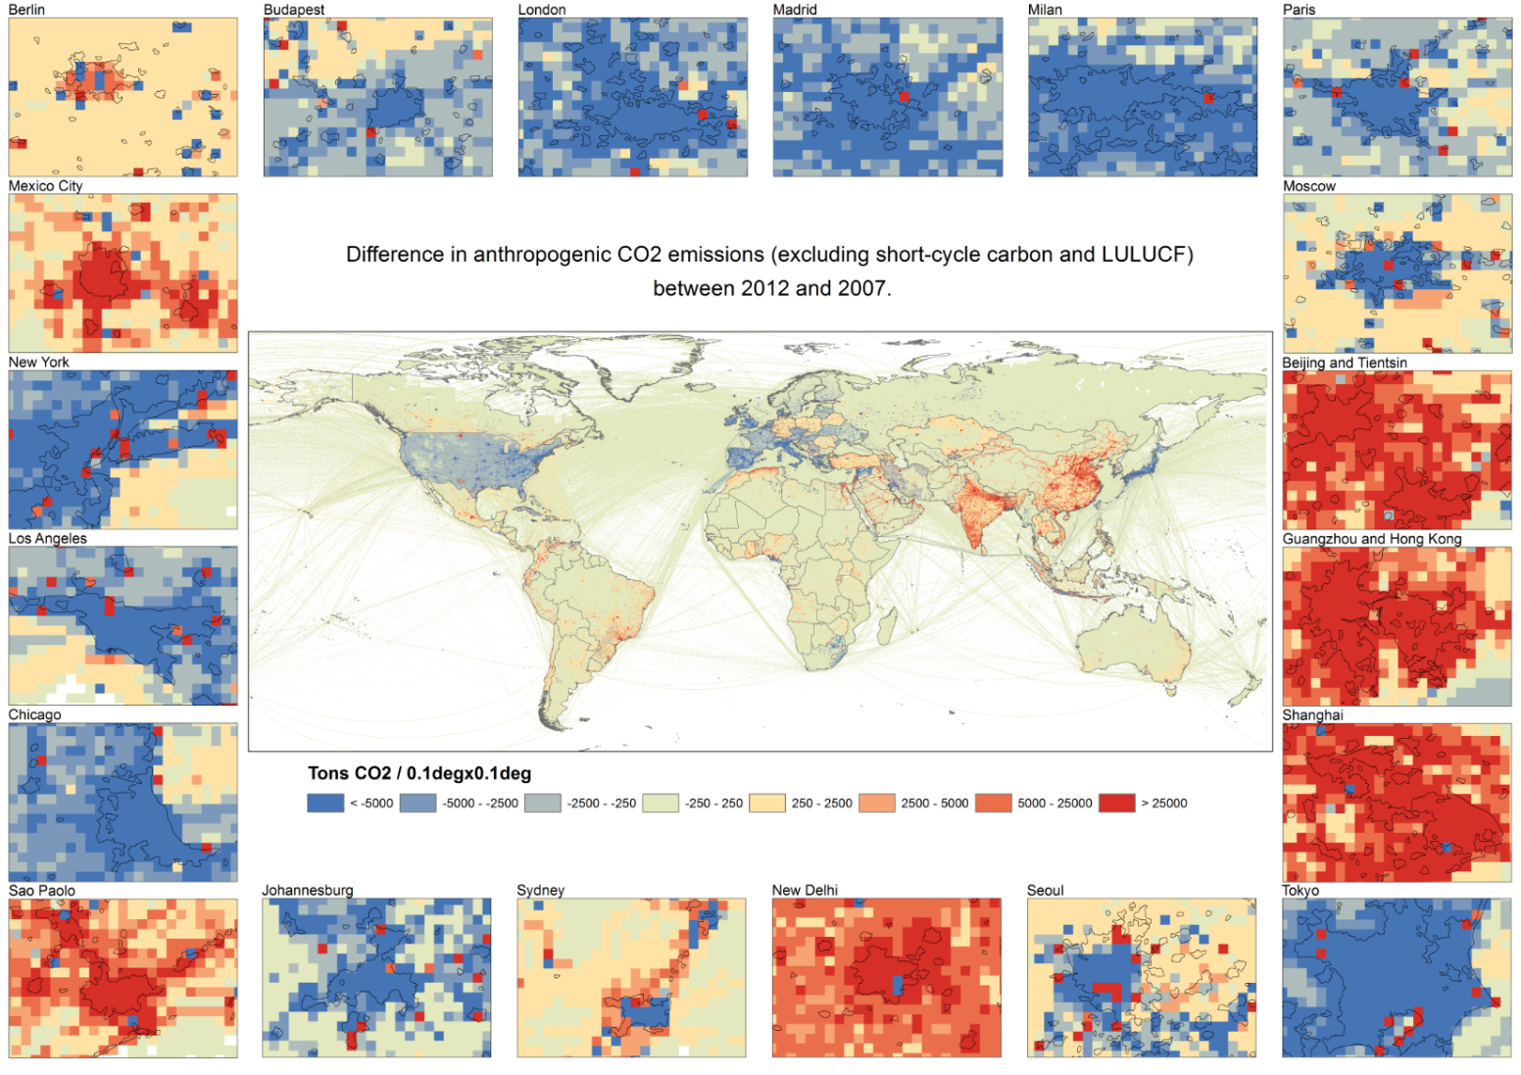
Fossil CO₂ Emission Difference 2012-2007
ton/yr
Change is expressed on a 0.1x0.1 degree grid
Notes:
Let us focus on some cities in the following zoom of the same gridmap of difference in annual emissions between 2012 - 2007. The European cities in the top row show that the hot spot changes are often present at the border of the city (because power plants are rather located just outside the city). Going global, it is noted that cities of USA (left column), South Africa or Japan show the same feature, whereas cities in Eastern countries (Russia, China) show large hot spot changes within the centre of the city (e.g. Moscow). The system would need to monitor all megacities with their suburban areas.

Slide 7
High Level Requirements for the System
km & daily scales
Detection of emitting hot spots such as megacities or power plants.
Monitoring the hot spot emissions to assess emission reductions/increase of the activities.
Assessing emission changes against local reduction targets to monitor impacts of the NDCs.
Assessing the national emissions and changes in 5-year time steps to estimate the global stock take.
Accuracy
Space & Time Resoltuion
200-400 ton/year
Notes:
The CO2 monitoring and verification system follows as modus operandus the following 4 steps "1) detection of hot spot, 2) quantification of hot spot emission and monitoring this over time, 3) assessing the sum of the changes of the hot spot emissions belonging to a given country (allowing to follow implemented measures on the largely emitting facilities), 4) monitoring the change in emission pattern to identify potential shifts or new hot spots and evaluate the trend of the country emissions (most challenging). While the first step requires high resolution to resolve the hot spot emissions (km, daily), the last step requires large coverage and no longer high spatial and temporal resolution. On the contrary, the accuracy needed to measure the changes in emissions are becoming more demanding for step 3 and 4 when covering all emissions for an entire country, which is not only composed of hot spots. To measure the emission changes of a European country (in average only 1% relative change per year, mounting to an averaged 10% change over 5 year), the system needs to distinguish a few hunderd ton of CO2 emissions per year for the gridcells/pixels composing the country.
200 tons per yr for the grid cell area of 0.1degx0.1deg corresponds to a change of 1% of the total inventory of Belgium, which is the expected change of the Belgian inventory over 5 yr.

Slide 8

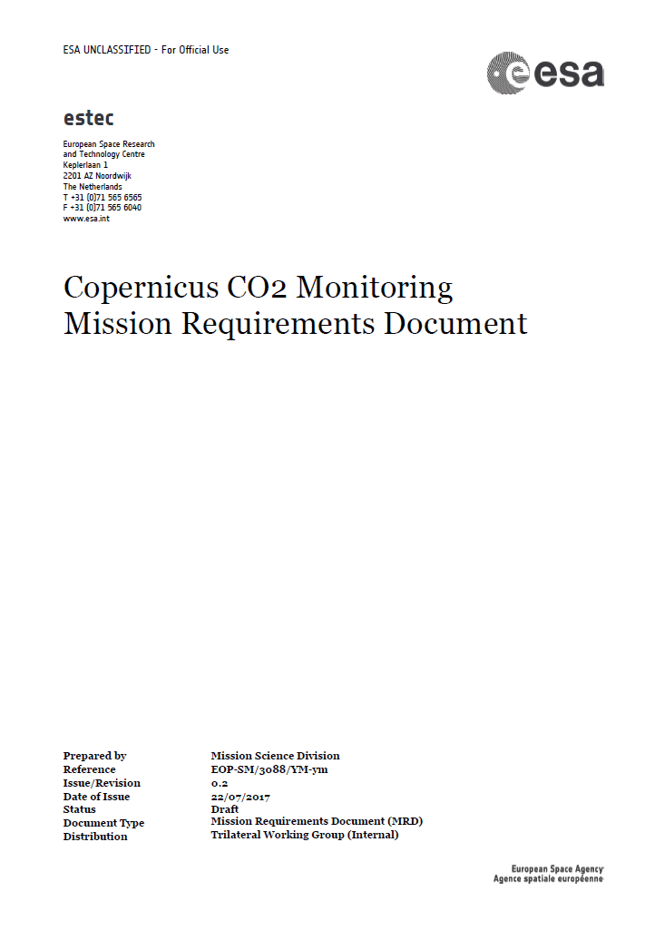
Timely inputs to policy makers
Paris
Agreement
Global Stock
Take 1
Global Stock
Take 2
CO₂ Task Force
using inventories of 2021
using inventories of 2026
2015
2017
2021
2023
2026
2028
Initial system capacity built up
Launch target for
Copernicus S-7
constellation

Slide 9
CEOS Chair 2018 priority A
Specific Chair Initiative #1: Laying the foundation for an international CO2 and GHG monitoring system
Three specific activities are foreseen for advancing this effort in 2017-2018:
Facilitate the completion and follow-on activities of the AC-VC whitepaper on defining an optimum constellation for CO2 and GHG monitoring, including the joint competences of CEOS and CGMS, and in the general framework of the continued implementation of the CEOS Carbon Strategy
Place the space segment in the broader context of a fully sustained system for CO2 monitoring. Individual CEOS Agencies have counterparts in their individual countries/regions who have responsibility for Inventories, the required modelling, in-situ infrastructure and the ground segment elements.
Advance the relationship with CGMS for an operationally implemented and sustained observation capability. Consider establishing a formal working relationship between CEOS and CGMS as with the successful ongoing relationship on Systematic Observations of ECVs in support of UNFCCC.

Slide 10
Chair priority A workshop in 2018
On “placing the space segment in the broader context of a fully sustained system for CO2 monitoring”
The EC proposes to organise a dedicated discussion workshop:
Bringing together these different stakeholders to define best practices and synergies
Exploring possibilities for common approaches to some of the system development.
This would also require the strong engagement of CGMS as well as CEOS Associate members such as the WMO.
End-May - > June 2018 period. Probably somewhere in Northern Italy …

