Slide 1
Outcomes from the Trial Joint Meeting of LSIVC, SDCG, and the GEOGLAM ad hoc Working Group Presenters: Brad Doorn, Eugene Fosnight, Adam Lewis
Committee on Earth Observation Satellites
SIT Workshop
Session 3: Item 13
Frascati, Italy
13 September 2017

Slide 2
Joint Meeting Outcomes
GEOGLAM perspective
Update at a Glance:
Requirements expanded for satellite and in situ data for more products
13 vs. 7
Includes questions on requirements for
Data
Analysis (includes pre-processing)
Allows users to specify “minimum” and “preferred” requirements
Supports LSI-VC efforts on CARD4L and MRI
Next Steps:
Workshop targeting operational users
2018
Identify gaps in data acquisition, provision, access/use
Inform R&D agenda based on gaps
Inform requirements based on operational user needs and R&D results

Slide 3
Joint Meeting Outcomes
GEOGLAM perspective (cont)
Demonstrated success of EO-based yield, area (i.e. crop production info)
Need to capture successes more systematically
Moving from data scarcity to data saturation
Improved processing is a priority task
Data Cube for JECAM
FS-TEP - ESA
ARD’s are not just an option anymore, but a necessity
Asia-RiCE - JAXA
Integrated multi-sensor products are priority
JECAM has a SAR inter-comparison & cross-site experiment (CSA support)
Sen2Agri, Asia-RiCE also participating

Slide 4
Joint Meeting Outcomes
SDCG perspective - LSI-VC -> GFOI
SDCG Baseline Acquisition Strategy considered a success as the EO community transitions from a period of data scarcity to data plenty providing today yearly multiple coverages of global forested area:
Reviewed status and future of major core products including Sentinel-2, Sentinel-1, Landsat, CBERS, and ALOS-2 mosaics
Baseline archive data sets including JERS-1, Landsat 1-5, and SPOT 1-5 products provide opportunities to establish longer forest monitoring frameworks
Landsat and Sentinel-2 transitioning to formal ARD surface reflectance products in 2018/2019
Sentinel-1 toolkit and ALOS-2 mosaics provide global core SAR ARD for user applications

Slide 5
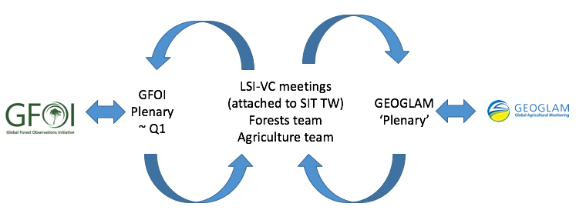
Joint Meeting Outcomes
SDCG perspective - GFOI->LSI-VC
GFOI Phase 2 has reemphasis on user driven requirements
R&D
GFOI/SDCG R&D reinvigorated with GOFC/GOLD-ESA leadership
Productive GFOI Early Warning meeting with WRI and GOFC-GOLD with major user requirements component for 2018
Data Services in support of countries
COVE tools available for generating country acquisition reports and for accessing data (70 countries on gfoi.org)
CEOS Data Cube and time series tool development continues with partners in several countries
Synergy between groups provide opportunities to share requirements and user experiences
Meeting would benefit from less overlap

Slide 6
Joint Meeting Outcomes
LSI-VC perspective
CARD4L
Identified a number of actions to better communicate benefits to data providers
Progressed Product Family Specifications and agreed how to implement and update them over the coming year
Discussed preparation for the SIT TW VC/WG day discussion on CARD4O and CARD4A possibility
Moderate Resolution Interoperability (MRI)
Discussed way forward for MRI
Identified a need to engage with users around CARD4L and interoperability
What do we need from SDCG and GEOGLAM?
LSI needs to engage with users to gather feedback on the benefits of CARD4L and MRI

Slide 7
Joint Meeting Outcomes
The Future of Joint Meetings
Thematic teams will continue to engage with their user communities
The mode of engagement with user communities demonstrated by GEOGLAM and SDCG is highly successful for CEOS and should continue.
There would be no benefit in ‘putting these under’ LSI-VC
Further joint meetings are anticipated to be beneficial
Co-location of meetings and shared discussion on common topics has the potential to identify significant synergies and allow common interests to be explored more effectively
Co-location of meetings poses some logistical challenges – larger venues are needed – yet reduces others – fewer meetings overall need to be arranged.
GEOGLAM and GFOI meetings with user groups would continue, and could not be replaced with joint meetings.
Future joint meetings are likely to need some ‘tweaking’, e.g., to have more joint sessions and less parallel sessions
A number of areas of shared work are emerging that would provide the subject material for joint meetings, such as:
Capturing user experiences in interoperability and analysis ready data, and feeding these back into CEOS e.g., Product Family Specifications
The increasing maturity of the requirements gathering process, building on the work of GEOGLAM / Alyssa Whitcraft
The use of a common requirements gathering framework to capture future requirements, anticipating that additional requirements will emerge as Earth observation is aligned with GEO and delivery to support the Sustainable Development Goals

Slide 8
Joint Meeting Outcomes
Implications for organisational structure
Thematic ad-hoc teams can be expected to be enduring for the period during which the flagship issue is supported:

