Slide 1

GEOGLOWS
Development and expectations
Selma Cherchali
(on behalf of the GEOGLOWS Steering Committee)
CEOS SIT Technical Workshop
Frascati, 13th September 2017

Slide 2

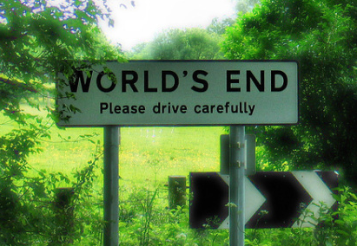
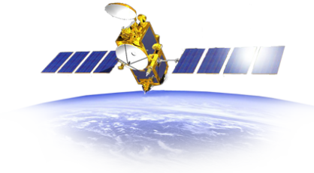
Introduction
The challenges
Climatic and environmental stakes
    What climate shall we have tomorrow?
    Increases in global sea and air temperatures
    Widespread melting of snow and ice
    Rising global sea level
    How to improve our models?
      What are the observation and accuracy needs for global water and energy cycle research, and for global climate change research? continental to global scales to augment climate networks.
    How to predict at a finer scale?
      What are the accuracy needs for water management, flood prediction, reservoir operation, agriculture and drought assessment? regional problems and real-time data needs to augment operational networks.
    To spatialize and to refine scale of perception
    Observations at high spatial and temporal scales
    (precipitations, evapotranspiration, water vapor…)
  “ We do not inherit the land from our ancestors, we borrow it from our children”
  (Native American proverb)

Slide 3
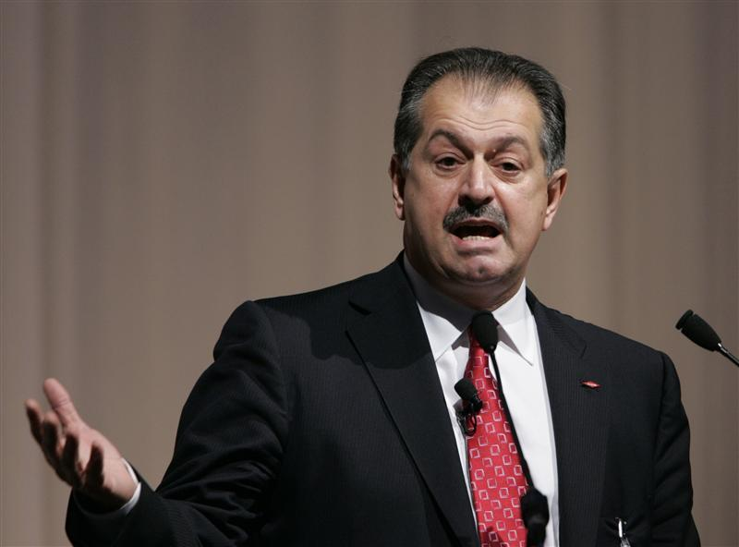
Introduction
The new challenges
“Water is the oil of the 21st Century”
Andrew Liveris, the chief executive of Chemical
water: a major stake in the 21th century
    → Understanding the processes which govern the production of the water and its distribution in the various compartments of the Earth surface
What type data for tomorrow and which distribution scheme ?
World programs in hydrology and water are looking to space-based observations to provide needed observations of sufficient accuracy for water resource applications.
What socio - economic benefits?
Consider end-users requirements
Benefits of Earth observations applications to decision making
Develop services

Slide 4
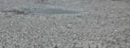
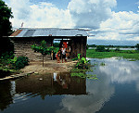
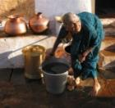
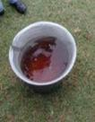
Why GEOGLOWS?
Water sustainability is a critical issue in sustainable development and for the achievement of the SDGs.
Decision-making in water resources planning and management can be supported with the improved use of earth observation data and associated analytical tools and services.
Poor awareness and use of the available and evolving data (incl. from earth observation) and analytical services especially in the developing world.
Strong need to improve open, public-domain access to critical data and analytical services
Need for improved partnerships to improve quality of supply of services and connect to demand of end-users.
This can lead to modernized management of water resources to improve productivity and better manage climate risks

Slide 5






GEOGLOWS’ Links with others initiatives
EO4SDGs
EO4W-E-F Nexus
GDIS
EartH2Observe

Slide 6

Integration and coordination with Blue Planet and Aquawatch

Slide 7
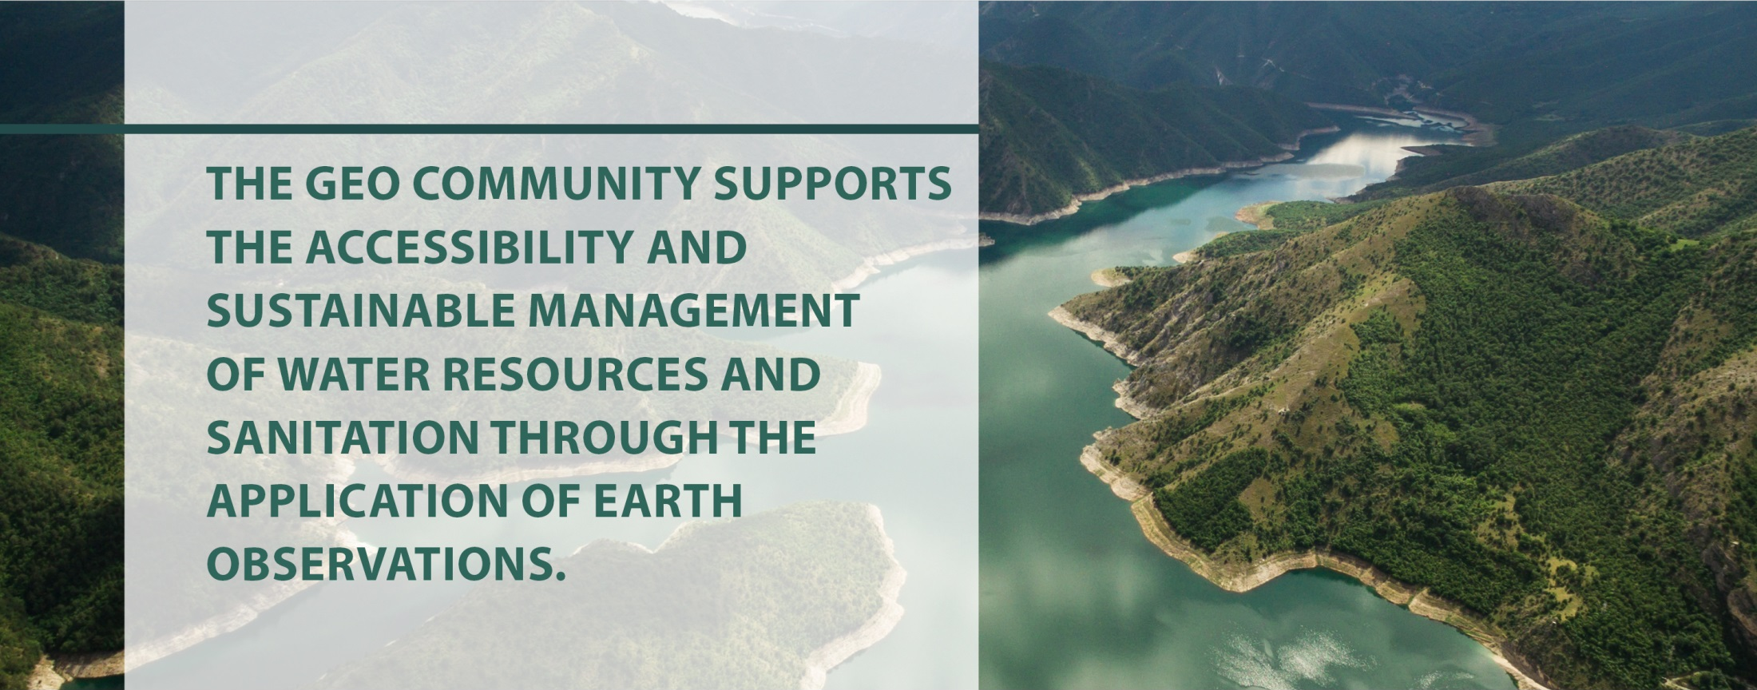
GEOGLOWS
Key element of the SBA Water Resource Management

Slide 8


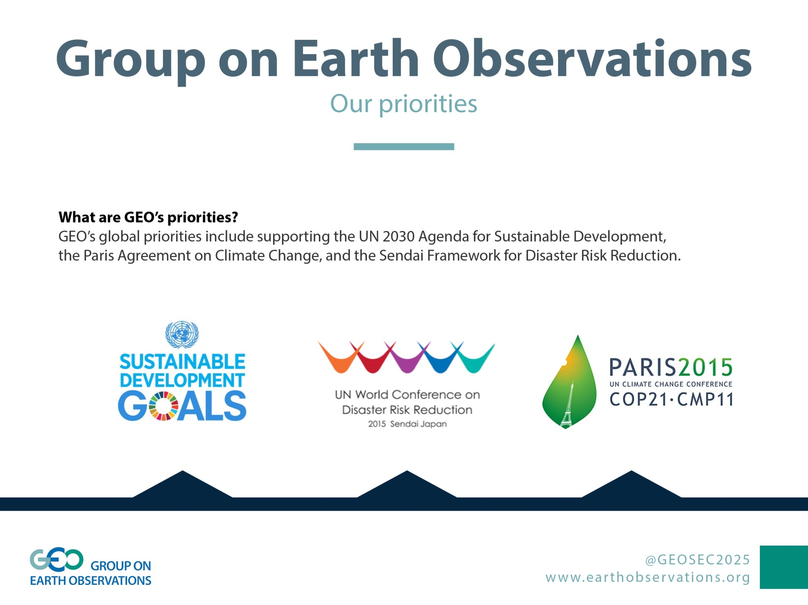


GEOGLOWS Policy Drivers

Slide 9
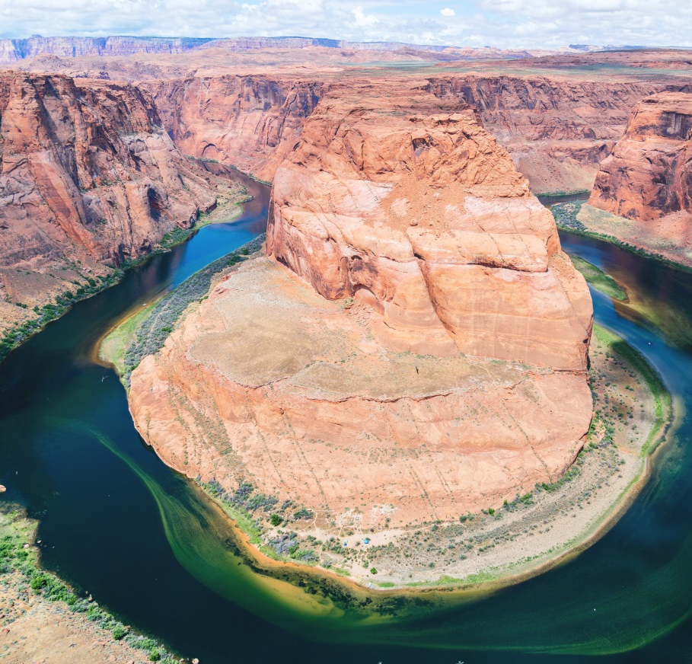
GEOGLOWS mission
To connect the demand for sound and timely environmental information to the supply of data and information about the Earth’s water system and to explore the science needed to achieve the goals outlined in the initiative.
To advocate for broad, open data policies and for the realization of the right to access information
To help ensure that the data collected through national, regional and global observing systems is both made available in the public domain and applied to decision-making.

Slide 10
GEOGLOWS
1st Steering Committee meeting, Tuscaloosa, 16 may 2017
Achivements:
The Steering Committee membership was adopted
The Steering Committee ToRs were revised and adopted
A second co-chair was identified and approved (Rose Alabaster)
It was agreed that a search would be made for a third co-chair to address the technical aspects of observation and information systems and data sharing
Subsequent to the meeting, a proposal has been developed for the World Bank to launch:
  A e-book on Earth observation applications
  Regional projects in developing countries
  A permanent GEOGLOWS Secretariat.
Minutes of the steering committee and business meetings available. Welcome to request it anytime.

Slide 11
GEOGLOWS
1st Steering Committee meeting, Tuscaloosa, 16 may 2017
GEOGLOWS Steering Committee Members:
Co-chairs Dr. Angelica Gutierrez-Magness, USGEO, USA Rose Osinde Alabaster, Waterlex, Switzerland/Kenya
Members
Mr. Carlos Gustavo Cano, Colombia | Prof. Toshio Koike, ICHARM, Japan
Dr. Selma Cherchali, CNES, France | Ms. Faith Mitheu, RCMRD / SERVIR, Kenya
Dr. Johannes Cullman (UN), WMO, Switzerland | Dr. Sylvester Mpandali, South Africa
Dr Paul DiGiacomo, CEOS, USA | Dr. Sekhar Muddu, India
Mr. Cesar Garay, CIRMAG, Colombia | Dr. Yubao Qiu, CSA, China
Dr. Nagaraja Rao Harshadeep, World Bank, USA | Dr. Peter Salamon, EC JRC, Italy
Dr. Srikantha Herath, Sri Lanka

Slide 12
GEOGLOWS Structure
Developing GEOGLOWS as an international initiative
Steering
Committe
Secretariat
Science, applications, product development
EWVs and observations
Data dissemination, portals & capacity building
Socio-Economic issues and Policy linkages
Paul DiGiacomo of NOAA has been nominated to serve as CEOS representative

Slide 13
Working Group Draft Deliverables
G. Huffman
EWVs and observations
A. Limaye & E. Beighley
Science, applications
product development
J. Nelson
Data dissemination, portals & capacity building
R. Alabaster
Socio-Economic issues and Policy linkages
Complete a study to quantify global water availability (and quality)
Develop an Inventory water related products
Develop tools
  for local, regional, global multi-variate (cross-catalog) analyses.
  For building relationships between global and local datasets for local scale applications at other locations.
Possible (Future) Deliverables
Outline science/application opportunities based on cross-GEO analyses and global water connectivity/models
Implement GEO-water framework to enable cross-GEO analyses.
Leverage existing forecasting systems to implement global water hindcasting/forecasting.
Coordinate with EWVs to ensure sufficient coverage to support the above needs.
Review the descriptions of the EWVs in the Water Strategy and make recommendations on what additional information is needed for the EWVs in order to meet the requirements of CEOS and other interested groups.
Undertake a study of the water quality EWVs and provide missing information
Survey the satisfaction of users with EWVs that they’re using.
Assess the potential of citizen data by exploring lessons learned from COCORAHS, mPing, GLOBE, others.
Joint studies with GPCC and GRDC to document the decline of the global precipitation and runoff gauge densities.
Possible Deliverables
Study of the sensitivity of results when integrating DEM, precipitation and other water cycle variables (If funding is available)
Survey/inventory and mapping of existing data portals already exist.
Develop global streamflow forecast system based on the ECMWF/GloFAS system, Tethys streamflow prediction app, ESRI map services, and Cloud Services with World Bank Support
Develop a marketing document showing better marketing for EO Capabilities and links with decision-makers based on past successes. Stories on:
  CORMagdelena/CIRMAG
  Dominican Republic
  Stakeholder Engagement Framework and application
  Impact Assessment Framework and application story
  Bolivia/SA project
Develop a plan for a user-engagement workshop and TEDx Talks.
Socio-economic database linked with the science data from GEOGLOWS.
Case study as a basis for capacity enhancement resources related to SDG 6b implementation.
Baseline information needs defined as a basis for integrated water management. Review of information needs and identification of gaps.
Scenario tools for assessing water use to be used by government planners/managers.
Undertake Pilots/Best Practices for country-level programmes / basin water management.
Possible:
Create scenarios for the different line ministries on water availability/quantity/quality using available data in a given basin or country.
Harvest and evaluate existing data sets to establish comprehensive data sets by basin.

Slide 14

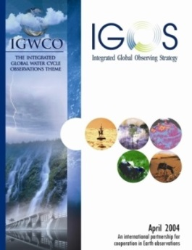
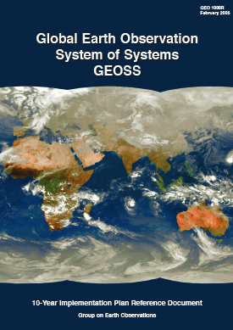
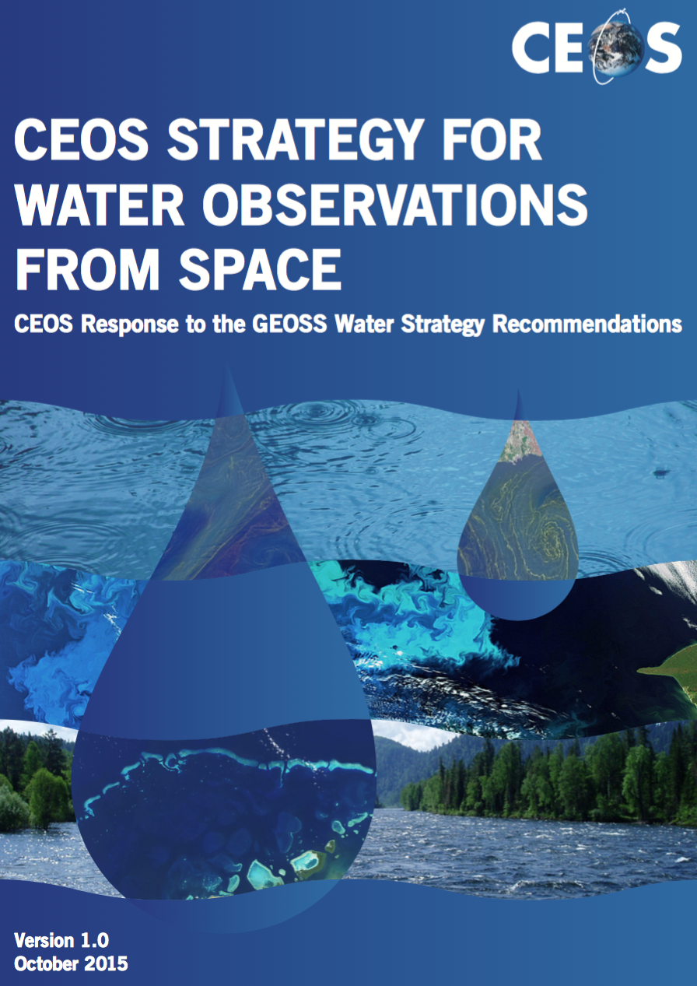
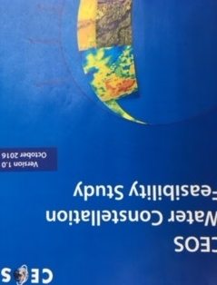
GEOGLOWS and the GEOSS Water Strategy
The GEOSS Water Strategy renews the observational component of the community’s efforts to communicate the needs of the Water community within the framework of GEOSS.
CEOS Water Strategy Implementation Study Team (WSIST) prepared the CEOS Water Strategy to the GEOSS Water strategy recommendations.
Working with other initiatives and organizations GEOGLOWS will implement the GEOSS water strategy recommendations.
GEO Water Strategy
CEOS Response
IGOS Water Theme report
April 2004
GEOSS 10 Year
Implementation Plan
February 2005
GEOSS Water Strategy
January 2014
CEOS Water Strategy
October 2015
CEOS Water Constellation
FS, October 2016

Slide 15
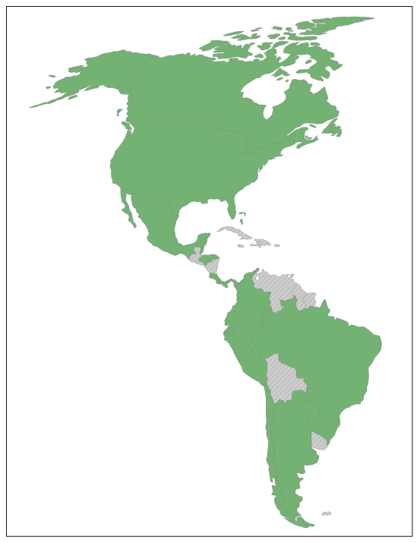
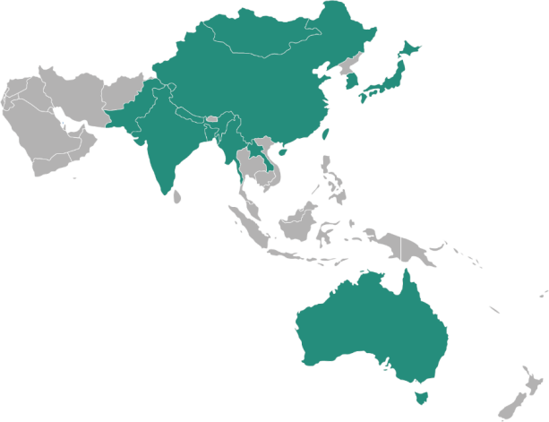
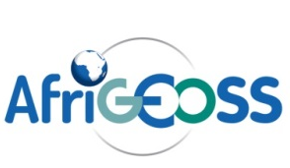


GEOGLOWS and Regional Initiatives
GEOGLOWS brings diverse regional water projects into a global framework
for improving water sustainability
US GEO Water
Global Data Products, Capacity Building, etc.
NextGEOSS (Europe)
Validation data
Regional
projects
Regional
expertise

Slide 16


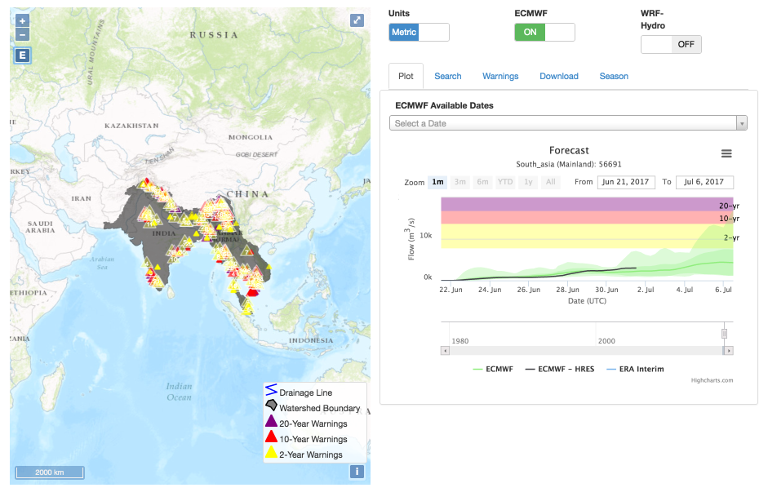
Examples of WG 4 regional activities
GEOGLOWS and the river authority of the BERMEJO river in Argentina agreed to initiate de development of a pilot project for the application of the Global Hydro-forecast project. This project is in coordination with the us secretary of water resources.
There first technical call will take place at the end of September". This is pilot # 6
International Stream Flow Forecasts
(from J. Nelson)

Slide 17
GEO 7th Programme Board meeting
Recommendations for GEOGLOWS
GEOGLOWS took note of the following comments:
Needs of multiple observations by ensuring the involvement and cooperation of wide range of bodies including CEOS and UN Agencies
Political commitment requires from those partners
Clarify and reinforce:
  The collaboration with Aquawatch and other initiatives
  The need of Space technologies for water. The Water sustainability as a resource need to include CEOS and Space technology.

Slide 18
GEOGLOWS list of connection with CEOS
Enhance the added value of Earth Observations to provide the right information for
water resource management.
Engage the CEOS agencies on requirement and link with the experts accross all the agencies
Collaborate with CEOS for use of satellite data
With Working groups (WGCapD, WGClimate, WGCV, WGDisasters, WGISS)
With CEOS Virtual Constellations (AC-VC, LSI-VC, OCR-VC, OST-VC, OSVW-VC, P-VC, SST-VC)
  Proposing a SAR-VC (Synthetic Aperture Radar) which would support GEOGLOWS as well as AquaWatch and Blue Planet for (CEOS) Water Activities
With CEOS Ad Hoc Teams (Ad Hoc Team on Sustainable Development Goals, Ad Hoc Team on Future Data Architectures, Ad Hoc Working Group on the Group on Earth Observations (GEO) Global Agricultural Monitoring (GEOGLAM) Initiative,
GEOSS Water Strategy: On going opportunity to collaborate on new area after further discussion with Aquawatch Blue Planet

Slide 19


Side Event
GEOGLOWS and the harmonization of GEO Water Activities
Monday 23 October, 08:00-13:00, Meridian C
Tuesday 24 October, 08:30-10:00, Meridian C
Inform one another about current activities, plans and future directions.
Identifying where there are synergies and where the various objectives of GEOGLOWS, AquaWatch, and Freshwater BON can help each other
Providing a platform to look at how GEO’s work on Water Sustainability is linked with the GEO work on wetlands and biodiversity
Identify a common strategy to improve earth observations and data sharing in support of the conservation of freshwater ecosystems and sustainable management of water resources.
Interface with CEOS and other data providers to enable the implementation of these activities

Slide 20

