Slide 1

CEOS Analysis Ready
CEOS Analysis Ready Data for Land (CARD4L) are satellite data that have been processed to a minimum set of requirements and organised into a form that allows immediate analysis with a minimum of user effort, and interoperability both through time and with other datasets
Committee on Earth Observation Satellites
SIT Technical Workshop
Session 2: Item 5
Frascati, Italy
Wednesday13 September 2017

Slide 2
Analysis Ready Data
Background
November 2015 - LSI-VC reconstituted
November 2016 - Definition of CARD4L and follow-on work endorsed to develop specifications
CARD4L Specification framework presented at SIT-32, in Paris. The framework includes:
  The CARD4L Definition
  Product Family Specifications
  Product Alignment Assessments

Slide 3
Analysis Ready Data
Progress in 2017
Product Family Specifications have been developed for:
  Radar backscatter
  Surface Reflectance
  Land Surface Temperature
Detailed input to the draft CARD4L specifications was received from multiple sources June-Sept 2017. This has significantly improved the documents and has improved awareness of CEOSs leadership in this area.
Very strong support for CARD4L is indicated by a range of experiences and activities. (UK, ESA, USA-USGS & NASA, Canada, Australia..).
More formal or structured approaches to capturing the benefits to users may be needed.

Slide 4
Analysis Ready Data
Relationship to FDA and MRI
The Future Data Architectures Ad Hoc Team (FDA-AHT) has asked that LSI-VC take steps:
  to develop and implement a strategy to promote the CARD4L framework to data providers, and,
  to engage with the task of expanding CEOS Analysis Ready Data beyond land to other domains such as oceans and atmosphere. This topic was discussed in the VC day, 12 Sept, Item 2. It will come forward as a recommendation from FDA.
ARD is also linked to the work that LSI-VC is hosting to explore Moderate Resolution Interoperability (MRI)
The relationships between FDA, MRI and ARD are explored in the following chart

Slide 5
CARD4L, MRI, and FDA Relationship
Full exploitation of EO data requires CARD4L, MRI, and FDA along with critical user feedback informing future directions
MRI
- Addresses how to combine data / scientific methods to maximize interoperability
    CARD4L is the first step to MRI
    - MRI provides feedback to CARD4L
FDA
MRI and CARD4L are vital components of FDAs
CARD4L-compliant products feed FDAs
CARD4L
Is the step to get the data ‘ready for’ FDAs and interoperability

Slide 6
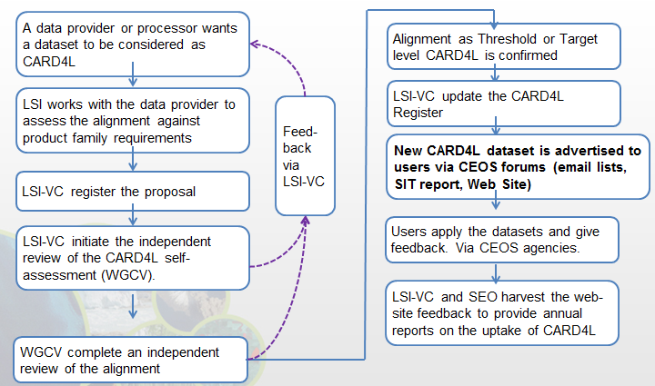
Analysis Ready Data
Implementation of CARD4L
LSI-VC will now move into an implementation phase which will have multiple objectives. It will:
  Develop the process for datasets to be assessed as CARD4L
  Identify data products that are on-track to become CARD4L
  Monitor and communicate progress of individual products toward CARD4L
  ‘road-test’ the Product Family Specifications, including through further technical teleconferences. (The PFSs will be evaluated, and if necessary updated, on an annual cycle based on the implementation experience.)
Implementation processes are under discussion

Slide 7
Analysis Ready Data
Communicating CARD4L
LSI-VC will also:
Engage with user communities, e.g., through GFOI and GeoGLAM, to capture and communicate user experiences of Analysis Ready Data / MRI
Take steps to promote the CARD4L framework to data providers. These include using the CEOS web site to communicate progress toward CARD4L products.
We expect that data providers will need to be:
  Aware of the Benefits of ARD production
  Supported to use and ‘own’ the CARD4L framework
  Recognised for achievements in production of CARD4L

Slide 8
Analysis Ready Data
Communicating CARD4L to data providers
Actions that LSI-VC / SEO will progress to better engage data providers in CARD4L: | Capture the Benefit | Support the implementation | Recognise the contributions
1. Complete the Framework, including independent assessment, continuous development of the guidance material, and review processes to refine / add / remove product family specifications - publish on the CEOS web site including progress toward Product Family Specifications |  | ✔
2. Develop an on-line list of CARD4L datasets, including the level of maturity (planned; algorithm development; test production; local production; systematic production; continuous improvement) |  | ✔ | ✔
3. Showcase certain CARD4L products – ALOS Global Mosaics; USGS-Landsat Surface Reflectance, and others, including their uses and benefits, on the web site. | ✔ | ✔ | ✔
4. Maintain an open and inclusive team (LSI / FDA ..), seeking welcoming contributions from new players to continue to support the development and maintenance of the Product Family Specifications. |  | ✔
5. Promote CARD4L (ARD) workshops or special sessions alongside conferences and SIT meetings. | ✔ | ✔ | ✔

Slide 9
Analysis Ready Data
LSI-VC membership
Expanded LSI-VC membership will help to support this work:
  Daniel Wicks, UKSA / Catapult
  Andreia Siqueira, GA
Best wishes and thanks to Bianca Hoersch and ESA for her contribution as co-chair!

Slide 10
Analysis Ready Data
Summary
CEOS Analysis Ready Data for Land is progressing to an implementation stage. This will include:
  Communication with data providers
  Capturing the experiences of users, initially through MRI case studies
  There are strong indications that this work is needed and valued by user communities.
CARD4Ocean / CARD4Atmosphere is an open question.
CARD4L, MRI and FDA are logically linked and the work within CEOS is being coordinated.
LSI-VC has two new members from UK and GA, new ESA – co-chair is pending.

Slide 12
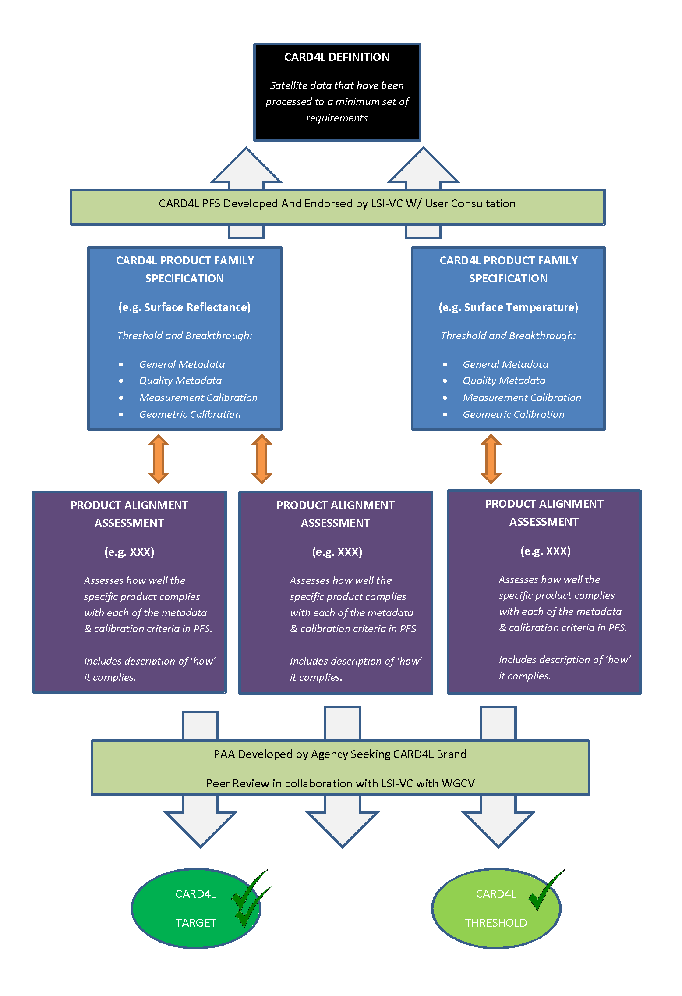
CARD4L Framework
Data that have been processed to a minimum set of requirements and organised into a form that allows immediate analysis with a minimum of user effort and interoperability both through time and with other datasets.
Product family specifications indicate the threshold and target requirements

Slide 13
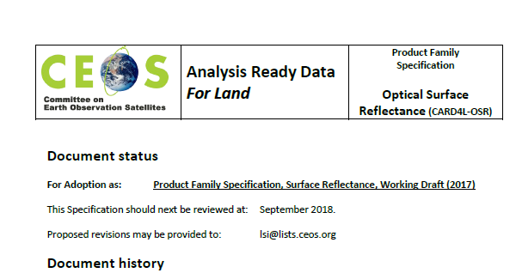
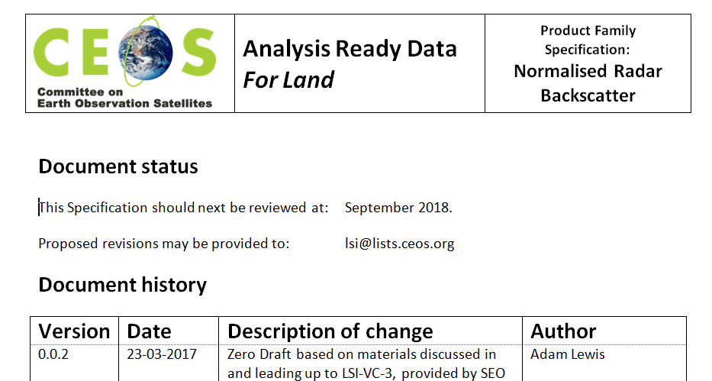
Objective and Background
Product Family Specification looks like ….

