Slide 1

AC-VC GHG White Paper
Prepared by David Crisp,
Jet Propulsion Laboratory,
California Institute of Technology
Copyright 2017 California Institute of Technology. Government sponsorship acknowledged
Committee on Earth Observation Satellites
Atmospheric Composition Virtual Constellation
SIT Tech Workshop 2017 Agenda Item #
Side Meeting “UNFCCC/IPCC Engagement”
CEOS Strategic Implementation Team Tech Workshop
ESA/ESRIN, Frascati, Italy
13th-14th September 2017

Slide 2
Progress since the CEOS SIT-32
The primary focus of the AC-VC Greenhouse Gas (GHG) effort since the CEOS SIT-32 meeting has been the development of the GHG White Paper.
Community contributions to the White Paper were solicited at the following meetings:
6-8 June: IWGGMS-13, Helsinki, Finland
  Discussion of Requirements of Future GHG missions
11-16 June: CGMS Jeju Korea
  WG-II/WG-III GHG joint session on carbon observations
  CGMS Plenary Session G: Carbon Observations
28-30 June: CEOS he AC-VC-13 in Paris, France
  Devoted the afternoon session to a discussion of the AC-VC GHG White Paper

Slide 3
White Paper Chapters
Contributions from participants at the CGMS and CEOS AC-VC meeting were incorporated into the White Paper structure:
Chapter 1: Need for space-based measurements of CO₂ and CH₄
Chapter 2: Existing space-based GHG Satellites and near term plans
Chapter 3: Lessons Learned from GOSAT and OCO-2
Chapter 4: Integrating Near-term Missions into a Virtual Constellation
Chapter 5: Defining GHG Constellation Requirements
Chapter 6: Candidate Constellation Architectures
Chapter 7: Ongoing studies of operational GHG constellations: the Copernicus CO2 Sentinels
Chapter 8: The Transition from Science to Operations
Chapter 9: Conclusions

Slide 4
Need for space-based measurements of CO₂ and CH₄
Reduce uncertainty in fossil fuel emission inventories and their time evolution
  Review origin, content, and limitations of present GHG inventories
  New requirements from UNFCCC Paris agreement (e.g. “global stocktaking”)
  Summarize challenges of discriminating and quantifying anthropogenic emissions in context of natural carbon cycle
Monitoring and predicting changes in the natural carbon cycle associated with climate change and human activities
  Deforestation, degradation, fire
  Changes in CO₂ and CH₄ associated with drought, temperature stress, melting permafrost
  Ocean thermal structure and dynamics

Slide 5
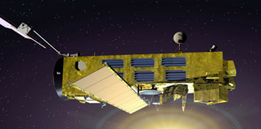
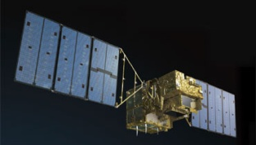
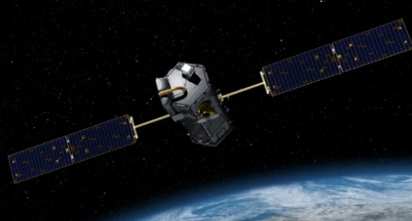
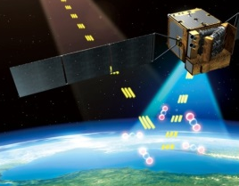
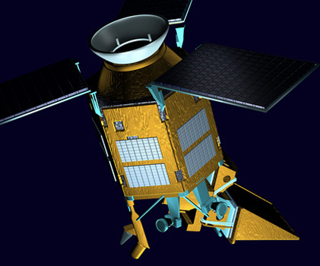
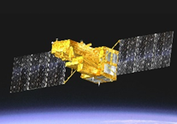
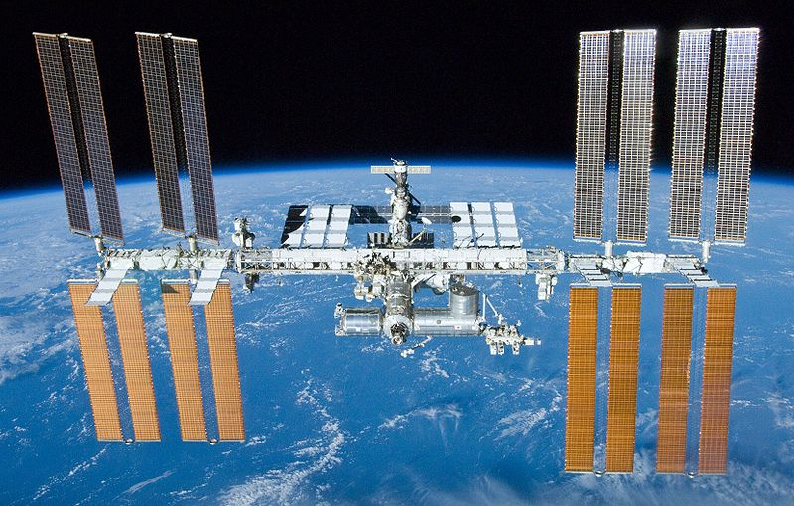
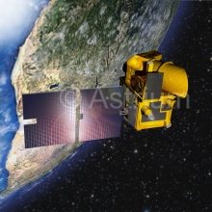
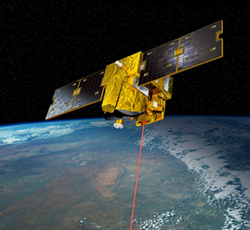
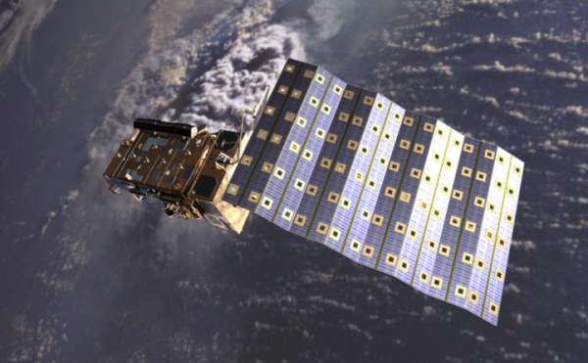
Existing space-based GHG Satellites and near term plans
Most existing and planned GHG missions are “science” missions, designed to identify optimal methods for measuring CO₂ and CH₄, not “operational” missions designed to deliver policy relevant GHG products focused on anthropogenic emissions
EnviSat SCHIAMACHY
PAST
2002-2012
GOSAT
OCO-2
TanSAT
CO₂ Only
CH₄ Only
PRESENT
CO₂ + CH₄
CO₂ + CH₄ + CO
2009 …
2014 …
2016 …
Feng Yun
3D
Gaofen 5
Sentinel 5p
GOSAT-2
OCO-3/ISS
NEAR FUTURE
2017
2017
2017
2018
2018
MicroCarb
MERLIN
GeoCarb*
GOSAT-3
Sentinel 7
2020’s*
2020
2022
2023
2025
2021
2025
* Pre-decisional, for planning and discussion purposes only.

Slide 6
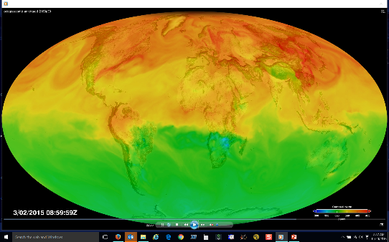
Lessons learned from GOSAT and OCO-2
High accuracy and low bias are both essential
High spatial resolution (footprint area < 4 km²)
  Critical for quantifying emissions from compact sources
    X_{CO2} anomaly associated with a given CO₂ injection is inversely proportional to the area of the footprint
  Critical for gathering data in presence of patchy clouds
Imaging rather than sampling the CO₂ and CH₄ field
  Critical for tracking emission plumes and resolving anthropogenic emission sources from the natural background
High resolution transport models for flux inversion
  Critical for quantifying at the scale of cities
  Needed for resolving anomalies associated with CO₂/CH₄ “weather” from local sources and sinks
Proxies (SIF, CO, and NO₂) may be needed for attribution
OCO-2 track through patchy clouds
GEOS-5 XCO2 Weather

Slide 7
Integrating Near-term Missions into a Virtual Constellation
A multi-satellite GHG constellation could
Exploit the benefits of observations from low Earth orbit (LEO), geostationary orbits (GEO), and Highly Elliptical Orbits (HEO)
Reduce revisit times in the presence of optically-thick clouds
Improve spatial coverage without requiring very broad swaths that
  Are technically difficult and expensive to implement
  Large atmospheric path lengths at the swath edges are more likely to be contaminated by clouds
Collect coincident observations of proxies (CO, NO₂, SIF) to facilitate the interpretation of the measurements
Provide resiliency to the loss/degradation of individual satellites
Facilitate data quality improvements through cross calibration and cross validation
Partnerships will help realize these objectives

Slide 8
Defining Constellation Requirements
Existing studies indicate that different approaches can be combined to define the measurement requirements needed to meet the demanding GHG flux requirements
  Point source mass balance methods show the sensitivity needed to quantify localized sources (cities, individual power plants)
  Signal detection experiments provide insight into the amplitude of X_{CO2} and X_{CH4} anomalies associated with persistent flux changes and their dependence on wind speed at local to global scales
  Realistic, end-to-end OSSEs are adequate for assessing flux uncertainties associated with sensor precision, resolution, and coverage in the presence of realistic transport and clouds
  Flux inversion experiments combining data from in situ, TCCON, GOSAT and OCO-2 are being validated against “withheld data” (from aircraft or surface stations) to provide insight into the impact of biases in concentration measurements and transport

Slide 9
A Candidate GHG Constellation Architectures
The coverage, resolution, and precision requirements could be achieved with a constellation that incorporates
A constellation of (3 or more) satellites in LEO with
  A broad (~200) km swath with a mean footprint size < 4 km²
  A single sounding random error near 0.5 ppm, and vanishing small regional scale bias (< 0.1 ppm) over > 80% of the sunlit hemisphere
  One (or more) satellites carrying ancillary sensors (CO, NO₂, CO₂ and/or CH₄ Lidar)
A constellation with 3 (or more) GEO satellites
  Monitor diurnally varying processes (e.g. rush hours, diurnal variations in the biosphere)
  Stationed over Europe/Africa, North/South America, and East Asia
One or more and one or more HEO satellites to monitor carbon cycle changes in the high arctic

Slide 10
Ongoing studies of operational GHG constellations: the Copernicus CO₂ Sentinels
The high-level monitoring system objectives are to
provide policy-relevant information (trends, impacts of measures),
support national emission inventories,
observe strong point & area sources (e.g., power plants and cities)
  As part of an integrated system comprising: satellite - in-situ – modelling - emission inventory components, for provision of timely input to policymakers
In view of the above system objectives, the following mission objective of the space component has been tentatively formulated:
  The CO₂ mission shall monitor anthropogenic CO₂ emissions using high spatial resolution imaging of total column CO₂

Slide 11
Moving Forward from “Science” to “Operational” GHG Missions
With the exception of the Sentinels, all of the existing and planned GHG missions are “science” missions, designed to identify optimal methods for measuring CO₂ and CH₄, not “operational” missions designed to deliver policy relevant GHG products focused on anthropogenic emissions
Following the model developed by the operational meteorological satellite constellation, future GHG constellation will also need to focus on orbit and mission coordination, data distribution, data exchange, and data format requirements
To fully exploit the information collected by future GHG constellations, the missions will also have to invest in training and capacity building as well as public outreach
CEOS should exploit the experience of CGMS and other organizations to foster the development of these capabilities

Slide 12
Conclusions
Data from a future, coordinated GHG constellation that combines LEO, GEO, and HEO vantage points could meet the measurement accuracy, precision, resolution, and coverage requirements
To provide reliable, verifiable constraints on GHG inventories as well as the response of the natural carbon cycle to climate change, advances are needed in:
  Laboratory measurements of gas absorption cross sections
  pre-launch and on-orbit calibration capabilities,
  GHG retrieval algorithms
  flux inversion algorithms
  GHG concentration and flux validation techniques
Open data policies that encourage the cross-calibration of sensors, the cross validation and free exchange of space based data products will accelerate the development of these capabilities and the acceptance of their results by scientists and policy makers

Slide 13
White Paper Status and Schedule
Rapid progress was made in May and June, but summer vacations and other commitments slowed progress during July and August.
We are still targeting an end-to-end draft of the white paper by the end of calendar year 2017
The target due date for publication is the 2018 CEOS SIT plenary

