Slide 1

An Effort for Improving Reliability of
GHG Monitoring from Space
– JAXA-NASA Joint Collaboration for 10 years -
Committee on Earth Observation Satellites
Akihiko KUZE
Earth Observation Research Center
Japan Aerospace Exploration Agency
UNFCCC/IPCC Engagement Side Meeting
SIT Tech Workshop 2017 ESA/ESRIN, Frascati, Italy
12th September 2017

Slide 2
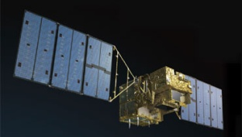
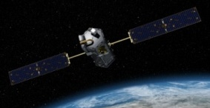

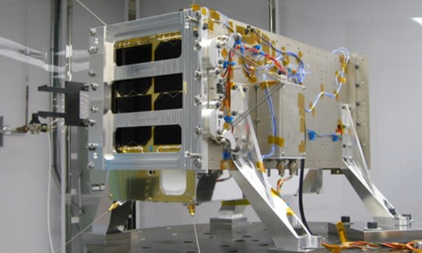
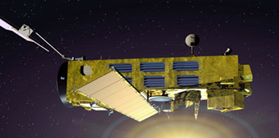
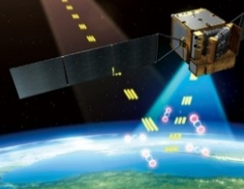
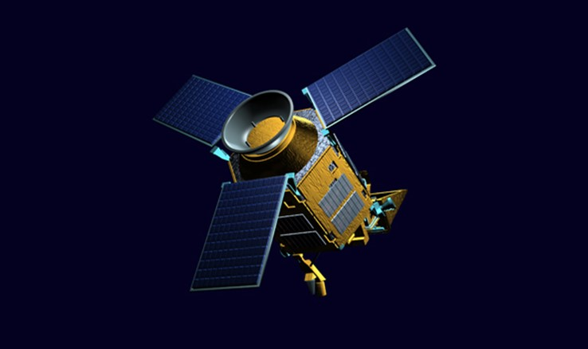
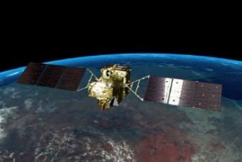
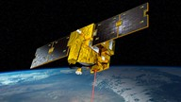
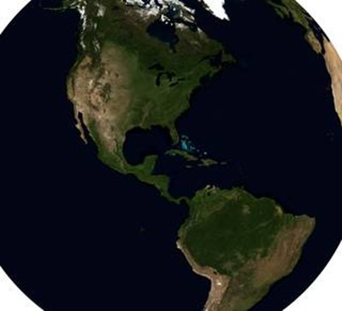
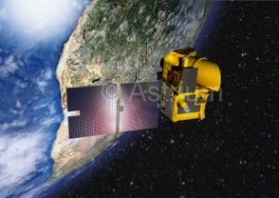
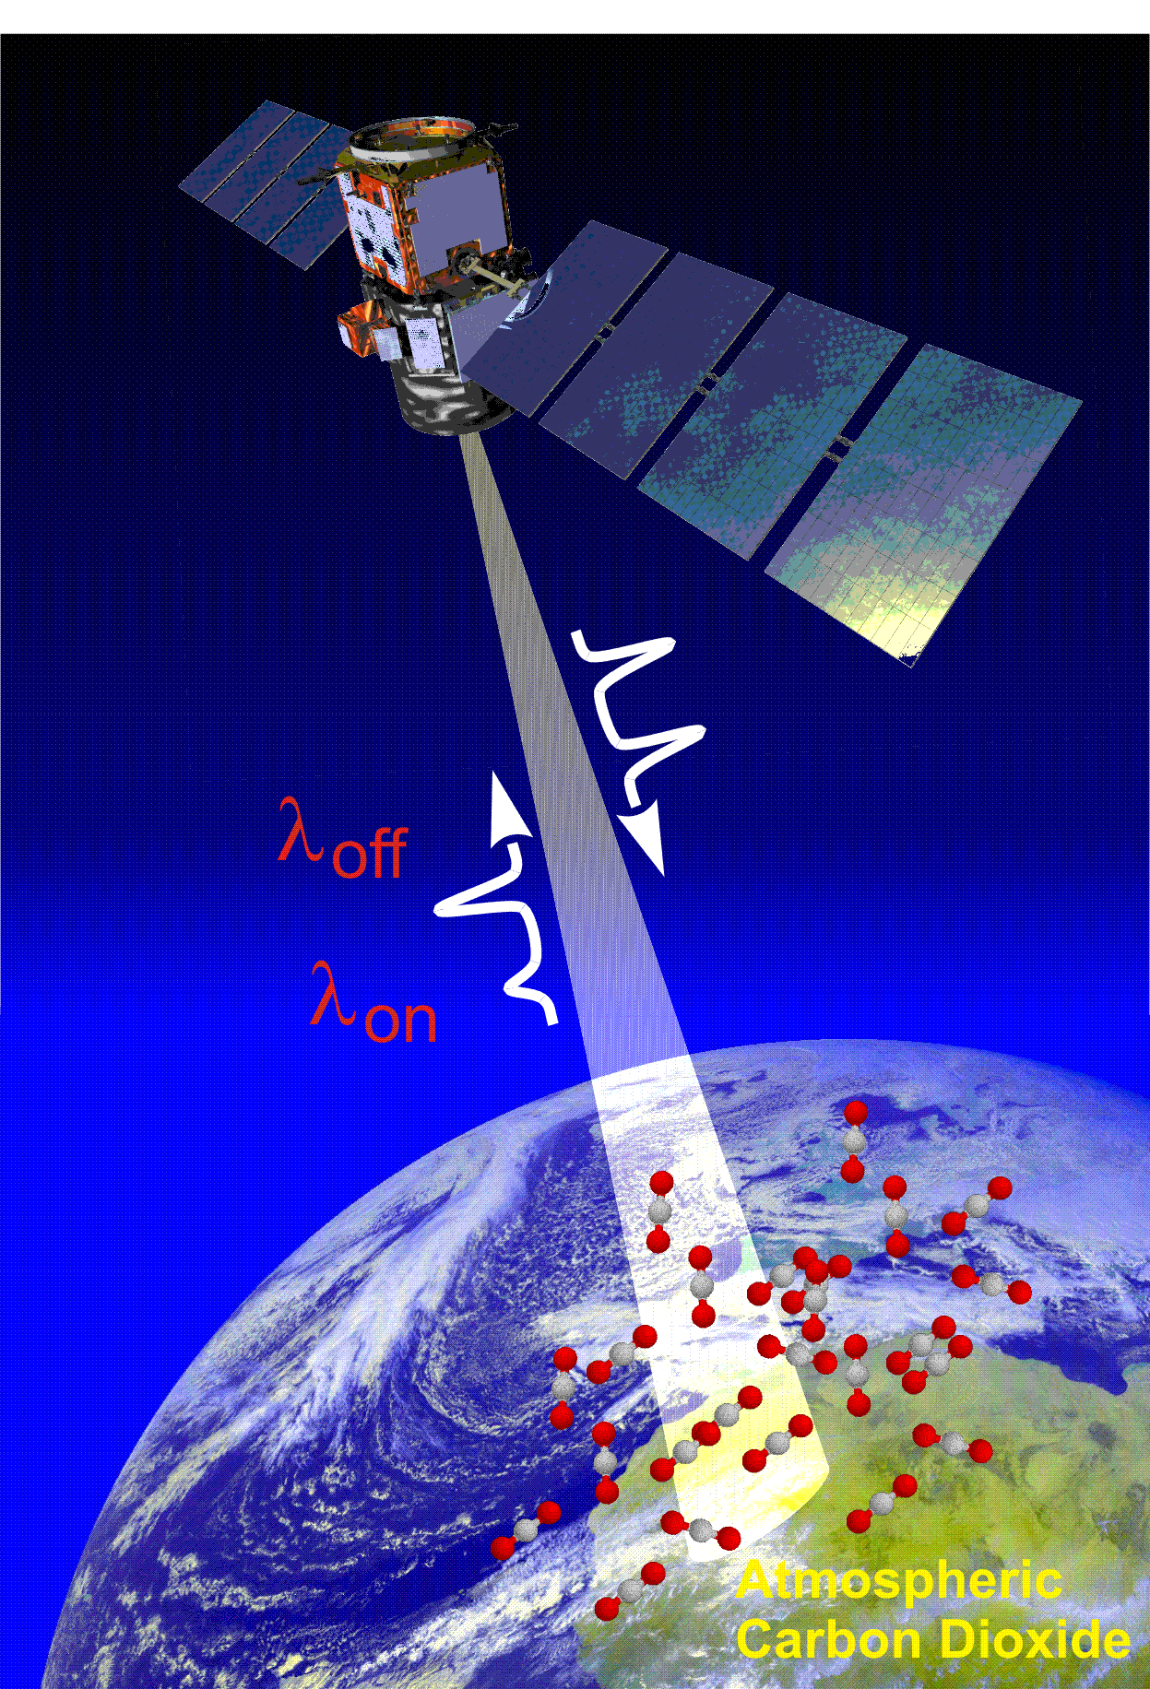
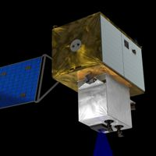
GHG measurements from space
SCIAMACHY (2002 - 2012) | GOSAT (2009 - ) | OCO-2 (2014-)OCO-3 (2018) |  | GHGsat (2016-)
TanSat (2016-) | TROPOMI (2017) | GOSAT-2 (2018-) | MERLIN (2020) | GeoCARB
MicroCarb (2020) | ASCENDS (2021) | CarbonSat (2022)
2

Slide 3
Intercomparison between Instruments
Steps Towards contribution to GHG Anthropogenic Emission Inventory
Challenges
Pre-launch
Radiometric Standard
Radiance Spectra
High spectral resolution data with different type of spectrometers
GHG Column Density
Topography, Observation geometry, aerosol scattering,
instrument degradation
Global and Regional Flux
Selection spatio-temporal sampling Pattern from limited number of data and spatial resolution
3

Slide 4
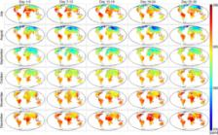
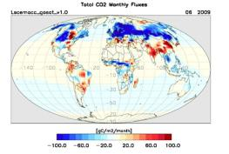
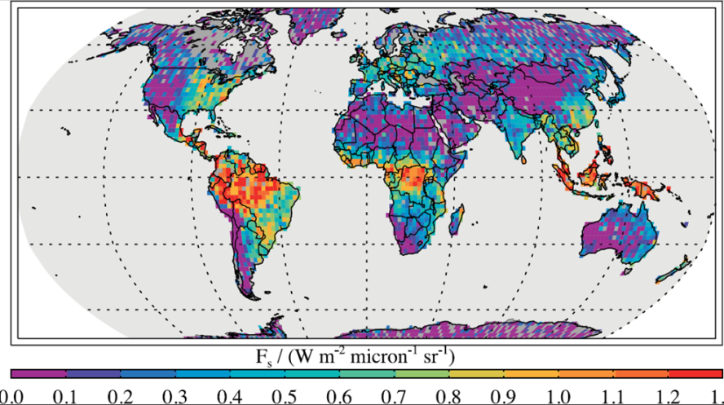
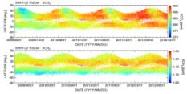
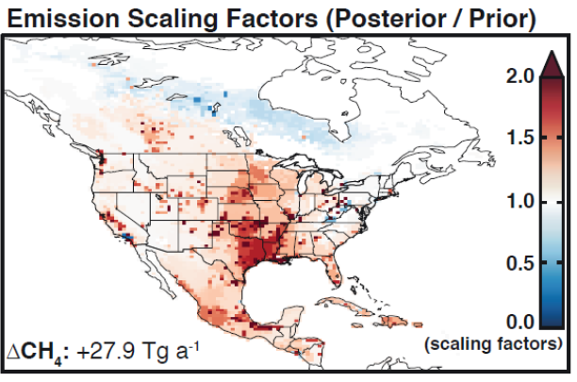
GOSAT Operation and Research Progress
since its Launch
Instrument Data Processing
Frequent and global CO₂ distribution
2011 Butz et al.
the accuracy of 2 ppm or 0.5% for CO₂ and 13 ppb or 0.7% for CH₄
Global flux inversion (b)
2011 Joiner et al. and Frankenberg et al.
Solar induced Chlorophyll Fluorescence (c)
Long term CO₂ and CH₄ (d)
2015 Turner et al. (e)
North American CH₄ emissions using prior information on source locations <aggregation, emission source classification>
Flux Emission from CH₄ point sources
Goal
City level CO₂ flux estimation with source classification
Feb. 2009
The first very-high spectral resolution spectrometer to measure column-averaged dry air mole fractions of CO₂ and CH₄ globally
Jul. 2014
OCO-2 launch
Pointing mechanism switched to the secondary
(Jan. 2015)
2-axis agile pointing system effectively collects science data over regions and areas of special interest.
(a) Hammerling et al.
Non-linearity corrections
Launch 2017
(b) Houweling et al.
(C) Frankenberg et al.
(d) NIES/JAXA/MOE
Level 1 V201 (2015)
Long-term uniform quality data set
V210 (2017)
(e) Turner et al.
4

Slide 5
International Effort to Demonstrate the Reliability
of Satellite GHGs observations.
Japanese GOSAT and US OCO-2 have different observation strategies.
TANSO-FTS onboard GOSAT has wide spectral coverage from SWIR to TIR and an agile pointing system at the expense of spatial context, while OCO-2 targets CO₂ with higher spatial resolution using imaging grating spectrometers.
Since the early phase of the two projects, both teams have worked to demonstrate the effectiveness of satellite greenhouse gases observation.
5

Slide 6

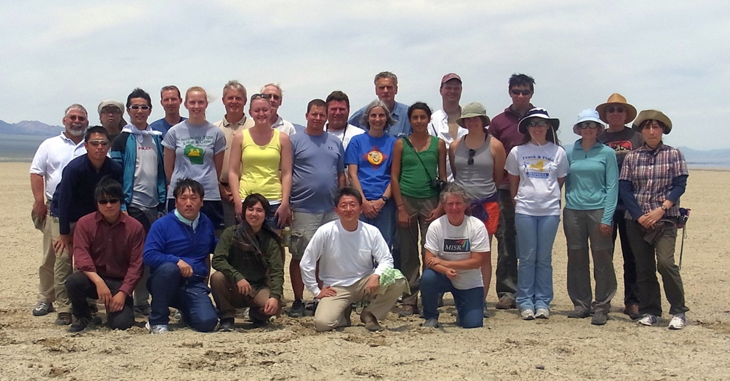
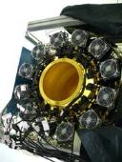
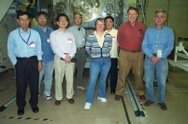

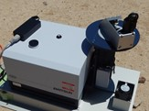
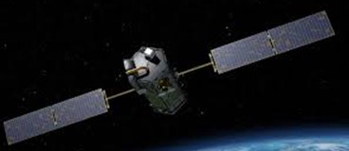
International Collaboration to Demonstrate the Reliability of the GHG Monitoring from Space
Inter-Comparison between GOSAT and OCO-2
2008 2009 2010 2011 2012 2013 2014 2015 2016 2017
Radiometric calibration
Prelaunch
X-CAL
Annual Vicarious Calibration at the desert playa in Nevada
CO₂ & CH₄ profile
In situ CO₂ and CH₄ on NASA AMES AJAX
XCO₂ XCH₄ XCO
Column with a compact FTS
Coincident Target
2014/09～2016/05
XCO₂ Level2 matchup
Agreement:
(ACOS-GOSAT B73.3
OCO-2 B7.3)
<0.18 ppm over Ocean
<0.57 ppm over Land, high gain
< 0.19 ppm over Land (desert)
Calibrated GOSAT and OCO-2 radiance spectra agrees within 5% for all bands (386 match up data).Katoka et al., (submitted)
6

Slide 7
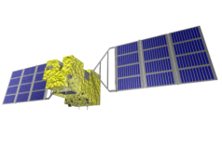

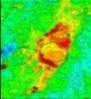
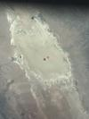





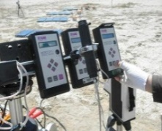
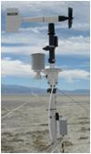
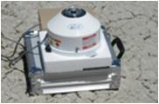
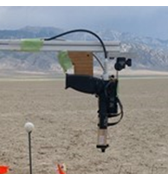
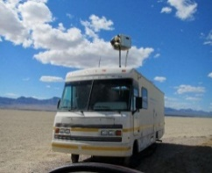


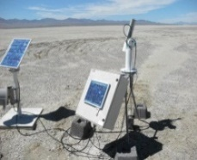
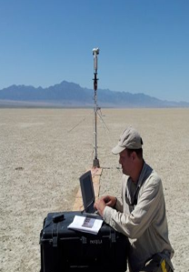
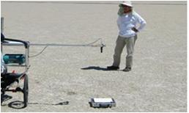
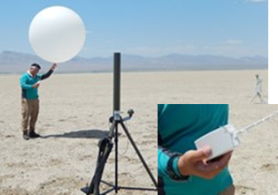
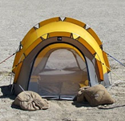
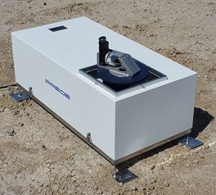
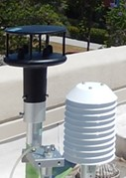
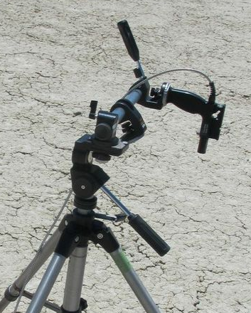
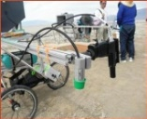
Annual Joint Campaign
Every June near summer solstice (9th in 2017) in Nevada Desert site
Almost all the geophysical parameters in radiative transfer have been measured
Path 37
from West
Path 36
from East
33.0deg
25deg
19deg
19.9deg
TOA Spectral radiance
High altitude
Horizontal
CO₂ CH₄
Vertical
CO₂ CH₄ O₃
Surface Thermal radiation
Surface and Profile
of Pressure, Temperature, Humidity
Aerosol Optical Depth
Surface
CO₂ CH₄ CO O ₃ Wind speed
Surface Spectral Reflectance
UV-SWIR
BRDF
Variability
7
Notes:
1

Slide 8

Long Term and Global Intercomparison
The time series of $∆$ XCO₂ from Sep. 2014
Kataoka et al. (submitted)
8

Slide 9
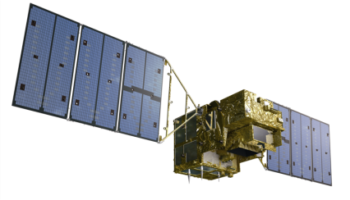



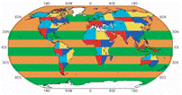
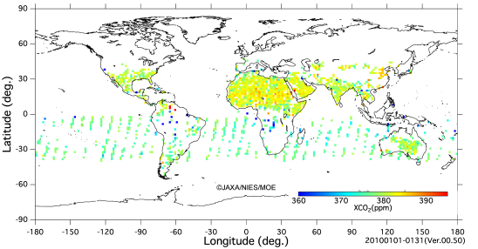
GOSAT Data Products and Distribution
JAXA
Measurement
H₂O
CH₄
CO₂
Interferogram
Level 1 processing
- processing to spectra
- calibration
Receive and Record
Data distribution
NIES
Level 1 Data
Level 4 Processing
- estimate the global net flux
Level 2 and 3Processing
- to produce the global distribution map for CO₂ and CH₄
- validation
Data distribution
Public
Regional Flux
9
Notes:
9

Slide 10
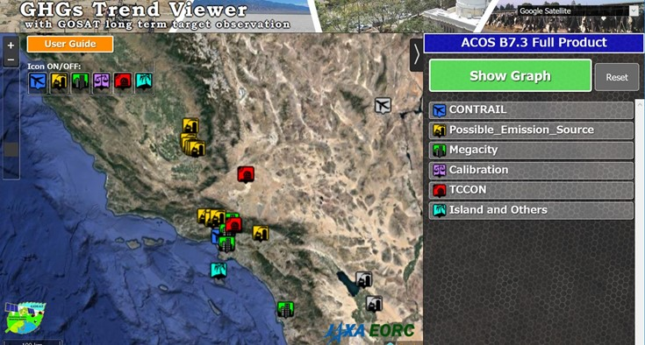
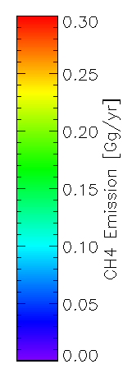
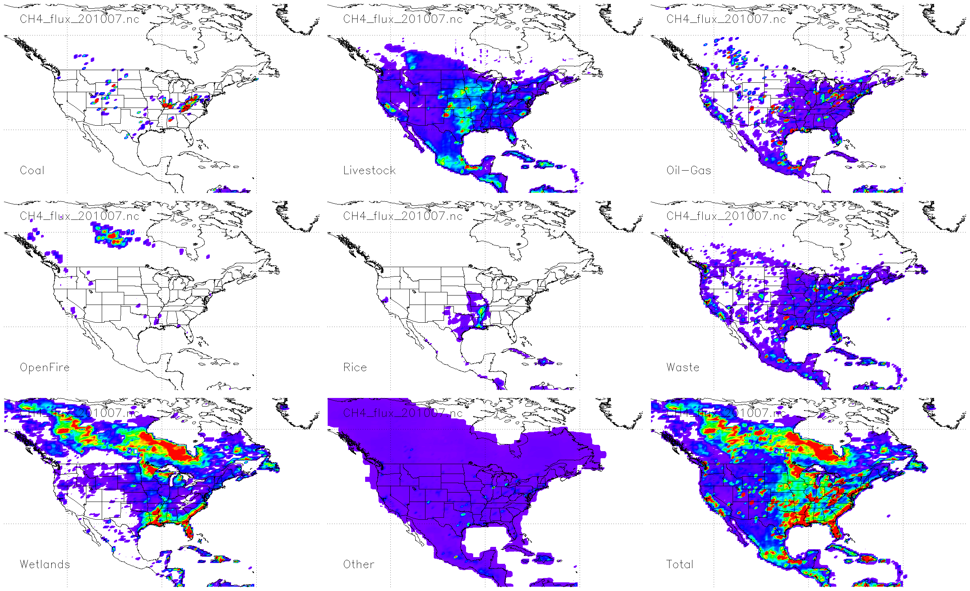
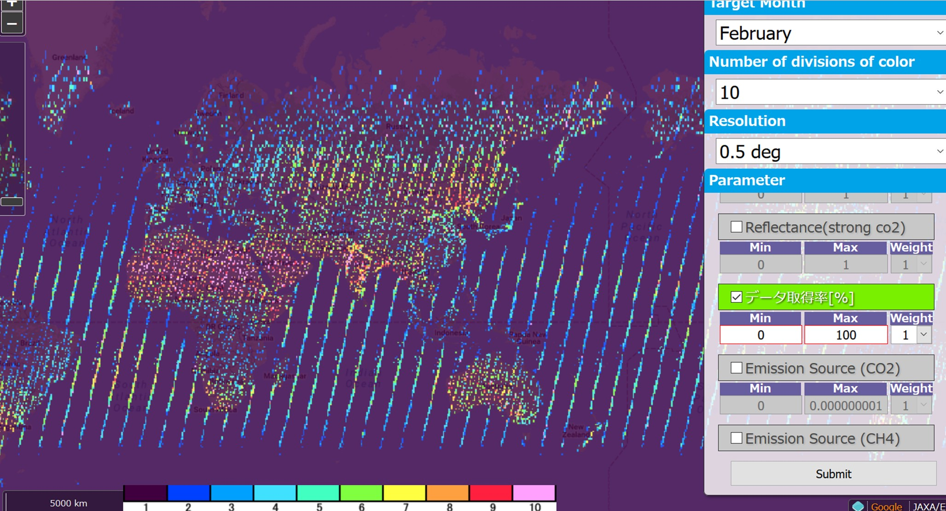
Beyond Data Products
Analytical Results Availability
NASA GES DISC (N America CH4 Emission)
CMS (Carbon Monitoring System) Methane (CH4) Flux for North America 0.5 deg x 0.667 The CMS Methane (CH₄) Flux for North America data set contains estimates in North America based on an inversion of the GEOS-Chem chemical transport model constrained by GOSAT.
July 2010
https://mirador.gsfc.nasa.gov/
CH₄ emission (Gg/year）
http://www.eorc.jaxa.jp/GOSAT/CO2_monitor/index.html
Contents: Long term
CO₂, CH₄, SIF, AOD measured by GOSAT
Solar-induced chlorophyll fluorescence
Aerosol optical depth
Coal
Livestock
Oil /Gas
Fire
Rice
Waste
Wetland
Other
Total
Ratio of successful retrieval by GOSAT
10

Slide 11
Conclusion
Almost all the geophysical parameters in radiative transfer have been measured during annual joint campaigns. Accuracy and precision of GHG satellite remote sensing have been well characterized.
The cross-comparison of spectral radiances and CO₂ estimates from long term and global GOSAT and OCO-2 observations demonstrated the reliability of CO₂ remote sensing from space.
These exercises will facilitate the interpretation of the data from the near-future satellites with unique instrument designs from different space agencies.
Both top-down satellite data and bottom-up emission inventories will be crucial to climate policy.
11

