Slide 1
Guidebook on use of GHG observations by satellites for estimating surface emissions: review of research
Shamil Maksyutov, Tsuneo Matsunaga
National Institute for Environmental Studies, Tsukuba, Japan
CEOS meeting, Frascati, Sep 12, 2017

Slide 2
Guidebook plan
Ministry of Environment, Japan and National Institute for Environmental Studies support preparation of a Guidebook on use of greenhouse gas (GHG) observations by satellites for estimating surface emissions (title is tentative)
The purpose of the Guidebook is to facilitate use of satellite GHG concentration observations for estimating the emissions, at a city to national scale, for applications such as national emission inventory improvement and verification in support of implementation of the Paris agreement on the gradual reductions of the GHG emissions
The timing and schedule of the Guidebook preparation is set to provide a contribution to materials available for use in 2019 Refinements to 2006 IPCC Guidelines on Emission Inventories.
Guidebook will include overview, introduction to satellite GHG data analysis methodology and a number of case studies, based on published research papers.

Slide 3
Guidebook table of contents and schedule
1. Overview
2. Fundamentals, Part 1
Satellite measurements of GHG concentration, retrievals, validation,
atmospheric transport models, emission sources, etc.
3. Fundamentals, Part 2
How to compare satellite GHG measurements and emission inventories
3.1 Concentration-based methods
3.2 Flux estimates by inverse modeling
4. Case Studies of using satellite observation data for emission estimates
4.1 ...
Appendix
1. List of available satellites and products
2. List of related peer-reviewed papers
Schedule and plan
- Language: English (The final edition will be translated into other languages later.)
- Number of pages: 4 - 8 printed pages (including figures and tables)
- Contents: Explaining methods for comparing flux estimation using the satellite GHG measurements with GHG emission inventories, and showing practical examples.
Submission deadline for case studies and chapters/sections: Friday, September 1, 2017
Draft edition of the guidebook to be completed and released on a website at the end of September,
First edition will be published at the end of March, 2018.
- Notes: Main methods on this manuscript must be published in peer-reviewed papers by the time of guidebook publication. Case studies using actual satellite GHG data are preferable.

Slide 4
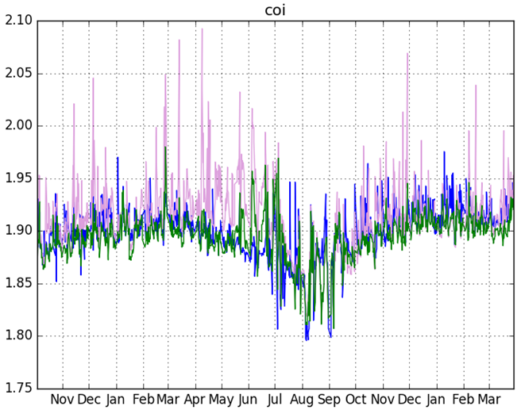
Emission estimation methods
Observing local concentration enhancements
Anthropogenic emissions of CO2, CH4, (and NOx, CO, …) lead to buildup of the concentration above the emission area and transport of a high concentration plume by wind downstream the emission source (city, powerplant, etc.). Satellites observe increased column GHG concentration when the plume is in the observation footprint. The plumes are identified either by using transport model, or by another pollution tracer observation (eg NO2 by OMI), or by long term averaging (see SCIAMACHY papers)
Processed mean enhancements are related to fluxes using either simple wind-speed dependent model, or high resolution transport model.
Inverse modeling
Inverse modeling optimize fluxes by providing flux corrections that reduce misfit/difference between observations and transport model simulations.
The inverse model provides fluxes at grid-point resolution, that can be used to estimate regional flux by summing over selected (country) area. The emission enhancement processing is not done usually, as transport model makes prediction of both background and emission influenced concentration.
OCO-2 observation over US,
Nassar et al 2017
model vs observations, CH4,
COI station (Japan)
observations
forward
inversion

Slide 5
Studies featured in the guidebook: CO₂
Schneising et al ACP 2008, ACP 2013 used 3 years of SCIAMACHY CO2 observations to show anthropogenic CO2 enhancements over W. Europe and their correlation with EDGAR emissions
Kort et al GRL 2012 Used GOSAT observations to quantify anthropogenic CO2 enhancements over megacities Los-Angeles and Mumbai
Reuter et al Nat. Geosci. 2014 looked at the ratio of NOx to CO2 enhancements and found decreasing emissions of NOx relative to CO2 in East Asia
Janardanan et al GRL 2016 used GOSAT observations and transport model to quantify anthropogenic CO2 enhancements around the globe and found good correlation between observations and model, allowing to infer regional emission biases in inventory
Hakkarainen et al GRL 2017 used XCO2 observations by OCO-2 and NO2 from OMI to map anthropogenic CO2 enhancements globally
Nassar et al 2017 (in review) used observations by OCO-2 to estimate CO2 emissions by several power plants in US using simple Gaussian plume model to simulate CO2 enhancements

Slide 6
Studies featured in the guidebook: methane
Schneising et al Earth's Future 2014, found increase of SCIAMACHY-observed CH4 enhancements over US gas and oil fields over time and used the data to estimate increase of fugitive methane emissions.
Kort et al GRL 2014 observed SCIAMACHY XCH4 anomaly over Four Corners region from 2003 to 2009, corresponding to large emissions from coal and gas basin
Buchwitz et al ACP 2017 estimated annual methane emissions from SCIAMACHY and GOSAT observations for the three regions: Four Corners, Central Valley, in USA, and Turkmenistan
Turner et al ACP 2015 used GOSAT XCH4 observations and inverse model to estimate methane emissions over the globe and North America
Janardanan et al RS 2017 (in print) used GOSAT XCH4 observations and transport model to quantify anthropogenic CH4 enhancements around the globe and estimated regional emission corrections for North America and East Asia

Slide 7
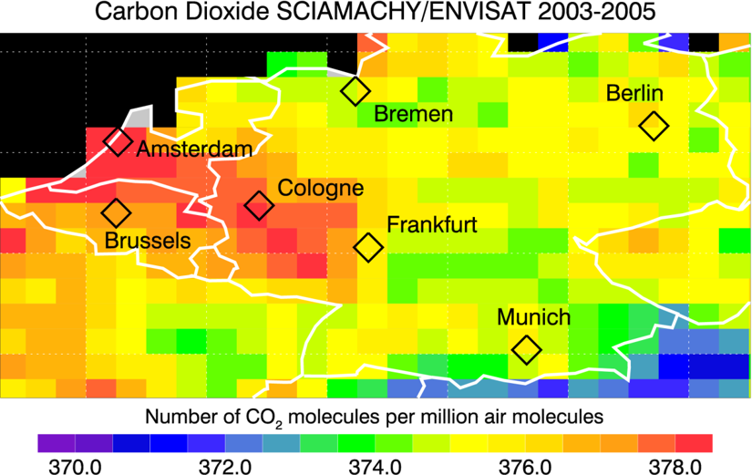
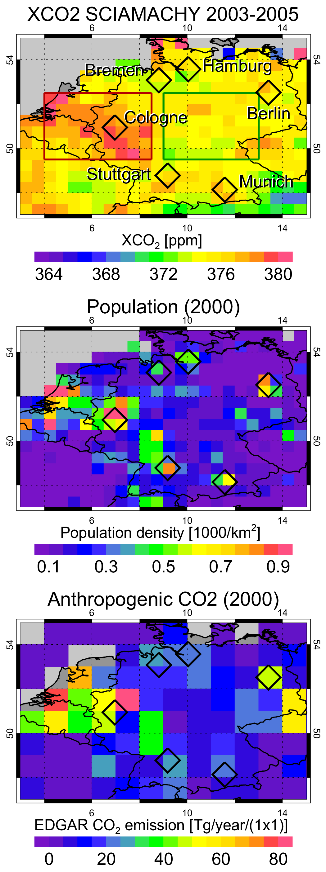
Detecting anthropogenic CO₂ concentration enhancements using SCIAMACHY observations
“When averaging the SCIAMACHY XCO2 over all three years we find elevated CO2 over the highly populated region of western central Germany and parts of the Netherlands (“Rhine-Main area”) reasonably well correlated with EDGAR anthropogenic CO2 emissions. On average the regional enhancement is 2.7 ppm including an estimated contribution of 1–1.5 ppm due to aerosol related errors and sampling” (Schneising et al, 2008)
Schneising, O., et al: Three years of greenhouse gas column-averaged dry air mole fractions retrieved from satellite – Part 1: Carbon dioxide, Atmos. Chem. Phys., 8, 3827-3853, 2008.
Schneising et al Anthropogenic carbon dioxide source areas observed from space: assessment of regional enhancements and trends, Atmos. Chem. Phys., 13, 2445-2454, 2013.

Slide 8
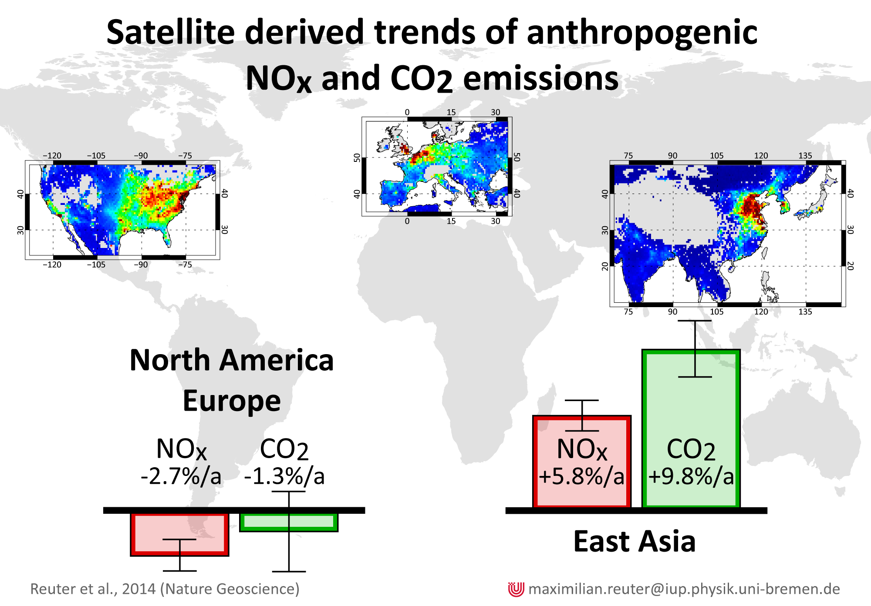
Decreasing emissions of NO_{x} relative to CO₂ in East Asia inferred from satellite observations (SCHIAMACHY)
Analyzed simultaneous and co-located satellite retrievals from SCIAMACHY of the column-average dry-air mole fraction of CO2 and NO2 for the years 2003–2011 to provide a top-down estimate of trends in emissions and in the ratio between CO2 and NOx emissions.
Findings suggest that the recently installed and renewed technology in East Asia, such as power plants, transportation and so on, is cleaner in terms of NOx emissions than the old infrastructure, and roughly matches relative emission levels in North America and Europe.
Reuter, M., M. Buchwitz, A. Hilboll, A. Richter, O. Schneising, M. Hilker, J. Heymann, H. Bovensmann and J. P. Burrows (2014), Nature Geoscience, doi:10.1038/ngeo2257

Slide 9
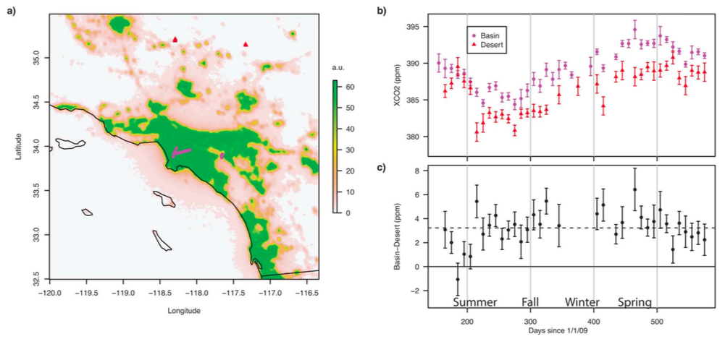
Space-based observations of megacity carbon dioxide (with GOSAT)
Enhancements, ppm
Observed XCO2 urban dome of Los Angeles from June 2009 to August 2010. (a) Nightlights map of the Los Angeles megacity and surroundings. Selected GOSAT observations within the basin (pink circles near 34ºN, 118ºW) and in the desert (red triangles near 35ºN, 117–118ºW). (b) Time-series for basin and desert observations averaged in 10-day bins. (c) The difference between 10-day block averages of basin and desert observations. The dashed black line shows the average difference (3.2 ±1.5 ppm)
Kort, E. A., C. Frankenberg, C. E. Miller, and T. Oda (2012), Geophys. Res. Lett., 39, L17806

Slide 10
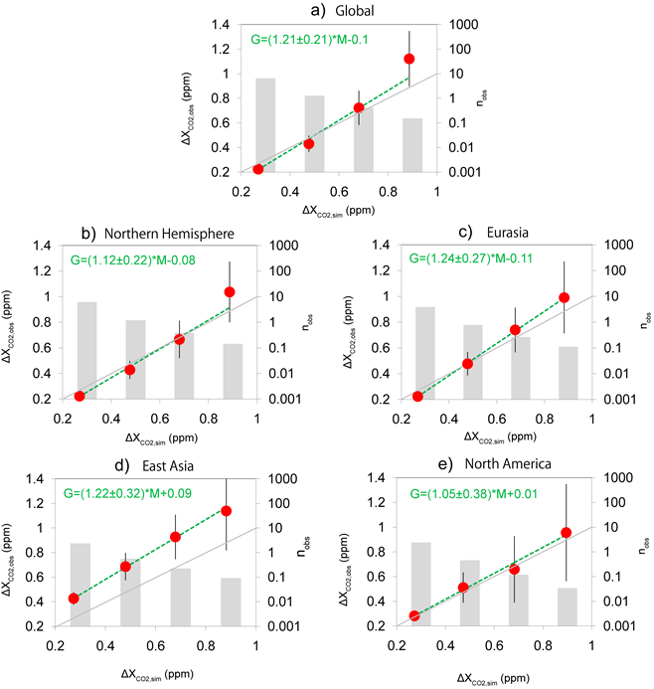
Comparing GOSAT observations of localized CO₂ enhancements by large emitters with inventory-based estimates
Simulated XCO2 enhancements agree with the observed over several continental regions across the globe, including North America with a regression slope of 1.05±0.21, but with a larger slope over East Asia (1.22±0.32).
GOSAT observed CO2 enhancements
Janardanan, R.; Maksyutov, S.; Oda, T.; Saito, M.; Kaiser, J. W.; Ganshin, A.; Stohl, A.; Matsunaga, T.; Yoshida, Y.; Yokota, T.. Geophysical Research Letters (2016), 43, 3486–3493
model+inventory

Slide 11
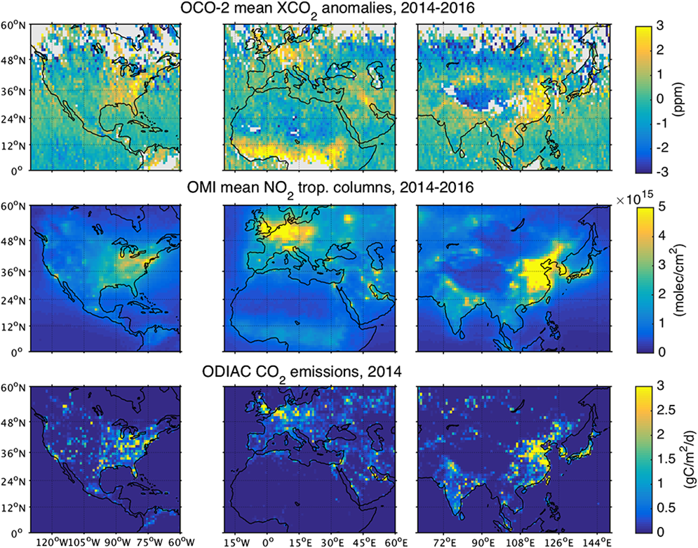
Direct space-based observations of anthropogenic CO₂ emission areas from OCO-2
Identification of anthropogenic CO2 signatures from space is challenging because of the strong effect of natural variability and transport.
For OCO-2, additional challenge is large amount of high spatial resolution data, - difficult to make global transport modeling
Authors developed a novel methodology to derive CO2 anomaly maps, solely based on collocated satellite-based OCO-2 CO2 and OMI NO2 measurements with high spatial coverage and detail.
Were able to identify the major anthropogenic CO2 emission regions, such as Europe, USA and China. In addition, several smaller isolated emitting areas, like individual cities, were detected.
Hakkarainen, J., I. Ialongo, and J. Tamminen (2016), Geophys. Res. Lett., 43, 11,400–11,406.

Slide 12
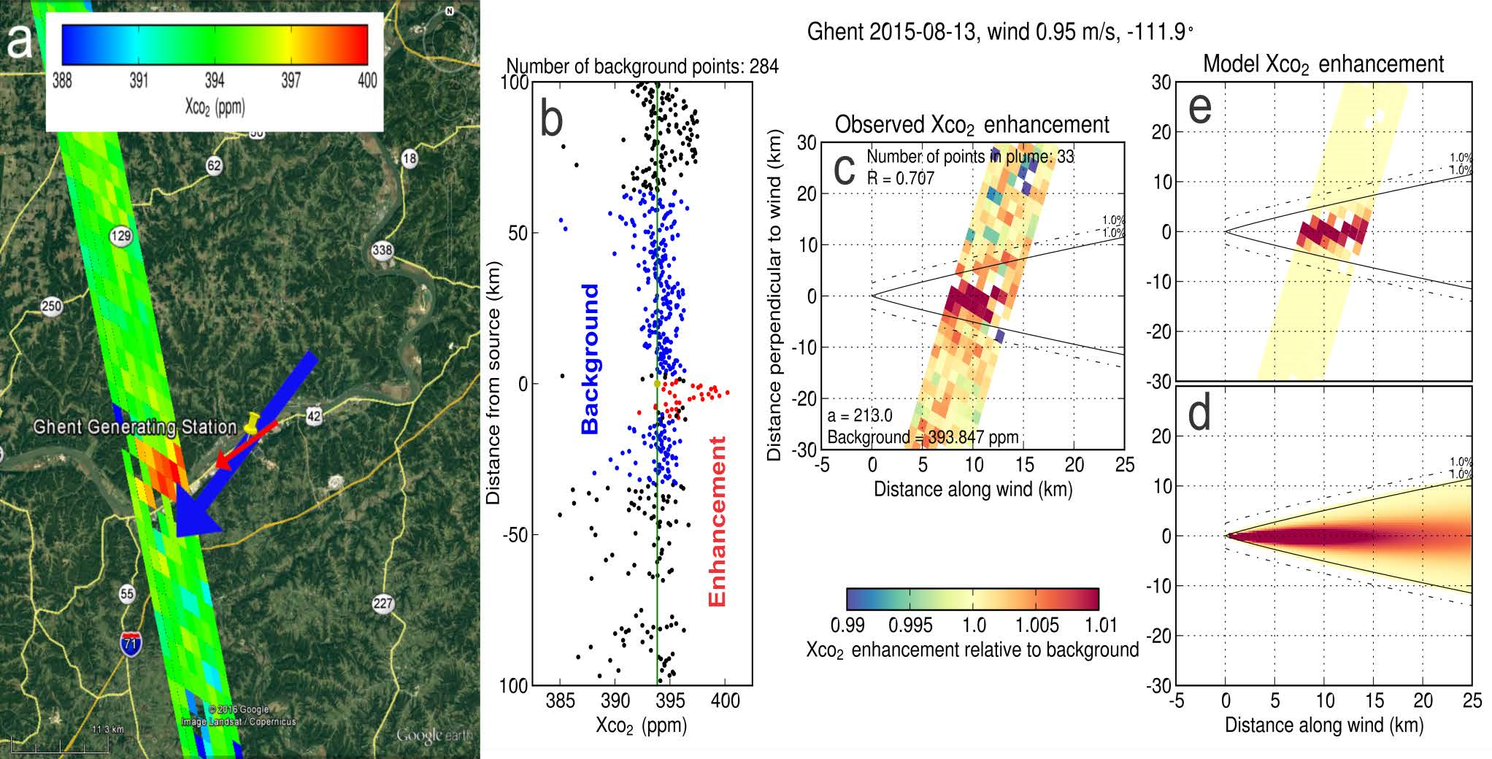
Quantifying CO₂ emissions from individual coal power plants using OCO-2 observations
“Close Flyby” of Ghent Generating Station
XCO
Relative to Background Average
2
Wind direction adjusted by +22.2
from mea
°
n
ECMWF -121.9
, 0.50 m/s
°
MERRA -138.4
, 1.41 m/s
°
Kentucky
2.5
km
Aug 2015
buffer zone
11.0
MtCO
/yr
2
~8 km to swath
EPA Reported Emissions: 29.2 ktCO
Enhancement is large due
2
/day
±
Estimated Emissions: 27.6
13.7
ktCO
/day
to low wind speed (~ 1 m/s)
Error budget:
±
2
wind speed:
13.2
kt/day
background ensemble:
±
0.5
kt/day
±
enhancement ensemble:
2.8
kt/day
R. Nassar, T. G. Hill, D. Wunch, D. Jones and T. Oda, IWGGMS, 2017
(do not cite: paper in review)

Slide 13
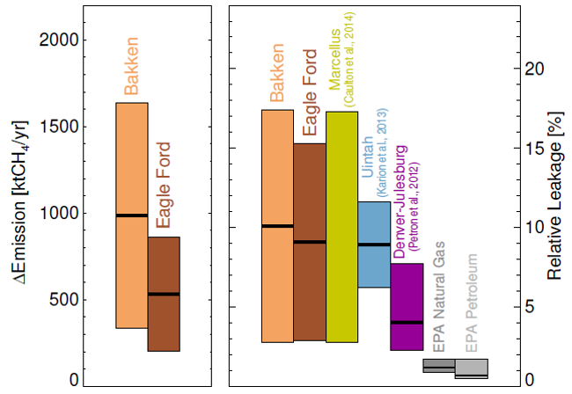
Remote sensing of fugitive methane emissions from oil and gas production in North American tight geologic formations
Estimated methane emissions are shown for the targeted regions Bakken in light brown, and Eagle Ford in dark brown. Shown are absolute emission increase (2009–2011 relative to 2006–2008) in the left panel, and the leakage rate relative to production in the right panel, in each case together with the 1𝜎-uncertainty ranges.
For comparison, leakage estimates from previous studies in Marcellus, Uintah and Denver-Julesburg (yellow, blue, and magenta) are shown together with the EPA bottom-up inventory estimates
Schneising, O., et al, Earth's Future, 2014.
The diﬀerence between the SCHIAMACHY mole fraction anomalies of methane, for the period 2009–2011 relative to the period 2006–2008. The locations of the oil and gas wells are shown in pink. Well positions are taken from the Fracking Chemical Database [SkyTruth, 2013]

Slide 14
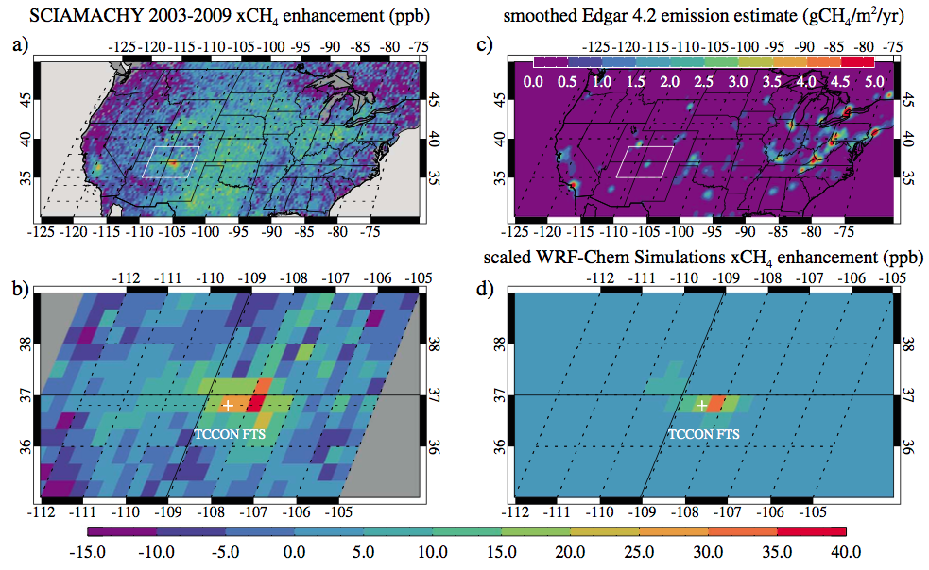
Four corners: The largest US methane anomaly viewed from space
Kort et al. (2014) found the Four Corners to be the largest single methane source in the continental US (0.59 Tg a⁻¹) on the basis of SCIAMACHY and TCCON observations, with a magnitude 3.5 times larger than EDGARv4.2 and 1.8 times larger than reported by the US EPA Greenhouse Gas Reporting Program (EPA, 2014).
Column methane anomalies and emissions over the U.S. (a) Average SCIAMACHY anomaly from 2003 to 2009. (b) Average anomaly over just the Four Corners region 2003 to 2009. (c) EDGAR v4.2 gridded methane emissions (smoothed). (d) WRF-Chem simulated methane anomaly using 3.5 times EDGAR v4.2 emissions for the Four Corners region.
Kort, E. A., C. Frankenberg, K. R. Costigan, R. Lindenmaier, M. K. Dubey, and D. Wunch (2014), Geophys. Res. Lett., 41, 6898-6903, doi:10.1002/ 2014GL061503

Slide 15
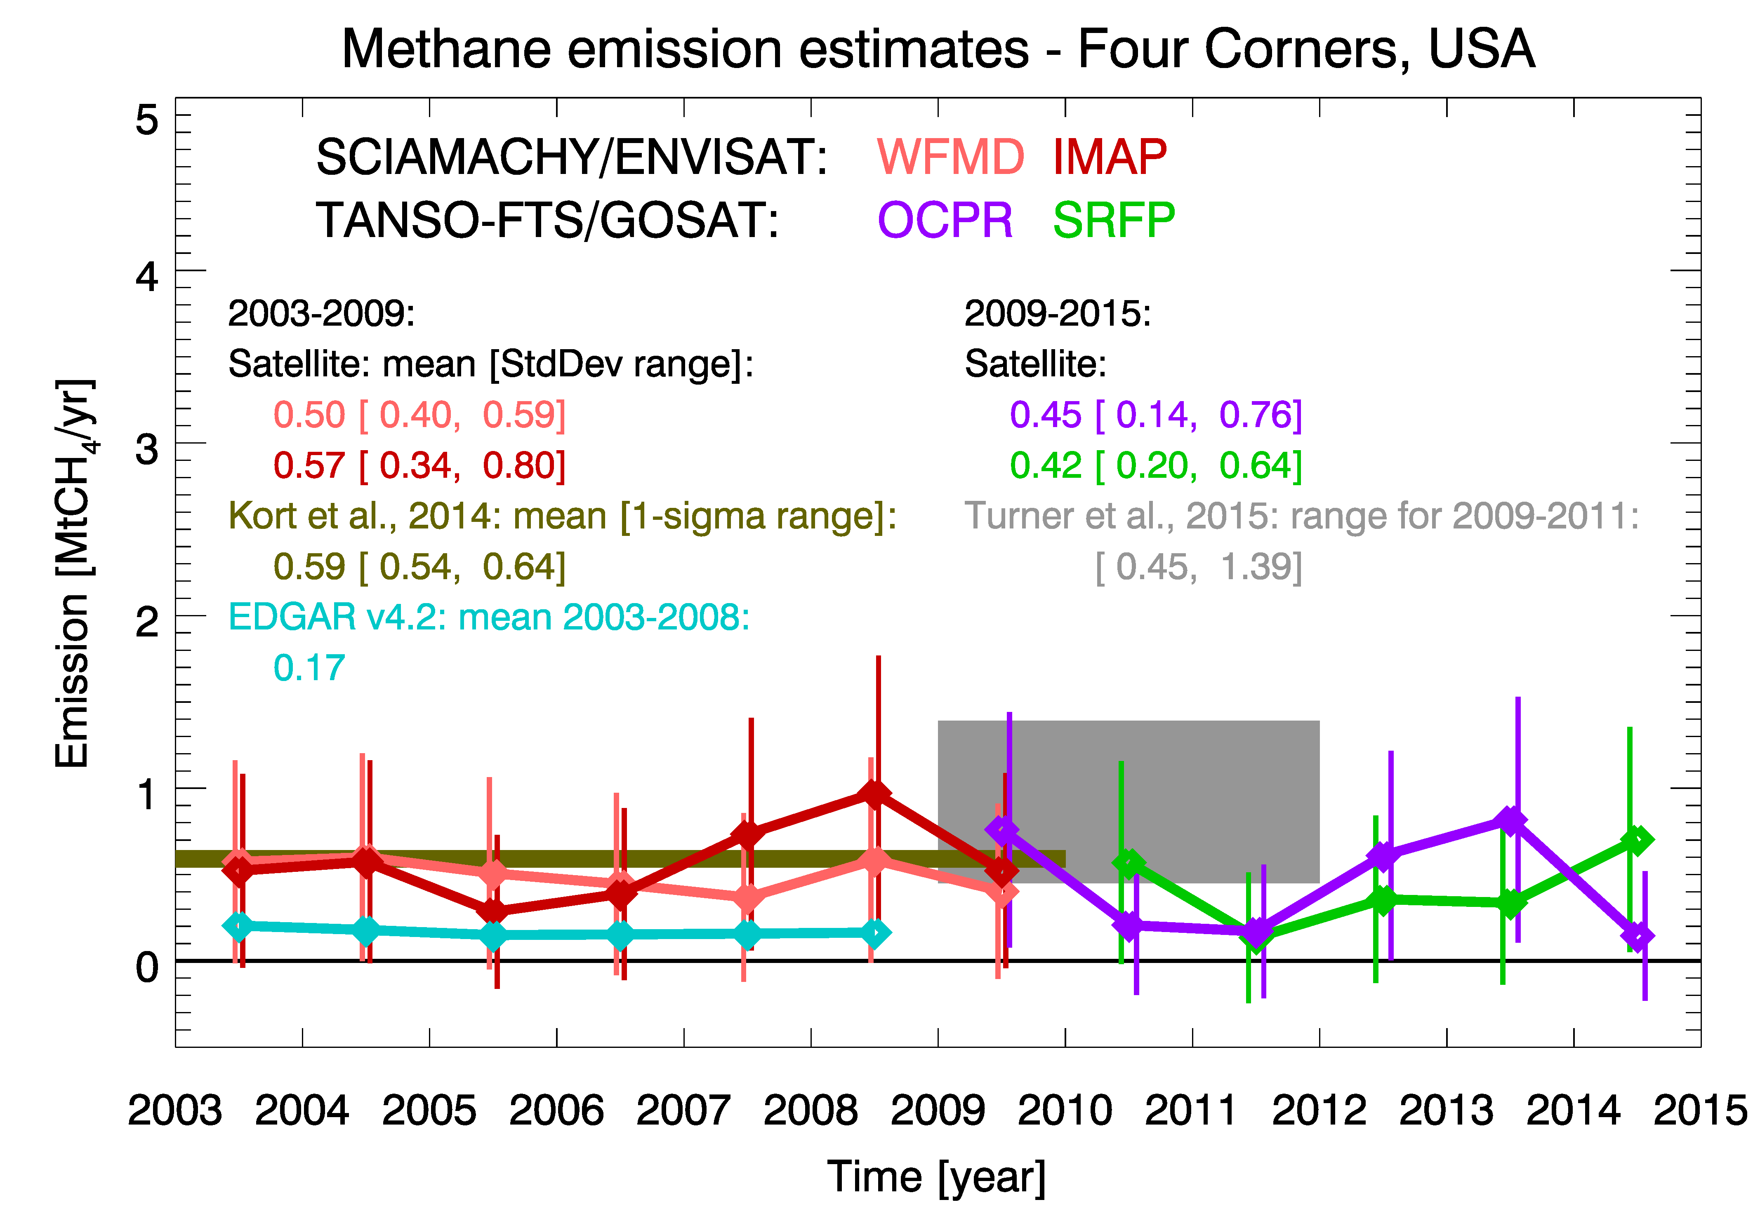
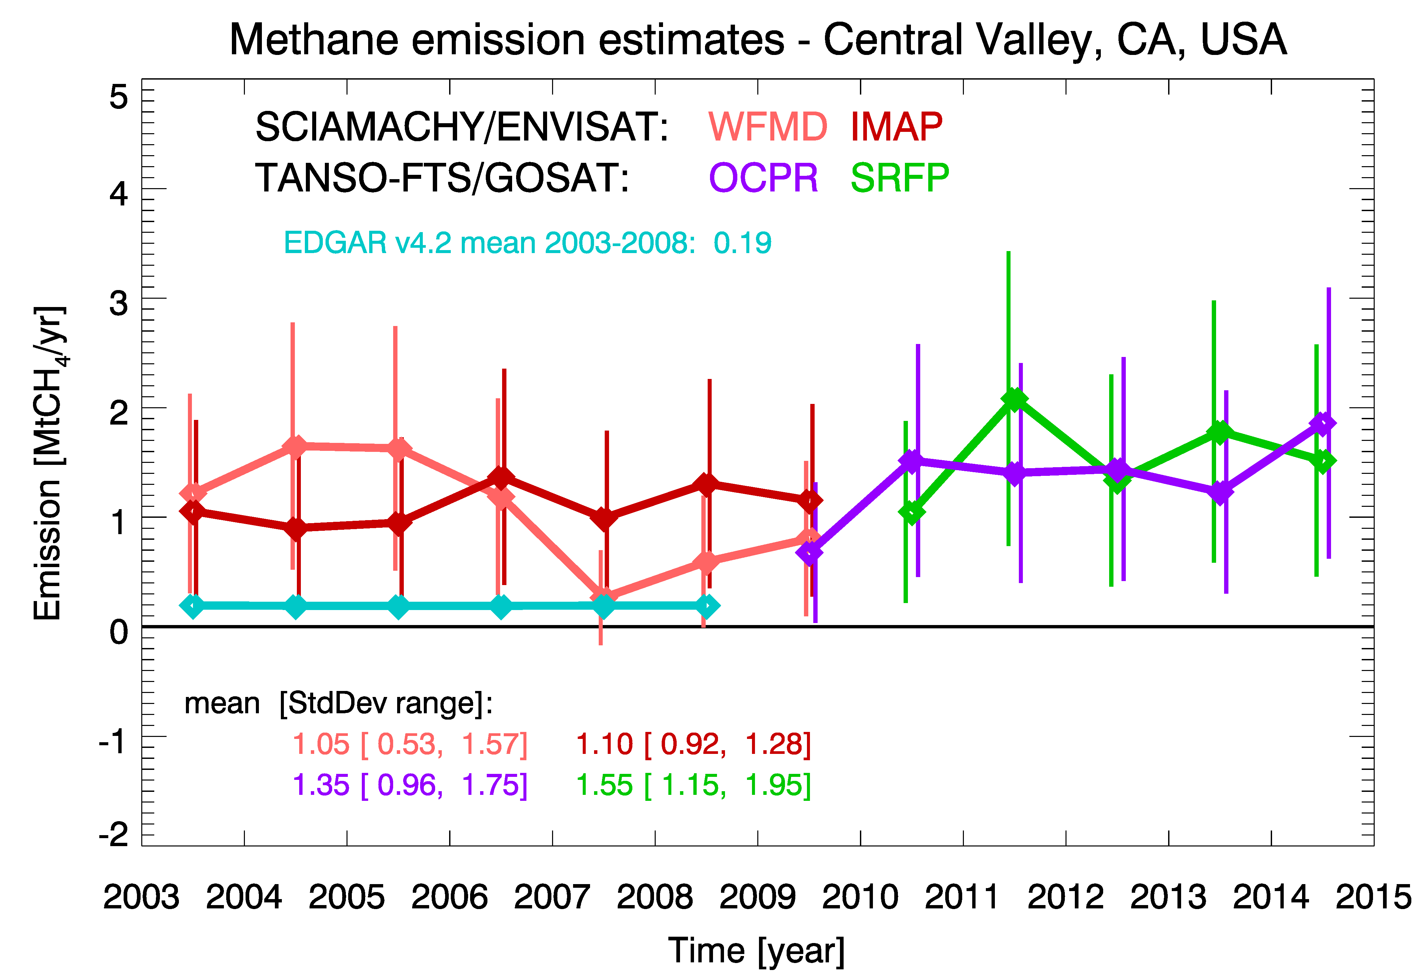
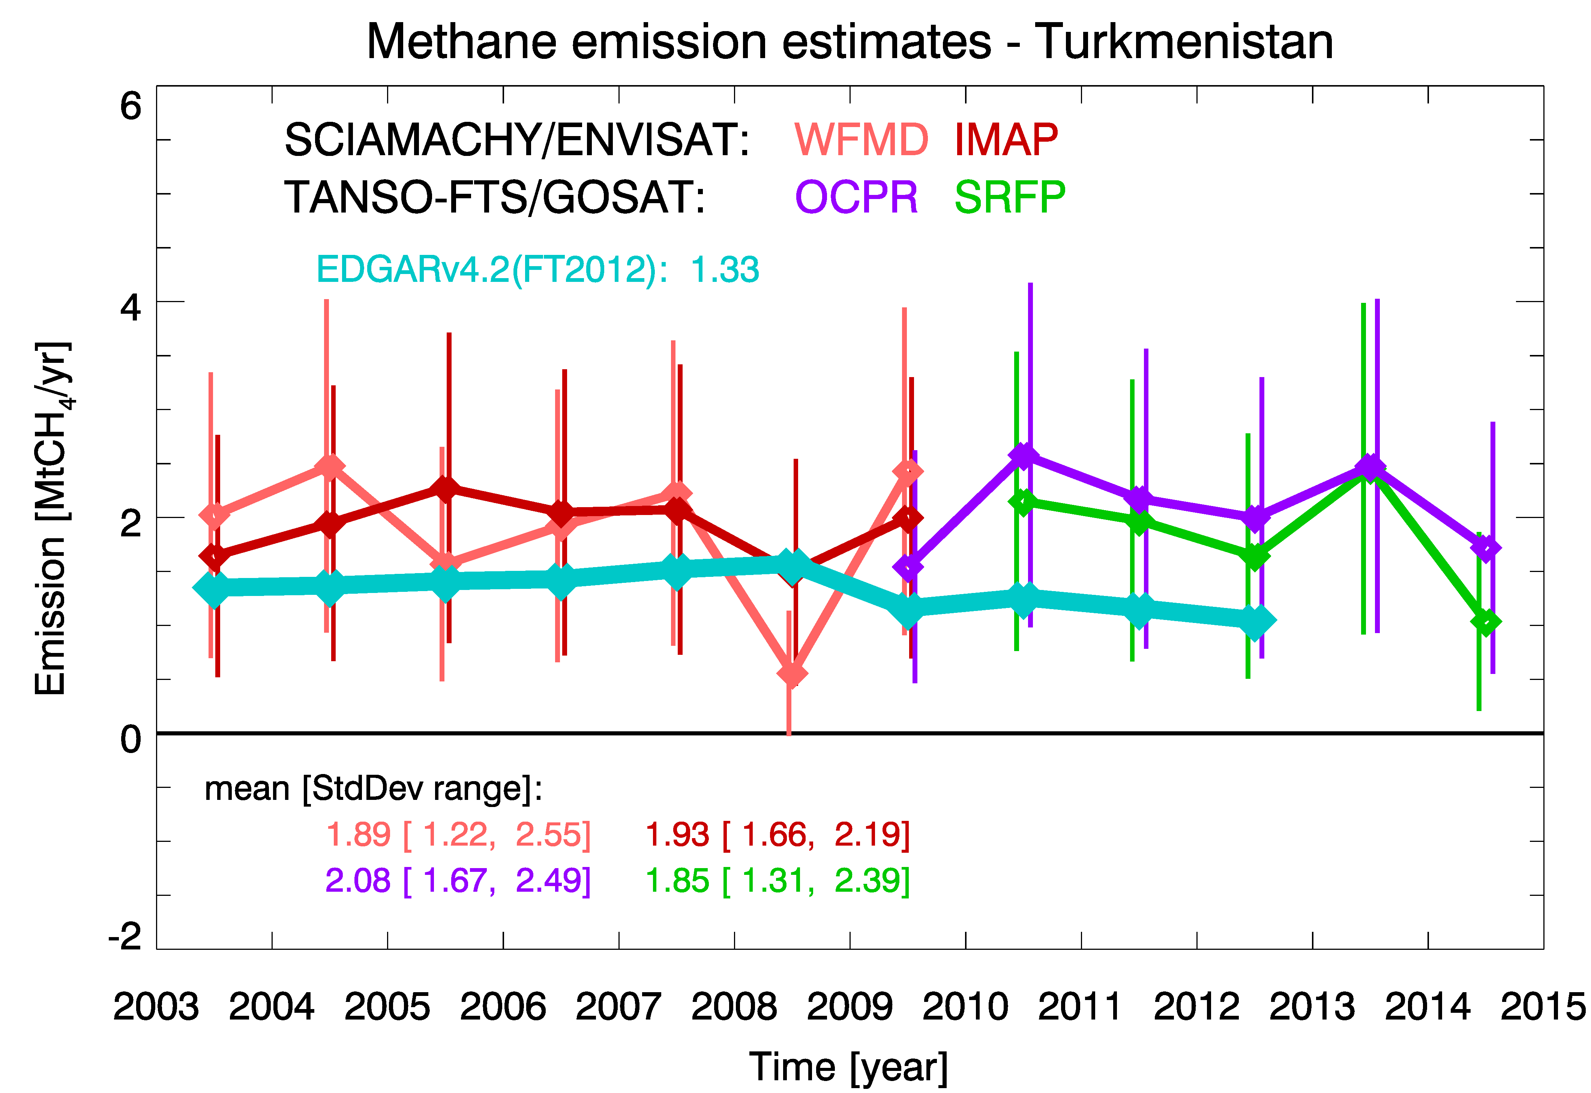
Satellite-derived methane hotspot emission estimates using a fast data-driven method
Annual methane emissions as obtained from SCIAMACHY and GOSAT for the three regions: (a) Four Corners in the USA, (b) Central Valley, California, USA, and (c) Turkmenistan compared with EDGAR and literature values.
Buchwitz, M., Schneising, O., Reuter, M., Heymann, J., et al, Atmos. Chem. Phys., 17, 5751-5774, https://doi.org/10.5194/acp-17-5751-2017, 2017.

Slide 16
Estimating global and North American methane emissions with high spatial resolution using GOSAT satellite data
Methane emissions in North America in 2009–2011 estimated with inverse model, using global GEOS-Chem transport model with 0.5 deg resolution zoom over N. America. The left panel show posterior (optimized=best fit) emissions and the right panel shows the scaling factors, ratio of posterior(optimized)/prior
Turner, A. J., Jacob, D. J., Wecht, K. J., et al. (2015). Atmospheric Chemistry & Physics, 15, 7049.

Slide 17
Summary
Guidebook on use of GHG observations by satellites for estimating surface emissions is now in preparation by MOE, NIES and expert scientists from around the world
The Guidebook introduce methods developed for estimating GHG emissions using satellite observations: observation of concentration enhancements around strong emitting sources and inverse modeling
Case studies based on more than 12 published research papers are presented to demonstrate application of the data analysis methods for regional to country level emission estimates based on satellite observations by SCIAMACHY, GOSAT and OCO-2
Guidebook publication is scheduled for March 2018, to make it available for use in 2019 Refinements to 2006 IPCC Guidelines on Emission Inventories

