Slide 1
WGISS Connected Data Assets
Committee on Earth Observation Satellites
Andrew Mitchell / Mirko Albani
VC/WG Day
CEOS SIT Tech Workshop 2016
Oxford, UK
13th September 2016

Slide 2
CEOS Work Plan 2016-2018
In the CEOS Work Plan 2016-2018,
DATA-2: Full representation of CEOS Agency datasets in the IDN and accessible via WGISS Interoperable Standards
Status: WGISS began discussions with ISRO and the following Australian centers in order to get their data accessible via WGISS interoperable standards (i.e. IDN, CWIC). (Geosciences Australia / CSIRO / Bureau of Meteorology /Australian National University &National Computational Infrastructure). New entries were added to the IDN from ESA, EUMETSAT, and JAXA datasets.
VC-1: List of Relevant Datasets from VCs
Status: WGISS is requesting updated list from the VCs.
VC-25 Increase the visibility of land surface imaging data holdings
Status: WGISS will work in conjunction with the LSI-VC to ensure relevant datasets are visible through WGISS Interoperable Standards.

Slide 3
WGISS Contributions to GEO
WGISS has been added as a contributor to the 2016 GEO Work Program Foundational Task GD-7 Subtask 2 ‘GCI Development’ and GD-2 ‘GCI Operations’.
As contributors, WGISS will:
continue to advocate for CEOS agency mission data to be contributed to the implementation of the GEOSS via the WGISS interoperable systems and standards. As more CEOS data providers adopt WGISS supported standards (e.g. OGC CSW 2.0.2 and CEOS OpenSearch Best Practices) these data providers holdings will be made discoverable via IDN, CWIC, and FedEO.
maintain the website titled ‘Connected data assets’ to provide up-to-date metrics for IDN, CWIC and FedEO.
contribute to this activity through the WGISS Technology Exploration Interest Group which serves as a forum for the exchange of technical information and lessons-learned about current and trending software technologies, services, and other internet-based software technologies.

Slide 4
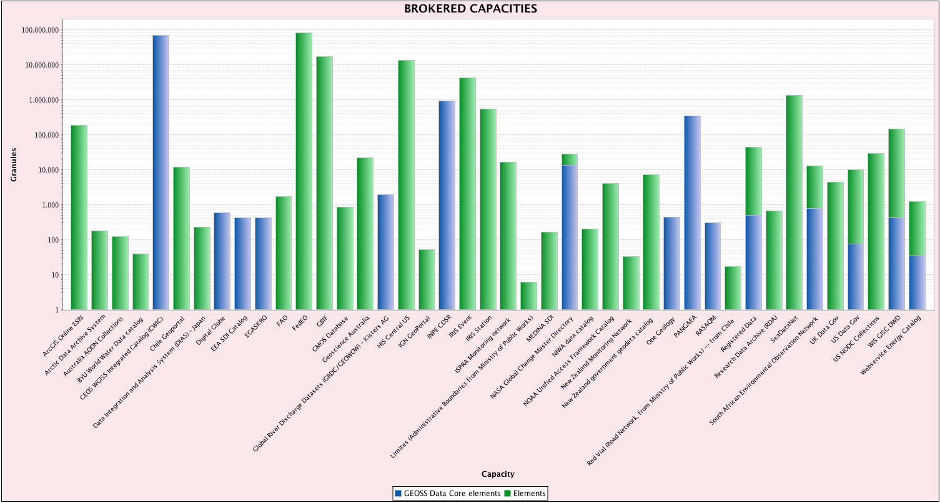
CEOS Resources
CWIC
70M Granules
All GEOSS Data-CORE
FedEO
82M Granules
No GEOSS Data-CORE

Slide 5
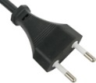
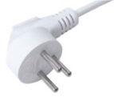
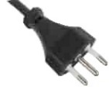
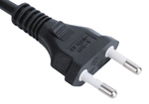
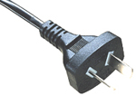
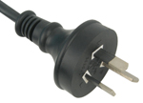
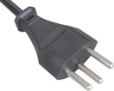
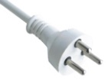
WGISS Interoperability
CWIC
FedEO
IDN
Adopted Interoperability Standards
System Level Support
Connected Datasets
Data Stewardship
Technology Exploration

Slide 6
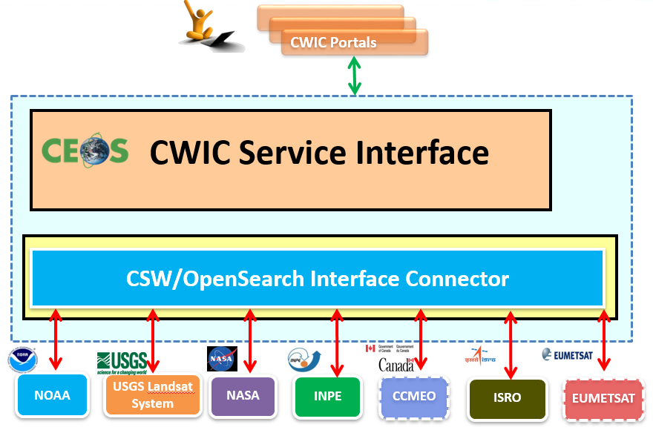
Interoperability - CWIC
CWIC = CEOS WGISS Integrated Catalog
Implemented to realize a federated catalogue for data discovery from multiple EO data centers
CWIC acts as a virtual clearinghouse of spatial, temporal, and science keyword metadata that brokers access to Earth Observation data by interoperating with data archives of other agencies and countries.
CWIC provides a translation gateway from the WGISS-supported search standards to the inventory systems of the CWIC Data Partners that describe collections of data granules.
CWIC is currently providing access to data from NASA, USGS, NOAA/GHRSST, INPE, EUMETSAT, ISRO (MOSDAC, NRSC), and CCMEO.

Slide 7
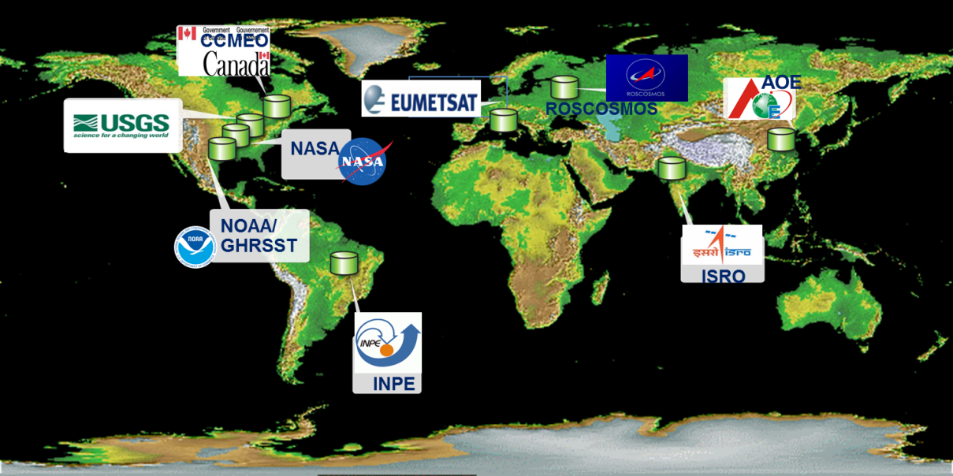
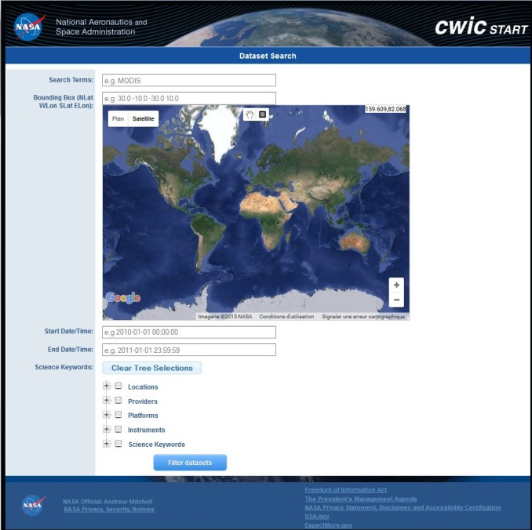
CWIC
Data partners:
NASA, NOAA/GHRSST,
USGS, INPE, CCMEO,
ISRO, EUMETSAT,
AOE, NOAA,
ROSCOSMOS
Implements CEOS Opensearch
Access to
Over 1900 collections
70+ millions granules

Slide 8
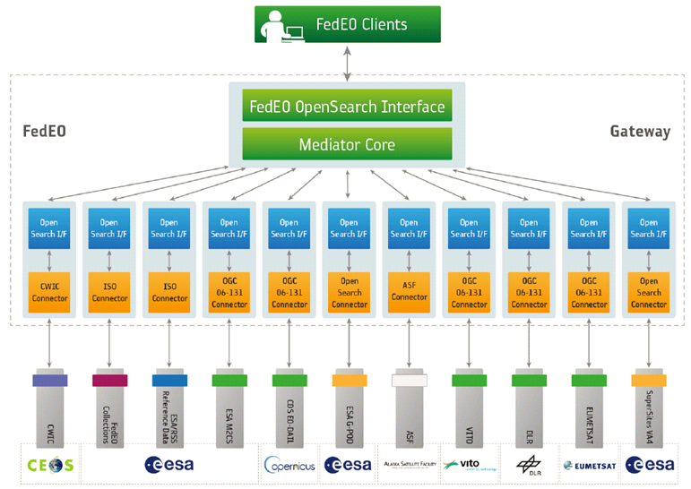
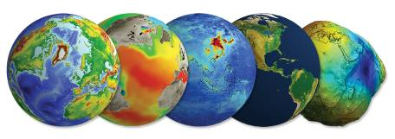
Interoperability - FedEO
FedEO = Federated Earth Observation missions access
The FedEO system provides a unique entry point to a growing number of scientific catalogues and services for, but not limited to, EO European and Canadian missions.
FedEO is deployed with ESA (European Space Agency) infrastructure as a gateway to:
Provide brokered discovery, access and ordering capability to European/Canadian EO missions data based on HMA (Heterogeneous Missions Accessibility) interfaces;
Implement the OpenSearch OGC (Open Geospatial Consortium) and other interfaces for an increased number of discoverable and accessible EO data collections;

Slide 9
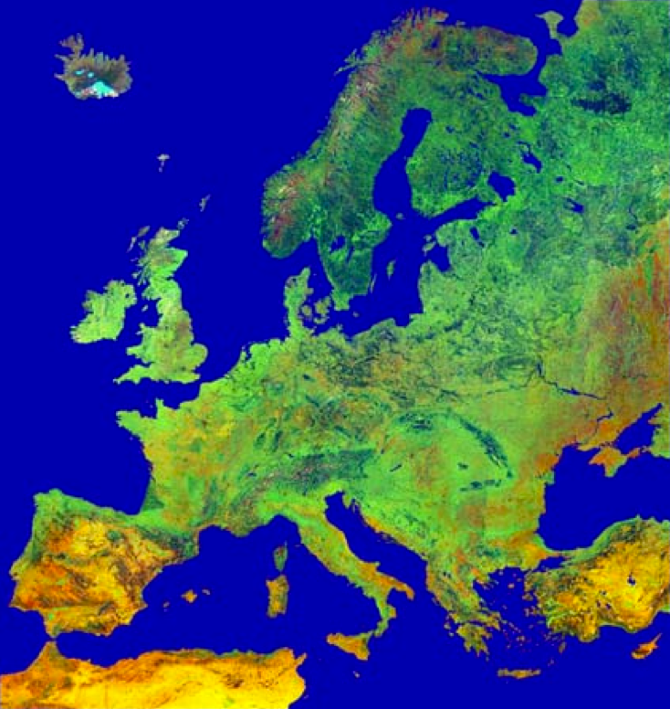
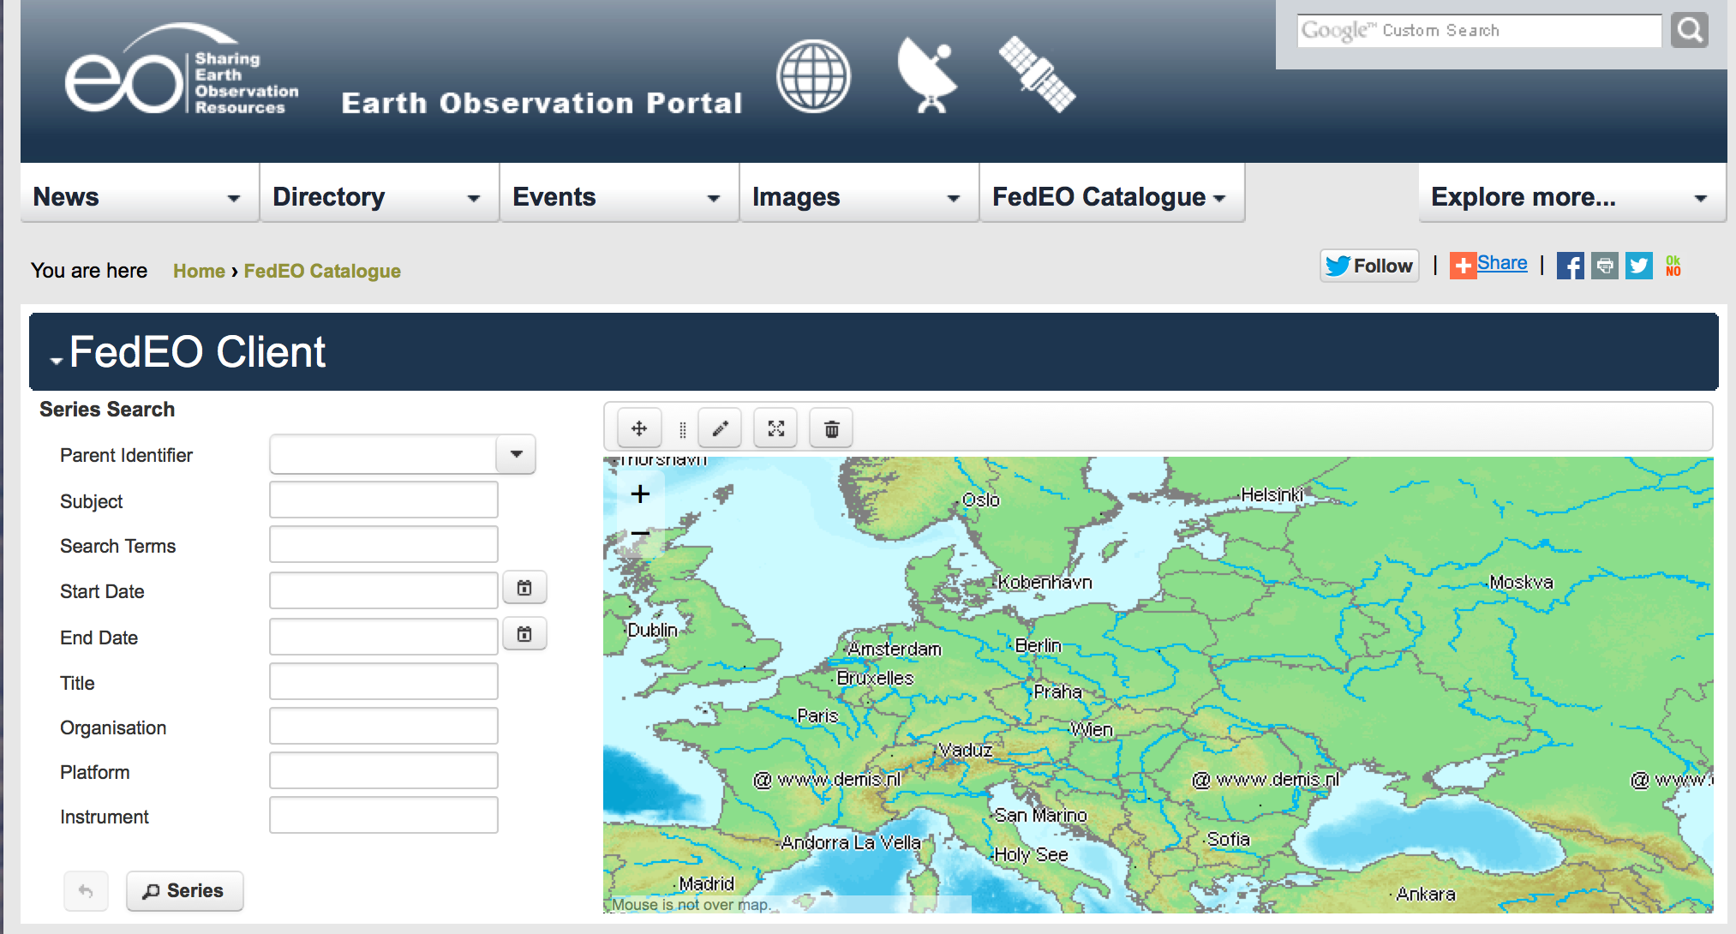
FedEO Federated Earth Observation
Gateway System
Brokered discovery, access and ordering
Implements HMA and CEOS OpenSearch interfaces
Partners (Europe and Canada):
ESA, DLR, CNES,
EU Copernicus
VITO, EUMETSAT,
NASA, ASF, ROSCOSMOS
Access to
477 collections
6+ millions granules

Slide 10
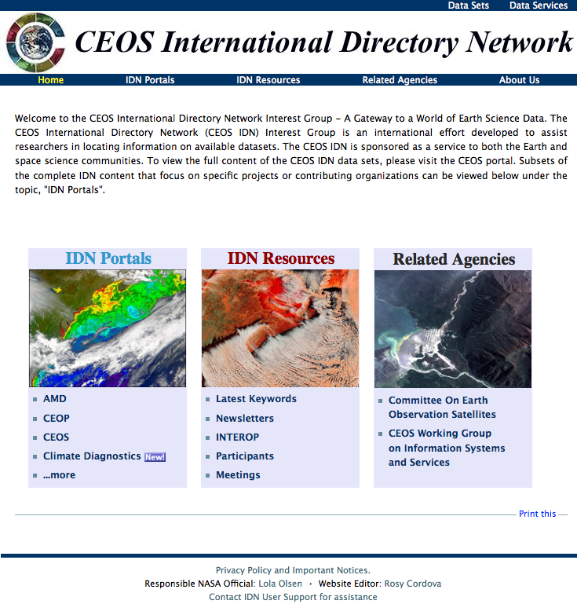
Interoperability - IDN
IDN = International Directory Network
An international effort developed to assist users in locating data sets, data services, and visualizations.
Provides free, online access to metadata on scientific data in the Earth sciences: geoscience, hydrospheric, biospheric, satellite remote sensing, and atmospheric sciences.
Provides clients/portals directory-level search of CEOS agencies and others who have registered their collections in the IDN
http://idn.ceos.org/

Slide 11
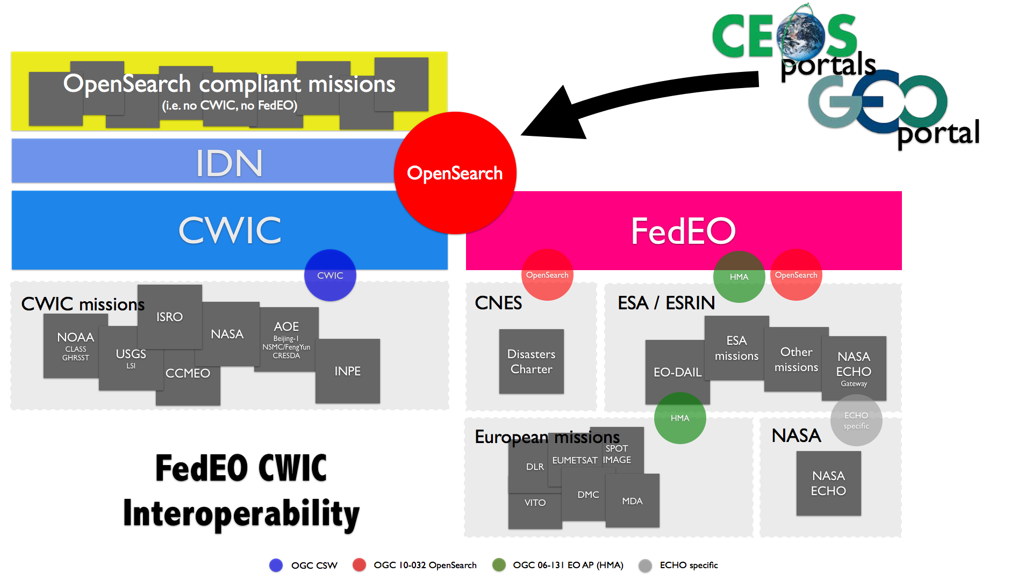
WGISS Interoperability Standards Architecture
WGISS has adopted the CEOS OpenSearch Best Practices in addition to the Open Geospatial Consortium (OGC) Catalog Services for the Web (CSW) v2.0.2 standards for searching remote sensing catalogs, both for collection and inventory information.
The FedEO, CWIC and IDN systems have implemented the WGISS supported standards are providing access to over 2300 collections and 76+ millions granules of EO mission data.
The IDN provides descriptions of data sets (collection level) of relevance to global change research. Both the CWIC and the FedEO systems offer search of inventory data (granule level) and access to the data records. A WGISS system level team will provide technical support to register data collections in the IDN and to on-board new data providers to connect their inventory systems to CWIC or FedEO.

Slide 12
Counting Data Assets
Why are we counting WGISS Connected Data Assets?
Need metrics - CEOS Agencies data that are searchable and accessible via WGISS supported standards
CEOS contribution to GEOSS
What are we counting?
Collection – consists of data records of one mission, sensor, and product type and the associated knowledge; an ensemble of some products/granules having a common focus or theme or purpose
Granule - the smallest aggregation of data which is independently managed (i.e. described, inventoried); A data collection can consist of many granules.
What are the requirements to be counted?
Collection is registered in the IDN
Granule metadata can be searched using the WGISS supported standards (OGC CSW 2.0.2 or the CEOS OpenSearch BP) by independent clients;
Data needs to have an access path
No need to be part of CWIC or FedEO!

Slide 13
Connected Data Assets

Slide 14
System Level Team Responsibilities
System Level Team
Assistance in registering data collections
On-boarding of new data partners
Tech support for client partners
Bug fixes
System level testing and monitoring
System level metrics
Plan and implement system evolution
Makes stuff work well!
Image Source http://www.provencecloud.com/infogerance/assistance-et-support-technique/

Slide 15
WGISS Data Stewardship
Activities in the Data Preservation and Curation context have the purpose to:
Enable the sharing of agency investigations, developments, experiences and lessons learned relating to EO data stewardship.
Draft common cross-agency best practices or guidelines of data stewardship for possible adoption by WGISS.
White Papers and Reports
Long-Term Archive Strategies
Data Preservation Techniques
Data Lifecycle Models and Concepts
Browse Survey 1997-2010
Guidelines for GIS-Ready Products
Browse Guidelines Document (version 2)
Offline Media Trade Study
Best Practices and Recommendations
EO Preserved Data Set Content
EO Data Preservation Guidelines
Preview Image Principle
Data Management Statement
CEOS Persistent Identifier Best Practices
Generic Earth Observation Data Set Consolidation Process
Long Term Preservation of Earth Observation Space Data: Preservation Workflow
Long-Term Preservation of Earth Observation Space Data: Glossary of Acronyms and Terms

Slide 16
Technology Exploration Webinars
Big Data, HPC and Cloud Computing
What CEOS needs? CEOS Challenges
Distributed data centers
Data processing (incl, Data cube)
Data distribution
Data Analysis
API and use of standards
Network (bandwidth, application)
Advantages and disadvantages
Searching for free satellite data from CEOS agencies
In suitable forms (related to FAD)
GCMD/IDN Keywords – what are they, how to add to these lists
Along with WGCAPD
Source Image https://www.iconfinder.com/icons/730862/blackboard_classoom_education_school_students_teacher_teaching_icon

Slide 17
Technology Exploration Webinars
Search Relevancy for Collection searches
Data Quality Semantics
Augmentation of meta data
Visualization of Data
Web-based visualization
Volume rendering
Tiling
Augmented Reality
Using authentication/SSO
Metrics of usage, metrics of datasets
Crowd Sourcing
Image Source http://blog.atomiclearning.com/tags/tags/taxonomy/term/200

Slide 18
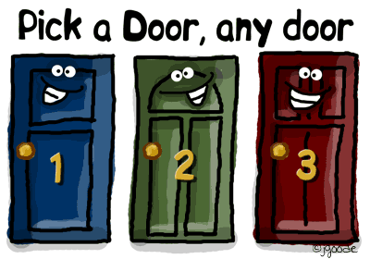
WGISS Connected Data Assets Architecture Discussion

Slide 19
Current Issues
For discussion
Not easily understandable outside (and inside?) WGISS

Slide 20
Current Issues
For discussion
Duplication: E2E architecture risks to return the same result twice (e.g. GEO DAB may route a request both to CWIC and FEDEO and get NASA CMR or EUMETSAT results twice)
User risks to get many collections that are anyhow included in other collections
User might get different results when accessing different portals
User has no idea about stability (e.g. DOI) and quality of collections (was the latest reprocessing applied? Quality Indicators?)

Slide 21
Current Issues
For discussion
Ranking of results might not match user query and does not take into account where the user might actually have higher rights to access data
Infrastructure leaves user “alone” for:
access to the real data (after discovery)
discovery and access to data associated knowledge and information: not linked to the data
Different metadata models and transport layers don’t make the user’s life easier… and implementation costly
Others?

Slide 22
Future Activities Objective
For discussion
Concerted approach to give a homogeneous results to the user allowing to easily filter duplicates within the CEOS Infrastructure
Address shared collections and mirror collections
Harmonize collection/product metadata models along ISO 19115
Enhance Directory information with data access condition information (e.g. pointer to T&C signature) and Quality Indicators
Provide result ranking with user-selectable criteria
Harmonize Terms & Conditions acceptance and data access authorisation process in a federated user management approach

Slide 23
Future Activities Implementation through WGISS
For discussion
Two Phase approach proposed:
PHASE 1: Consolidation of current CWIC/FedEO/IDN overall architecture to quickly address some of the identified open issues
PHASE 2: Dedicated “Interoperability Project” to evolve and fully address all open issues

Slide 24
PHASE 1 activities
For discussion
Consolidate overall architecture and concept
Consolidate components and interfaces to Partners; population
Remove duplicated discovery and access to identified data collections (e.g. EUMETSAT, NASA, ASF, ROSCOSMOS) to align with overall concept
Consolidate and maintain WGISS web pages and a coherent set of statistics
Complete update of Opensearch Best Practice
Contributors: CWIC/FedEO/IDN teams, WGISS support

Slide 25
PHASE 1: Current Architecture Consolidation
For discussion
Objectives: architecture “operationalization” & redundancy, data duplication removal, improve minor shortcomings of current standards
CLIENTS
FedEO Node
CWIC Node
Collection
Directory
(FedEO, CWIC)
Collection metadata population & harvesting
Search (1st step)
IDN
Collection
Directory
(CWIC, FedEO, Others)
Non-European Partners
product catalogues:
USGS, NASA, ISRO, NOAA, NOAA/GHRSST, INPE, AOE, CCMEO
European Partner product catalogues:
ESA, EU Copernicus, DLR, CNES, ROSCOSMOS, VITO, EUMETSAT, ASI, UKSA

Slide 26
Questions for VCs & WGs
Which products do your VC/WG have difficulty discovering or accessing?
Is there a need from your VC/WG to have science discipline focused data access portals?
GEOSS Data Portal
GeoSUR
GHRSST
GeoPlatform community and the ArticSDI community
Biomass?
Are there technologies that WGISS should prioritize in our Technology Exploration webinars?
Cloud Computing?
Product Formats?
What are your overall data access, data discovery, technology pain points?
Network performance?

Slide 27
Conclusion
WGISS will continue to work towards a common understanding of the information model for satellite data, the identification and testing of common search criteria for satellite data products, and adaption and testing of the common standards and protocols to describe, search, and access satellite data.
WGISS will provide technical support to CEOS agencies providing their climate data records through the WGISS supported standards (e.g. CEOS OpenSearch) and data access infrastructure (IDN, CWIC, FedEO).

Slide 28
For more information, please contact:
WGISS Chair
Andrew Mitchell Andrew.E.Mitchell@NASA.gov
WGISS Vice-Chair
Mirko Albani Mirko.Albani@esa.int

