Slide 1
Actions & Conclusions (what you should have thought we agreed)
Committee on Earth Observation Satellites
Stephen Briggs, ESA SIT Chair
Agenda Items #32 & 33
CEOS SIT Technical Workshop
Oxford, UK
14th-15th September 2016

Slide 2
Committee on Earth Observation Satellites

Slide 3
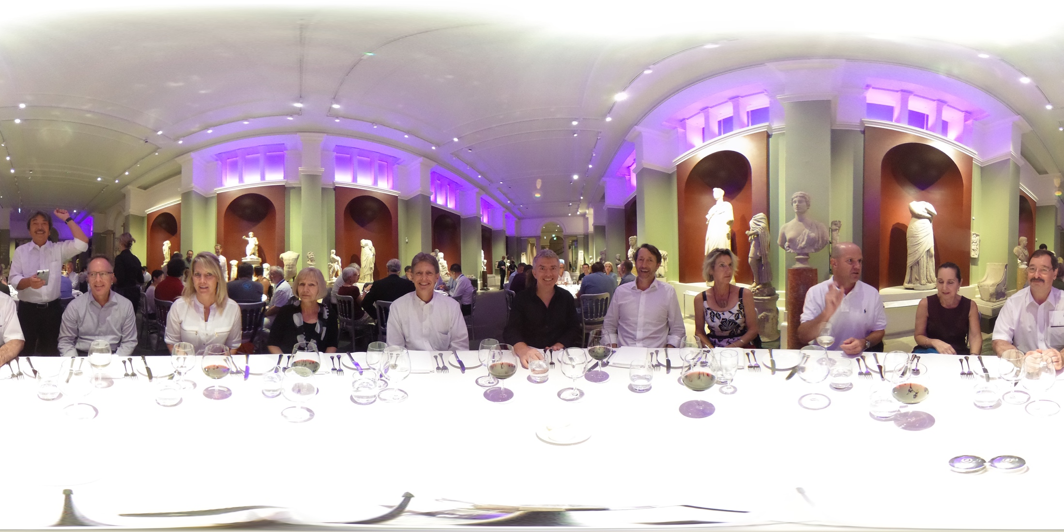
Committee on Earth Observation Satellites

Slide 4
Partnerships
Partnerships
discussed options with dev. banks, UN, data giants, and NGOs.
high-level vs case-by-case discussed
GEO assumed to have the preferred geometry
More difficult with in-situ data providers.
Sketch up common principles of engagement and communication
lessons learned might help familiar obstacles
small poll of CEOS initiatives
Short audit of CEOS/agency relationships with dev. Banks and UN system (as a first step towards better coordination)
Advocate for GEO role and leadership
CSIRO indicated this topic for further discussion at Plenary, stressing that many user groups are unaware of benefits from using EO data

Slide 5
CEOS Data Cube and ARD
The first FDA-related pilots emerging bottom-up within CEOS
Work well advanced within SEO/SDCG/LSI-VC
CEOS Data Cube Work Plan developed to document and communicate the many threads and dimensions
ARD spec progressing well – needs broader participation and addition of radar expertise
Endorse the 3 Yr CEOS Data Cube Work Plan
Endorse the CARD4L high level definition and encourage further work and application to CEOS missions
FDA-team propose a CDC/ARD/GFOI pilot (see later)

Slide 6
LSI User Requirements
SIT Chair Team requested consideration of common approaches to harmonise thematic acquisition strategies of CEOS
Inputs on tools and processes from a number of agencies
Need to broaden the user base for EO satellite data to more sectors and more users.
Exploring adoption and generalisation of the CEOS ad hoc Working Group on GEOGLAM approach to apply to other thematic areas
ensuring capture of both observational requirements and downstream product/service requirements
Plan to look at CEOS Carbon Strategy for pilot implementation

Slide 7
CEOS Info Systems Survey
Fill out the survey by end of the month:
https://www.surveymonkey.com/r/ceos-info-systems
Provide it to your stakeholder communities
SIT Team will ask GEOSEC to circulate

Slide 8
Future Data Architectures
Short-term recommendations well received
SIT recommends Plenary to endorse the 1-year extension of the FDA team – leadership and participation will be confirmed by USGS and CSIRO
Encouraged continued relevant work by WGISS
Propose to Plenary an integration of existing CEOS activities as a more focused demo of FDA benefits
Small-scale ARD production in a CEOS Data Cube framework
GFOI Colombia demonstrator
12-24 months
Expanded proposal for Plenary
Explore other suggestions in parallel (CEOS TEP etc)

Slide 9
Non-met Applications
Report to be finalised for Plenary
Framing of recommendations to be considered, with a range of opportunities identified:
Consider exploring collaborative efforts for algorithm development and intercomparison activities (consistent GEO-ring);
Seek opportunities to broadly engage with the EO-community and LEO science teams to foster the collaborative development of advanced algorithms and to identify potential non-met applications for coordinated GEO-ring implementation;
Consider how the “Analysis-Ready Data” concept would apply to GEO-LEO integration;
Continue working towards the operational delivery of NMA geophysical products to achieve quasi-global consistent coverage, particularly radiometric products that underpin downstream products;
Study the suitability of GEOs to contribute to ECVs/CDRs and UN SDGs in detail; and
Consider identifying a suitable pilot project within existing coordination activities.

Slide 10
GEO engagement
GEO updates from GEOSEC and our CEO and SIT Chair
Re our PB engagement
CEOS has re-nominated for next three years, using existing names for Principal and Alternates
We will ‘update’ the details of our PB representatives consistent with internal protocols, e.g. SIT Chair transitions, CEO transitions, SEC processes
Principal CEOS PB Rep will be duty of SIT Chair, consistent with SIT Chair ToR
Noted re-framing of GEO approach and priorities
GEO Plenary prep agreed

Slide 11
GFOI
Global Data Flows study affirms many of the messages emerging from the FDA work
Importance of ARD stressed by user countries
CEOS Data Cube good example
SDCG to write to several CEOS agencies on global coverage
JAXA/JERS-1
CONAE/SAOCOM-1A
CNES/SPOT archive
SDCG Sec has no forward operating budget as of Plenary – asked to raise at CEOS Plenary
SDCG to seek clarity on risks to GFOI Office continuity

Slide 12
GEOGLAM & Disasters
New organisational framework
Review of EO data requirements – MGD-style approach
Future commercial sector engagement needed
Pilots going well
RO demo ongoing, with WB participation
Glossy report for 2017
Engaging with GEO-DARMA

Slide 13
Water
Reorganisation of GEO Water SBA activities, (GEOGLOWS)
New CoP on Water Quality - AquaWatch
WSIST Feasibility Study near conclusion – final report to Plenary
Hyperspectral Water Quality task underway (A Dekker) and asked to report by SIT-32 (?)
Other tasks may be based on 2015-2017 GEO WP tasks – CEOS may need to revisit
GEOGLOWS aims to provide effective coordination framework for water activities, requirements, observations… will take some time to coalesce.

Slide 14
Carbon
Focus on 5-7 VC/WG initiatives
ACC GHG Constellation Paper
WGClimate Carbon gap analysis (ECVI)
WGISS portal
WGCV actions
NASA biomass cal/val and products
JAXA IPCC TFI engagement
Prototypes for cross-cutting aspects
Continue with GEO Carbon initiative engagement, mapping agency level projects onto Carbon actions
Plan for a 2-yearly CEOS Carbon Workshop
Plenary to agree on overall approach – update 2017, review 2018
Plenary to comment on individual initiatives
CEOS-CGMS CO₂ coordination – confirm at Plenary to write to CGMS noting ACC-VC efforts and invitation to augment

Slide 15
SDGs
SIT-31 decision: CEOS way forward on the UNSDGs will be undertaken in conjunction with GEO & UN-GGIM, supplemented by a top-down dialogue with relevant UN Agencies and with individual CEOS Agencies making connections within their governments.’
Formalise coordination of SDG-specific activities into a new CEOS Ad-Hoc team (CSIRO volunteer to lead) to:
Interact with and support GEO activity on SDGs in advance of GEO-XIII (i.e. complete with a month)
Coordinate:
Development of a small CEOS brochure Updates on the dedicated webpage for SDGs on the CEOS website (http://ceos.org/ourwork/other-ceos-activities/sustainable-development-goals/)
Actions for GEO Plenary (exhibition, and any GI-18 side meetings)
CEOS participation in key international SDG-related meetings e.g. ISRSE (SA, 2017)
Liaison w. WGCapD around future workshops on EO and monitoring of SDGs, guidance on the use of EO for official statistics, etc.
Engagement as needed with key UN agencies or other players (eg World Bank, etc.)

Slide 16
VC/WG Issues
Main topics: Harmonizing Cal/Val activities; INSITU-OCR; Connected Data Assets and coordination of data exchange; WGISS Interoperability Standards Architecture; and The VC-WG marketplace
Passive Microwave Radiometers (PMW) for SST gap analysis recommendations to be put to Plenary
On idea of a Polar Observations VC it was agreed that PSTG well covers the core issues. CEOS discussion to be communicated to PSTG with VC Process Paper
Ask PSTG to confirm coordination of passive microwave observations of polar ice
Ocean VCs will review the COVERAGE proposal and liaise with the team to bring an update to SIT-32 (perhaps a Plenary session)

Slide 17
GCOS & UNFCCC
GCOS IP (inc Satellite Supplement) ready for COP-22
WGClimate to prepare reviewed SBSTA statement for COP-22
Poster materials also
Side events: REDD+, EarthInfo Day, Space Agency heads
Space Agency response in planning for COP-23

Slide 18
Organisational aspects
Await news of EC consideration of Chair 2018 role
Await nominees for CEO/DCEO from late 2017 – action for a reminder

