Slide 1

CEOS Ocean Variables Enabling Research and Applications for GEO (COVERAGE):
Committee on Earth Observation Satellites
An Initiative Proposal to CEOS
Drs. E. Lindstrom, V. Tsontos & J. Vazquez
NASA
SIT Tech Workshop 2016 Agenda Item # 29
CEOS Strategic Implementation Team Tech Workshop
Oxford, UK
14th-15th September 2016

Slide 2
COVERAGE Motivation
COVERAGE is a response to:
Need for improved, unified access to data from the 4 CEOS ocean virtual constellations (VCs) for GEO (SSH, SST, Color, OVW, but also potentially SSS and Ocean Currents)
Importance of improved access/integration of multivariate, multi-platform ocean observations, thematically organized and in a common frame (including those from the Ocean VCs), available in near real-time where possible in support of GEO-Blue Planet initiative in particular.
Conceived at a CEOS Strategic Implementation Team meeting in Pasadena in 2013.
Proposed COVERAGE initiative for CEOS:
Low Footprint R&D Project! - no new VC or WG.
Provide a coherent, focal point activity and mechanism promoting the advancement of the aforementioned needs consistent with CEOS programmatic objectives.
We invite the interest and participation of other CEOS agencies in this effort.
Collaborative Opportunities: data sharing, technical exchange
Stakeholder Beneficiaries:
Internal: Ocean VCs, WGISS
External: GEO-Blue Planet, UN/IOC GOOS

Slide 3
COVERAGE Alignment with CEOS Strategic Objectives
CEOS Goals ¹:
Achieve better integration across the full range of Earth observations (space-based->in situ)
Facilitate open & easy access to CEOS agency data for maximal societal benefit CEOS via improved discovery, interoperability, coordinated data access portals in specific topical areas, promoting use of open-source tools
CEOS 2016-18 Work Plan² :
3.6. Capacity Building, Data Access, Availability and Quality:
II. Future Data Architectures: Address data access/usage obstacles & “Big Data” challenge
3.8 Support to Other Key Stakeholder Initiatives:
Commitment to priority actions identified by GEO Blue Planet Initiative:
    CEOS ocean VCs role in sustainment/continuation/harmonization of essential ocean variables
    develop experimental & operational coordinated, multi-sensor ocean products & services to explore optimal utility of developing a collocated, readily accessible dataset package with fit-for-purpose latency for applied, industrial, and research uses.
GEO-Blue Planet goals³: advance/exploit synergies among observational programs for sustained development & use of ocean and coastal observations for the benefit of society via:
increased integration of and access to in situ and remote sensing ocean observation data
the conception, promotion and end-to-end ocean information services
1. CEOS Strategic Guidance, Nov. 2013 2. CEOS 2016-2018 Work Plan, Mar. 2016 3. http://geoblueplanet.com/

Slide 4



COVERAGE Overview
CEOS Ocean Variables Enabling Research and Applications for GEO
Build a project to bring together 4 CEOS Ocean Constellations, via broader international participation, enabling wider use of ocean satellite data, and utilize emerging data management and cloud capabilities.
Vision: International collaboration via CEOS and GEO-Blue Planet engagement for a global COVERAGE “portal product” developed around a priority set of community driven use cases
COVERAGE aims to assemble and present satellite and in situ ocean data in a compelling web-based format to demonstrate the value added of multivariate ocean data integration is support of science, applications, and public engagement.
Develop a data rich platform (utilizing both established standards/protocols but also emerging data management and cloud technologies where necessary) for delivery and access to integrated, analysis ready ocean data :
  multi-parameter observations, easily discoverable and usable, thematically organized, available in near real-time (where possible), collocated to a common grid and including climatologies.
  complemented by a set of value-added data services available via the COVERAGE portal including: an advanced Web-based visualization interface, subsetting/extraction, data collocation/matchup and other relevant on demand processing capabilities (eg. trend analysis, anomaly detection, dynamic regridding).
  establish technical interfaces and data delivery and aggregation pipelines.
Leverage relevant technologies (several open source) developed under NASA-AIST & ACCESS and a successful project implementation model (eg. NASA Sea Level Change Portal)

Slide 5
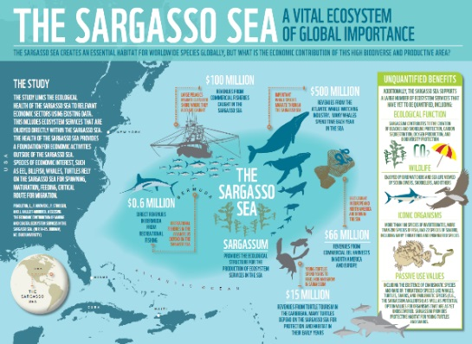

Sargasso Sea Pilot Project (1/2)
Use the Sargasso Sea and NASA as a regional pilot application for Sargasso Sea Commission to ensure that the development is user-driven and effective.
Collaboration with the Sargasso Sea Commission (SSC)
  SSC: Network of international partners led by the Government of Bermuda, including UK, USA and intergovernmental agencies (IUCN, ISA) aiming to advance the recognition of the importance of the Sargasso Sea and promote its protection in accordance with the Law of the Sea Convention (UNCLOS)
  Periodic interactions with SSC over a 1.5 year period to define the scope and contents of a pilot COVERAGE application for the Sargasso region and undertake a joint workshop to present the prototype to stakeholders
Value of COVERAGE for SSC
  Provide access to data for data poor high seas area
  Illuminate the relationship between oceanographic conditions and uses of the Sargasso Sea
  Identify ocean use by marine species and humans & highlight areas of conflicting usage
  Tool supporting future measures resulting from ongoing UN negotiation of a new marine biodiversity treaty for areas beyond national jurisdiction (ABNJ) as an extension to UNCLOS.

Slide 6
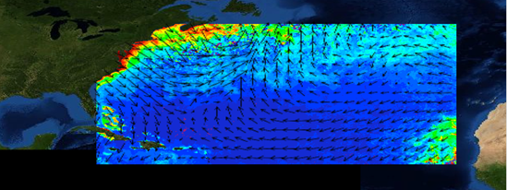
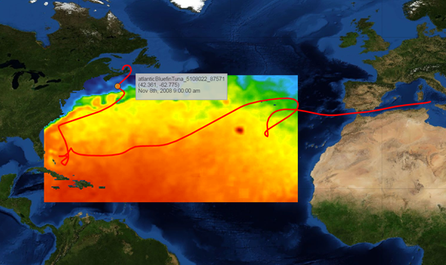
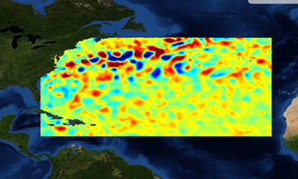
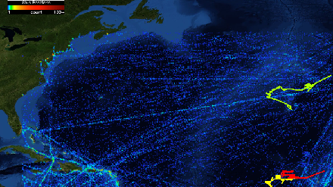
COVERAGE - Sargasso Sea Web Application (2/2)
  Leverages JPL web-based data visualization platform and cloud data integration technologies
  Incorporates range of co-located satellite ocean products on ~25km daily grids including: SST, SST anomaly & gradients, CHL-A, SSS, Surface Currents & Wind Speed, Sea level anomaly, SST gradients
  Diverse in situ datasets including: SPURS1 field campaign data, AIS vessel tracking data, fish telemetry data (Bluefin tunas, Mako & Tiger sharks, Eels)
  Spatial domain: Sargasso Sea defined as 15N to 45N and 80W to 20W
  Enables overlay of all parameters and the visual exploration of inter-relationships between layers
  Animation allows examination of dynamic evolution of structure and relationships between variables
MODIS CHL-A +
ASCAT Ocean Surface Winds
Bluefin tuna archival tag track + Reynolds SST
AVISO Sea level anomaly
AIS Vessel Positions
Heat map + Tracks

Slide 7
COVERAGE-Sargasso Workshop
& UN Presentation
NASA-funded workshop hosted by SSC, Key West, FL., March 20-22, 2016
36 participants including SSC Secretariat, Commissioners & scientists from agencies including NASA, NOAA, academia, industry with expertise in the Sargasso region
Objectives:
  Expose the COVERAGE pilot project to peer review and comment.
  Examine utility of COVERAGE for resolving relationships between ocean conditions and uses of the Sargasso Sea.
  Identify high-priority applications for COVERAGE to enable “use cases” for future implementation
Key Outcomes:
  Workshop report/recommendations and presentation materials
  Overwhelming consensus on usefulness of COVERAGE as an accessible data integration platform
  Priority thematic areas for the Sargasso region: “Ships & Sargassum”, “Fisheries, Organisms & their Environment”, “Regional early warning system for Sargassum beach inundation events”
  Recommendations on additional datasets & strategic partnerships (UN-IOC/OBIS, ICCAT)
  Need for automated data pipelines for (near real-time) data delivery
  Detailed feedback from participants on tool functionality
http://www.sargassoseacommission.org/about-our-work/workshops/nasa-sargasso-sea-workshop
COVERAGE-SS presented at an event at UN-HQ on 31 Aug.2016 in the margins of the Preparatory Committee meeting (PREPCOM2) for ABNJ treaty negotiations

Slide 8
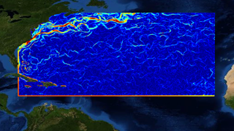
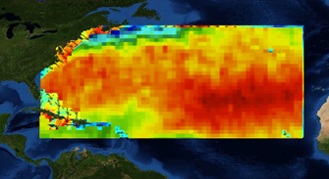
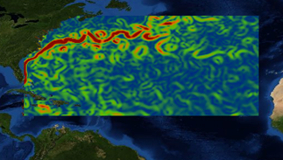
Future Steps for COVERAGE
COVERAGE Initiative Paper submission & presentation CEOS-SIT Oxford meeting (completed)
Circulation of paper within CEOS Ocean VCs and WGs for comment
Confirm interest and in-principle agency support for and contributions to the proposed activity.
Possible updated proposal paper incorporating broader CEOS agency feedback and contributions circulated to Principals at least 2 weeks prior to Plenary (mid-Oct. 2016)
Presentation and discussion at 30th CEOS Plenary, Brisbane, Oct-Nov, 2016
COVERAGE envisaged as a 3-year R&D commitment within CEOS towards an “operational” capability by the end of 2020.
MUR-SST Gradients
Aquarius Sea Surface Salinity
OSCAR Surface Currents

Slide 9
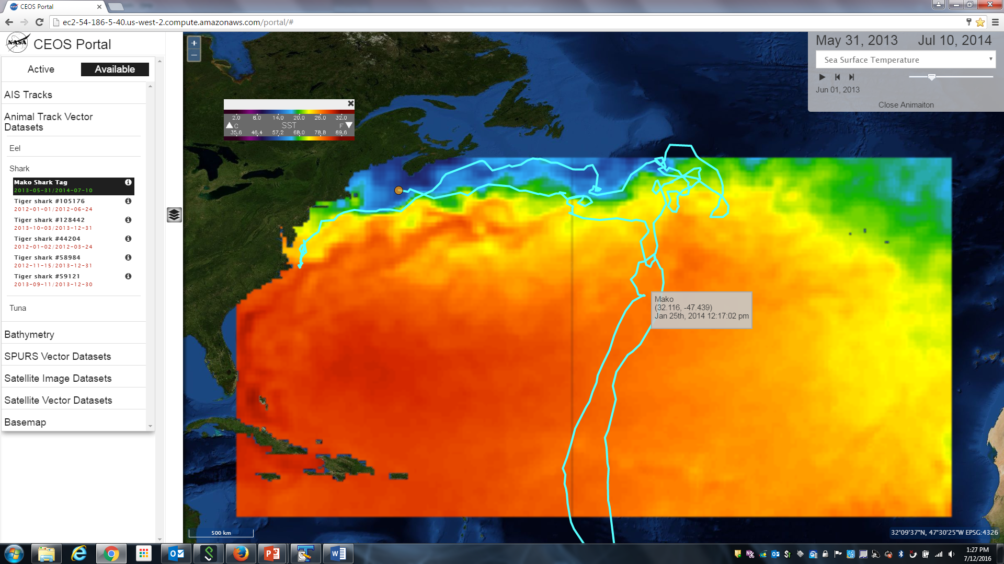
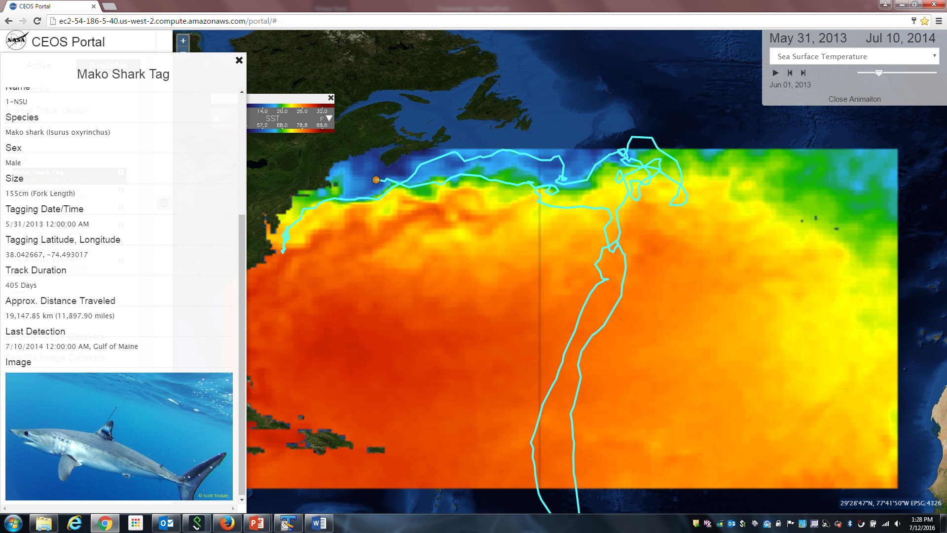
Questions / Discussion
COVERAGE Demonstration Prototype for the Sargasso Sea
Mako shark satellite tag track + Reynolds SST

