Slide 1
Report from the VC-WG Day Jean-Louis Fellous, SIT Chair Team
Committee on Earth Observation Satellites
with concurrence of the session moderators
Paul DiGiacomo, Philippe Escudier, Andrew Mitchell and Albrecht von Bargen,
and a presentation by Anne O’Carroll
Oxford, UK
15th September 2016

Slide 2
VC/WG Day Organization
Following the first VC/WG Day successfully held in Montpellier on September 16, 2014 and on September 16, 2015 in Darmstadt, it was agreed to organize a 3rd VC/WG Day
The format and topics for this 3rd VC/WG Day were discussed during the June-July 2016 tag up teleconferences.
Preference was expressed for a meeting “by invitation only” in order to facilitate exchange and discussion among VCs and WGs – it being understood that the door remained open to anyone interested
The first topic (Carbon Strategy session) was introduced and moderated by Mark Dowell (who will also report to the SIT TW)
Like in 2014 and 2015, other topics were allocated one hour and moderated by (sometimes volunteered) volunteers
We are extremely grateful to the moderators for their assistance in leading the VC/WG Day to significant outcomes, and I shall report to the SIT Technical Workshop on these outcomes

Slide 3
VC/WG Day Agenda
 | Topic | Moderator | Contributors
09:00-10:30 | Carbon Strategy Action items | Dowell | All VCs & WGs
10:30-11:00 | Coffee/tea break
11:00-12:30 | Carbon Strategy (cont’d) | Dowell | All VCs & WGs
12:30-13:30 | Lunch
13:30-14:30 | Harmonizing Cal/Val activities | DiGiacomo (OCR-VC) & Escudier (OST-VC) | All VCs & WGs
14:30-15:30 | Connected Data Assets and coordination of data exchange | Mitchell (WGISS) | All VCs & WGs
15:30-16:00 | Coffee/tea break
16:00-17:00 | Market Place (up to 5’ for each group) | von Bargen (WGCV) | All VCs & WGs on their selected issues

Slide 4
Harmonizing Cal/Val activities
Paul DiGiacomo (NOAA/STAR, OCR-VC) and Philippe Escudier (CNES, OST-VC) were the moderators for this topic
Paul introduced the INSITU-OCR (International Network for Sensor Inter-comparison and Uncertainty assessment for Ocean Color Radiometry) initiative aimed at integrating and rationalizing inter-agency efforts on satellite sensor inter-comparisons and uncertainty assessment for remote sensing products with particular emphasis on requirements addressing the generation of ocean color Essential Climate Variables as proposed by the Global Climate Observing System (GCOS).
Philippe discussed classical Cal/Val methods, and highlighted the importance of multi-technique data, statistical analysis and scientific analysis, citing the example of BioArgo and climate monitoring as illustrations of the complementarity and potential of these diverse techniques.

Slide 5
INSITU-OCR
Under the guidance of the International Ocean Color Coordinating Group (IOCCG), representatives of Space Agencies and Institutions supporting INSITU-OCR agreed on a series of recommendations on activities critical to ensure high accuracy and consistency among products from present and future ocean color missions. Those recommendations call for thoughtful consideration by Space Agencies contributing to OCR-VC in view of achieving the final goal of developing consistent long-term Climate Data Records.
Key recommendations address:
i. space sensor radiometric calibration, characterization and temporal stability;
ii. development and assessment of satellite products;
iii. in situ data generation and handling;
iv. information management and support.
Special consideration is given to traceability, application and accessibility of the necessary in situ measurements, which are a fundamental element of any ocean color mission.

Slide 6
Harmonizing Cal/Val – Discussion
The discussion addressed various issues and ideas:
Volz raised the issue of commercial (ocean color) data and, more generally, any other radiometric data streams that do not follow basic standards for calibration and validation
Dowell mentioned the NASA-ESA IMBIE project aimed at closing the balance of ice sheet mass balance, reconciling existing measurements using satellite altimetry, gravimetry and the input-output method and suggested pursuing more of these closure experiments
Lecomte mentioned the ESA CCI and the importance of the collocation meetings where all ECV-related projects share techniques and experience
Holmlund drew attention to the current focus on Polar regions, which implies an effort on assessing measurement uncertainties. He also pointed out the need to improve optical (lunar) calibration.
Dowell cited the AERONET (aerosol properties and radiative properties) as a nice example of harmonization

Slide 7
Harmonizing Cal/Val – Discussion
O’Carroll stressed the need to engage with in situ data producers. Concerning multi-technique data and sharing of tools, she referred to the GHRSST experience which is departing from the past trend to isolate uncertainty estimation from other activities, in view of the coupling between parameters and through physics of measurement
DiGiacomo inquired on the dialogue with modelers. Lecomte mentioned the role of the CMUG in the CCI as the integrator of the various ECV projects
Al-Saadi raised the issue of surface reflectance distribution and heterogeneities for atmospheric parameter retrievals
Lewis identified surface reflectance and surface temperature as the most critical Cal/Val issues for the LSI-VC
Neeck recalled the experience of TRMM leading to including Cal/Val activities as an integral part of the GPM constellation ground segment. He also cited the success in leveraging contributions from non-space entities that have relevant assets.
Thome and O’Carroll stressed the importance of SI traceability

Slide 8
Connected Data Assets and coordination of data exchange
Andrew Mitchell (NASA, WGISS) moderated this topic
He started with a presentation of WGISS activities as reflected in the CEOS Work Plan 2016-2018 (DATA-2, VC-1, VC-25) and the GEO Work Program (GD-7/2 and GD-2)
He described the CWIC, FedEO, and IDN interoperability systems aimed at brokering discovery, access and ordering data, recognizing the complexity of the overall system for non-experienced users. A system-level team is being established to help and support users. Webinars are being implemented along with WGCapD to help users to navigate within these technologies.
The current structure is still confusing for users: duplication, different responses from different portals, lack of quality information, etc. WGISS is now preparing to resolve these issues.

Slide 9
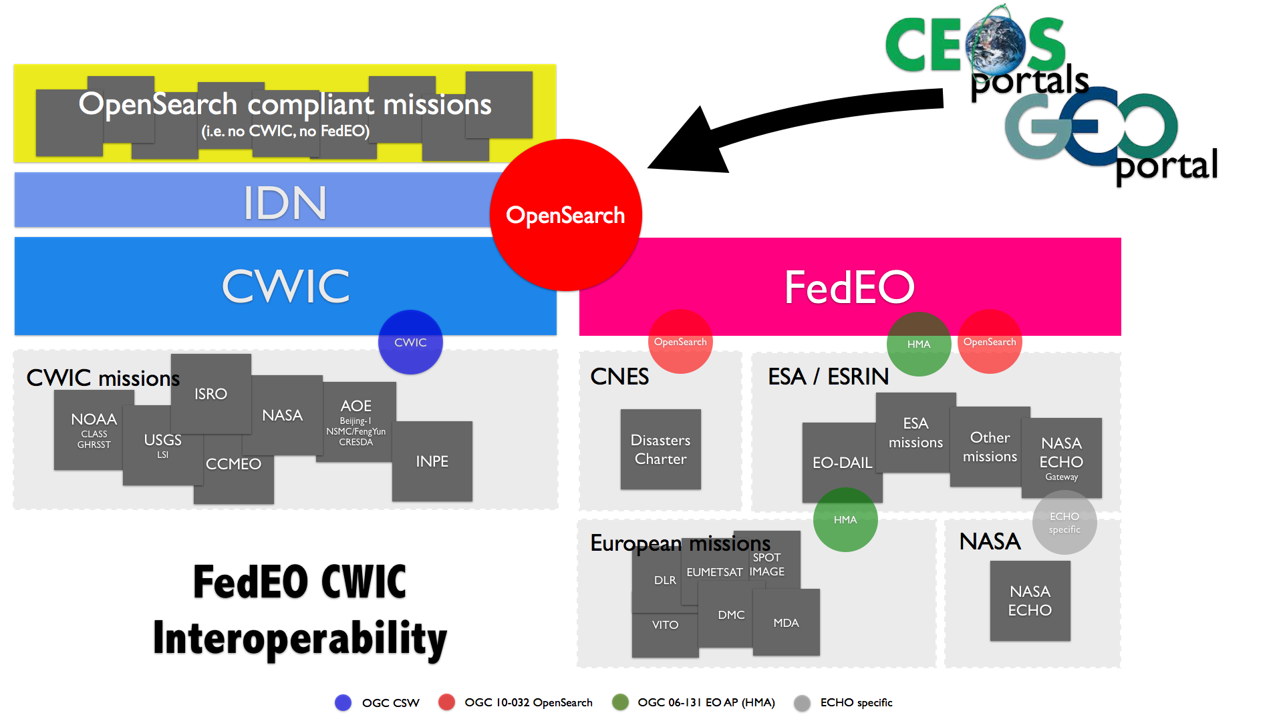
WGISS Interoperability Standards Architecture
WGISS has adopted the CEOS OpenSearch Best Practices in addition to the Open Geospatial Consortium (OGC) Catalog Services for the Web (CSW) v2.0.2 standards for searching remote sensing catalogs, both for collection and inventory information.
The FedEO, CWIC and IDN systems have implemented the WGISS supported standards are providing access to over 2300 collections and 76+ millions granules of EO mission data.
The IDN provides descriptions of data sets (collection level) of relevance to global change research. Both the CWIC and the FedEO systems offer search of inventory data (granule level) and access to the data records. A WGISS system level team will provide technical support to register data collections in the IDN and to on-board new data providers to connect their inventory systems to CWIC or FedEO.

Slide 10
CEOS Work Plan 2016-2018
DATA-2: Full representation of CEOS Agency datasets in the IDN and accessible via WGISS Interoperable Standards
Status: WGISS began discussions with ISRO and the following Australian centers in order to get their data accessible via WGISS interoperable standards (i.e. IDN, CWIC). (Geosciences Australia / CSIRO / Bureau of Meteorology /Australian National University &National Computational Infrastructure). New entries were added to the IDN from ESA, EUMETSAT, and JAXA datasets.
VC-1: List of Relevant Datasets from VCs
Status: WGISS is requesting updated list from the VCs.
VC-25 Increase the visibility of land surface imaging data holdings
Status: WGISS will work in conjunction with the LSI-VC to ensure relevant datasets are visible through WGISS Interoperable Standards.
QUESTIONS FOR VC/WGs
Which products do your VC/WG have difficulty discovering or accessing?
Is there a need from your VC/WG to have science discipline focused data access portals?
Are there technologies that WGISS should prioritize in our Technology Exploration webinars?
What are your overall data access, data discovery, technology pain points?

Slide 11
The VC-WG Market Place
Albrecht von Bargen (DLR, WGCV) moderated this session
DiGiacomo advertised the Blue Planet concept, goal and objectives
Chalifoux discussed the evaluation of pilot success and sustainability – how to measure performance? What are the criteria for success? – and asked for help in that respect.
Lecomte mentioned the gap analysis, which will require the active support of the VCs (to happen within one year). Dowell added that VCs will also be solicited in the next steps.
DiGiacomo discussed the fast-maturing topic of (short-term) “ecological forecasting”, and invited other VCs and WGs to contact him in order to review opportunities in that respect.
Lewis expressed interest as regards land processes. DiGiacomo mentioned the forecasting of their impacts on coral reefs, fisheries, etc. and other cross-boundary issues.

Slide 12
The VC-WG Market Place
Lewis discussed the topic of ARD and where it is heading within the LSI-VC.
Some participants questioned the fact that data policy and accessibility of ARD are not part of the ARD general definition.
O’Carroll introduced the impacts of a multi-purpose Passive Microwave Constellation on operational forecasting to be presented in more detail to the SIT TW.
Neeck expressed interest from the P-VC (and also the proposed Water Constellation) in furthering the discussion of this concept. O’Carroll noted that the same presentation was given to CGMS-44 in view of the need to access operational data stream.

Slide 13
2 items for Plenary endorsement
Albrecht von Bargen will now introduce two items for endorsement by Plenary
New WGCV Terms of Reference
Nomination of a new WGCV Vice-Chair

Slide 14
SST-VC presentation
Anne O’Carroll (EUMETSAT, SST-VC) will now present recent information compiled by the SST-VC and GHRSST on the impact of a Multi-purpose Passive Microwave Constellation on operational analyses and forecasts.

Slide 15
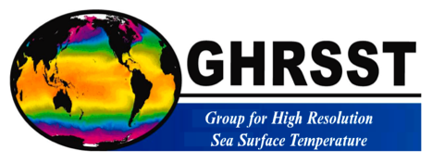
Importance of PMW constellation for SST and impacts
Committee on Earth Observation Satellites
CEOS Sea Surface Temperature Virtual Constellation SST-VC and
Group for High Resolution Sea Surface Temperature
SIT Tech Workshop 2016 Agenda Item 21
CEOS Strategic Implementation Team Tech Workshop
Oxford, UK
14th-15th September 2016

Slide 16
Outline
Current and future Passive Microwave Radiometer (PMW) Missions for Sea Surface Temperature
Impact of PMW Sea Surface Temperature on operational analyses and forecasts
Summary and requests to CEOS plenary

Slide 17
Background in 2016
SIT-31, April 2016: Passive Microwave Radiometer constellation for SST
Uncertain future for PMW SSTs, especially at high latitudes where the PMW SSTs provide valuable through-cloud data in the region where the climate is changing most rapidly.
The current outlook means there is a high risk of a gap, particularly for SSTs using the ~7GHz channel.
CGMS-44, June 2016: Passive Microwave Radiometer constellation for Sea Surface Temperature
Progress has been made regarding ‘reference’ dual-view SST data (Sentinel-3 SLSTR); geostationary SST over full Indian Ocean; increased participation of agencies with SST capability to GHRSST and the SST-VC.
There is a risk to the current and continued PMW constellation for SST and a need for a redundant capability of PMW with ~7 GHz. These concerns are now heightened with no confirmed continuity of plans for AMSR-2 available.
Operational availability of PMW data from HY-2 and in the future from Meteor.

Slide 18
List of Current and Future Passive Microwave Radiometer Missions for SST Observation
Compiled by M. Kachi, JAXA, on behalf of the CEOS SST-VC

Slide 19
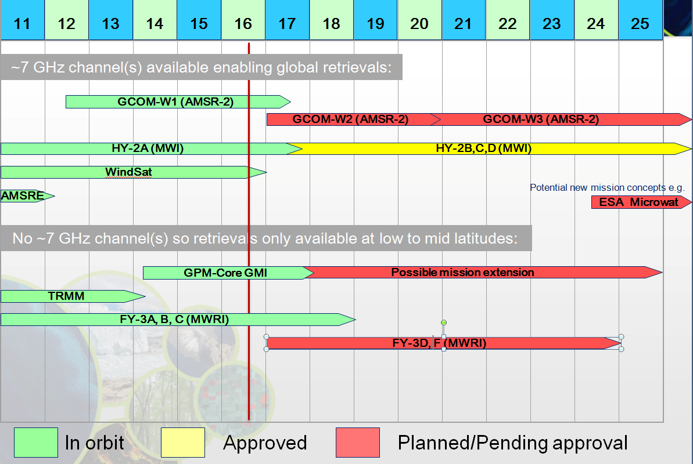
FY-3E does not have MWRI

Slide 20
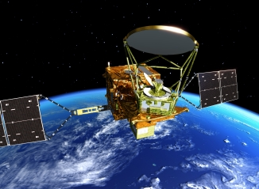
Global Change Observation Mission – Water (GCOM-W)
Phase: OPERATION
Developer:
JAXA (Japan)
Launch: 17 May, 2012
Instrument(s):
Advanced Microwave Scanning Radiometer 2 (AMSR2)
Orbit: Sun-synchronous, 700km
Local Time Ascending Node (ATAN): 13:30
Image by JAXA
AMSR2 Specification
Antenna size [m] | 2.0
Swath width [km] | 1600
Channel number | 16
Frequency [GHz] | 6.925-89.0
Resolution at 6GHz [km] | 35x62
Resolution at 10GHz [km] | 24x42

Slide 21
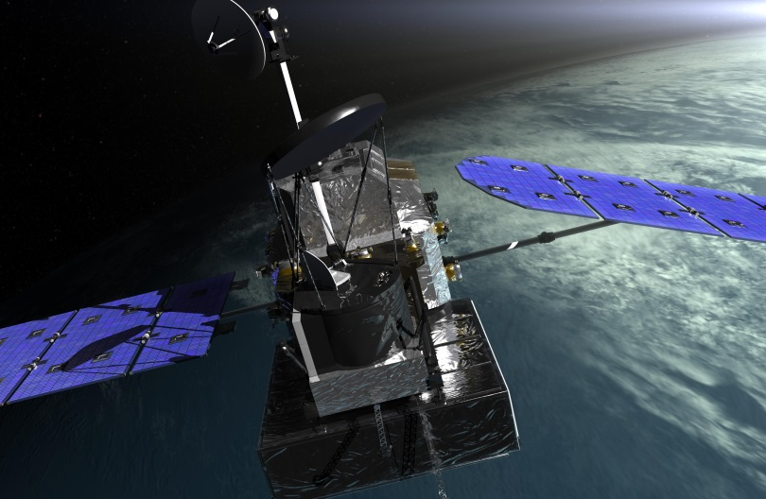
GPM Core Observatory
Phase: OPERATION
Developer:
NASA (US) (GMI, platform)
JAXA (Japan) (DPR)
Launch: 27 February, 2014
Instrument(s):
GPM Microwave Imager (GMI)
Dual-frequency Precipitation Radar (DPR)
Orbit: Non-Sun-synchronous, 402.5km
Local Time Ascending Node (ATAN): N/A
Image by NASA
GMI Specification
Antenna size [m] | 1.2
Swath width [km] | 885
Channel number | 13
Frequency [GHz] | 10.65-183.3
Resolution at 6GHz [km] | N/A
Resolution at 10GHz [km] | 19x32

Slide 22
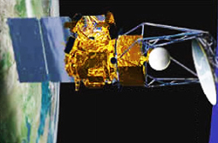
Coriolis
Phase: OPERATION
Developer:
DoD (US)
Launch: 6 January, 2003
Instrument(s):
Windsat (Wind Microwave Radiometer)
Solar Mass Ejection Imager (SMEI)
Orbit: Sun-synchronous, 840km
Local Time Ascending Node (ATAN): 18:00
Image by NASA
Windsat Specification
Antenna size [m] | 1.8
Swath width [km] | 1000
Channel number | 22
Frequency [GHz] | 6.8-37
Resolution at 6GHz [km] | 40x60
Resolution at 10GHz [km] | 25x38

Slide 23
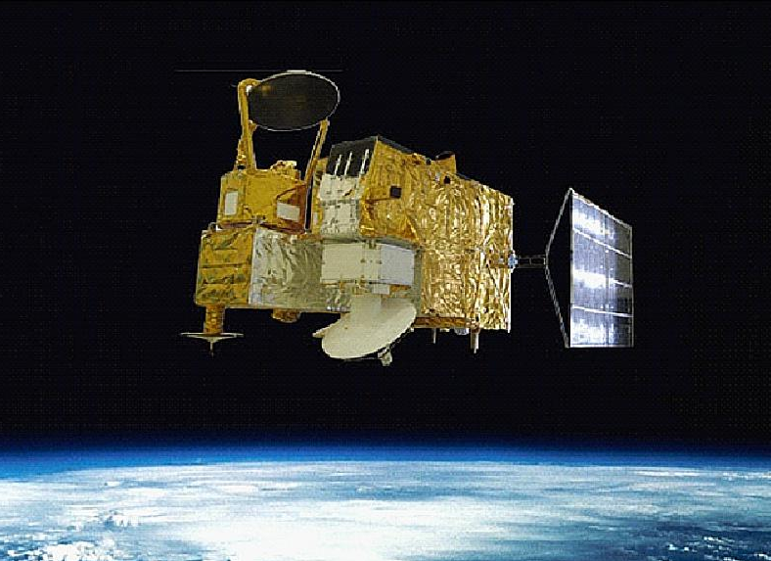
HaiYang-2A (HY-2A)
Phase: OPERATION
Developer:
SOA/NSOAS (China)
Launch: 15 August, 2011
Instrument(s):
Microwave Radiometer Imager (MWRI)
Radar Altimeter (RA)
Ku-band Rotational Fan-beam Scatterometer (SCAT), etc.
Orbit: Sun-synchronous, 973km
Local Time Ascending Node (ATAN): 18:00
Image by NSOAS
MWRI Specification
Antenna size [m] | 1.0
Swath width [km] | 1600
Channel number | 9
Frequency [GHz] | 6.6-37
Resolution at 6GHz [km] | 100x75
Resolution at 10GHz [km] | 75x50

Slide 24
HaiYang-2B (HY-2B)
Phase: APPROVED
Developer:
SOA/NSOAS (China)
Launch: 2017
Instrument(s):
Microwave Radiometer Imager (MWRI)
Radar Altimeter (RA)
Ku-band Rotational Fan-beam Scatterometer (SCAT), etc.
Orbit: Sun-synchronous, 970km
Local Time Ascending Node (ATAN): 18:00
Image by NSOAS
MWRI Specification
Antenna size [m] | 1.0
Swath width [km] | 1600
Channel number | 9
Frequency [GHz] | 6.9-37
Resolution at 6GHz [km] | 150x90
Resolution at 10GHz [km] | 110x70
The Earth incidence angle of HY-2A MWRI is 47.7 deg, while the Earth incidence angle of HY-2B MWRI is 53 deg.

Slide 25
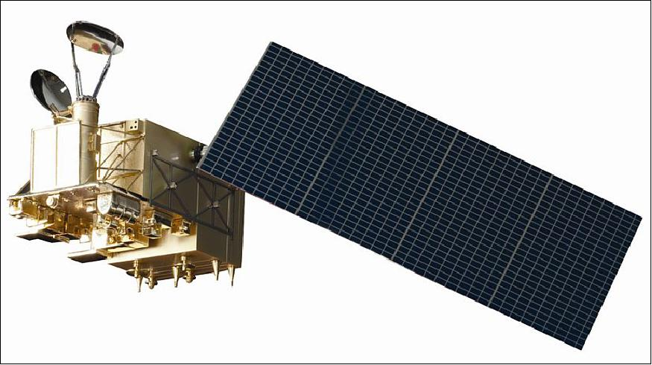
FengYun-3B (FY-3B)
Phase: OPERATION
Developer:
CMA (China)
Launch: November 5, 2010
Instrument(s):
Microwave Radiometer Imager (MWRI)
Microwave Temperature Sounder (MWTS)
Microwave Humidity Sounder (MWHS), etc.
Orbit: Sun-synchronous, 836.4km
Local Time Ascending Node (ATAN): 13:40
Image by CMA/NMSC
MWRI Specification
Antenna size [m] | 0.98x0.90
Swath width [km] | 1430
Channel number | 10
Frequency [GHz] | 10.65-89
Resolution at 6GHz [km] | N/A
Resolution at 10GHz [km] | 51x85

Slide 26
FengYun-3C (FY-3C)
Phase: OPERATION
Developer:
CMA (China)
Launch: 23 September, 2013
Instrument(s):
Microwave Radiometer Imager (MWRI)
Microwave Temperature Sounder (MWTS)
Microwave Humidity Sounder (MWHS), etc.
Orbit: Sun-synchronous, 836.4km
Local Time Ascending Node (ATAN): 22:00
Image by CMA/NMSC
MWRI Specification
Antenna size [m] | 0.98x0.90
Swath width [km] | 1430
Channel number | 10
Frequency [GHz] | 10.65-89
Resolution at 6GHz [km] | N/A
Resolution at 10GHz [km] | 51x85

Slide 27
FengYun-3D (FY-3D)
Phase: PLANNED
Developer:
CMA (China)
Launch: late 2016
Instrument(s):
Microwave Radiometer Imager (MWRI)
Microwave Temperature Sounder (MWTS)
Microwave Humidity Sounder (MWHS), etc.
Orbit: Sun-synchronous, 836.4km
Local Time Ascending Node (ATAN): PM
Image by CMA/NMSC
MWRI Specification
Antenna size [m] | 0.98x0.90
Swath width [km] | 1430
Channel number | 10
Frequency [GHz] | 10.65-89
Resolution at 6GHz [km] | N/A
Resolution at 10GHz [km] | 51x85

Slide 28
FengYun-3F (FY-3F)
Phase: PLANNED
Developer:
CMA (China)
Launch: 2019
Instrument(s):
Microwave Radiometer Imager (MWRI)
Microwave Temperature Sounder (MWTS)
Microwave Humidity Sounder (MWHS), etc.
Orbit: Sun-synchronous, 836.4km
Local Time Ascending Node (ATAN): PM
Image by CMA/NMSC
MWRI Specification
Antenna size [m] | 0.98x0.90
Swath width [km] | 1430
Channel number | 10
Frequency [GHz] | 10.65-89
Resolution at 6GHz [km] | N/A
Resolution at 10GHz [km] | 51x85

Slide 29
Impact of PMW Sea Surface Temperature on operational analyses and forecasts
Compiled by S.Good, Met Office, on behalf of the Group for High Resolution Sea Surface Temperature

Slide 30
Impact on OSTIA analyses
Emma Fiedler
Met Office

Slide 31
Large positive “bias” for REMSS AMSR2 compared OSTIA reference data (in situ and high quality subset of MetOp AVHRR) off the coast of Africa (see plot).
Mean AMSR2 bias to OSTIA reference, Jan 2016 (K)
Likely linked to Saharan aerosols.
Microwave AMSR2 instrument not sensitive to aerosols, unlike reference AVHRR.
-1.2
1.2
Microwave useful as independent dataset for verification. Agreement with VIIRS (infra-red; not shown) on differences to reference data in Arctic suggests MetOp AVHRR reference data too cold. Useful comparison as in situ observations for validation in Arctic not available.
Microwave dataset provides additional information which is erroneously “corrected” out by comparison to reference infra-red dataset.

Slide 32
Argo minus OSTIA for January 2016, global statistics
Experiment | RMS diff to Argo (K)
Control | 0.50
+ AMSR2 | 0.44
+ VIIRS | 0.44
+ AMSR2, VIIRS | 0.42
Assimilation of REMSS AMSR2 L2P microwave data improves OSTIA analysis RMS difference to Argo over including ACSPO VIIRS L3U alone (though not necessarily due to specific properties of microwave SST data).
AMSR2 provides more observations than other datasets at very high latitudes, important for analysis as observations sparse here.
Microwave data is likely to improve SST feature resolution in regions of persistent cloud cover (future work to verify this)

Slide 33
Impact on MGDSST analyses
Toshiyuki Sakurai
Japan Meterological Agency

Slide 34
Impact of Windsat SST on MGDSST analysis (1)
Any microwave SST data had not been used in the operational MGDSST
analysis from Oct. 2011 to Jan. 2013 due to AMSR-E instrument failure.
Impact test was conducted by assimilating Windsat SST on MGDSST analysis for the period from Oct. 2011 to Mar. 2012, and each analysis was compared with buoy SST.
Assimilating Windsat SST reduced the RMSD in the global ocean by about
0.02°C, compared to the routine analysis.
Assimilating Windsat SST Routine ( no microwave SST)
Global ocean
(C°)
0.8
0.75
0.7
0.65
0.6
0.55
0.5
0.45
RMSD
Oct. | Nov. | Dec. | Jan. | Feb. | Mar.
 | 2011 |  |  | 2012

Slide 35
Impact of Windsat SST on MGDSST analysis (2)
Another impact test of Windsat SST was conducted for the period from Jun. to Sep. 2012.
Assimilating Windsat SST significantly reduced the RMSD in the North
Pacific by about 0.05°C. This is because availabilities of SST by IR sensors become very low in the summer North Pacific due to persistent cloud cover, while the microwave sensor has the ability to retrieve SST in cloud-cover region.
(C°)
0.8
0.75
0.7
0.65
0.6
0.55
0.5
0.45
North Pacific
Assimilating Windsat SST Routine ( no microwave SST)
RMSD
Jun.
Jul.
Aug.
Sep.
2012

Slide 36
Persistent cloud cover
Number of satellite’s observations for 8 days from 13 to 20 Jul. 2012 ( number is counted for daily averaged value)
AVHRR/NOAA18
Windsat
Availabilities of SST by IR sensors are lower than those by MW sensors
in the summer North Pacific where persistent cloud cover exists.

Slide 37
Impact on Met Office ocean forecasts
Isabella Ascione
Met Office

Slide 38
Global FOAM Trials
Results were averaged over sub- regions of the global ocean
Global Ocean SST errors in the Control experiment (black) and in AMSR2 experiment (blue)
SST field difference between the AMSR2 experiment and the Control experiment at the end of the simulation period.
Control Experiment (Without AMSR2)
with AMSR2

Slide 39
Summary
Modelling experiments were carried out to test AMSR2-JAXA SST data in FOAM system
The global average results show that differences between experiments were minimal
Error statistics show that all experiments performed well
Results at the end of the simulation period show that the largest SST differences between the experiments were found at high latitudes.

Slide 40
Impact on the Bureau of Meteorology ocean model
Pavel Sakov
Bureau of Meteorology

Slide 41
Impact of WindSat SST on Ocean Model OceanMAPS2
Assimilating WindSat microwave SST (in addition to existing AVHRR infrared SST) resulted in significant reduction in SST forecast innovation RMSD in the ABoM regional 0.1° resolution ocean model during 2012

Slide 42
High resolution SST fields from microwave observations
Emmanuelle Autret Ifremer

Slide 43
High Resolution SST fields from microwave observations
Small scales and SST fronts make a significant contribution to the horizontal and vertical transport in the upper oceanic layers :
●
●
Interactions of sharp SST gradients and the marine atmospherique boundary layer and deeper atmosphere Major contribution in methods aiming to retrieve horizontal velocities from surface data
●
We are provided with :
●
Low resolution (LR, ~ 60 km) SST observations with a global and quasi daily coverage
Discontinuous high resolution (HR, ~ 1-5 km) SST
observations that are valid only for clear-sky conditions (high energetic regions can be poorly sampled)
Microwave (MW) and infrared (IR) from SSTs AMSR-E and MODIS
Enhanced resolution of global and daily SST fields can be achieved with Eulerian or Lagrangian techniques. The results presented here are produced from microwave observations from gradient transformation (Autret 2014, Autret 2016 in prep.). The Eulerian technique relies on the characterization of high resolution SST fields (~ IR products res.) with respect to low resolution (~ MW products res.). The method allows for reconstructing the major SST fronts from microwave observations and improve the spatial resolution up to 15 km.
Left : Reconstructed HR SST field from the AMSR-E data ; Middle : example of SST front from AMSR-E (grey), MODIS (black) and the reconstructed field (blue). Right : SST spectra from AMSR-E (grey), MODIS (black) and the reconstructed field (blue).

Slide 44
Summary for CEOS plenary
Use of Passive Microwave Radiometers (PMW) for SST retrievals is an essential component of global constellation of SST sensors.
Provides temperature of ocean under clouds, not possible from infrared sensors, albeit with poorer spatial resolution. Important in high-latitude regions and in areas of extensive and persistent cloud cover or in case of a large volcanic event.
Impact studies of SST analyses / ocean forecasts show PMW needed for:
Verification of SST analyses (and inter-comparisons) at the poles.
Aerosol regions (robust to IR sensitivity displayed in these regions).
Improves feature definition (e.g. fronts) esp. where persistent cloud.
Impact studies show improvement in RMSD (e.g. 0.02K global to 0.05K regional). Particularly important at high latitudes.
Retrievals of Ocean Surface Salinity Measurements give better performance when using SST analyses including PMW data (e.g. Meissner et al, TGRS-2016-00278)

Slide 45
Request / action for CEOS plenary
Currently there are risks and gaps identified in constellation, therefore continuity and redundancy of PMW for SST continues to be sought.
Proposal of draft action text:
Given the current risk to the current and continued PMW constellation for SST and the need for a redundant capability of PMW with ~7 GHz, CEOS is requested to coordinate and encourage its agencies to ensure the continuation of the existing capability and to facilitate the coordination of agencies to ensure continuity and redundancy of PMW for SST.
Impact studies have shown that these data are particularly important for SST analyses and ocean models at high latitudes, aerosol regions, persistent cloudy regions, feature definition and overall contribute to an improvement in ocean forecast skill.

