Slide 1
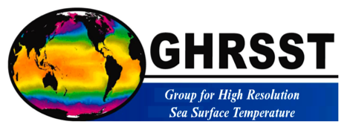
Importance of PMW constellation for SST and impacts
Committee on Earth Observation Satellites
CEOS Sea Surface Temperature Virtual Constellation SST-VC and
Group for High Resolution Sea Surface Temperature
SIT Tech Workshop 2016 Agenda Item 21
CEOS Strategic Implementation Team Tech Workshop
Oxford, UK
14th-15th September 2016

Slide 2
Outline
Current and future Passive Microwave Radiometer (PMW) Missions for Sea Surface Temperature
Impact of PMW Sea Surface Temperature on operational analyses and forecasts
Summary and requests to CEOS plenary

Slide 3
Background in 2016
SIT-31, April 2016: Passive Microwave Radiometer constellation for SST
Uncertain future for PMW SSTs, especially at high latitudes where the PMW SSTs provide valuable through-cloud data in the region where the climate is changing most rapidly.
The current outlook means there is a high risk of a gap, particularly for SSTs using the ~7GHz channel.
CGMS-44, June 2016: Passive Microwave Radiometer constellation for Sea Surface Temperature
Progress has been made regarding ‘reference’ dual-view SST data (Sentinel-3 SLSTR); geostationary SST over full Indian Ocean; increased participation of agencies with SST capability to GHRSST and the SST-VC.
There is a risk to the current and continued PMW constellation for SST and a need for a redundant capability of PMW with ~7 GHz. These concerns are now heightened with no confirmed continuity of plans for AMSR-2 available.
Operational availability of PMW data from HY-2 and in the future from Meteor.

Slide 4
List of Current and Future Passive Microwave Radiometer Missions for SST Observation
Compiled by M. Kachi, JAXA, on behalf of the CEOS SST-VC

Slide 5
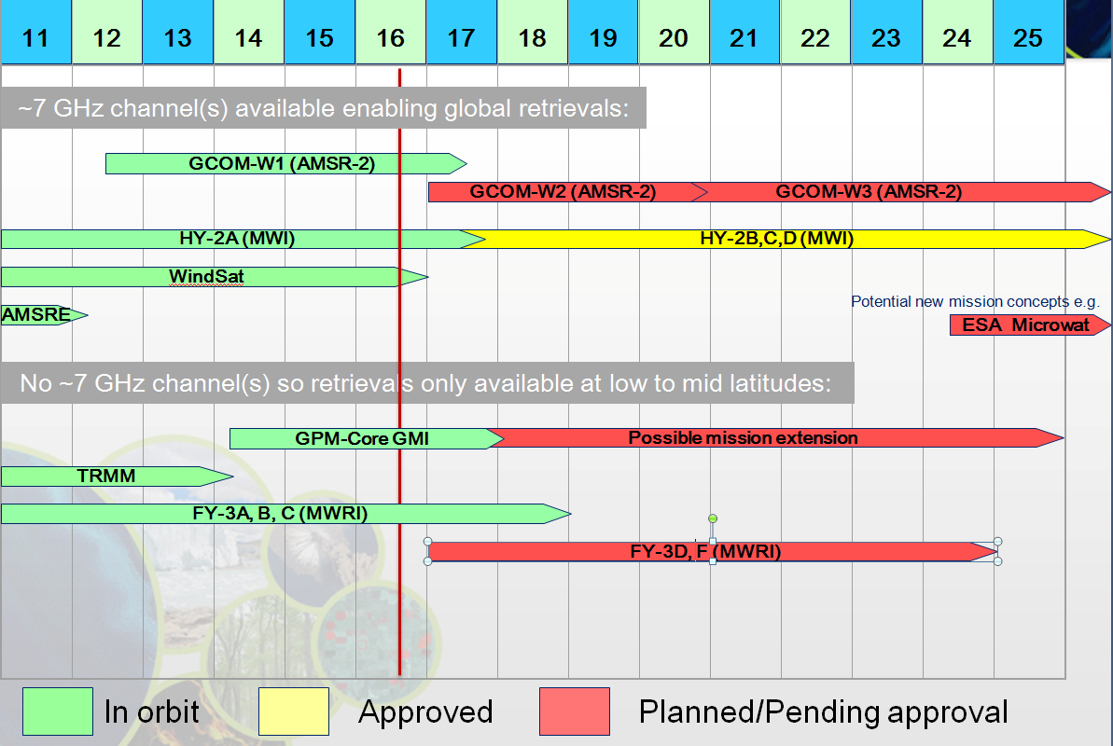
FY-3E does not have MWRI

Slide 6
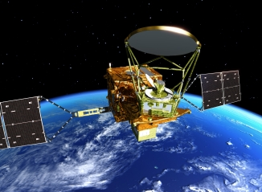
Global Change Observation Mission – Water (GCOM-W)
Phase: OPERATION
Developer:
JAXA (Japan)
Launch: 17 May, 2012
Instrument(s):
Advanced Microwave Scanning Radiometer 2 (AMSR2)
Orbit: Sun-synchronous, 700km
Local Time Ascending Node (ATAN): 13:30
Image by JAXA
AMSR2 Specification
Antenna size [m] | 2.0
Swath width [km] | 1600
Channel number | 16
Frequency [GHz] | 6.925-89.0
Resolution at 6GHz [km] | 35x62
Resolution at 10GHz [km] | 24x42

Slide 7
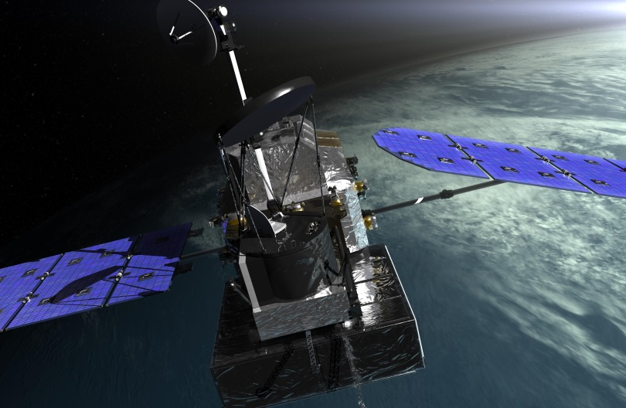
GPM Core Observatory
Phase: OPERATION
Developer:
NASA (US) (GMI, platform)
JAXA (Japan) (DPR)
Launch: 27 February, 2014
Instrument(s):
GPM Microwave Imager (GMI)
Dual-frequency Precipitation Radar (DPR)
Orbit: Non-Sun-synchronous, 402.5km
Local Time Ascending Node (ATAN): N/A
Image by NASA
GMI Specification
Antenna size [m] | 1.2
Swath width [km] | 885
Channel number | 13
Frequency [GHz] | 10.65-183.3
Resolution at 6GHz [km] | N/A
Resolution at 10GHz [km] | 19x32

Slide 8
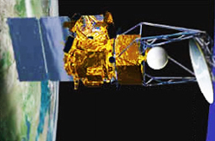
Coriolis
Phase: OPERATION
Developer:
DoD (US)
Launch: 6 January, 2003
Instrument(s):
Windsat (Wind Microwave Radiometer)
Solar Mass Ejection Imager (SMEI)
Orbit: Sun-synchronous, 840km
Local Time Ascending Node (ATAN): 18:00
Image by NASA
Windsat Specification
Antenna size [m] | 1.8
Swath width [km] | 1000
Channel number | 22
Frequency [GHz] | 6.8-37
Resolution at 6GHz [km] | 40x60
Resolution at 10GHz [km] | 25x38

Slide 9
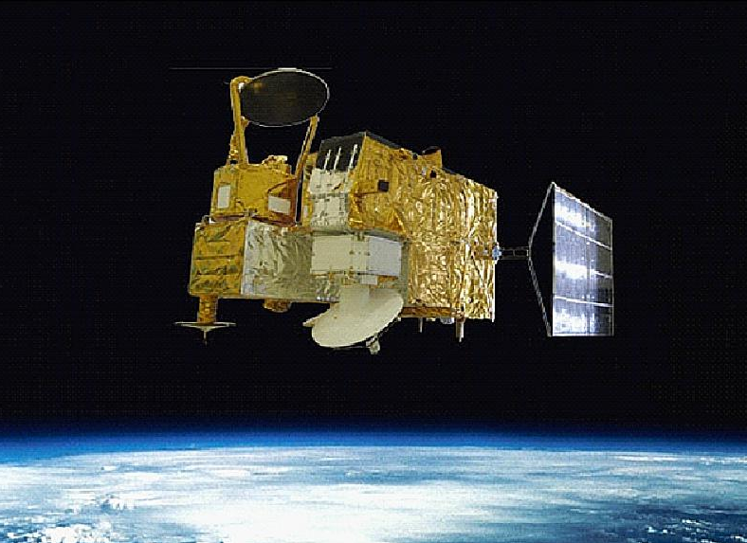
HaiYang-2A (HY-2A)
Phase: OPERATION
Developer:
SOA/NSOAS (China)
Launch: 15 August, 2011
Instrument(s):
Microwave Radiometer Imager (MWRI)
Radar Altimeter (RA)
Ku-band Rotational Fan-beam Scatterometer (SCAT), etc.
Orbit: Sun-synchronous, 973km
Local Time Ascending Node (ATAN): 18:00
Image by NSOAS
MWRI Specification
Antenna size [m] | 1.0
Swath width [km] | 1600
Channel number | 9
Frequency [GHz] | 6.6-37
Resolution at 6GHz [km] | 100x75
Resolution at 10GHz [km] | 75x50

Slide 10
HaiYang-2B (HY-2B)
Phase: APPROVED
Developer:
SOA/NSOAS (China)
Launch: 2017
Instrument(s):
Microwave Radiometer Imager (MWRI)
Radar Altimeter (RA)
Ku-band Rotational Fan-beam Scatterometer (SCAT), etc.
Orbit: Sun-synchronous, 970km
Local Time Ascending Node (ATAN): 18:00
Image by NSOAS
MWRI Specification
Antenna size [m] | 1.0
Swath width [km] | 1600
Channel number | 9
Frequency [GHz] | 6.9-37
Resolution at 6GHz [km] | 150x90
Resolution at 10GHz [km] | 110x70
The Earth incidence angle of HY-2A MWRI is 47.7 deg, while the Earth incidence angle of HY-2B MWRI is 53 deg.

Slide 11
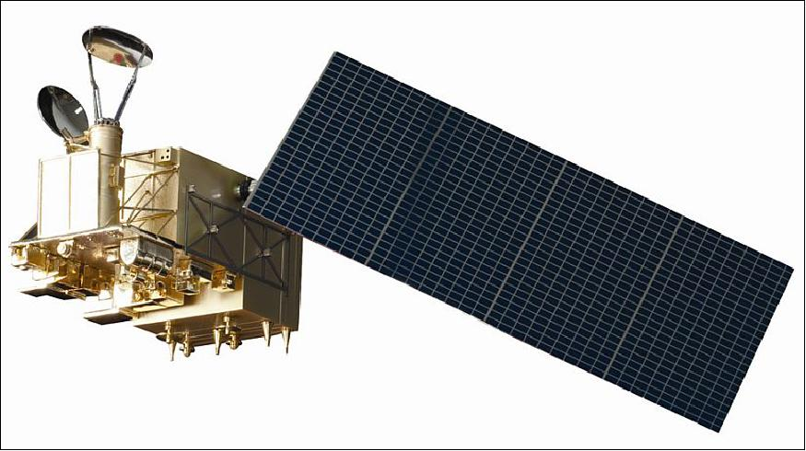
FengYun-3B (FY-3B)
Phase: OPERATION
Developer:
CMA (China)
Launch: November 5, 2010
Instrument(s):
Microwave Radiometer Imager (MWRI)
Microwave Temperature Sounder (MWTS)
Microwave Humidity Sounder (MWHS), etc.
Orbit: Sun-synchronous, 836.4km
Local Time Ascending Node (ATAN): 13:40
Image by CMA/NMSC
MWRI Specification
Antenna size [m] | 0.98x0.90
Swath width [km] | 1430
Channel number | 10
Frequency [GHz] | 10.65-89
Resolution at 6GHz [km] | N/A
Resolution at 10GHz [km] | 51x85

Slide 12
FengYun-3C (FY-3C)
Phase: OPERATION
Developer:
CMA (China)
Launch: 23 September, 2013
Instrument(s):
Microwave Radiometer Imager (MWRI)
Microwave Temperature Sounder (MWTS)
Microwave Humidity Sounder (MWHS), etc.
Orbit: Sun-synchronous, 836.4km
Local Time Ascending Node (ATAN): 22:00
Image by CMA/NMSC
MWRI Specification
Antenna size [m] | 0.98x0.90
Swath width [km] | 1430
Channel number | 10
Frequency [GHz] | 10.65-89
Resolution at 6GHz [km] | N/A
Resolution at 10GHz [km] | 51x85

Slide 13
FengYun-3D (FY-3D)
Phase: PLANNED
Developer:
CMA (China)
Launch: late 2016
Instrument(s):
Microwave Radiometer Imager (MWRI)
Microwave Temperature Sounder (MWTS)
Microwave Humidity Sounder (MWHS), etc.
Orbit: Sun-synchronous, 836.4km
Local Time Ascending Node (ATAN): PM
Image by CMA/NMSC
MWRI Specification
Antenna size [m] | 0.98x0.90
Swath width [km] | 1430
Channel number | 10
Frequency [GHz] | 10.65-89
Resolution at 6GHz [km] | N/A
Resolution at 10GHz [km] | 51x85

Slide 14
FengYun-3F (FY-3F)
Phase: PLANNED
Developer:
CMA (China)
Launch: 2019
Instrument(s):
Microwave Radiometer Imager (MWRI)
Microwave Temperature Sounder (MWTS)
Microwave Humidity Sounder (MWHS), etc.
Orbit: Sun-synchronous, 836.4km
Local Time Ascending Node (ATAN): PM
Image by CMA/NMSC
MWRI Specification
Antenna size [m] | 0.98x0.90
Swath width [km] | 1430
Channel number | 10
Frequency [GHz] | 10.65-89
Resolution at 6GHz [km] | N/A
Resolution at 10GHz [km] | 51x85

Slide 15
Impact of PMW Sea Surface Temperature on operational analyses and forecasts
Compiled by S.Good, Met Office, on behalf of the Group for High Resolution Sea Surface Temperature

Slide 16
Impact on OSTIA analyses
Emma Fiedler
Met Office

Slide 17
Large positive “bias” for REMSS AMSR2 compared OSTIA reference data (in situ and high quality subset of MetOp AVHRR) off the coast of Africa (see plot).
Mean AMSR2 bias to OSTIA reference, Jan 2016 (K)
Likely linked to Saharan aerosols.
Microwave AMSR2 instrument not sensitive to aerosols, unlike reference AVHRR.
-1.2
1.2
Microwave useful as independent dataset for verification. Agreement with VIIRS (infra-red; not shown) on differences to reference data in Arctic suggests MetOp AVHRR reference data too cold. Useful comparison as in situ observations for validation in Arctic not available.
Microwave dataset provides additional information which is erroneously “corrected” out by comparison to reference infra-red dataset.

Slide 18
Argo minus OSTIA for January 2016, global statistics
Experiment | RMS diff to Argo (K)
Control | 0.50
+ AMSR2 | 0.44
+ VIIRS | 0.44
+ AMSR2, VIIRS | 0.42
Assimilation of REMSS AMSR2 L2P microwave data improves OSTIA analysis RMS difference to Argo over including ACSPO VIIRS L3U alone (though not necessarily due to specific properties of microwave SST data).
AMSR2 provides more observations than other datasets at very high latitudes, important for analysis as observations sparse here.
Microwave data is likely to improve SST feature resolution in regions of persistent cloud cover (future work to verify this)

Slide 19
Impact on MGDSST analyses
Toshiyuki Sakurai
Japan Meterological Agency

Slide 20
Impact of Windsat SST on MGDSST analysis (1)
Any microwave SST data had not been used in the operational MGDSST
analysis from Oct. 2011 to Jan. 2013 due to AMSR-E instrument failure.
Impact test was conducted by assimilating Windsat SST on MGDSST analysis for the period from Oct. 2011 to Mar. 2012, and each analysis was compared with buoy SST.
Assimilating Windsat SST reduced the RMSD in the global ocean by about
0.02°C, compared to the routine analysis.
Assimilating Windsat SST Routine ( no microwave SST)
Global ocean
(C°)
0.8
0.75
0.7
0.65
0.6
0.55
0.5
0.45
RMSD
Oct. | Nov. | Dec. | Jan. | Feb. | Mar.
 | 2011 |  |  | 2012

Slide 21
Impact of Windsat SST on MGDSST analysis (2)
Another impact test of Windsat SST was conducted for the period from Jun. to Sep. 2012.
Assimilating Windsat SST significantly reduced the RMSD in the North
Pacific by about 0.05°C. This is because availabilities of SST by IR sensors become very low in the summer North Pacific due to persistent cloud cover, while the microwave sensor has the ability to retrieve SST in cloud-cover region.
(C°)
0.8
0.75
0.7
0.65
0.6
0.55
0.5
0.45
North Pacific
Assimilating Windsat SST Routine ( no microwave SST)
RMSD
Jun.
Jul.
Aug.
Sep.
2012

Slide 22
Persistent cloud cover
Number of satellite’s observations for 8 days from 13 to 20 Jul. 2012 ( number is counted for daily averaged value)
AVHRR/NOAA18
Windsat
Availabilities of SST by IR sensors are lower than those by MW sensors
in the summer North Pacific where persistent cloud cover exists.

Slide 23
Impact on Met Office ocean forecasts
Isabella Ascione
Met Office

Slide 24
Global FOAM Trials
Results were averaged over sub- regions of the global ocean
Global Ocean SST errors in the Control experiment (black) and in AMSR2 experiment (blue)
SST field difference between the AMSR2 experiment and the Control experiment at the end of the simulation period.
Control Experiment (Without AMSR2)
with AMSR2

Slide 25
Summary
Modelling experiments were carried out to test AMSR2-JAXA SST data in FOAM system
The global average results show that differences between experiments were minimal
Error statistics show that all experiments performed well
Results at the end of the simulation period show that the largest SST differences between the experiments were found at high latitudes.

Slide 26
Impact on the Bureau of Meteorology ocean model
Pavel Sakov
Bureau of Meteorology

Slide 27
Impact of WindSat SST on Ocean Model OceanMAPS2
Assimilating WindSat microwave SST (in addition to existing AVHRR infrared SST) resulted in significant reduction in SST forecast innovation RMSD in the ABoM regional 0.1° resolution ocean model during 2012

Slide 28
High resolution SST fields from microwave observations
Emmanuelle Autret Ifremer

Slide 29
High Resolution SST fields from microwave observations
Small scales and SST fronts make a significant contribution to the horizontal and vertical transport in the upper oceanic layers :
●
●
Interactions of sharp SST gradients and the marine atmospherique boundary layer and deeper atmosphere Major contribution in methods aiming to retrieve horizontal velocities from surface data
●
We are provided with :
●
Low resolution (LR, ~ 60 km) SST observations with a global and quasi daily coverage
Discontinuous high resolution (HR, ~ 1-5 km) SST
observations that are valid only for clear-sky conditions (high energetic regions can be poorly sampled)
Microwave (MW) and infrared (IR) from SSTs AMSR-E and MODIS
Enhanced resolution of global and daily SST fields can be achieved with Eulerian or Lagrangian techniques. The results presented here are produced from microwave observations from gradient transformation (Autret 2014, Autret 2016 in prep.). The Eulerian technique relies on the characterization of high resolution SST fields (~ IR products res.) with respect to low resolution (~ MW products res.). The method allows for reconstructing the major SST fronts from microwave observations and improve the spatial resolution up to 15 km.
Left : Reconstructed HR SST field from the AMSR-E data ; Middle : example of SST front from AMSR-E (grey), MODIS (black) and the reconstructed field (blue). Right : SST spectra from AMSR-E (grey), MODIS (black) and the reconstructed field (blue).

Slide 30
Summary for CEOS plenary
Use of Passive Microwave Radiometers (PMW) for SST retrievals is an essential component of global constellation of SST sensors.
Provides temperature of ocean under clouds, not possible from infrared sensors, albeit with poorer spatial resolution. Important in high-latitude regions and in areas of extensive and persistent cloud cover or in case of a large volcanic event.
Impact studies of SST analyses / ocean forecasts show PMW needed for:
Verification of SST analyses (and inter-comparisons) at the poles.
Aerosol regions (robust to IR sensitivity displayed in these regions).
Improves feature definition (e.g. fronts) esp. where persistent cloud.
Impact studies show improvement in RMSD (e.g. 0.02K global to 0.05K regional). Particularly important at high latitudes.
Retrievals of Ocean Surface Salinity Measurements give better performance when using SST analyses including PMW data (e.g. Meissner et al, TGRS-2016-00278)

Slide 31
Request / action for CEOS plenary
Currently there are risks and gaps identified in constellation, therefore continuity and redundancy of PMW for SST continues to be sought.
Proposal of draft action text:
Given the current risk to the current and continued PMW constellation for SST and the need for a redundant capability of PMW with ~7 GHz, CEOS is requested to coordinate and encourage its agencies to ensure the continuation of the existing capability and to facilitate the coordination of agencies to ensure continuity and redundancy of PMW for SST.
Impact studies have shown that these data are particularly important for SST analyses and ocean models at high latitudes, aerosol regions, persistent cloudy regions, feature definition and overall contribute to an improvement in ocean forecast skill.

